Slide 1

Testing of Front-End Readout Prototype ASICs Designed for WCDA in LHAASO
Speaker: Jiaming Lu
Shengzhi Zhou, Lei Zhao, Yuxiang Guo, Ruoshi Dong, Boyu Cheng, Jiajun Qin, Sifan Qian, Shubin Liu, Qi An
zhousz@mail.ustc.edu.cn
State Key Laboratory of Particle Detection and Electronics, USTC
14 Jun 2018
Notes:
Good afternoon, everyone! My name is Jiaming Lu, from State Key Laboratory of Particle Detection and Electronics, USTC
Today’ presentation is concerning about Testing of Front-End Readout Prototype ASICs Designed for WCDA in LHAASO

Slide 2
Contents
Background Introduction
Amplification & Shaping ASIC
Successive Approximation (SAR) ADC ASIC
Testing of Two ASICs
Conclusion
Notes:
The presentation contains the following sections including the introduction of background, structure & testing of two ASICs and the conclusion.

Slide 3
Contents
Background Introduction
Amplification & Shaping ASIC
Successive Approximation (SAR) ADC ASIC
Testing of Two ASICs
Conclusion
Notes:
First I will introduce the background.

Slide 4
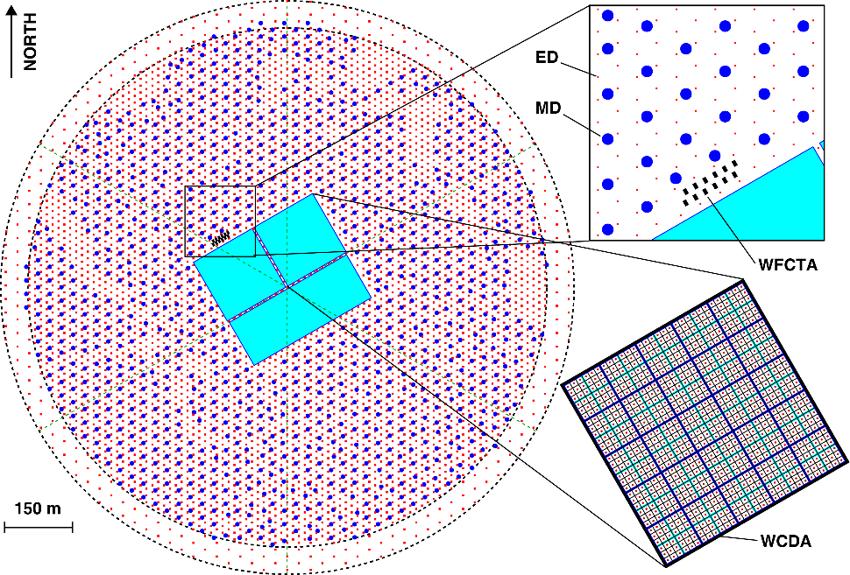
Background Introduction
WCDA in LHAASO
Water Cherenkov Detector Array
Large High Altitude Air Shower Observatory
WCDA
3 water ponds
More than 3000 Photomultiplier Tubes (PMTs)
Notes:
The Large High Altitude Air Shower Observatory with the abbreviation of LHAASO, is a multi-purpose complex. It aims to discover cosmic ray origin and carry out advanced scientific research in the field of high-energy physics and astronomy. The Water Cherenkov[tʃəˈreŋkəf] Detector Ar’ray , with the abbreviation of WCDA, is one of the key detectors in LHAASO. The WCDA is composed of 3 water ponds with more than 3000 Photomultiplier Tubes de’ployed.

Slide 5
WCDA Readout System
Front-End Electronics (FEE) module
High precision time & charge measurement
1 Photon Electron (P.E.) to 4000 P.E
Application Specific Integrated Circuit (ASIC)
9 PMT signals
Notes:
To target the research purpose, both high-precision time and charge measurement are required over a large dynamic range from 1 Photon Electron to 4000 P.E. In order to simplify the circuit structure of the readout electronics, a readout scheme based on ASIC is proposed.
The readout system of LHAASO WCDA is shown as this figure.
The output PMT signals are transmitted to the front-end electronics and then the digitalized data are sent to DAQ (which is the abbreviation of Data Acquisition system) through switches.
One front-end electronics module is able to deal with 9 PMT output signals.

Slide 6
ASIC-based PMT FEE
Two prototype ASICs
Amplification & Shaping ASIC
Successive Approximation (SAR) ADC ASIC
Notes:
This figure is the architecture of the ASIC-based PMT front-end readout electronics.
Charge measurement is performed by a combination of anode and dynode channels to cover a 1 ~ 4000 P.E. dynamic range inside the first ASIC.
Output signals from the shaper are then digitized by the second ASIC, which is a Successive Approximation ADC.
Digitized amplitude information is then transfered to the FPGA for peak detection.
As for the time measurement, anode signal is fed into the discrimi’nation circuits inside the amplification & shaping ASIC and then digitized by a following FPGA TDC.

Slide 7
Contents
Background Introduction
Amplification & Shaping ASIC
Successive Approximation (SAR) ADC ASIC
Testing of Two ASICs
Conclusion
Notes:
Next ,I will introduce Two prototype ASICs designed for the Front-End Readout electronics which are Amplification & Shaping ASIC
and SAR ADC ASIC.
Firstly I will introduce the Amplification & Shaping ASIC.

Slide 8
Amplification & Shaping ASIC
Global Foundry 350 nm CMOS dual gate technology
Three channels in one chip
Structure
Preamplifier
RC⁴ shaping circuit
Output buffer
Discriminator
Notes:
The figure shows the structure of the amplification & shaping ASIC which consists of pre-’amplifiers, RC4 shaping circuits, output buffers and discrimi’nators.
This ASIC is designed with 3 anode and 3 dynode channels based on Global Foundry 350 nanometers CMOS dual gate technology.
As for charge measurement, two channels are used to read out the signals from the anode and dynode of one PMT to achieve a large dynamic range.
As for time measurement, both a low and high threshold are used, and the latter is used to avoid the deterio’ration [dɪˌtɪrɪəˈreʃən] of time resolution
of large input signals.

Slide 9
Test system
PMT signal
Attenuator
Amplification & Shaping ASIC
ADC & Data transmission board
Notes:
This is the test system Block diagram of Amplification & Shaping ASIC.
The PMT output signals from signal source are sent into the at’tenuator to simulate the dynamic range from 1 to 4000 P.E.
Then the signals are fed into the ASIC for time and charge measurement .
The time & charge signals are then transmitted to ADC & Data transmission board and finally to the computer for further analysis.
Output signals of the discriminators are digitized by the FPGA TDC.
Output signals from the shapers are digitized by AD9222, a 12-bit commercial ADC, with a sampling rate of 62.5 Mega Samples per Second in the test.

Slide 10
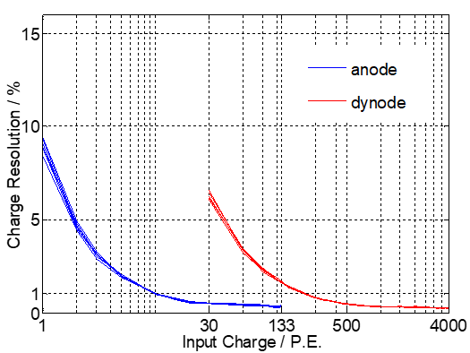
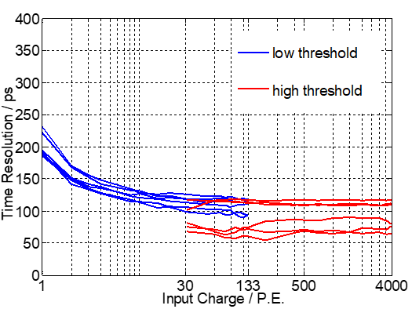
Test results
6 channels
Charge resolution : better than 10%@1 P.E. and 1% @ 4000 P.E.
Time resolution : better than 250 ps
Notes:
Testing results of this ASIC are shown as this 2 figures. A total of 6 channels are tested.
The two figures indicate that the charge resolution is better than 10%@1 P.E. and 1% @ 4000 P.E., while the time resolution is better than 250 ps.

Slide 11
Contents
Background Introduction
Amplification & Shaping ASIC
Successive Approximation (SAR) ADC ASIC
Testing of Two ASICs
Conclusion
Notes:
Next, I will introduce the structure and testing of SAR ADC ASIC.

Slide 12
SAR ADC ASIC
Global Foundry 1P6M 180 nm
CMOS technology
12-bit , 30 Msps
Structure
Sampling and holding circuits
Capacitive DAC
Dynamic comparator
Asynchronous SAR logic
Reference voltage buffer
Clock generator
Notes:
According to the features of the shaper output signal, as well as the charge resolution requirement, an ADC ASIC is designed with a 12-bit resolution with a sampling rate of around 30 Maga Samples per Second based on Global Foundry 1P6M 180 nanometer CMOS technology.
The structure of this ADC is shown in this figure, including the sampling and holding circuits, the capacitive DAC, the dynamic comparator, the a’synchronous SAR logic, the reference voltage buffer, and the clock generator .

Slide 13
Test system
Signal source(sine wave)
SAR ADC ASIC
Data transmission board
Notes:
This is the test system block diagram of SAR ADC ASIC.
Sine waves are generated from SMA 100A signal source and then fed to the ASIC for digitization.
The quanti’zation codes are parallelly sent to Data transmission board for Data Processing and Storage.
And finally transferred to computer through USB.
The static performance is tested by the Code Density Histogram A’nalytic Method and the dynamic is tested by Fast ‘Fourier Transformation.

Slide 14
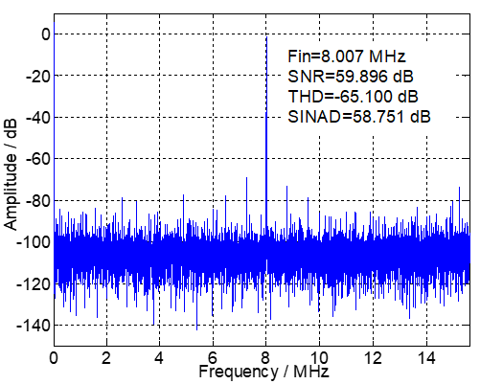
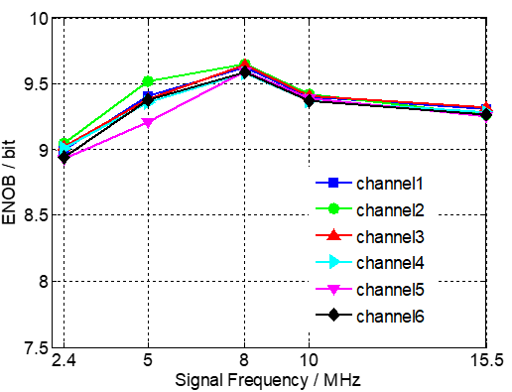
Test results
Sampling rate : 31.25 Msps
Typical frequency spectrum
ENOBs of 6 channels : 8.92 ~ 9.58 bit
Notes:
Test results are shown in this 2 figures.
The sampling rate is set to 31.25 Mega Samples per Second.
Input signals are sine waves and the frequencies are chosen as 2.4, 5, 8, 10 and 15.5 megahertz.
The left figure shows a typical frequency spectrum at 8 megahertz input frequency.
The right figure indicates that effective number of bits of all the 6 ADC channels under test are between 8.92 and 9.58 bit.

Slide 15
Contents
Background Introduction
Amplification & Shaping ASIC
Successive Approximation (SAR) ADC ASIC
Testing of Two ASICs
Conclusion
Notes:
After independent testing of this two ASICs. combination testing of these two prototype ASICs were conducted.

Slide 16
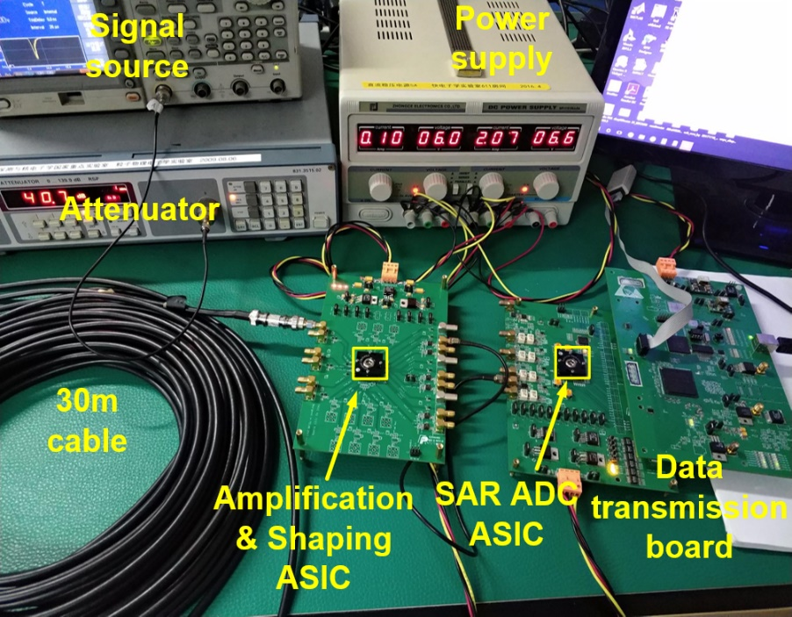
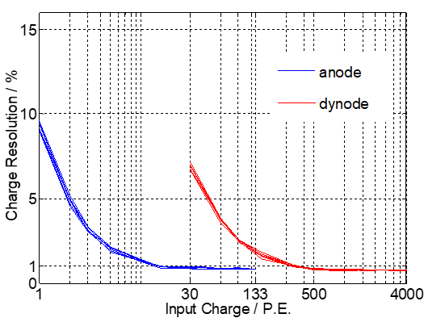
Testing of Two ASICs
Test bench of combination test
Charge measurement
Notes:
Combination tests of these two prototype ASICs were conducted to evaluate the overall charge measurement performance.
The left figure shows the test bench. (指着图片说 加油相信自己！)The output signal from the signal source is transmitted to Amplification & shaping ASIC through the attenuator and 30m cable.
After the shaping circuit, the signal is fed to SAR ADC ASIC for quantitation. And finally the code is transferred to Data transmission board for further processing and storage.
The right figure indicates that the charge resolution is better than 10%@1 P.E. and 1% @ 4000 P.E., which meets the requirements of the readout electronics for WCDA.

Slide 17
Contents
Background Introduction
Amplification & Shaping ASIC
Successive Approximation (SAR) ADC ASIC
Testing of Two ASICs
Conclusion
Notes:
Finally, conclusion is presented as follows.

Slide 18
Conclusion
LHAASO WCDA readout electronics requirements
Two prototype ASICs
SAR ADC ASIC: ENOB is between 8.92 and 9.58 bit @31.25Msps
Amplification & Shaping ASIC:
time resolution is better than 250 ps RMS
charge resolution is better than 10%@1 P.E. and 1% @ 4000 P.E.
Notes:
Due to the requirements of high-precision time and charge measurement over a large dynamic range for LHAASO WCDA, the research and design of ASIC are carried out based on amplification, shaping, and A/D conversion, along with the digital peak detection method.
Two prototype ASICs are designed and tested.
Testing results indicate that the SAR ADC ASIC can function well at 31.25 Mega Samples per Second and its effective number of bits is between 8.92 and 9.58 bits;
the time resolution is better than 250 ps RMS and the overall charge resolution using these two ASICs is better than 10%@1 P.E. and 1% @ 4000 P.E.

Slide 19
THANKS
Thanks for your attention!

