Slide 1

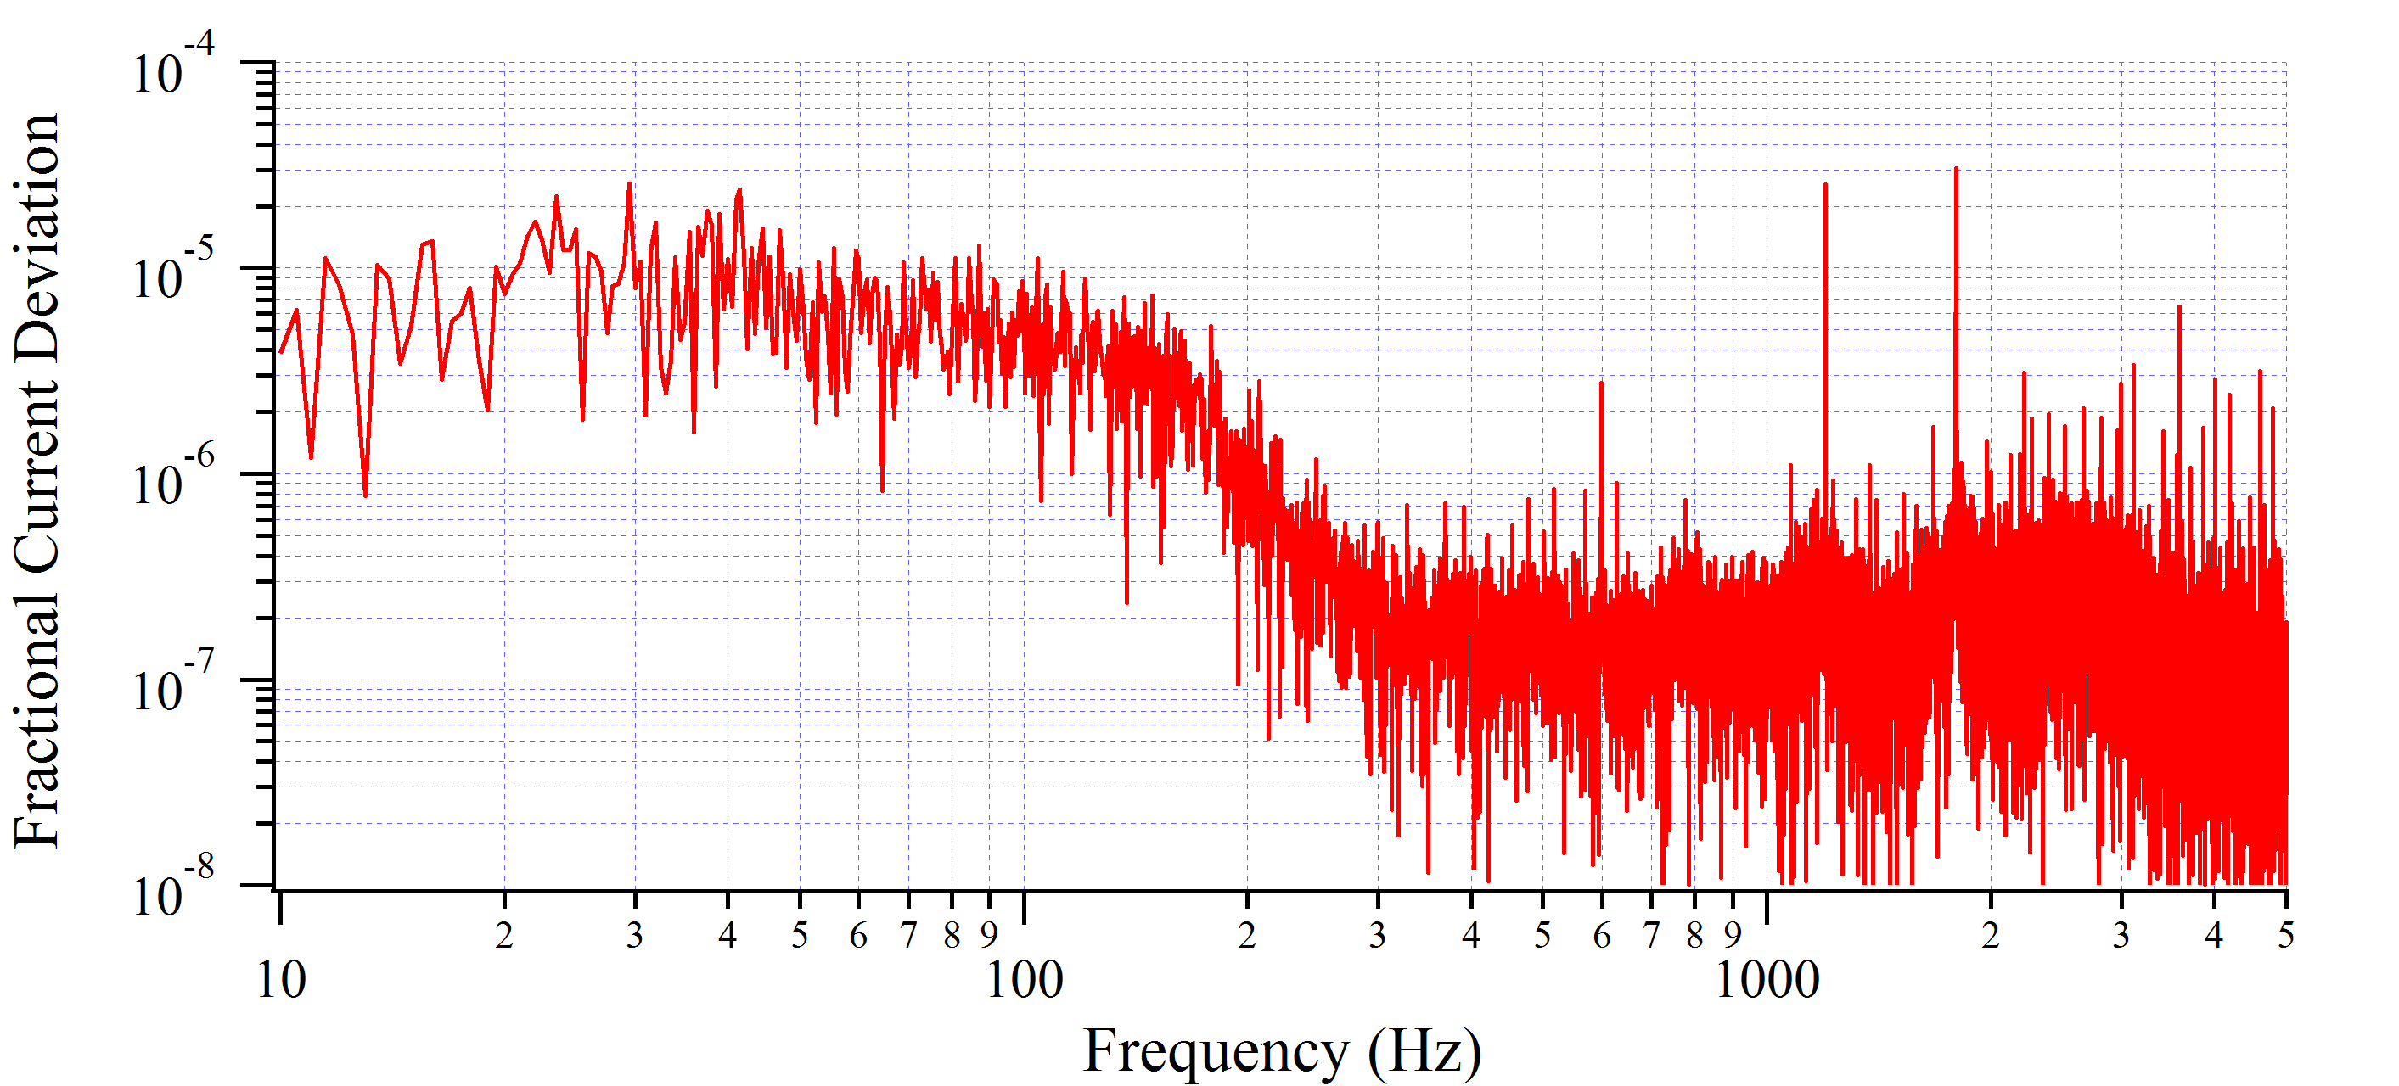
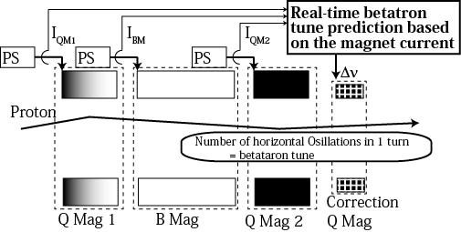

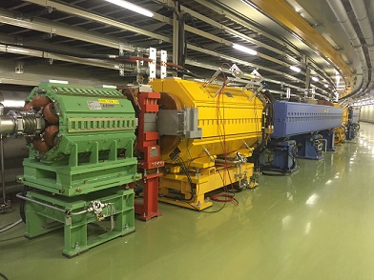
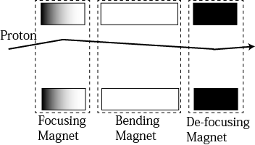
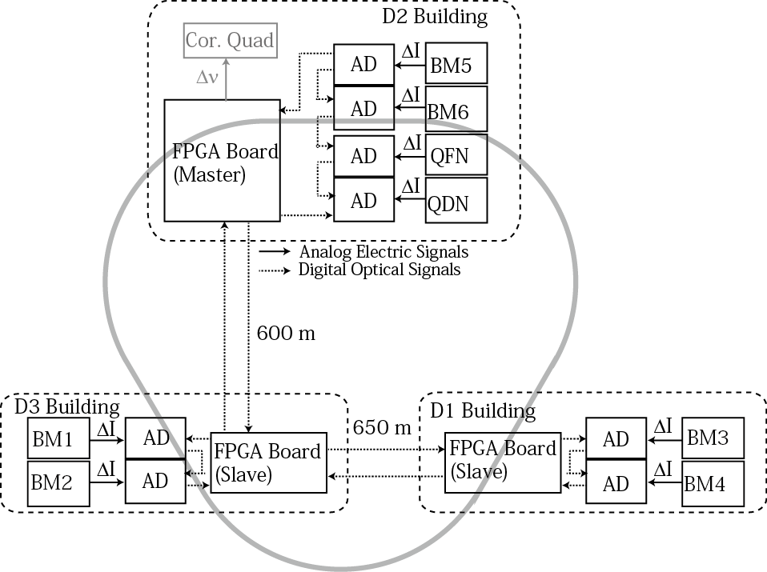
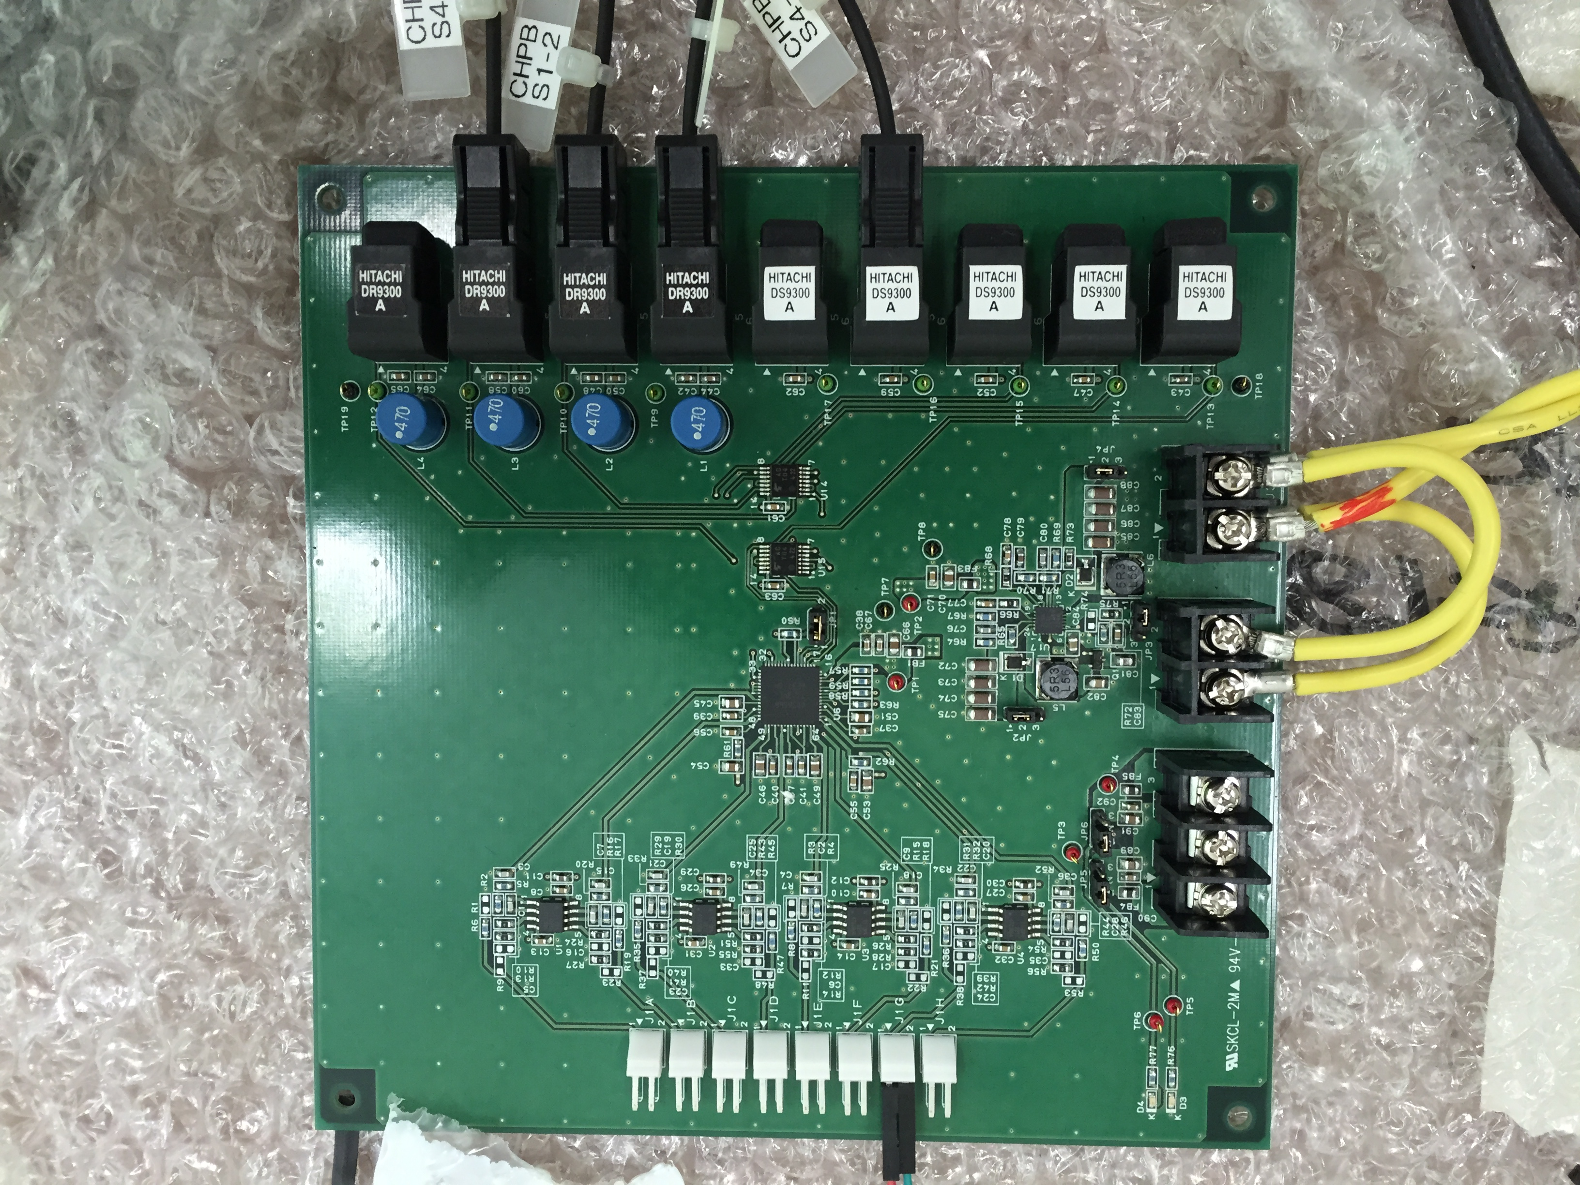
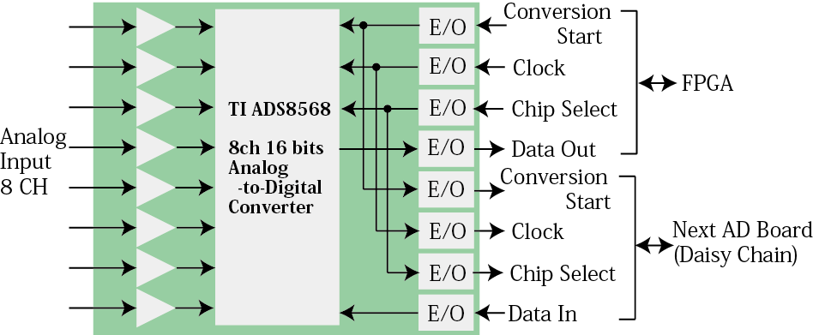
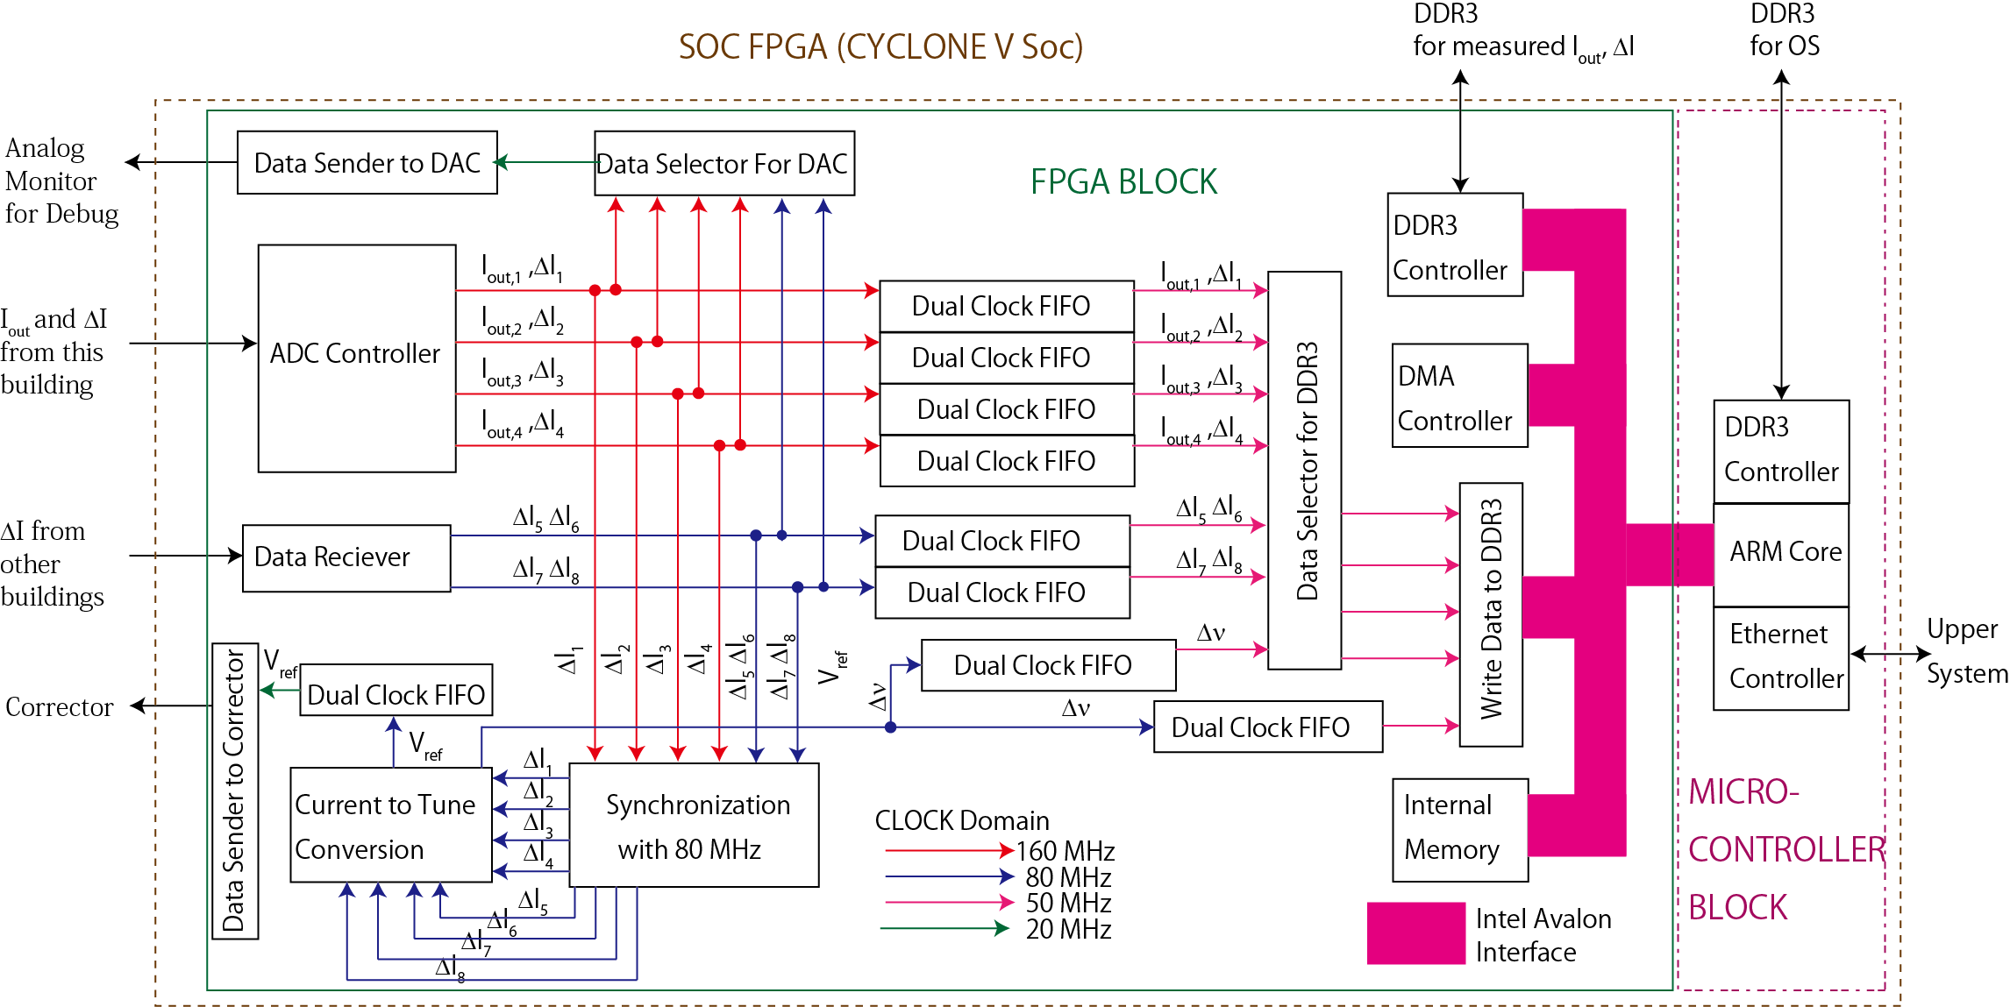
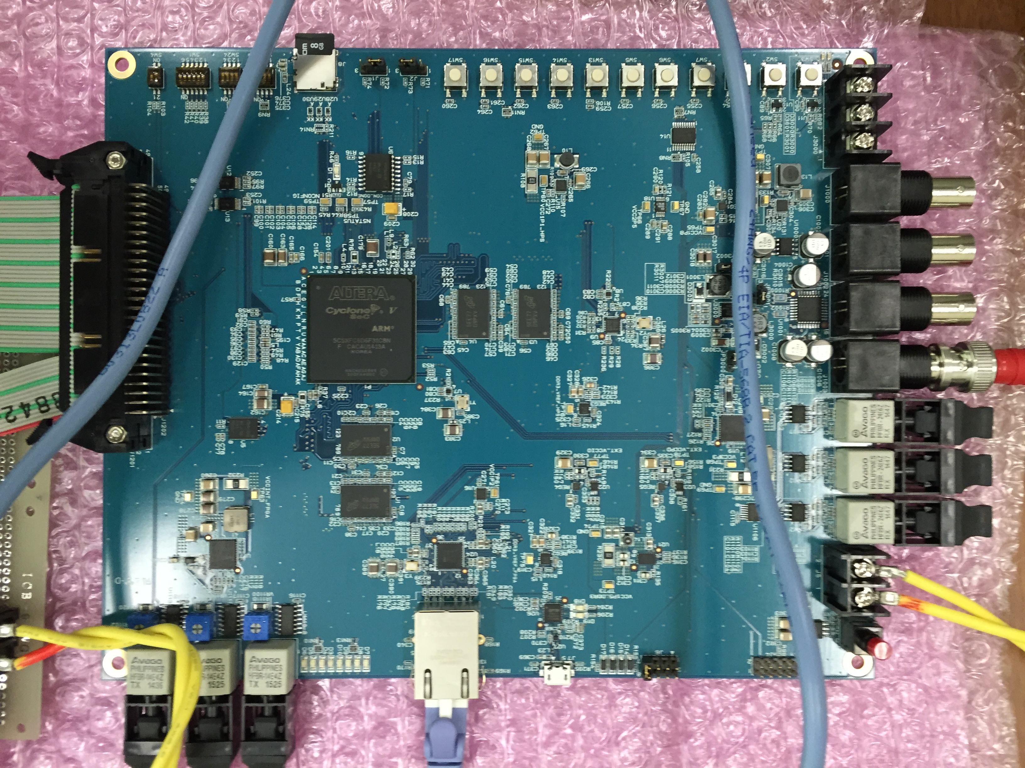
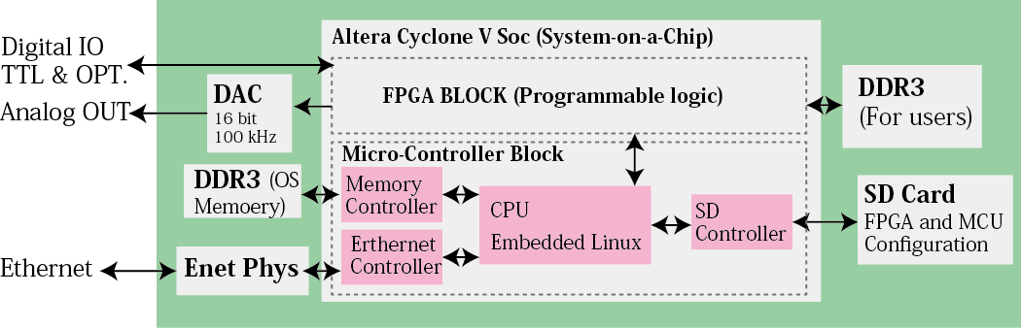
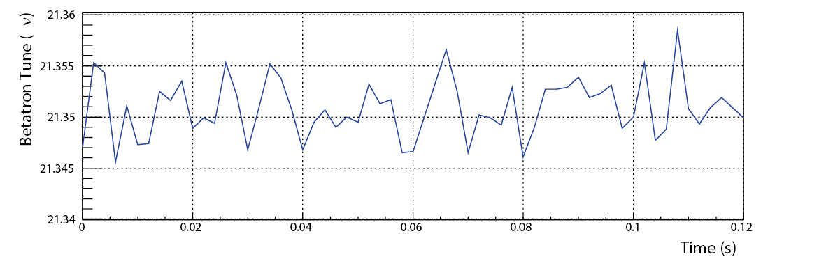
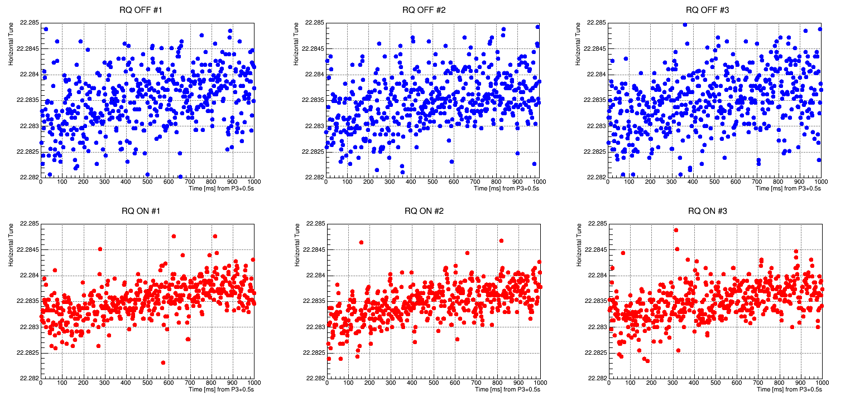
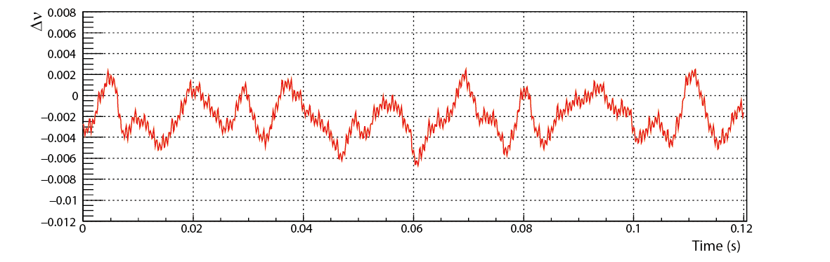
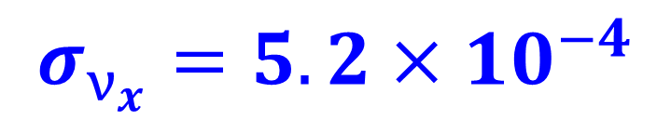


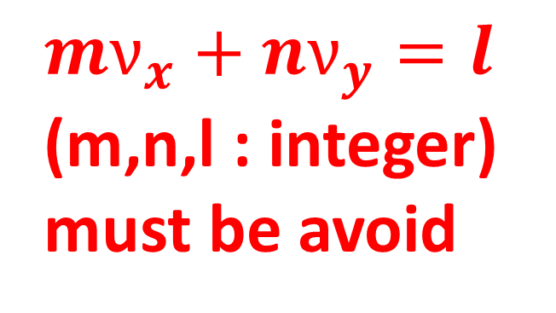




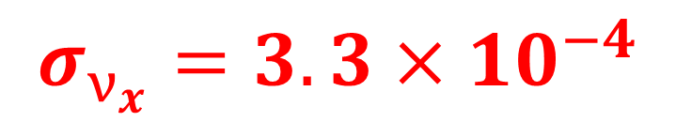

Real-Time Betatron Tune Correction with the Precise Measurement of Magnet Current
Yoshinori Kurimoto, Tetsushi Shimogawa and Daichi Naito
High Energy Accelerator Reaserach Organization
Abstract - The betatron tune, which is defined as the number of transverse oscillations in one turn of a ring accelerator, must be precisely controlled by electrode magnets. The ripple of the magnet current directly displaces the betatron tune from its designated value. We have developed a system that corrects the betatron tune displacement using the measured magnet current at the J-PARC (Japan Proton Accelerator Research Complex) Main Ring. We adopted Field Programmable Gated Arrays (FPGA) to convert from the measured magnet current to the betatron tune in real time. Using the system, we have decreased the fluctuation of the betatron tune by approximately 43 % at the frequencies less than 250 Hz.
Introduction
Betatron Oscillation
$$x(s)=\sqrt{εβ\left(s\right)}\cos{(φ\left(s\right)+φ_{0})}$$
Real-Time ν Correction with Magnet Current
Focusing and de-focusing magnets are alternatively placed along the ring so that the transverse motion can be controlled
Motivation
Large current ripple causes v fluctuation
Dominant current ripple is at < 100 Hz
Direct ν measurement is not possible during the user operation
Betatron Tune $ν_{x(y)}$
Resonance Condition of $ν_{x(y)}$
Current Ripple ΔI/I
The number of the oscillation in one turn
Ex. ν_{x} = integer
$$ν_{x(y)}=\frac{1}{2π}\oint{φ\left(s\right)ds}$$
${mν}_{x}+nν_{y}=l$
(m,n,l : integer)
must be avoid
x’
X phase space
Dipole Errors are accumulated
x
Proposed Method
How to control the $ν_{x(y)}$
Magnets
Betatron Oscillation
The current ripple is affected by the fluctuation of the grid voltage and frequency
Current Regulators
B
I
$ν_{x(y)}$
Bend.
Not predictable
Quad.
Real-Time Correction
Precise current regulation is the key to controlling the $ν_{x(y)}$
Experimental Setup at the J-PARC MR
Overview
AD Board
Constraint at the J-PARC MR
The magnet current regulators are located at 3 different buildings
The current regulator of the corrector is located at the 1 building
AD Converter : TI ADS8568, 8 CH, 16 Bit, 10 kSPs
Digital IO : Optical, Serial Communication
Others : Daisy Chain
8 current regulators are chosen.
・All 96 bending magnets
・96 ( out of 216 ) quadrupole magents
Firmware Design
③
⑤
The AD conversion of the current deviation ΔI @ each regulator
All digitized ΔI s are sent to the corrector via optical fibers
The FPGA board converts all ΔI s to the ν.
①
④
FPGA Board
②
FPGA : Altera Cyclone V Soc (System-on-a-Chip)
DDR3 : 2 GB, 1 GB for User, 1 GB for OS
Digital IO: LVTTL and Optical
Analog Out : 4ch 16 bit DAC
Others: Giga-bit Ethernet, On-board flash, μSD
① Receive ΔI data from the current regulators
② Convert ΔI data to Δν and sent it to the corrector
③ Store ΔI data in the DDR3 connected to FPGA
④ Move ΔI data to the DDR3 connected to the CPU with DMA
⑤ Send ΔI data to the upper system
ν correction
On-line Monitoring
Comparison with the Direct measurement
ν Correction using the System
Direct ν Measurement
Direct Measurement
Direct measurement with the corrector turned on.
Sensitive to the ν variations below 250 Hz
Frequency measurement of the betatron oscillation excited by the stripline kicker.
OFF
ON
The tendencies of the time variations are roughly same
Real-Time prediction with ΔI s (this system)
$$ν_{x}$$
$$ν_{x}$$
Possible reasons for the discrepancies
$$σ_{ν_{x}}=5.2×{10}^{−4}$$
Time (s)
$$σ_{ν_{x}}=3.3×{10}^{−4}$$
Time (s)
The precision of the direct measurement
Not all magnet currents are used.
Conclusion
The proposed system can reduce the v fluctuation by 43 %

