Slide 1

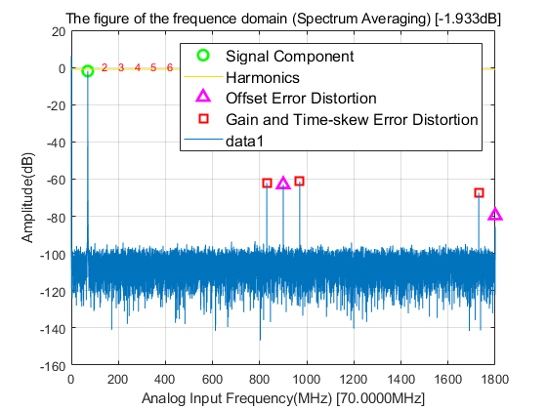
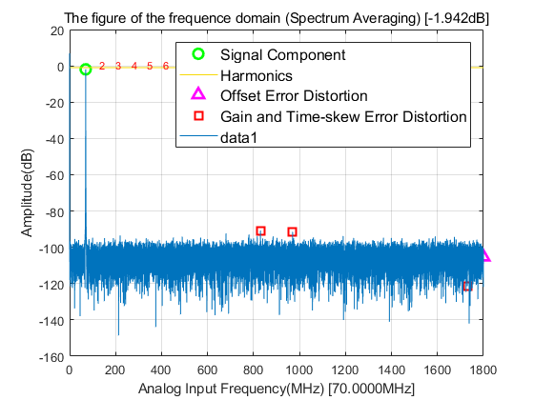
A new all-digital background calibration technique for time-interleaved ADC using first order approximation FIR filters
Jiadong Hu
University of Science and Technology of China

Slide 2
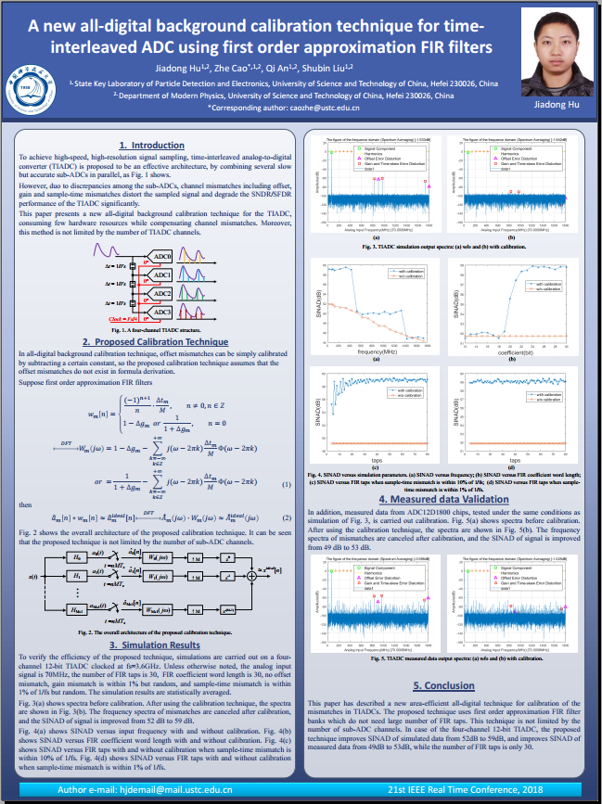
Poster
Introduction
Proposed Calibration Technique
Measured data Validation
Simulation Results
Poster session 2,
Abstract ID 416
14/06/2018, 14:35
University of Science and Technology of China

