Slide 1

HIE-ISOLDE REVIEW MEETING
beam dynamics STUDIES
Matthew Fraser - en/Sti, cern, uni. Of Manchester and cockcroft institute
matthew.alexander.fraser@cern.ch
In collaboration with…
Matteo Pasini (Instituut voor kern- en stralingsfysica, K.U.Leuven and cern)
roger jones (Cockcroft institute and Uni. of manchester)
alessandro d’elia (cockcroft institute and cern)
Slide 1 of 28
Matthew Fraser – HIE-ISOLDE Review Meeting, 15th June 2009

Slide 2
PRESENTATION CONTENT
Introduction to the HIE-LINAC.
Studies of first-order beam dynamics simulations using LANA.
Studies of realistic field beam dynamic simulations:
  Single particle tracking in the high-beta cavity.
    Beam steering effect.
    Transverse asymmetry.
  Multi-particle simulations using TRACK.
    Preliminary results from an error and misalignment study.
    Conclusions.
    Future.
Slide 2 of 28
Matthew Fraser – HIE-ISOLDE Review Meeting, 15th June 2009

Slide 3
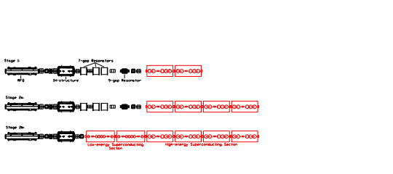
THE HIE-LINAC LATTICE DESIGN
9.5 MeV/u
Staged construction.
5 keV/u
300 keV/u
1.2 MeV/u
3.0 MeV/u
5.5 MeV/u
10 MeV/u
Target energy of 10 MeV/u for the nominal beam, A/q = 4.5.
Final design comprises of 2 low energy and 4 high energy cryomodules.
Slide 3 of 28
Matthew Fraser – HIE-ISOLDE Review Meeting, 15th June 2009
Notes:
The linac will be built in a staged fashion in order to minimise beam downtime. The new infrastructure is shown in red and consists of two different geometries of cavity, operating at beta = 6.3 % and 10.3 % speed of light. The first stages will augment the energy of the linac by adding high energy cryomodules at the end of the existing REX infrastructure. For increased energy variability a dedicated low energy section will replace the 7 and 9 gap accelerating stuctures.

Slide 4
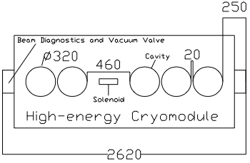
THE HIGH ENERGY LATTICE
Five high-beta cavities per module (geometric velocity, β_{g} = 10.3 %).
One solenoid per module.
Drift distances minimised:
Inter-cryomodule distance with single vacuum now only 50 cm.
Centre of solenoid to cavity 23 cm (Field from solenoid < 0.02 G).
Slide 4 of 28
Matthew Fraser – HIE-ISOLDE Review Meeting, 15th June 2009

Slide 5
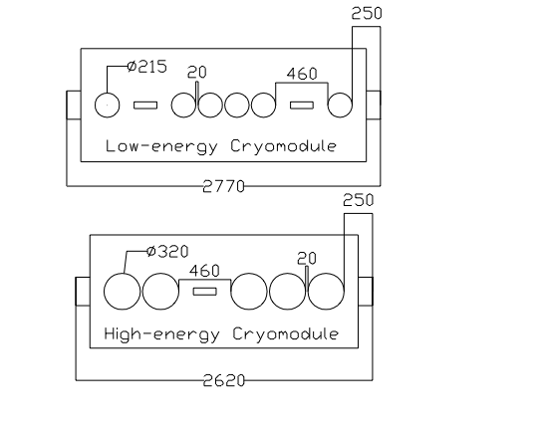
THE LOW ENERGY LATTICE
Six low-beta cavities per module (geometric velocity, β_{g} = 6.3 %).
An extra solenoid per module, to control the stronger transverse RF defocusing force at low energy.
First cavity is seperated by a drift allowing it to act as a bunching cavity.
Reduction in the phase extent of the beam is critical to cut down transverse
emittance growth.
Slide 5 of 28
Matthew Fraser – HIE-ISOLDE Review Meeting, 15th June 2009

Slide 6
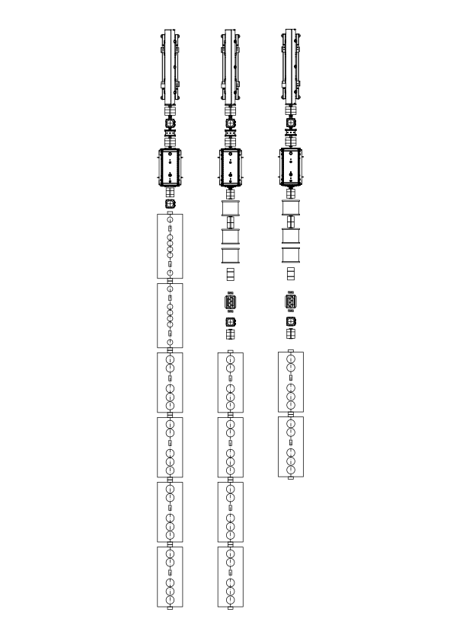
FIRST-ORDER BEAM DYNAMICS SIMULATIONS
Objectives:
  To assess the lattice design’s ability to accelerate to the target energy and preserve emittance.
  To define the specification of the focusing system.
Scenario:
  The full stage 2b (final stage) HIE-LINAC.
  Work carried out early in the design stage, the « worst-case » scenario was used, i.e. large inter-cryomodule drift (80 cm) distance and large injection distance after the IH-structure (100 cm).
  Trans. injection emittance (measured by D. Voulot): ε^{100%}_{T,norm} = 0.3 π mm mrad
  Longitudinal injection emittance (simulated), ε^{100%}_{L} = 2.0 π keV/u ns.
  Injection energy out of IH-structure: E = 1.2 MeV/u.
Challenges:
  No pre-buncher before injection.
  No transverse matching section between low and high energy cryo’s.
Slide 6 of 28
Matthew Fraser – HIE-ISOLDE Review Meeting, 15th June 2009
Notes:
Assumptions: hard-edge model, constant accelerating field in gaps

Slide 7
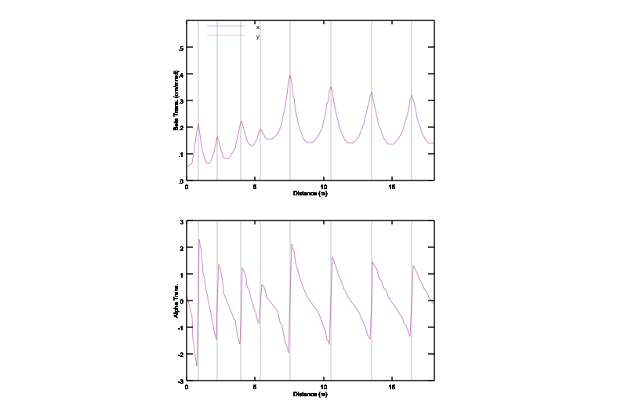
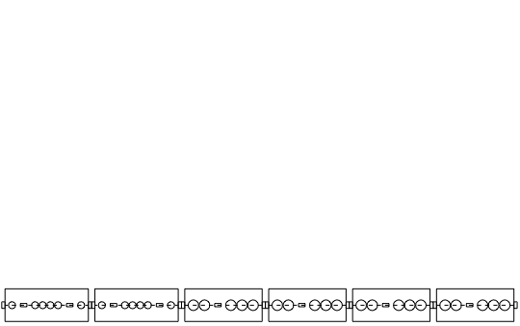
BEAM DYNAMICS OF THE NOMINAL BEAM (A/Q= 4.5)
LOW-ENERGY
HIGH-ENERGY
Transition section to be discussed.
Slide 7 of 28
Matthew Fraser – HIE-ISOLDE Review Meeting, 15th June 2009
Notes:
The horizontal and vertical betatron (envelope) functions along the linac. Beam is symmetric at first-order. Peak energy, 10 MeV/u, is attained with minimal emittance growth. This linac is operated at 90 degrees phase advance per focusing period in the high-energy section, as will be discussed.

Slide 8
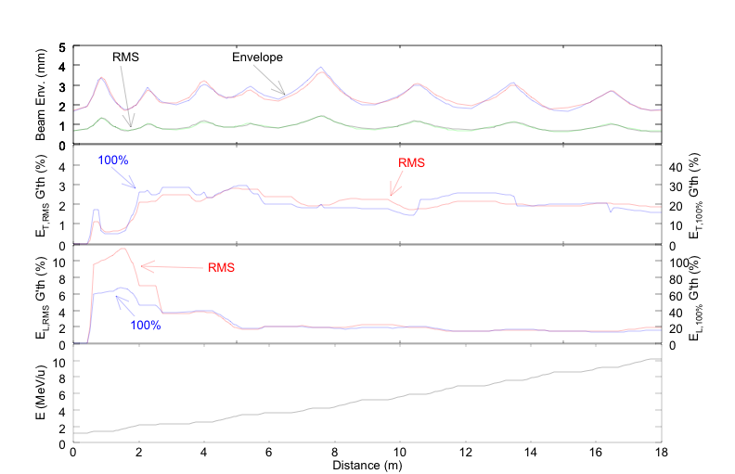
beam dynamics of the nominal beam (A/Q= 4.5)
Slide 8 of 28
Matthew Fraser – HIE-ISOLDE Review Meeting, 15th June 2009
Notes:
Peak beam size occurs in the first solenoid after the transition region – 4 mm (this will be the most constraining part of the design on the aperture). Aperture is 15 mm! RMS emittance grows only by 2 %, and although the longitudinal emittance grows sharply on injection (large phase spread in the non-linear accelerating field, we operate at -40 deg sync. phase to improve bunching) it is recovered by the end of the low-energy section. Energy reaches the nominal 10 MeV/u.

Slide 9
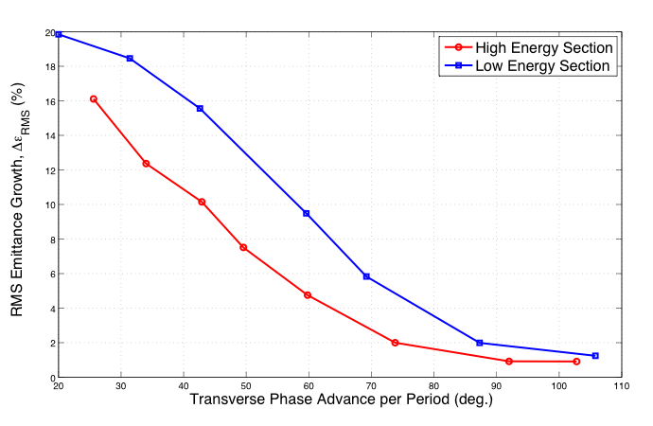
EMITTANCE GROWTH vs. PHASE ADVANCE
Periodic solutions of the envelope function were found and the emittance growth in the low and high energy sections analysed separately.
Transverse emittance growth was studied as a function of the strength of the focusing system, parameterised by the phase advance per focusing period.
Emittance growth minimised for Phase Adv. > 90 degrees per period.
A/q = 4.5
Slide 9 of 28
Matthew Fraser – HIE-ISOLDE Review Meeting, 15th June 2009
Notes:
The linac was longitudinally to maximise energy gain without significant longitudinal emittance growth. The emittance growth is worse, as expected, at low energy but emittance growth is minimised when operating in a region above 90 degrees phase advance per period.

Slide 10
BEAM PARAMETERS AND SOLENOID DESIGN SPECIFICATION
A/q | E_{K,inj.} (MeV/u) | E_{K,ej.} (MeV/u) | Δε_{RMS} (transverse) (%) | B_{PEAK} (In 20 cm hard-edge solenoid) (T) | Magnetic Field Integral (T² m)
4.5 | 1.2 | 10.2 | 2 | 8.70 | 15.1
3.5 | 1.2 | 12.6 | 3 | 7.00 | 9.8
2.5 | 1.2 | 16.5 | 5 | 5.95 | 7.1
Transverse equation of motion for a solenoid, in the paraxial ray approximation.
Slide 10 of 28
Matthew Fraser – HIE-ISOLDE Review Meeting, 15th June 2009
Notes:
Operating the high-energy section at 90 degrees phase advance demands a solenoid capable of delivering over 15.1 T^2 m.

Slide 11
MATCHING SECTION
Beam diverges in the transition region because of the change in length of the solenoid focusing period.
Problem: Running at high phase advance at low-energy makes it impossible to match into the high-energy section at a high phase advance.
At a beam waist:
To optimise the matching we have the variables:
  Magnitude of betatron (envelope) function at the transition region.
  Transition region length (inter-cryomodule distance).
  Lattice (change the number of cavities in transition focusing period).
Low Energy Period Length (m) | High Energy Period Length (m)
1410 | 2164 (with 80 cm inter-cryomodule distance)
LOW-ENERGY
HIGH-ENERGY
Maximise β (at transition region) to minimise divergence.
Slide 11 of 28
Matthew Fraser – HIE-ISOLDE Review Meeting, 15th June 2009
Notes:
Preferably we want to operate the machine at 90 degrees phase advance per period throughout. Due to the transition region from low to high energy, this is not possible.

Slide 12
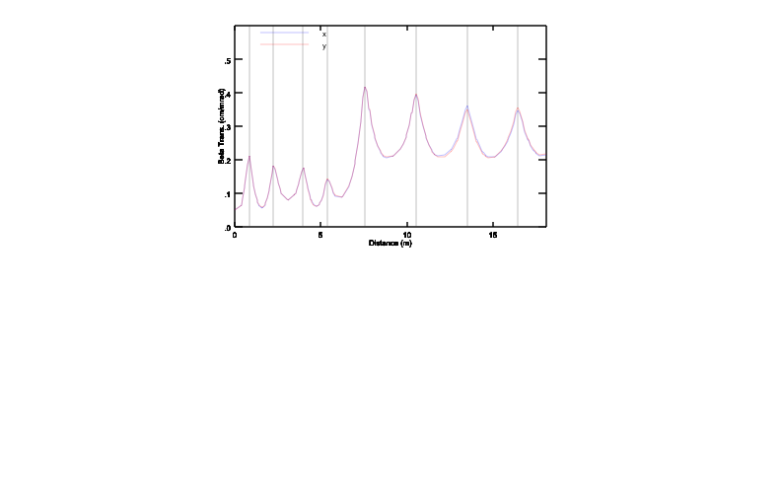
MATCHING SECTION
With the designated lattice, we investigate the effect of relaxing the solenoid fields and decreasing the phase advance fields at low-energy in order to have a higher phase advance in the high energy section.
Period | 1 | 2 | 3 | 4 | 5 | 6 | 7
Phase Advance (deg.) | 85 | 90 | 50 | 65 | 90 | 90 | 90
Period | 1 | 2 | 3 | 4 | 5 | 6 | 7
Phase Advance (deg.) | 90 | 90 | 90 | 90 | 65 | 65 | 65
Slide 12 of 28
Matthew Fraser – HIE-ISOLDE Review Meeting, 15th June 2009
Notes:
There is a trade off between running at higher phase advances in the high energy section but potentially suffering from larger emittance growth in the low energy section.

Slide 13
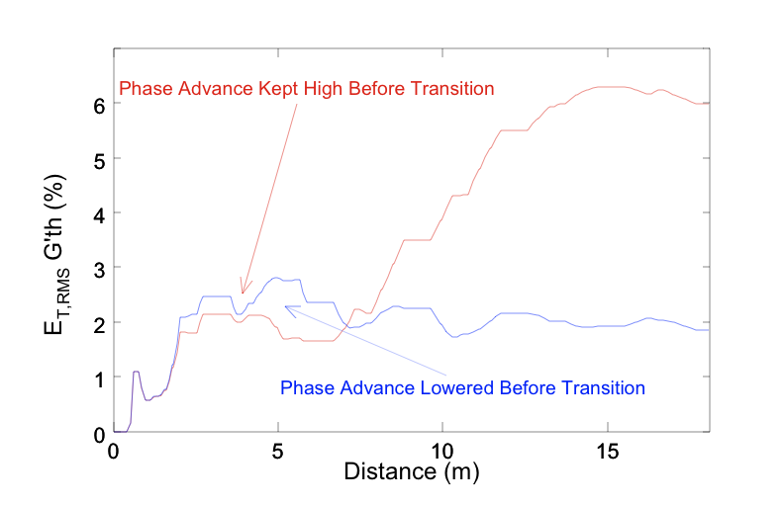
MATCHING SECTION
Emittance growth along the linac is reduced from 6 % to 2 % by lowering the phase advance in the low energy section, but running at 90 degrees per period in the high-energy section.
Slide 13 of 28
Matthew Fraser – HIE-ISOLDE Review Meeting, 15th June 2009
Notes:
NOTE: REPLOT SHOWING DISTANCE AND 99% EMITTANCE

Slide 14
REALISTIC FIELD SIMULATIONS
Focus on the high-energy section, with realistic high-beta cavity fields simulated in Microwave Studio (A. D’Elia).
Single particle dynamics was studied by writing a routine to integrate the equations of motion in the realistic fields:
  Dipole kick.
  Transverse asymmetry in cavity defocusing forces.
  Misalignment and correction studies through a matrix parameterisation.
  Multi-particle simulations carried out using TRACK.
  Realistic solenoid fields simulated in SUPERFISH (R. Maccaferri).
A/q = 4.5:
1.2 MeV/u
2.8 MeV/u
9.5 MeV/u
Slide 14 of 28
Matthew Fraser – HIE-ISOLDE Review Meeting, 15th June 2009
Notes:
NOTE: REPLOT SHOWING DISTANCE AND 99% EMITTANCE

Slide 15
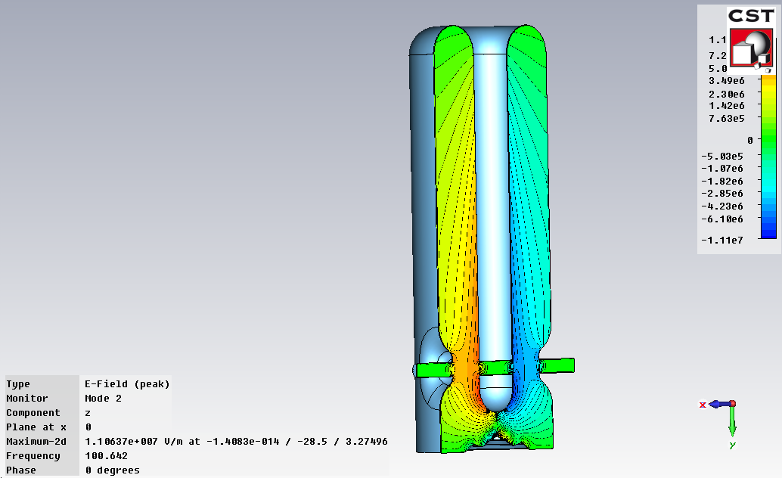
HIGH-BETA QUARTER-WAVE RESONATOR
Design Parameter | Value
f (MHz) | 101.28
β₀ (%) | 10.3
Nominal Sync. Phase (deg.) | -20
Design Gradient (MV/m) | 6
Active Length (m) | 0.3
Gap Length (mm) | 85
Design Voltage (MV) | 1.8
Cavity Diameter (m) | 0.3
Cavity Height (m) | 0.8
BEAM
The High-beta Cavity
Slide 15 of 28
Matthew Fraser – HIE-ISOLDE Review Meeting, 15th June 2009
Notes:
Alex will go into more details about the cavity design. I study the

Slide 16
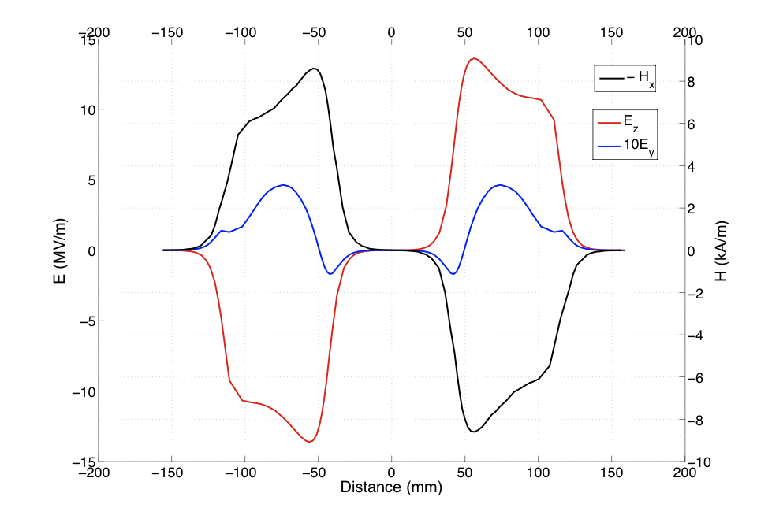
HIGH-BETA QUARTER-WAVE RESONATOR
Asymmetry around the beam port leads to:
  Dipole kick – Beam steering within the cavity.
  Asymmetric RF defocusing forces in the transverse plane.
Slide 16 of 28
Matthew Fraser – HIE-ISOLDE Review Meeting, 15th June 2009

Slide 17
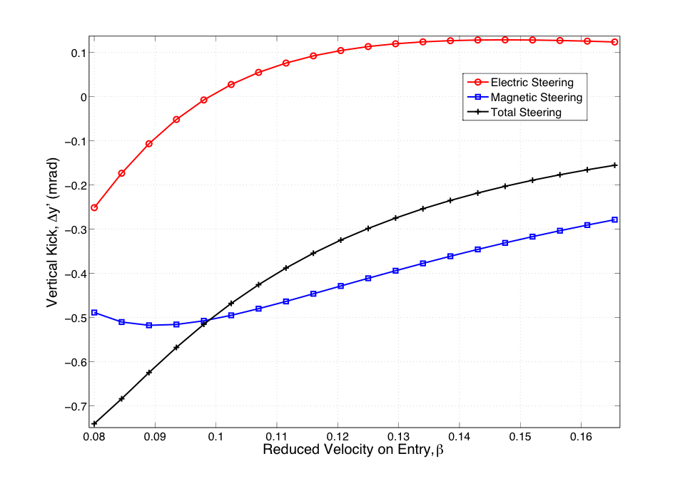
BEAM STEERING ON AXIS
Transverse fields impart a phase dependent vertical kick to the beam.
Strongly couples longitudinal and transverse motion, and a source of emittance growth if not corrected.
A/q = 2.5, ϕ_{s}= -20 deg.:
Net kick is downwards.
Maximum kick of 0.75 mrad at injection energy, 3 MeV/u, or a velocity of 0.08c.
Dominated by the magnetic steering on axis.
Kick a factor of 2.5/4.5 less for the nominal beam.
A/q = 2.5, ϕ_{s}= -20 deg.
Slide 17 of 28
Matthew Fraser – HIE-ISOLDE Review Meeting, 15th June 2009
Notes:
Electric kick is mainly positive and the magnetic kick negative.

Slide 18
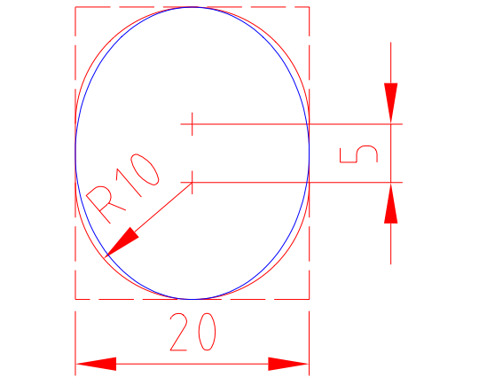
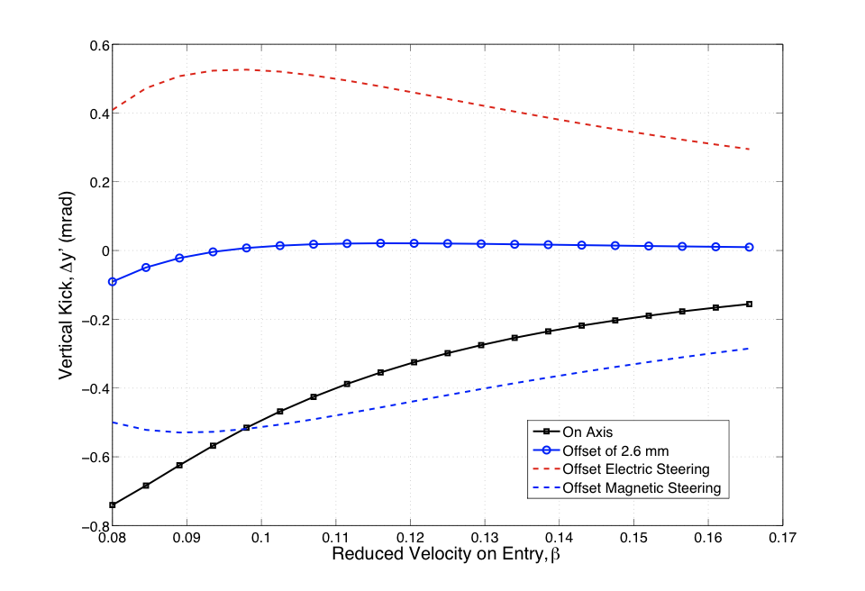
BEAM STEERING COMPENSATION SCHEME
Offset the beam 2.6 mm vertically in order to use the vertical electric force to compensate the magnetic steering.
Offset decided by minimising the total integrated kick along the linac (assuming the beam enters each cavity at the same offset).
Beam Port
Racetrack shape.
Maximise acceptance (lose only 1 % with beam offset).
Maximise TTF (minimise stray field).
A/q = 2.5, ϕ_{s}= -20 deg.
Slide 18 of 28
Matthew Fraser – HIE-ISOLDE Review Meeting, 15th June 2009
Notes:
Alex will go into more details about the cavity design. I study the

Slide 19
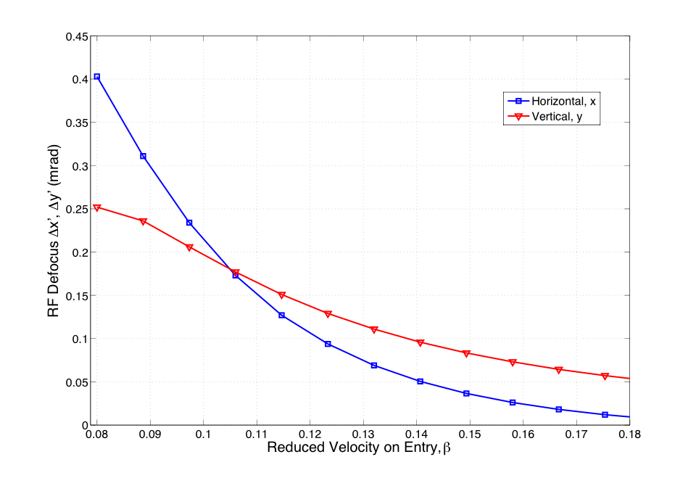
RF DEFOCUSING ASYMMETRY
Asymmetry caused by the cylindrical geometry of the cavity.
Beam distortion and rotation could cause emittance growth when rotated in solenoid focusing channel.
Splits the vertical and horizontal betatron (envelope) functions.
Phase advance per period is different in the vertical and horizontal directions.
Use TRACK to assess the consequences on a beam.
Horizontal force dominates
Vertical force dominates
A/q = 2.5, ϕ_{s}= -20 deg.
At 1 mm from offset axis
Slide 19 of 28
Matthew Fraser – HIE-ISOLDE Review Meeting, 15th June 2009
Notes:
Alex will go into more details about the cavity design. I study the

Slide 20
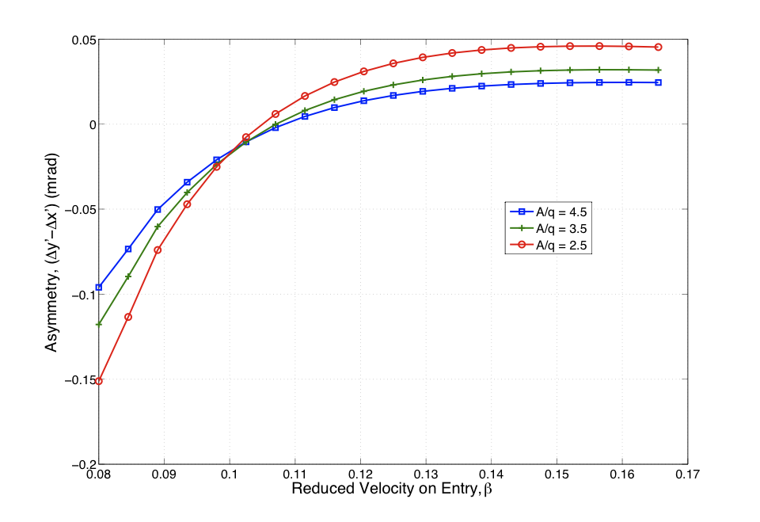
RF Defocusing Asymmetry
The effect of the field asymmetry is proportional to the mass to charge state.
In the worst case, A/q = 2.5, at injection we see a difference of 0.15 mrad between defocusing in the horizontal and vertical directions.
Slide 20 of 28
Matthew Fraser – HIE-ISOLDE Review Meeting, 15th June 2009

Slide 21
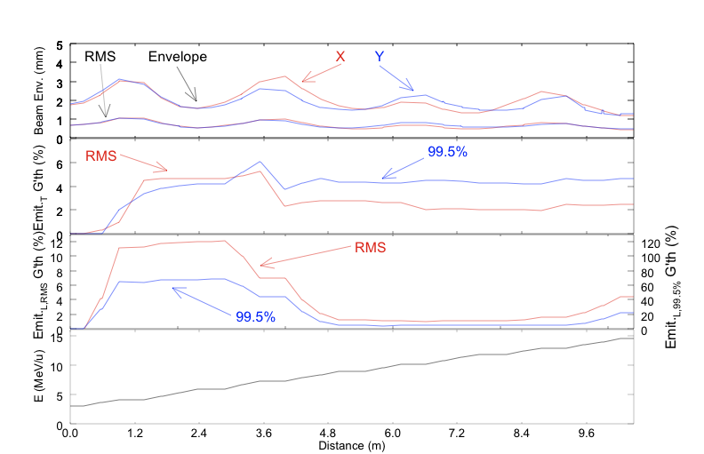
MULTI-PARTICLE SIMULATIONS WITH REALISTIC FIELDS IN TRACK (A/q = 2.5)
Slide 21 of 28
Matthew Fraser – HIE-ISOLDE Review Meeting, 15th June 2009
Notes:
Energy of nearly 15 MeV/u reached from stage 2a, transverse RMS emittance growth only 2 % and 99.5% emittance growth only 4%. Good agreement to first-order approximations. One can observe the splitting in the x and y envelope symmetry produced by the asymmetric nature of the cavity fields.

Slide 22
MULTI-PARTICLE SIMULATIONS WITH REALISTIC FIELDS IN TRACK (A/q = 2.5)
Perfectly aligned linac with no external steering correction applied.
Low transverse emittance growth – dominant source is from the phase spread of the bunch in the cavity.
About 0.7 % emittance growth can be attributed to the asymmetric distortion of the beam in the cavities followed by rotation in the solenoid focusing channel.
A/q | E_{K,inj.} (MeV/u) | E_{K,ej.} (MeV/u) | Δε_{RMS} (trans.) (%) | Δε_{99.5%} (trans.) (%) | Maximum Centroid Excursion (mm)
4.5 | 2.80 | 9.3 | 2.5 | 3.5 | 0.5
2.5 | 3.07 | 14.5 | 2.5 | 4.5 | 0.5
Slide 22 of 28
Matthew Fraser – HIE-ISOLDE Review Meeting, 15th June 2009

Slide 23
ERROR AND MISALIGNMENT STUDY
I will present preliminary results.
Carried out a study of the longitudinal emittance blow-up due to jitter of the cavity phase and voltage, using the TRACK module.
Wrote a program to track single particles through a misaligned linac. The realistic cavity and solenoid fields are parameterised in matrices.
This method agrees well with TRACK simulations.
A correction routine was applied, assuming no error in BPM measurement.
Just transverse misalignment has been studied.
Slide 23 of 28
Matthew Fraser – HIE-ISOLDE Review Meeting, 15th June 2009

Slide 24
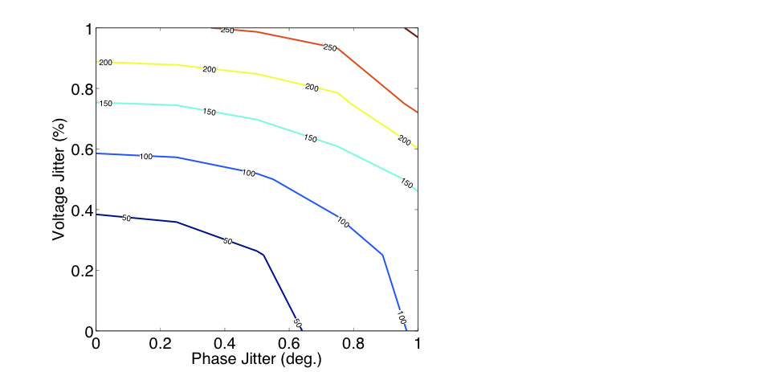
FAST JITTER ERRORS IN CAVITY (A/Q = 4.5)
Fast cavity jitter in an aligned linac.
In units of % and degrees, the emittance growth is most sensitive to the voltage jitter.
Long. Emittance growth relative to the case with no jitter
Voltage Jitter (%) | Phase Jitter (deg.) | Δε_{RMS} (long.) (%)
0.25 | 0.25 | 30
0.5 | 0.5 | 100
1.0 | 1.0 | 300
To keep the longitudinal emittance growth minimal we look for stability of less than 0.5% in voltage and 0.5 degrees in phase.
Slide 24 of 28
Matthew Fraser – HIE-ISOLDE Review Meeting, 15th June 2009
Notes:
Mention how the transverse emittance growth figures were calculated.

Slide 25
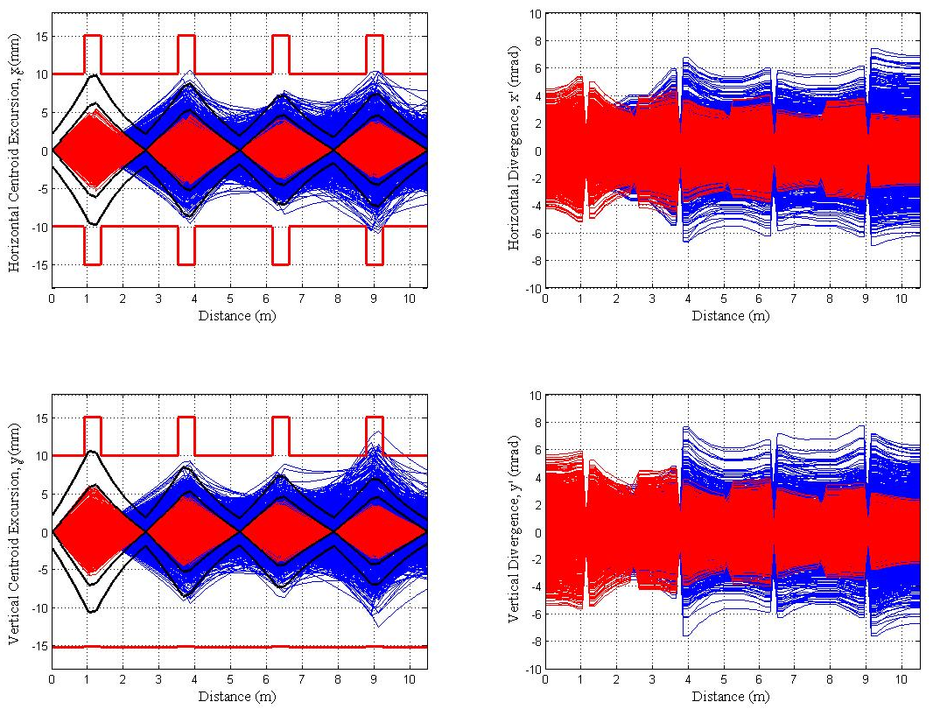
MISALIGNMENT STUDY using a matrix parameterisation of realistic fields
Misalignment:
σ_{cav, x,y}= 0.5 mm
σ_{sol, x,y}= 0.5 mm
σ_{BPM, x,y} = 0 mm
Correction:
Correct for position only.
Corrector before every cryo. with BPM after.
Assume no emittance growth from coupling with longitudinal jitter.
No Correction = BLUE, Correction = RED, 3σ_{RMS} Envelopes = BLACK
Slide 25 of 28
Matthew Fraser – HIE-ISOLDE Review Meeting, 15th June 2009
Notes:
Comment on the aperture. Used cavity aperture in order to be cautious. I wrote this code.

Slide 26
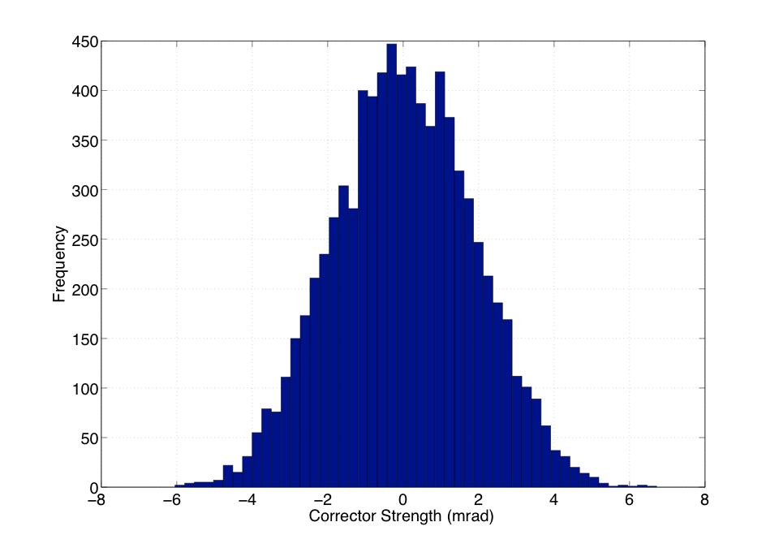
RESULTING CORRECTOR STRENGTH
RMS Corrector Strength required:
σ_{RMS}= 1.8 mrad
Slide 26 of 28
Matthew Fraser – HIE-ISOLDE Review Meeting, 15th June 2009
Notes:
Comment on the aperture. Used cavity aperture in order to be cautious.

Slide 27
CONCLUSIONS
First-order study shows the lattice design can provide beams with a minimal emittance dilution at the design energy (10 MeV/u).
Lack of a dedicated matching section between the low and high energy sections does not hinder beam quality and matching can be done whilst accelerating.
The linac should be operated above 90 degrees phase advance (except when matching the beam) with solenoids capable of delivering more than 15.1 T² m of focusing power.
Realistic field simulations of the high-energy section confirm the strength of the design and show the beam steering and asymmetric effects are not problematic.
The stability of the cavity phase and voltage should be better than 0.5 degrees and 0.5 % in order to keep the growth of longitudinal emittance growth less than 100 %.
With correction, static misalignment errors of 0.5 mm in transverse position of beam line elements can be tolerated without beam loss – demanding correctors able to impart 6 mrad of kick.
Slide 27 of 28
Matthew Fraser – HIE-ISOLDE Review Meeting, 15th June 2009
Notes:
Note that this is not an RMS error, but the maximum of an uniform probability distribution. RMS errors will be implemented in the code.

Slide 28
FUTURE
Study realistic low-beta cavity fields.
Introduce low-beta cavity fields into the simulations and assess error and misalignment tolerances of the entire linac.
Introduce BPM errors into the correction routine.
Correlate cryomodule misalignment with the misalignment of the solenoid in order to account for a beam-based alignment of the cryomodule.
Cross-check error and misalignment study in TRACK (Brahim Mustapha sent me a mail on Saturday which looks like he has fixed a small problem in the code when correcting for position only…can now proceed with TRACK!).
Slide 28 of 28
Matthew Fraser – HIE-ISOLDE Review Meeting, 15th June 2009

