Slide 1
HIE-ISOLDE SC-RF Cavities
Sergio Calatroni

Slide 2
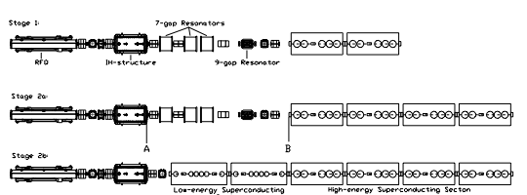
HIE linac staged installation
3 stages installation
1.2 MeV/u
3 MeV/u
5.5 MeV/u
10 MeV/u
From: M. Pasini

Slide 3
Why Nb/Cu cavities?
Mechanical stability (reduction of microphonics and sensitivity to He bath pressure)
Simpler cryostat: no magnetic shielding, conduction cooling
CERN experience (LEP, LHC, R&D)
  Largest experience of niobium sputtering for cavities
  Extensive experience of copper surface treatments
Available experience from INFN-LNL
  Choice of biased diode sputtering as baseline
EuCARD WP10.4.3: development of sputter technology (magnetron sputtering, Hipims) for QWR, aimed at HIE-ISOLDE

Slide 4
BCS surface resistance
Performance will be dominated by R_{res} which is expected to be acceptable for our target parameters. Our goal < 75 nOhm @ nominal field

Slide 5
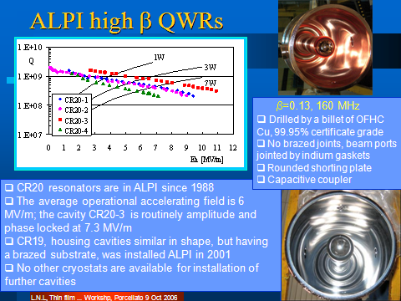

Slide 6
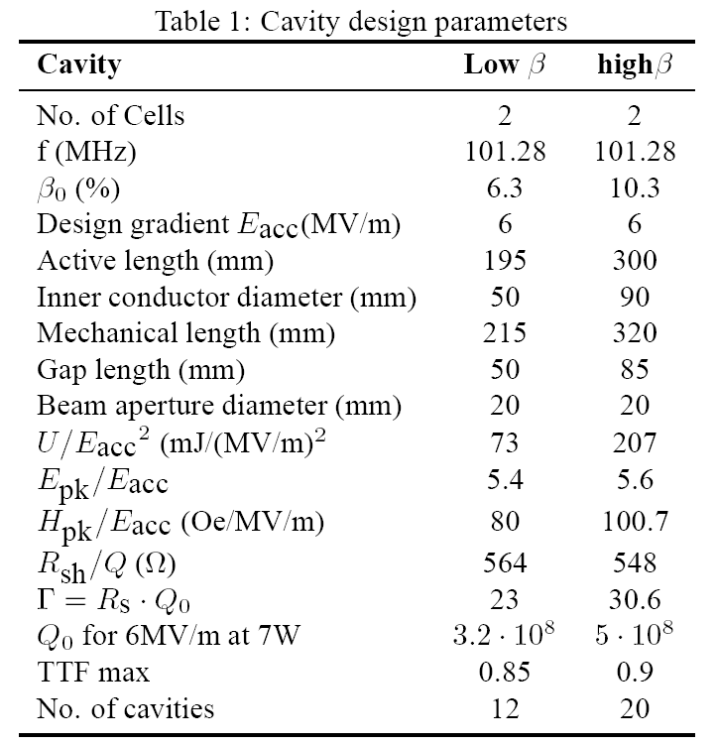
Low-β and high- β cavities

Slide 7
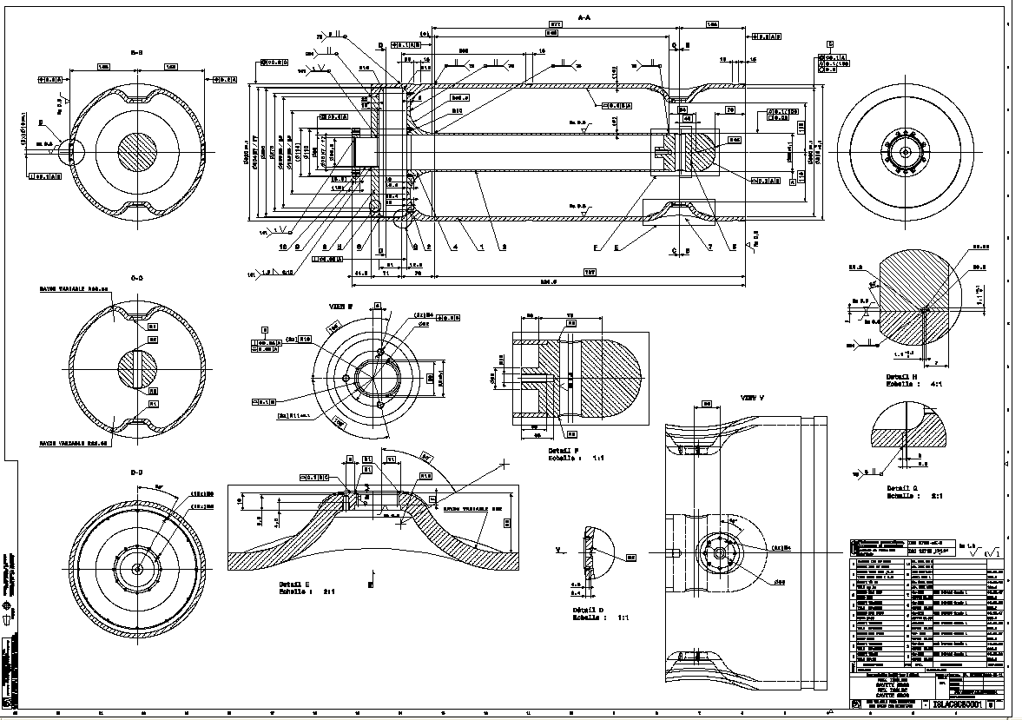

Slide 8
Mechanical design criteria
Avoid any brazing or annealing:
  Negative experience from LNL for coating performance
  Loss of mechanical properties
Cu-OFE C10100 cold worked (rolled sheets, forged billets).
Choice of manufacturing 100% at CERN workshop, thus using only available techniques:
  Long distance EB welding possible
  Inner EB welding not possible
  Deep drawing preferred over 3D machining for beam ports.

Slide 9
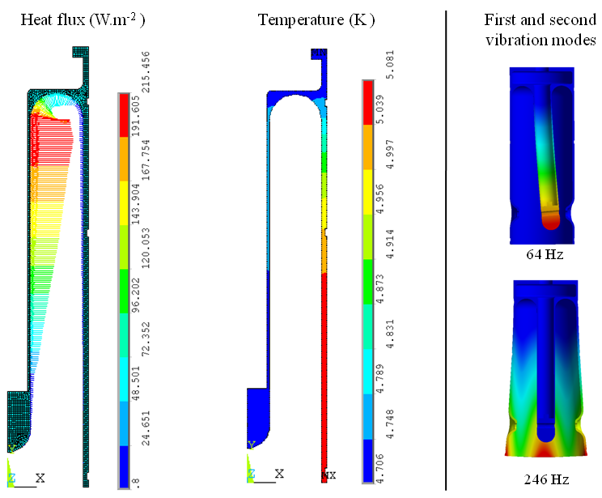
FEM analyses
Heat flux input and resulting temperature distribution in the cavity, considering the thermal conductivity of copper RRR=100 and pool boiling cooling in convection and nucleate boiling regimes.
First and second vibration mode shapes and corresponding frequencies.

Slide 10
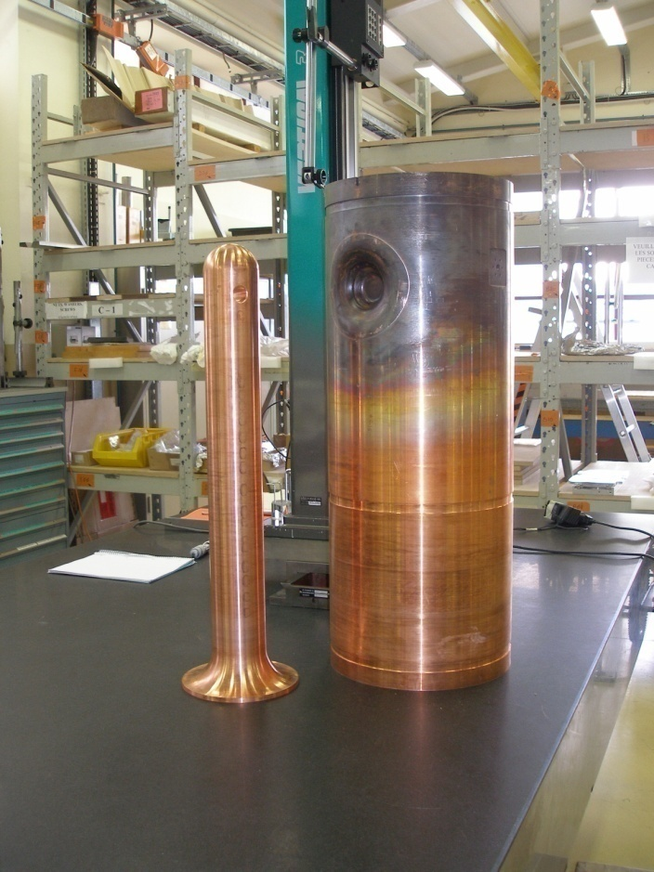
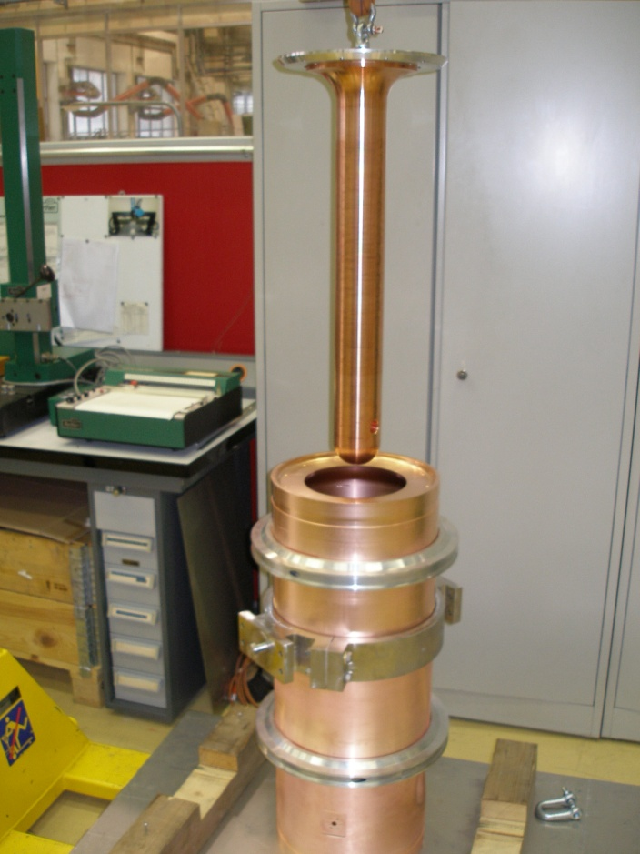
Inner and outer cylinders

Slide 11
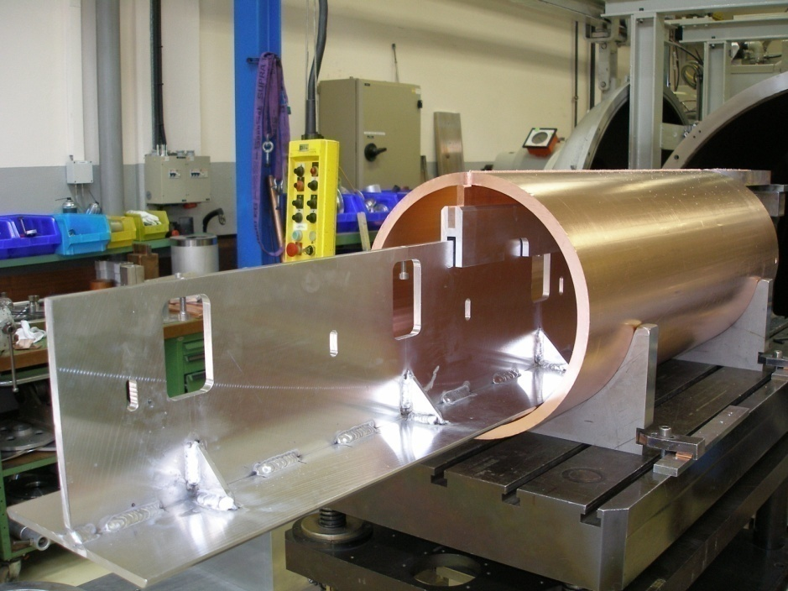
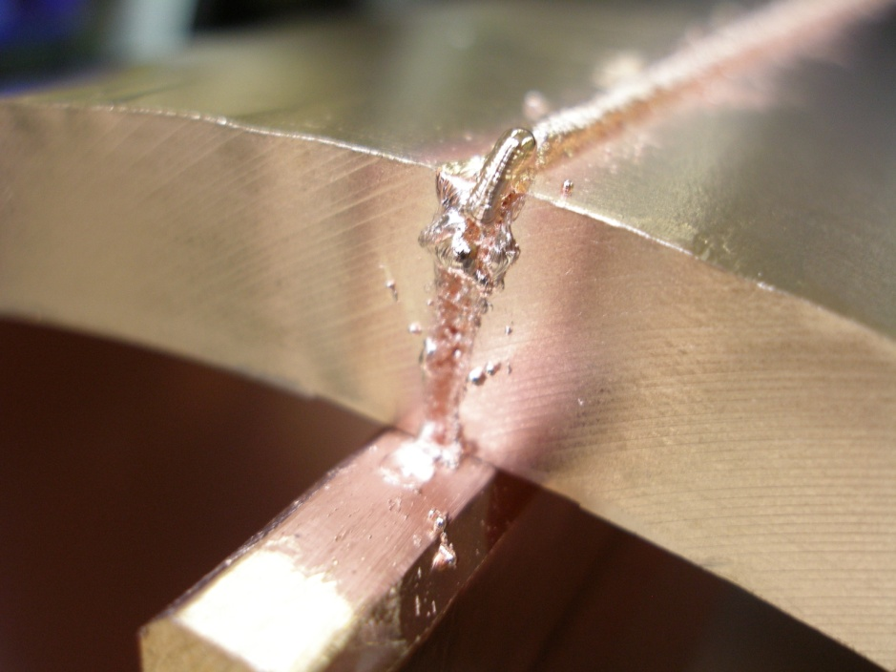
Outer cylinder

Slide 12
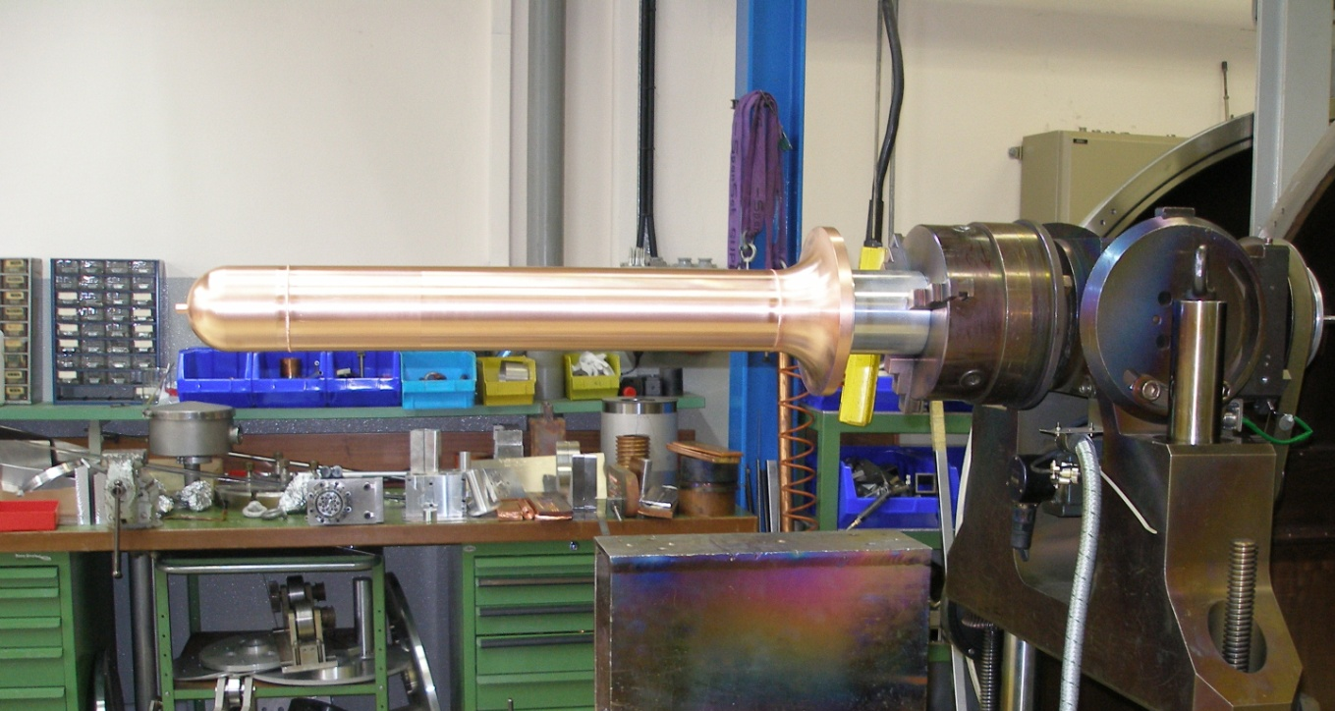
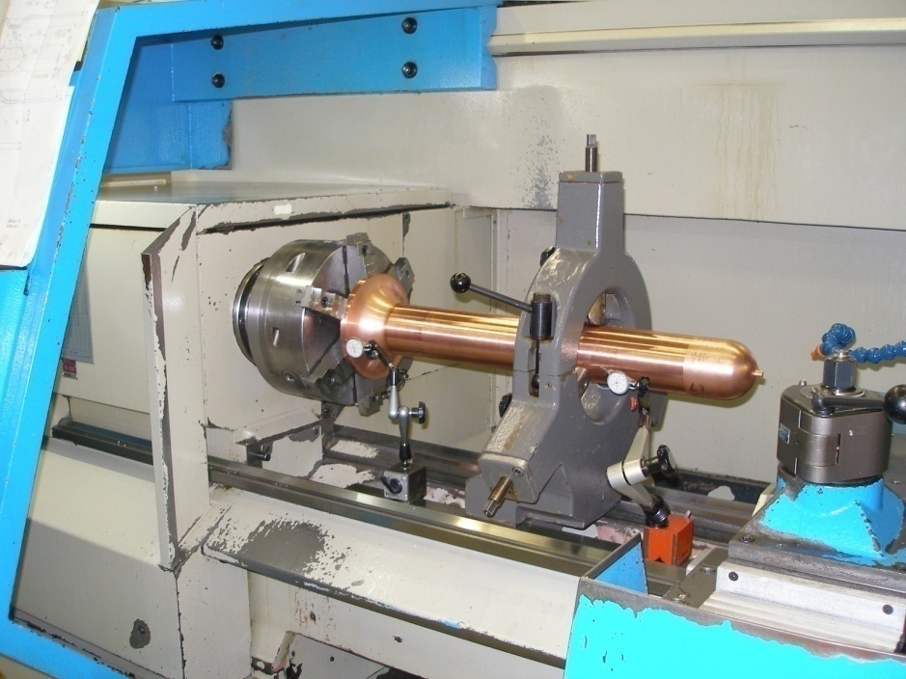
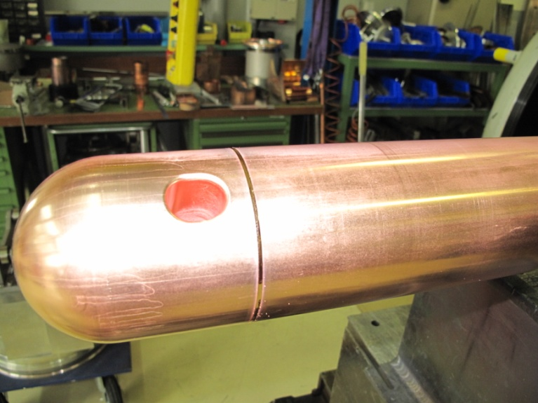
Inner cylinder

Slide 13
Manufacturing sequence
13
3
2
1
6
7
11
8
9
9
10
12
4
5
Rolling of half tubes, longitudinal welding, rough machining
Machining of end piece
E-beam welding
Fine machining of inner surface
“Bossage” and machining of beam ports
Manufacturing of baseplate of inner conductor
Manufacturing of central tube
Manufacturing of head
E-beam welding of the 3 parts of inner conductor
Fine machining of inner conductor
Drilling of beam line
Final long-distance e-beam welding
E-beam welding of top flange ensemble

Slide 14
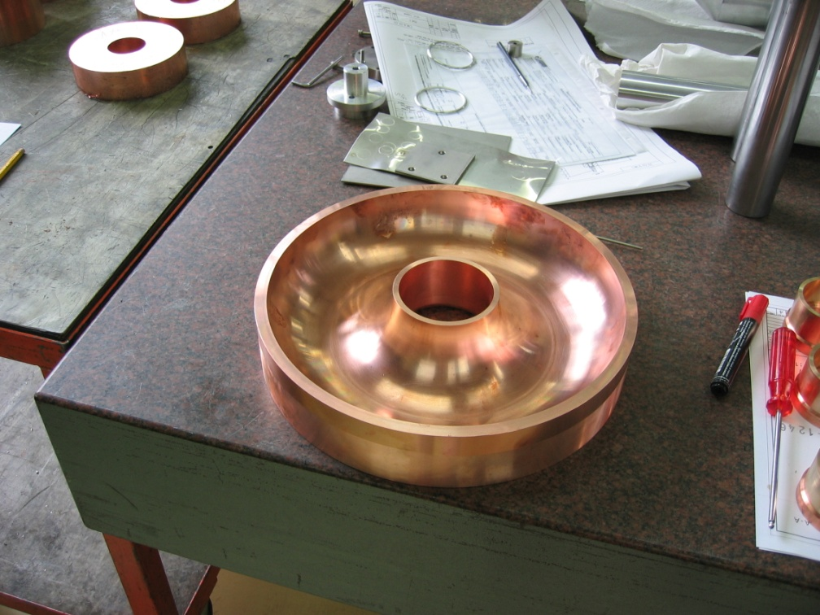
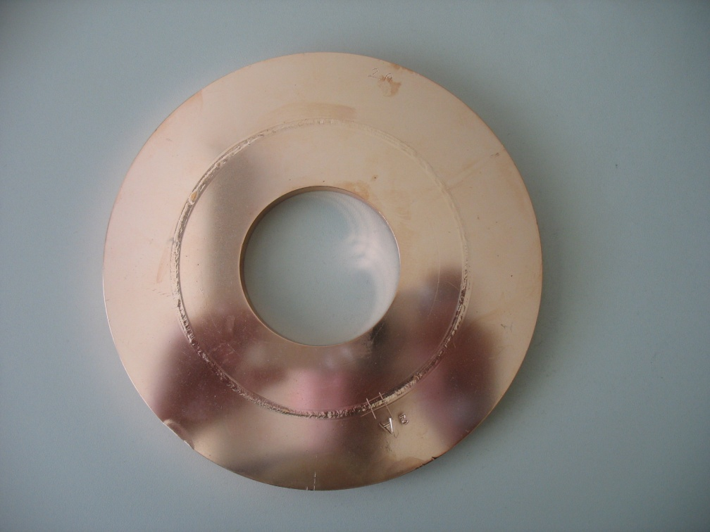
Welding test: 1000 mm distance e-beam
Roughness measured after welding and SUBU chemical polishing, 20 µm removed
Achieved Ra better than 0.8 µm, target value based on LEP/LHC/1.5 GHz CERN experience

Slide 15
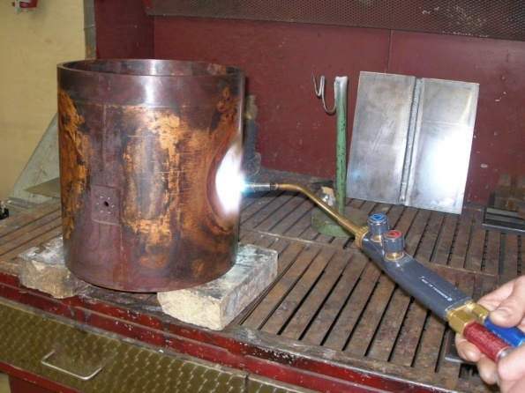
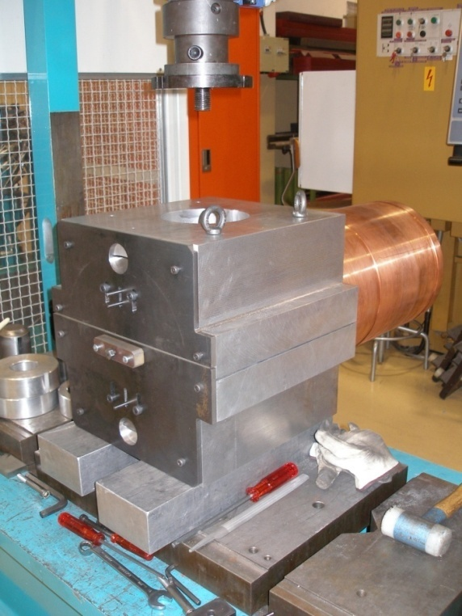
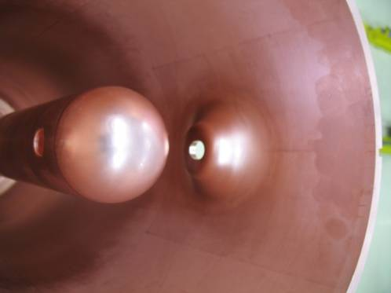
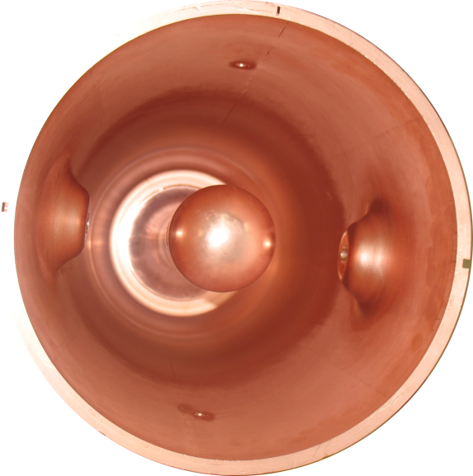
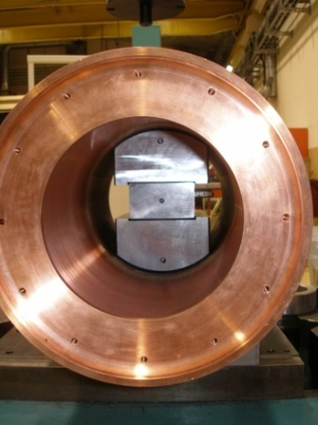
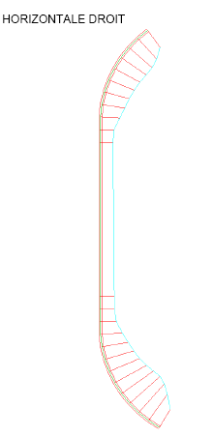
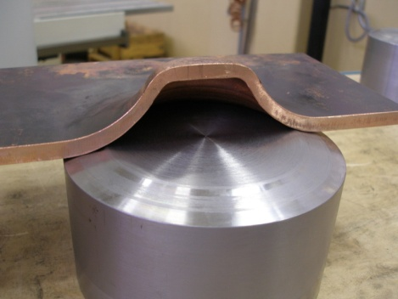
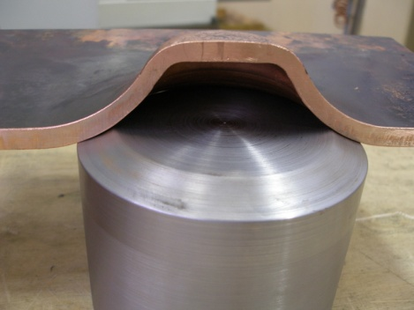
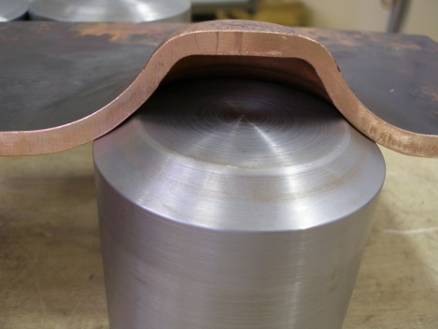
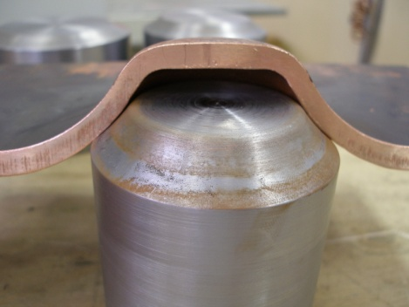
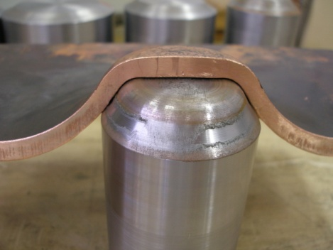
Beam ports
Obtained shape accuracy
better than 0.1 mm

Slide 16
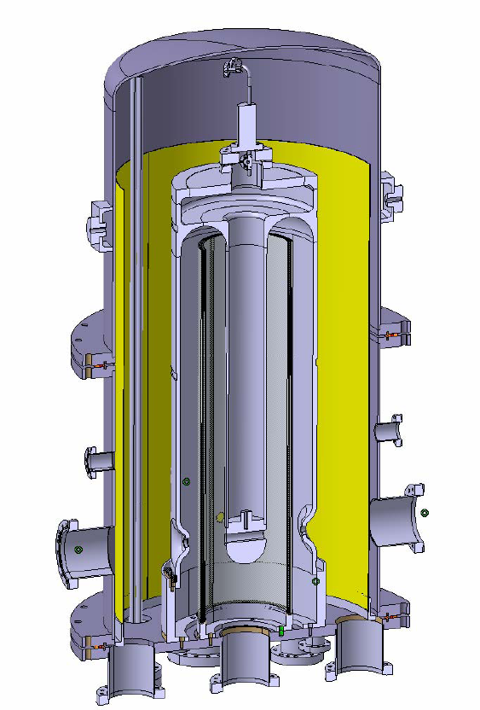
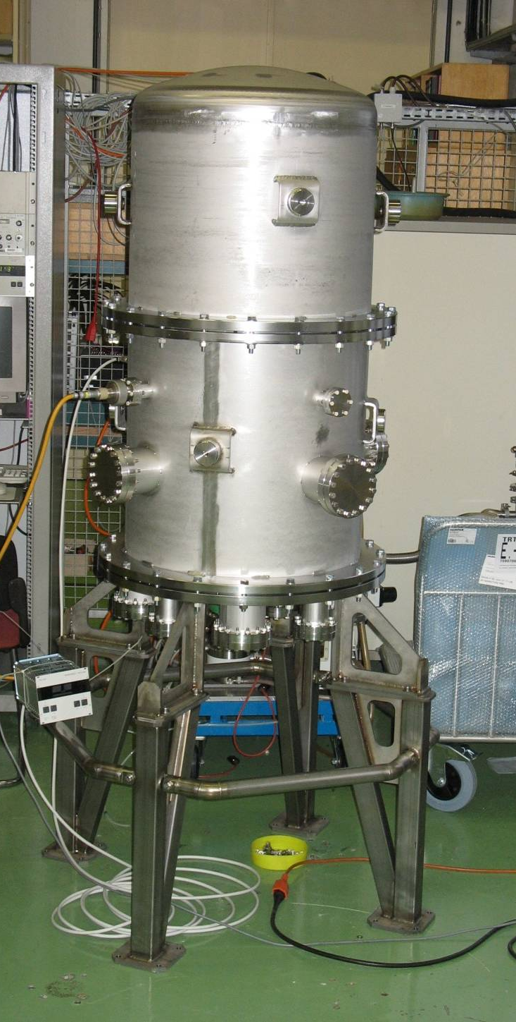
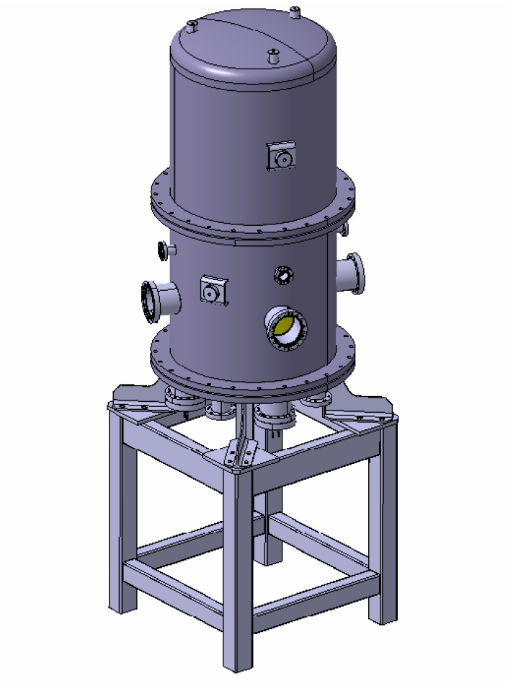
Design of bias sputter coating system
Vacuum tank
Cavity
Thermal shield
Cooling
Sputtering cathode
Cooling feedthrough
Pump connection
HV feedthrough

Slide 17
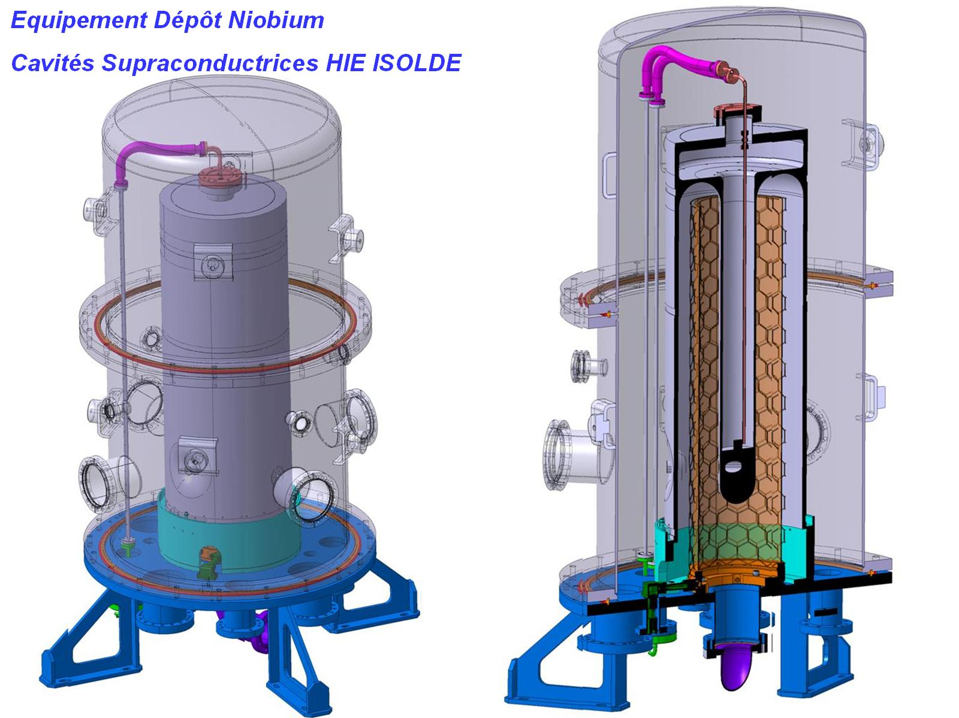
Coating assembly: cathodes and cavity cooling

Slide 18
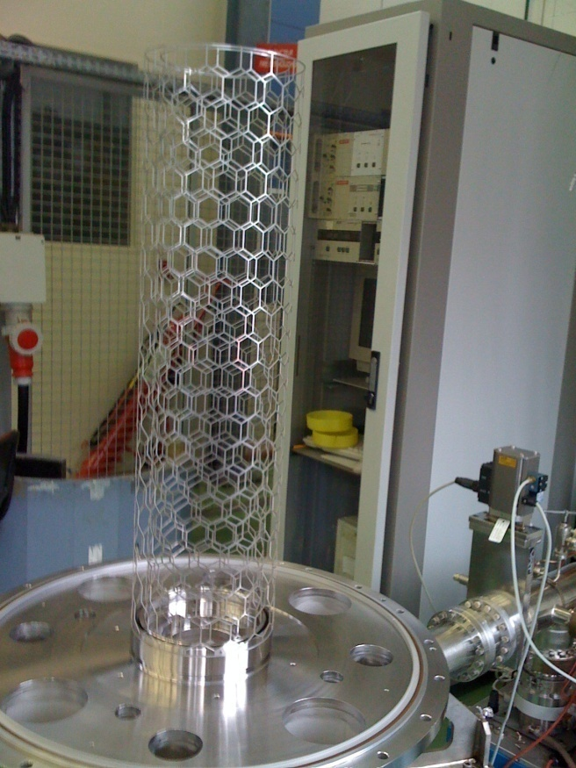
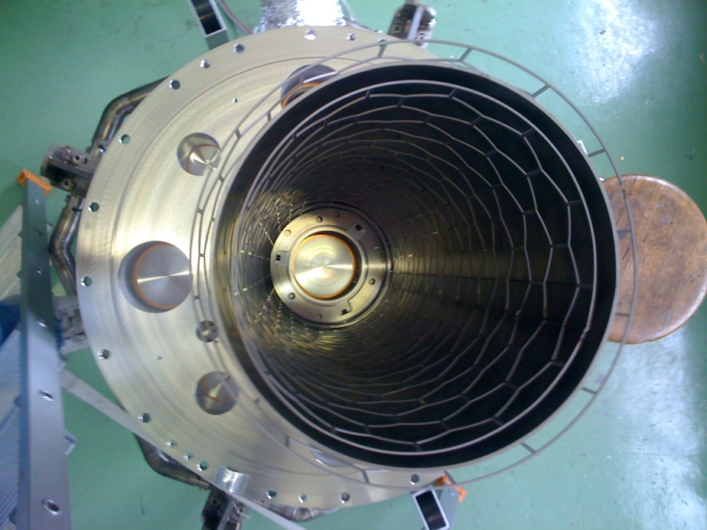
Details of diode bias sputtering
- 80 V
Object - cavity
Kr
Kr+
Kr+
e
0 V
Kr
+
-
1000
V
Sputter cathode Nb
Vacuum pump
Target thickness: 1 µm (20x δ)
Cavity cooled during coating

Slide 19
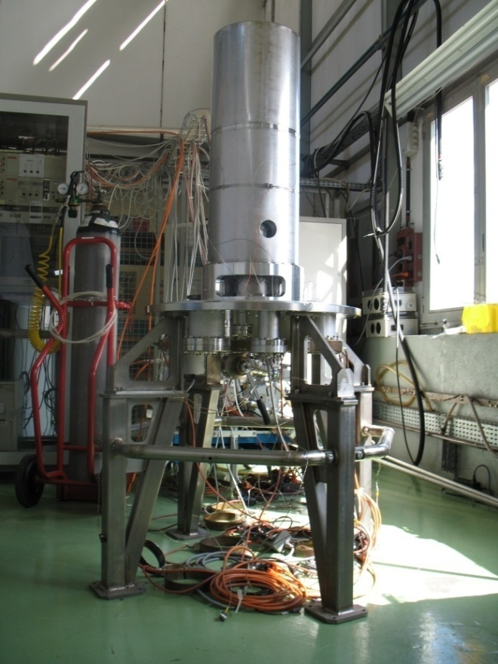
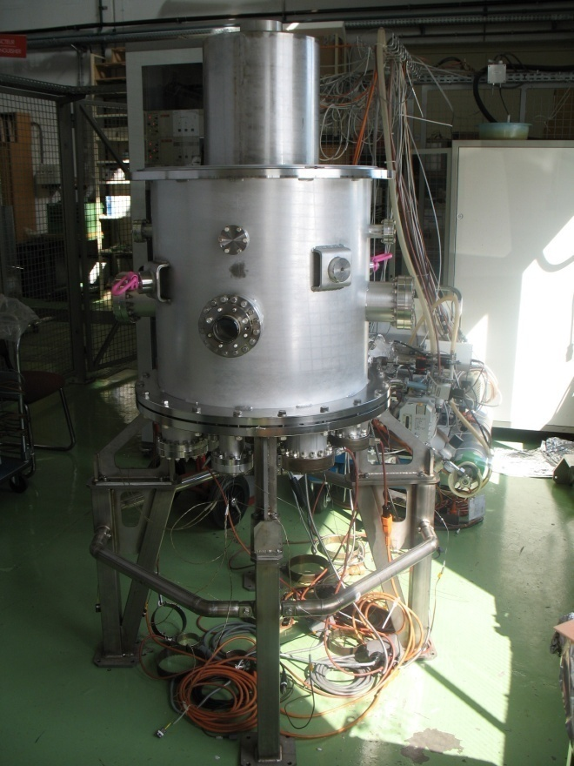
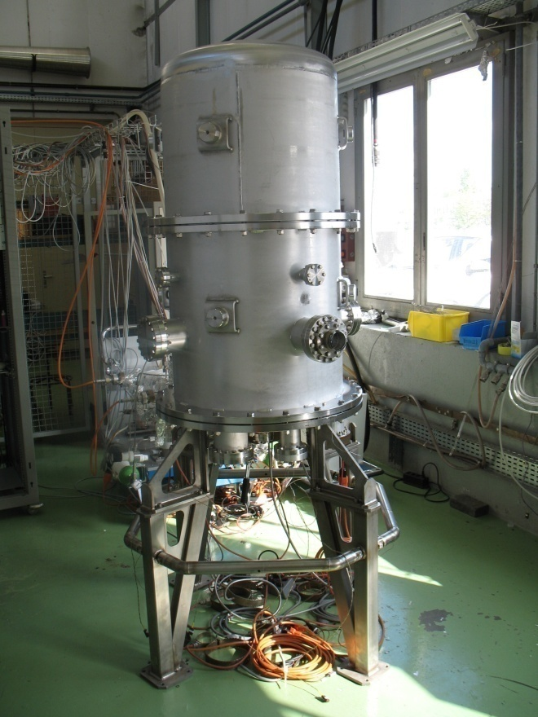
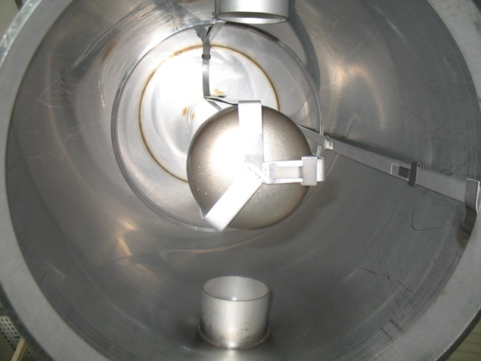
Tests on samples
Quartz samples for thickness calibration, RRR, Tc

Slide 20
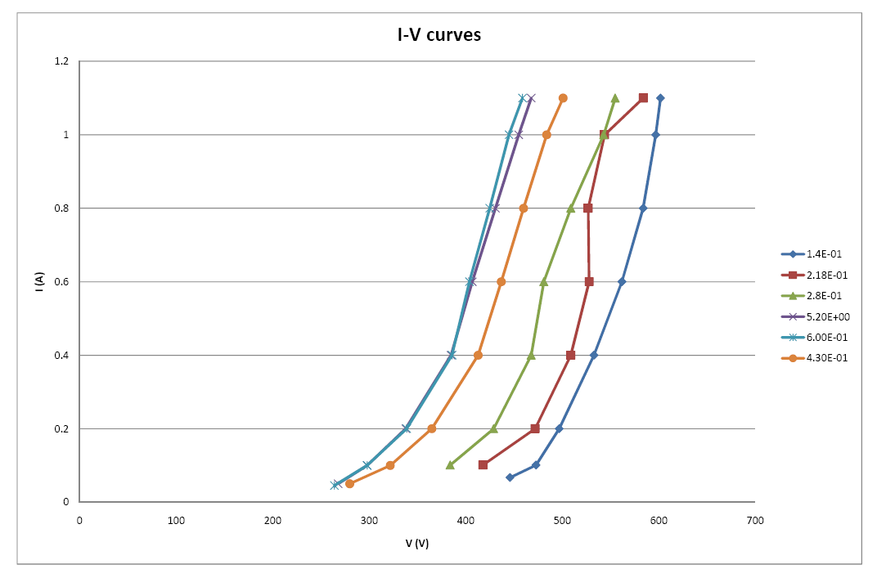
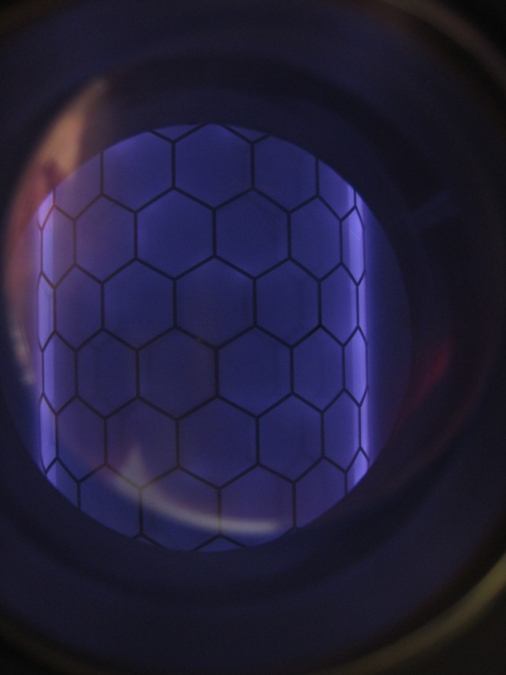
First plasma (Kr as sputter gas)

Slide 21
Foreseen coating procedure and quality controls
Cavity manufacturing
  Metrology checks, US and X-ray of weldings, roughness guaranteed by respect of manufacturing procedure (checked on samples)
Surface treatment: SUBU 20 µm
  Check by weigh loss and visual inspection
Coating:
  Quality checked by RRR and Tc on quartz samples
  Control and reproduction of sputtering parameters: Kr pressure, sputter V-I, bias voltage, cavity temperature.
(Water rinsing: resistivity, particle count and TOC of output water)

Slide 22
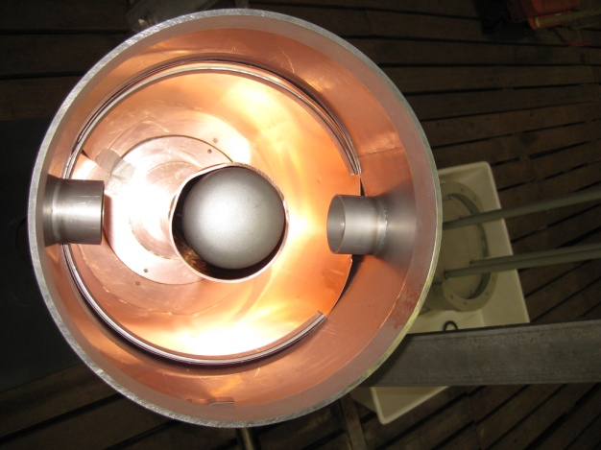
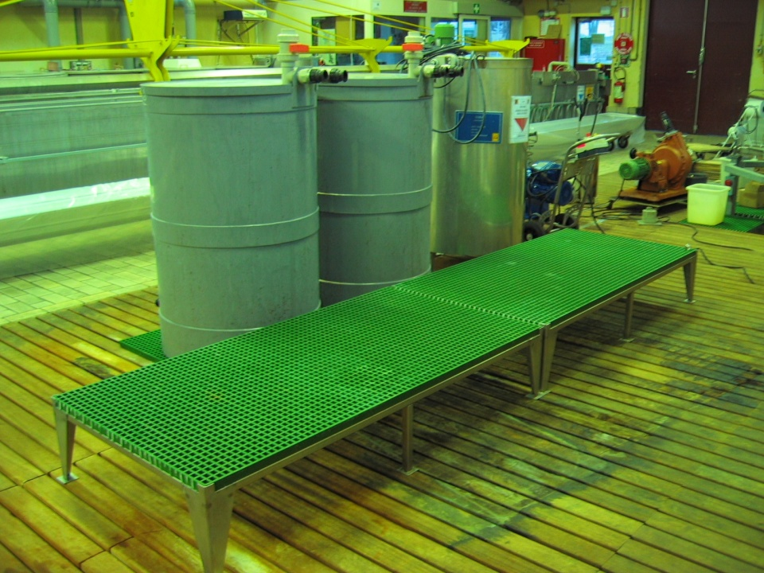
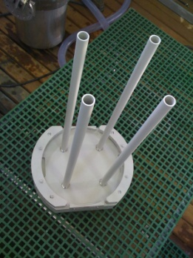
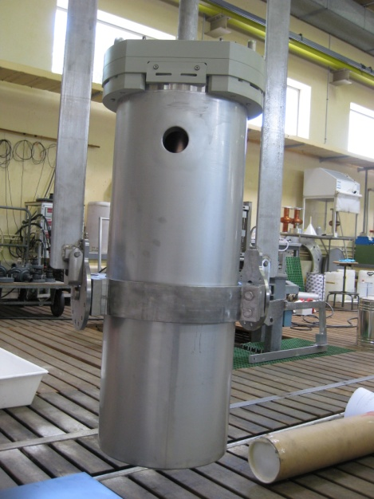
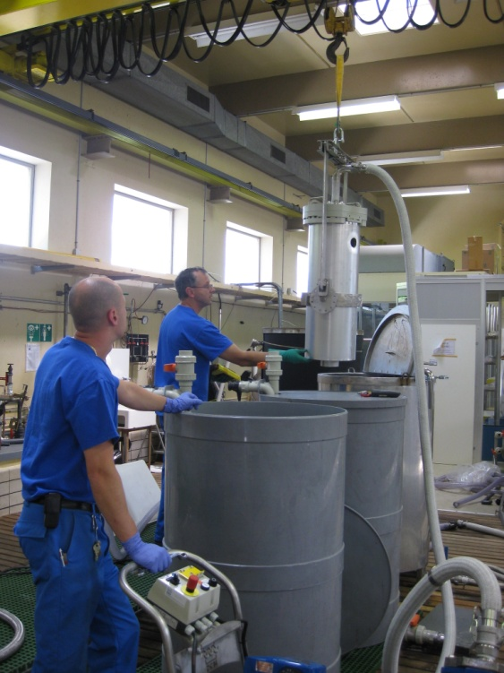
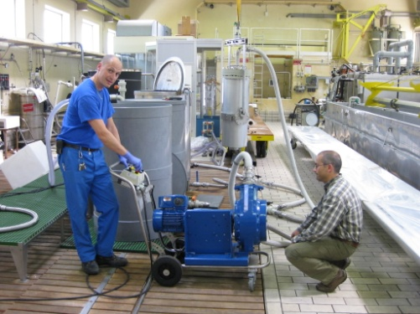
Surface treatment

Slide 23
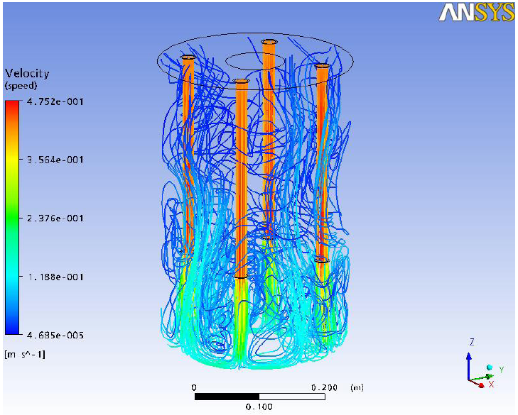
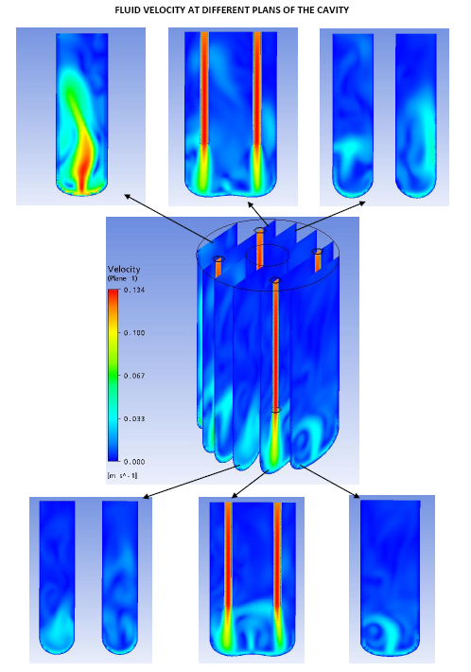
CFD studies of chemical polishing bath
The velocity of the fluid close the bottom wall of the cavity is quite uniformly distributed.
The values obtained are comprised between 0.04 m/s and 0.06 m/s.
SUBU: Sulfamic acid (H₃NO₃S) 5 g/L, H₂O₂ 5% vol, n-butanol C₄H₁₀O 5% vol, di-ammonium citrate (C₆H₁₄N₂O₂) 1 g/L.
Chemical polishing is carried out at 72 °C and is preceded and followed by washing with H₃NO₃S.

Slide 24
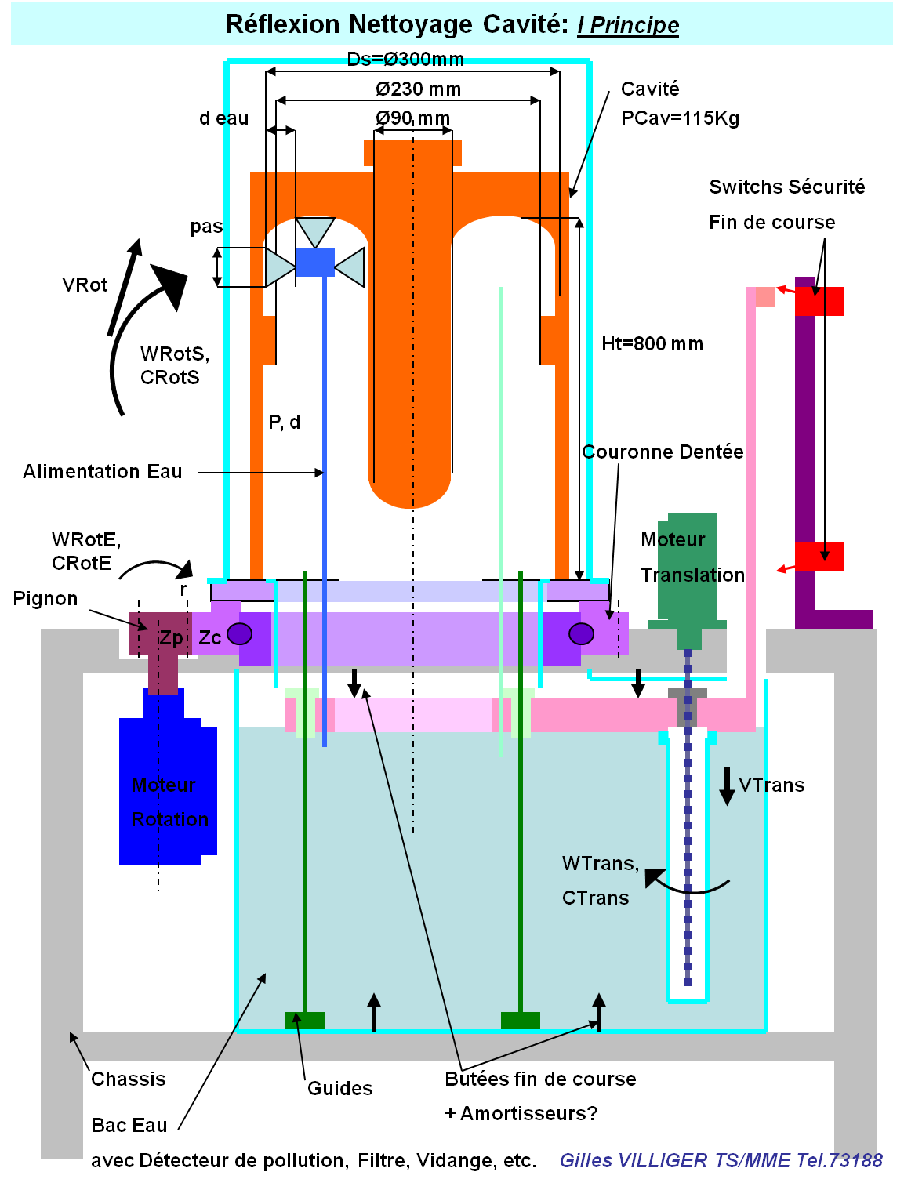
Study of rinsing system (after CP/ after coating)

Slide 25
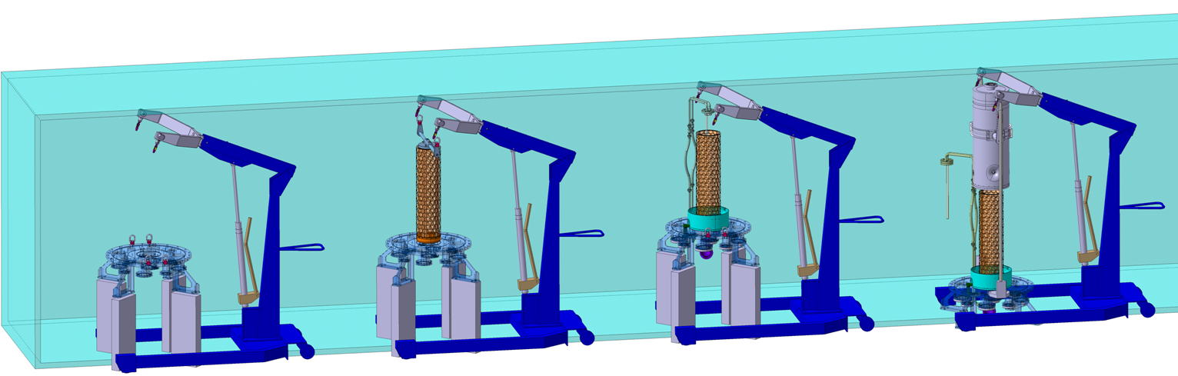
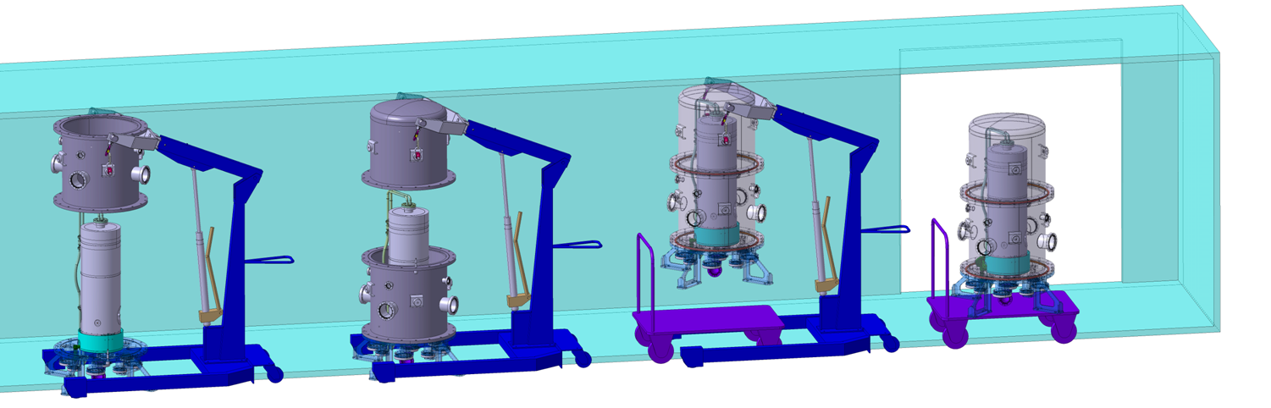
Study of clean room assembly
1.Installation Bride de Base 2. Installation Dépôt Niobium 3. Enlèvement Rehausses 4. Installation Cavité Ø300
Sens Montage
5. Installation Tank Inférieur 6. Installation Tank Supérieur 7. Enlèvement Rehausses 8. Equipement prêt pour sortir
From: G. Villiger

Slide 26
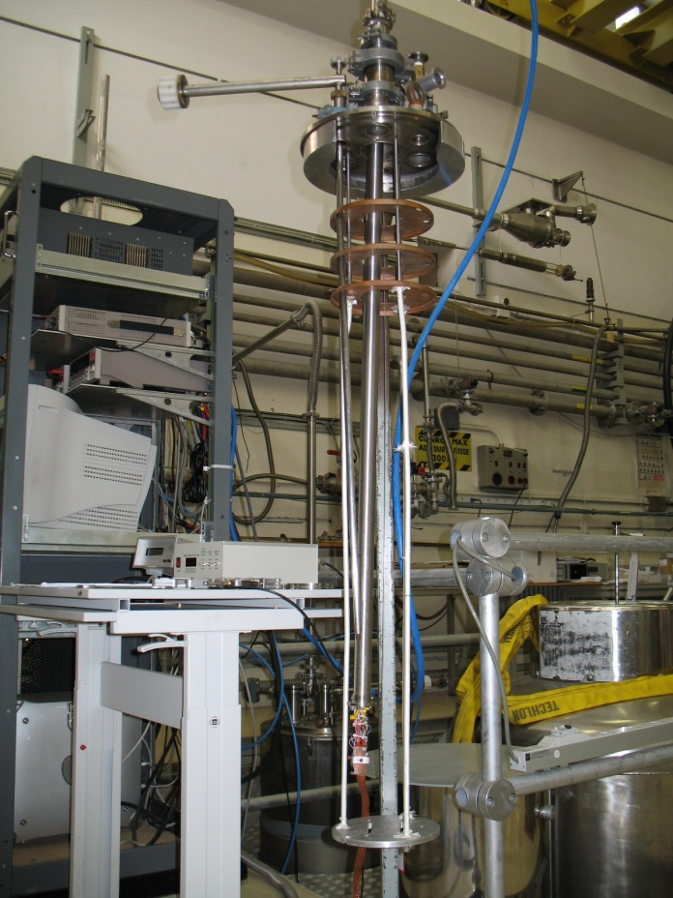
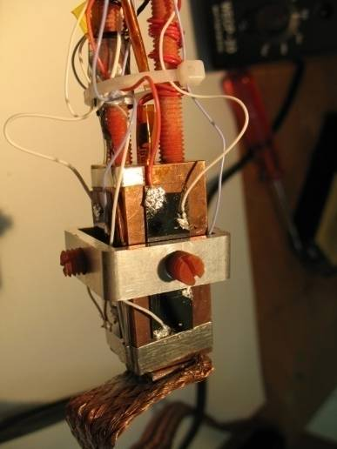
RRR measurements
System tested for preliminary Nb coating run of RF tuning plate

Slide 27

Study of RF tuning plate (in construction)

Slide 28




FEM analyses
Displacement: +15 mm (up)
-5 mm (down)
(Apparent concentration of stresses due to probable numerical errors. Plastification would anyhow spread the stress around)

Slide 29
Conclusions and outlook I
Cavity prototype fabricated.
  Tooling an teething problems ironed out
  5 more pre-series in fabrication (one full cryomodule)
  Tuning plate, couplers in fabrication
Coating development:
  Study I-V curves as a function of sputter gas pressure, bias voltage.
  Characterize RRR of samples.
  Optimize geometry if necessary
Surface treatment optimization:
  Tests on samples and on dummy cavity successful
  Waiting for first cavity treatment
Samples characterization setup ready
  Plus access to CERN facilities: SEM, XPS, etc.

Slide 30
Conclusions and outlook II
First cavity coating expected during July/August 2009
  Optimization work has to proceed fast
  All tooling is ready (for clean room assembly, etc.) except for ultrapure water rinsing. This operation will be done by hand, series tooling delayed after first prototype.
  RF test not available at CERN in the short term
Goal: achieve nominal specifications by end 2009

Slide 31

Finally
Main contributors
Mechanical design: Philippe Trilhe, Franck Thierry, Philippe Perret, Gilles Villiger, Delio Duarte Ramos, Luca Gentini, Ricardo De Morais Amaral
Mechanical fabrication: Thierry Tardy, Christian Saint-Jal, Jean-Marie Geisser, Jean-Pierre Brachet, Pierre Moyret, Rene Claret, Ahmed Cherif, Dominique Pugnat.
Surface treatments: Leonel Ferreira, Serge Forel, Marc Thiebert
Coating: Giulia Lanza, Antonio Mongelluzzo, Jean Cave, Anna Gustafsson
Cryolab: Tapio Niinikoski, Friedrich Haug, Sebastien Prunet, Laetitia Dufay-Chanat

