Slide 1
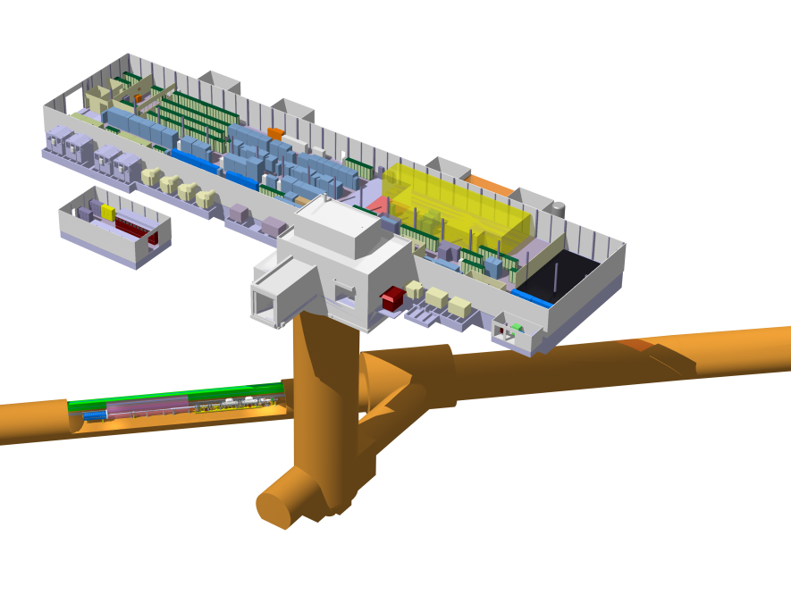
Zones for cable extremities
BA6
Surface equipment area
LSS6
TA6 access tunnel
TA6 Alcove

Slide 2
Master schedule
CM
TEST RUN 2018
SPS

Slide 3
Preliminary naming of locations for pre-DIC
Zone | Name | Description
BA6 | Cryo Compressor | Cryogenic compressor
BA6 | RF Power 1 | RF Power amplifier station 1
BA6 | RF Power 2 | RF Power amplifier station 1
BA6 | Faraday cage | Low Level RF, Faraday cage
BA6 | Rack row | racks
TA6 | TA6 alcove | Behind the freight lift
TA6 | TA6 access tunnel | TA6 tunnel from the freight lift to the SPS tunnel
LSS6 | 61737 | SPS DECUM, Crab cavity zone, mid location

Slide 4
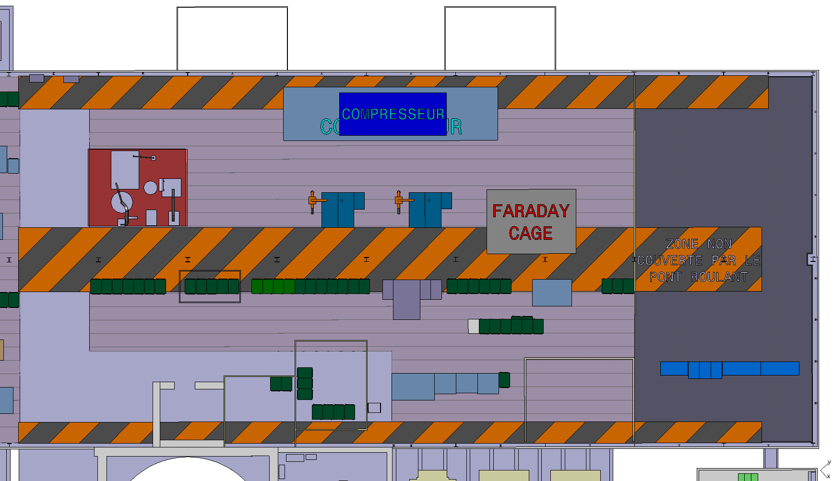
BA6 – surface building
Cryo Compressor
RF Power1
RF Power2
Rack row

Slide 5
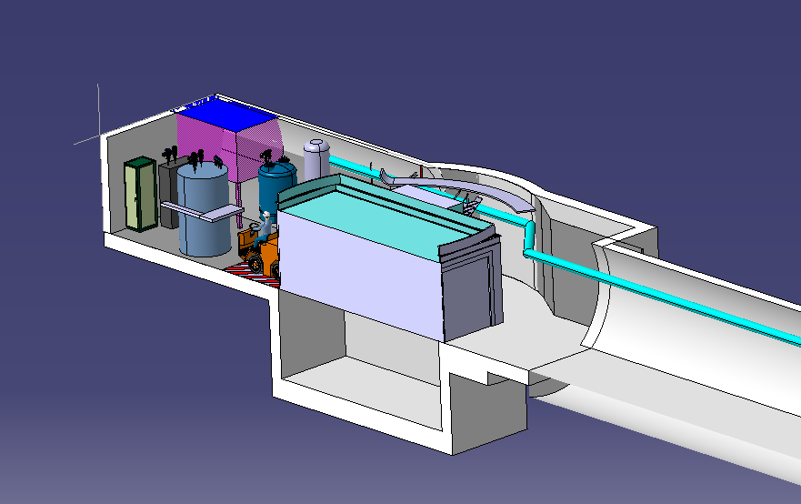
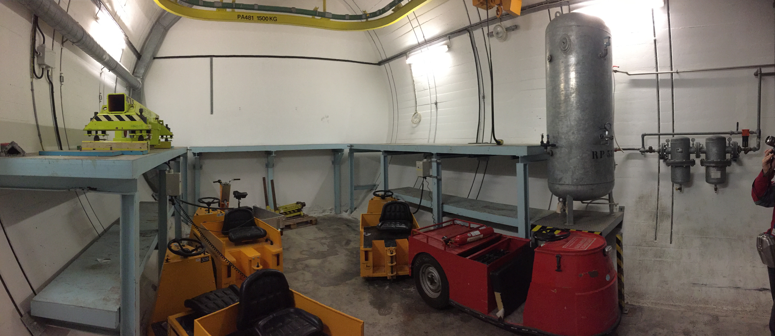
PA6 – Cold box and cryo ancillaries
TA6 alcove
Freight lift
TA6 access tunnel

Slide 6
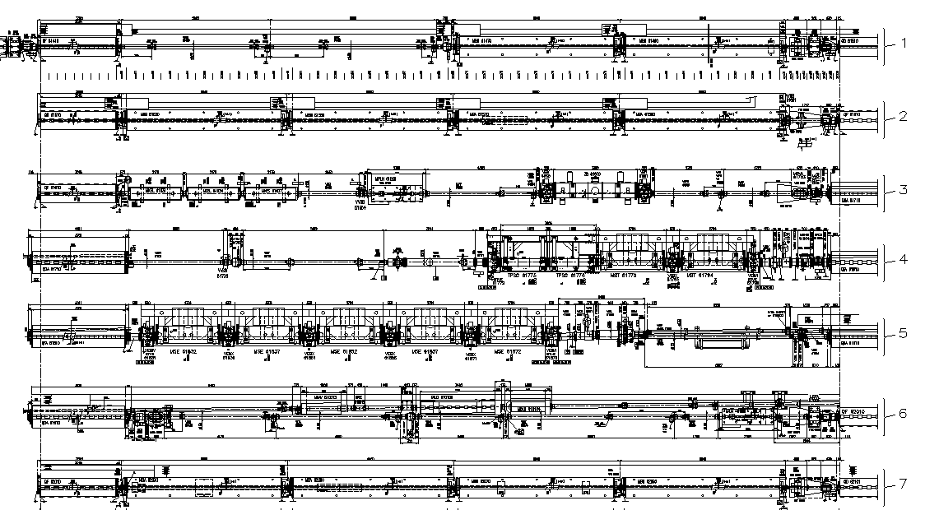
Layout SPS LSS6
6149
QDA617

Slide 7
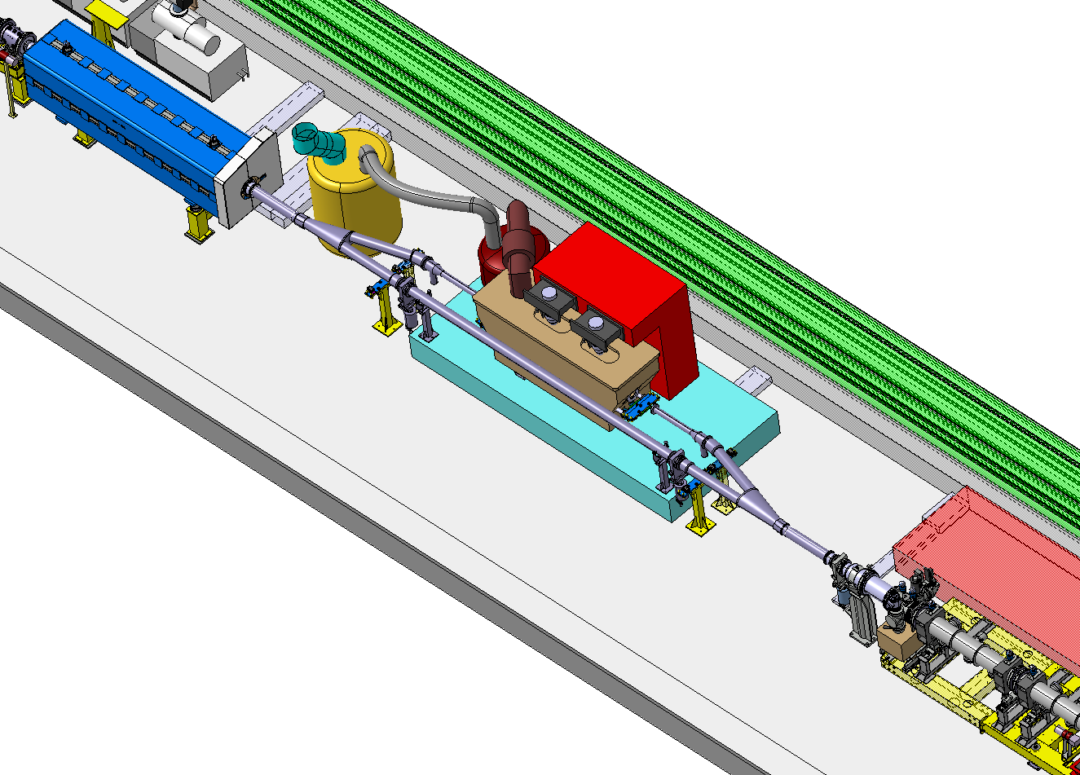
Crab cavity test stand
QDA617
Helium pumps
QD61710
Dewar
Service module
Y-chamber
RF power, loads & circulators
Cryo-module
Cable tray
Transfer table
QDA617+11m
Survey pillar
Y-chamber
SPS DECUM: 61737
Transport lane

Slide 8
Pre-DIC already handed in
TE/VSC beam and insulation vacuum
EN/ACE Survey
BE/BI BPM

