Slide 1
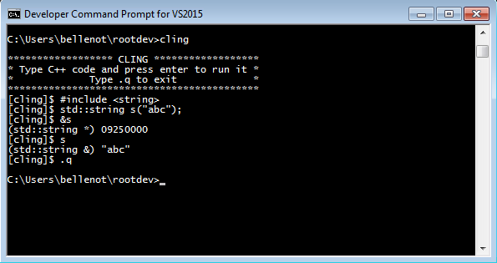
Cling on Windows: Good News
Cling compiles on Windows with the new llvm & clang and Visual Studio 2015
Cling also runs on Windows:

Slide 2
Cling on Windows: Symbols Issue
Cling needs to access methods at run time. Then:
Need to export symbols by either
  Adding __declspec(dllexport) in the code
  Using /DEF:cling.def linker flag (with a module-definition file)
Only a few (30) symbols needed to run cling.exe
Much more (?) needed to run the tests
Currently creating the module-definition file using ROOT’s bindexplib.exe! (need to find another solution)

Slide 3
Cling on Windows: Test Suite
Most of the tests fail
  Expected Passes : 16
  Expected Failures : 11
  Unresolved Tests : 19
  Unexpected Failures: 49
Not all failures are due to cling. Some are due to:
  Python errors (to be investigated)
  Shell scripts (to be converted/replaced/disabled)
  Linux commands (to be converted)

