Slide 1
Study ABROAD in the sciences
A national science policy challenge: access to major research facilities abroad in an era of increased globalization
Homer A. Neal
University of Michigan
A Workshop Held at the Center for Strategic and International Studies
June 1, 2009
Sponsored by the Lounsbery Foundation and the University of Michigan

Slide 2
What’s the problem?
In an era of increased globalization, more and more frontier research centers will be located elsewhere (LHC, ITER, WHO, telescopes, …)
Exposure to actual frontier research has been a key recruitment and training tool for science undergraduates in the past
There is a risk that future U.S. long term science priorities will be set by convenience rather than by scientific importance as today’s undergraduates make their career choices

Slide 3
A Personal interest/ obligation – H. Neal
HEPAP STUDY ON HEP IN UNIV.
SMITHSONIAN REGENTS
SSS BOARD OF OVERSEERS
NATIONAL SCIENCE BOARD /86-100
CERN REU PROGRAM
BEYOND SPUTNIK

Slide 4
Why study abroad?
Concept has been widely accepted as a powerful learning and teaching tool in the humanities and arts (e.g., Florence and the Uffizi)
Why are study abroad programs so little used in the sciences? What is the difference between Florence/Uffizi and Geneva/LHC -- Or Geneva/WHO?

Slide 5
What is Happening in high energy physics?
For decades the U.S. and Europe were the two indisputed leaders in this field – arguably the most fundamental field of all scientific disciplines
Now we are facing the prospect of having no field-leading frontier facility within the U.S. national boundaries, with the world’s undisputed center being in Geneva with no U.S. counterpart
Now facing the prospect that U.S. undergraduates will have little opportunity to directly participate in cutting-edge high energy physics research

Slide 6
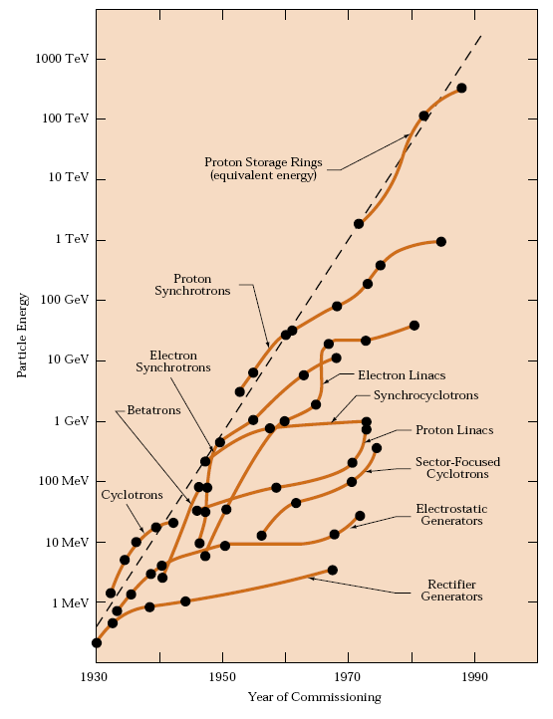
The quest for higher energies – and deeper insight

Slide 7
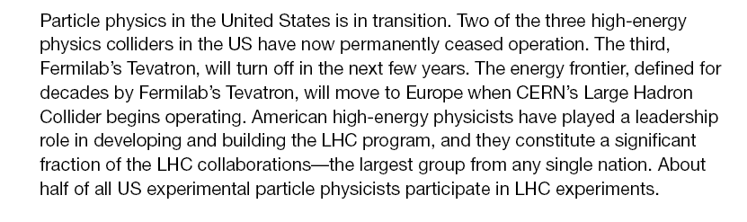
RECENT HEPAP P5 report excerpt……

Slide 8

(continued)
http://www.science.doe.gov/hep/files/pdfs/P5_Report%2006022008.pdf

Slide 9
HEPAP UGPS Subpanel report …
Now that many experiments are operating overseas, we have the opportunity not only to engage our students in the excitement of science but also to engage them in international collaboration. Whether these students go on to become particle physicists or to work in some other field, they will carry this valuable experience with them.
Finding: Undergraduates thrive in research, and those who so participate are
more likely to pursue careers in science and technology.
Finding: The LHC and other experiments abroad offer a spectacular opportunity
to engage undergraduates and high school teachers in research. This research
experience will be particularly powerful for those who spend time at the experiment site.

Slide 10
(continued)
……..providing a remarkable opportunity for any young physics student. It is even conceivable that such a cooperative agreement would allow students to incorporate their REU experience into their university’s study-abroad program, perhaps even receiving credit for their work. All in all, opportunities exist for a sizable expansion of this program, in spite of the challenges.
http://www.science.doe.gov/hep/files/pdfs/ugpsreportfinalJuly22,2007.pdf

Slide 11
globalization
We should celebrate the fact that many nations are now interested in, and capable of, hosting major scientific facilities
The challenge falls to U.S. universities and the U.S. Government to make sure that our students continue to have access to cutting-edge research facilities
There is no reason to expect that the U.S. dominance in most fields will continue – but we should not ignore the need to evolve our educational system accordingly to mitigate the effects

Slide 12
U.s. options
Do nothing special and hope that “market forces” and student interest will do their job
..or
Pick a few strategic scientific fields and do whatever is necessary to insure student access to the frontier facilities in those fields

Slide 13
Tough questions
How to site it
How to manage it
How to fund it
Host country considerations
Identification of instructors
Taking local courses
Host laboratory considerations
Student mentorship
Measurement of success
Planning process
Sunrise and sunset considerations

Slide 14
Conference goals
Assess the scope, tractibility and completeness of the questions on the previous slide
Assess the likely level of support and interest on the part of the physics community, international program officers at universities, university consortia, key agency officials, and the Department of State
To receive general guidance on next steps

Slide 15
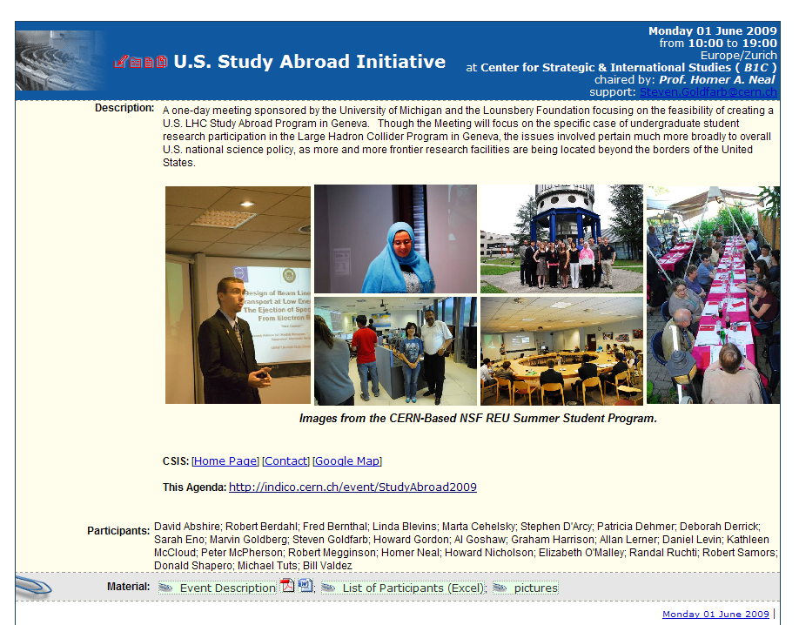

Slide 16
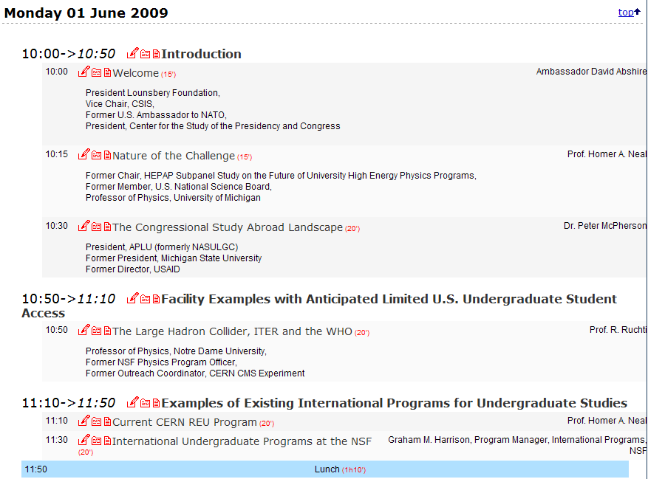

Slide 17
