Slide 1

Halbach magnets and correctors for the Cβ and eRHIC projects
N. Tsoupas, S. Brooks, A. Jain, G. Mahler, F. Meot, V. Ptitsyn, D. Trbojevic
FFAG’16

Slide 2
Conclusion
This study and the measurements show that the Halbach type permanent magnets with wedges have many advantages over the Iron dominated magnets, and can be used as magnets in an FFAG cell.
FFAG’16
2/20

Slide 3
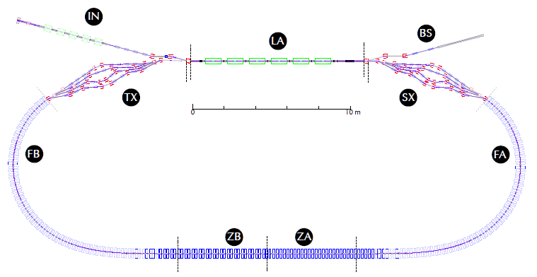
The Cβ project is a prototype electron accelerator for the eRHIC project
Injection: 5 MeV e⁻ 100 mA rep-rate 325 MHz
5 MeV Beam dump
Merger
Splitter
1.3 GHz 16 MV/m ~80 MeV
Two concepts: Energy Recovery Linac (ERL)
Fixed Field Alternating Gradient (FFAG)
Energies [GeV]
76
146
216
286
FFAG’16

Slide 4
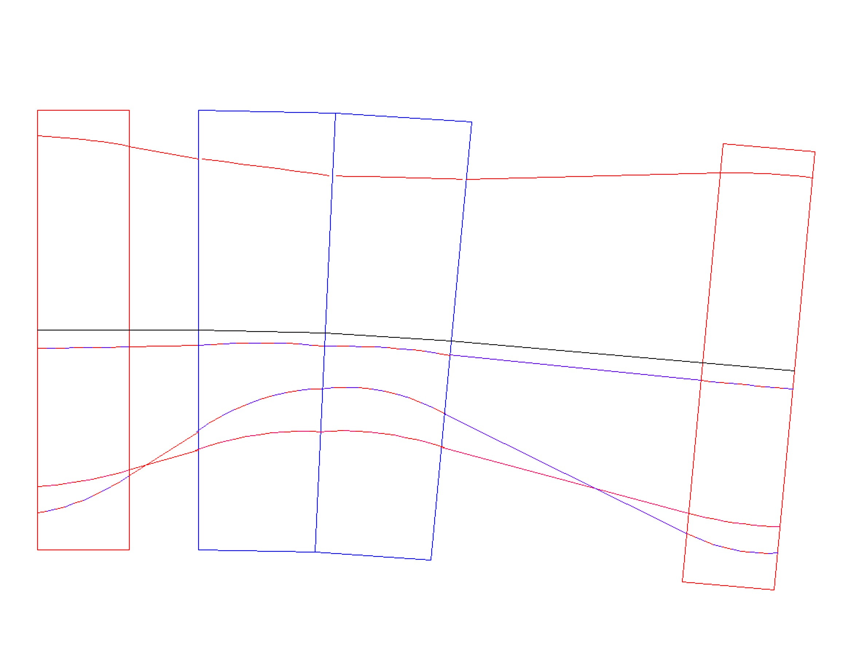
76 – 286 MeV NS-FFAG Cornell Lattice
100 cells : Orbits and magnets in the 10.5 m diameter
G_{F} = 42.54 T/m B_{yF} =-0.104 T
G_{D} = -27.493 T/m B_{yD} = 0.5044 T
x (mm)
LINAC ENERGY 70 MeV
Injector 6 MeV
286 MeV
QF/2
13.598
16.04
11.9 mm
BD
QF/2
E_{CEN}=225 MeV
-2.44
QFC
-8.98 mm
216MeV
-13.364
10.924
-18.331 mm
16 mm
146 MeV
QDC
76 MeV
4.0 cm
3 cm
11 cm
10.99 cm
4.0 cm
32.99 cm
Quads are displaced by ~16 mm and are 3 cm apart
FFAG’16
4/20

Slide 5
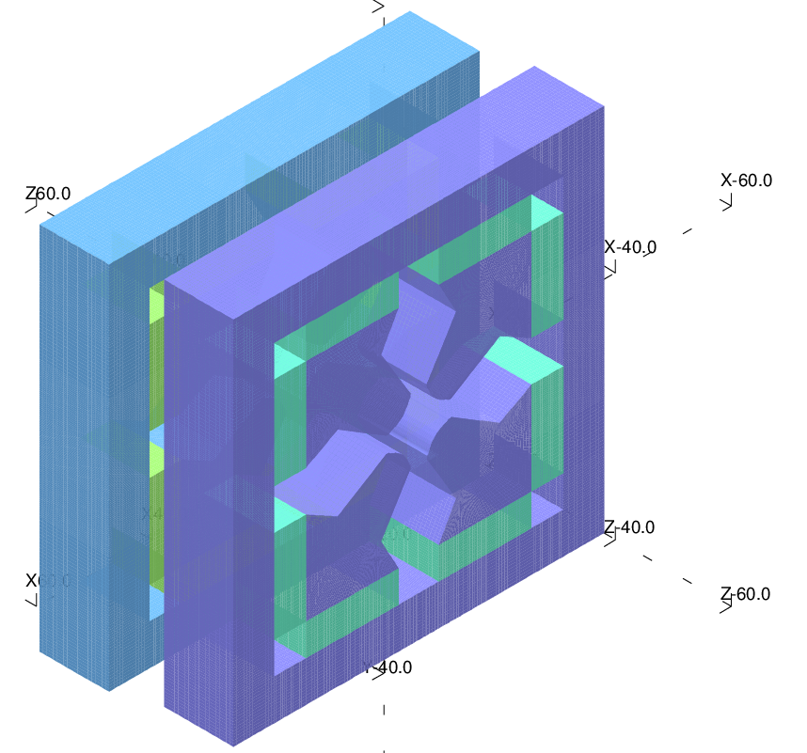
Conventional Quad
16 mm diplacement
Displaced transversely: LARGE APERTURE
3 cm separation
Small Distance apart: INTERFERENCE
FFAG’16

Slide 6
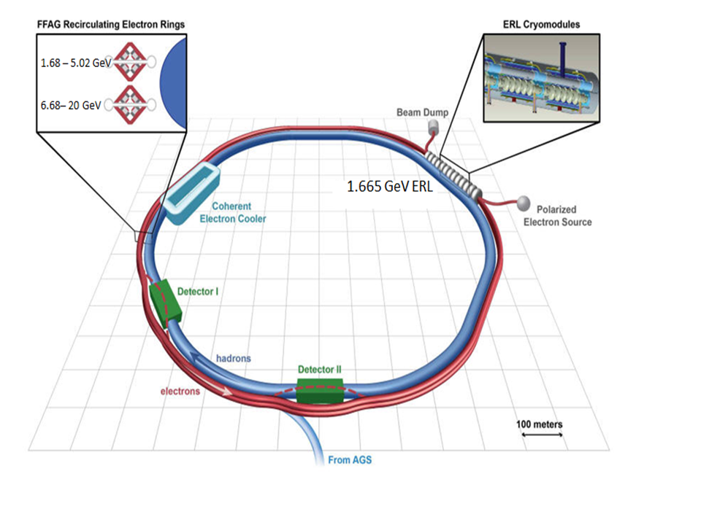
One of the versions of the proposed eRHIC projects
3 Trajectories
9 Trajectories
FFAG’16

Slide 7
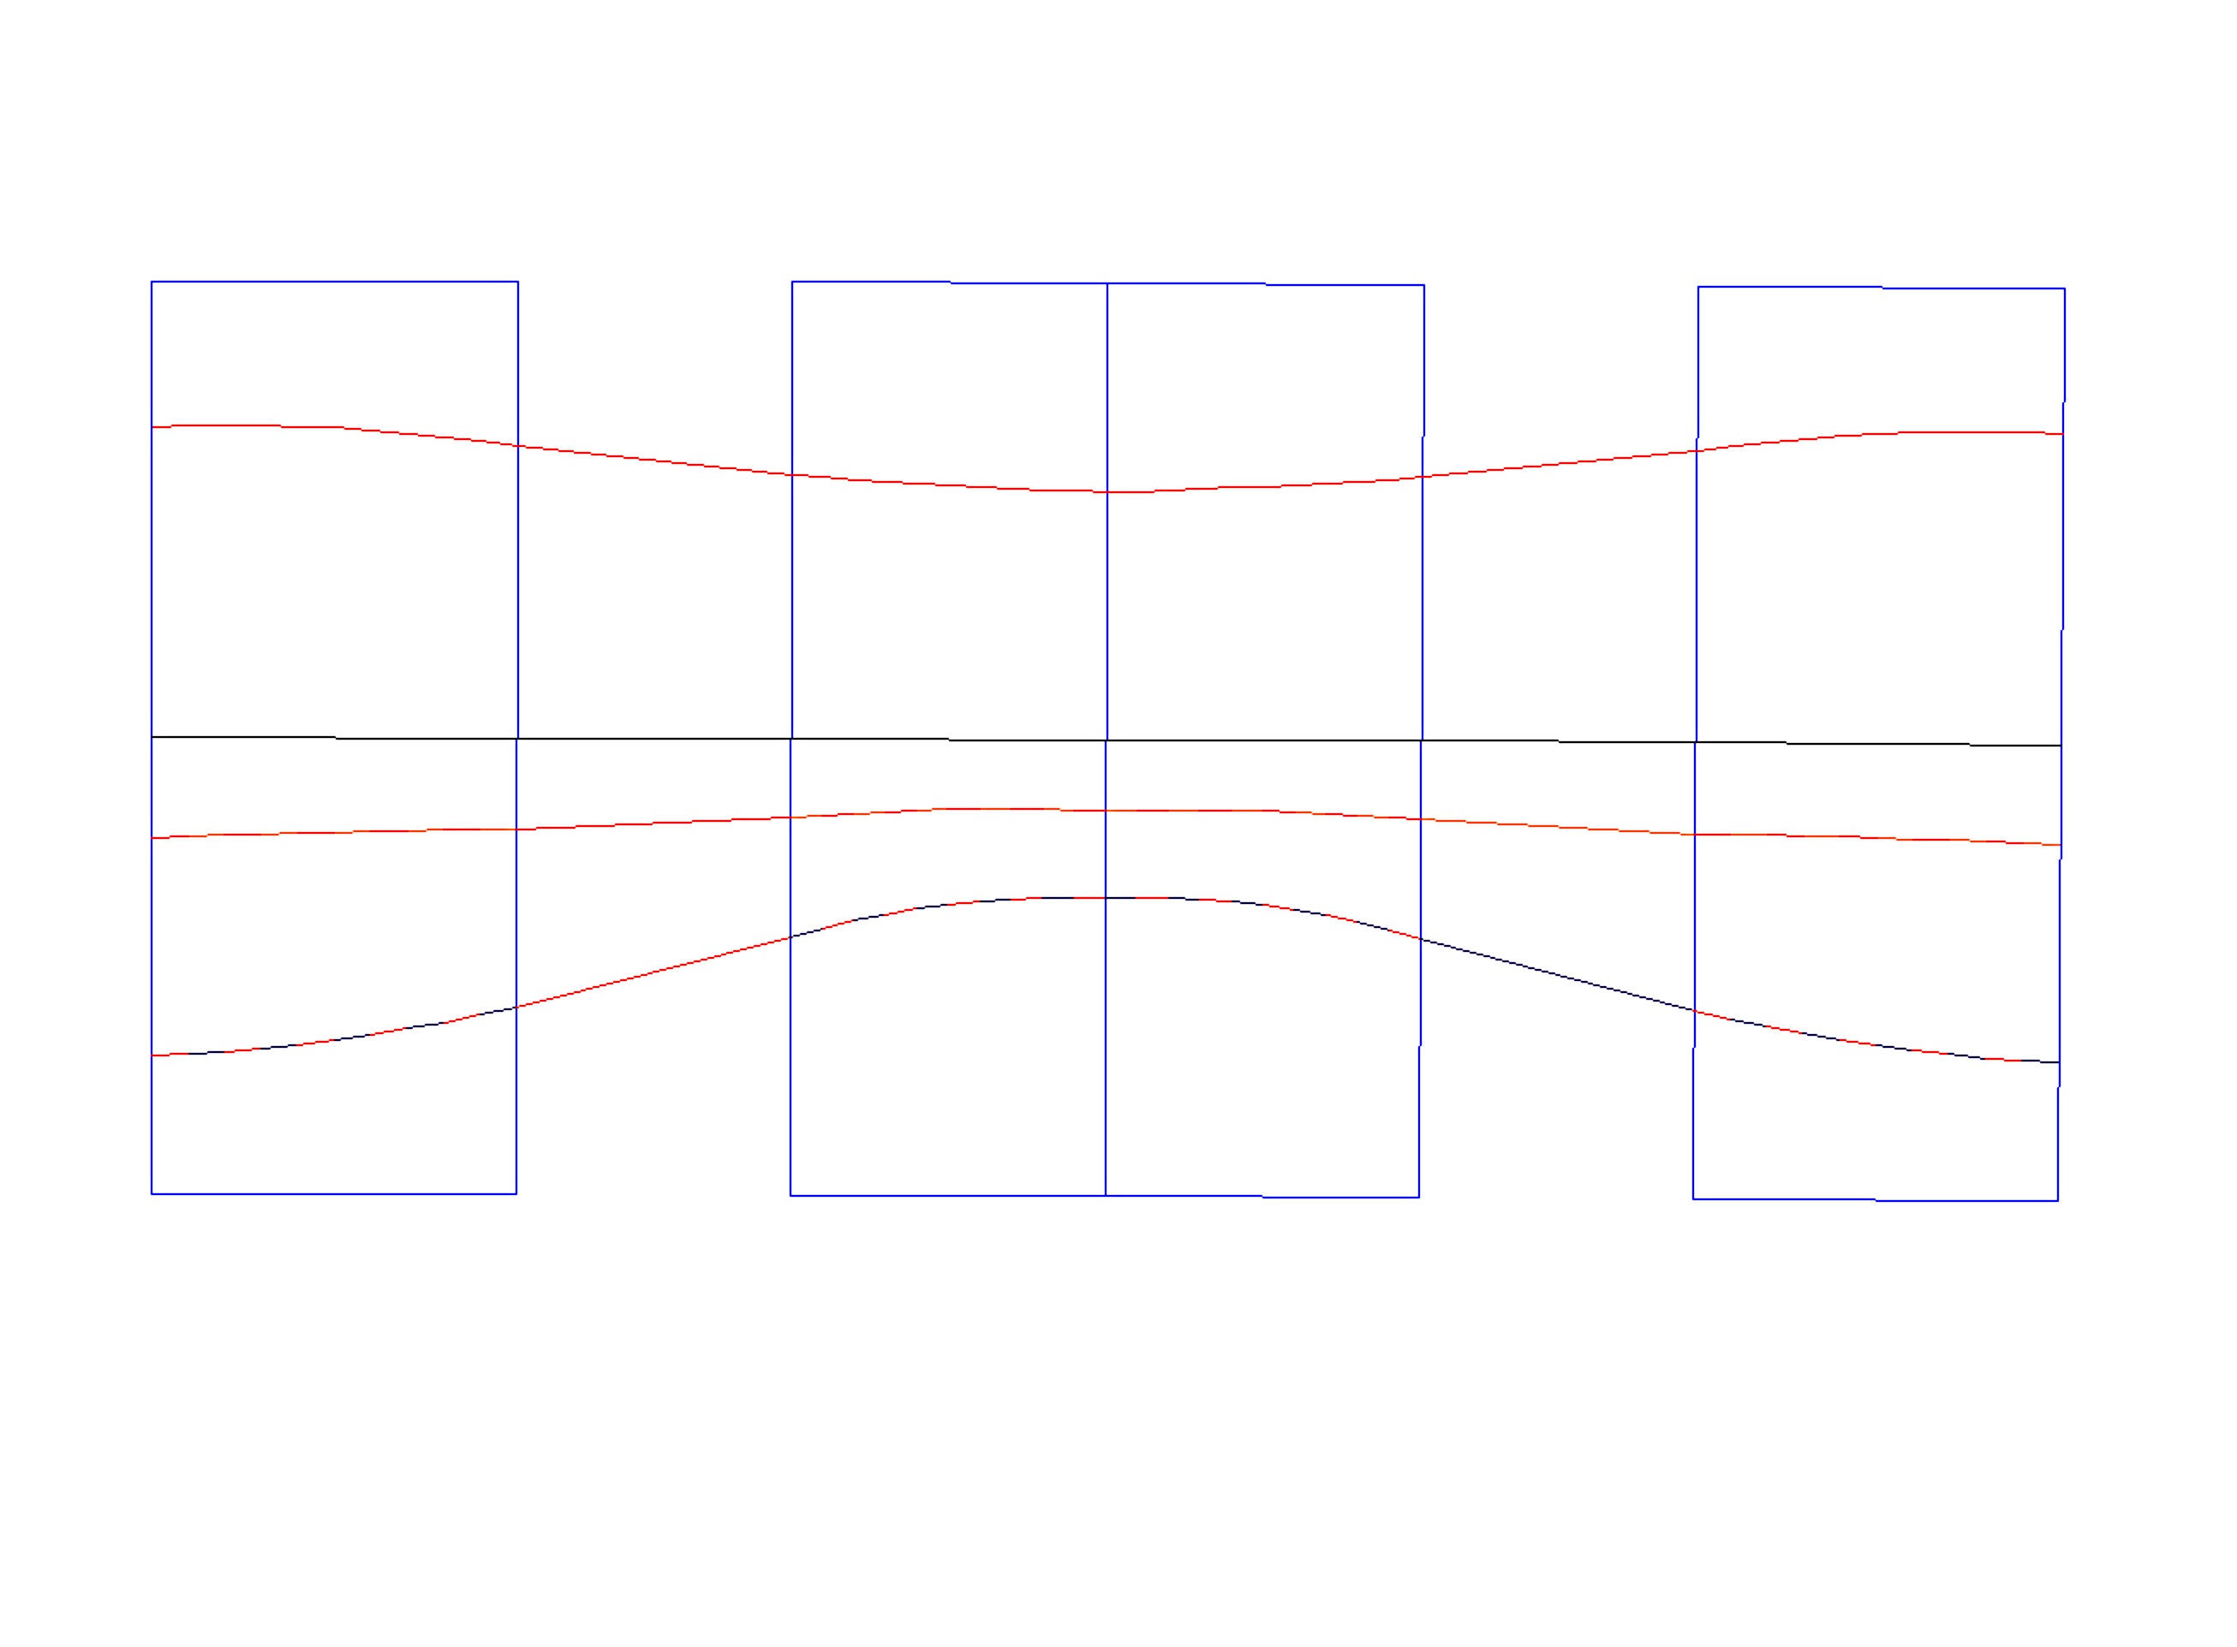
Low Energy (Scott Berg) NS-FFAG Cell 1.685-5.015 GeV
Magnet Interference and
Transverse displacement
x(mm)
B_{F}= 0.0465 T,
G_{F}= 8.631T/m
x_{Foffset}= -5.3 mm
B_{D} =0.0465 T,
G_{D} = -8.631 T/m
x_{Doffset}=+5.3 mm
Not a problem
Consumption of energy may be problem
F/2
D
F/2
5.015 GeV
3.5
Quad center
10.7
8.8
16.0
5.3 mm
-12.1
E_{CEN}=3.8 GeV
-5.3
-6.8
3.350 GeV
Quad center
-5.6
-10.9
1.685 GeV
θ_{F/2}=3.9115/2 mrad
θ_{D}= 3.3757mrad
θ_{F/2}=3.9115/2 mrad
1.065/2 m
0.40 m
0.9194 m
0.40 m
1.065/2 m
2.7846 m
FFAG’16

Slide 8
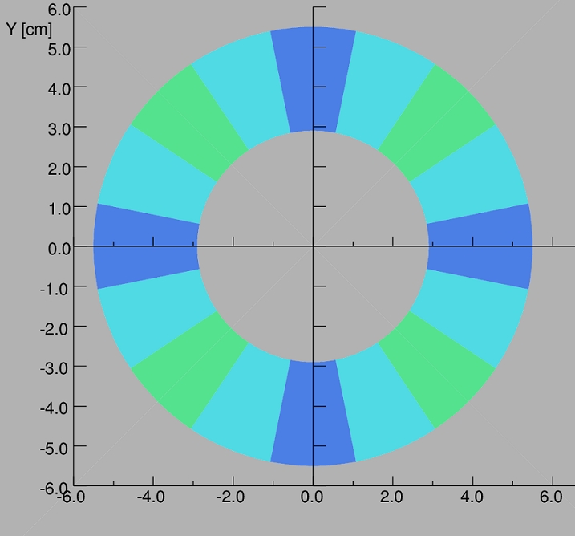
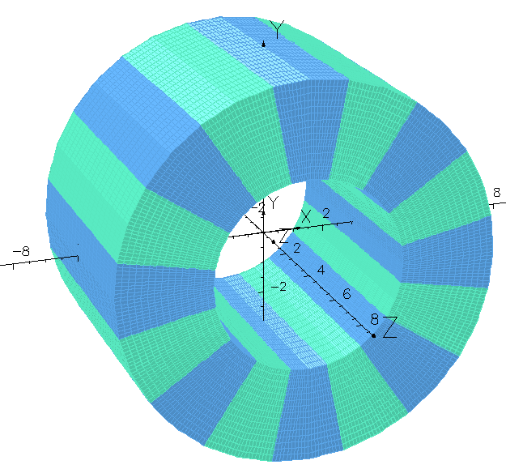
Electron bunches
θ
α
Isometric view of Magnetized Wedges
Dipole n=1
Quad n=2
Sext n=3
Direction of the easy axis α=(n+1)θ +π/2
FFAG’16
8/20
Cross section of Magnetized Wedges of NdFeB or SmCo

Slide 9
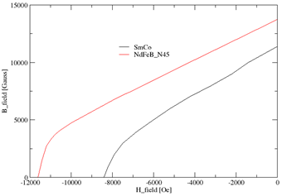
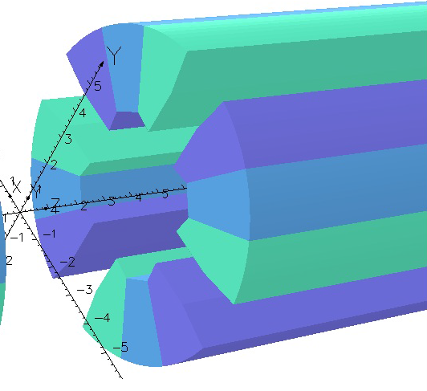
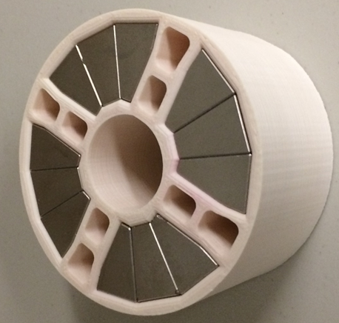
Perm. Magnet Material NdFeB
2D Design establishes the direction of the easy axis for 12pole multipole=0 at R=1 cm
This error can be minimized to < 1%
FFAG’16
9/20

Slide 10
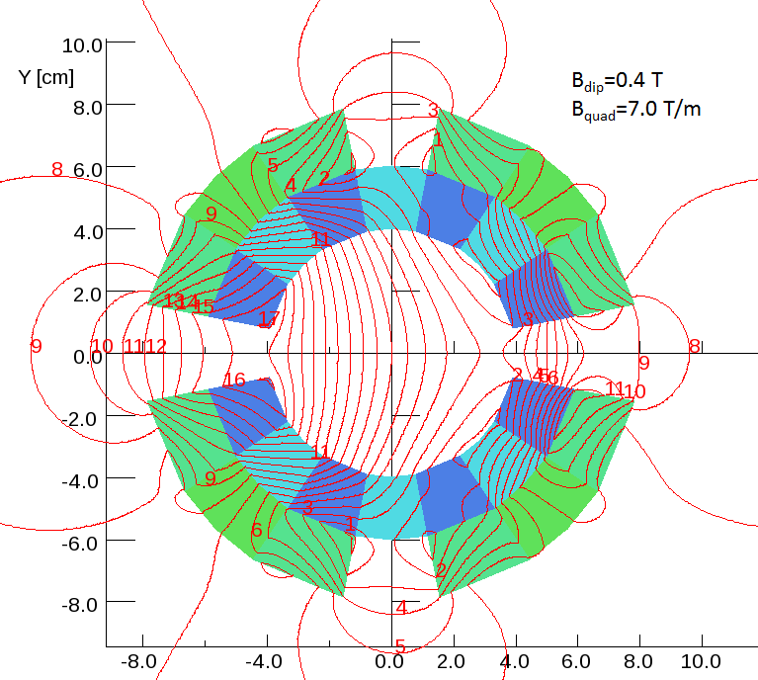
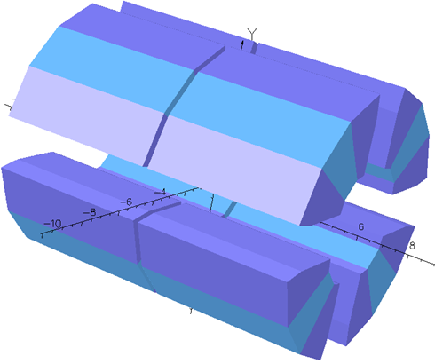
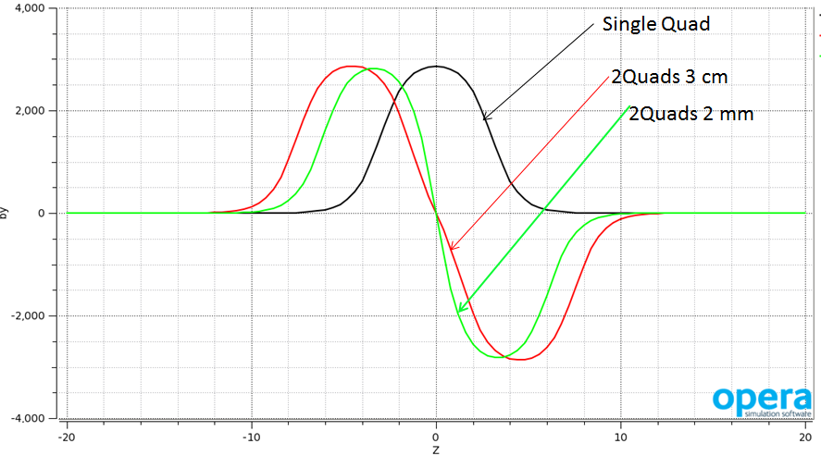
Superposition of multipoles
Advantages of using
Halbach type of magnets
B_{tot}=B_{quad}+B_{dip}
No Displacement
of the Quad is needed
B_{tot}=B_{upstream}+B_{downstrm}
Insignificant field distortion
FFAG’16
10/20

Slide 11
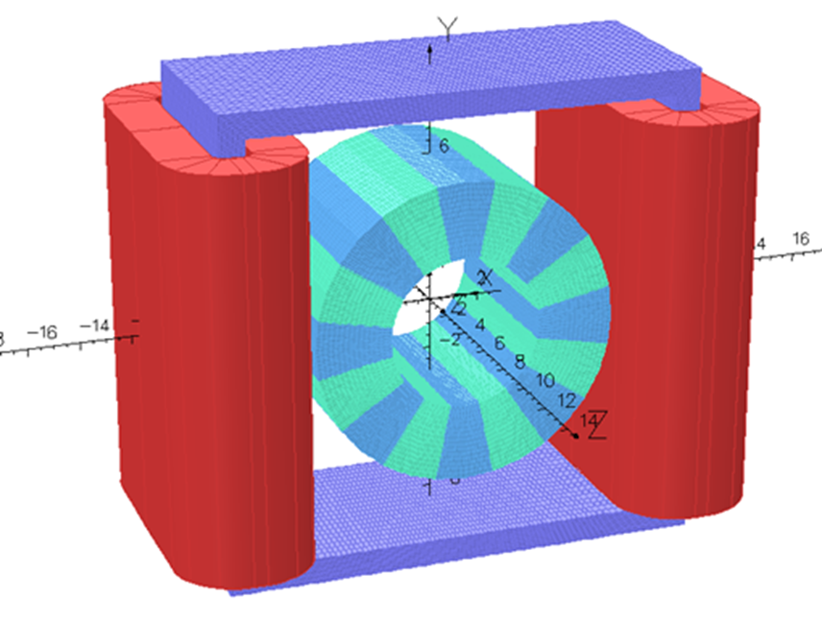
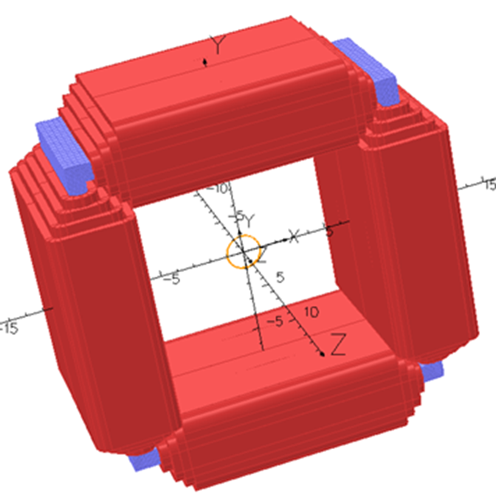
A Halbach magnet can accept corrector magnets
This field superposition was tested experimentally.
Due to the high saturation of the PM material (μ∼1.0)
Any external field will not alter the field generated by the PM.
B_{tot}= B_{PM} + B_{ext} superposition of fields.
Material is isotropic.
FFAG’16
11/20

Slide 12
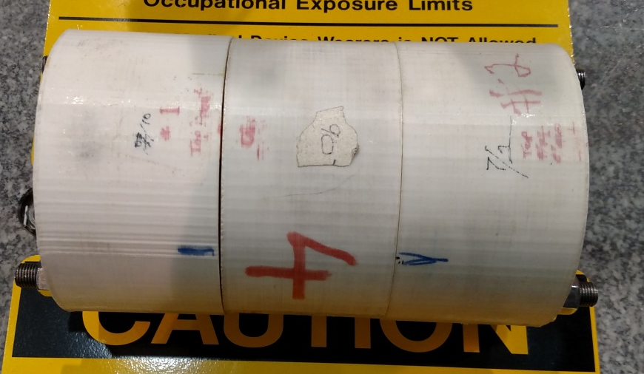
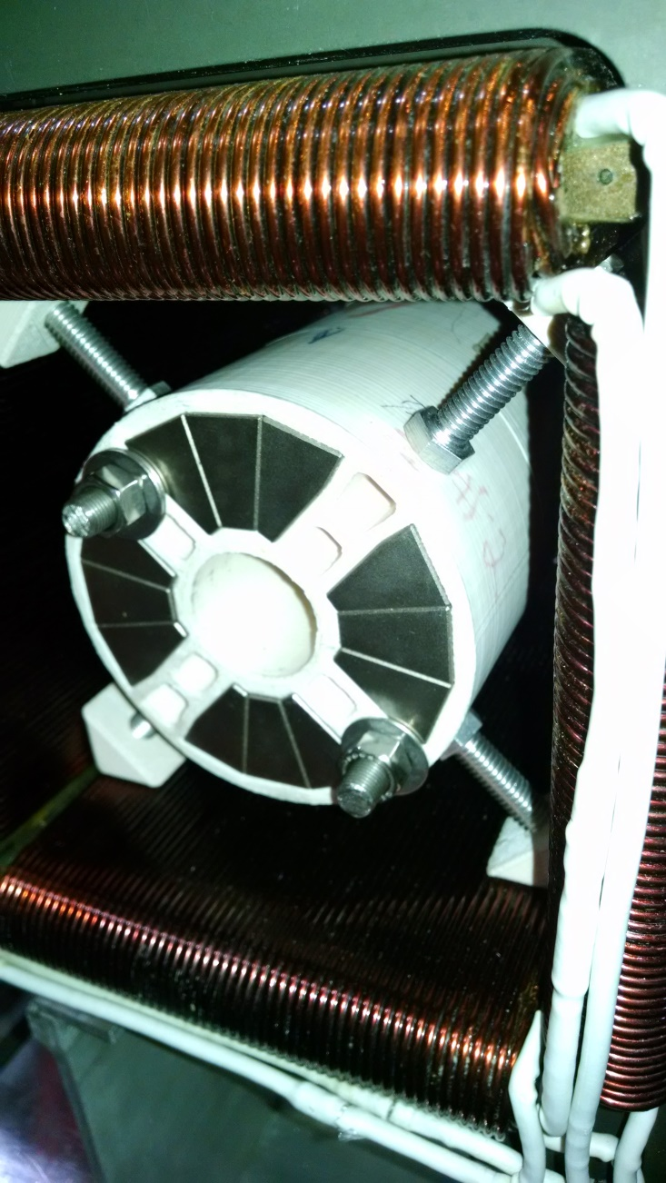
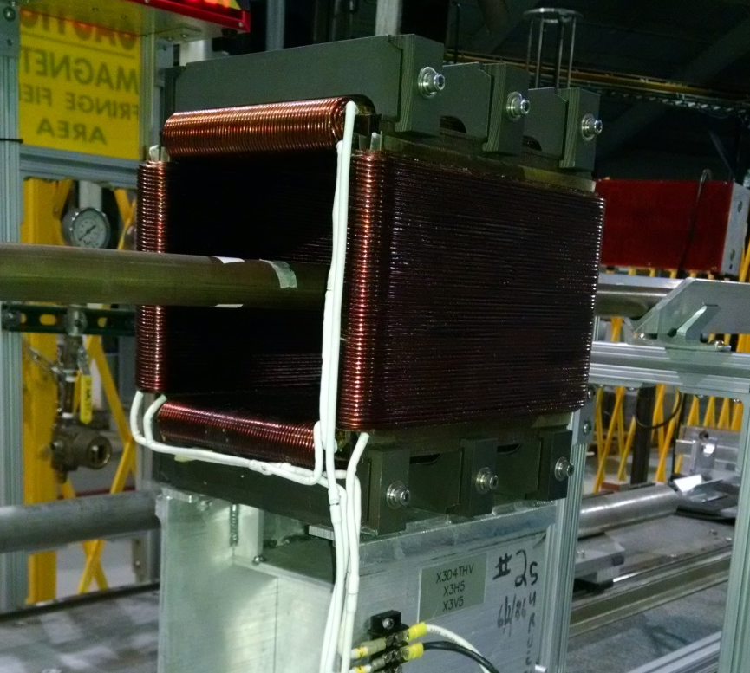
Test of Field superposition with permanent magnets
PMQ #1
Spacer
PMQ #2
Window frame dipole
Quad assembly inside dipole
(Approximately centered)
FFAG’16
12/20

Slide 13
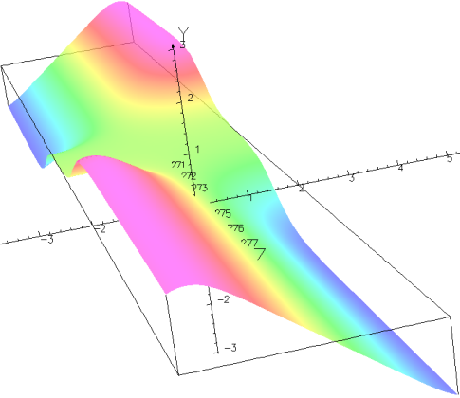
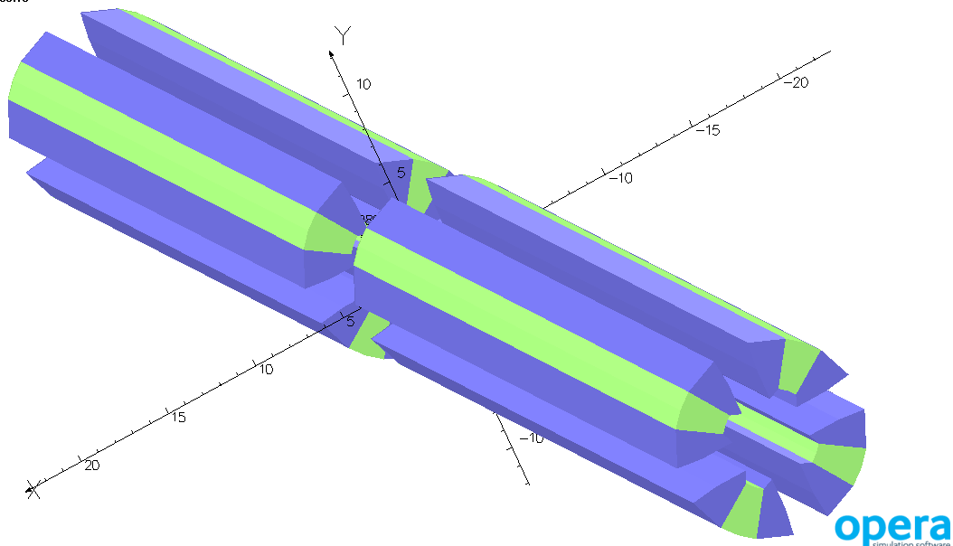
3D Magnetic field calculations for the FFAG cells
B_{y} component at the median plane
between the two magnets
3Dimensional Field map is
obtained over the volume of
a single cell where beam exists.
FFAG’16
13/20

Slide 14
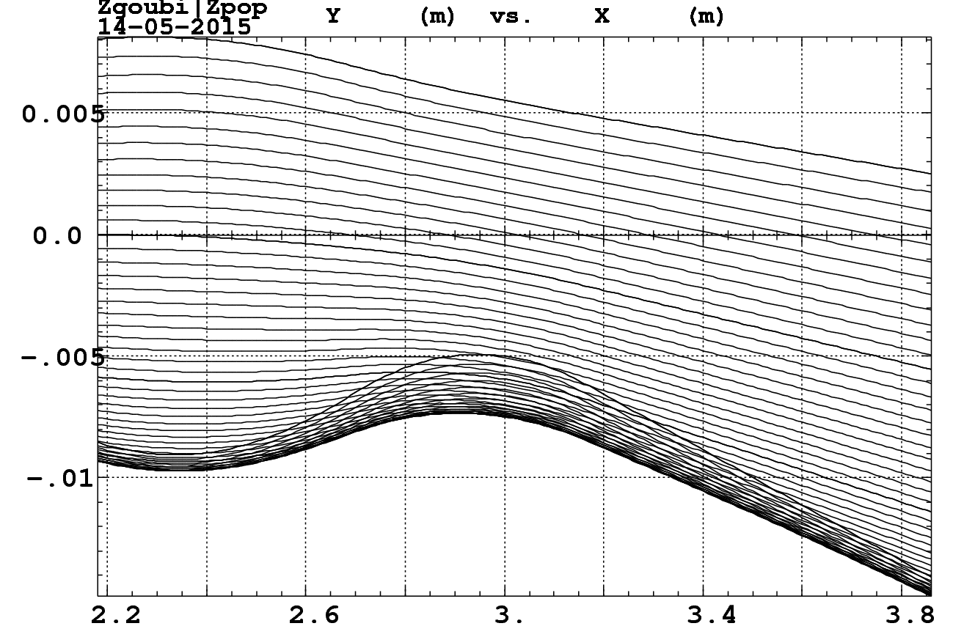
Closed orbits in the range 1.3 GeV to 6.6 GeV
Y transverse [m]
QF
QD
x-along beam [m]
FFAG’16
14/20

Slide 15
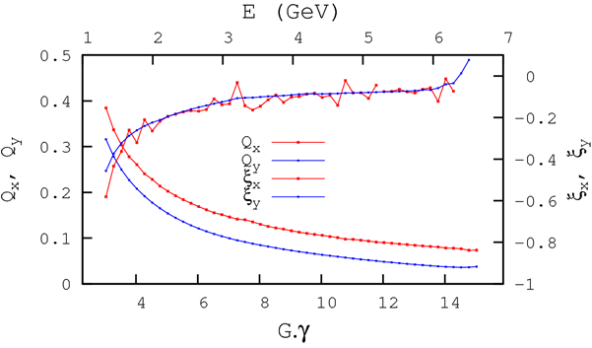
Tunes Q_{x},Q_{y} and chromaticities ξ_{x}, ξ_{y}; Range: 1.3 GeV to 6.6 GeV
FFAG’16
15/20

Slide 16
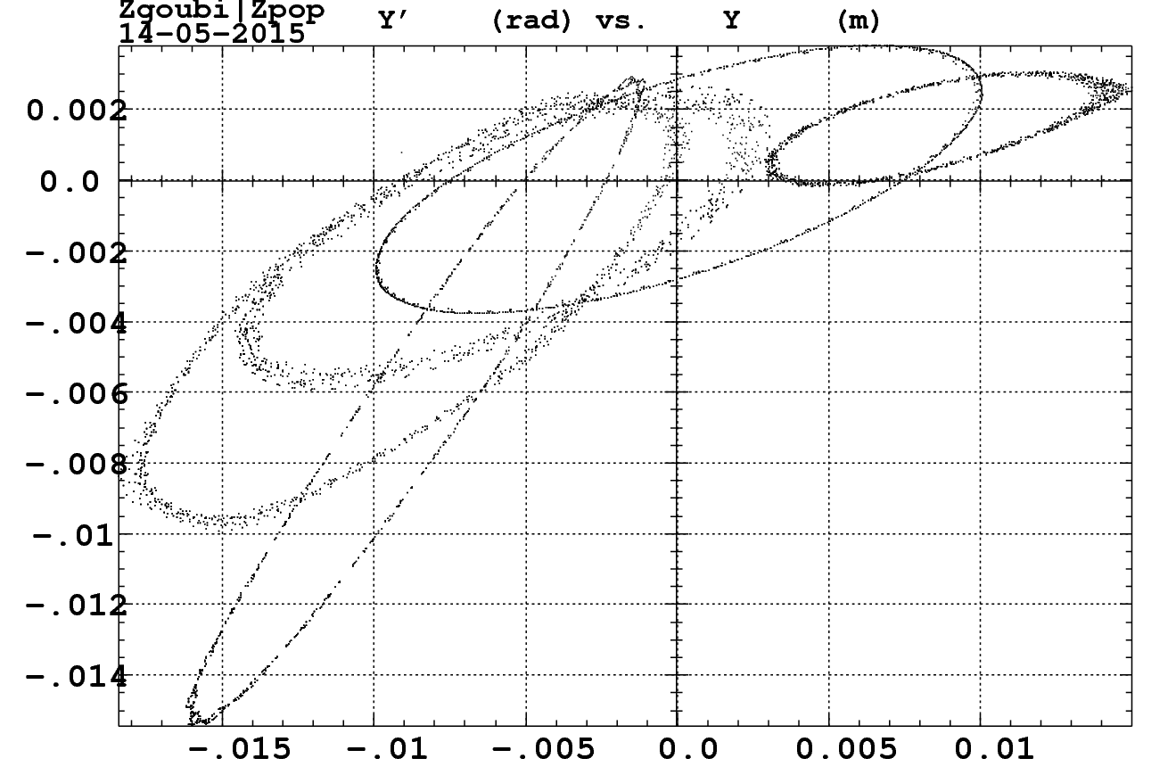
Calculations of the maximum beam emittance ε_{x} transported in all six arcs for each of the five orbits.
Max_ε_{N-rms}=0.02 m.rad
Required_ε_{N-rms} to be transported=30x10⁻⁶ m.rad
5.28 GeV
6.60 GeV
3.96 GeV
2.64 GeV
1.32 GeV
FFAG’16
16/20

Slide 17
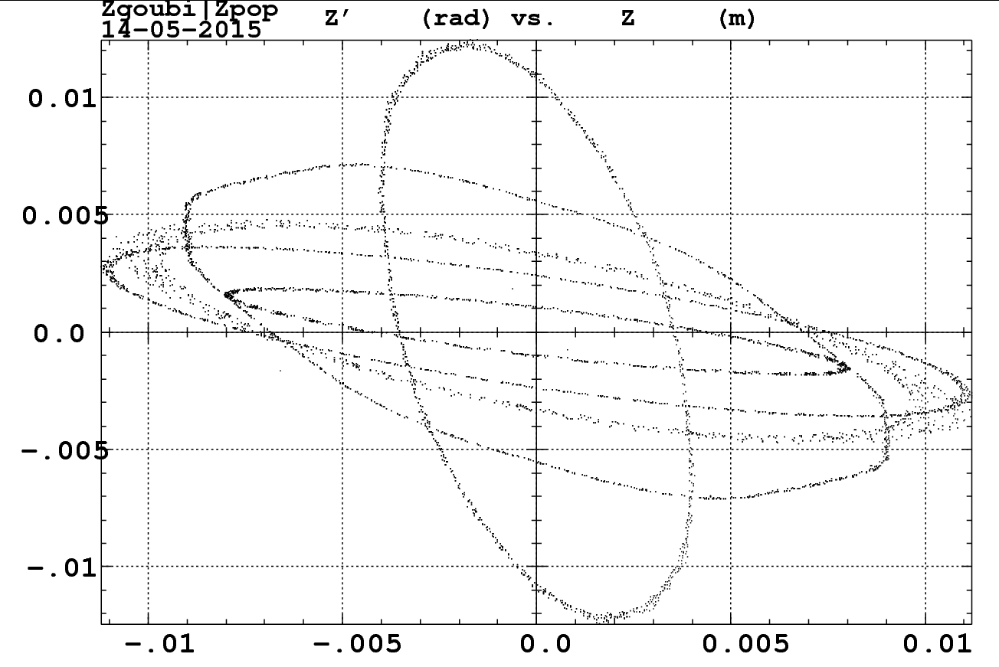
Calculations of the maximum beam emittance ε_{y} transported in all six arcs for each of the five orbits.
Max_ε_{N-rms}=0.02 m.rad
Required _εN-rms to be transported=30x10⁻⁶ m.rad
FFAG’16
17/20

Slide 18
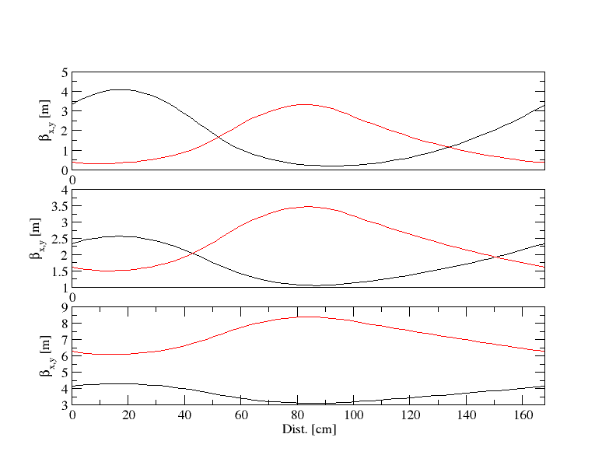
Beta functions of 3 different energies
QF
QD
β_{x}
1.3 GeV
β_{y}
2.6 GeV
6.6 GeV
FFAG’16
18/20

Slide 19
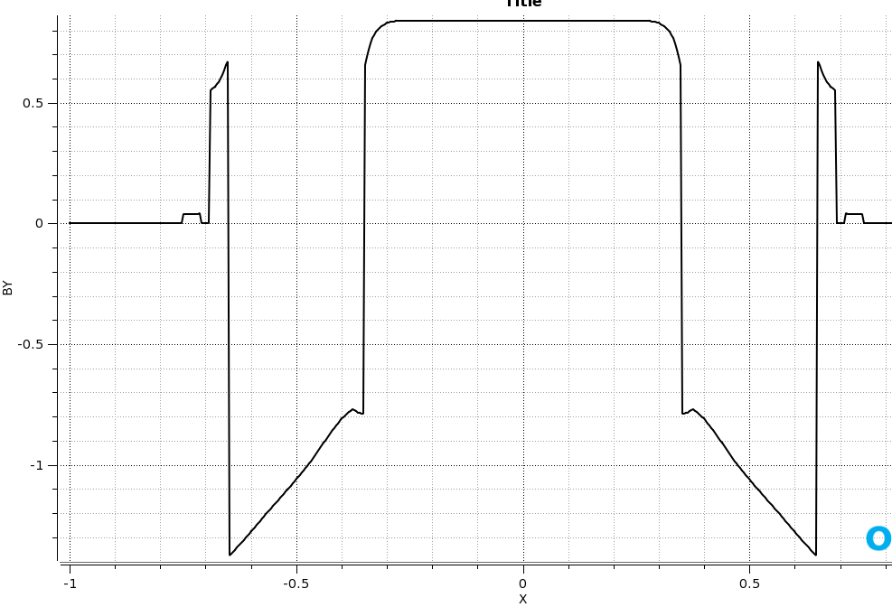
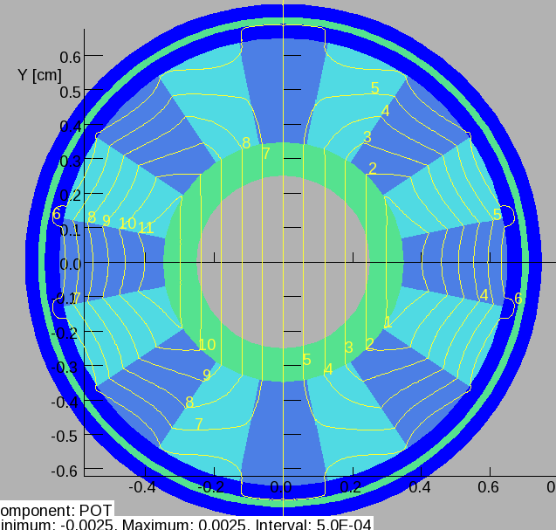
A 5 mm septum Permanent Magnet
B=0.83 T
B=0.03 Gauss
5 mm
0.4 mm Iron
5 mm
0.1 mm Al
1 mm Inconel
FFAG’16
19/20

Slide 20
Conclusions
Issues with Halbach type PM
Temperature compensation may be needed for (NdFeB) material. But there are ways to solve temperature compensation issues.
Tolerances of easy axis direction and Br
The Halbach type permanent magnets with wedges is a good alternative to replace the Iron Dominated permanent magnets.
FFAG’16
20/20

Slide 21
The End
Thank you for your attention
FFAG’16

