Slide 1
Initial Racetrack design
5M straight sections
He 70-330 MeV stage
Dr. C. Johnstone
Fermilab
4/18/ 2016

Slide 2
General Comments
He/Ion therapy is of great interest internationally
430 MeV/nucleon required for full carbon therapy; 250 MeV/nucleon for He
  However 330 MeV/nucleon (pelvis) is required for imaging with protons (H₂⁺) – particle imaging is a high priority
    1 p/rf bucket implies that a CW beam is required
    Standalone 330 MeV proton machine for imaging is not marketable
    For combined with therapy variable energy is required
      Degrader is problematic above 250 MeV/nucleon
Dual Stage accelerator system is optimal for
  Beam dynamics and low losses
  Variable energy extraction – smaller aperture to span
    Degrader operation is problematic with ions
  Lower energy stage – supports an eye line or melanomas, mesothelioma, shallow surface tumors

Slide 3
National Center for Particle Beam Radiation Therapy
Multi-ion capability | p, He, Li, B, C O and Ne also desirable Fast switching between ion species (1 sec)
Energy range | 60 MeV/nucleon to 430 MeV/nucleon Depths up to 30 cm for carbon ions
Field size | At least 20 x 20 cm² optimally up to 40 x 40 cm²
Real-time imaging (radiography & CT: For tumor position verification and motion management | For patient sizes up to 60 cm in depth.
Dose delivery rates hypofractionated regime: Hypofractionation treatments in under one minute (ideally in one breath hold) | 20 Gy/min/ liter 7 Gy/8 sec/ liter (corresponding to 4x10¹² p/sec for cubic liter)
Pencil beam scanning: Fast treatment for a large variety of tumor sizes and shapes. Two extremes are considered: 30 cm x 30 cm tumor single layer in depth and a cubic volume | Transverse scanning rate of 1-10 cm/msec Energy step time of 10-100 msec (These are present state-of-the-art)
Transverse beam size: selectable, with stable, Gaussian profiles. | 3 mm to 10 mm FWHM
Energy step size | Protons: 2 MeV (~0.25 cm in range) Carbon: 2 MeV/nucleon (~0.1 cm in range)
Lateral targeting accuracy at the Bragg peak | Protons: ±0.5 mm Carbon: ±0.2 mm
Dose accuracy/fraction | 2.5% monitored at ≥40 kHz during dose deposition

Slide 4
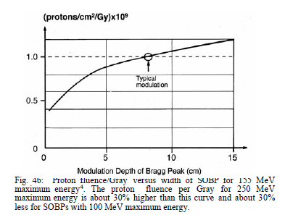
Translating into Accelerator Performance
Dose Delivery Rate | 30 x 30 cm² field single layer/energy sweep step size 5 mm | 10 x 10 x 10 cm³ field 40 layers/energy steps sweep step size 5 mm
Normal Fraction: 1-2 Gy/fraction 1 Gy/min 1 Gy/sec | 1/60 x 10¹² p/sec 1 x 10¹² p/sec | 4/60 x 10¹² p/sec 4 x 10¹² p/sec* (requires transverse scanning rate of 13 cm/sec and energy modulation time of 10 ms)
Hypofraction Regime: 5-8 Gy/fraction 5-8 Gy/min 5-8 Gy/sec 5-8 Gy/breathhold | (5-8)/60 x 10¹² p/sec 5-8 x 10¹² p/sec 1 x 10¹² p/sec | (5-8)/60 x 10¹² p/sec 2-3 x 10¹³ p/sec* 4 x 10¹² p/sec* *requires transverse scanning rate of 13 cm/msec and energy modulation time of 10 ms
Radiobiology: up to 20 Gy/fraction 20 Gy/min 20 Gy/sec 20 Gy/breathhold | (2)/60 x 10¹³ p/sec 2 x 10¹³ p/sec 2-4 x 10¹² p/sec | 8/60 x 10¹³ p/sec 8 x 10¹³ p/sec* 1-2 x 10¹³ p/sec* *requires transverse scanning rate of 13 cm/msec and energy modulation time of 10 ms
G. Coutrakon, et. al.,
Proceedings 1999 PAC

Slide 5
Comparison of Accelerator Technologies
- All ion accelerators can accommodate up to 430 MeV/nucleon carbon; fixed field use charge to mass of 1/2
Accelerator Type | Size | Dose Rate Per liter | Energy Modulation Var / Acc Beam Fixed Delivery NC / SC |  |  |  | Scan Trans / Long
SC Synchrotron | 40 m (diam) | 5 Gy/min 0.2 Gy/sec | V | 1 ms -2 sec | 10 ms | 100 ms | T + L in cycle
RC Synchrotron | 20 m (diam) | x Cycle factor* 1.3-20 Gy/min | V | 1 – 66 ms | 10 ms | 100 ms | L in cycle T cyc to cyc
Compact Proton Synchrotron Hitachi | 5 m (diam) 8 m | 0.075 Gy/min 0.0025 Gy/sec 0.75 Gy/min 0.025 Gy/sec | V V | 1 ms -2 sec | 10 ms | 100 ms | T + L in cycle
Linac/Cyclinac | 40 -80m | Any rate | V | 1 ms | 10 ms | 100 ms | Any
Cyclotron | 6.3 m (diam) | 5 Gy/min 0.08 Gy/sec | F | 1 ms | 10 ms | 100 ms | T then L
FFAG | 4m x 6m racetrack | Any rate | V | 50 μsec | 10 ms | 100 ms | Any
* In principle RCS = cycle time factor x circumference factor x SC Synchrotron dose rate

Slide 6
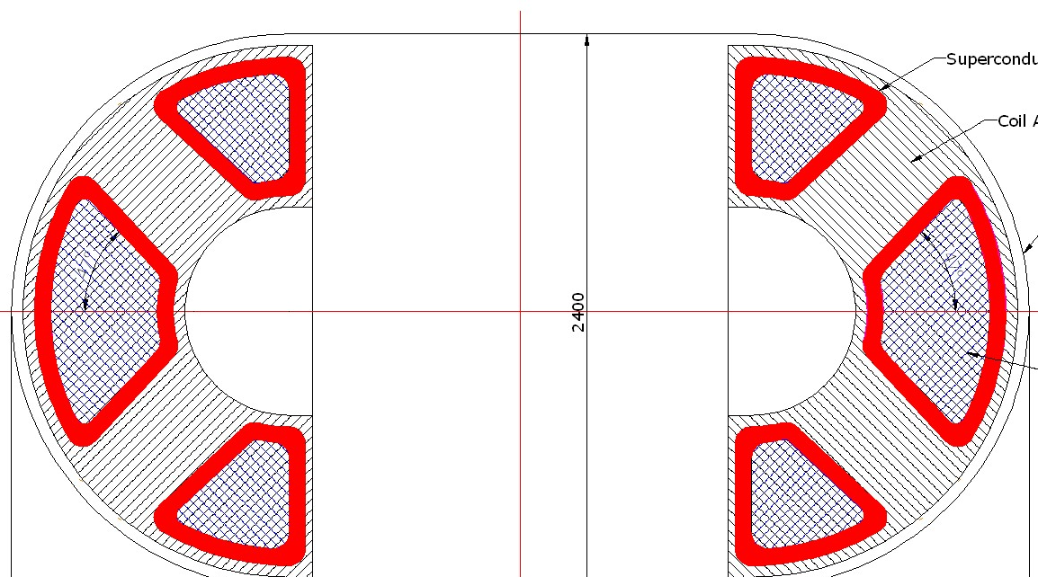
Dual-stage ion FFAG proton FFAG with proton CT (pCT)
1st stage: Cyclotron or FFAG
1st stage
  18 – ~250-330 MeV H⁻
    Fixed or swept-frequency RF, DC beam
    Low intensity for pCT
    Stripping controls extraction energy and
    intensity in addition to source modulation
    OR
  9-~70-90 MeV charge to mass ratio of ½
    Fixed-frequency RF, DC beam for all ions
    Variable energy extraction
    Upstream injector for high-energy ring
2nd stage (~4 m x 5-6 m long for SC)
  70/90 MeV – 430 MeV/nucleon
  Variable energy extraction
  Adjustable, fast orbit bump magnets/extraction septum in long straight
    DC extracted beam
    Variable energy on scale of tens of microseconds
    Investigating extracted energy range
2nd stage: 70/90 – 430 MeV/nucleon ions
Variable energy selection:
Injection/extraction straight

Slide 7
Preliminary Parameter Estimate
Calculation of approximate aperture for isochronous condition for an ~ circular format
With β the relativistic velocity – so if a long straight increases the injection circumference significantly it shows up as aperture

Slide 8
Apertures as a function of straight section length
For charge to mass of 1/2
  70 MeV/nucleon: β = 0.366
  90 MeV/nucleon: β = 0.409
  330 MeV/nucleon: β = 0.673
  430 MeV/nucleon: β = 0.728
For MD Anderson the present machine radius is ~5 m; variable energy extraction will drive the length of the straight section - start with this extraction radius for the arc
Machine apertures
Energy Range MeV/ nucleon | Straight 0 meters | Straight 2 meters | Straight 4 meters
70-330 | 2.28 | 2.67 | 2.86
90-330 | 1.96 | 2.21 | 2.63
70-430 | 2.2 | 2.80 | 3.12
90-430 | 2.5 | 2.47 | 2.75

Slide 9
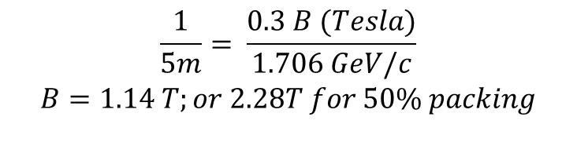
Estimate of Peak Magnetic Field
Dipole packing fraction of 50% is realistic
  In the nonscaling FFAG the reverse bend CF magnet is not the inverse of the normal/focusing CF magnet
  The magnitude of the reverse dipole component is about an order of magnitude less and is not significant unlike the scaling FFAGs
  At medium energies the CW nonscaling FFAG, particularly the racetrack is more compact than the separated sector iso-cyclotron
For 5 m radius ring/arc
$$\frac{1}{5m}= \frac{0.3 B (Tesla)}{1.706 GeV/c}$$
$B$ $=1.14 T;or 2.28T for 50\% packing$

Slide 10
Machine Design Concepts
Racetrack
  ~4 and ~5m extraction straights
  3-bump and 4-bump configurations
    3-bump has back to back magnets (two C magnets or septum+ C magnet)
  0.2m - 0.25 m transition to arcs (warm to cold transitions for example)
Peak Magnetic Fields
  NC and SC arcs: ~2.5T and ~5T
  Extraction assumes normal conducting: 2.5-2.7T, pulsed and bipolar ramps
  Are higher swept-field magnets possible since average current is lower?
SC vs NC Extraction
  NC: 15 Hz (66 msec) energy sweeping frequency
  SC: how fast 0.2-1 sec?

Slide 11
70-330 MeV Extraction
Bipolar Extraction magnets
4 / 5m straight
330 MeV
Septum or C magnet
ΔR
NC: 2.9 m
SC: 1.7 m
C magnet
Lowest extracted energy
70 MeV
0.75 / 1 m
0.25/0.2 m
1.5 / 2 m
0.25/0.2 m
0.75 / 1 m
Field direction is bipolar; field decreases and flips sign for maximum energy extraction (blue to red lines). Extraction magnetic fields are limited to 2.5-2.7T although higher may be possible with ramped fields. The orbit separation at the beginning of extraction is shown for NC (2.9m) and SC (1.7m).

Slide 12
Energy Range extracted:
70-250 MeV Acceleration Range
250 MeV NC and SC designs: Bipolar field extraction
Racetrack Straight | ΔR (m) | Lowest Energy Extracted MeV/nucleon
4 m NC arcs SC arcs | 2.25 1.4 | 170 110
5 m NC arcs SC arcs | 2.4 1.5 | 125 70

Slide 13
Alternative :70-330/250 MeV
Bipolar Extraction magnets
4.5/5.5 m total straight
0.1 m
0.1 m
330/250 MeV
septum
0.1 m
0.1 m
ΔR given in tables
0.75m/1m
Lowest extracted
energy
70 MeV
0.75/1m
0.75/1m
0.75/1 m
0.75/1 m
Field direction is bipolar; field decreases and flips sign for maximum energy extraction (blue to red lines). Extraction magnetic fields are limited to 2.5-2.7T. The orbit separation at the beginning of extraction for this configuration is given in the tables on the following slide.

Slide 14
Energy Range extracted:
70-250/330 MeV Acceleration Range
250 MeV NC and SC designs:
Bipolar field extraction
330 MeV NC and SC designs:
Bipolar field extraction
Racetrack Straight | ΔR (m) | Lowest Energy Extracted MeV/nucleon
4.5 m NC arcs SC arcs | 2.3 1.43 | SC extraction 130
5.5 m NC arcs SC arcs | 2.44 1.56 | 120 70
Racetrack Straight | ΔR (m) | Lowest Energy Extracted MeV/nucleon
4.5 m NC SC | 2.93 1.8 | SC extraction SC extraction
5.5 m NC SC | 3.1 1.94 | 190 or SC extraction 105-110

Slide 15
Summary
330 MeV (for imaging) requires
  for NC extraction
    SC arcs
    3-bump extraction layout only
    ≥5m extraction straight
  For SC extraction
    Shorter extraction straights
250 MeV requires
  for NC extraction
    SC arcs again best – can achieve full energy-range extraction
    However can raise injection energy to ~100-125 MeV/nucleon
    3-bump and 4-bump extraction layouts work; 4-5 m extraction straights
    NC arcs require 5.5m extraction (120 MeV/nucleon lowest extracted energy)
  SC extraction is not required
Back to back 3-bump magnets / required orbit separation
  May require two accelerating cavities
  Counter-phasing can fine tune orbit separations during acceleration and fine tune extraction energy

Slide 16
Machine Design Concepts
Two layouts – circular and racetrack
Circular (4-fold periodicity)
  Establishes methodology
  Confirm tunes and dynamics in circular machine
  Particle tracking results; beam loss, etc.
Racetrack (2-fold periodicity)
  Field design, identical and beam dynamics similar
  Confirm performance
Acceleration
  Add single gradient cavity racetrack
  Add single and two opposing cavities in circular machine for comparison

Slide 17
Racetrack Concepts
Racetrack (2-fold periodicity)
  4-5m straight section
  1-2m short straight in center of arc for vacuum and cryo connections
    Will be reduced to 1.5 – 1 m straight
Performance
  Large DA – particle tracking has been performed
  Vertical tune initially crossed integer ~175-250 MeV/nucleon
  This was fixed by controlling the vertical extent of the field or “flutter” in cyclotron terms

Slide 18
Geometry and field
2m
F mag
D mag
F mag
D mag
2m
Approximate radial range of beam: only two types of magnets
Short straight increases stability

Slide 19
Geometry and field
5m
F mag
D mag
F mag
1m
D mag
Approximate radial range of beam: only two types of magnets
Short straight increases stability

Slide 20
Field Profile Racetrack

Slide 21
Evolution of Machine Tune
Initial 5m/2m to 5m/1m straight sections
Circular 2 m straights to 3.5/0.5 m to 3m/1m straights
Tunes with realistic field falloffs: total kinetic energy of He (divide by 4 for MeV/nucleon)

Slide 22
Closed Orbits – from field map
÷4 for MeV/nucleon

Slide 23
Cosy Particle Tracking

Slide 24
Difference in TOF from field map
Injection TOF can likely be corrected with shims

Slide 25
ZGOUBI Tracking and Cyclops
COSY agrees with Cyclops – may be a field map issue with what I gave to F. Meot

Slide 26
Tracking by S. Machida

Slide 27
TOF and Tunes

Slide 28
Voltage Requirement

Slide 29
Tracking 10 MV/turn – Baartman estimates 14 MV/turn for full range

Slide 31
Summary
A racetrack with large, stable dynamics has been designed
Variable energy extraction has been conceptually designed
NC and SC designs
250-330 MeV designs range from
  ~2.5-5 m radius for single energy extraction
  10-15 m x 11 m for a racetrack variable energy extraction
Large DA aperture
TOF requires shimming/work near injection
These machines really benefit from an injector ~50 – 100 MeV/nucleon – this is an easy injector
For a charge to mass of 1 (protons) – we have 3x5 m racetrack (SC) design at 1 GeV

