Slide 1
Compact CW FFAGs for High-intensity Applications
Dr. Carol Johnstone
Fermilab
FFAG’16
Sept. 9, 2016
Imperial College
London, UK

Slide 2
Outline
Motivation and Background
    Medical, security, energy applications
    Isochronous or CW beam required to realize high mA currents
      Implies next generation fixed magnetic-field accelerators
    For medium energies – ~600 MeV – 2 GeV
      Strong focusing for low-loss beam confinement
      For circular machines: control of machine tunes (field gradients)
      Isochronous (CW) strong focusing cyclotrons; i.e. FFAGs
These machines require high gradient acceleration for high currents
    Low acceleration and extraction losses
    High gradient cavities require “drift” or component-free sections
    Compactness further requires SCRF
  Large horizontal aperture of the FFAG, like the cyclotron, is a challenging problem for SCRF design; PSI has solved large aperture NCRF designs

Slide 3
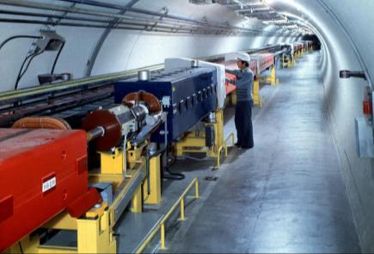
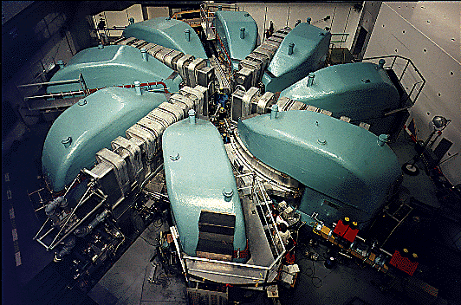
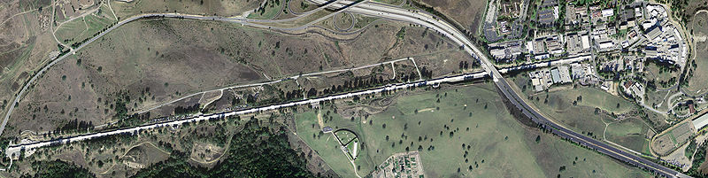
Applied acceleratorS
Synchrotons
  Pulsed magnetic fields
  Swept-frequency accelerating systems
  Separated components
  Long component-free straight sections
  Size scales with momentum/charge to mass ratio.
  Current limited - μA
Cyclotrons
  Fixed magnetic fields
  DC beams, fixed-frequency accelerating system
  Relativistic energies: swept-frequency accelerating systems
    Synchrocyclotron.
  Monolithic pole pieces – no straight sections
  Very large at high energy
  High currents (mA)
Linacs
    Longest footprint
    Costly – no recirculating beam or “reuse” of components
    Ultra-high currents – 100 mA
FFAGs
  Fixed magnetic fields
  DC beams well into the relativistic regime
  Compact
  Separated components
  Synchrotron-like dynamics allow component-free straight sections
  High current – tens of mA
Synchrotron
Low Current (<mA)
High Energy (TeV)
Pulsed Beam
Cyclotron
High Current (<10mA)
Medium Energy (600MeV)
Continuous beam
Linac
High Current, High Energy
Pulsed or continuous beam: Large, expensive
FFAG
High Current (~20mA) , High Energy (GeV) Continuous beam, compact

Slide 4
Cyclotrons:
Cyclotrons are the highest current, most compact solution, but only up ~200 MeV for protons
As the energy becomes increasingly relativistic, orbit separation becomes smaller and smaller for CW operation
Higher energies require separated sectors (like the 590-MeV PSI or 500-MeV TRIUMF machines) – in order to insert strong accelerating (RF) systems.
  Stronger acceleration is required to minimize beam losses and radioactivity particularly during beam extraction
  Fewer acceleration turns and larger between different acceleration orbits facilitate efficient extraction.
However, once space is inserted between the magnetic sectors of the cyclotron, the footprint grows rapidly.
At relativistic energies, above 200 MeV, cyclotrons do not scale. Field profile must be nonlinear at relativistic energies for CW operation

Slide 5
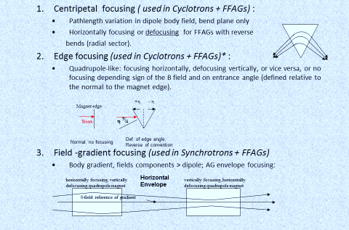
Principles of Beam Transverse Focusing: a short review
Magnet edge
+η - η
Beam
η
Normal, no focusing
Def. of edge angle,
Reverse of convention
Horizontal Envelope

Slide 6
So what is a FFAG?
Next generation cyclotron
A Fixed Field Alternating Gradient Accelerator is a ~ a cyclotron with strong synchrotron-like focusing
The ns-FFAG combines all forms of transverse beam (envelope) confinement in an arbitrary, optimized magnet field:
  For the horizontal, the three terms are
The power of the nonscaling FFAG is that the confinement terms can be varied independently to optimize machine parameters such as footprint, aperture, and tune in a FFAG AND DC beam can be supported to very high energies
cyclotron
synchrotron

Slide 7
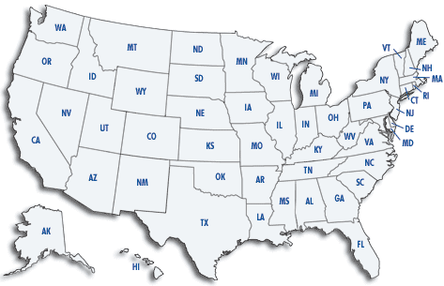




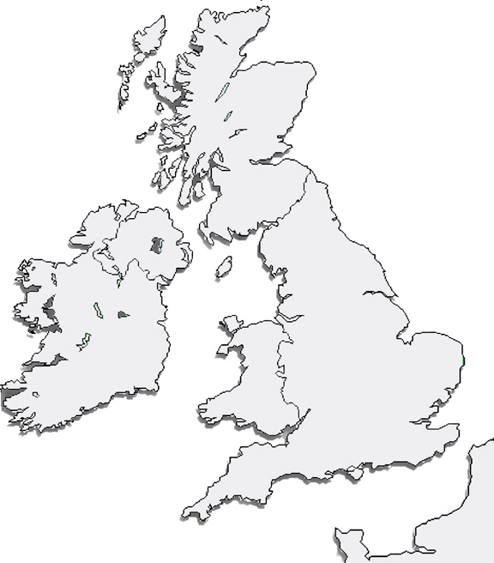














INTERNATIONAL ffAG COLLABORATION
Accelerator Science and Technology Centre

Slide 8
Quick Guide to FFAGs
Simplest Dynamical Definition:
  FFAG is ~ a cyclotron with a gradient; beam confinement is via:
    Strong alternating-gradient (AG) focusing, both planes: radial sector FFAG
      normal/reversed gradients alternate (like a synchrotron)
    Gradient focusing in horizontal, edge focusing in vertical: spiral sector FFAG
      vertical envelope control is through edge focusing (like a cyclotron)
      the normal gradient increases edge focusing with radius /momentum (unlike a cyclotron)
Types of FFAGs:
  Scaling:
    B field follows a scaling law as a function of radius - r^{k} (k a constant;) present-day scaling FFAGs: Y. Mori, Kyoto University Research Reactor Institute
  Nonscaling:
    Linear (quadrupole) gradient; beam parameters generally vary with energy (EMMA FFAG, Daresbury Laboratory, first nonscaling FFAG)
    Nonlinear-gradient; all parameters of the machine can be optimized

Slide 9
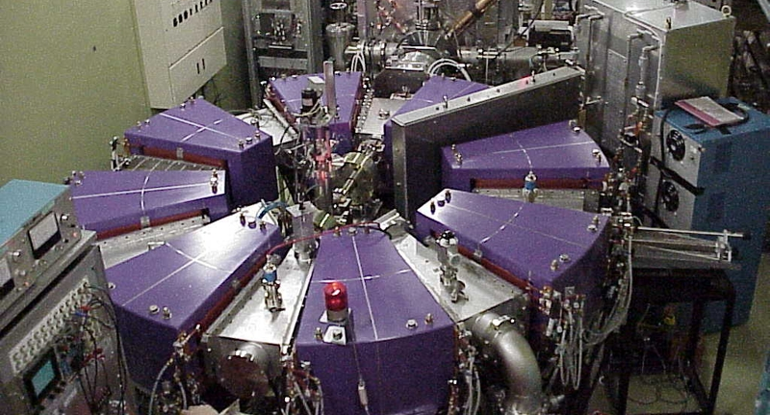
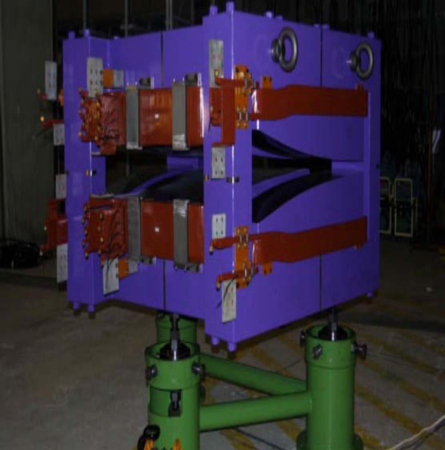

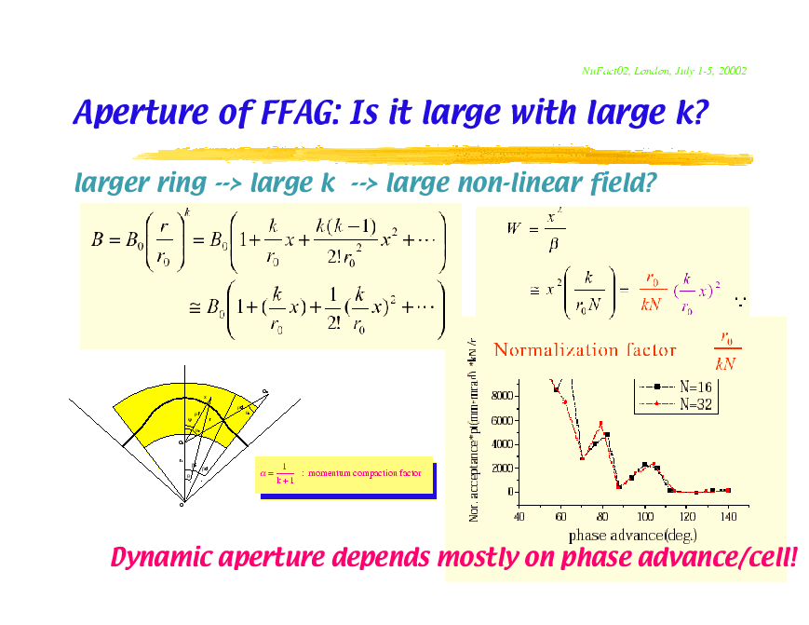
FFAGs and their Variations
Scaling FFAGs (spiral or radial-sector) are characterized by geometrically similar orbits of increasing radius, imposing a constant tune (field and derivative gradient scale identically with r). Magnetic field follows the law B ∝ r^{k}, with r as the radius, and k as the constant field index.
Spiral Sector: example: more compact; positive bend field only. Vertical focusing controlled by edge crossing angle.
Field expansion: k determines multipole order;
Comments: the lower the k value, the more slowly field increases with r and the larger the horizontal aperture, but the more linear the field composition and dynamics.
F
Radial Sector: example: This is a triplet DFD cell; there are also FDF, FODO and doublets. In a radial sector the D is the negative of the F field profile, but shorter.
D
D

Slide 10
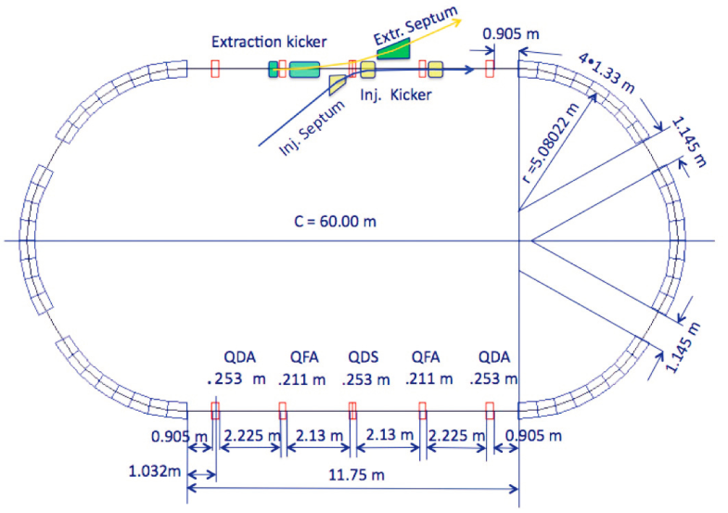
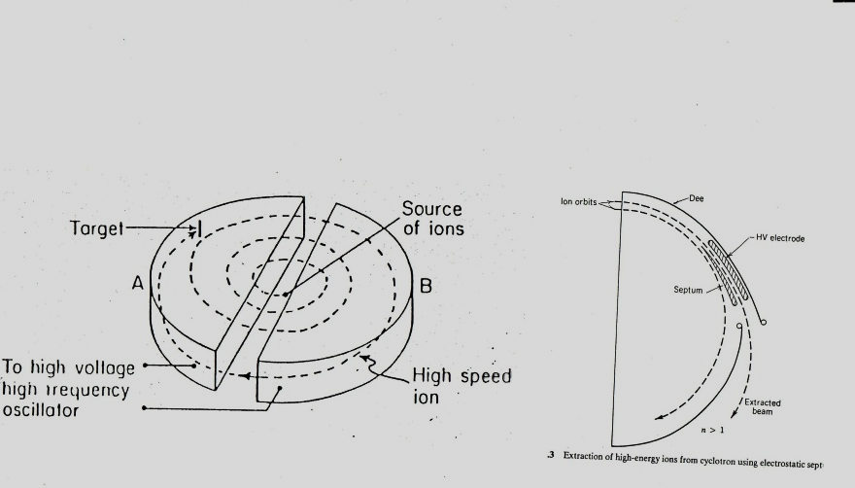
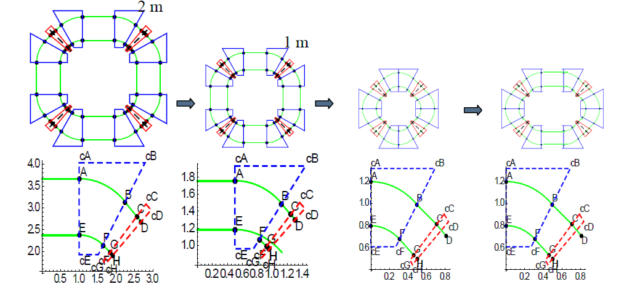
Understanding a ns-FFAG
Apply a “synchrotron” strong-focusing field profile to each “cyclotron” orbit; effectively eliminate reverse dipole bend
Strong-focusing allows
  Long injection/extraction or synchrotron-like straights
  Strong RF acceleration modules
  Low –loss profile of the synchrotron
  DC beam to high energies in compact structure
    400 MeV/nucleon: charge to mass of ½ (carbon)
    1.2 GeV protons
  Avoidance of unstable beam regions
    constant machine tune
straight =
CONSTANT MACHINE
TUNES AT NEAR AND FAR RELATIVISTIC ENERGIES
BEYOND CONVENTIONAL CYCLOTRON

Slide 11
Relativistic CW (DC-beam) ns-FFAGs
NS FFAG can maintain isochronous orbits at relativistic energies
  Pathlength of isochronous orbits are proportional to velocity
  Orbits as a function of momentum follow, therefore the B field must scale with velocity
  At relativistic energies, momentum is an increasingly nonlinear function of velocity; therefore B field transitions from a linear slope to nonlinear, non-relativistic to relativistic as an approximate function of radius.
  THIS HAS BEEN ACHIEVED IN RECENT NONLINEAR NS FFAG DESIGNS
  Nonlinear field expansion + edge angle can constrain the tune
  Nonlinear gradient provides very strong focusing at high energy in both planes relative to the cyclotron
FFAG limit
≥2 GeV protons
Cyclotron limit
~ 1 GeV protons
P (MeV/c)
<Br> ∝ p/β for isochronous orbits
β or normalized path length

Slide 12
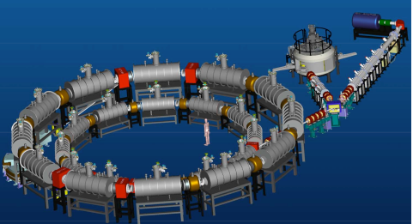
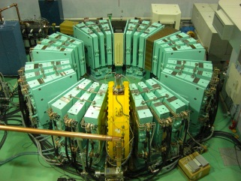
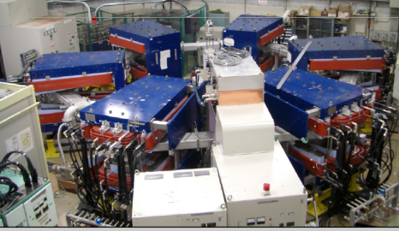
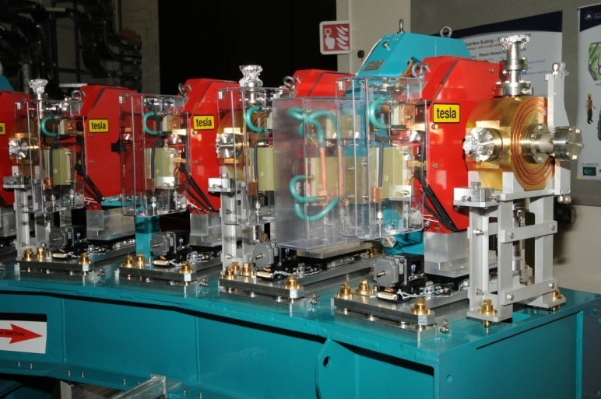
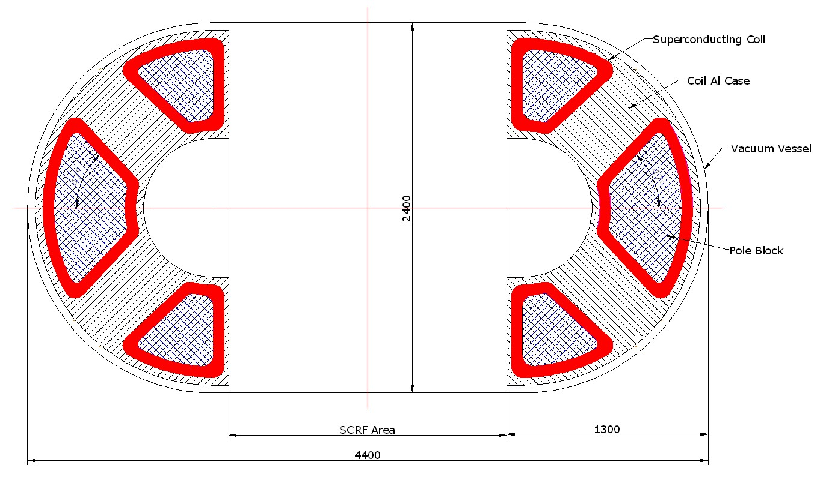
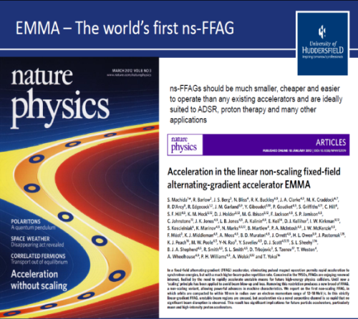
INTERNATIONAL DEVELOPMENT OF FFAGS
PAMELA: hadrontherapy design
Oxford, U.K.
RACCAM: proton therapy LPSC Grenoble, France
ERIT: neutron source
KURRI, Japan
PRISM: intense muon beam
Lepton flavor violation exp.
Osaka, Japan
0.2 -1 GeV intense proton FFAG (ADS)
Compact Racetrack
~ 4 m
Injection
extraction
EMMA: POP muon acc demo
Daresbury Laboratory, U.K.
KURRI: ADS test
Kyoto U. Research Reactor
Institute, Japan
RF
~6 m
Compact CW ns-FFAG racetrack design capable of variable energy and various applications
POP, 1st p FFAG, KEK, Japan

Slide 13
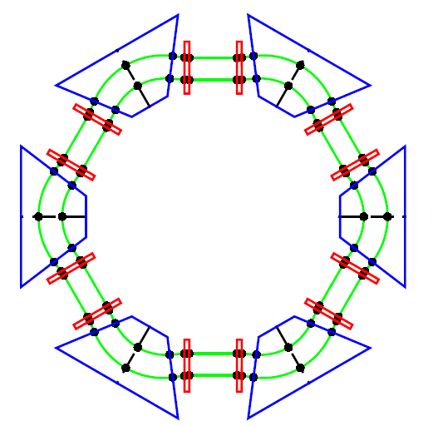
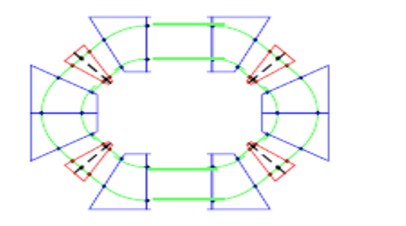
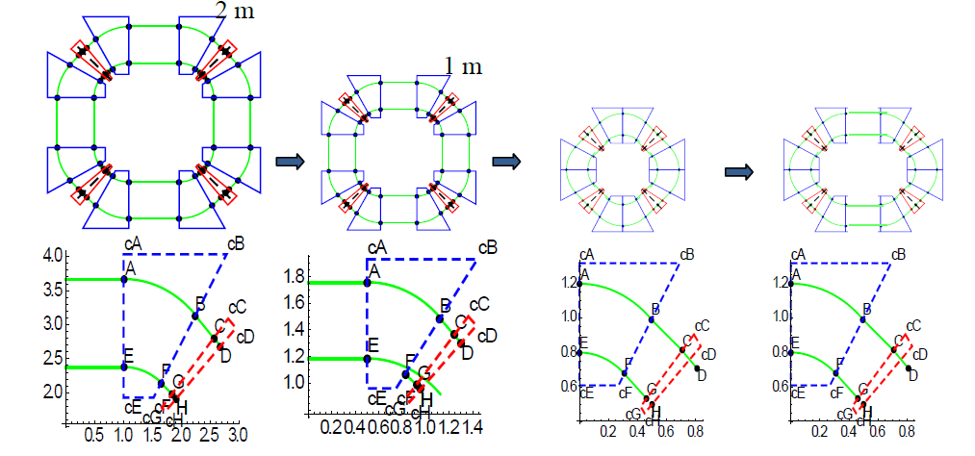
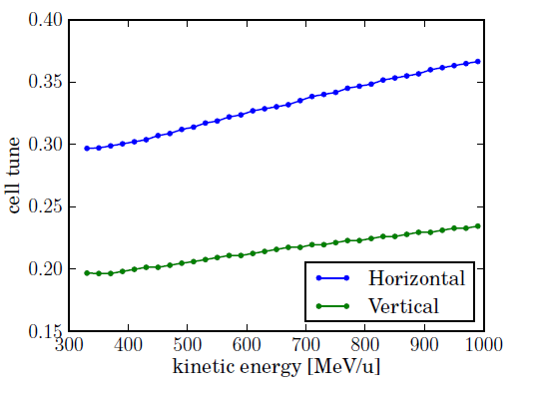
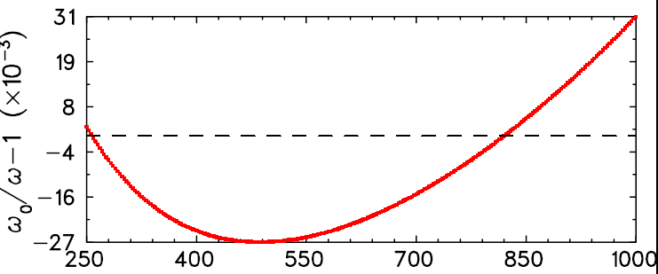
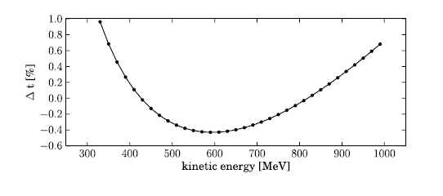
Advanced designS
Isochronous 1GeV NS-FFAG
2m
General Parameters of an initial 0. 250/0.330 – 1 GeV non-scaling, near-isochronous FFAG lattice design; peak fields are ~2-4T.
Three machines have been designed and studied
ENORMOUS DYNAMIC APERTURE
strong-focusing machine tunes

Slide 14
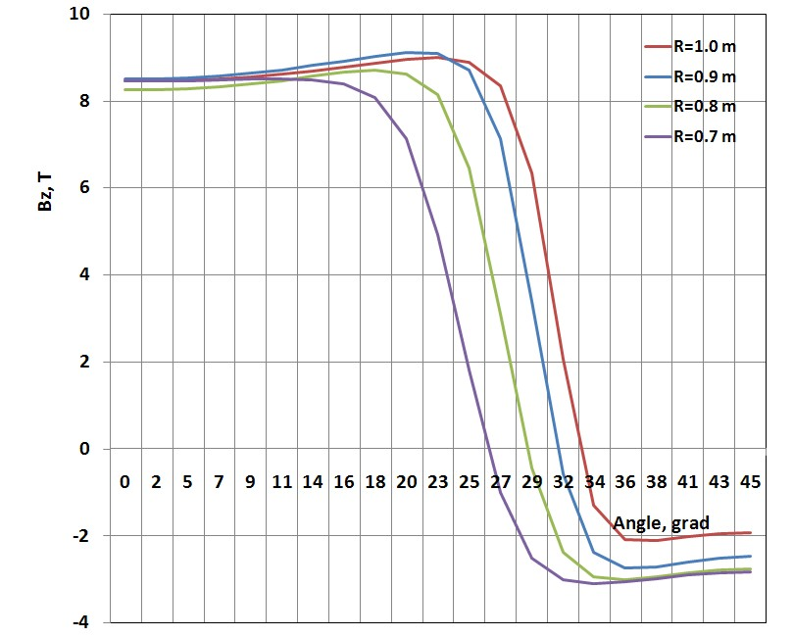
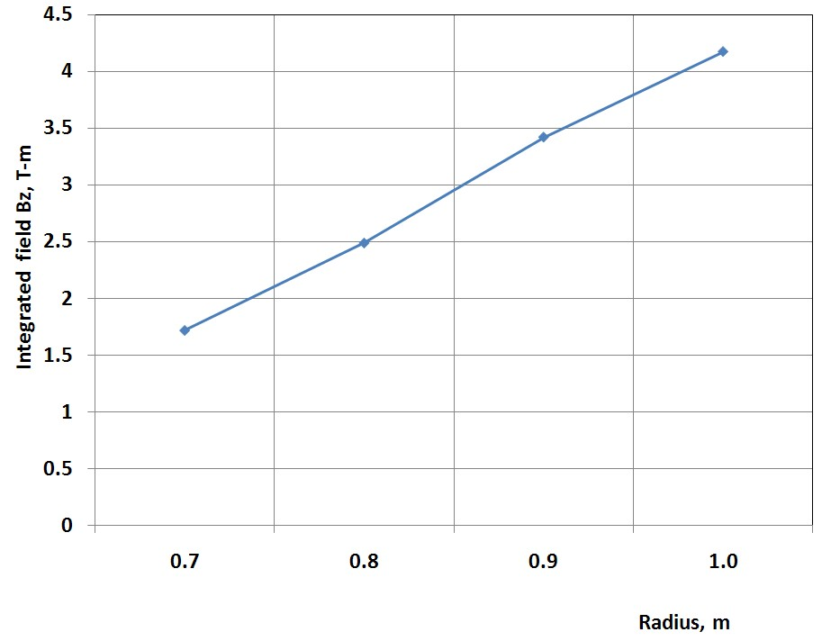
MAGNETS and modeling
Parameter | Units | Value
Number of magnets |  | 6
Number of SC coils |  | 12
Peak magnetic field on coils | T | 7-11
Magnet Beam Pipe gap | mm | 50
Superconductor type |  | NbTi
Operating Temperature | K | 4.0
Superconducting cable |  | Rutherford
Coil ampere-turns | MA | 3.0
Magnet system height | M | ~1
Total Weight | tons | ~10
< 3 m
< 5 m
One straight section occupied by RF cavities
and injection/extraction in the other
Self-supporting coils with Reverse gradient field between magnets (2012)
The magnetic field is relatively flat under the F-pole but the angular field length strongly depends on the radius providing the needed range from injection to extraction. The return flux provides the D or reverse gradient but needs careful optimization

Slide 15
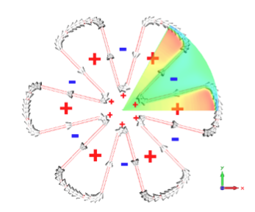
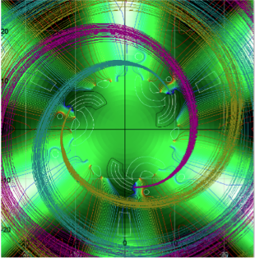
The AIMA Reverse Valley B-Field Cyclotron®
Pierre Mandrillon @ ThEC13
Achieving isochronism while keeping
vertical focusing at high energies is
challenging: isochronism implies a large
Positive radial gradient of the average B-field resulting in a strong vertical defocusing:
Δν_{z}² = -(γ²-1) = - (d<B>/dr)r/<B>
which could be overcome by edge and
spiral focusing (cf. PSI Ring Cyclotron)
ν_{z}² =-(γ²-1)+F²(1+2 tan²ζ)
F² = Field Flutter = (<B²>-<B>²)/<B>
Where ζ = spiral angle of the sector
A simpler Separate Sector Cyclotron:
=> No spiral => Stronger Flutter
= Reverse valley B-field
Proton extraction through stripping of H₂⁺ is simple !
A major advantage: The B-field configuration in the central
Region allows acceleration at low energies
➔An injector cyclotron is not needed anymore !

Slide 16
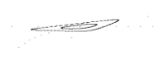
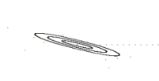
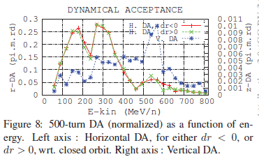
Comparing Dynamic Apertures
FFAG Stable beam area @200 MeV vs DA of ultracompact 250 MeV cyclotron
cyclotron
cyclotron
10 mm x 9 mr
ε_{V} = 90π mm-mr
ε_{norm} =62π mm-mr
80 mm x 293 mr
ε_{H} = 23,440π mm-mr
ε_{norm} = 16,059π mm-mr
FFAG: Horizontal – 1 cm steps
FFAG: Vertical – 1 mm steps
FFAG Stable beam area @1000 MeV vs. DA of 800 MeV Daeδalus cyclotron*:
factor of 4 larger for ~ a factor of 4 smaller footprint
Tracked: 130 mm x 165 mr
ε = 21450π mm-mr
ε_{norm} = 38820π mm-mr
Tracked: 10 mm x 5 mr
ε = 50π mm-mr
ε_{norm} =90π mm-mr
*FFAG vert. stable area at aperture limits.
*F. Meot, et. al., Proc. IPAC2012

Slide 17
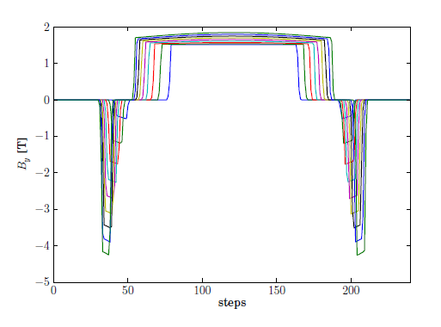
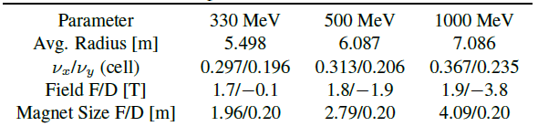
Design of an Isochronous 0.3-1GeV DFD FFAG
2m
Vertical magnetic field from 0.33-1 GeV in 80 MeV steps and variation of cell tunes using OPAL in 20 MeV steps
General Parameters of an initial 0. 3 – 1 GeV isochronous FFAG lattice design (±0.5% TOF variation)
Variation cell tunes / OPAL in 20 MeV steps
Preliminary Design – a resonance is crossed at 617 MeV which needs to be addressed

Slide 18
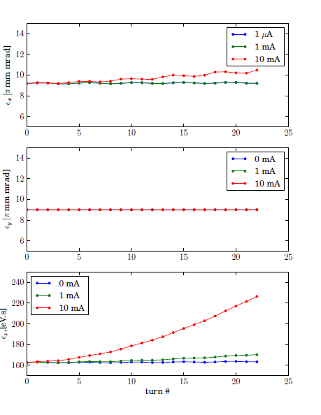
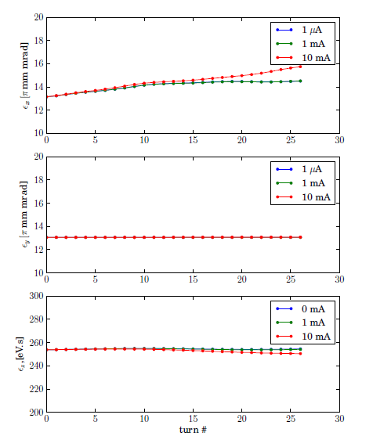
Simulation with space charge
S. Sheehy/A. Adelmann
Emittance variation at 330 MeV (left) and 610 MeV (right) for fixed energy tracking (no acceleration) with space charge for 0 – 10 mA and a 100mm long single bunch
With no longitudinal focusing the bunch expands in length but space charge has little impact on transverse emittance due to strong focusing

Slide 19
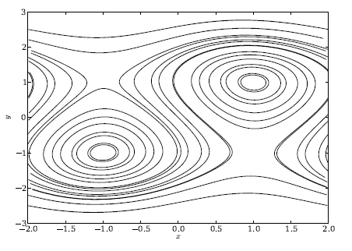
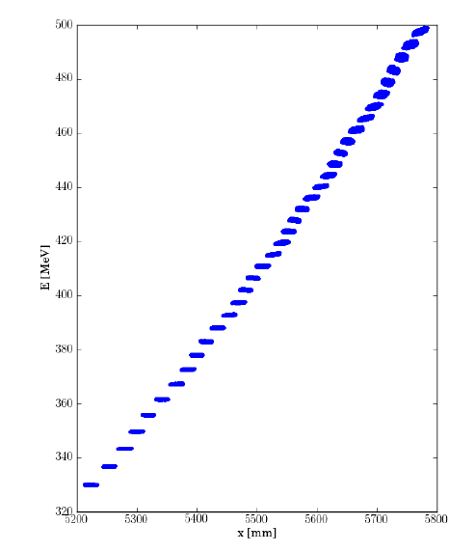
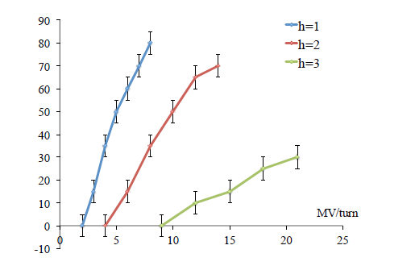
ACCELERATION with space charge
S. Sheehy/A. Adelmann
Serpentine channel for = 4=3 contours plotted for regularly spaced values of x=y.
Maximum serpentine acceptance in degrees for varying voltage per turn and harmonic number.
Turn-by-turn radial position vs energy for a low intensity beam in the serpentine channel accelerated to 500MeV.

Slide 20
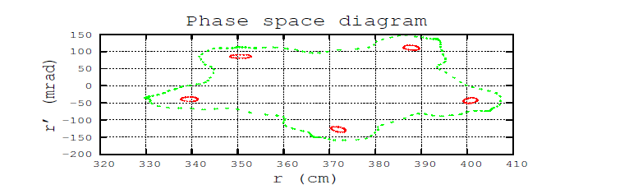
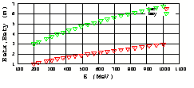
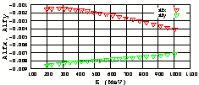
ZGOUBI simulations of the circular FFAG
Haj-Tahar Malek
Periodic betatron functions vs energy at azimuthal angle =0. – analytical model
.

Slide 21
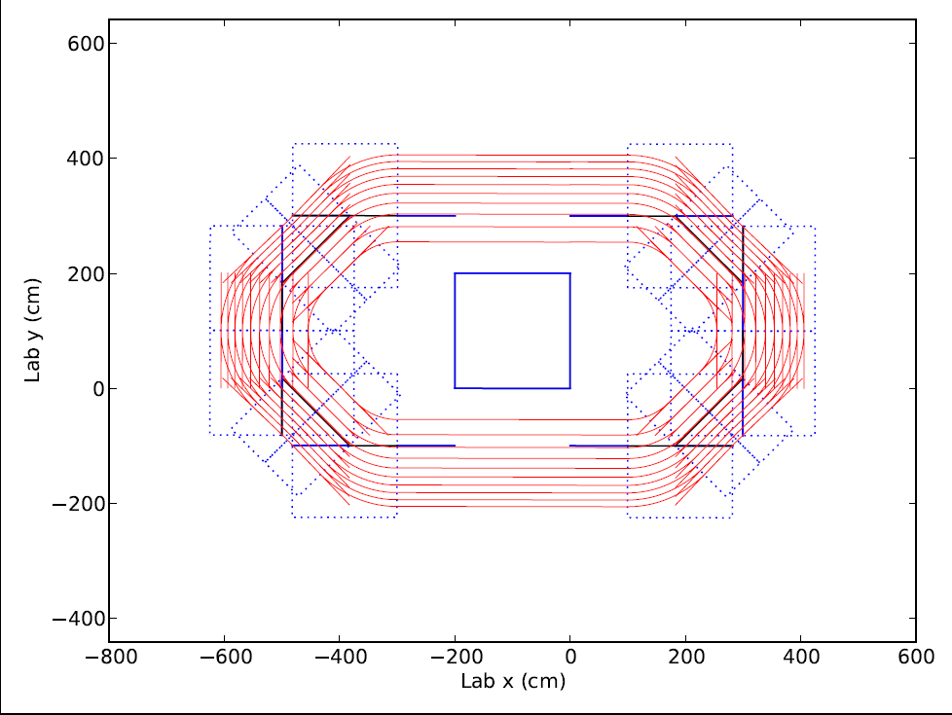
Racetrack layout
Start with the 2m straight, 3.7 m radius, ~2T fields
Remove 2 m straights from sides and add to two opposing straights
12m
.
8m
.
4m
.
Layout of racetrack FFAG for simulations and half arc layout
.
PyZoubi tracks
.

Slide 22
Circular vs Racetrack simulations using PyZgoubi/ R. Appleby
Machine tunes for the 2m ring (left) and the mini-racetrack FFAGs (right) as a function of beam energy.
.
Dynamic aperture | Horizontal π.mm.mrad | Vertical π.mm.mrad
200 MeV 40 turns | 74700 | 107
200 MeV 200 turns | 72600 | 91
800 MeV 40 turns | 156300 | 364
800 MeV 200 turns | 155100 | 356
Dynamic aperture | Horizontal π.mm.mrad | Vertical π.mm.mrad
200 MeV 40 turns | 25000 | 46
200 MeV 200 turns | 23700 | 43
800 MeV 40 turns | 63000 | 277
800 MeV 200 turns | 63000 | 223
Very preliminary unnormalized DA for circular (left) and racetrack (right) computed with PyZoubi

Slide 23
Error Analysis: Circular vs Racetrack - R. Appleby
Racetrack is showing similar stability to misalignments and errors
The relative drop in dynamic aperture as a function of misalignment for the circular 2m straights FFAG (left and the 4m straights racetrack (right) computed with PyZgoubi.
.

Slide 24
Observations
DA of a FFAG ≥ cyclotron for medium energies (~100-200 MeV) and equivalent footprint
DA aperture for these new constant-tune isochronous FFAGs are large – tens of thousands of π mm-mr (normalized)
DA scales almost completely geometrically with size of the machine – ultracompact FFAGs show identical dynamical stability

Slide 25
RF Design specifications
Large horizontal beam aperture of 50 cm
Cavity should operate at 150 or 200 MHz (harmonic of the revolution frequency)
Should provide at least 5 MV for proton beam with energies 200 – 900 MeV
Peak magnetic field should be no more than 160 mT (preferably, 120 mT or less)
Peak electric field should be minimized
Cavity dimensions should be minimized

Slide 26
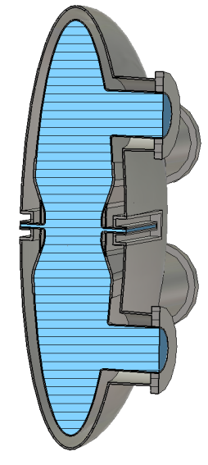
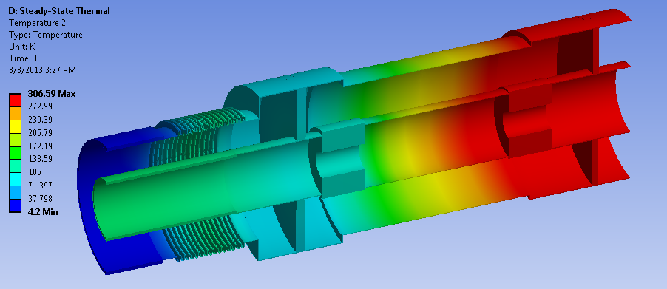
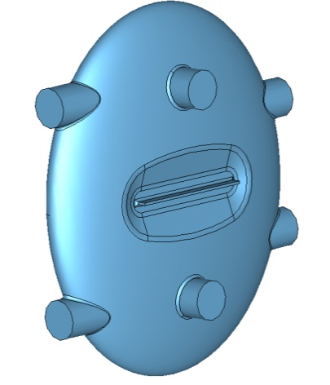
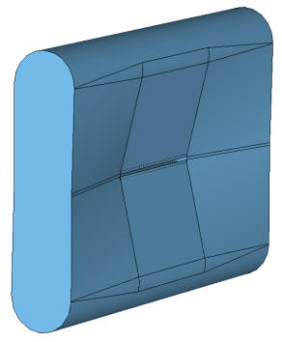
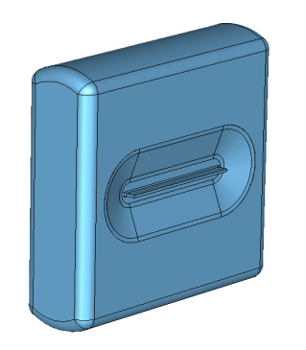
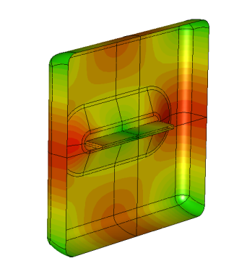
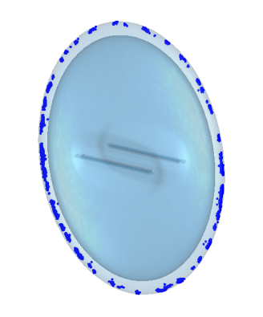
SCRF design: 10 MV/m; 50 cm x 5 cm (WxH)
RF input coupler
Mechanical design: port layout
Nb shell and He jacket
Parameter | Rectangular (Fig.1.3c) left | Rectangular (Fig.1.6) middle | Elliptical right
Frequency, MHz | 200 | 200 | 200
Length, cm | 100 | 100 | 120
Height, cm | 104.5 | 92.9 | 142
Voltage (β=0.56, edge), MV | 4.67 | 4.66 | 4.68
Voltage (β=0.78, center) , MV | 6.72 | 6.71 | 6.89
Voltage (β=0.86, edge) , MV | 5.00 | 5.00 | 5.00
R/Q (β=0.86, edge), Ohms | 82.8 | 89.7 | 75.0
G, Ohms | 147.9 | 150.2 | 134.2
Peak magnetic field, mT | 92.1 | 72.7 | 77.2
Peak electric field, MV/m | 55.2 | 47.0 | 48.1
First and final optimized rectangular cavity shape (left, middle left) and surface magnetic field profile (middle right) and elliptical cavity (right).

Slide 27
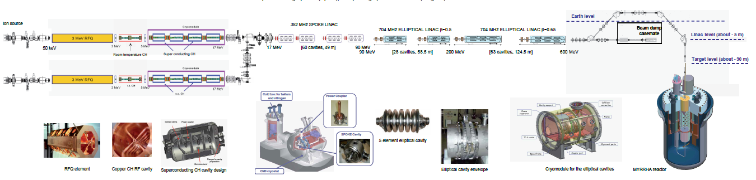
The FFAG accelerator for ADSR waste transmutation
A linac accelerator for nuclear waste transmutation
MYRHHA Mol, Belgium
A FFAG high power
accelerator facility
Length reduction of about 800’, cost reduction of 100 in accelerator alone – more in civil

Slide 28
Summary
The nsFFAG has evolved to an isochronous, high energy, high current application supporting ≥20mA
With constant strong-focusing machine tunes and optics that are independent of energy
  Avoids resonance crossing – low acceleration losses
  The DA aperture is 10,000 – 100,000π mm-mr depending on size and tunes
In the relativistic regime, the FFAG becomes more compact than the separated sector cyclotron and more stable if designed properly
  The racetrack is the most compact
Large aperture high-gradient cavities including SCRF have been designed; NCRF @1MV/m a PSI-like design
Ironless, self-supported coil SC magnets are also being developed with a reverse field generated by return flux

