Slide 1
MPE-EM Workshop
Survey results
Betty Magnin 16.06.2016

Slide 2
MPE-EM Mandate
To provide a CERN-wide support for
  the layout
  the production
  the assembly
in the domain of
  printed circuit boards
  flexible circuits
  hybrids and fine pitch detectors (MPGD)
Notes:
current thresholds: RQTD/F: <100 A: 2 V, 190 ms, 100 < I < 350 A: 100 mV, 190 ms, above to be reassessed
limit number of trips at 7 TeV → give Rainer all necessary freedom

Slide 3
MPE-EM Structure
Design, manufacturing
and assembly
Planning and subcontracting
Technological and commercial choices
Ordering, collecting components, tracking
Invoicing
Design Office
2 staff, 2 FSU
1 staff, 8 FSU
Repair
Fine-pitch photolithography facility - PCB manufacturing
Assembly Workshop
Industry
3 Staff / 1TTE
3 staff, 1 TTE

Slide 4
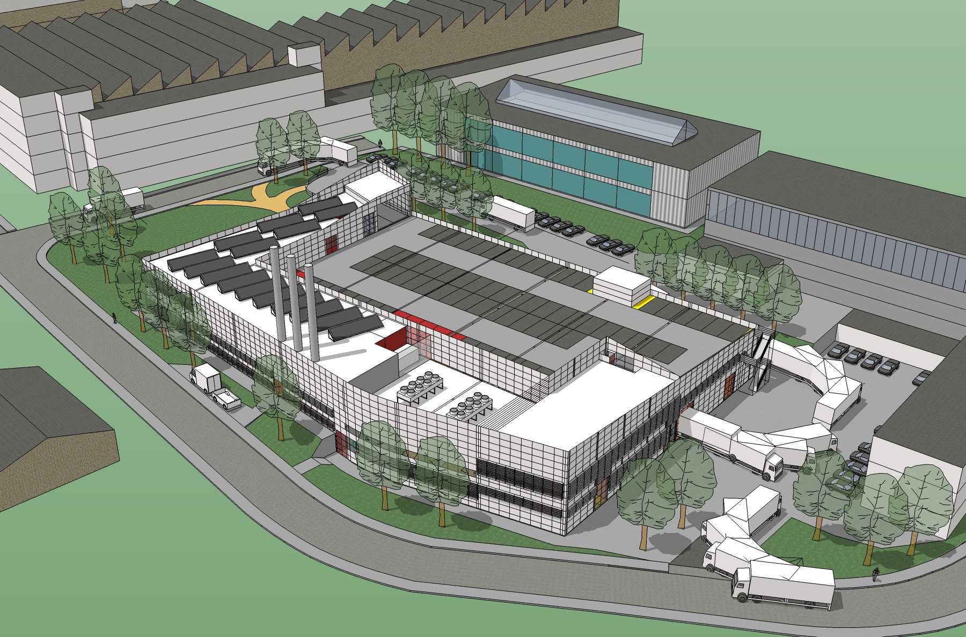
MPE-EM Infrastructure
Today : spread on 2 locations (B1, B622)
By Early 2018, B107, new building for TE-MPE-EM and TE-VSC

Slide 5
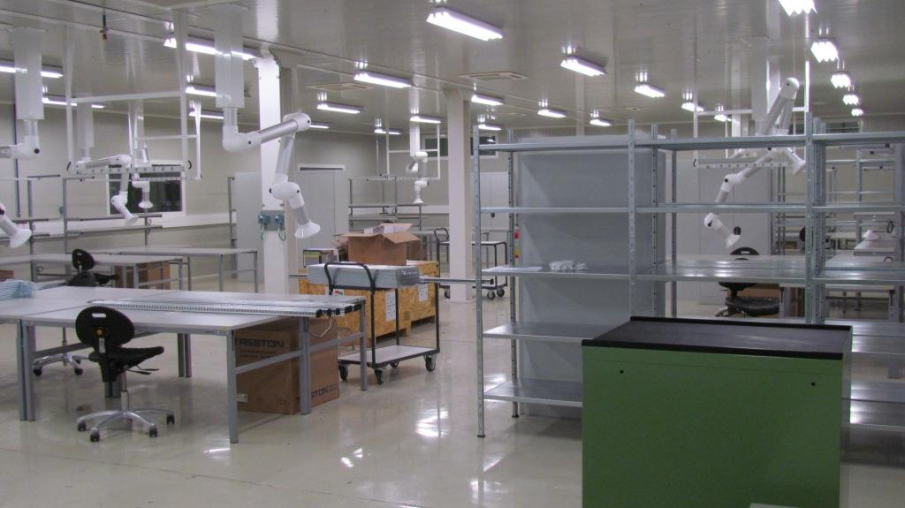
MPE-EM Infrastructure
B867 Electronic workshop for the repair of radiated parts

Slide 6
The survey
Sent to all groups working with MPE-EM
  BE-RF, CO, BI
  TE-EPC, VSC, ABT, MSC
  EN-EL, STI
  EP-ESE, experiments
  HSE-RP
Global survey to GL and SL:15 replies
Detailed survey to users: 53 replies

Slide 7
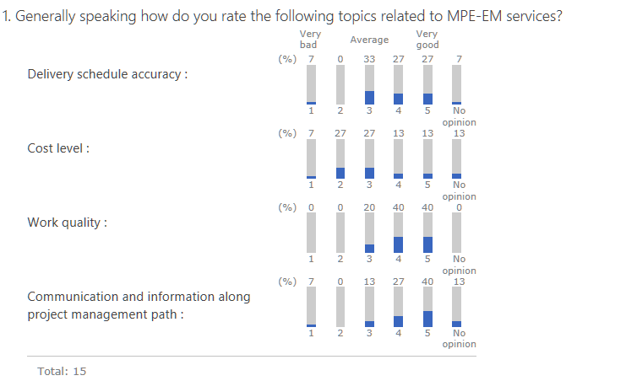
Survey results (GL-SL)

Slide 8
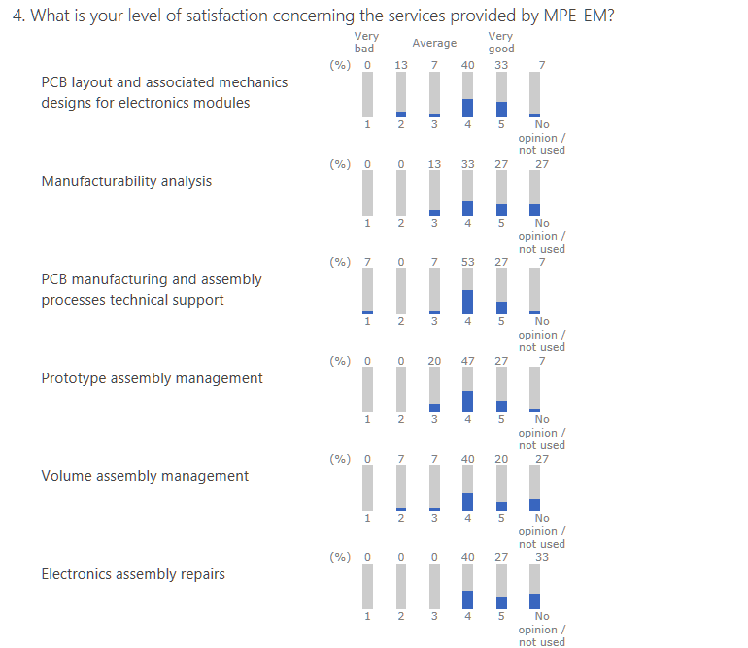
Survey results (GL-SL)

Slide 9
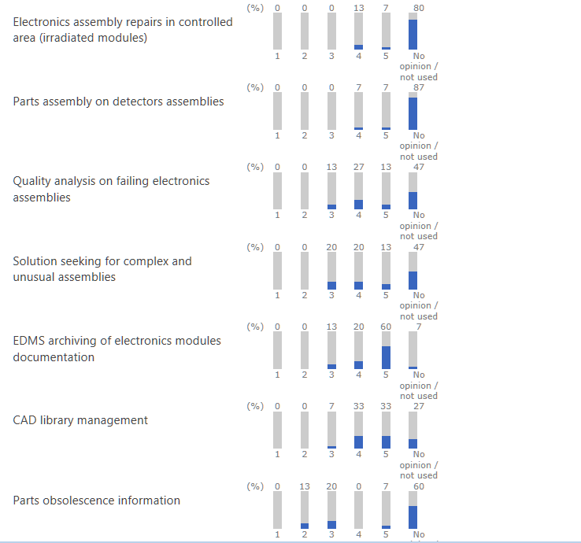
Survey results (GL-SL)

Slide 10
Survey results summary
Same trend from GL-SL and from users
  Positive
    Communication along project management
    Quality (layout and production)
    Schedule
  Average or negative
    Costs
  No opinion
    Expertise on faults
    Assembly of detectors
    Repair in controlled area
    Part obsolescence
    Solution seeking for unusual assemblies

Slide 11
Survey results - improvements
Costs
  Too expensive for first prototypes («Kleenex PCB»)
  Lack of forcast at the beginning of the project
  No communication about costs during the job
  Bad surprise with the invoice when the work is delivered
  The next presentations will give some more explanations about pricing and invoicing

Slide 12
Survey results - improvements
  Scheduling
  Several points have an impact on the schedule
    Inputs and visibility
    Installed capacity
    Planning tool
  The next presentations will give some more explanations about how this works and can be improved

Slide 13
Survey results - improvements
Communication about EM services
  Website
  WIKI
  Knowledge transfer to users
  Communication during the job
Visibility outside CERN
  Open-hardware
  KICAD
  Librairies
  To be further discussed during the round table at the end of the workshop

Slide 14
Questions ?

