Slide 1
TE-MPE-EM WORKSHOP
Subcontracting and company selection
Raphaël Berberat
June 16, 2016

Slide 2
Content
MPE-EM Procurement structure
PCB procurement
PCB manufacturer selection
Electronic Assembly procurement
Electronic Assembly subcontractor selection
We keep in touch
Questions
Raphaël Berberat

Slide 3
MPE-EM Procurement structure
Planning
Coordination
Clients
PCB procurement
Subcontracting
team
Components suppliers
Harness subcontractors
Mechanical subcontractors via EN-MME
Outsourced assembly for electronic boards
Raphaël Berberat

Slide 4
PCB procurement analysis
From 01.06.2015 to 31.05.2016
DAI issued: | 247
Total cost: | 624’835.- CHF
DAI < 5'000.-CHF: | 229
DAI > 5'000.- and <10'000.-CHF: | 11
DAI > 10'000.-CHF: | 7
Most expensive DAI: | 33'000.- CHF
Average cost per DAI: | 2'530.- CHF
Raphaël Berberat

Slide 5
PCB procurement strategy
The PCB is the most critical part of an assembly if it fails, the whole board is scrapped
An income inspection cannot detect the defects
Several process steps can be considered as special process in terms of QA
Most of the PCB ordered are similar in terms of technology
A pricing model is easy to establish, based on layer count, size, density, leadtime, material, batch size
Raphaël Berberat

Slide 6
PCB procurement strategy
MS based on IPC-1710A standard and IT launched in 2013-2014
89 companies listed for the MS
23 answers received
9 preselected on the basis of the technical questionnaire of the MS and visited for a technical audit
7 qualified for the IT
Final adjudication with 2 contracts to the 2 lowest bidders.
Advantage of the contact:
orders <5k are managed as small orders by purchasing office (instead of <1k)
With the pricing model, no bad surprise, the costs remain under control
We have the guarantee for 3 years of the lowest prices for the quality and leadtime required
&
The companies validated during the IT phase represent an alternative to keep the pressure on Price, Quality and Leadtimes
Raphaël Berberat

Slide 7
PCB procurement strategy
In parallel with the contracts, some production is given to EP-DT-EF:
Low volume or prototypes
Fast Track production
Specific design
Process validation
In order to maintain in this section the minimum load to keep the basic process under control
Raphaël Berberat

Slide 8
How to select a PCB manufacturer
General requirements
ISO 9001:2008 certified company
Production shall be done in CERN Member States
All process steps shall be done in-house, no subcontracting allowed
Halogen free base material shall be used → IS41, CERN standard
Acceptance of the PCB shall be compliant with IPC-A-600 standards
Controlled impedances
Finished holes diameter: down to 0.2 mm, aspect ratio to 8:1
Blind and buried via holes according to IPC-DR-572
Surface finishing: electroplated Au, Ni/Au electroless
Raphaël Berberat

Slide 9
How to select a PCB manufacturer
Specific requirements
The firm shall have a cold room for the stock of base material
The firm shall have a chemical laboratory
measurement (at least every day) of the concentration of all liquids used in the humid chemistry process. A database shall be updated each day with the measured values and the corrective parameter change.
The firm shall insert test coupon in the normal production
to be able to make micro-section on these sample during the day.
The firm shall perform an electrical test to the final product with a test programm generated from customer file and not from their own files they generated and used for production
Raphaël Berberat

Slide 10
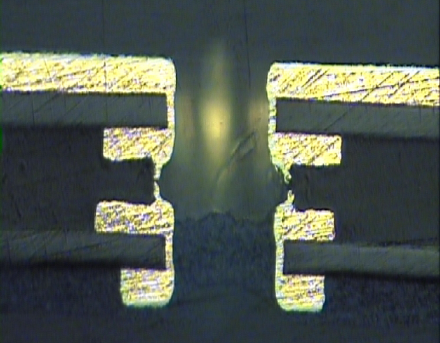
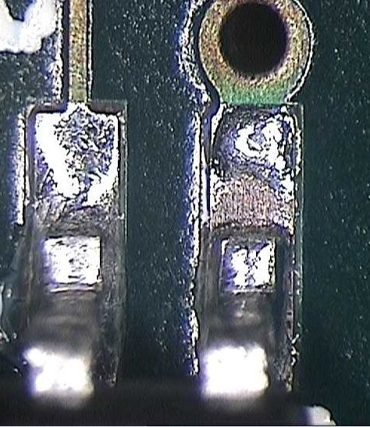
How to select a PCB manufacturer
2 specific points to make the difference
Copper plating
Critical point due to thermal expension of base material during reflow process
Holes plating is critical during PCB manufacturing, max ratio recommended 8:1
→ Fatal issue
Surface finishing
ENIG finition is our standard
Critical point due to chemical process in humid chemistry.
→ Fatal issue
It is mandatory to check these 2 points during audit
Raphaël Berberat

Slide 11
PCB specification
The first step to get quality at the end is to properly define the requirements in the beginning
Each PCB designed by MPE-EM is specified according to IPC-2220 series standards
Each PCB managed by MPE-EM design office is documented into EDMS
Gerber files are not sufficient to define a PCB and the required quality
Raphaël Berberat

Slide 12
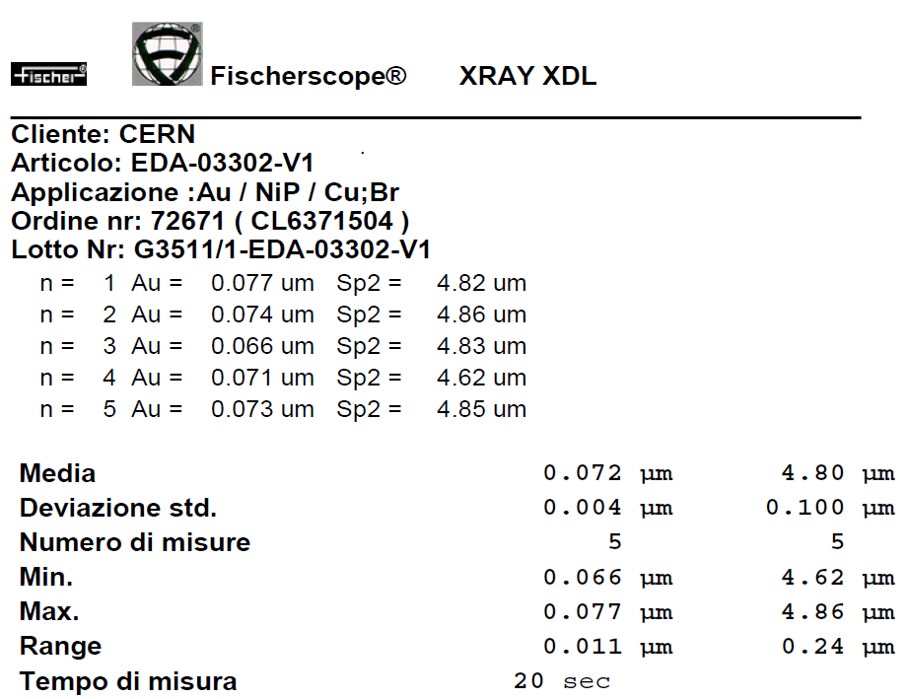
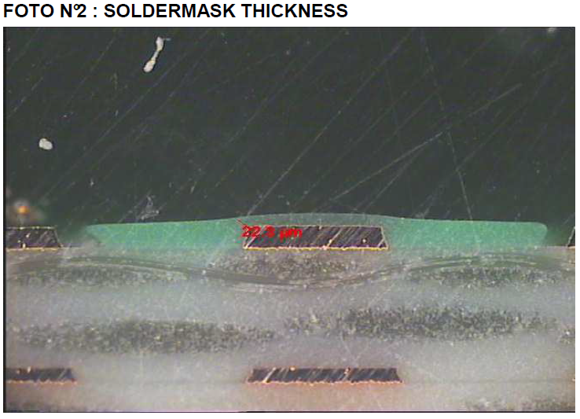
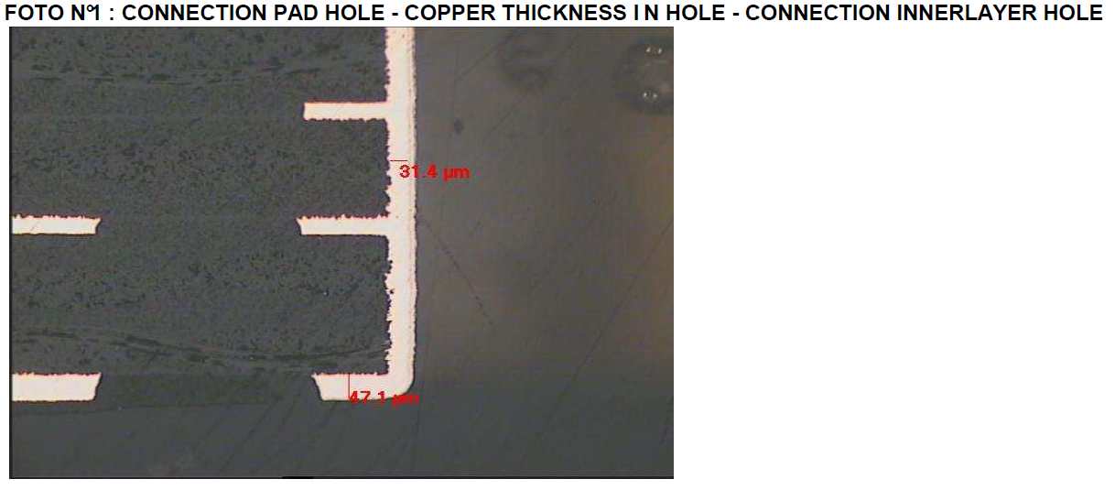
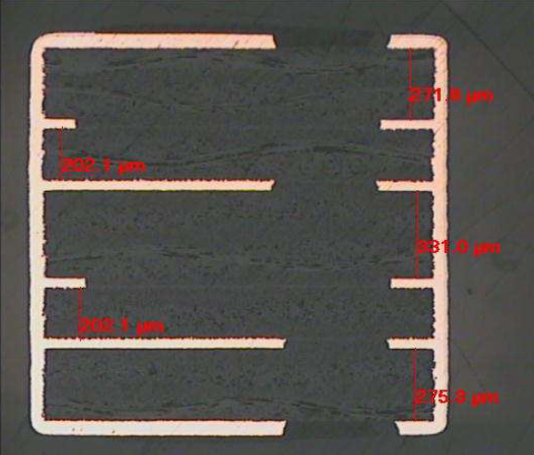
PCB procurement validation
For multilayer PCB, a micro section report and test coupon is part of the deliverables for each order
Raphaël Berberat

Slide 13
And for electronic assemblies?

Slide 14
Assembly procurement analysis
From 1st of June 2015 to 31st of Mai 2016
Number of DAI issued for electronic assembly: | 242
Total cost: | 786'114.- CHF
DAI < 5'000.-CHF: | 216
DAI > 5'000.-<10'000.-CHF: | 19
DAI > 10'000.-CHF: | 7
Most expensive DAI: | 77'346.- CHF
Average cost per DAI: | 3'248.- CHF
Raphaël Berberat

Slide 15
Electronic assembly procurement strategy
The boards to be mounted can be split into several categories
Simple: through hole components, low density
Intermediate: Through hole and simple SMD components
Complex: BGA, QFN, LGA
Each category has its assembly requirements, leading to different installed processes
A firm equipped for complex boards will not be competitive for simple ones
Urgent projects often require proximity with the firm
An open contract requires a pricing model to guarantee the best cost at any time for any project. For assembly, a price model is not easy to establish
Raphaël Berberat

Slide 16
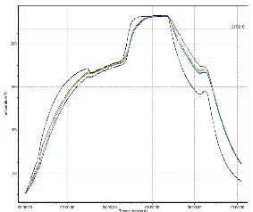
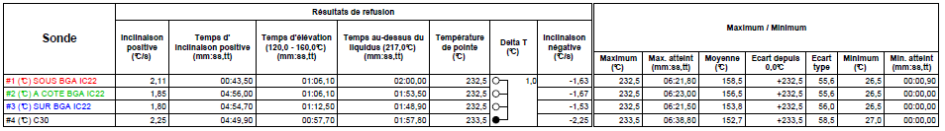
Electronic assembly procurement strategy
No contract signed between CERN and Assembler
10 - 12 validated company and under control
Validation of the firm through a technical audit on production site
On the basis of a specification defining CERN general requirement
Periodic follow-up audits to prevent bad surprises
Constant survey to keep contact with the market and stay up-to-date with the necessary processes
Technical specification for assembly
MPE-EM created 2 documents to specify its general requiments
Specification for reflow thermal profile to be used as a function of the components to be mounted
Raphaël Berberat

Slide 17
How to select an EMS (Electronics Manufacturing Services)
General requirements
ISO 9001:2008 certified company
Production shall be done in CERN member states
All steps of process shall be done in-house, no subcontracting allowed
Acceptance of the electronic assemblies shall be compliant with IPC-A-610 standard, class 3
Class 1 -- General Electronic Products
Includes products suitable for applications where the major requirement is function of the completed assembly.
Class 2 -- Dedicated Service Electronic Products
Includes products where continued performance and extended life is required, and for which uninterrupted service is desired but not critical. Typically the end-use environment would not cause failures.
Class 3 -- High Performance Electronic Products
Includes products where continued high performance or performance-on-demand is critical, equipment downtime cannot be tolerated, end-use environment may be uncommonly harsh, and the equipment must function when required, such as life support or other critical systems.
Industrial cleaning equipment in house
Vapor phase oven may be an advantage
Raphaël Berberat

Slide 18
How to select an EMS (Electronics Manufacturing Services)
3 specific points to make the difference
ESD equipment shall be deployed in the complete production area
ESD tester and records of each tests done per employee
ESD personnal equipment for each collaborator
ESD personnal equipment for each visitor
Thermal profiling for BGA/LGA component
A thermal profiler with minimum 4 thermal couplers shall be present in the firm
The thermal profiler shall be qualified on maximum annual basis
Thermal measurement before production
Vapour phase oven may be a real advantage for complex assemblies
Industrial cleaning equipment
Aqueouse or solvent basis
Maintenance of this system shall be carefully defined and respected
Raphaël Berberat

Slide 19
Assembly procurement specification
REFERENCE STANDARDS
- IPC/JEDEC J-STD-001 Requirements for soldered electrical and electronic assemblies
- IPC-A-610 Acceptability of electronic assemblies
- ANSI/ASQ Z1.4-2003 Sampling procedures and tables for inspection by attributes
- IPC/JEDEC J-STD-609 Marking and labeling of components, PCBs and PCBAs, to identify lead (Pb), lead free and other attributes
- ANSI/ESD-S-20.20 Protection of electrical and electronic parts, assemblies and equipments
- IPC/JEDEC J-STD-033 Handling, packing, shipping and use of moisture/reflow sensitive surface mount devices
Raphaël Berberat

Slide 20
Assembly parameter validation
Before the production MPE-EM shall validate 2 documents to be provided by the firm:
The process chart that will be used during the manufacturing of the assemblies
Even if NoCLEAN fluxes are used, an industrial cleaning process is mandatory
Attention should be paid to non-cleanable components
The temperature profile measured on a representative board
After production and with the parts, the firm shall provide a quality report including :
Non-conformities found during the production setup (false or bad documents, missing components, design errors, etc)
Non-conformities found during the production quality controls and the related corrective actions that have been taken
Raphaël Berberat

Slide 21
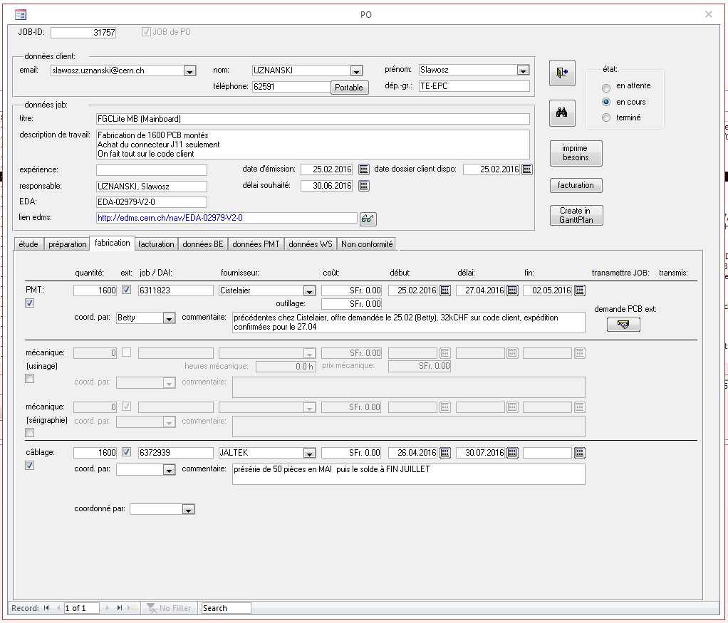
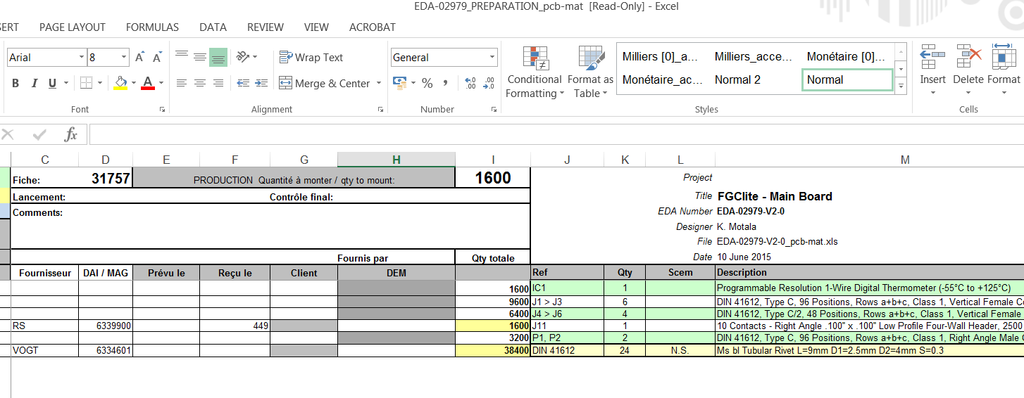
Our tools ≠ GPAO
Access database
Excel files
1st of June 2016:
85 jobs announced
166 jobs running
We are near the limits of our tools and a
real GPAO may be needed in the futur
Raphaël Berberat

Slide 22
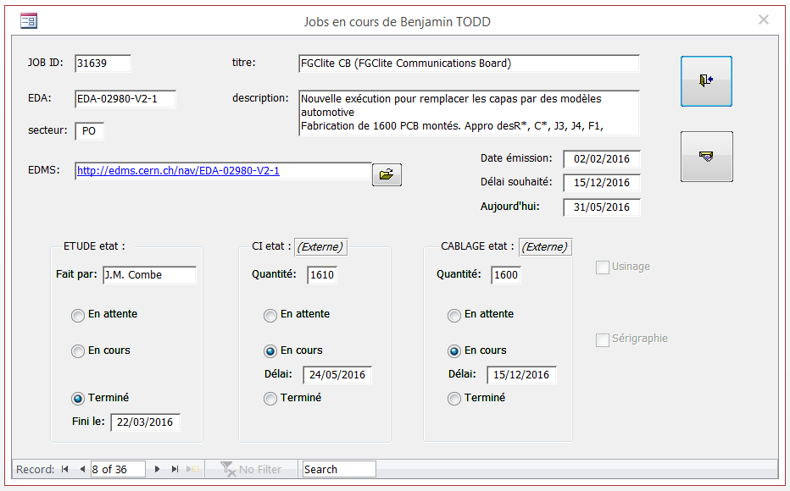
Customer dedicated application
We keep in touch
With our “consultation client” application
\\cern.ch\dfs\Services\Electronics\DEM\Public\Consultation_client
Raphaël Berberat

Slide 23
Questions?

