Slide 1


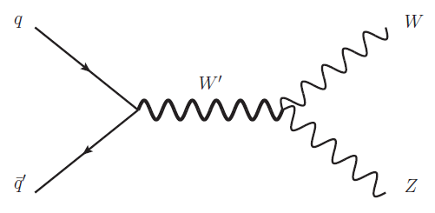
Trigger Study for WZ resonance
Mohamed V University
Faculty of Sciences
Rabat
WZ l ν l’l’
S. DAHBI , Y. TAYALATI ( Mohamed V University Rabat)

Slide 2
Introduction
The aim of this study is to estimate the gain added by using other triggers than the single lepton trigger currently used in this analysis
Samples:
  mc15_13TeV. 302267.MadGraphPythia8EvtGen_A14NNPDF23LO_HVT_Agv1_VcWZ_lvll_m0600.merge.DAOD_HIGG2D1.e4148_s2608_r6869_r6282_p2425_tid08367894_00.root
Triggers:
  Single-Electron triggers, Di-Electrons triggers,Tri-Electrons triggers.
  Single-Muon triggers, Di-Muon triggers,Tri-Muon triggers.
  Combined Electron-Muon triggers.
  MissingEt trigger.

Slide 3
Triggers
Single-Electron triggers :
  HLT_e24_lhmedium_L1EM18VH
  HLT_e60_lhmedium
  HLT_e120_lhloose
Single-Muon triggers :
  HLT_mu20_iloose_L1MU15
  HLT_mu50
Nominal Triggers
Di-Electron triggers :
  HLT_2e12_lhloose_L12EM10VH
Di-Muon triggers :
  HLT_2mu10
  HLT_mu18_mu8noL1
Tri-Electron triggers :
  HLT_e17_lhloose_2e9_lhloose
Tri-Muon triggers :
  HLT_3mu6
  HLT_3mu6_msonly
  HLT_mu18_2mu4noL1
Combined Electron-Muon triggers :
  HLT_2e12_lhloose_mu10
  HLT_e12_lhloose_2mu10
  HLT_e7_medium_mu24
  HLT_e17_lhloose_mu14
  HLT_e24_medium_L1EM20VHI_mu8noL1
  MissingEt trigger :
  HLT_xe60
  HLT_xe70
  HLT_xe80
  HLT_xe100

Slide 4
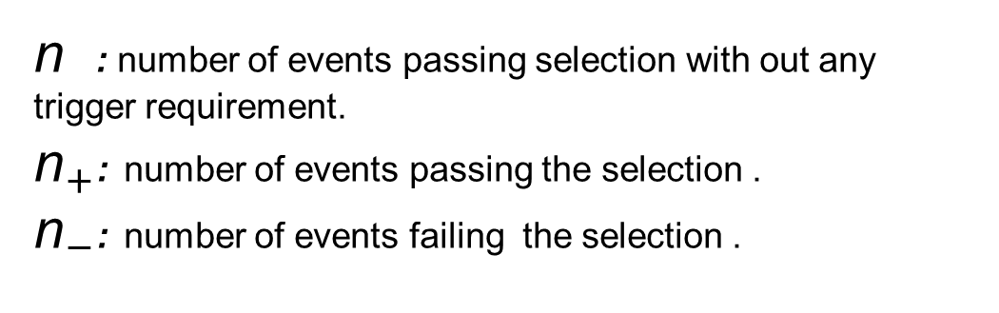
Trigger efficiency
n : number of events passing selection with out any trigger requirement.
${\text{n}}_{+}$: number of events passing the selection .
${\text{n}}_{−}$: number of events failing the selection .
The errors in the efficiency distribution , usin binomial errors :

Slide 5
Trigger efficiency at preselection level
▪ Look at the lepton preselection level.
▪ Calculate trigger efficiency w.r.t nominal trigger selection.
Preselected electrons requirements
Preselected muons requirements
Likelihood loose electrons
(medium++ for Z and tight++ for W)
ET>25 GeV
Object Quality requirements
|z0 sin(theta)| < 0.5
|d0/σd0| < 3
Handled by the IsolationSelectionTool Working point is LooseTrackOnly.
Combined muons |η|<2.5
pT>25 GeV
d0<1mm cosmic cut
|z0 sin(theta)| < 0.5
|d0/σd0| < 3.
Handled by the IsolationSelectionTool Working point is LooseTrackOnly. To be optimized
▪ No Z lepton pairing, W tighter requirements or MET cut applied

Slide 6
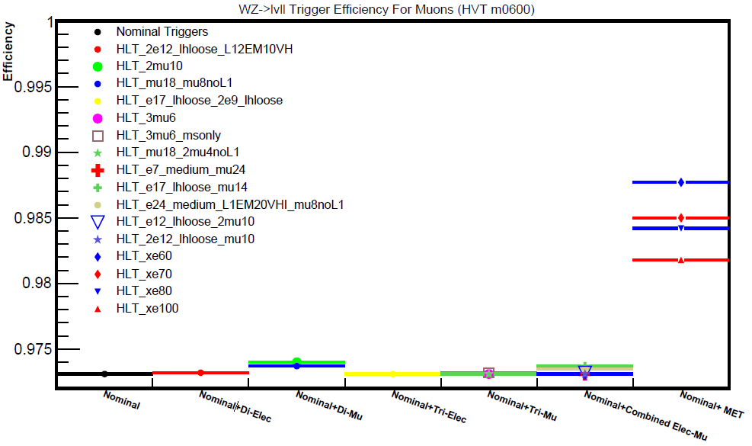
Trigger efficiency in muon channel

Slide 7
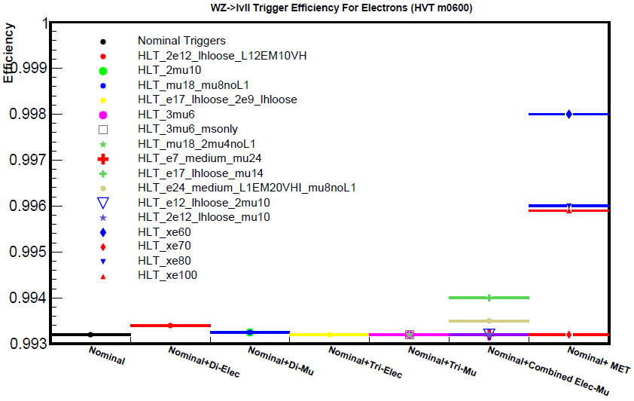
Trigger efficiency in electron channel

Slide 8
Trigger efficiency using final selection
Used HVT samples (m = 600 GeV)
Look at the final selection (no optimized cuts for signal selection applied yet).
https://twiki.cern.ch/twiki/bin/view/AtlasProtected/WZlvllSearchRun2
Calculate trigger efficiency for
  Nominal trigger
  Nominal triggers + adding dilepton, trilepton or MET triggers

Slide 9
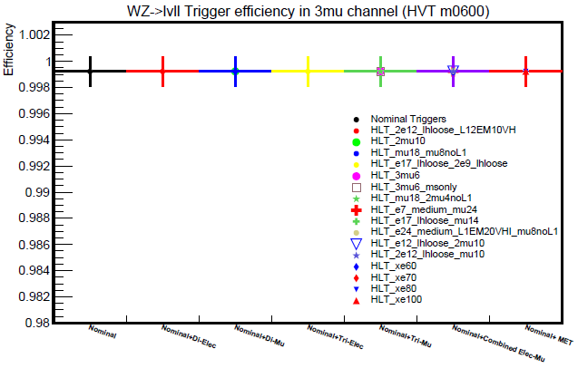
Trigger efficiency for 3mu Channel.

Slide 10
Trigger efficiency for others Channels.

Slide 11
Summary
By looking at the HVT signal at the lepton preselection level less 1% gain by MET ,dilepton or Trilepton triggers , no effect at all if we look at final WZ selection.
Using the single lepton triggers for HVT signals of (m=600 GeV) we have an efficiency of ~99%
Not evident gain in signal by adding MET ,dilepton or Trilepton triggers to our final HVT selection.

