Slide 1
Expected Performance of
LHC HL Transverse Feedback
Wolfgang Hofle
Acknowledgement
G. Kotzian, D. Valuch, K. Li
ADT power team (BE-RF-PM), software (BE-RF-CS section, OP group)
BE-BI, BE-CO, BE-ABP

Slide 2
Outline
Run 2 and ongoing improvements of ADT
Key performances
  Kick strength
  Signal-to-Noise ratio
  Bandwidth and damping time
Conclusions

Slide 3
ADT – Run 2
see G. Kotzian
@ Evian 2015
Power System (bandwidth and kick strength)
  Maintenance of power amplifiers, no changes in LS1
Pick-up System
  Additional pick-ups cabled and available (2x)
Electronics (LLRF)
  New processing VME electronics
    Capable of combining four pick-ups per plane and beam
    Disentangled gain functions for feedback (main/witness bunches), cleaning and blow-up (four functions) available
  New A/D converters and processing of analogue PU signals
    In preparation → potential to improve S/N
    Tested on one of the additional pick-ups (D.V.)

Slide 4
ADT – Run 2
see G. Kotzian
@ Evian 2015
Algorithms (also define gain versus frequency)
  Potential improvements for feedback (vector sum)
  Diagnostics (head tail movement mode 1)
  Automated set-up and check of damping time
Obs Box for data recording and LIST instability network
  Extendable, under exploitation

Slide 5
Additional Pick-ups
Will become gradually available
Improved performance of electronics (S/N)
More degrees of freedom for algorithms (robustness to tune changes)
B1 horizontal | Q10L | Q9L | Q8L | Q7L | Q7R | Q8R | Q9R | Q10R
 |  | β = 111 m |  | β = 106 m |  | β = 133 m |  | β = 153 m
 |  | existing |  | existing |  | new |  | new
B1 vertical | Q10L | Q9L | Q8L |  | Q7R | Q8R | Q9R | Q10R
 | β = 175 m |  | β = 155 m |  | β = 161 m |  | β = 142 m
 | new |  | new |  | existing |  | existing
B2 horizontal | Q10L | Q9L | Q8L |  | Q7R | Q8R | Q9R | Q10R
 | β = 158 m |  | β = 96 m |  | β = 150 m |  | β = 101 m
 | new |  | new |  | existing |  | existing
B2 vertical | Q10L | Q9L | Q8L | Q7L | Q7R | Q8R | Q9R | Q10R
 |  | β = 160 m |  | β = 167 m |  | β = 151 m |  | β = 180 m
 |  | existing |  | existing |  | new |  | new

Slide 6
Processing Electronics
VME based, FESA 3
HL-LHC: Jointly drive with CO / BI migration to new plat-form, post VME
  Considered a “consolidation”
  Increased controllability and accessibility to data expected
Loop A: Main loop
New in 2015:
Loop B: Witness bunches
Loop C: Cleaning
Loop D: Blow-up ++

Slide 7
ADT Key Performance
Maximum kick strength → 2 μrad @450 GeV
  Given by max operating voltage (12 kV) and current of the tetrode amplifier system and the need to change voltage for injection damping in the kicker gap
  Needed for injection damping & cleaning
  Regular change of tetrodes needed to maintain peak kick strength (32 tetrodes in operation)
    Lifetime of tetrode (2-3 years under current operating conditions)
    Consider R&D for replacement before 2035 if indications that tetrode system becomes obsolete → needs study
  Impact on beam can be improved by higher beta function at kickers (ATS optics ?) if needed
  As kick strength sufficient additional kickers of the same kind not needed

Slide 8
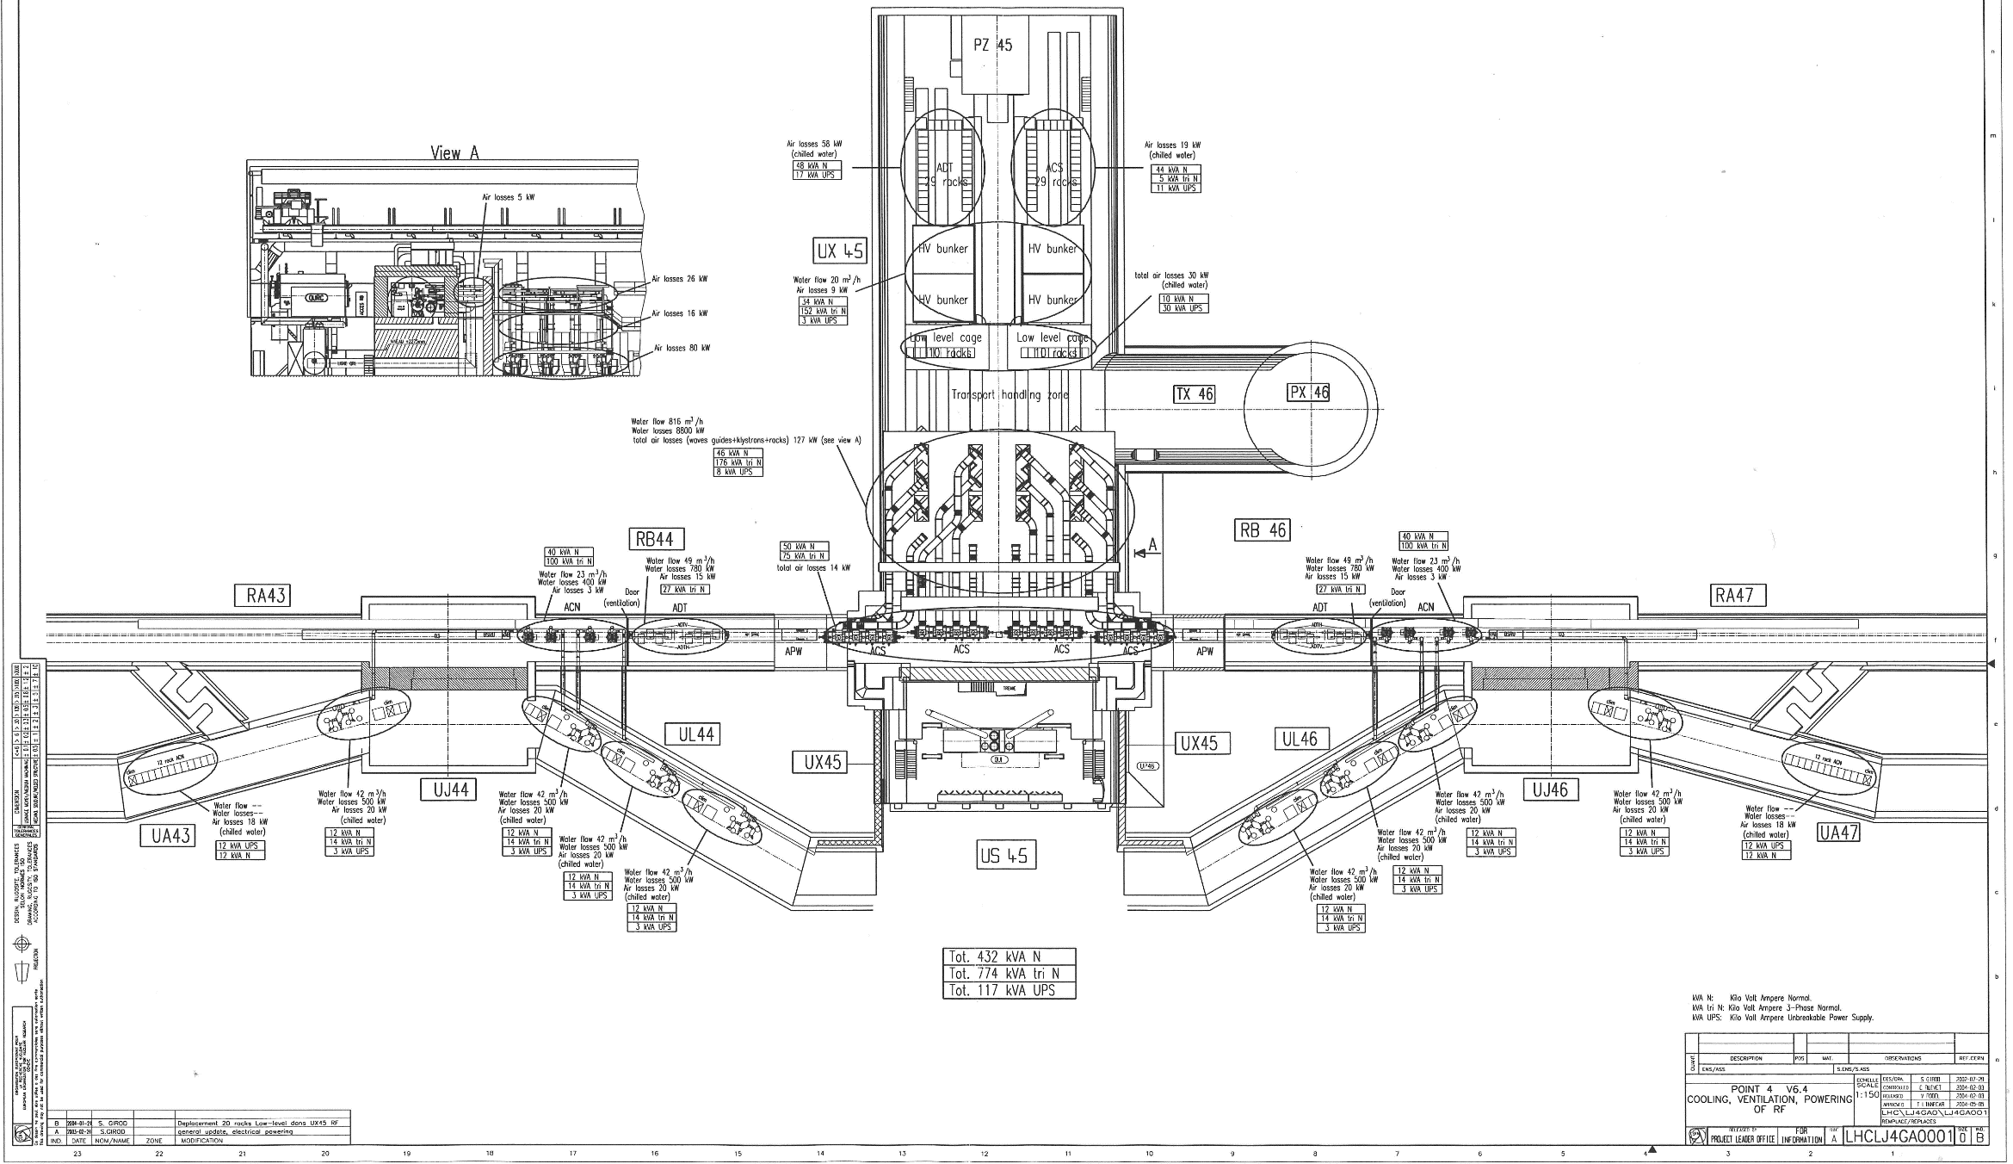
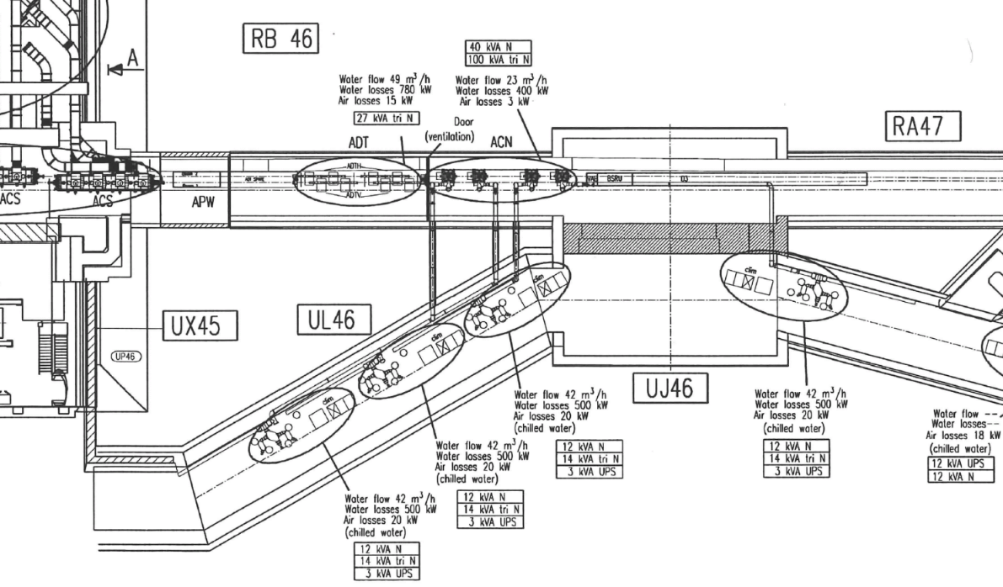
Original Layout
Reserve space for ADT upgrade (left and right of IP 4)

Slide 9
ADT Key Performance
Signal to noise ratio
  defines smallest amplitude oscillation that can be detected
  can lead to blow-up
    potentially more critical for HL LHC with increased tune spread and operation with crab cavities
  Experience to be gained in SPS for concurrent Operation of transverse feedback and crab cavities
  Presently beam rms 2 μm observed with ADT at
  β ~150 m
  → target: improvement for high lumi era by a factor
  two to four (benchmark method to be defined)

Slide 10
ADT key Performance
Bandwidth (linked to damping time vs. frequency)
  Power system adapted to a resistive wall impedance that rolls-off with frequency
  Flat frequency response and faster rise-time possible by pre-distortion of drive signal
    implemented in digital processing
    used operationally in Run 1 and Run 2
    at expense of max kick strength
    impact on blow-up in stable beams seen in run 1
  Present system not optimally adapted to “popcorn” instability (one bunch going unstable)
  Damping effect to internal modes with dipolar moment shown in simulation

Slide 11
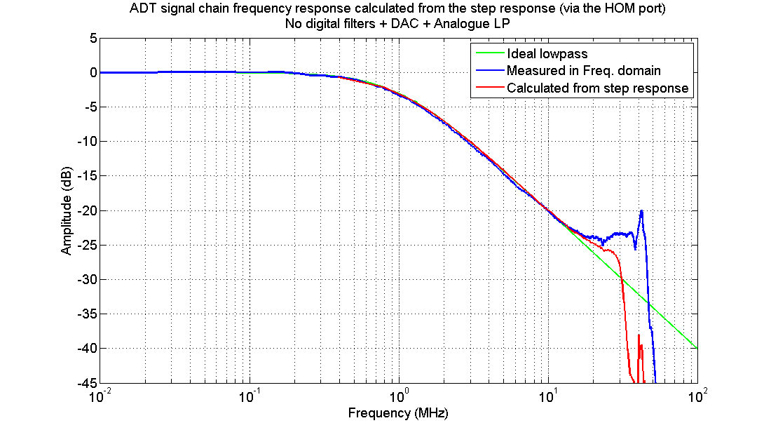
Bandwidth – Power System
kick @ 10 MHz,
10% strength left

Slide 12
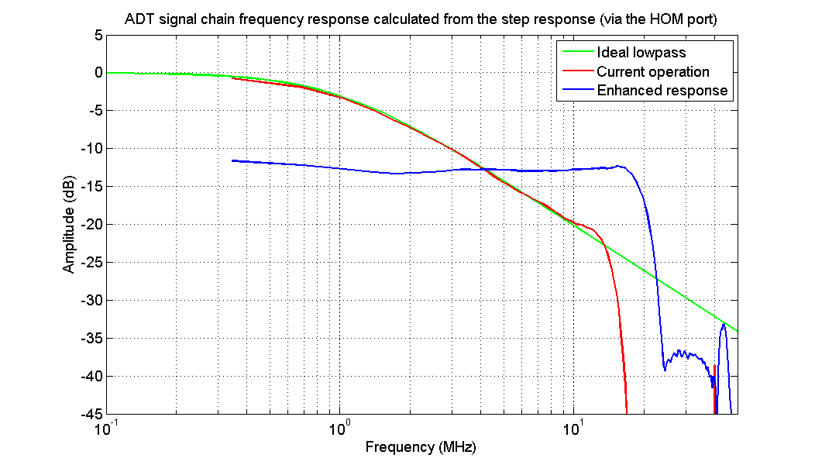
Bandwidth - Enhanced
12dB needs to be compen-
sated for same damping time
LBOC 2012 (D.V.)

Slide 13
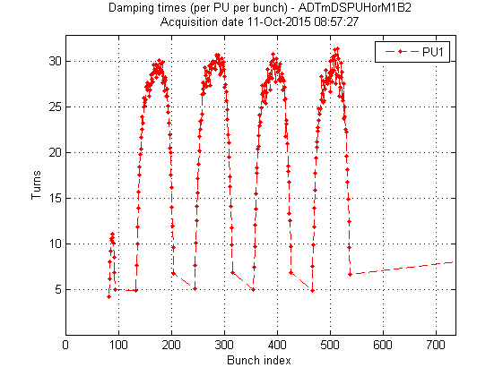
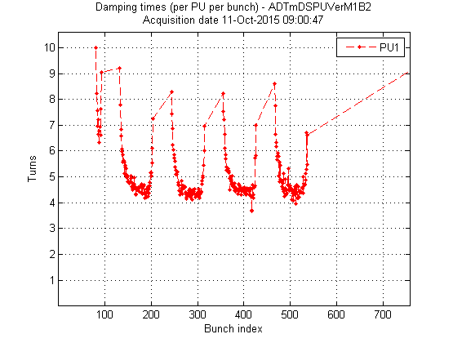
Bandwidth – Injection Damping
Performance (examples) w/o bandwidth enhancement
  Risk of control instability if damping times pushed below 10 turns
H-plane (beam 2)
V-plane (beam 2)
30 turns
8-10 turns
Too much gain
12b
12b
4 turns
Batches of 144 bunches
Batches of 144 bunches

Slide 14
Bandwidth - Instability
LMC, 30.05.2012
5x Gain needed to cure single bunch instability at edge of batch
7 to 8x Gain needed for case of bunch well inside batch

Slide 15
HL-LHC Bandwidth - Summary
Injection damping with 10 turns possible
Expect slower damping for kicker ripple and on edges
  can make damping equal for all bunches, but at expense of damping time, 40 turns more realistic in this case
Popcorn instability and intra bunch motion (when dipolar movement present) can be damped by present feedback but higher bandwidth desirable as effective gain is low

Slide 16
Conclusions
Three possible directions of performance improvement
  Bandwidth is critical and HL may profit a lot from a new kicker system
  Signal-to-Noise is critical with operation with crab cavities, potential for improvement exists
  Kick Strength is considered sufficient
Consolidation and Obsolescence (→ 2035)
  Power system (tetrodes ?)
  Electronics (plat-form beyond VME)

