Slide 1
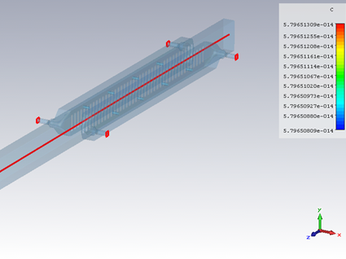
Do we need a Wide-Band
Transverse Feedback in the LHC/HL-LHC?
K. Li, W. Hofle, J. Kamppolou, E. Metral
WP2 Meeting, 23. August 2016, CERN

Slide 2
Context & Outline
Context:
The HL-LHC upgrade features a doubling of the nominal LHC intensity together with reduced emittances with the goal of delivering higher brightness beams to considerably increase the luminosity. Intensity effects and possible limitations are likely to become more pronounced. For this it will be important to draw up adequate mitigation measures. One of the potential options is a wideband feedback system which will be discussed more closely here.
Outline:
Introduction
Instabilities from impedance
Instabilities from electron cloud
Performance of demonstrator system
Specification together with need, capabilities and cost

Slide 3
Context & Outline
Context:
Brief outline of what is meant by wideband feedback system.
Outline:
Introduction
Instabilities from impedance
Instabilities from electron cloud
Performance of demonstrator system
Specification together with need, capabilities and cost

Slide 4
Brief description of a wideband feedback system
Courtesy W. Hofle
Active damping of single or coupled bunch instabilities
High frequency allows damping of intra bunch motion
No introduction of additional tune spread
No introduction of additional non-linearities
Technically challenging and complex system → close follow-up required during operation
Imperfections can lead to loss of stabilization (i.e. noise or saturation)
Impedance contribution of kickers must be addressed

Slide 5
Brief description of a wideband feedback system
More applications not mentioned:
Excitation of intra-bunch motion – measure beam response → diagnostics for impedance, machine optics…
Elimination of individual bunches with high selectivity
Individual controlled blow-up of bunches
…
Courtesy W. Hofle
Active damping of single or coupled bunch instabilities
High frequency allows damping of intra bunch motion
No introduction of additional tune spread
No introduction of additional non-linearities
Technically challenging and complex system → close follow-up required during operation
Imperfections can lead to loss of stabilization (i.e. noise or saturation)
Impedance contribution must be addressed

Slide 6

The present transverse feedback system – “ADT”
Primarily designed for:
  Damping of injection oscillations
  Damping of oscillations driven by coupled bunch instability
  Important role in preservation of the beam’s transverse emittance
Since the LHC start in 2008 it grew into (view from the CCC):
Injection oscillation
damping
Transverse blow-up
(used for loss maps)
Injection cleaning
Instabilities detection
(with the damper PU)
Slide: Delphine Jacquet, LHC Beam Operation Workshop, Evian 2012
Abort gap cleaning
Tune measurement
From D. Valuch, EVIAN 2014

Slide 7
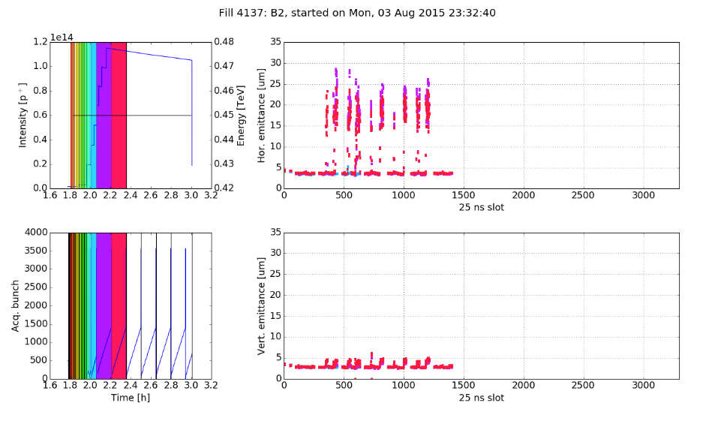

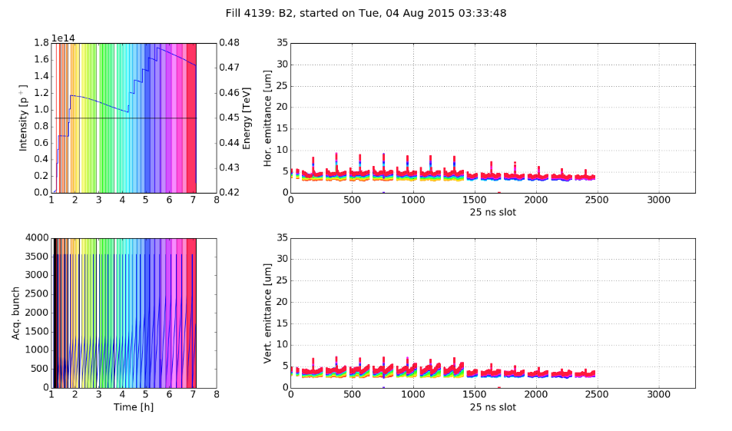
The present transverse feedback system – “ADT”
After switching to optimized settings
of the transverse damper – impeccable fill
Primarily designed for:
  Damping of injection oscillations
  Damping of oscillations driven by coupled bunch instability
  Important role in preservation of the beam’s transverse emittance
Since the LHC start in 2008 it grew into (view from the CCC):
Transverse damper:
operational experience has also shown, it is also absolutely essential for control of instabilities and emittance blow-up for coupled as well as single bunches
Injection oscillation
damping
Transverse blow-up
(used for loss maps)
Injection cleaning
Instabilities detection
(with the damper PU)
Slide: Delphine Jacquet, LHC Beam Operation Workshop, Evian 2012
Abort gap cleaning
Tune measurement
From D. Valuch, EVIAN 2014

Slide 8
HL-LHC challenges
HL-LHC targets for high luminosity:
  Intensity 1.15e11 → 2.2e11
  Emittance 3.75um → 2.5 um
Intensity effects are detrimental for performance:
  Instabilities
  Beam-beam tune spread
  IBS
Can HL-LHC sustain the high brightness beams without loss of performance?
Do we require means of additional beam stabilization?

Slide 9
HL-LHC predictions
Impedances:
  Simulations based on the present HL-LHC impedance model predict that the present means of stabilization (i.e. Landau octupoles and transverse damper) are sufficient to ensure beam stability
E-cloud:
  Simulation work is ongoing
  E-cloud in dipoles: main source of instabilities (at least at flat top) – ‘scrubbable?’
  E-cloud in quadrupoles: less crucial for instabilities
  E-cloud in triplets: triplets are coated
Incoherent effects:
  Tune spread significant due to high chromaticities and octupoles
  In addition enhanced by LR and HO collisions
  Means of compensation are under investigation (i.e. wires)

Slide 10
HL-LHC predictions
Impedances:
  Simulations based on the present HL-LHC impedance model predict that the present means of stabilization (i.e. Landau octupoles and transverse damper) are sufficient to ensure beam stability
E-cloud:
  Simulation work is ongoing
  E-cloud in dipoles: main source of instabilities – ‘scrubbable’
  E-cloud in quadrupoles: less crucial for instabilities
  E-cloud in triplets: triplets are coated
Incoherent effects:
  Tune spread significant due to high chromaticities and octupoles
  In addition enhanced by LR and HO collisions
  Means of compensation are under investigation (i.e. wires)
Wideband feedback:
Do we need it? Let’s tackle this at the end…
Can it work? We look at this first…

Slide 11
Context & Outline
Context:
We investigate instabilities expected from pure impedance effects and identify whether a wideband feedback system could theoretically provided sufficient cure.
Outline:
Introduction
Instabilities from impedance
Instabilities from electron cloud
Performance of demonstrator system
Specification together with need, capabilities and cost

Slide 12
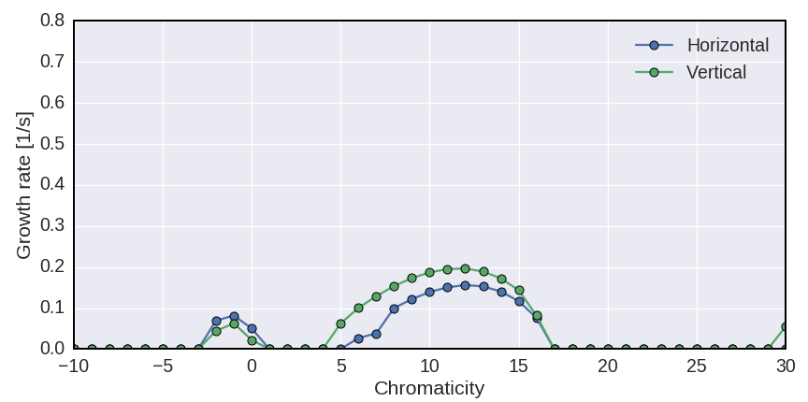
Impedance and instabilities
The HL-LHC impedance model
  7 TeV
  15 cm beta*
  5um Mo and MoC coated TCTs
Predictions on single bunch stability from PyHEADTAIL simulations
  7 TeV with present impedance model
  Perfect transverse damper – damping rate 50 turns, single bunch
Intensity: 2.3e11

Slide 13
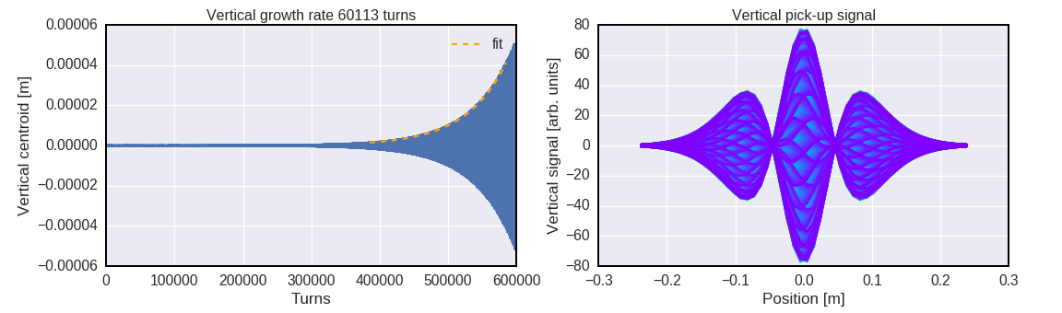
Impedance and instabilities
The HL-LHC impedance model
  7 TeV
  15 cm beta*
  5um Mo and MoC coated TCTs
Predictions on single bunch stability from PyHEADTAIL simulations
  7 TeV with present impedance model
  Perfect transverse damper – damping rate 50 turns
Mode pattern: (0, 2)
Intensity: 2.3e11

Slide 14
Impedance and instabilities
The HL-LHC impedance model
  7 TeV
  15 cm beta*
  5um Mo and MoC coated TCTs
Predictions on single bunch stability from PyHEADTAIL simulations
  7 TeV with present impedance model
  Perfect transverse damper – damping rate 50 turns
Mode pattern: (0, 2)
Intensity: 2.3e11
MD example – in LHC, it actually exists!

Slide 15
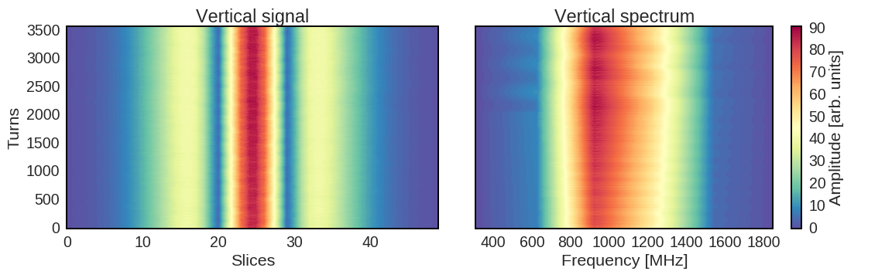
Impedance and instabilities
The HL-LHC impedance model
  7 TeV
  15 cm beta*
  5um Mo and MoC coated TCTs
Predictions on single bunch stability from PyHEADTAIL simulations
  7 TeV with present impedance model
  Perfect transverse damper – damping rate 50 turns
Mode pattern: (0, 2)
Intensity: 2.3e11
Spectrogram reveals frequency components up to 1 - 1.5 GHz for this mode
Can this mode be damped by a transverse damper and what is the necessary bandwidth?

Slide 16
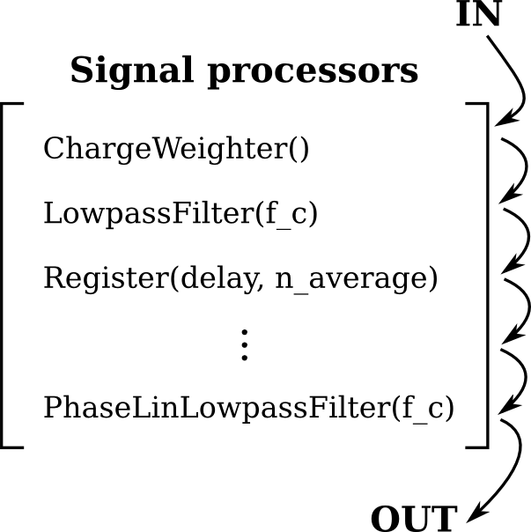
New PyHEADTAIL Feedback module
Accelerator loop
p0
y
Feedback loop
z
x
p1
New module to handle the feedback loop.
Concept of list of abstract signal processors.
Several pickups and kickers at different positions possible.
To date – filter functions, delay/registers, noise, gain functions.
J. Komppula

Slide 17
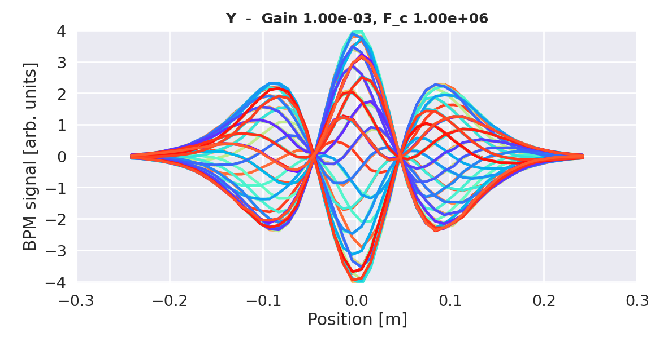
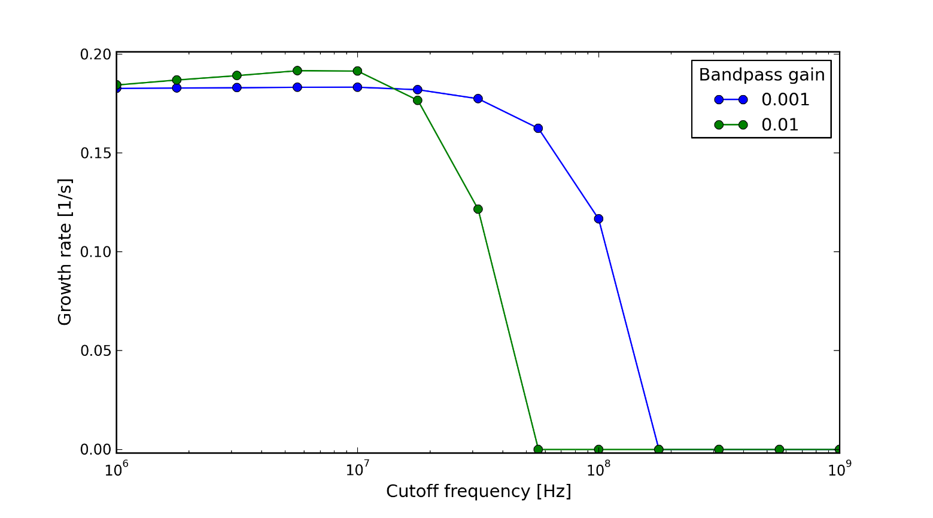
Impedance and instabilities
The HL-LHC impedance model
  7 TeV
  15 cm beta*
  5um Mo and MoC coated TCTs
Predictions on single bunch stability from PyHEADTAIL simulations
  7 TeV with present impedance model
  Perfect transverse damper – damping rate 50 turns
Bandwidth limitation via a 1-pole roll-off TF
J. Komppula

Slide 18
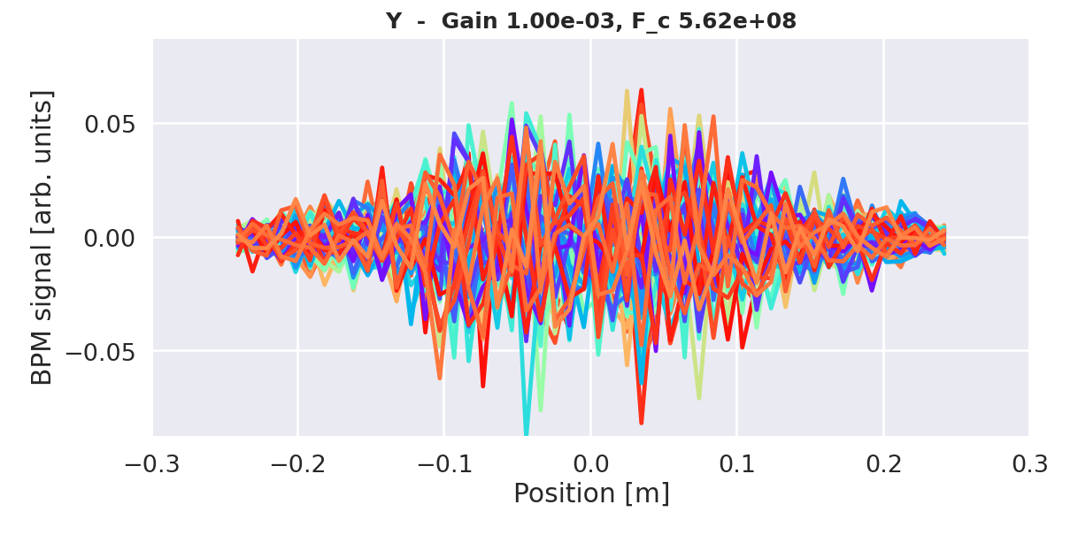
Impedance and instabilities
The HL-LHC impedance model
  7 TeV
  15 cm beta*
  5um Mo and MoC coated TCTs
Predictions on single bunch stability from PyHEADTAIL simulations
  7 TeV with present impedance model
  Perfect transverse damper – damping rate 50 turns
Bandwidth limitation via a 1-pole roll-off TF
J. Komppula

Slide 19
Impedance and instabilities
The HL-LHC impedance model
  7 TeV
  15 cm beta*
  5um Mo and MoC coated TCTs
Predictions on single bunch stability from PyHEADTAIL simulations
  7 TeV with present impedance model
  Perfect transverse damper – damping rate 50 turns
Stabilisation is achieved with very low gains – the risetimes at flat top are very long.
Even for lower cut-off frequencies, the gain around 1 GHz is still sufficient.
The model includes the frequency roll off but is ideal in the sense that there is:
  No noise
  No delay
  Perfect phasing between pick-up and kickers
We still need to include some margin in these estimates,
but a bandwidth of <2 GHz seems reasonable.
J. Komppula

Slide 20
Context & Outline
Context:
We outline the status and plans for investigating the impact of electron cloud on beam stability and how we want to include a wideband feedback system into the model.
Outline:
Introduction
Instabilities from impedance
Instabilities from electron cloud
Performance of demonstrator system
Specification together with need, capabilities and cost

Slide 21
E-cloud and instabilities
Ongoing simulation campaign with PyHEADTAIL + PyECLOUD (G. Iadarola, A. Romano)
Studying stability limits in dipoles, quadrupoles and the impact of chromaticity, octupoles and, new, also the transverse damper

Slide 22
E-cloud and instabilities
Ongoing simulation campaign with PyHEADTAIL + PyECLOUD (G. Iadarola, A. Romano)
Studying stability limits in dipoles, quadrupoles and the impact of chromaticity, octupoles and, new, also the transverse damper
Simulations in the past have shown chromaticity to be the main stabilizing parameter with octupoles virtually ineffective (K. Li, G. Rumolo, IPAC 2012)

Slide 23
E-cloud and instabilities
Ongoing simulation campaign with PyHEADTAIL + PyECLOUD (G. Iadarola, A. Romano)
Studying stability limits in dipoles, quadrupoles and the impact of chromaticity, octupoles and, new, also the transverse damper
Simulations in the past have shown chromaticity to be the main stabilizing parameter with octupoles virtually ineffective at high energies (K. Li, G. Rumolo, IPAC 2012)
What do we want to learn from these simulations?
  Identify a possible scenario with limitation from e-cloud
  Include new feedback module and make a bandwidth – gain study

Slide 24
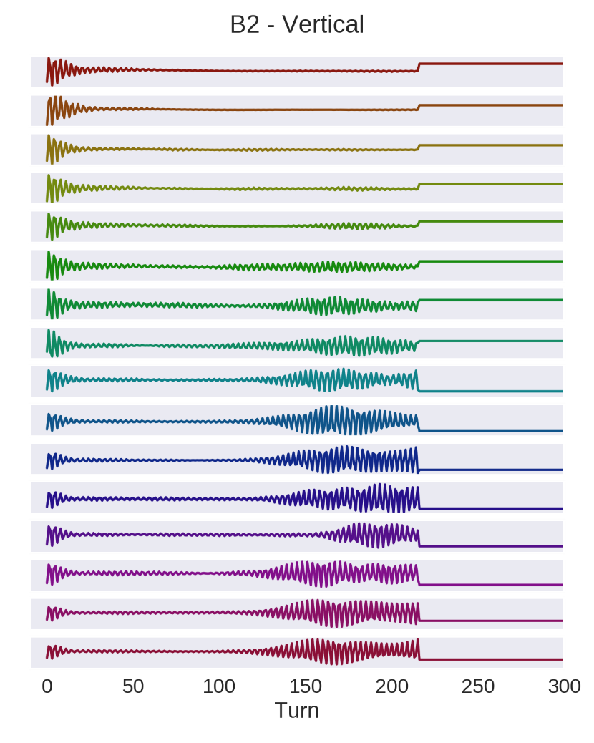
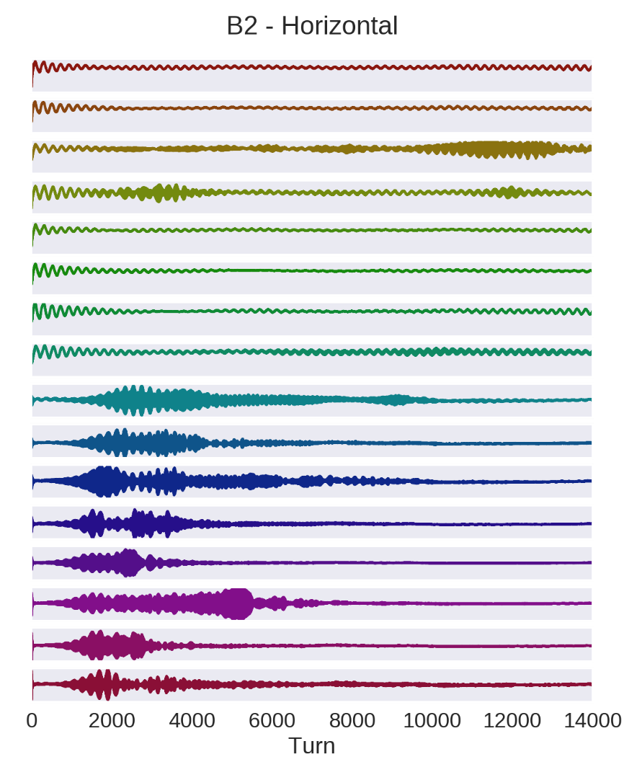
E-cloud and instabilities
Jul 2015
Ongoing simulation campaign with PyHEADTAIL + PyECLOUD (G. Iadarola, A. Romano)
Studying stability limits in dipoles, quadrupoles and the impact of chromaticity, octupoles and, new, also the transverse damper
Simulations in the past have shown chromaticity to be the main stabilizing parameter with octupoles virtually ineffective at high energies (K. Li, IPAC 2012)
What do we want to learn from these simulations?
  Identify a possible scenario with limitation from e-cloud
  Include new feedback module and make a bandwidth – gain study
Later in 2015
Example from scrubbing runs: in the LHC, it is real!

Slide 25
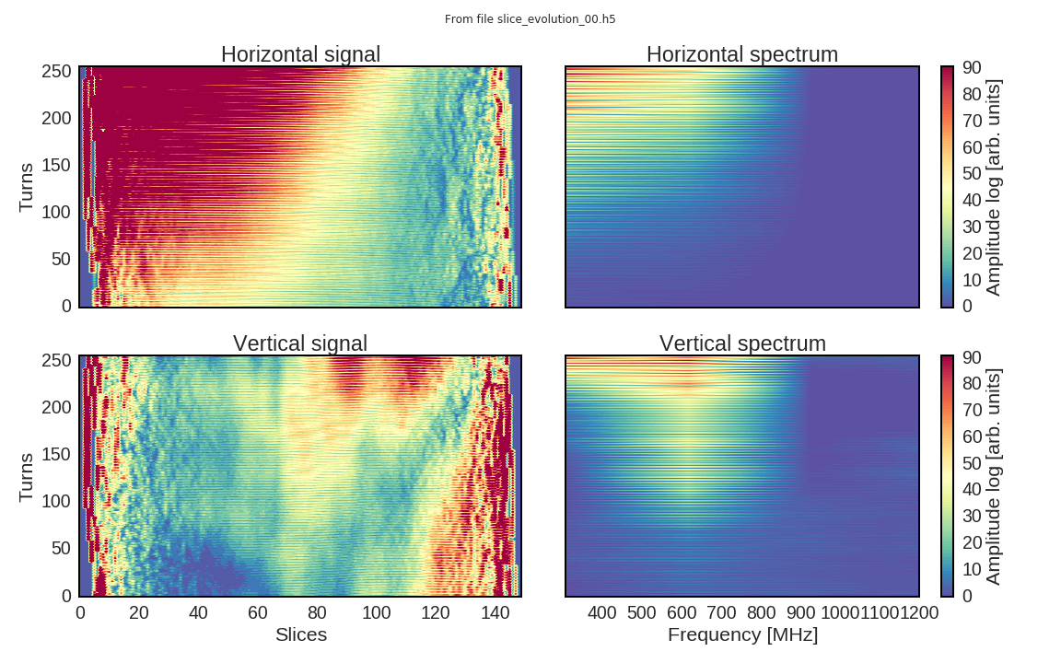
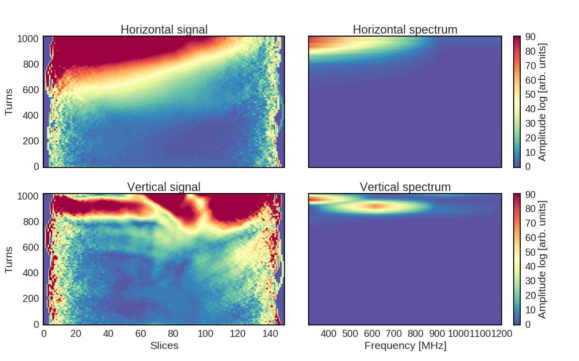
E-cloud and instabilities
Simulations:
E-cloud in dipoles with chromaticity
Horizontal shows strong centroid motion – this can be damped by the conventional system
Vertical motion shows higher frequency content at ~600 MHz – this cannot be damped by the conventional system
We will identify a representative scenario and add the new feedback to investigate bandwidth requirements
Jul 2015
Ongoing simulation campaign with PyHEADTAIL + PyECLOUD (G. Iadarola, A. Romano)
Studying stability limits in dipoles, quadrupoles and the impact of chromaticity, octupoles and, new, also the transverse damper
Simulations in the past have shown chromaticity to be the main stabilizing parameter with octupoles virtually ineffective at high energies (K. Li, IPAC 2012)
What do we want to learn from these simulations?
  Identify a possible scenario with limitation from e-cloud
  Include new feedback module and make a bandwidth – gain study
Later in 2015
Tail
Head
A. Romano, G. Iadarola

Slide 26
Context & Outline
Context:
We briefly describe the wideband feedback demonstrator system developed in collaboration with SLAC (within the US-LARP) and highlight some recent MD results that indicate successful damping of intra-bunch as an experimental proof-of-principle.
Outline:
Introduction
Instabilities from impedance
Instabilities from electron cloud
Performance of demonstrator system
Specification together with need, capabilities and cost

Slide 27
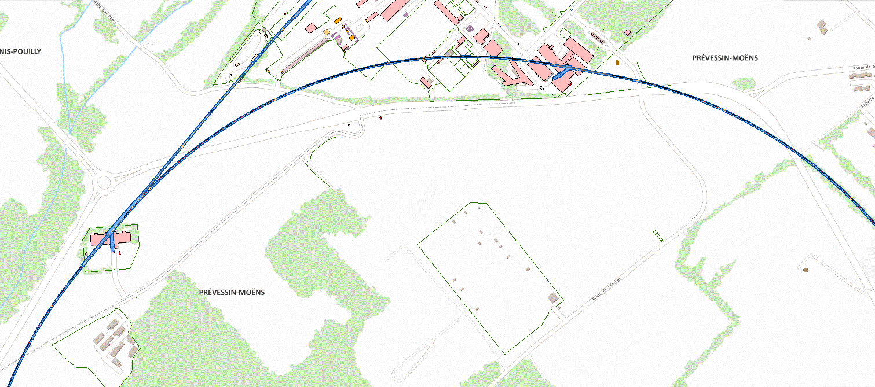
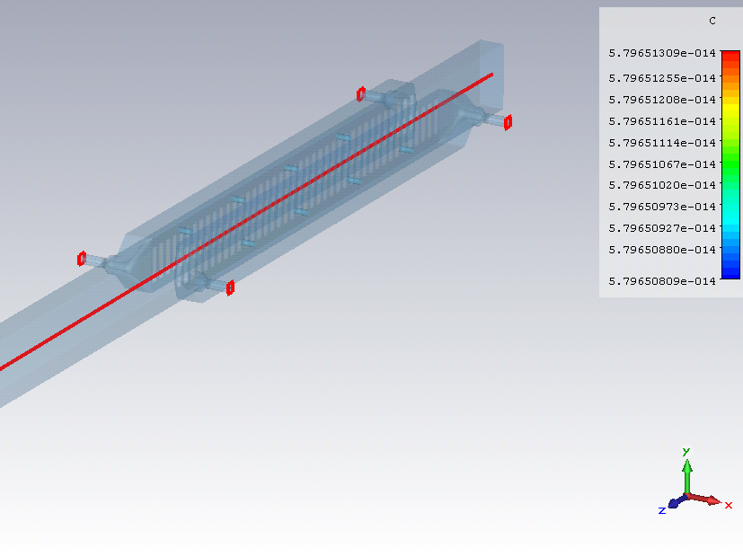
Can it work in practice?
“The Box”:
Complete processing channel from pickups through kicker, running a digital reconfigurable system up to 4 GS/s is installed and ready for use at 3.2 Gs/s. Now includes multi-bunch processing of up to 64 bunches in any configuration.
2 stripline kickers + 2 x 2 power amplifiers
Power: 250 W
Frequency range: 5 – 1000 MHz

Slide 28
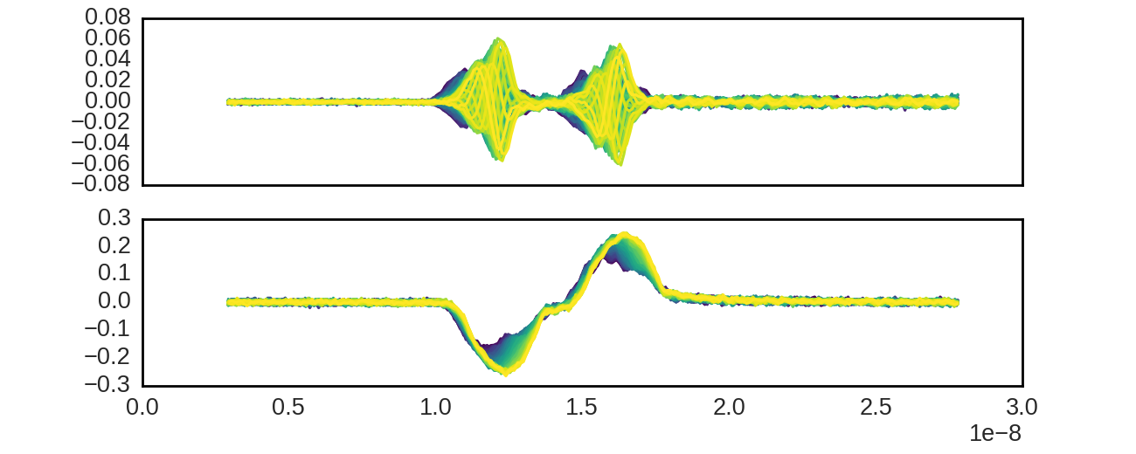
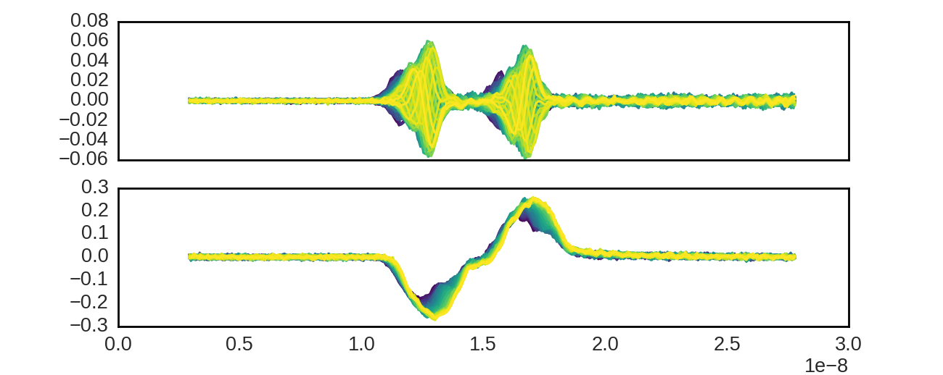
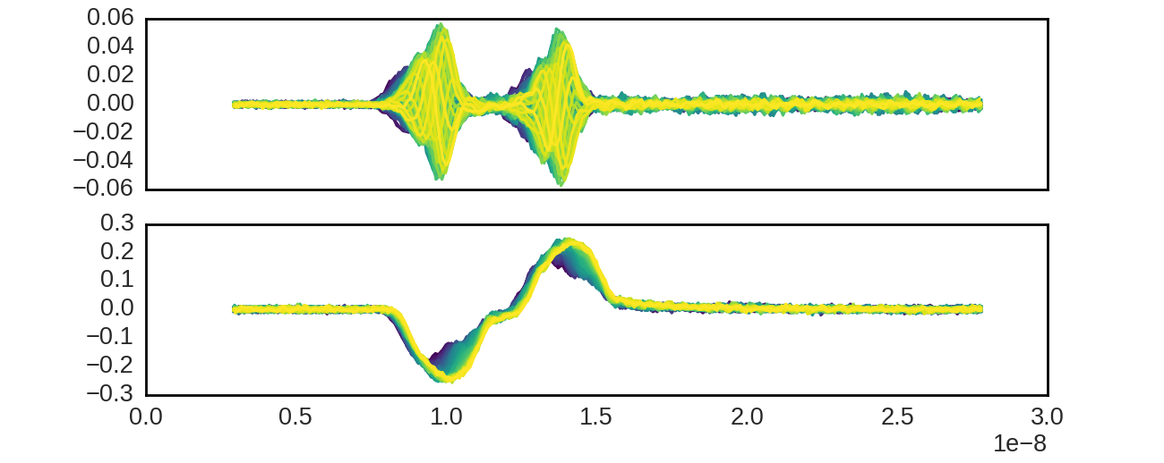
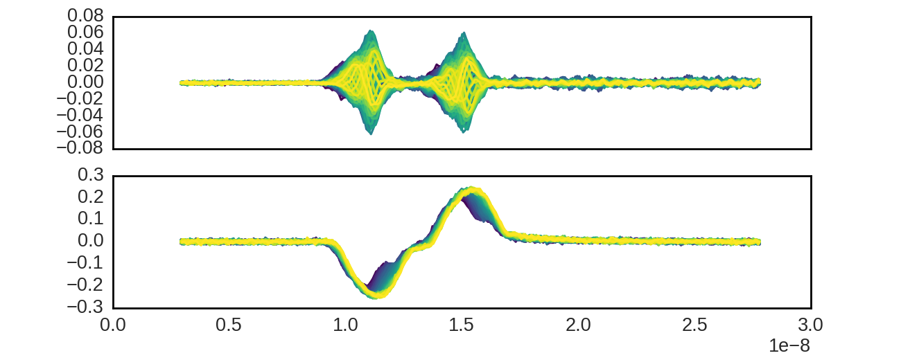
Observation in the SPS for Q26 single bunch MDs
Different shorts:
  Top: delta signal – bottom: sum signal
  Yellow: early turns – blue: late turns
Mo
We
Mo
Fr

Slide 29
Observation in the SPS for Q26 single bunch MDs
Different shorts:
  Top: delta signal – bottom: sum signal
  Yellow: early turns – blue: late turns
Mo
We
Mo
Fr
H. Bartosik: CERN-THESIS-2013-257

Slide 30
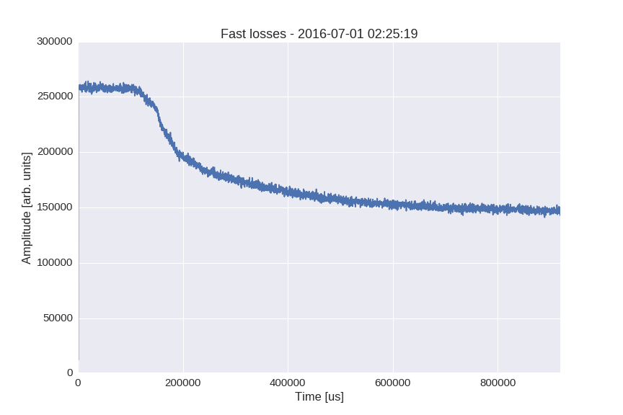
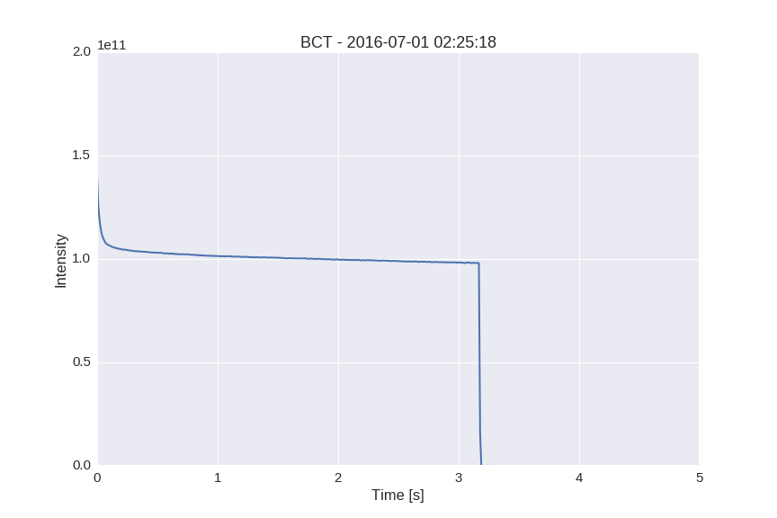
Data from the ADC of the Box
Open loop
Intensity ~1.6e11 – 1.8e11
Low vertical chromaticity
Low 200 MHz voltage
Transverse damper active to remove injection oscillations

Slide 31
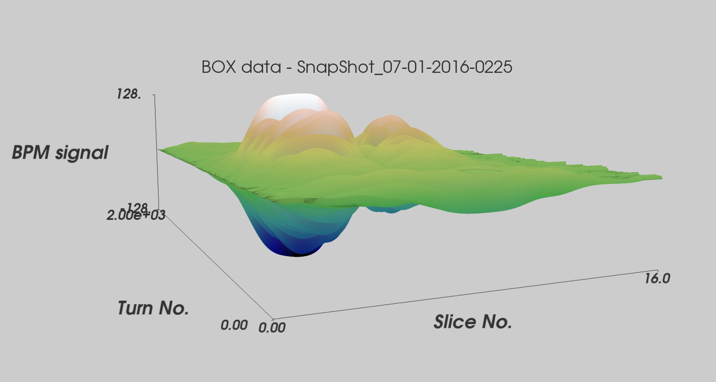
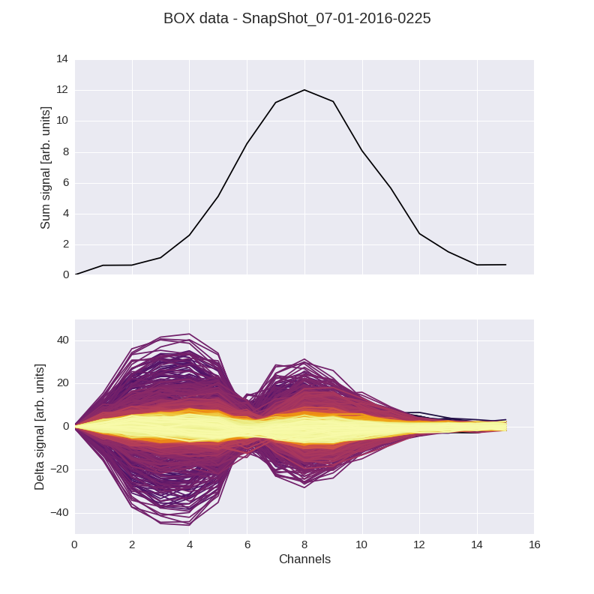
Data from the ADC of the Box
Open loop
Tail
Head

Slide 32
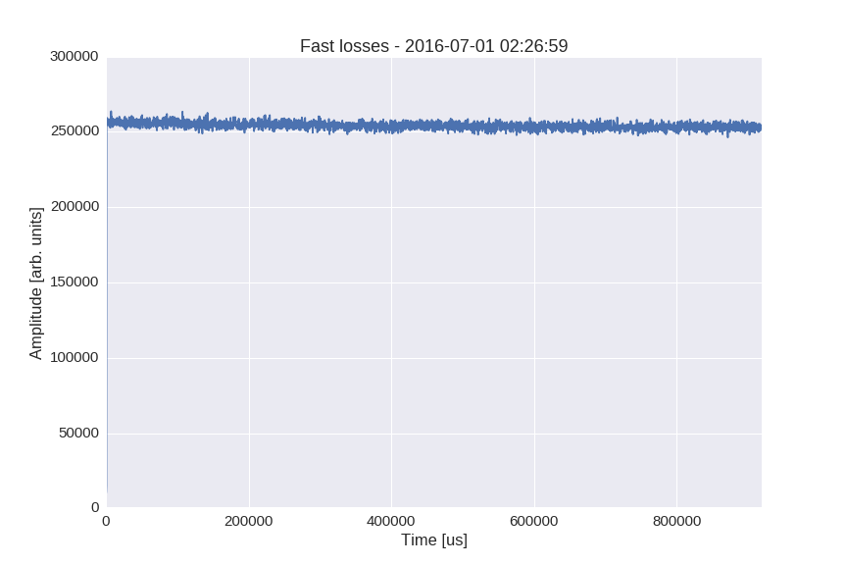
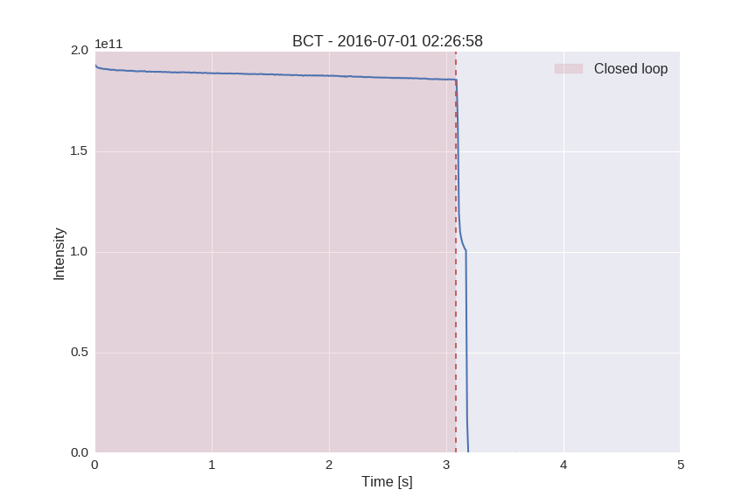
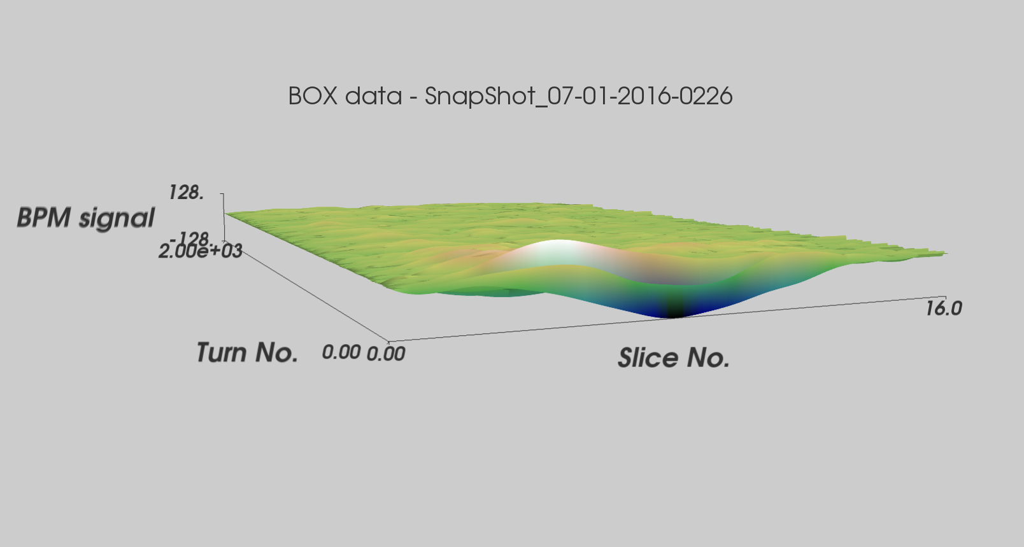
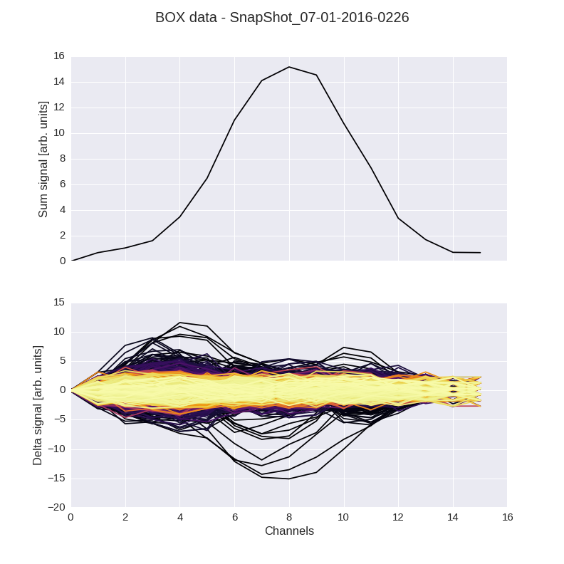
Data from the ADC of the Box
Closed loop
Tail
Head

Slide 33
Context & Outline
Context:
Based on what we have learned so far, we investigate specifications and options for wideband feedback system configurations which are suitable for HL-LHC.
Outline:
Introduction
Instabilities from impedance
Instabilities from electron cloud
Performance of demonstrator system
Specification together with need, capabilities and cost

Slide 34
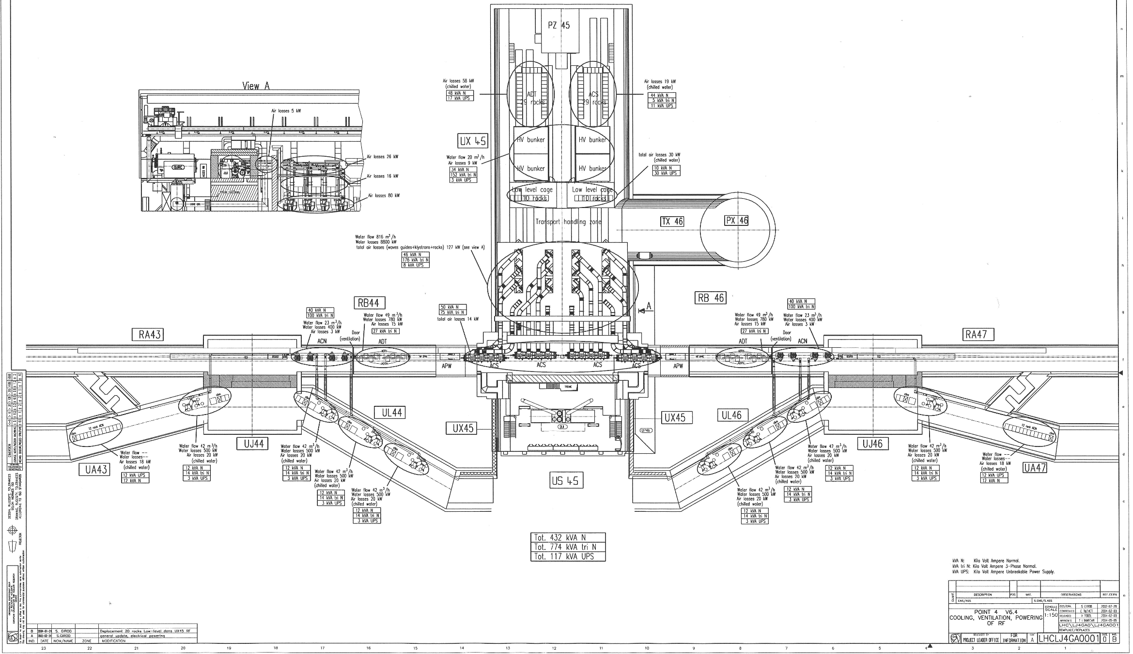
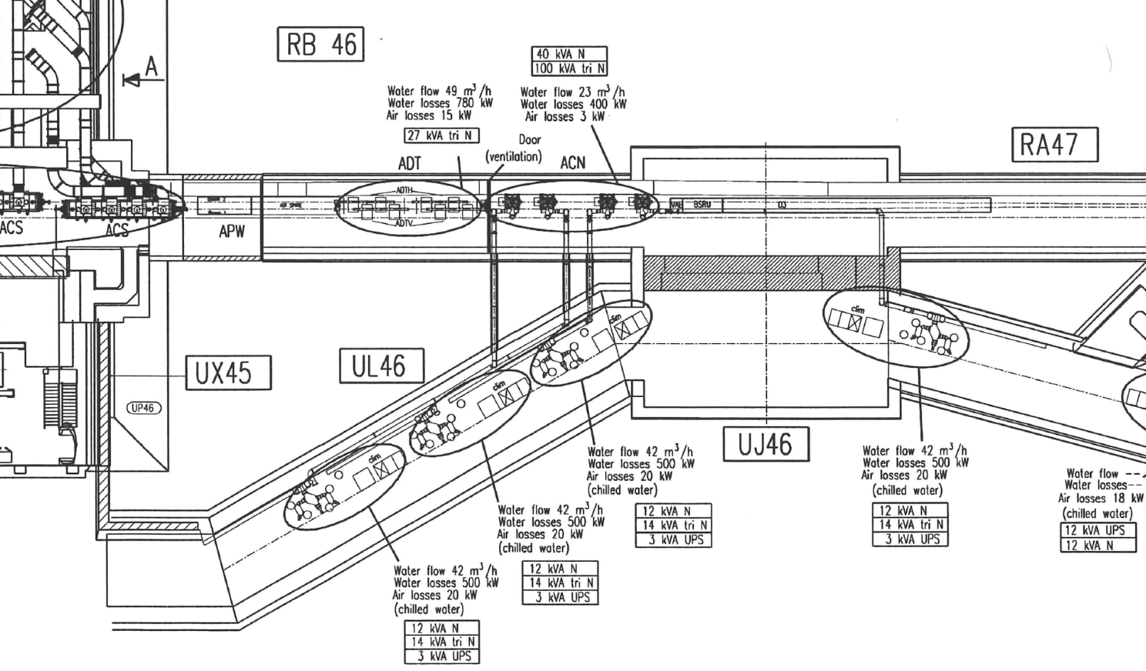
Potential location in HL-LHC
Some space was already foreseen for a possible damper upgrade
~ 5m at each side of the ADT,
gallery with ~ 10 racks for amplifiers)
LHC, point 4

Slide 35
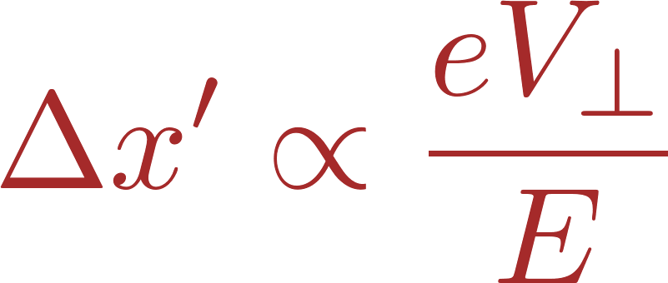
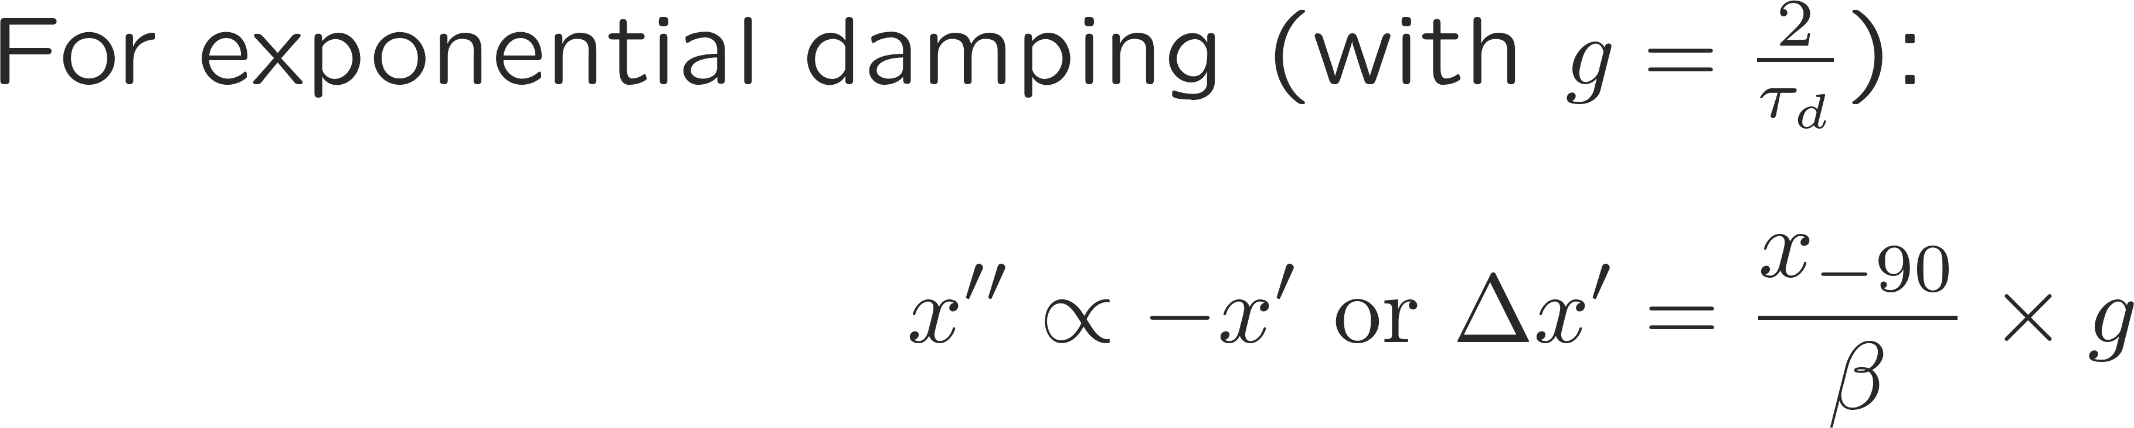
Kicker specs – examples from the SPS
Some space (~ 5m at each side of the ADT) was already foreseen for a possible damper upgrade
Stripline – 10 cm
Slotline – 1 m
+- 5 m on each side
J. Cesaratto et al.:
SPS Wideband Transverse Feedback Kicker: Design Report,
CERN-ACC-NOTE-2013-0047
LHC would of course require a re-design, that could, however, build on the SPS designs
LHC, point 4

Slide 36
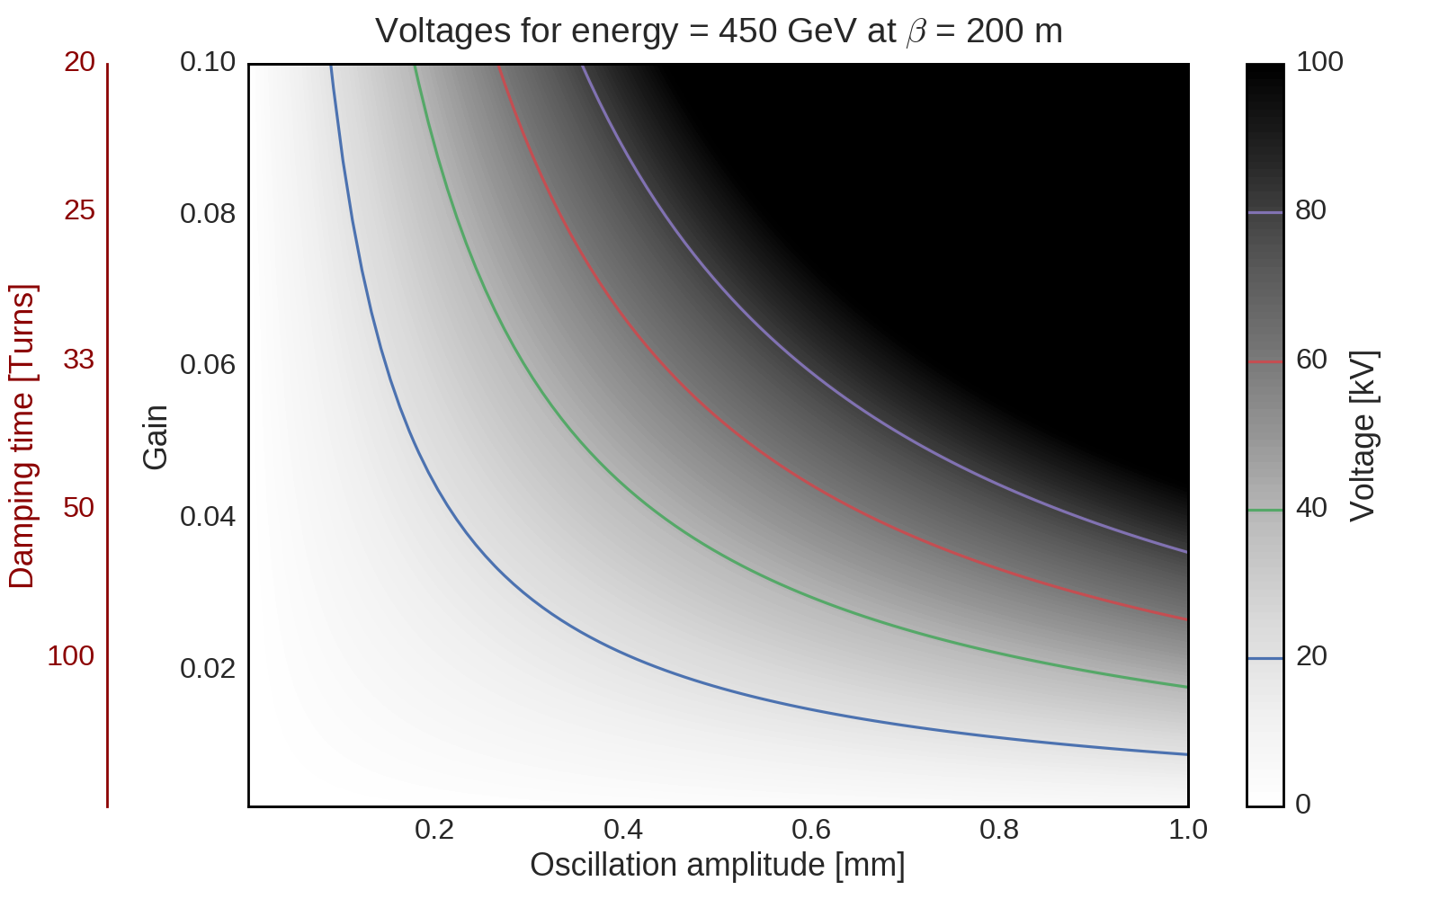
Wideband feedback system – scaled to LHC
Damper kick strength/voltage:
  With 5 m space – consider installation of 4 slotline kickers → V ~ 37 kV with 2 kW amplifiers at 1 GHz
  Slotline dimensions are smaller for LHC – can gain a factor 2 in kick strength
Millimetre oscillations can still be damped at reasonable rates.

Slide 37
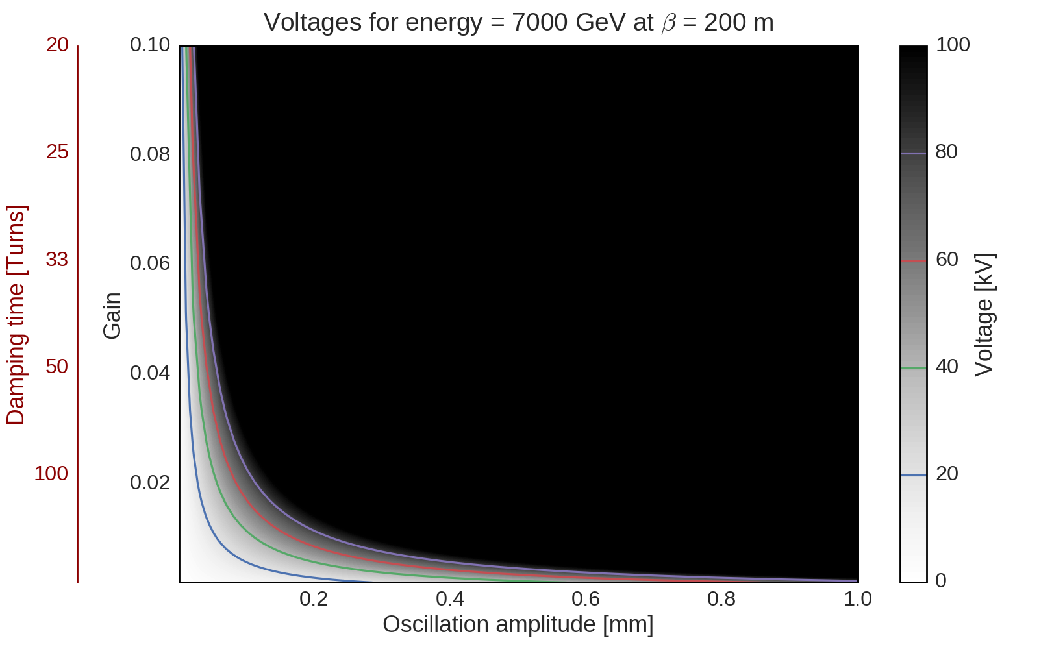
Wideband feedback system – scaled to LHC
Damper kick strength/voltage:
  With 5 m space – consider installation of 4 slotline kickers → V ~ 37 kV with 2 kW amplifiers at 1 GHz
  Slotline dimensions are smaller for LHC – can gain a factor 2 in kick strength
Beam gets more rigid at flat-top, where…

Slide 38
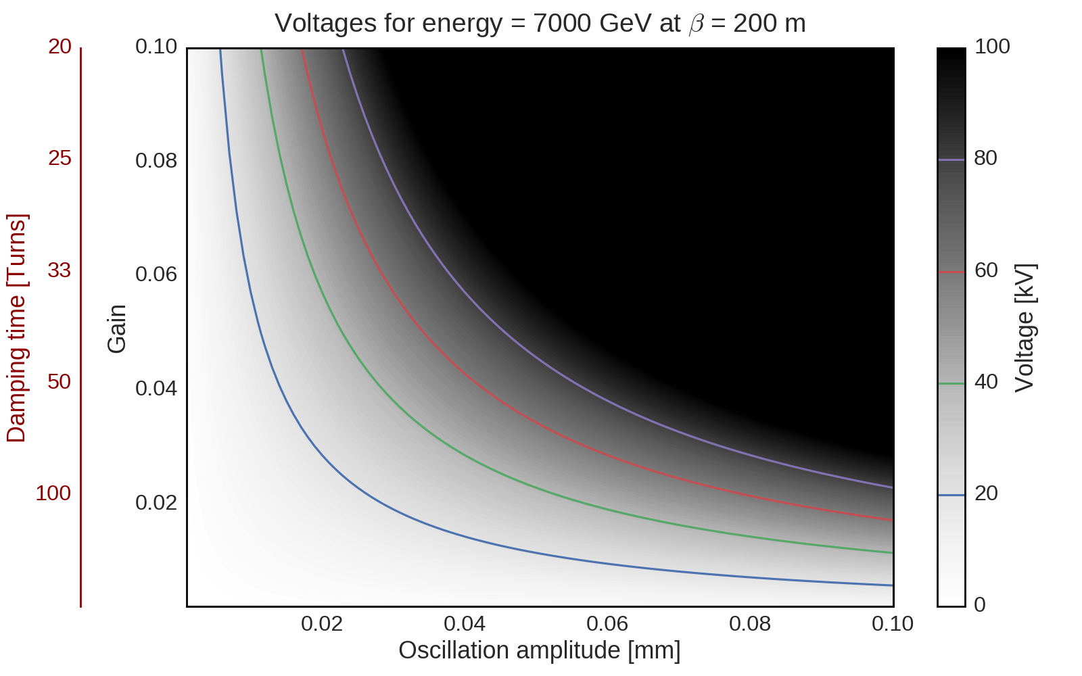
Wideband feedback system – scaled to LHC
Damper kick strength/voltage:
  With 5 m space – consider installation of 4 slotline kickers → V ~ 37 kV with 2 kW amplifiers at 1 GHz
  Slotline dimensions are smaller for LHC – can gain a factor 2 in kick strength
… transient effects are usually less critical. If detection level is at the <100 um range, we still get reasonable damping rates.

Slide 39
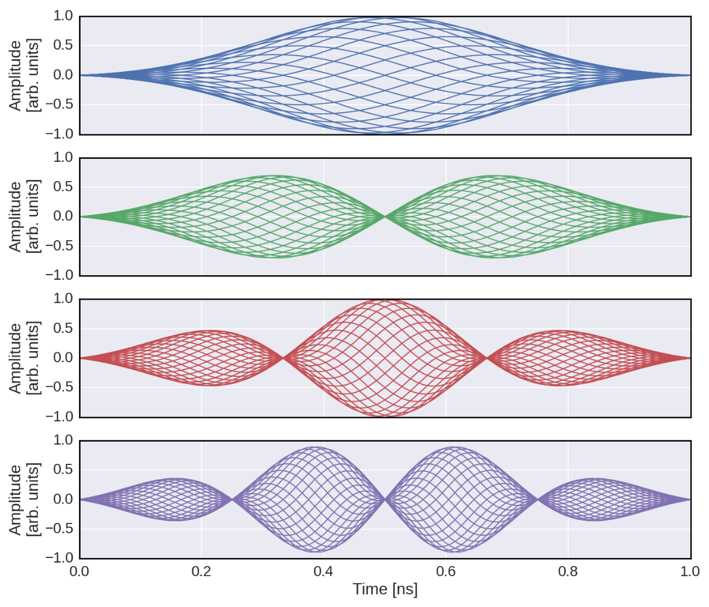
Wideband feedback system – scaled to LHC
Damper kick strength/voltage:
  With 5 m space – consider installation of 4 slotline kickers → V ~ 37 kV with 2 kW amplifiers at 1 GHz
  Slotline dimensions are smaller for LHC – can gain a factor 2 in kick strength
Bandwidth:
  Slotline dimensions are smaller for LHC – can gain a factor 2 in frequency reach
  Options:
  Extension of current system:
  long stripline at 40 MHz for true bunch-by-bunch damping
  Band-by-band approach:
  Stripline at 400 MHz in combination with slotlines at 800, 1200, 1600, 2000, 2400,… MHz

Slide 40
Wideband feedback system – scaled to LHC
Damper kick strength/voltage:
  With 5 m space – consider installation of 4 slotline kickers → V ~ 37 kV with 2 kW amplifiers at 1 GHz
  Slotline dimensions are smaller for LHC – can gain a factor 2 in kick strength
Bandwidth:
  Slotline dimensions are smaller for LHC – can gain a factor 2 in frequency reach
  Options:
  Extension of current system:
  long stripline at 40 MHz for true bunch-by-bunch damping
  Band-by-band approach:
  Stripline at 400 MHz in combination with slotlines at 800, 1200, 1600, 2000, 2400,… MHz
0.5 GHz
1 GHz
1.5 GHz
2 GHz
Instabilities observed in the LHC, typically below 2GHz.

Slide 41
Context & Outline
Context:
We answer the question whether a wideband feedback system will be needed for HL-LHC and check how this compares to other mitigation measures such as the RF quadrupole.
Outline:
Introduction
Instabilities from impedance
Instabilities from electron cloud
Performance of demonstrator system
Specification together with need, capabilities and cost

Slide 42
Do we need it? – HL-LHC predictions
Impedances:
  Simulations based on the present HL-LHC impedance model predict that the present means of stabilization (i.e. Landau octupoles and transverse damper) are sufficient to ensure beam stability
E-cloud:
  Simulation work is ongoing
  E-cloud in dipoles: main source of instabilities (at least at flat top) – ‘scrubbable?’
  E-cloud in quadrupoles: less crucial for instabilities
  E-cloud in triplets: triplets are coated
Incoherent effects:
  Tune spread significant due to high chromaticities and octupoles
  In addition enhanced by LR and HO collisions
  Means of compensation are under investigation (i.e. wires)

Slide 43
Do we need it? – HL-LHC predictions
Simulations using the impedance model suggest it may not be needed.
Simulations using e-cloud are still in progress.
Simulations rarely include all relevant effects:
The real machine tells a different story – running at high chroma, instabilities are still observed throughout the cycle (2012, injection, squeeze, adjust, stable beams)
The tasks is to identify relevant effects and to include them into the simulations (e-cloud, non-ideal transverse damper, or linear coupling as a recent example)
Symbiosis between observations and simulations will eventually enable to draw a complete picture
Beam stability corresponding to exclusively the pure impedance, as such, was not yet demonstrated in the machine.
We do not know whether there are any hard limits (e.g. minimum SEY, correction limits).
Strategy
We need to continue to gather experience with the running machine
We need to in parallel continue R&D on possible mitigation measures to be ready with a system that can be deployed in case nominal performance turns out to be limited or even excluded.
Impedances:
  Simulations based on the present HL-LHC impedance model predict that the present means of stabilization (i.e. Landau octupoles and transverse damper) are sufficient to ensure beam stability
E-cloud:
  Simulation work is ongoing
  E-cloud in dipoles: main source of instabilities – ‘scrubbable’
  E-cloud in quadrupoles: less crucial for instabilities
  E-cloud in triplets: triplets are coated
Incoherent effects:
  Tune spread significant due to high chromaticities and octupoles
  In addition enhanced by LR and HO collisions
  Means of compensation are under investigation (i.e. wires)

Slide 44
Comparison of mitigation techniques
 | Active feedback | Passive elements (e.g. RF Quad) | Comments
Control method | Active – resistive feedback | Passive – tune spread | (*) AF: active feedback
Additional functionality | High | Low | AF: Individual bunch excitation, diagnostics etc.
Complexity | High | Low | AF: requires expert support
Flexibility | High | Low | AF: constitutes a programmable impedance
Concomitant incoh. effects | Noise | By design (tune spread)
Slow headtail | Demonstrated in simulations | Demonstrated in simulations
Fast headtail | Demonstrated in experiments | Not demonstrated so far
E-cloud instability | Demonstrated in simulations | Not demonstrated so far
Status | Demonstrator system installed in the SPS | Prototype under study / development
Cost | ??? | ???

Slide 45
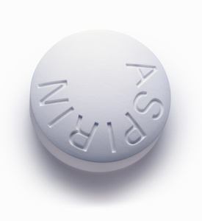

Comparison of mitigation techniques
 | Active feedback | Passive elements (e.g. RF Quad) | Comments
Control method | Active – resistive feedback | Passive – tune spread | (*) AF: active feedback
Additional functionality | High | Low | AF: Individual bunch excitation, diagnostics etc.
Complexity | High | Low | AF: requires expert support
Flexibility | High | Low | AF: constitutes a programmable impedance
Concomitant incoh. effects | Noise | By design (tune spread)
Slow headtail | Demonstrated in simulations | Demonstrated in simulations
Fast headtail | Demonstrated in experiments | Not demonstrated so far
E-cloud instability | Demonstrated in simulations | Not demonstrated so far
Status | Demonstrator system installed in the SPS | Prototype under study / development
Cost | ??? | ???
Highly configurable and powerful – can forge the ‘ultimate’ cure
Complex, needs setup, understanding, continuous expert support
General purpose, all-round, generic cure for ‘light’ instabilities – but has inherent limits
Over-the-counter, easy to operate

Slide 46
Path of choice
Continue R&D on kickers – target for ~2 GHz
Exploit the SPS system for studies and to gain experience
Amplifiers can still be investigated, to ultimately favour:
  Full-blown wideband feedback for maximum flexibility and gain – expensive and main cost driver
  Band-by-band approach – less flexible but likely the cheaper solution

Slide 47
Summary
We investigated beam instabilities in the HL-LHC from pure impedances and demonstrated numerically that a wideband feedback system can mitigate these instabilities.
We sketched a path for investigating instabilities in the HL-LHC from electron cloud and how we want to check whether a wideband feedback system can mitigate these instabilities.
We showed recent examples for an experimental proof-of-principle using the wideband feedback demonstrator system installed in the SPS.
We sketched possible scenarios of real systems in the machine.
We presented a strategy on how to proceed with this type of systems and how they compare to an RF quadrupole.

Slide 48
Open questions and future studies
Include the system in e-cloud simulations.
Refine the system to add delays, real DSP, noise etc.
Investigate the impact of noise on the emittance.
Check saturation effects.
Any other items linked to this that urgently need to be checked?

Slide 49
BACKUP

Slide 50
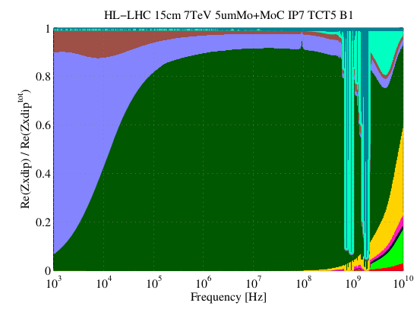
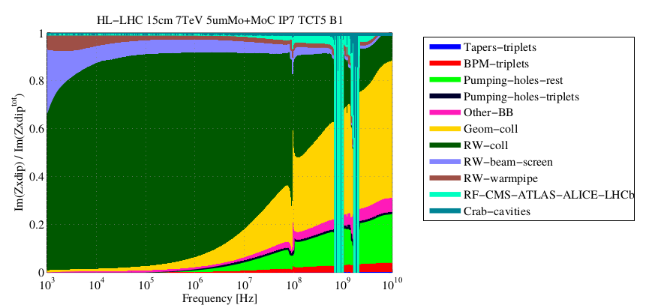
HL-LHC impedance horizontal plane – 7 TeV
N. Biancacci

Slide 51
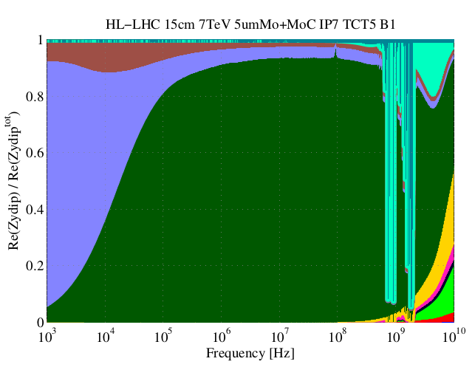
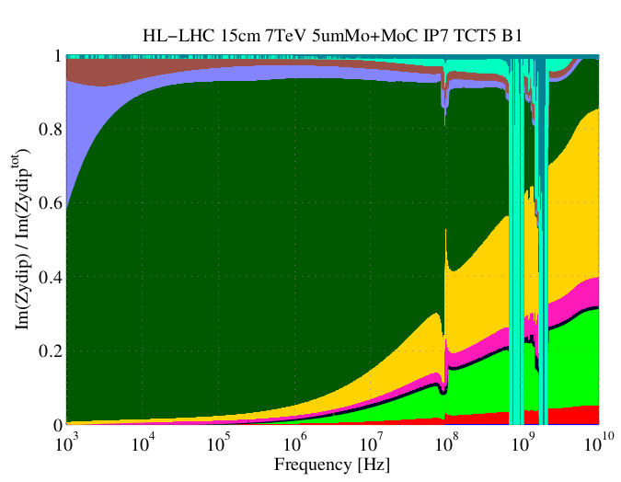
HL-LHC impedance vertical plane – 7 TeV
N. Biancacci

Slide 52
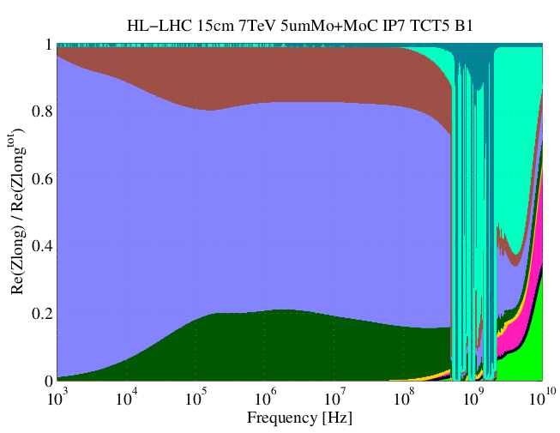
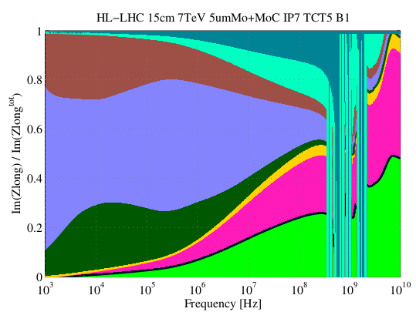
HL-LHC impedance longitudinal plane – 7 TeV
N. Biancacci

Slide 53
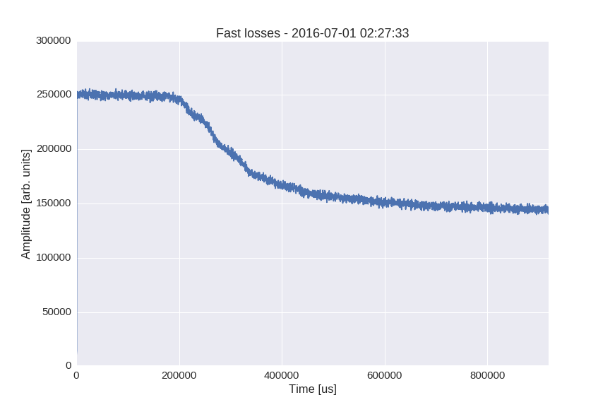
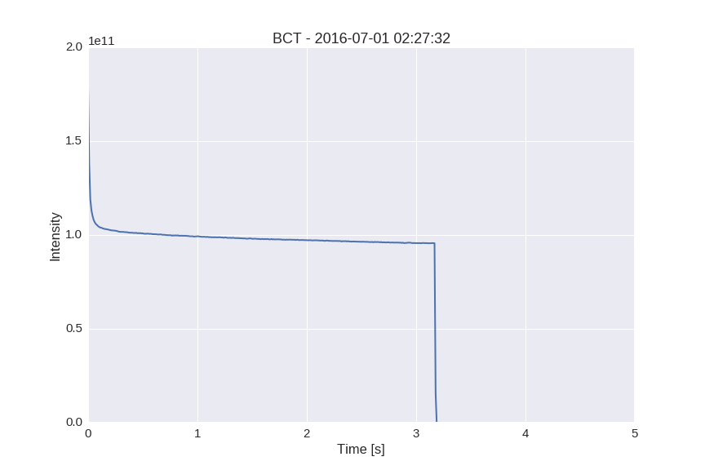
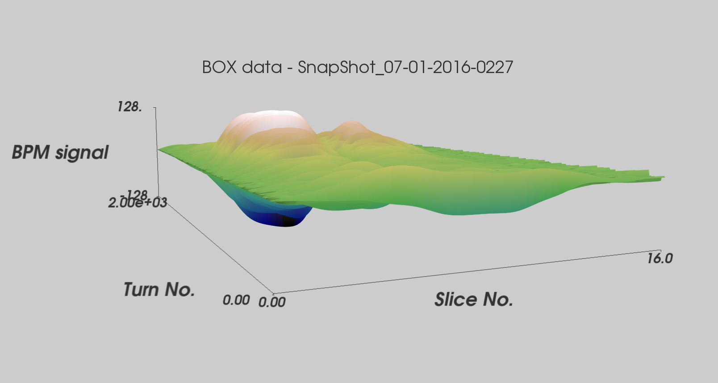
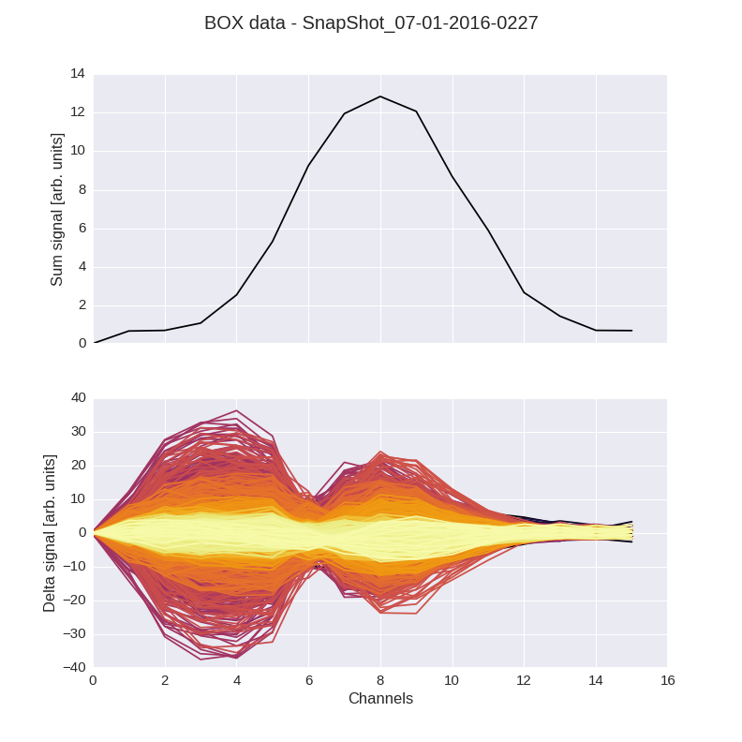
Data from the ADC of the Box
Open loop

Slide 54
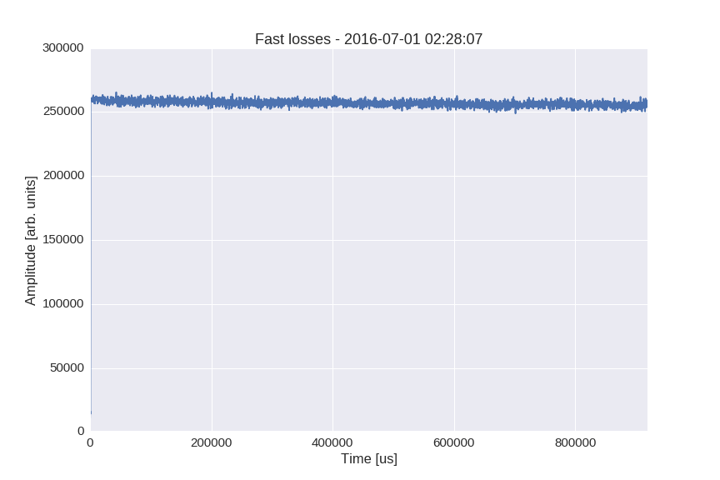
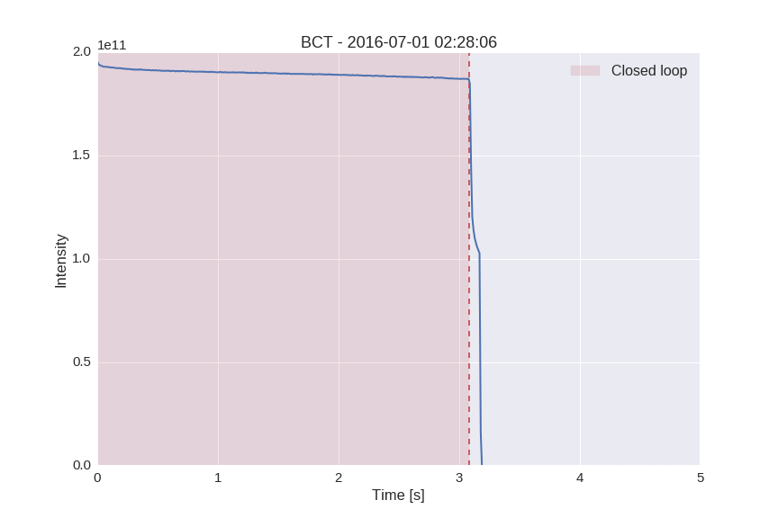
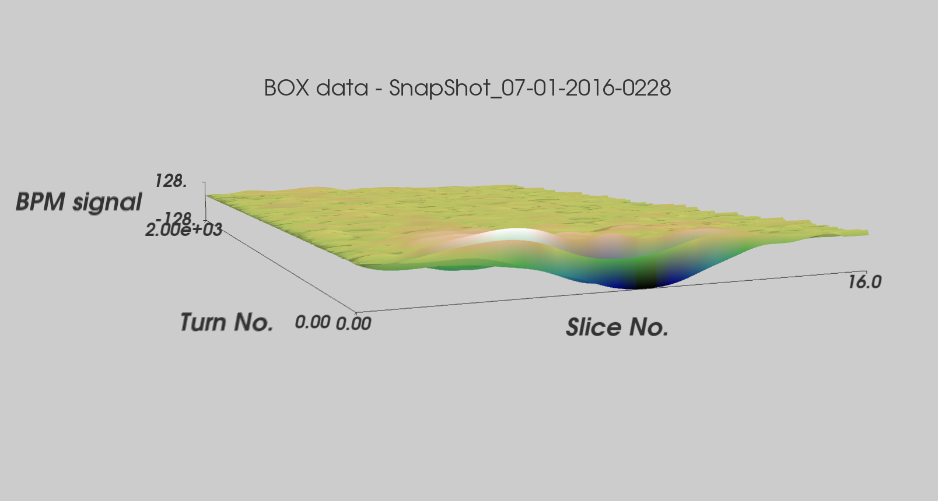

Data from the ADC of the Box
Closed loop

Slide 55
Do we need it?
Scalings based on available system in the SPS
Assuming 1 GHz frequency range based on simulations
Using slotline kicker with higher power amplifiers
Other scenarios can be thought of, i.e. slotlines in combination with short striplines
Kicker design and manufacturing expected to be feasible
Power amplifiers with specified power over the full frequency range is more challenging

Slide 56
Do we need it? – HL-LHC predictions
Impedances:
  Simulations based on the present HL-LHC impedance model predict that the present means of stabilization (i.e. Landau octupoles and transverse damper) are sufficient to ensure beam stability
E-cloud:
  Simulation work is ongoing
  E-cloud in dipoles: main source of instabilities – ‘scrubbable’
  E-cloud in quadrupoles: less crucial for instabilities
  E-cloud in triplets: triplets are coated
Incoherent effects:
  Tune spread significant due to high chromaticities and octupoles
  In addition enhanced by LR and HO collisions
  Means of compensation are under investigation (i.e. wires)
Simulations using the impedance model suggest it may not be needed.
Simulations using e-cloud are still in progress.
Simulations rarely include all relevant effects:
  The real machine tells a different story – running at high chroma, instabilities are still observed throughout the cycle (2012, injection, adjust, squeeze, stable beams)
  The tasks is to identify relevant effects and to include them into the simulations (e-cloud, linear coupling, non-ideal transverse damper)
  Symbiosis between observations and simulations will eventually enable to draw a complete picture
Beam stability corresponding to pure impedance was never demonstrated in the machine.
We do not know whether there are any hard limits (e.g. minimum SEY, correction limits).
Strategy
  We need to continue to gather experience with the running machine
  We need to in parallel continue R&D on possible mitigation measures to be ready with a system that can be deployed in case nominal performance turns out to be limited or even excluded.

Slide 57


Instability in the machine - LHC
Stability predictions using the LHC impedance model show good agreement.
However…
t = 0.5 – 1 s
Courtesy of N. Biancacci, L. Carver
t = 15 – 20 s

Slide 58
Instability in the machine - LHC
Stability predictions using the LHC impedance model show good agreement.
However…
Additional effects (e.g. e-cloud) can considerably alter the predicted behaviour
t = 0.5 – 1 s
Courtesy of N. Biancacci, L. Carver
t = 15 – 20 s
Horizontal instability

Slide 59


Instability in the machine - LHC
Fill 4642 with uncorrected tune drift
→ blow-up during injection
Fill 4643 with tune correction
→ no blow-up
Coupling C- for these fills was below 0.004
Tune separation and coupling correction
  At injection, when tunes approach each other and coupling is not well corrected, instabilities and emittance blow-up.
  The instability mechanism was studied in simulations and identified as a loss of Landau damping.
  This observation was confirmed in MDs.

Slide 60
Comparison of mitigation techniques
 | Active feedback | Passive elements (e.g. RF Quad) | Comments
Control method | Active – resistive feedback | Passive – tune spread
Additional functionality | High | Low | AF: Individual bunch excitation, diagnostics etc.
Complexity | High | Low | AF: requires expert support
Flexibility | High | Low | AF: constitutes a programmable impedance
Concomitant incoh. effects | Noise | By design (tune spread)
Slow headtail | Demonstrated in simulations | Demonstrated in simulations
Fast headtail | Demonstrated in experiments | Not demonstrated so far
E-cloud instability | Demonstrated in simulations | Not demonstrated so far
Status | Demonstrator system installed in the SPS | Prototype under study / development
Cost | ??? | ???

