Slide 1
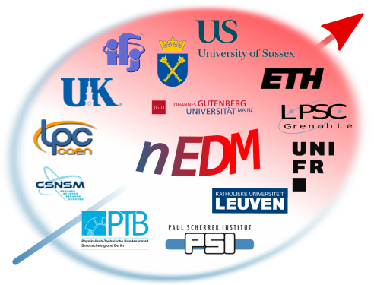
Neutron Electric Dipole Moment experiment at PSI
A story of CP violation searches
in the high precision experiment
Malgorzata Kasprzak
on behalf of the nEDM collaboration
SPS Meeting, Lugano, 25.08.2016

Slide 2
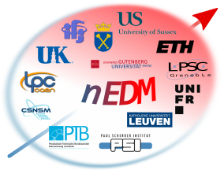
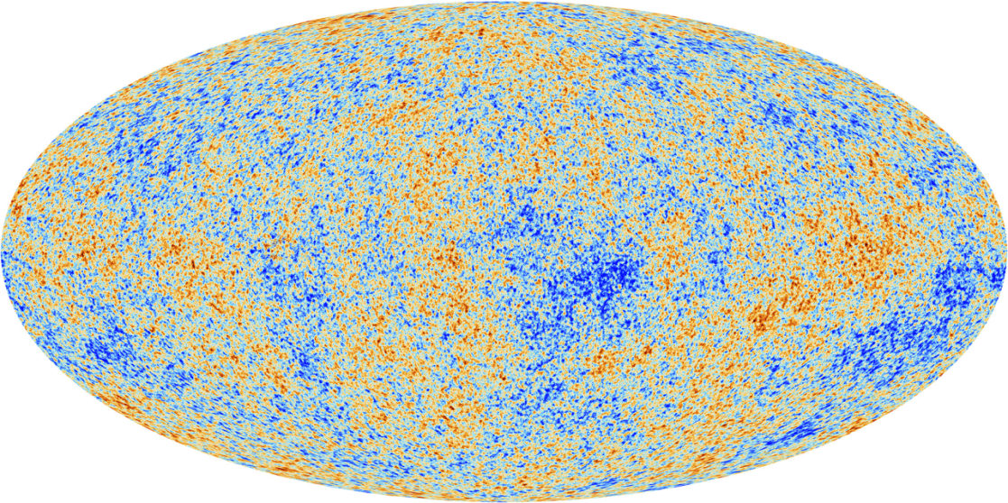
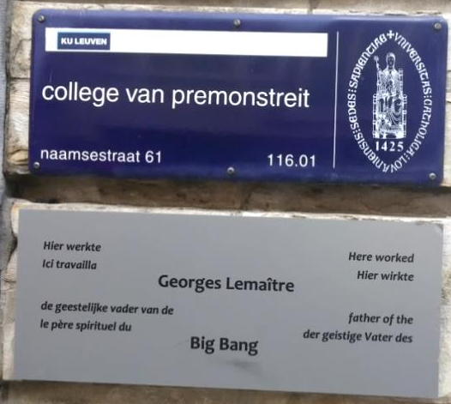
Big Bang model and
Baryon Asymmetry of the Universe (BAU)
“In the beginning was the Big Bang, so we now say with great certainty”
John C. Mather, NASA, Nobel Lecture 2006
Baryon-to-photon ratio
“cosmic egg” model
Picture: ESA and the Planck Collaboration
Perfectly symmetric Universe
Where is the antimatter?
Theory (Standard Model)

Slide 3

CP violation in the Standard Model (SM) and Beyond
Sakharov conditions:
CP and C violation
Baryon number violation
Thermal non-equilibrium
CPV signatures
High energy physics
Electric dipole moments
Neutrino physics
CPV
CPV in QCD (θ term)
CPV in weak interactions
see M. Rawlik talk
CPV in lepton sector
CPV in SUSY

Slide 4
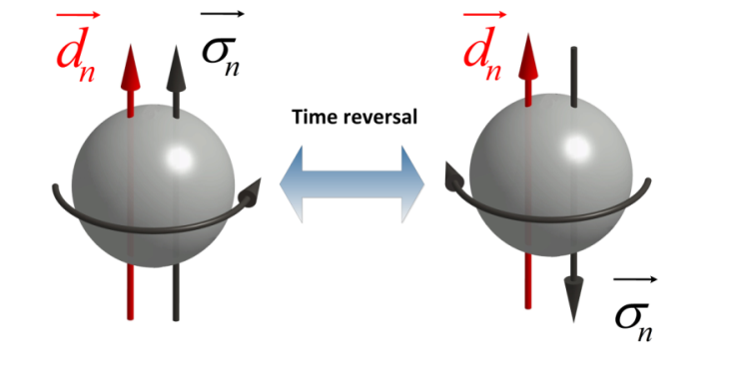



nEDM and T violation
CM
QM
Time reversal violation translates into CPV if the CPT symmetry is valid

Slide 5
nEDM prediction and measurements
Upper limit on nEDM :
Standard Model :
Pendlebury et al., PRD92 (2015) 092003
New Physics scenarios :
Ultimate aim of nEDM @ PSI
New physics
Standard Model

Slide 6
nEDM principle :
Spin precession in E and B fields
μ_{n} d_{n}
High-precision
measurements of
magnetic field
Posters:
Z. Grujic
S. Komposch

Slide 7
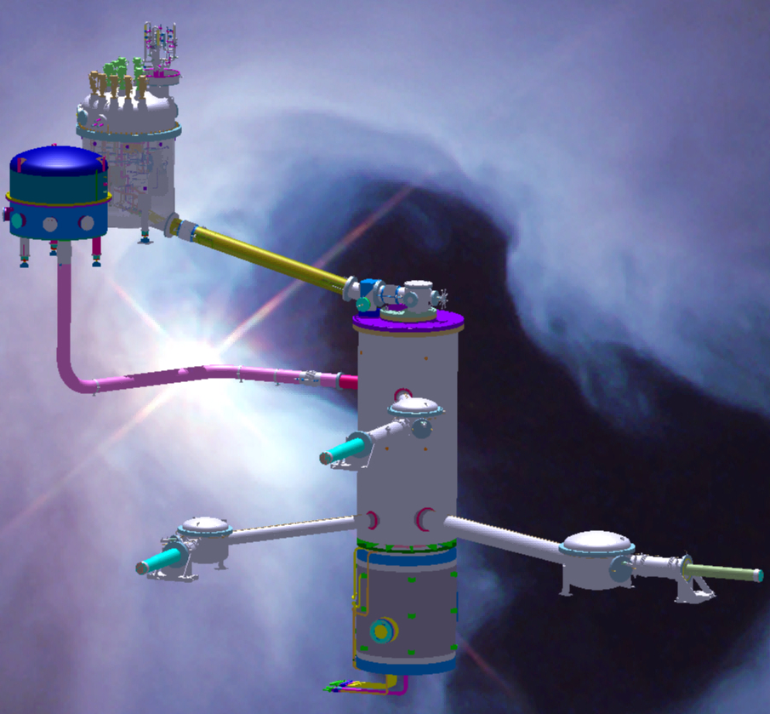
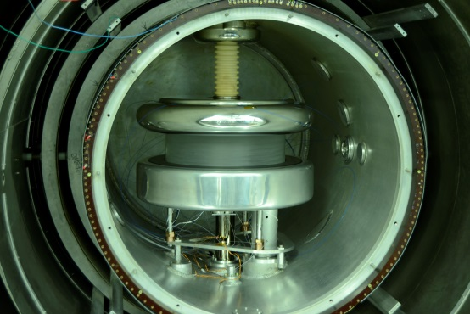
Ultracold neutron source and nEDM experiment at PSI
velocities < 8 m/s
energies < 300 neV
Neutron bottle (22 liters)
5T
Spin Filter
Polarized UCN
N. Hild, poster

Slide 8
Ramsey method in time space
μ_{n} d_{n}
time
“Spin up” neutron
π/2 spin flip
2s
Free precession
180s
E B
E B
Second π/2 spin flip
2s

Slide 9
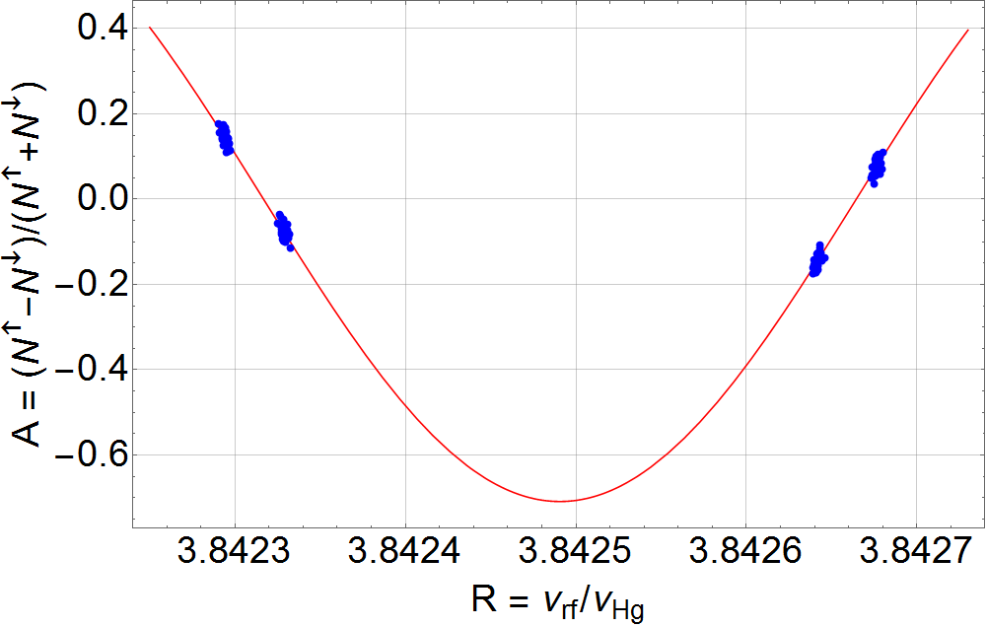
Neutron resonance frequency
P. Mohan Murhty, poster

Slide 10
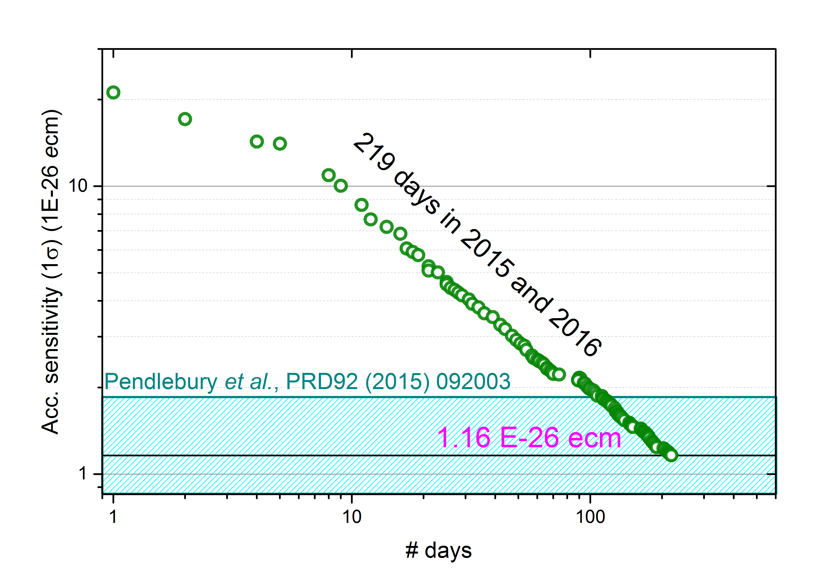
Statistical sensitivity in the running experiment

Slide 11
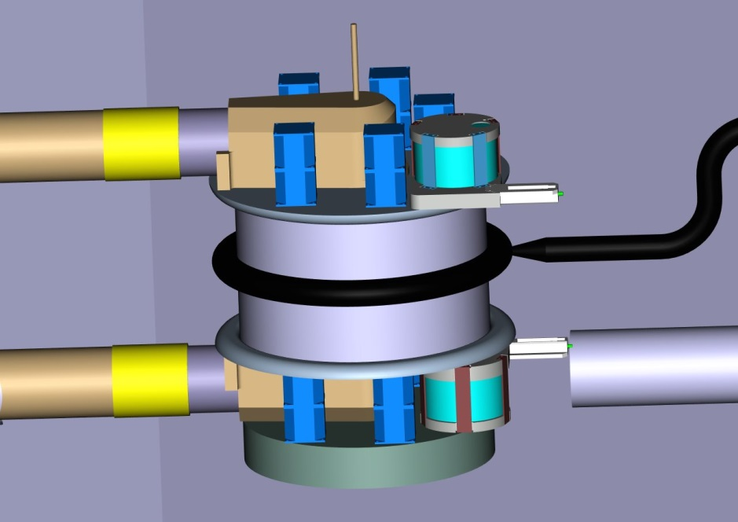
Next step: new setup and increased sensitivity
Double precession chamber
Better adaptation to the UCN source
Stronger electric field

Slide 12
Conclusions
Search for a neutron EDM probes the New Physics
The existence of a nEDM has cosmological implications on BAU
nEDM@PSI is running with the world’s best sensitivity (accumulated sensitivity of 1.16 x 10⁻²⁶ e.cm) and expecting to deliver a new nEDM upper limit soon
Upgrade of the nEDM@PSI in the next years with an ultimate aim of 5 x 10⁻²⁸ e.cm

Slide 13
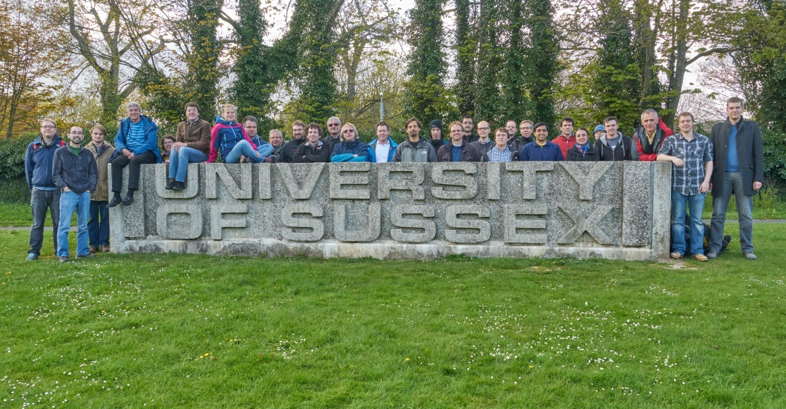
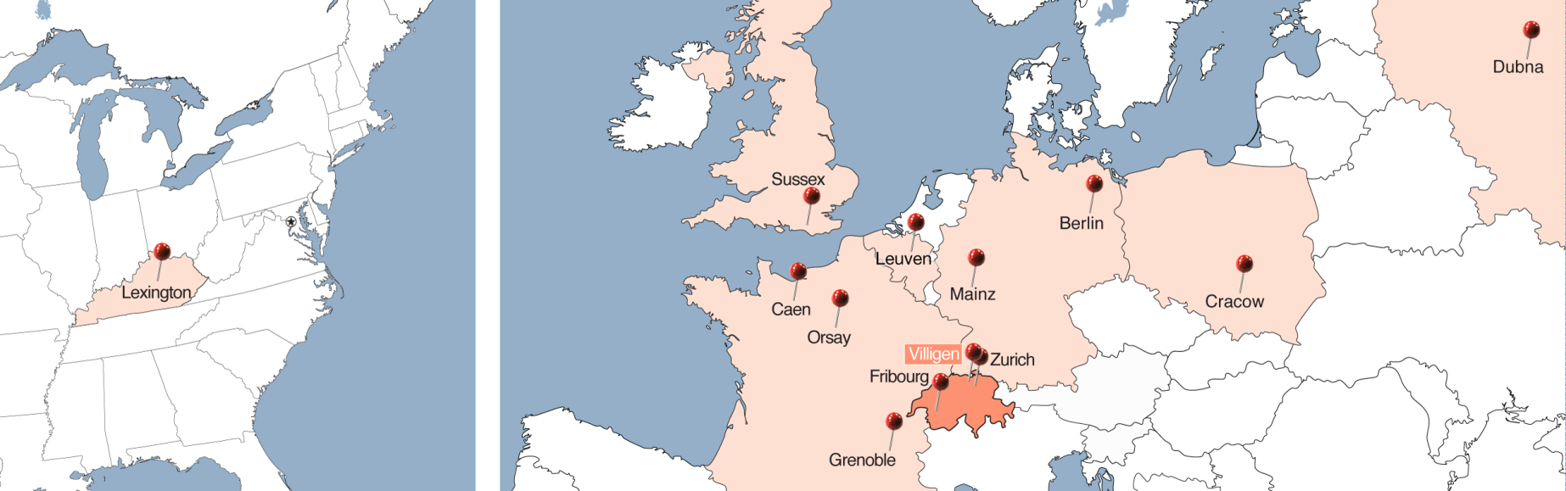
nEDM collaboration
~ 50 members
14 institutions
7 countries
Thank you for your attention

Slide 14
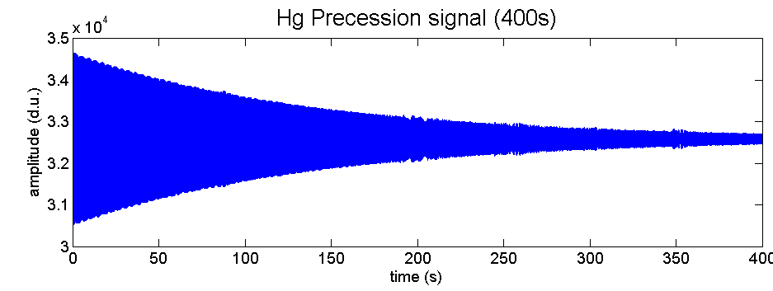
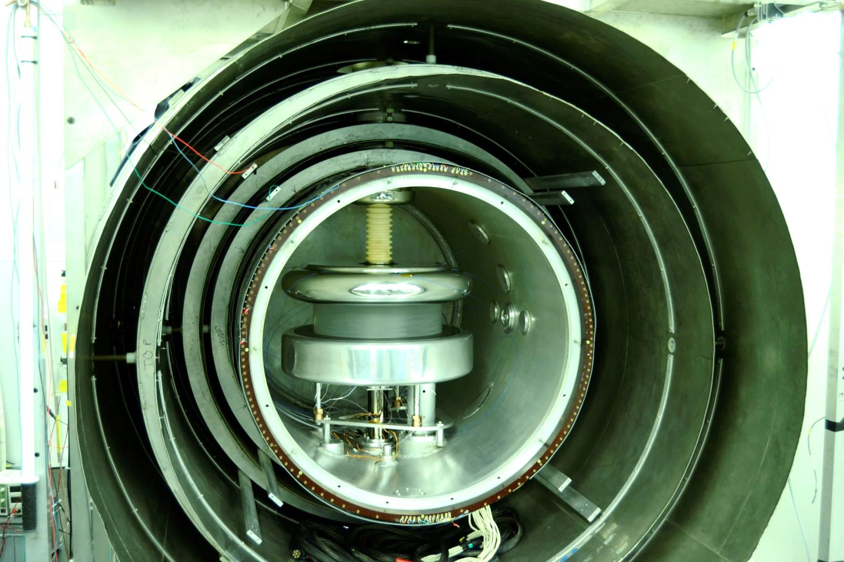
Hg co-magnetometer
Hg lamp
Photomultiplier
precessing Hg atoms

Slide 15
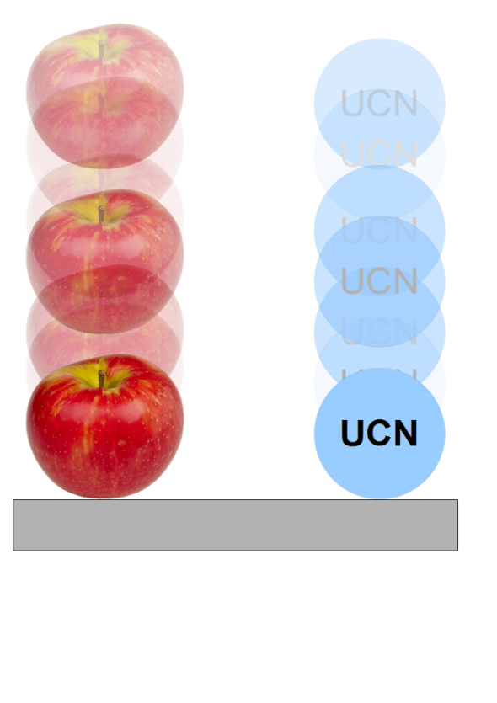
Gravitational shift
UCN
Hg

Slide 16
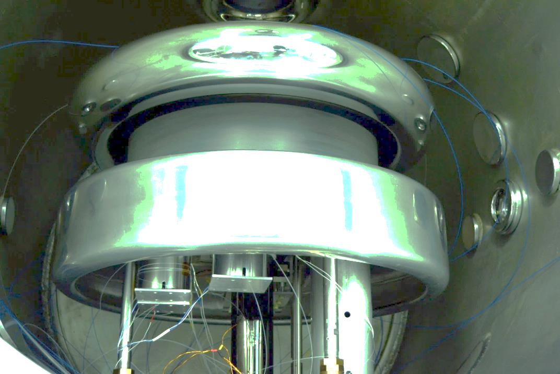
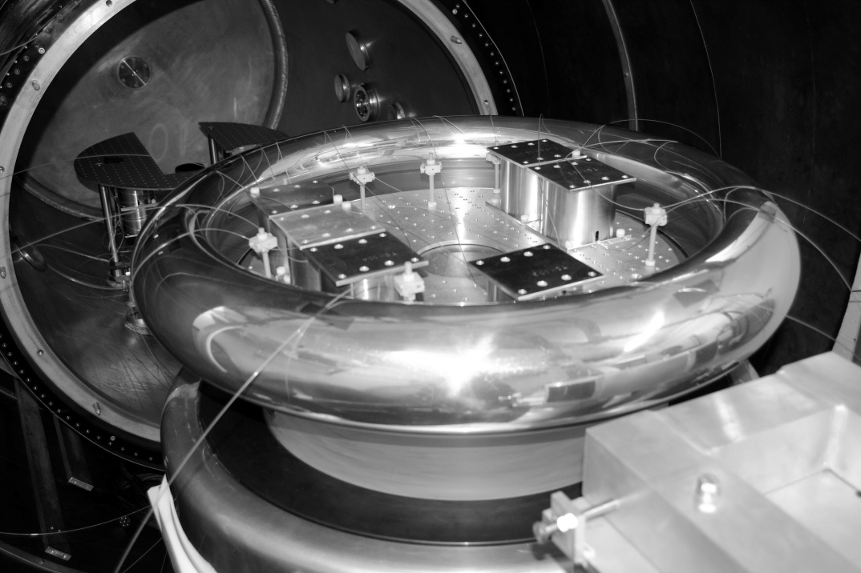
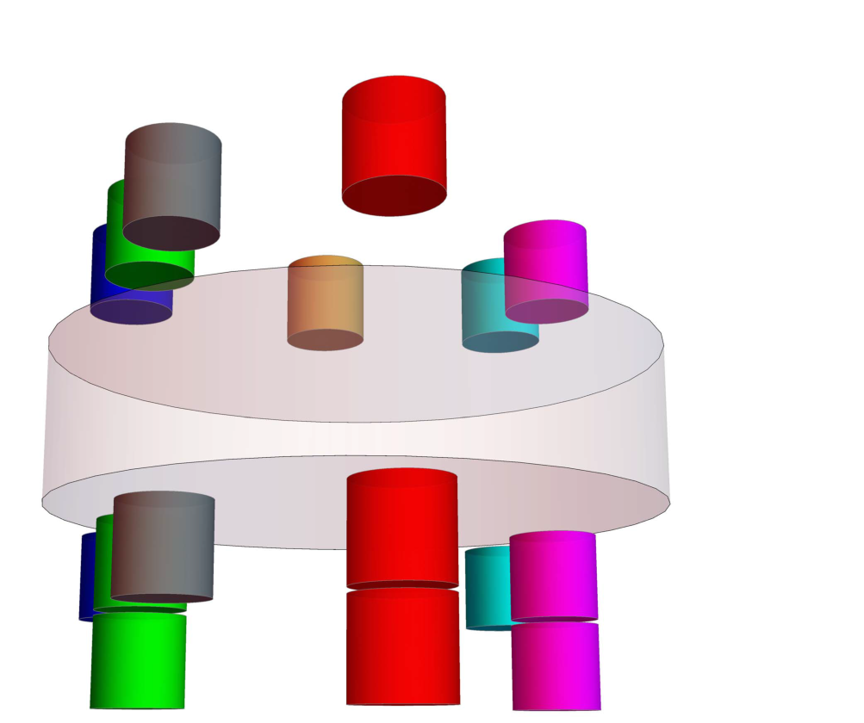

Slide 17


Slide 18
Ramsey method in time space
μ_{n} d_{n}
time
“Spin up” neutron
π/2 spin flip
2s
Free precession
180s
E B
E B
Second π/2 spin flip
2s

