Slide 1
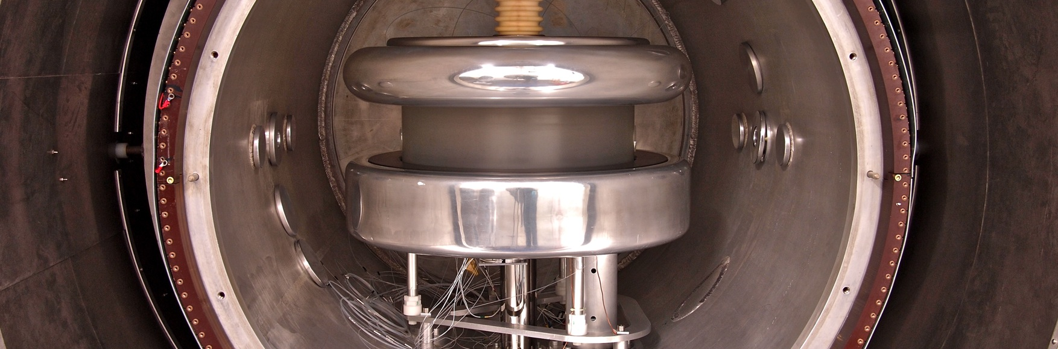
Looking for axions with nEDM experiments
Michał Rawlik on behalf of the nEDM collaboration
with: N. Ayres, M. Fairbairn, V. V. Flambaum, D. J. E. Marsh, Y. V. Stadnik

Slide 2
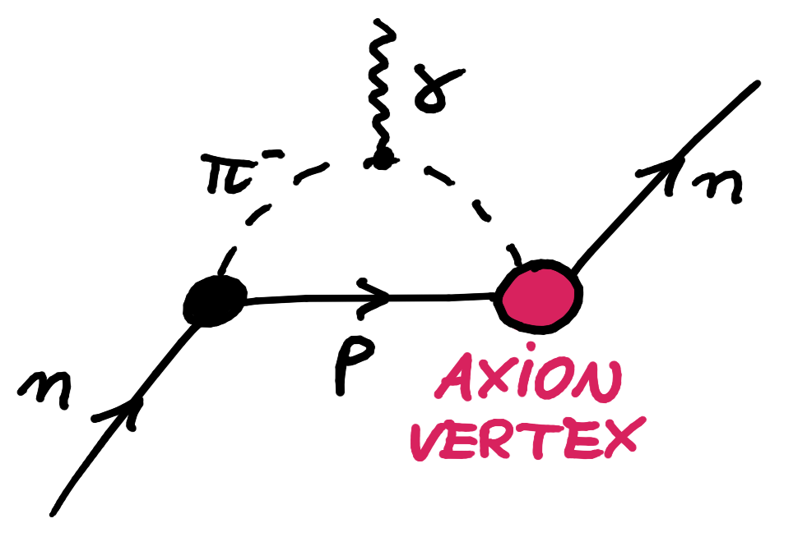
What is an axion?
Axions tackle two problems of the modern physics:
  The strong CP problem of QCD.
  Dark matter, being a candidate therefor.
Most searches focus on an axion coupling to photons.
Recently, searching for a gluon coupling has been proposed:

Slide 3
Axion-induced nEDM oscillation
ILL & PSI
nEDM measurements:
neutron precession frequency
If oscillates, will oscillate too.

Slide 4
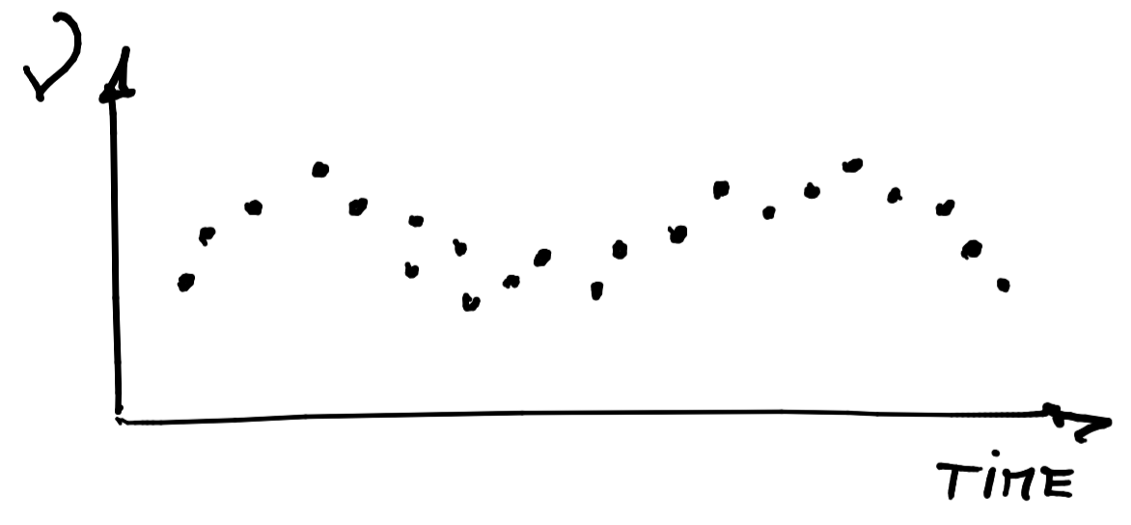
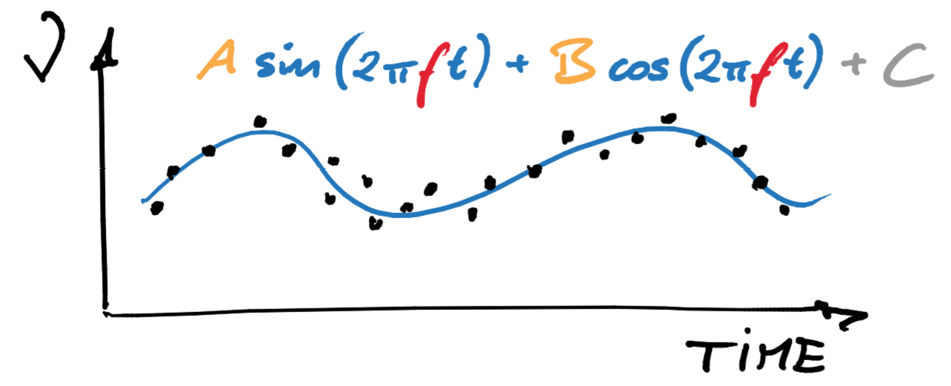
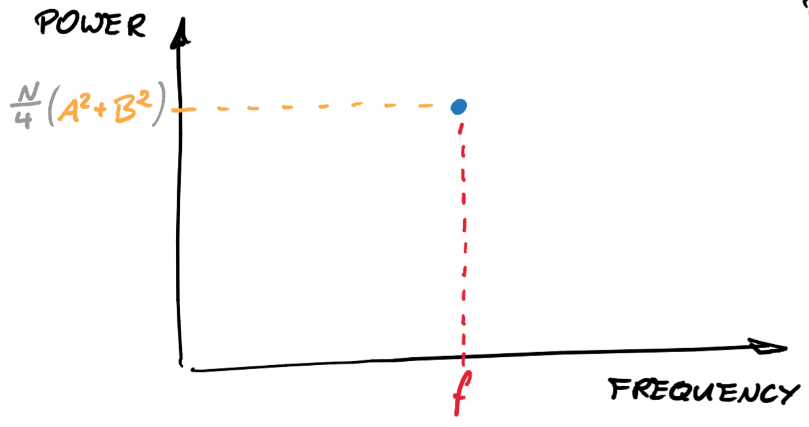
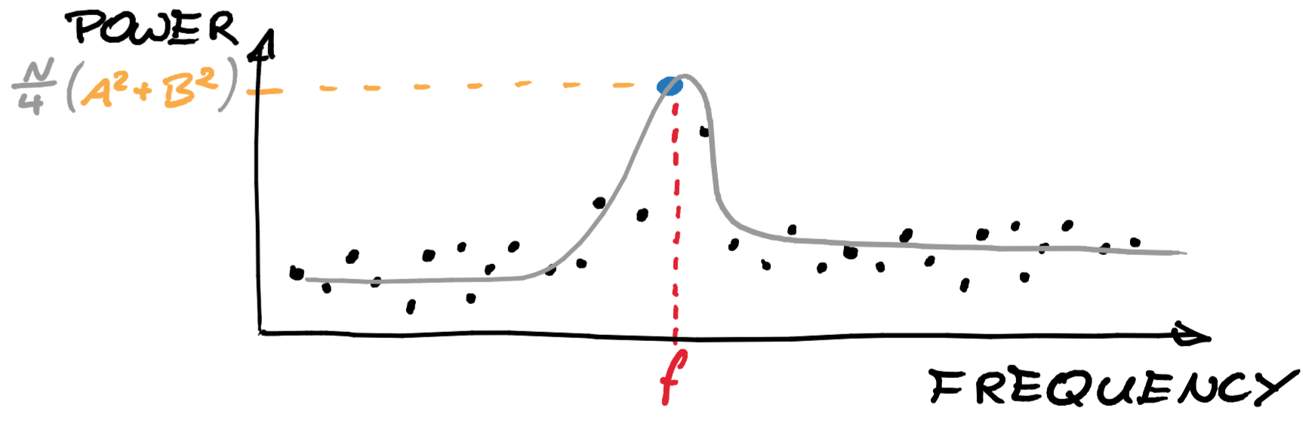
Least Squares Spectral Analysis (LSSA)

Slide 5
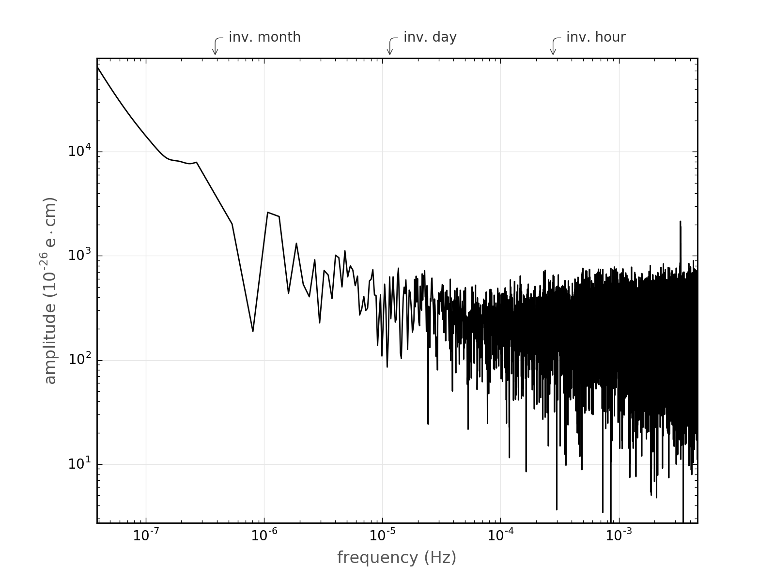
The Data Periodogram

Slide 6
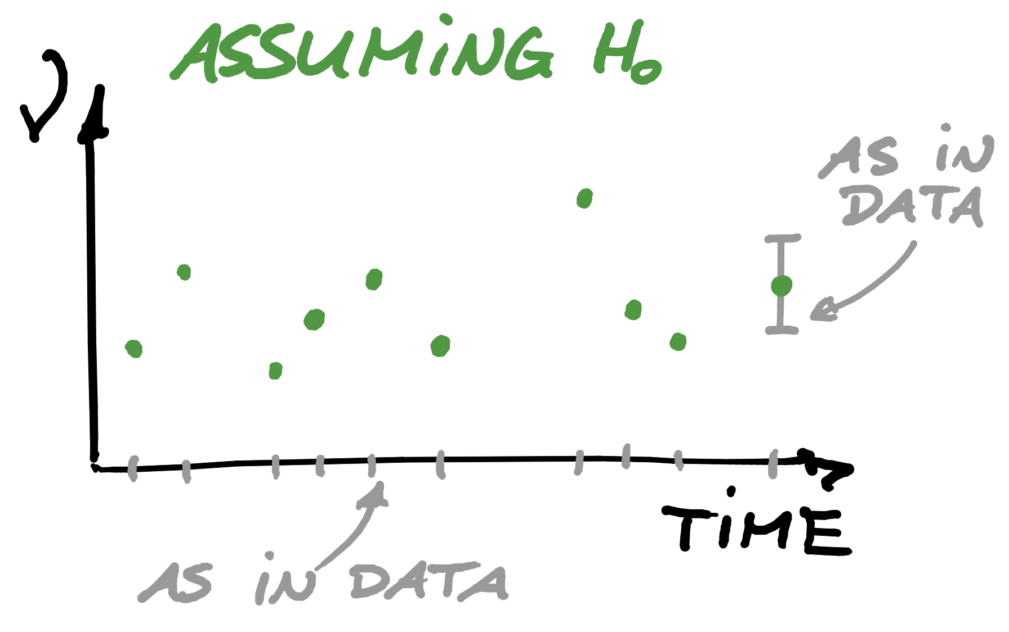
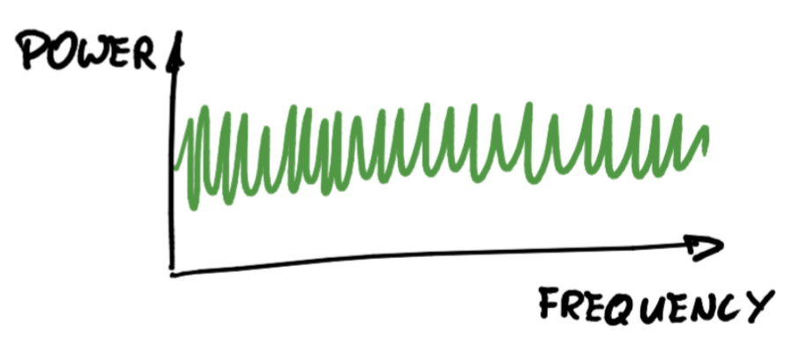
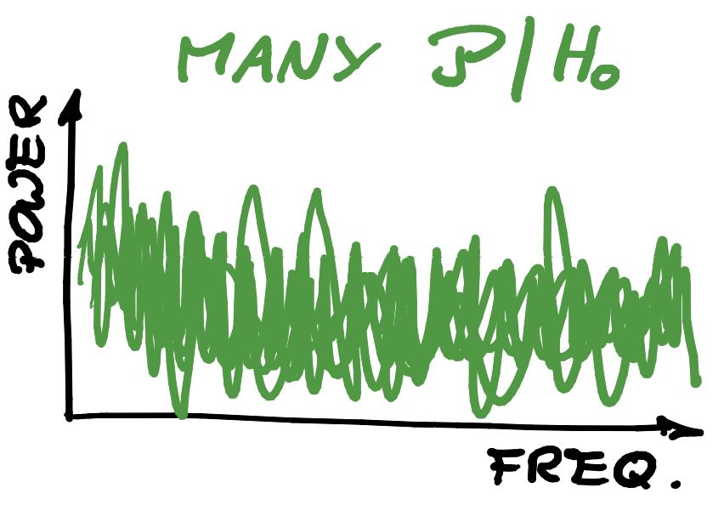
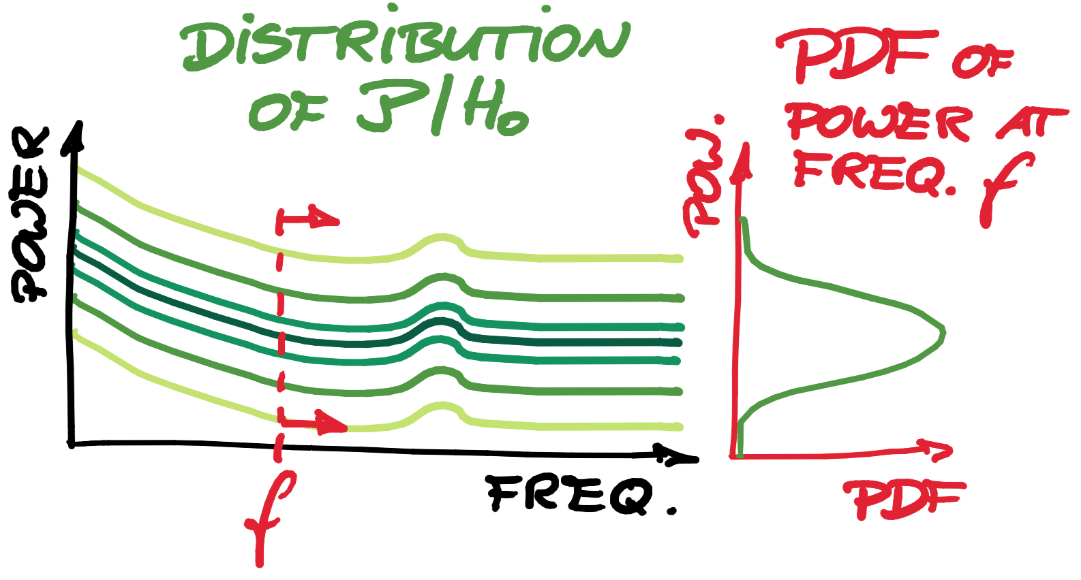
The Periodogram Under the Null Hypothesis

Slide 7
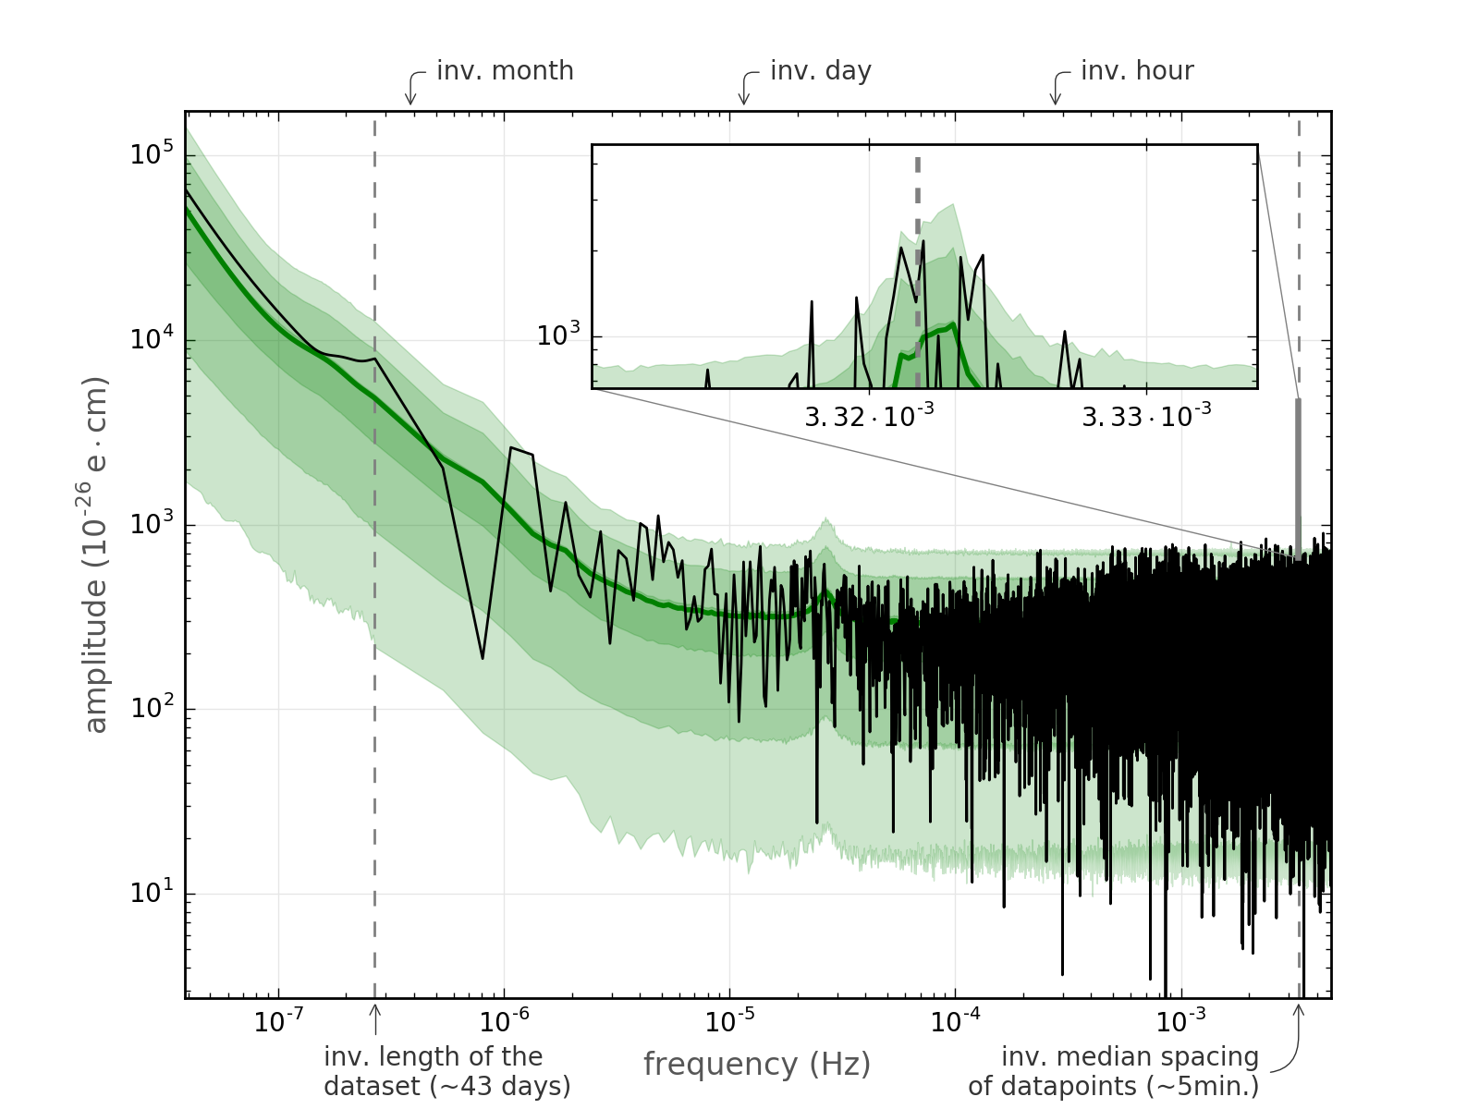
The Data Periodogram vs. the Null Hypothesis

Slide 8
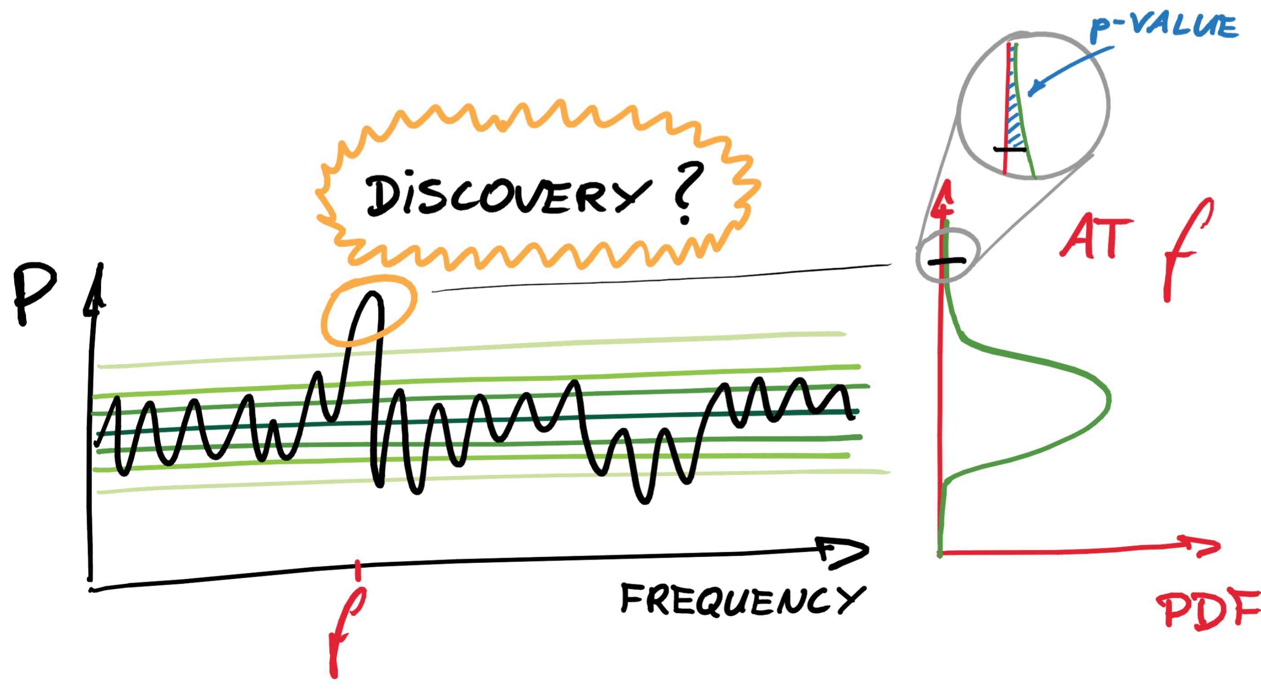
The Null Hypothesis Test

Slide 9
The Look-Elsewhere Effect
number of frequencies = 1 000 000
p_{global} = 3-sigma level
p_{local} = 6-sigma level

Slide 10
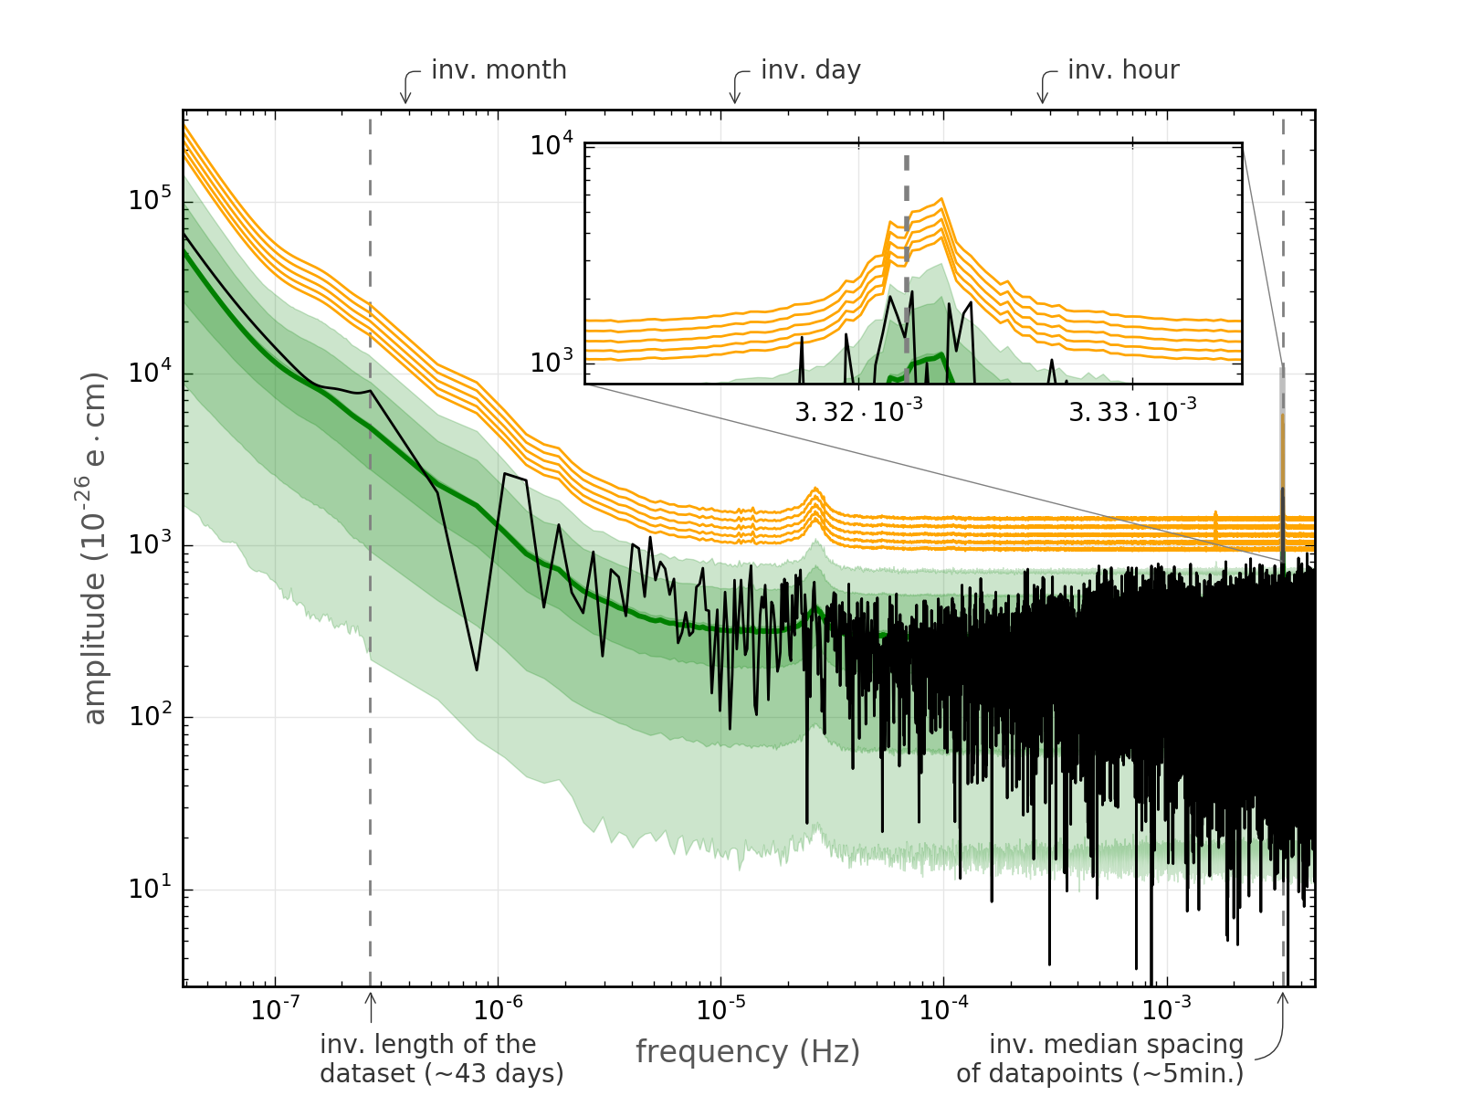
False-Alarm Thresholds

Slide 11
First Experimental Limits on the Axion-Gluon Coupling
We cover periods
from minutes to
decades.

Slide 12

Thank you for your attention!
Further reading:
D. J. E. Marsh, Phys. Rep. 643, 1 (2016)
Y. V. Stadnik, V. V. Flambaum, Phys. Rev. D 89, 043522 (2014)
J. D. Scargle, Astrophys. J. 263, 835 (1982)
S. Algeri, J. Conrad, D. A. van Dyk, B. Anderson, arXiv:1602.03765 (2016)

Slide 14
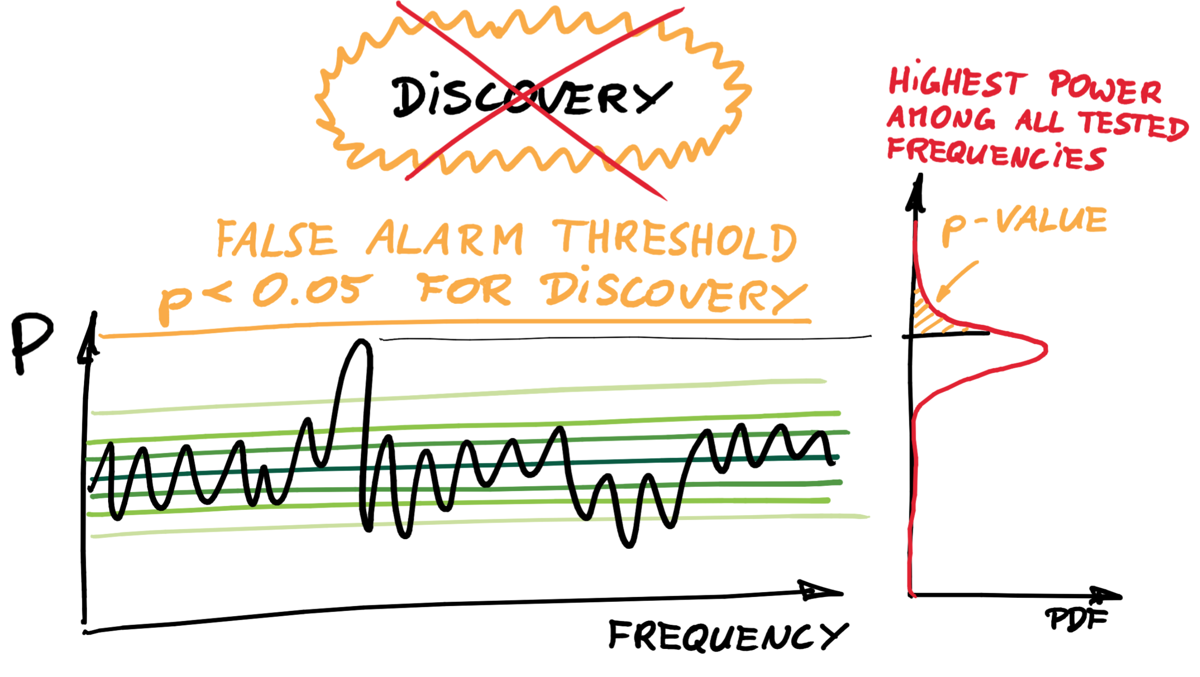
the look-elsewhere effect

Slide 15
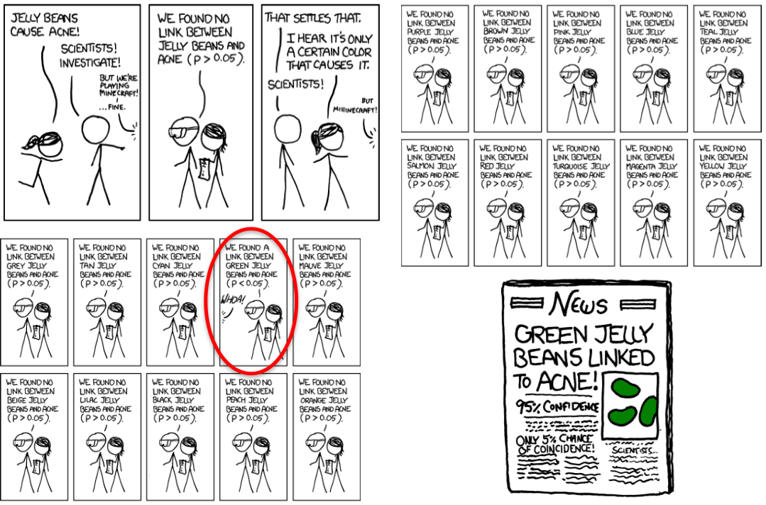
first experimental limits on the axion-gluon coupling

Slide 16
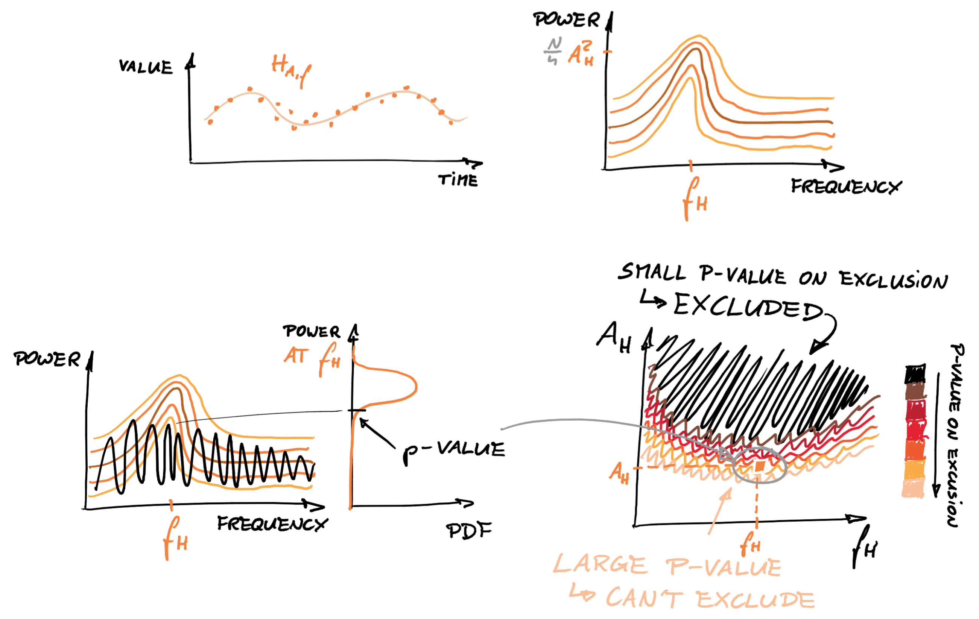
determining the exclusion region

Slide 17
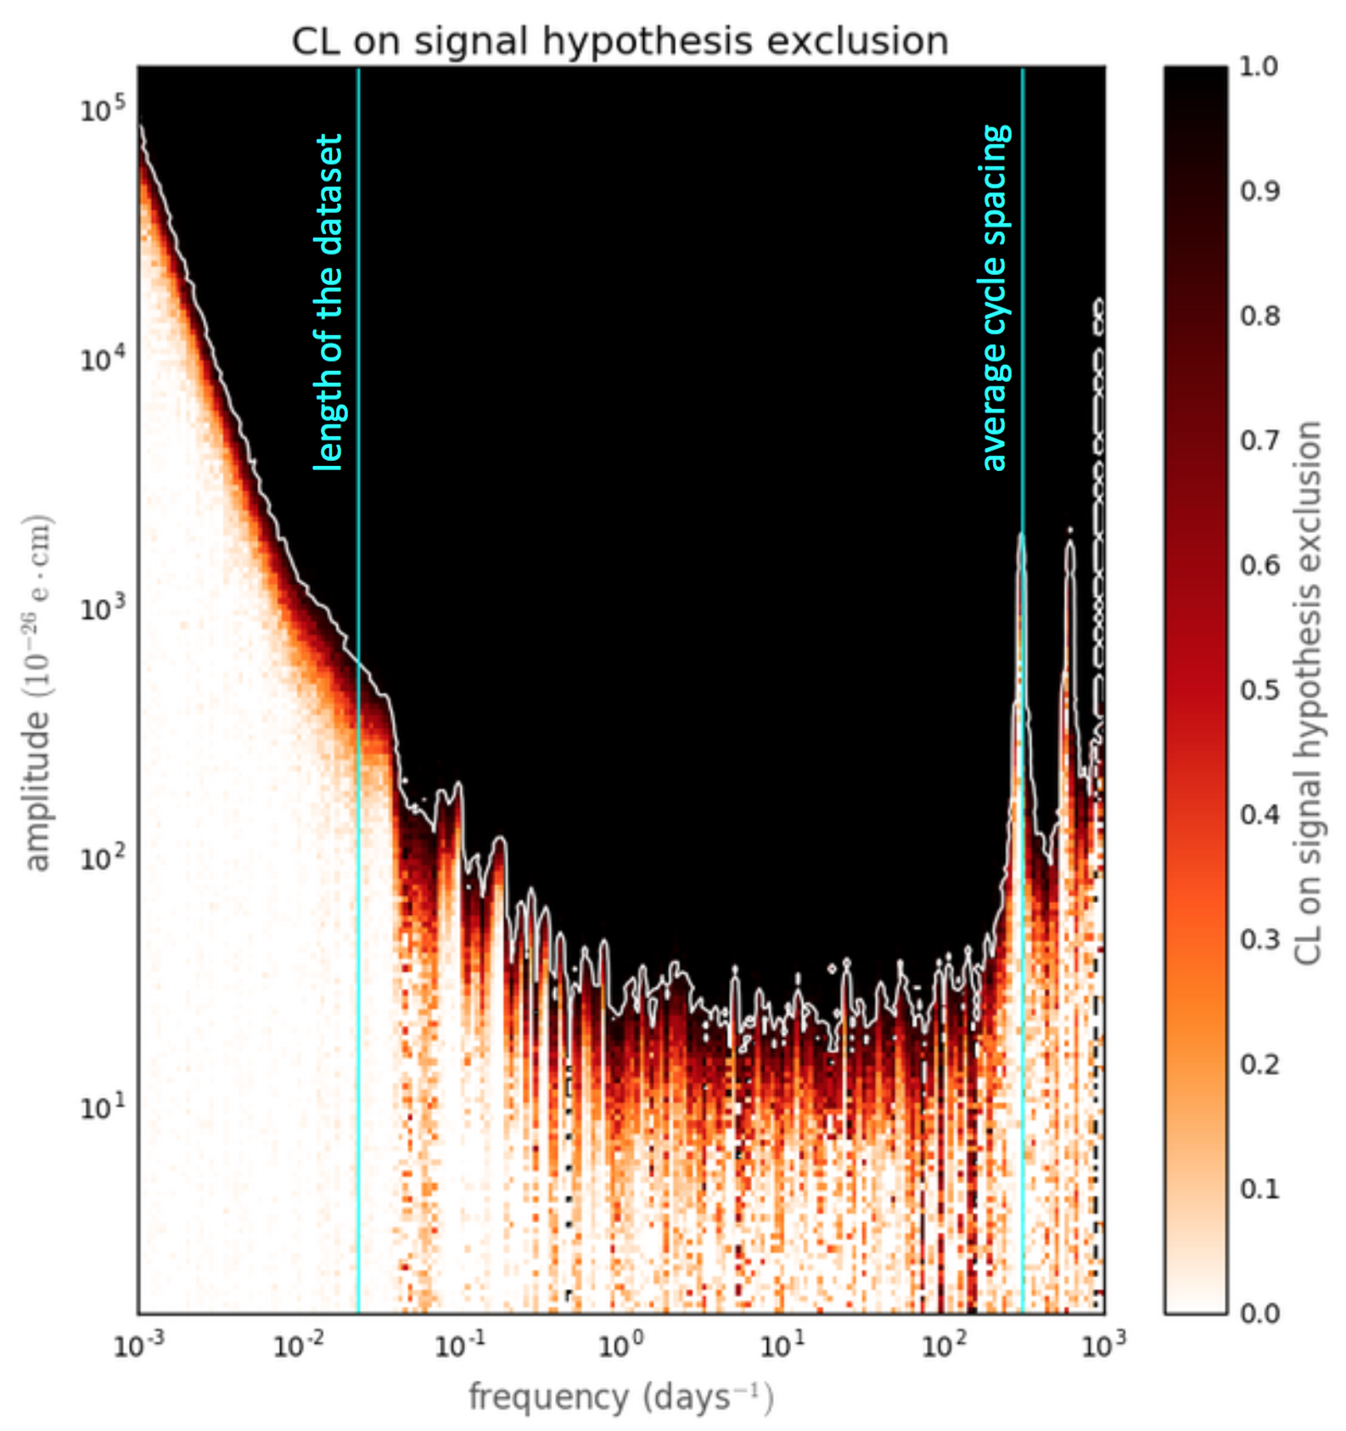
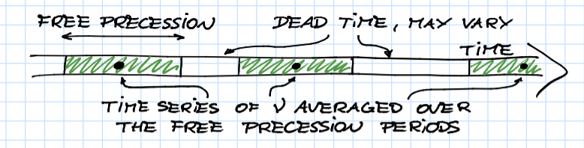
the exclusion region

