Slide 1
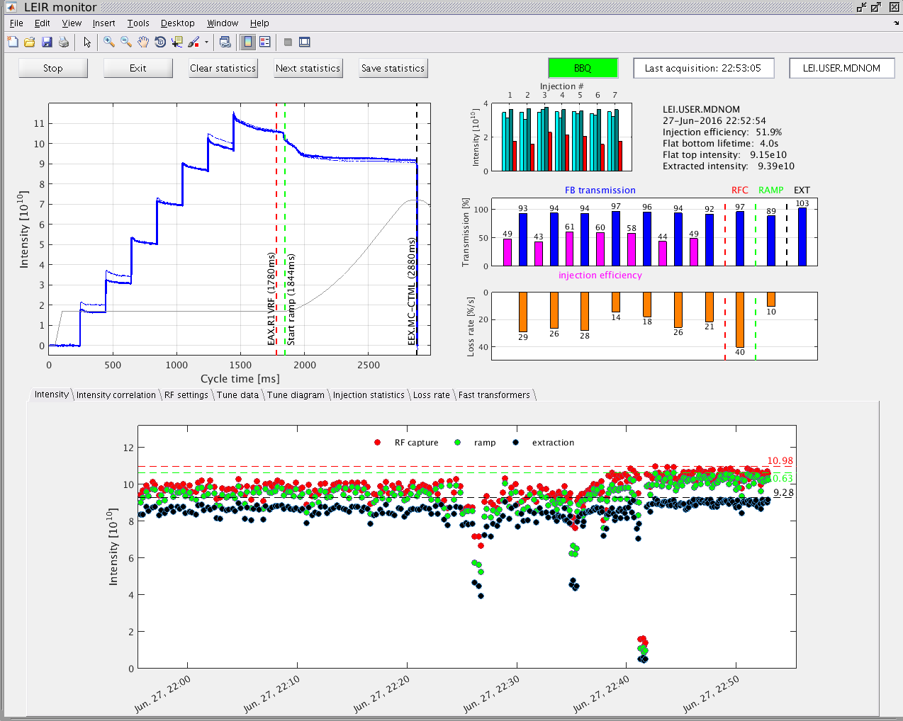
LEIR Record
9E10 charges (well above LIU requirement
Well set up first injections.
7 Injections (~30uA).
Increased chromaticity.
High bunching factor.
…

