Slide 1
LEIR MD progress
H. Bartosik and A. Huschauer on behalf of LIU-Ions PS Injectors team
Acknowledgements:
M.E. Angoletta, G. Arduini, J. Axensalva, G. Bellodi, N. Biancacci, A. Blas, C. Carli, M. Gabriel, S. Gilardoni, S. Hancock, S. Jensen, V. Kain, D. Küchler, D. Manglunki, M. Meddahi, M. Migliorati, Y. Papaphilippou, S. Pasinelli, G. Rumolo, R. Scrivens, G. Sterbini, G. Tranquille

Slide 2
LEIR MD planning
  Studies on injection plateau
    Resonance compensation and losses with advanced RF capture on injection plateau
    Maximum accumulated intensity with 13 injections
    Injection efficiencies for high number of injections
    Test of 10 Hz injection rate
    Test of e-cooler operation at 400 mA and maximum cooling rate with 10 Hz injection rate
  Test of PS stray field compensation

Slide 3
LEIR MD planning
  Studies on injection plateau
    Resonance compensation and losses with advanced RF capture on injection plateau
    Maximum accumulated intensity with 13 injections
    Injection efficiencies for high number of injections
    Test of 10 Hz injection rate
    Test of e-cooler operation at 400 mA and maximum cooling rate with 10 Hz injection rate
  Test of PS stray field compensation

Slide 4
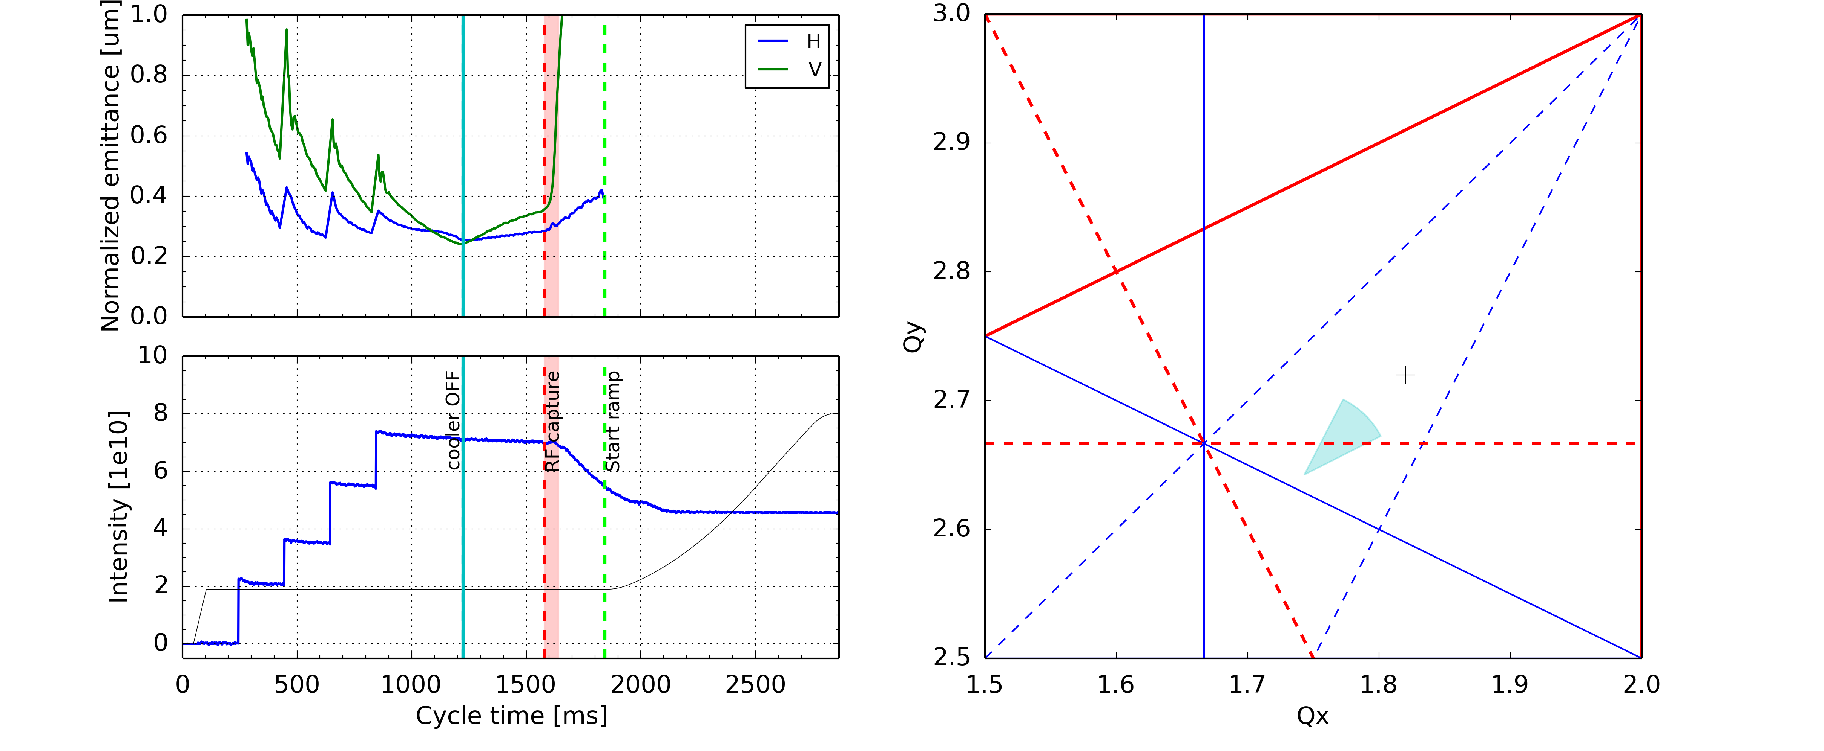
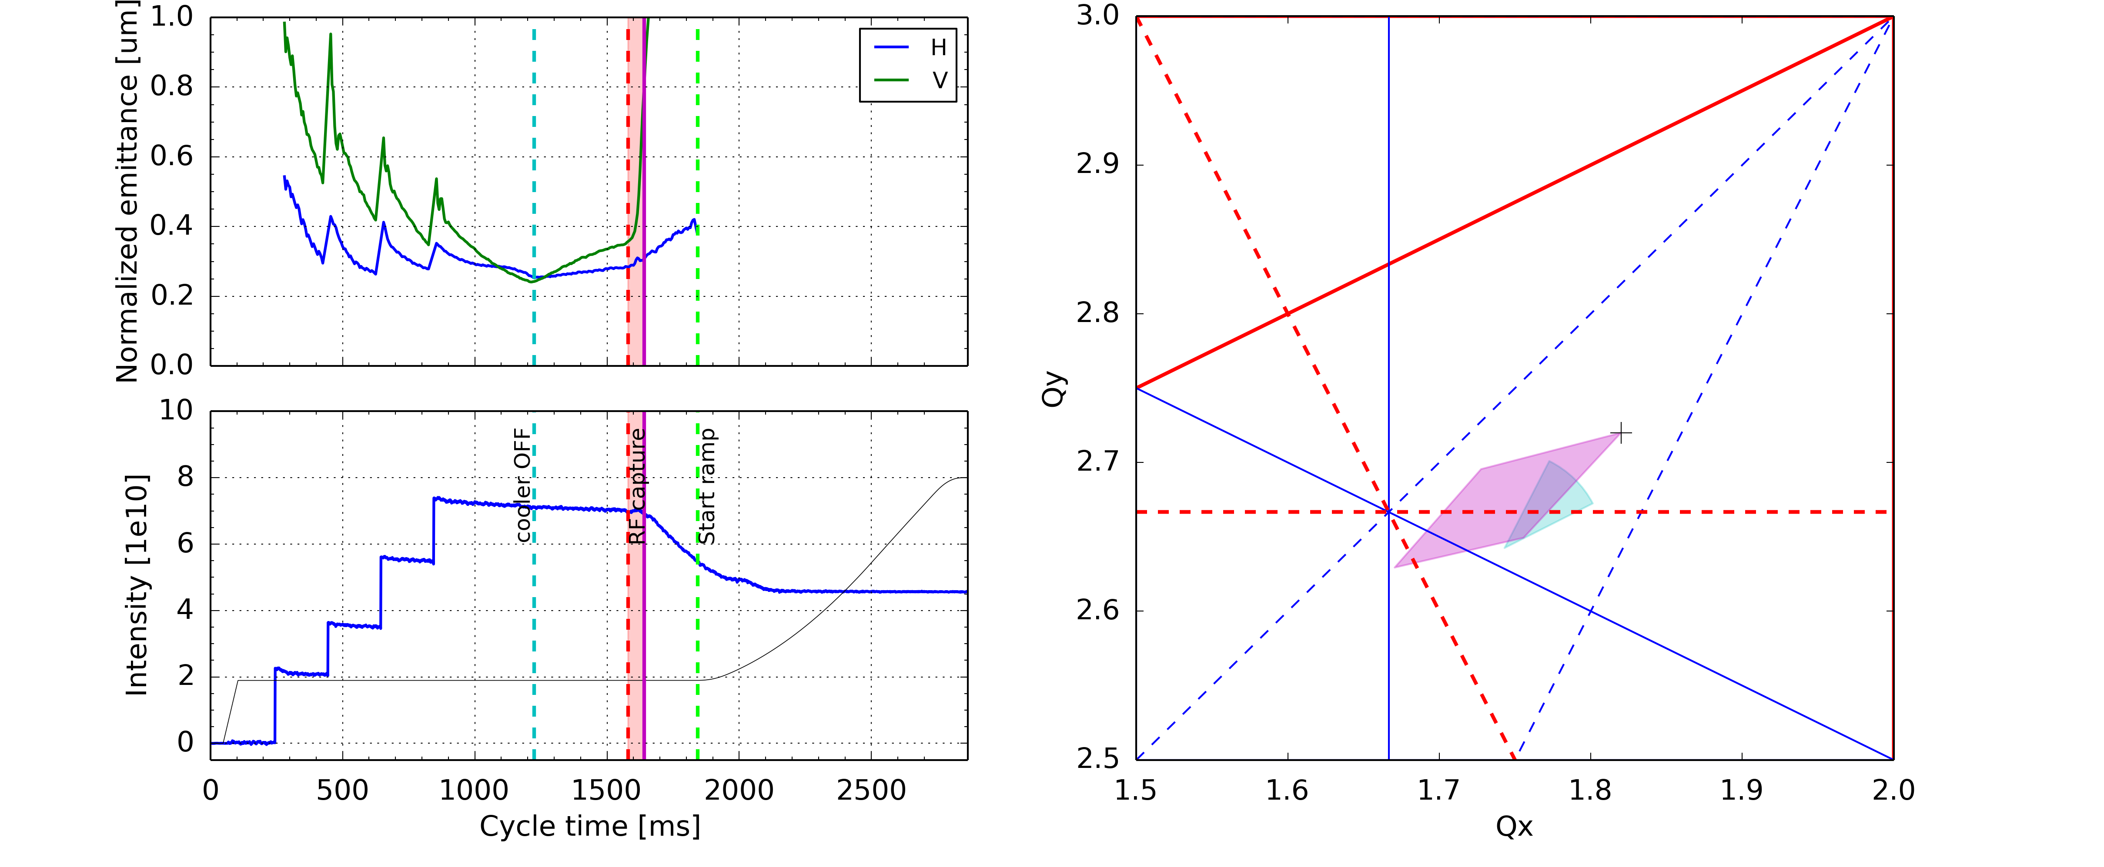
Space charge detuning
Studies of losses at long injection plateau with advanced RF capture
  Same loss characteristics → not related to the ramp (e.g. particles outside RF bucket)
  Emittance increase drastically changes at RF capture (especially in the vertical plane)

Slide 5
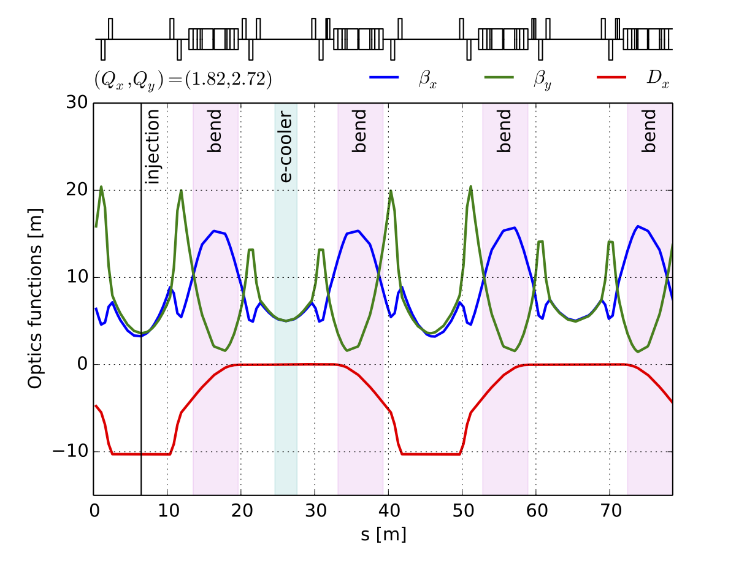
LEIR optics
Vertical beam size especially critical at entrance and exit of the four 90∘ dipoles

Slide 6
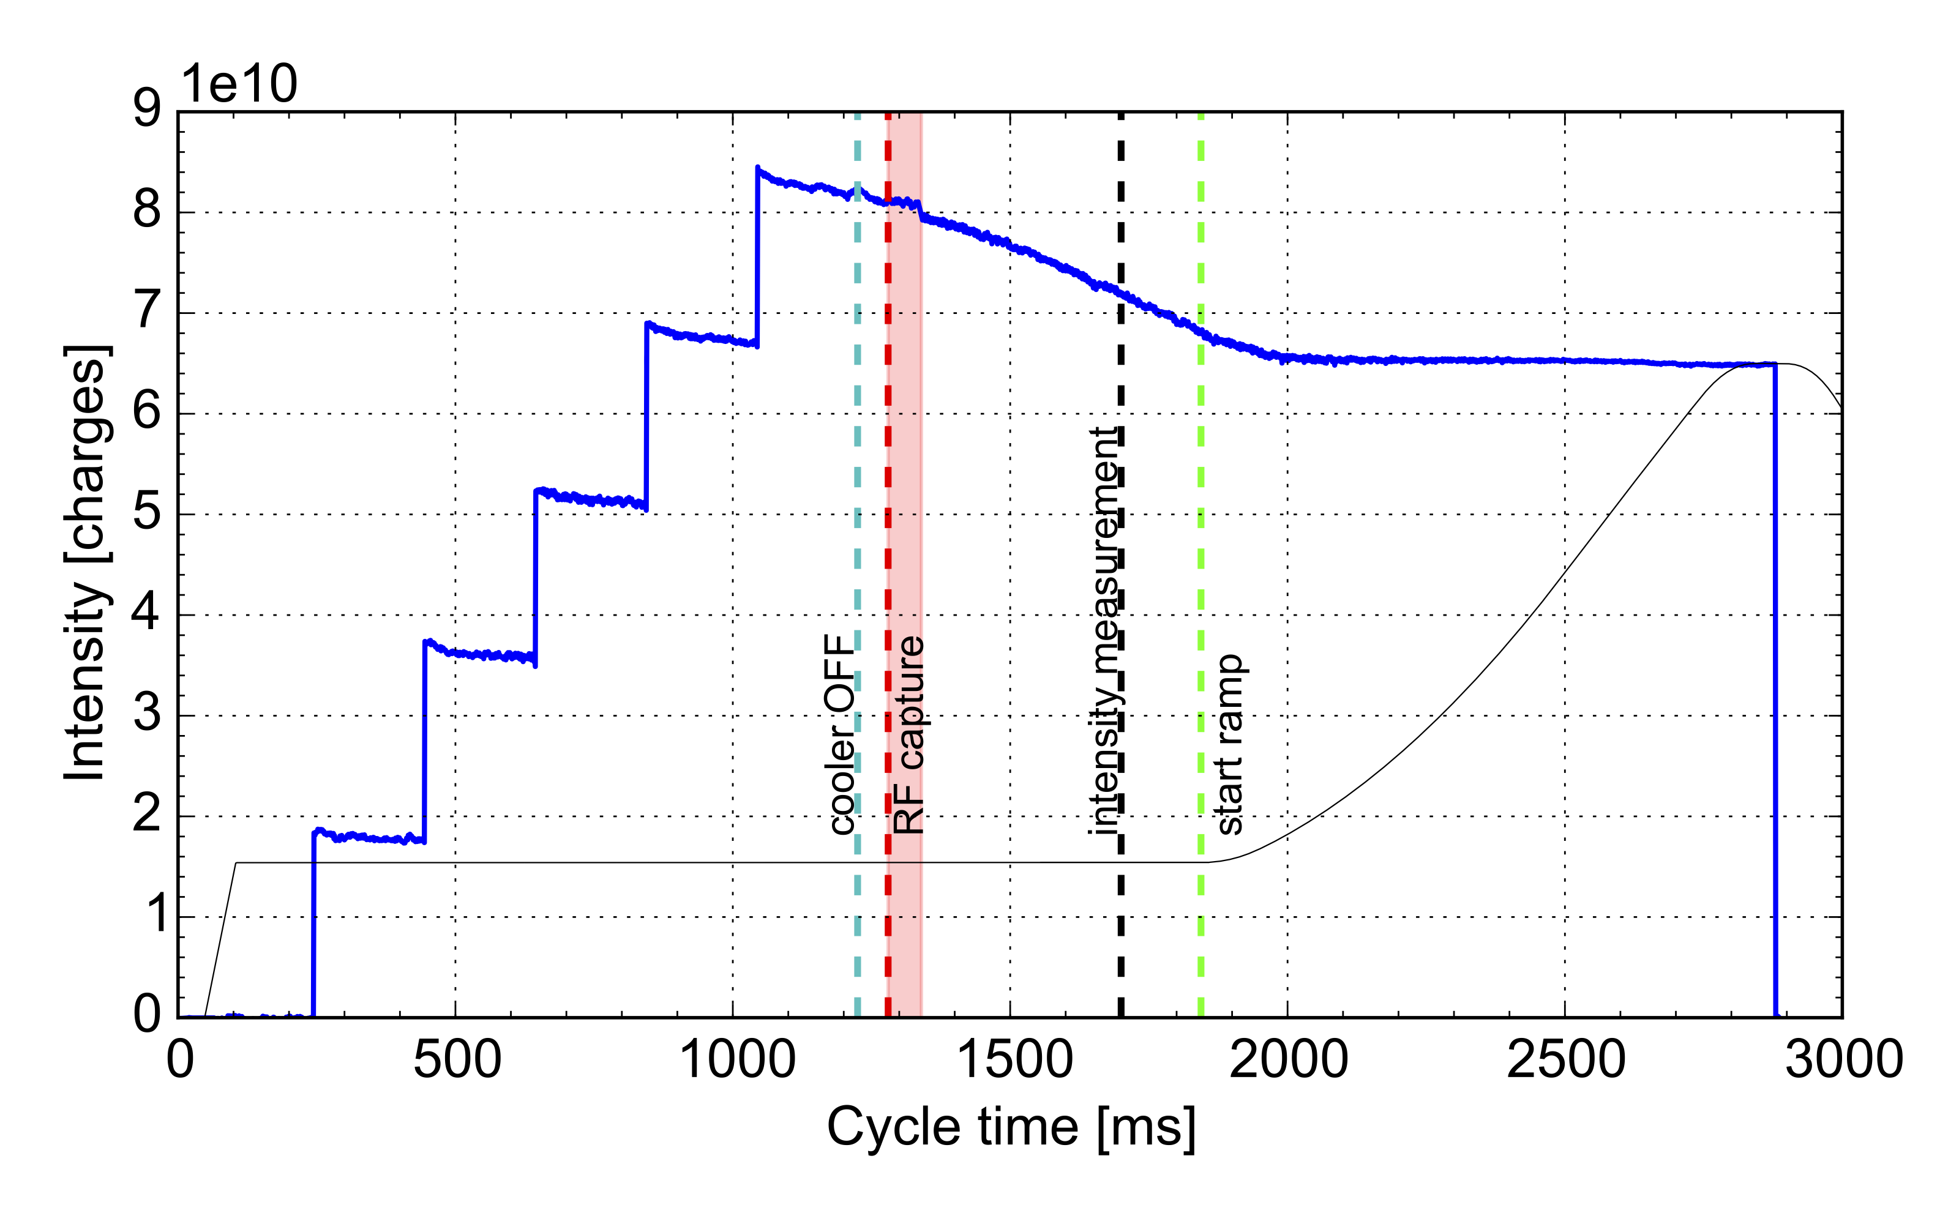
Tune scan
Measurement technique:
  Working point moved with cooler ON
  Beam loss at 1700 ms investigated (after RF capture)
Strong losses close to sextupole resonances
  Skew: 3Qy = 8
  Normal: Qx + 2Qy = 7
Octupole resonances appear to be excited as well

Slide 7
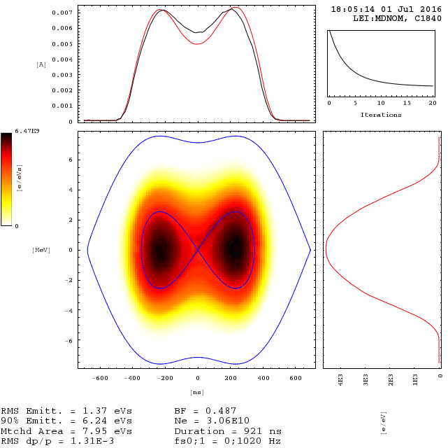
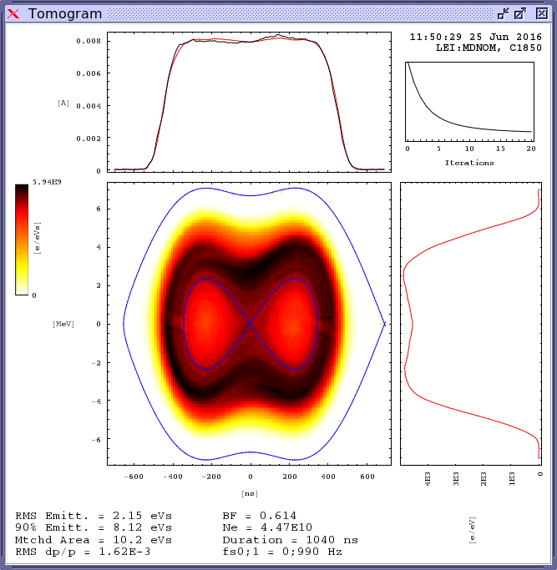
Mitigation measures (I)
Maximize bunching factor to reduce transverse space charge detuning
  Iso-adiabatic capture of coasting beam in double harmonic RF (bunch lengthening)
  Offset the capture frequency away from central beam energy results in flat line density profile
capture frequency centered
capture frequency offset

Slide 8
Mitigation measures (II)
standard sextupole settings
improved sextupole settings
Reduction of sextupole excitation
  Reduced current in the chromatic sextupoles at the end of injection plateau
  Clear beneficial impact on resonance excitation and beam loss

Slide 9
Mitigation measures (III)
Optimization of vertical orbit correction (aperture restriction in dipoles)
before correction
after correction

Slide 10
Mitigation measures implemented
Intensity assumed for LIU beam parameters

Slide 11
LEIR MD planning
  Studies on injection plateau
    Resonance compensation and losses with advanced RF capture on injection plateau
    Maximum accumulated intensity with 13 injections
    Injection efficiencies for high number of injections
    Test of 10 Hz injection rate
    Test of e-cooler operation at 400 mA and maximum cooling rate with 10 Hz injection rate
  Test of PS stray field compensation

Slide 12
LEIR MD planning
  Studies on injection plateau
    Resonance compensation and losses with advanced RF capture on injection plateau
    Maximum accumulated intensity with 13 injections
    Injection efficiencies for high number of injections
    Test of 10 Hz injection rate
    Test of e-cooler operation at 400 mA and maximum cooling rate with 10 Hz injection rate
  Test of PS stray field compensation

Slide 13
10 Hz injection rate
R. Scrivens, G. Tranquille
13 injections with 100 ms spacing
9 injections with 100 ms spacing
Electron current increased to 400 mA (instead of 200 mA)
First attempt of optimization
  Orbit in the injection region and the electron cooler
  Energy of circulating beam
  Transfer line settings, …
Cooling efficiency to be improved to benefit from 100 ms spacing
Alternative option: 150 ms injection spacing (changes to source pulsing)

Slide 14
Impact of increased electron current at 5 Hz
Electron current increased to 400 mA (instead of 200 mA)
Improved accumulation using 5 Hz injections (≈ 13x10¹⁰ charges)
Effect of different electron distributions to be investigated

Slide 15
LEIR MD planning
  Studies on injection plateau
    Resonance compensation and losses with advanced RF capture on injection plateau
    Maximum accumulated intensity with 13 injections
    Injection efficiencies for high number of injections
    Test of 10 Hz injection rate
    Test of e-cooler operation at 400 mA and maximum cooling rate with 10 Hz injection rate
  Test of PS stray field compensation

Slide 16
LEIR MD planning
  Studies on injection plateau
    Resonance compensation and losses with advanced RF capture on injection plateau
    Maximum accumulated intensity with 13 injections
    Injection efficiencies for high number of injections
    Test of 10 Hz injection rate
    Test of e-cooler operation at 400 mA and maximum cooling rate with 10 Hz injection rate
  Test of PS stray field compensation

Slide 17
PS stray field compensation
M. Gabriel , S. Pasinelli
Correction applied to ETL.BHN10 to account for stray field of PS magnet
Test of improved algorithm showed clear improvement of injection efficiency
More dedicated studies required to verify system for different SC compositions

Slide 18
LEIR MD planning
  New optics with tunes below half integer
    LSA implementation (tune, chromaticity knobs, e-cooler compensation, injection fast bumps)
    Closed orbit, tune and chromaticity correction along cycle
    Optimisation of injection process
    Losses in comparison to nominal optics
    Resonance compensation
  Impedance model
    tune shift
    instability growth rates
  Optimization of extraction transfer line optics

Slide 19
LEIR MD planning
  New optics with tunes below half integer
    LSA implementation (tune, chromaticity knobs, e-cooler compensation, injection fast bumps)
    Closed orbit, tune and chromaticity correction along cycle
    Optimisation of injection process
    Losses in comparison to nominal optics
    Resonance compensation
  Impedance model
    tune shift
    instability growth rates
  Optimization of extraction transfer line optics
Studies to be started in the following days

Slide 20
LEIR MD planning
  New optics with tunes below half integer
    LSA implementation (tune, chromaticity knobs, e-cooler compensation, injection fast bumps)
    Closed orbit, tune and chromaticity correction along cycle
    Optimisation of injection process
    Losses in comparison to nominal optics
    Resonance compensation
  Impedance model
    tune shift
    instability growth rates
  Optimization of extraction transfer line optics

Slide 21
LEIR impedance model
M. Migliorati, N. Biancacci
https://espace.cern.ch/be-dep/ABP/HSC/Meetings/LEIR_impedance_model_MM.pdf
Longitudinal impedance
Transverse impedance
First evaluation of contribution of different machine elements to impedance
Main source of impedance: vacuum chambers in dipoles
MDs ongoing to:
  Measure tune shift with intensity (coasting/bunched)
  Measure growth rate of instabilities
  Characterize TFB
Discrepancies between measurements and theory to be understood

Slide 22
Outlook
Maximization of accumulated intensity by reducing injection spacing
  Efficiency of electron cooling with increased electron current to be further studied:
    For current injection rate at 200 ms
    Alternatively at 100 and 150 ms
Operation at a different working point
  Needs development of completely new machine optics
  Critical point: optimization of injection efficiency
Understand the origin of the skew sextupolar
resonance
  Measurement of resonance driving terms
  Resonance compensation
  Further characterization of the loss mechanism
Optimization of the longitudinal distribution
  Maximizing the longitudinal emittance in combination
  with increased RF voltage using second cavity
Optics change before RF capture
  Aim: gain vertical aperture in the bending magnets

Slide 23
Thank you for your attention!

