Slide 1
LIU Ions
R. Scrivens for the LIU IONS PS Injector team
14/07/2016

Slide 2
Outline
Beam Intruments – Pick Ups
Low Level RF
Transverse Feedback
LinacBoosterSpectrometer Line
Others….
General Schedule.

Slide 3
Beam Instruments
Injection Pick Ups
Preparation and installation of 4 pick ups targeted for EYETS2016-17.
All installation teams informed.
Planning bottlenecks:
  Production not yet committed to schedule. Will be considered with drawings (foreseen end July) and make request of external offers.
  Raw material is being ordered (SS, flanges, bellows).
  2 pick ups in EI must be NEG coated and baked (sector 1). Planning for this is very tight to be ready before 08/05/2017 xenon restart. The EI pick up installation is not possible if LEIR restart advanced.
(Meetings: https://indico.cern.ch/category/8230/)

Slide 4
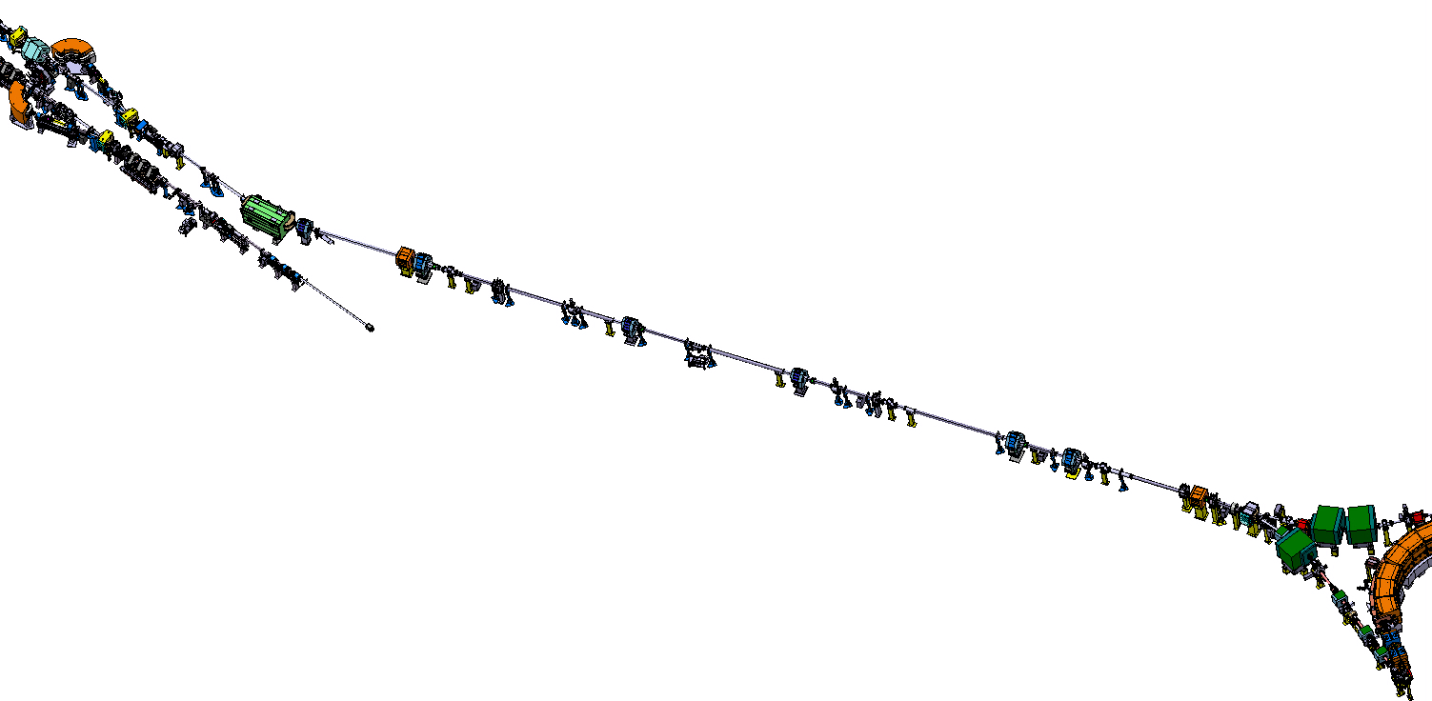
Injection Pick Ups
#2
#1
#3
(ITE line)
(ETL line)
#4
#5
#6
#7
Ions
9 BPMs TO BE INSTALLED ON ITE, ETL, EI LINES
4 (#1, #2, #8, #9) TO BE INSTALLED DURING EYETS (ITE by March 2017)
#8
(EI line)
#9

Slide 5
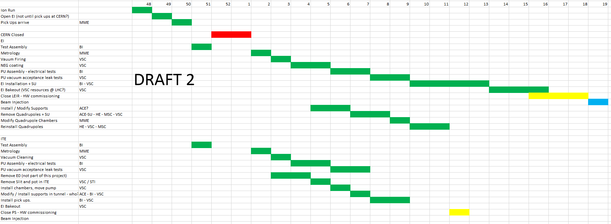
Injection Pick Ups Draft Installation Planning
2016
2017

Slide 6
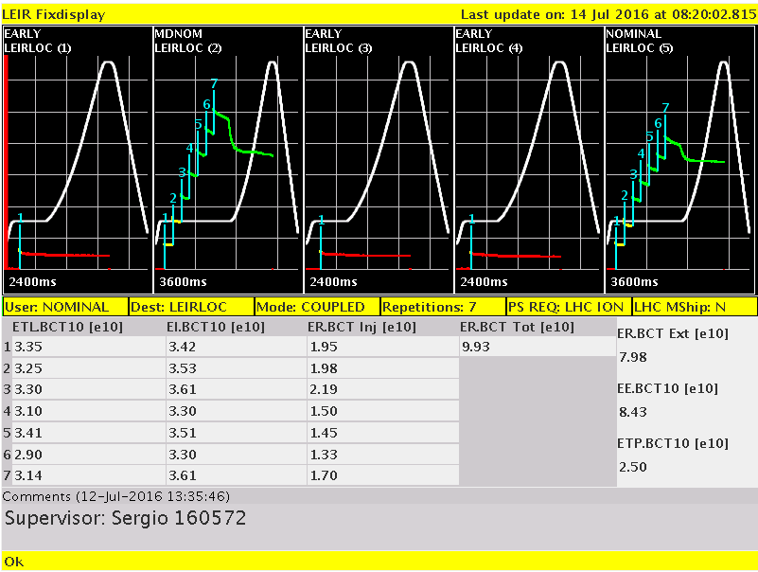
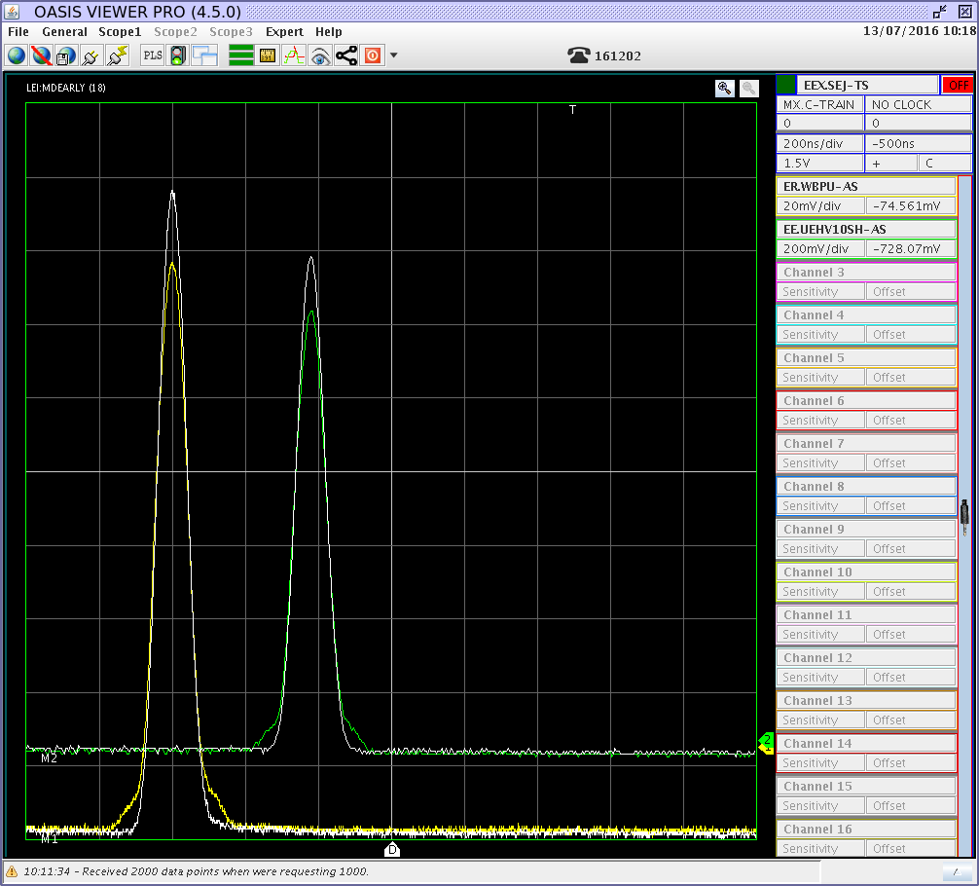
Low Level RF
New Low Level RF system is now operational:
Both EARLY and NOMINAL beams have been setup (although not optimised) and delivered to the PS.
Switch will now be done of the spare cavity (CRF43) to the new cavity control
The system integration is well advanced and allows already full system operation at the same level as the old LLRF. In addition more diagnostics will become available soon (as the software commissioning is finished).
We hope to experience the same level of reliability shown at the PSB.
LEIR with new Low Level RF
Early Bunch compared between old and new LLRF

Slide 7
Transverse Feedback
TFB has worked well to help produce >9E10 charges.
RF team are collecting requests for changes as they come. (https://indico.cern.ch/event/546599/)
RF have been asked to make a strategic view the system, taking into account also the long term maintainability. Consolidation or LIU funding?

Slide 8
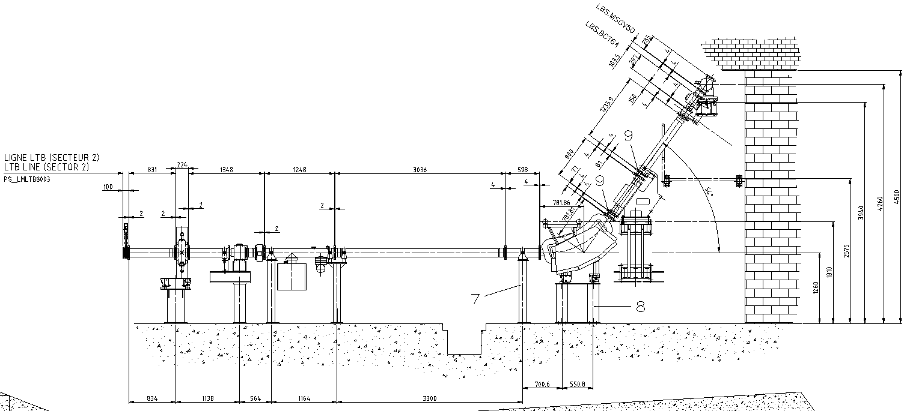
LBS Line
Specification for the changes in the line in Engineering check circulation and presented
  https://indico.cern.ch/event/543446/
  https://edms.cern.ch/comment/1703607/0.1
ECR on vacuum modifications being prepared.
Water connection modifications (magnet and PC) clarified with EN-CV (although still decisions to take by CV).
Modifications are planned for LS2.
  In an early Linac4 connection, the LBS modifications do not impact on Linac4.
  They can be made in a later stop (when 2GeV upgrade is made).
  EN-HE have confirmed they will be able to make the transports in the future.

Slide 9
Dump
  Requires the SSR to be made this year.
  3D model finished. Detailed design (dump and magnet Y chamber) launched.
  Installation foreseen YEST2017-18.
  Discussion to use the spare budget to refurbish the beam-stoppers between L3-LEIR.
Ring Orbit Electronics
  Production ongoing.

Slide 10
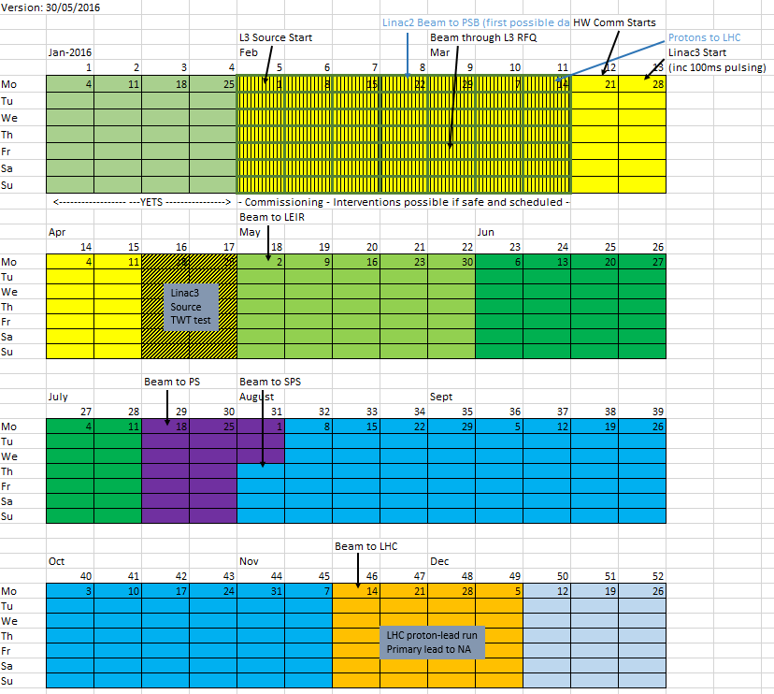
LEIR
Commissioning
LEIR
MD
EARLY -> PS
NOMINAL -> PS
LEIR and Linac3 MDs continue in parallel

Slide 11
Thanks To
R. Alemany Fernandez, M-E. Angoletta, J. Axensalva, S. Albright, H. Bartosik, G. Bellodi, N. Biancacci, A. Blas, M. Bodendorfer, M. Bozzolan, J. Broere, C. Carli, J-M. Cravero, P. Dahlen, A. Findlay, A. Dworak, A. Frassier, S. Gilardoni, H. Hancock, B. Holzer, A. Huschauer, D. Kuchler, S. Jensen, V. Kain, M. Maintrot, D. Manglunki, J. Marques, C. Mastrostefano, A. Michet, M. Migliorati, R. Mompo, M. O’Neil, S. Pasinelli, A. Perillo, G. Piccinini, T. Rijoff, F. Roncarolo, G. Rumolo, S. Sadovich, L. Soby, G. Sterbini, L. Timeo, V. Toivanen, G. Tranquille, F. Wenander, M. Zerlauth, + more….

