Slide 1
Source and Linac3 activity progress
G Bellodi for the Linac3 team

Slide 2
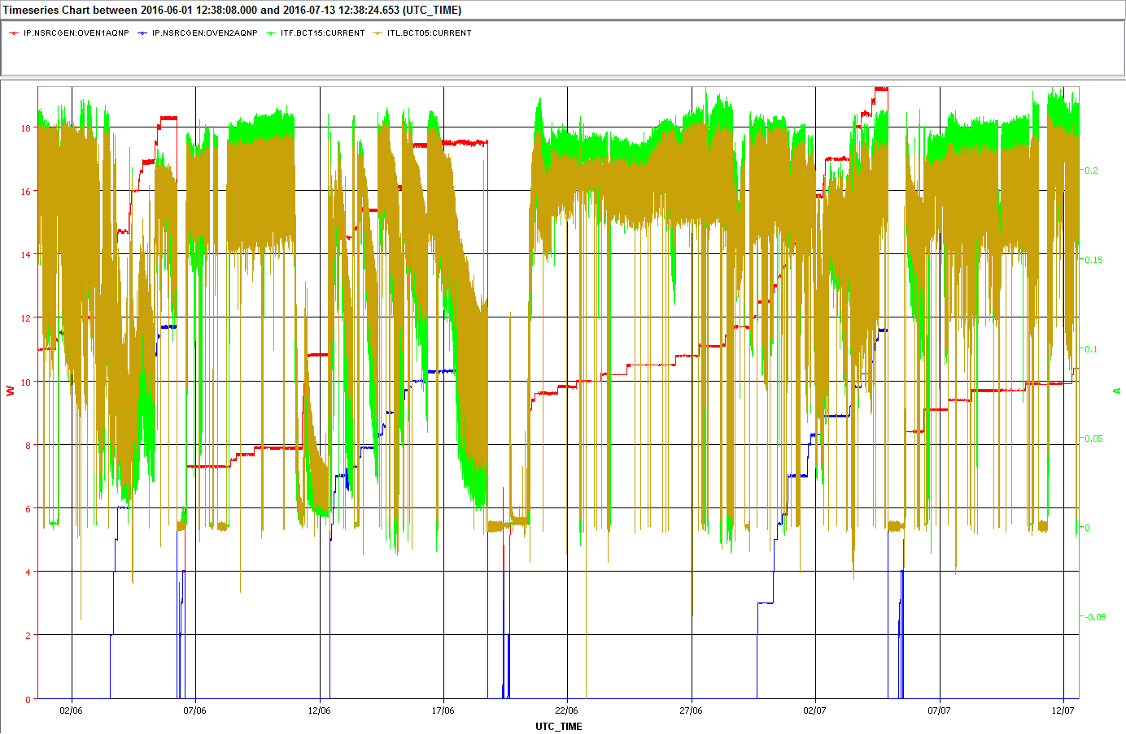
Source & Linac3 operation since 01/06

Slide 3
Einzel lens measurements
Last LIUPT 01/06/2016
Now
 | Current on FC2 | Current on FC3
0kV – typical | 200 μA | 130 μA
9kV | 215 μA | 127 μA
-18kV | 197 μA | 118 μA

Slide 4
Einzel lens– measurements
Guillotine → variation in offset after solenoid1, similar beam size
Comparable or slightly higher transmission to FC2 after LEBT re-tuning, ~nominal or slightly lower intensity on FC3 (indication of lower RFQ transmission)

Slide 5
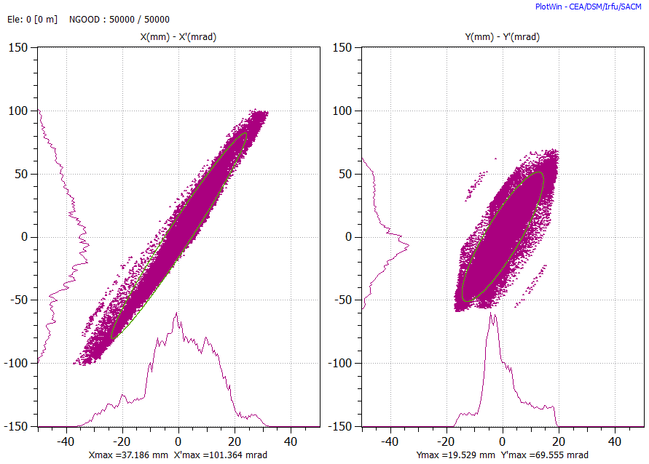
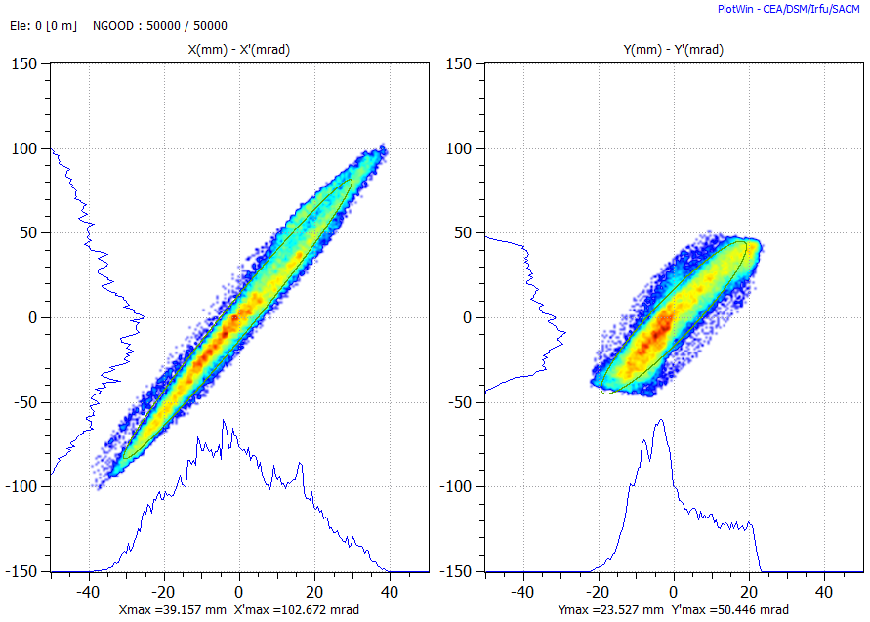
Tomographic reconstruction of beam distribution from quadrupole scans
Beam @ triplet input
Einzel | X emittance RMS mm mrad | Y emittance RMS mm mrad
0 kV | 0.24 | 0.21
9 kV | 0.25 | 0.19
-18 kV | 0.26 - tbc | 0.16 - tbc
Purple = 0kV
Blue = 9 kV

Slide 6
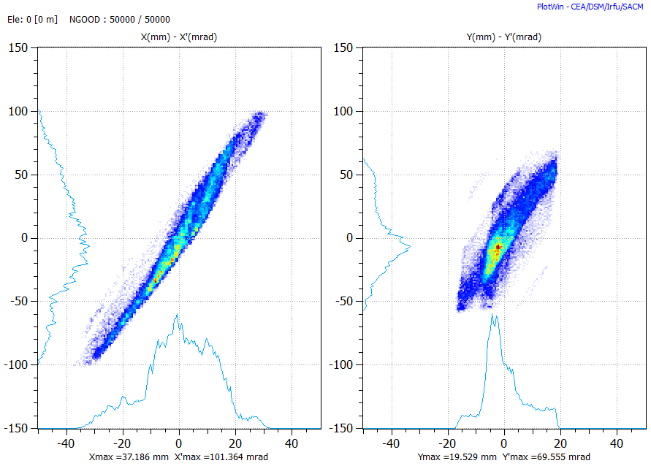
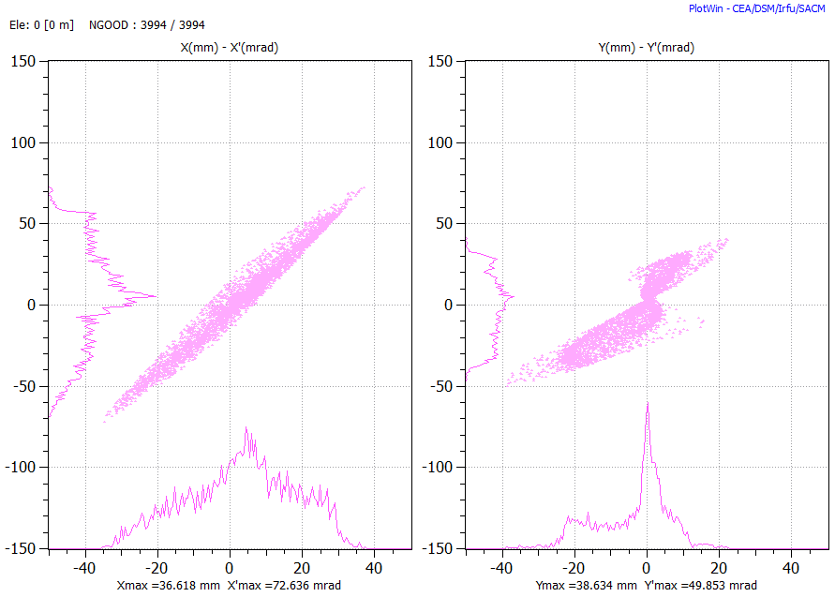
Simulations vs measurements
Beam @ triplet input
Pink= simulation result of beam tracking from source extraction,
Blue=tomographic reconstruction
New particle charge assignment introduced in IBsimu, found inconsistency with PATH
Corrected input beam distributions in preparation
Simulations of 9kV/-18kV to follow and benchmark with measurements

Slide 7
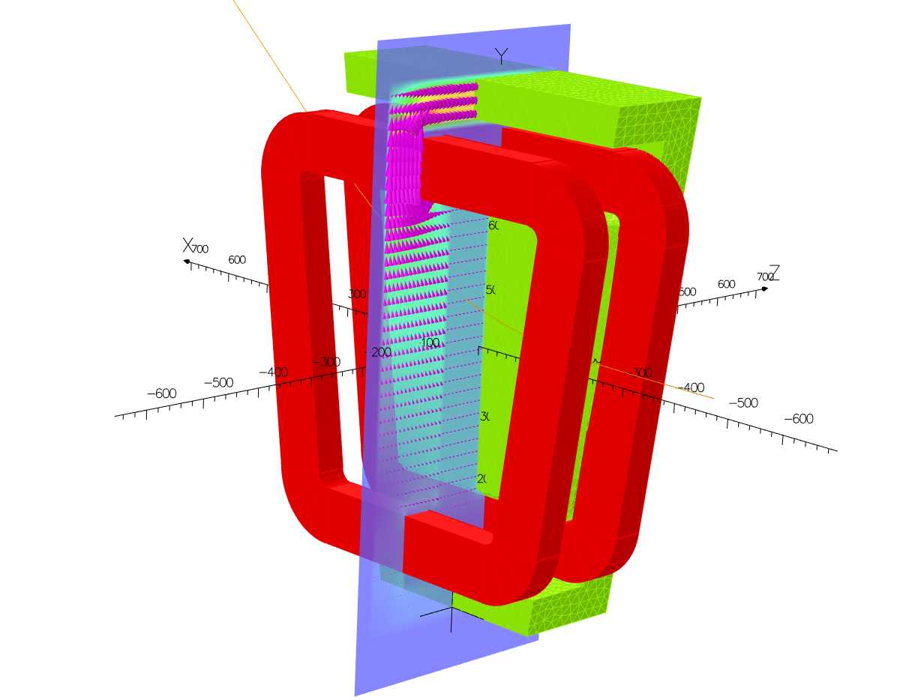
OPERA calculation of bending magnet field and benchmark/comparison with PATH model
Critical element in the LEBT beam dynamics with a complicated geometry
C Valerio

Slide 8
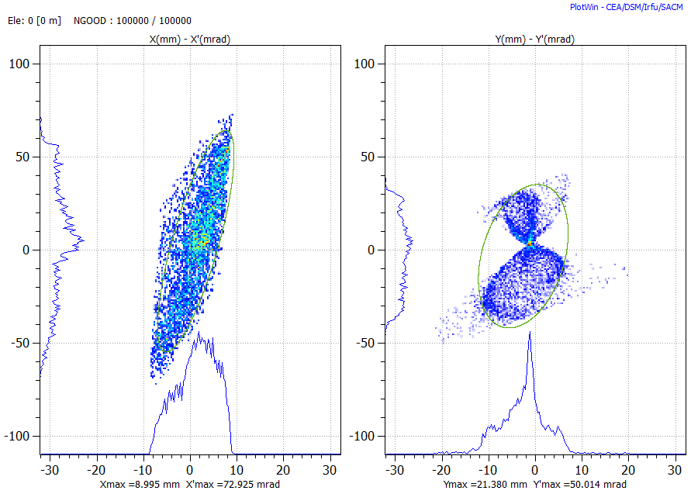
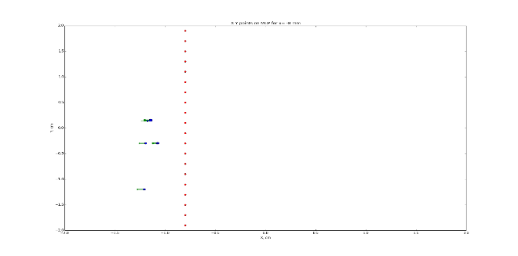
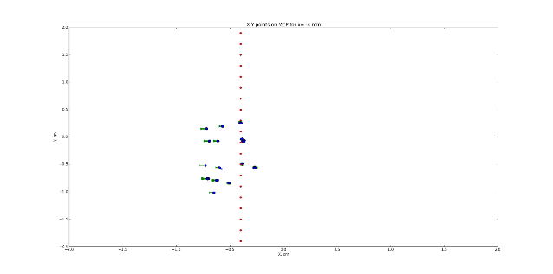
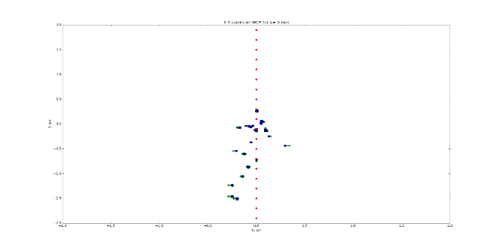
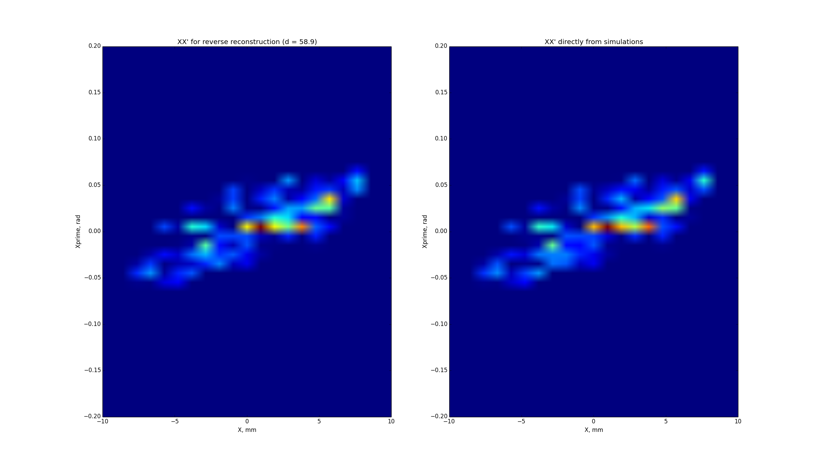
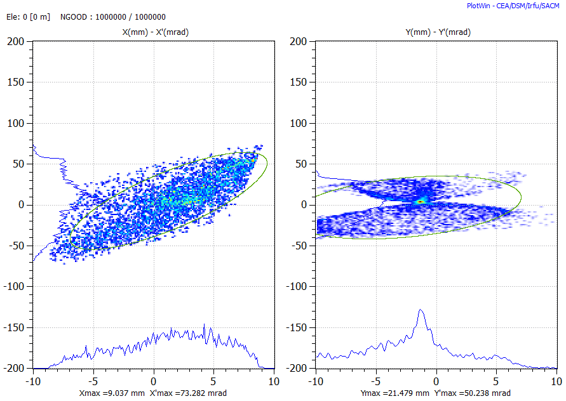
Pepper pot reconstruction code benchmark
PATH simulation of a pepper pot scan
1mm step frames
reconstructed
original
XX’
Use these frames as data input for beam reconstruction

Slide 9
Pepper pot conclusions – so far
Layout of the pepper pot mask is not suited to the beam to be measured (too strong vertical divergence that causes beamlet contamination in the diffraction images on the MCP, added to complicated pattern due to x-y correlations and dipole fringe field effects)
Reconstruction technique (as benchmarked with simulations) works correctly in XX’ plane, but fails in YY’ (no recipe for correct association of holes and beamlets)
Solutions under discussion:
    change in geometry : increase hole spacing in the mask or decrease distance between mask/MCP to mitigate divergence issue
    change in location : find a spot where beam is less divergent (but it would make more difficult to characterise multiple charge states other than the operational one. Space availability issue)
    Removal tout court (aperture limitation effect not yet completely excluded)

Slide 10
TWTA update
The TWTA unit arrived at CERN.
Installation details are under discussion (extra electronics rack or just a plain support on the source cage)
Market options for procurement of an oscillator and bi-directional coupler are being evaluated.
Installation and commissioning timeline to be discussed in compatibility with operational constraints

Slide 11
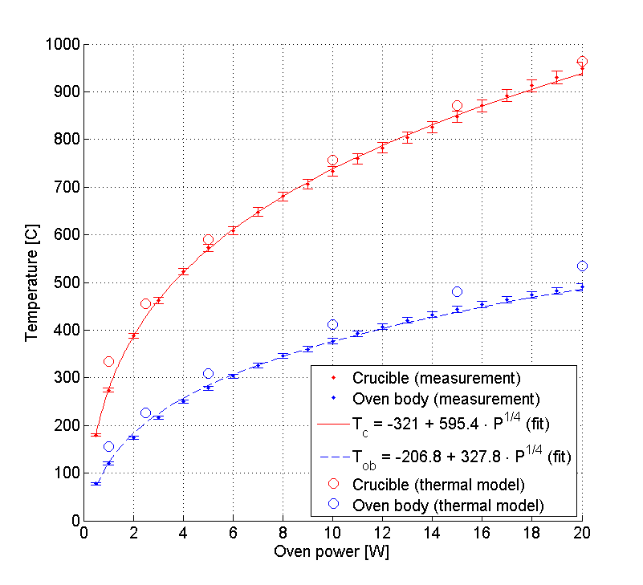
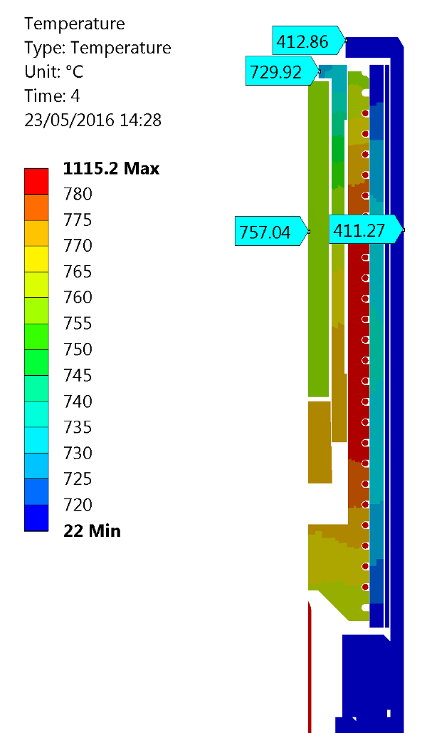

Oven test stand – oven temperature characterisation
Axisymmetric model with ANSYS from EN/MME
Measured data
$$T_{crucible}=54.6+1.8 T_{oven body}$$
Power = 10 W
Model has good correlation with measured temperature behaviour
An example of oven temperature distribution

Slide 12
Oven test stand – to come
Program to be continued by doctoral student arriving in autumn.
Next steps:
Measurement of Pb evaporation rate (study link to input power and temperature)
Study of oven performance with oxygen atmosphere
    Replicate the Linac3 ion source operation conditions more closely
Study of oven performance with different Pb samples and crucibles
  (new vs recirculated samples and crucibles)
Thermal model
  Evolution of temperature distribution with Pb loading (cooler oven tip, etc.)
  Effect of varied oven structure to temperature distribution

