Slide 1
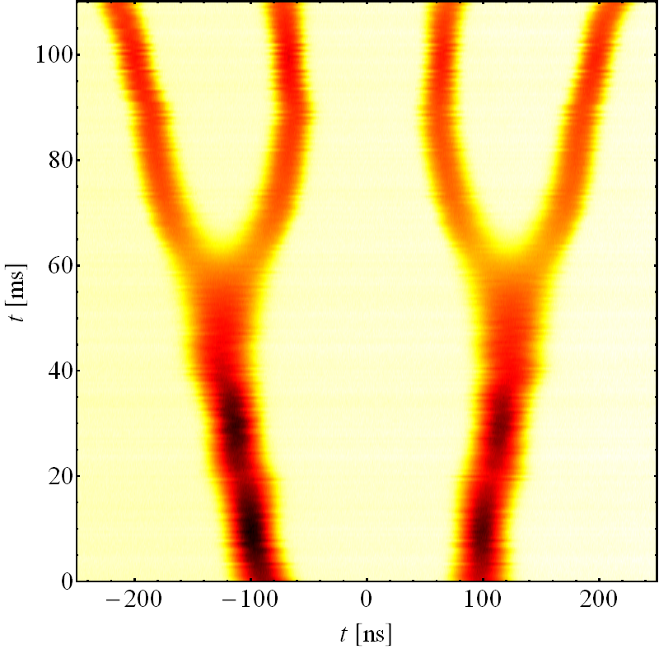
Status of lead beams in the PS
Single-bunch (‘early’)
New front-end amplifier for beam signal replacing mechanical relay
Compensation of beam phase loop delays at h = 16 redone
4 bunches spaced by 100 ns (ILHC100#4b) for proton-lead run
Complete re-programming of 10 MHz cavity voltages, harmonics and phases
Pre-LS1 cycle fully adapted to present tuning group structure
Compensation of beam phase loop delays at h = 16/21 for new amplifier
S. Hancock and HD
RF manipulation re-setup
Basic 1st iteration longitudinal setting-up of both operational variants, but
Not yet deliverable to SPS
MDs for 50 ns bunch spacing not started → 2nd half of August at earliest
Many thanks to LEIR for the beams!
2016 measurement

