Slide 1



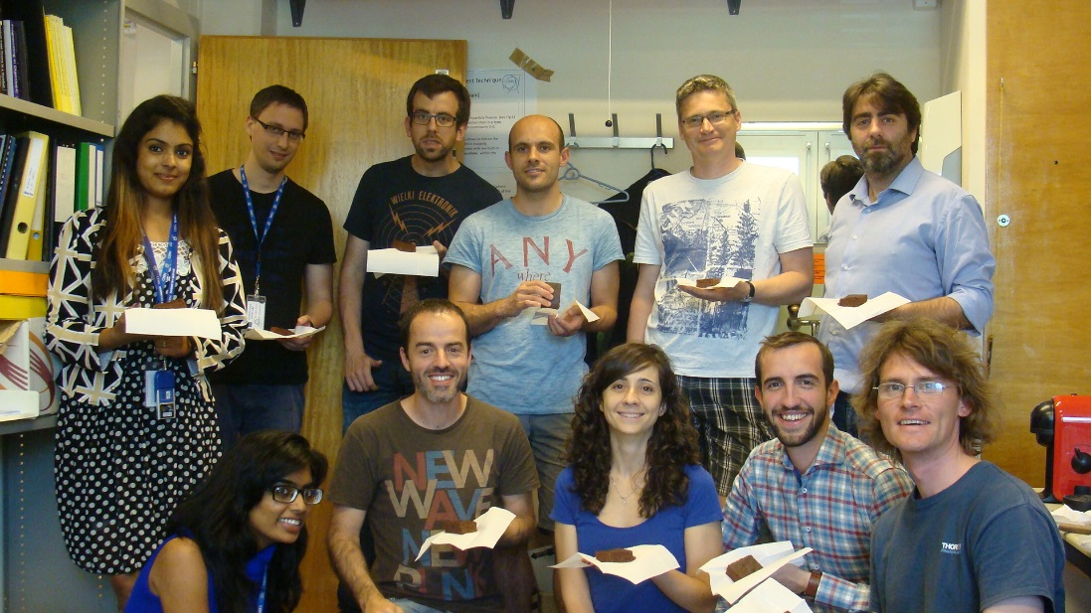
PH-DT-DD: SSD-Solid State Detectors
EP-DT-DD Meeting – 8.7.2016
EP-
R&D: Development of radiation tolerant silicon detectors
in the framework of RD50 and CMS
Service: Characterization of semiconductor detectors
The team today (CERN & visitors):
PhD students:
Sofia OTERO UGOBONO
Esteban Curras Rivera
Hannes Neugebauer
Laura Franconi
Summer students:
Ayushi, Bhavita,
Shivika, Urban
Urban
Isidro
Michael
Visiting Scientist:
Marcos Fernandez Garcia
Trainee/FTEC:
Joaquin Gonzalez (0.5 FTE)
Isidro Mateu Suau (0.5 FTE)
CERN Staff
Michael Moll (0.6 FTE)
Esteban
Joaquin
Shivika
Left SSD since Nov.15:
Christian Gallrapp (Fellow)
Celso (Trainee)
Marcos
Julien
Hannes
Bhavita
Laura
….no dedicated technician!
Sofia
..soon visiting: Rogelio (Seville)

Slide 2
Present Projects and Services
SSD activities at CERN
RD50 Collaboration
  Steering and Management of the RD50 collaboration (50 Institutes, 300 members)
    Michael: Co-Spokesperson, budget holder, CERN Contact, Glimos; Veronique: secretary
  Characterization and simulation of radiation effects in silicon devices
    Development of characterization tools (TSC, edge-TCT, Two-Photon TCT, …)
    Measure damage parameter (CV,IV, CCE, TCT) and defect properties (TSC, I-DLTS)
    Simulate detector performance (TCAD, TRACS)
    Defect/Material engineering: p/n-type, different resistivity, impurities,…
  LGAD (Low Gain Avalanche Detectors) and APDs (Avalanche Particle Detectors)
    Fast timing applications
    Charge amplification in highly damaged detectors
  3D detectors, CMOS sensors, …
CMS Collaboration & RD50
  Sensor development for the High Granularity Calorimeter (HGC)
Service
  Measurement of sensors for/with external groups
….its all about silicon sensors
and their application as HEP detector.
No major changes since November 2015

Slide 3
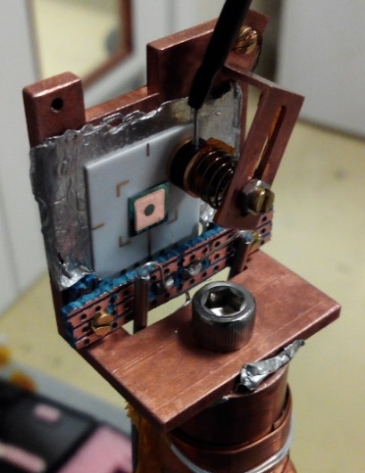
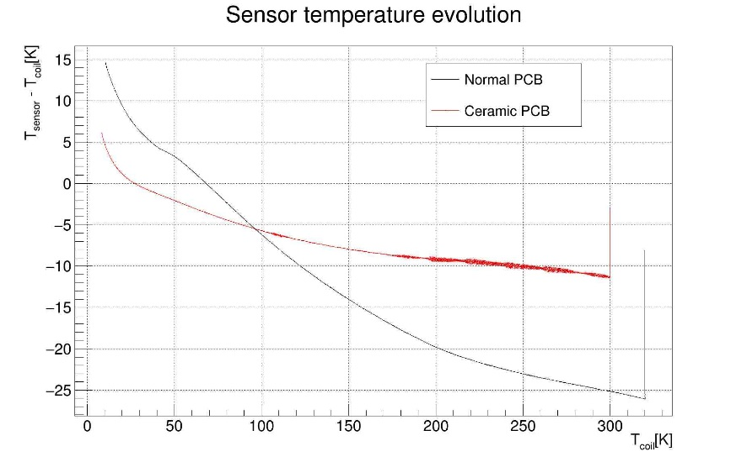
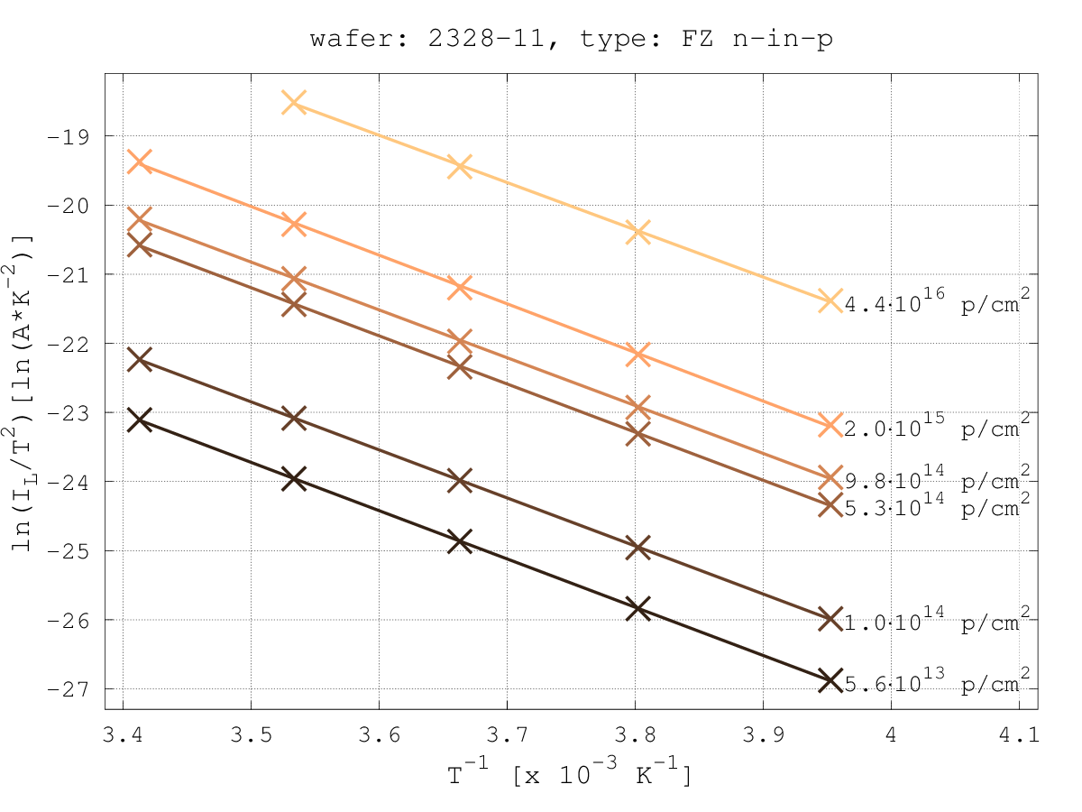
Damage & defect parameterization
Lab infrastructure improvements
  Cryocooler
    Optimization of cryocooler for more accurate temperature reading during temperature scan (20K to 240K in 20min)
    Design and simulation of new PCB using a ceramic substrate (collaboration with MPT Workshop: Antonio, Rui)
    Re-design of the mechanical support and connections to reduce thermal loads
  Addition of functionalities in the controlled temperature chamber (Susi)
    Automatic I-V measurements at different temperature steps, I-T measurements, C-V measurements
Study on leakage current temperature dependence
  Evaluation of activation energy for silicon (work with IRRAD team)
    Wide range of temperature scaling values published in literature
    A value of Ea = 1.20 eV was obtained by our work in agreement of theoretical predictions with midgap defect level
10K/min
(Proof of concept for the new Cryocooler design (Ceramic PCB + Temperature sensor pressed near the DUT + reduced thermal load due to cables)
Details: RD50 workshop 6/2016: Isidre for T-scaling of leakage current [link]

Slide 4
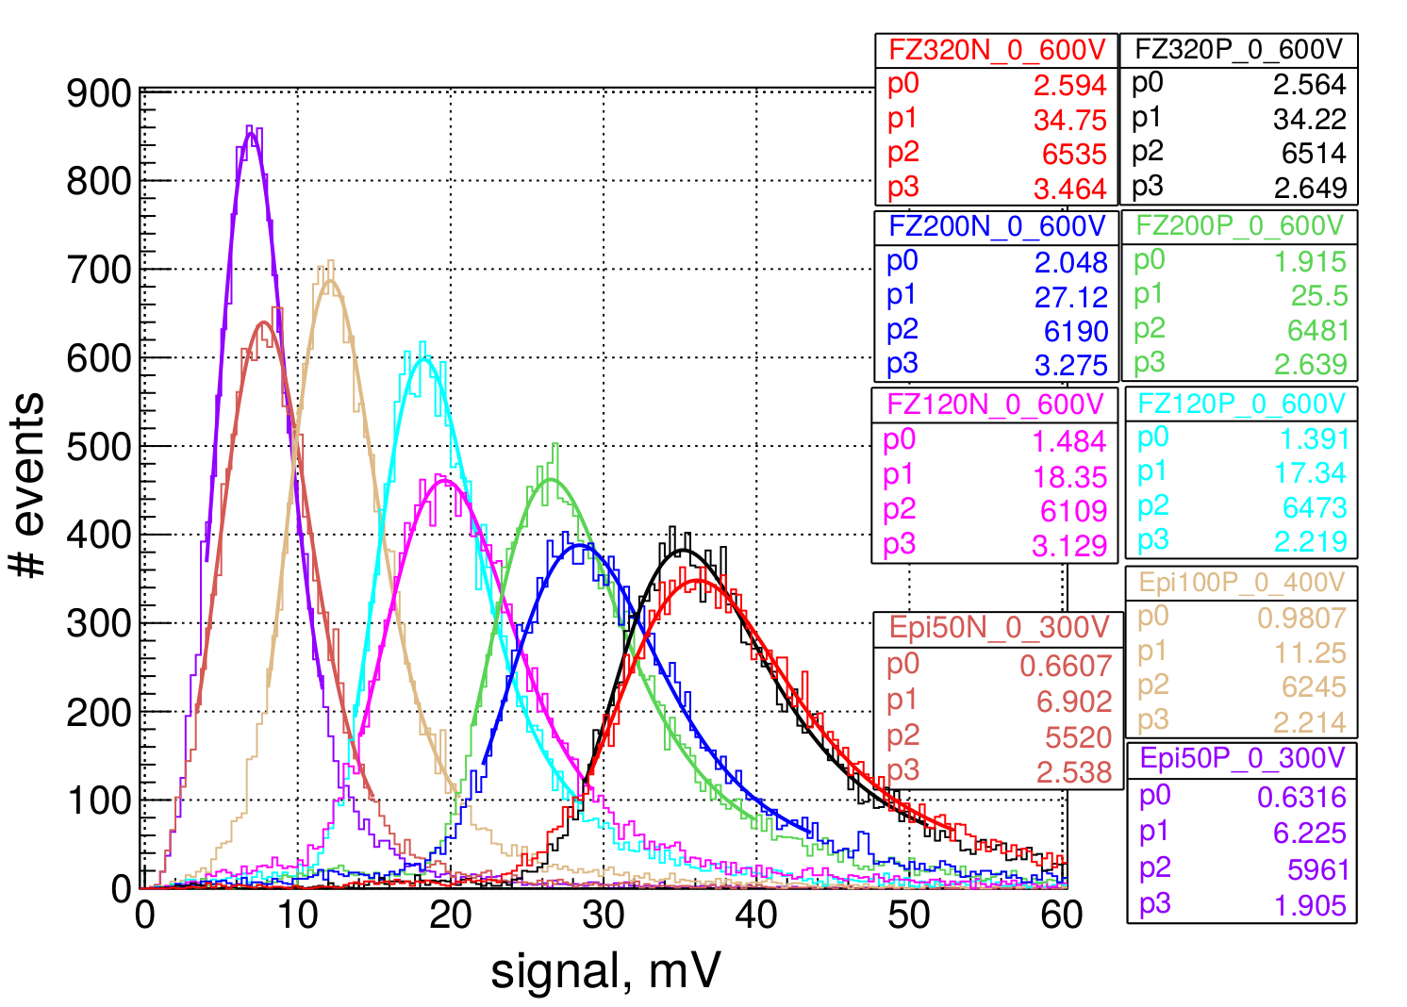
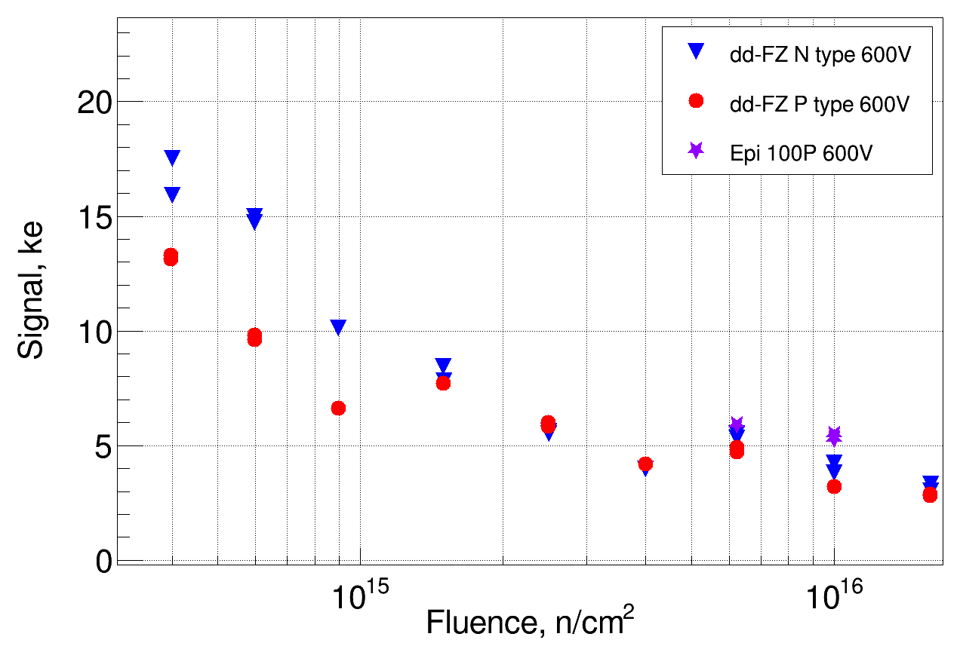
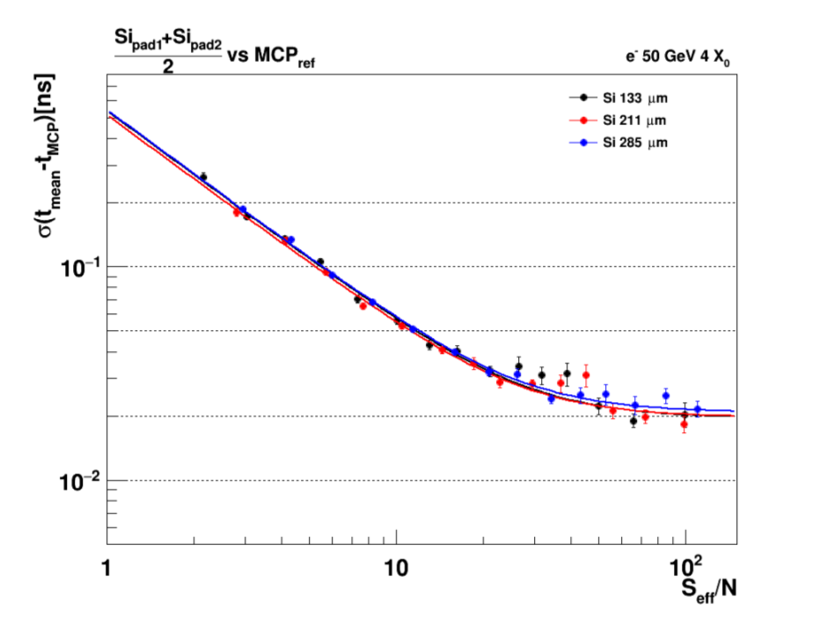
CMS: High Granularity Calorimeter
HGC
  600 m² of silicon sensors (6M channels) exposed up to 1.5x10¹⁶ n_{eq}/cm²; Structure of sensors: Hexagonal pads
  Radiation tests of sensor structures performed by SSD [Esteban thesis] with Uni HH
  CCE (beta, laser), CV, IV, test beam (with CMS team) on irradiated sensors: (p, n, FZ, EPI, 50 to 300 μm)
-30°C
dd-FZ 320um
dd-FZ 200um
dd-FZ 120um
Epi 100um
Sensors: p- vs. n-type ; FZ vs. EPI
  Proof of concept: Sensors operational up to highest fluence
  300μm sensors: unclear why n-type is better !?
  120μm sensors: unclear why EPI better than DD-FZ !?
    Very welcome effect: For HPK 8” production no DD-FZ wafers available, will have to use epitaxial wafers!
Timing (test beam data)
    Reaching 20ps time resolution for S/N > 30
20ps
Details: RD50 workshop 6/2016: Esteban for HGC sensor radhard testing [link]

Slide 5
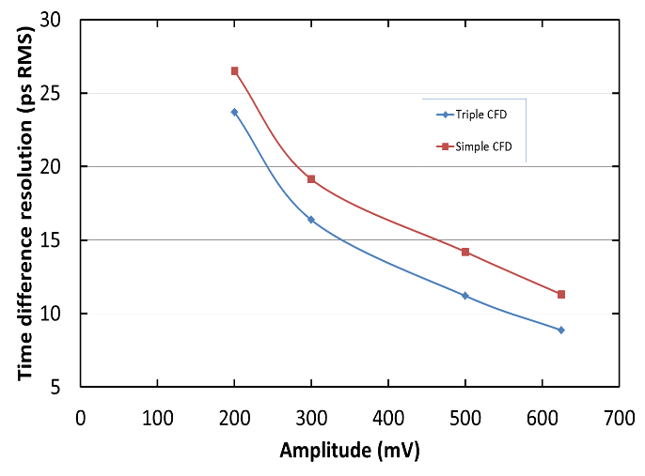
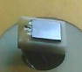
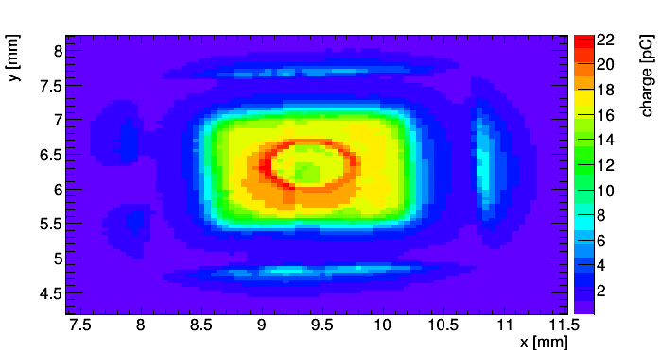
Sensors with intrinsic gain
LGAD (Low Gain Avalanche Detectors) [Ultrafast Silicon Detectors – UFSD]
  RD50 collaboration (several institutions); producer CNM and FBK, soon: HPK
  Experiments considering LGAD as option: ATLAS HGT, CMS fast (hermetic) timing, CTPPS
  SSD: Study of gain homogeneity and gain loss after proton irradiation
gain approx. 5 before irradiation
DD-APD (Deep Diffused Avalanche Particle Detectors) [Hyperfast Detectors]
  Collaboration with some US CMS groups and producer RMD in the US
  Time resolution obtained on un-irradiated devices: 15ps
  Test beam in collaboration with RD51 (….analysing data)
~ 1 MIP
~ 15ps
Details: RD50 workshop 6/2016: Sofia for LGAD [link], Michael for DD-APD [link]

Slide 6
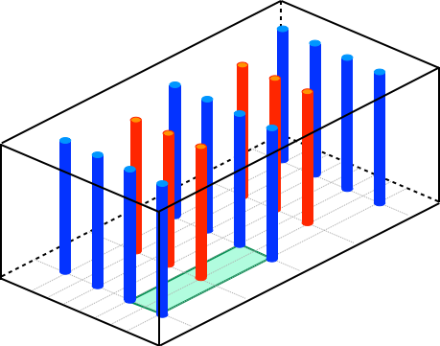
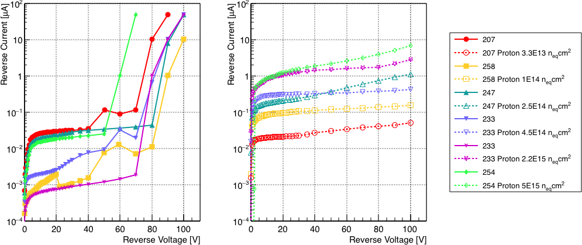
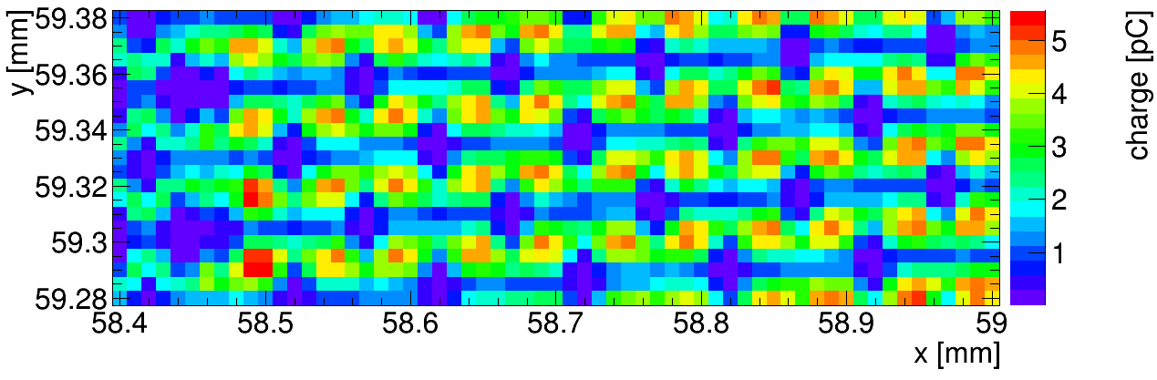
3D sensors
Project of Laura Franconi (visiting PhD student, Talent) ….writing thesis now
p+ column
IV curves before and after proton irradiation at different fluences
Same colour = same 3D diode, before and after irradiation
n+ column
Sketch of 3D sensor
Laser mapping in SSD lab
3.3E13 n_{eq}/cm²
1.0E14 n_{eq}/cm²
Red front light gets reflected on the metal lines connecting the n⁺ and the p⁺ columns and on the columns themselves: reduced charge collection in these areas.
2.5E14 n_{eq}/cm²
4.5E14 n_{eq}/cm²
2.2E15 n_{eq}/cm²
5.0E15 n_{eq}/cm²
... good example of collaborative use of the SSD equipment (service)
Punch through
column
n+ column
p+ column

Slide 7
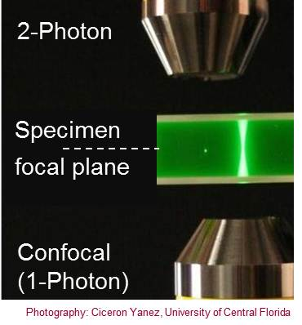
TPA – Two Photon Absorption
Two Photon absorption:

Slide 8
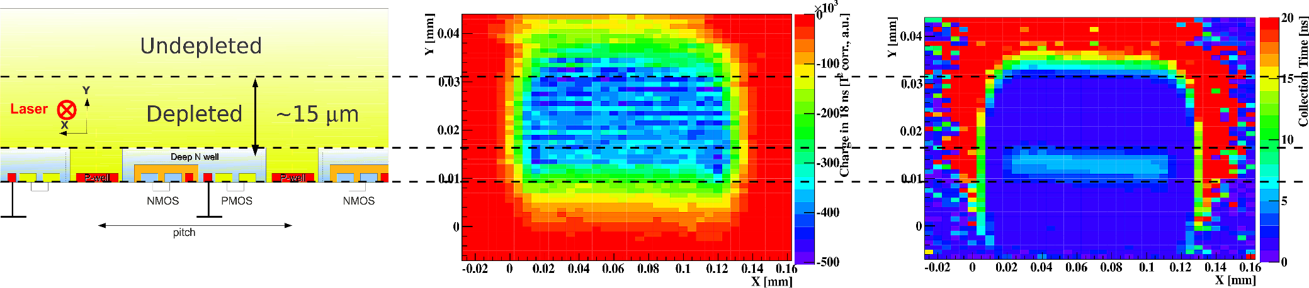
TPA – Two Photon Absorption
Two Photon absorption:
Investigation on a new technique
for sensor characterization (TPA – TCT)
  Deposition of charge at specific position in detector
  Laser: λ ∼ 1300 nm; P ∼ 50-100 pJ; ΔT ∼ 240 fs
  Proof of principle presented last LHCC
  Example of application:
    HVCMOS sensors (AMS 180nm), 10 ohmcm
    100μm x 100 μm passive pixel, measured at 80V, 20°C
[M.Fernandez-Garcia et al, VCI 2016, Feb.2016]
    Map of charge
    collected within 10ns
    Map of collection time
    needed to get 98% of charge
    Sketch of HVCMOS sensor

Slide 9
TPA-TCT after irradiation
Technique can also applied to heavily irradiated sensors!
YES !!!!
[M.Fernandez-Garcia, RD50 Workshop, 6/2016]

Slide 10
1year outlook – SSD activities
Laboratory and equipment
    Continue working on sample holder fitting on “all characterization stations”
    Continue building up a TSC system for defect characterization (evaluate possibility to get DLTS)
    Prepare TCT+ to measure time resolution with laser beams
    Evaluate possibility for “low-cost” TPA system at CERN
Upcoming projects in framework of RD50 with SSD participation
  Nitrogen enriched silicon (RD50-2016-01)
    Status: Material produced in collaboration with TOPSIL, Mask design finalized
    [CERN SSD → TCT, CCE(Alibava), proton irradiation]
  Gallium doped LGAD sensors (RD50-2016-02)
    Status: First tuning of implantation and diffusion hardware at CNM against TCAD tools finished; First set of detectors with different implant/diffusion ready for distribution to project partners [CERN SSD → TCT, CCE, proton irradiation]
  HVCMOS sensors
    Preparation of RD50 submission ongoing [CERN SSD → e-TCT, TPA-TCT]
  Acceptor removal and defect characterization
    Dedicated production run at CIS, Erfurt for CERN SSD finished, sensors arrived at CERN, next step: testing of sensors and irradiation
    Continue development of TSC at CERN to participate in defect characterization
  Timing with LGAD and APD
    Study of time resolution as function of fluence (Ga-LGAD and DD-APD)
CMS HGC
    Finalize CCE study on highly irradiated sensors and test beam studies [Esteban]
    Start evaluating epitaxial silicon [….HPK has no deep diffused 8” possibility!]

Slide 11
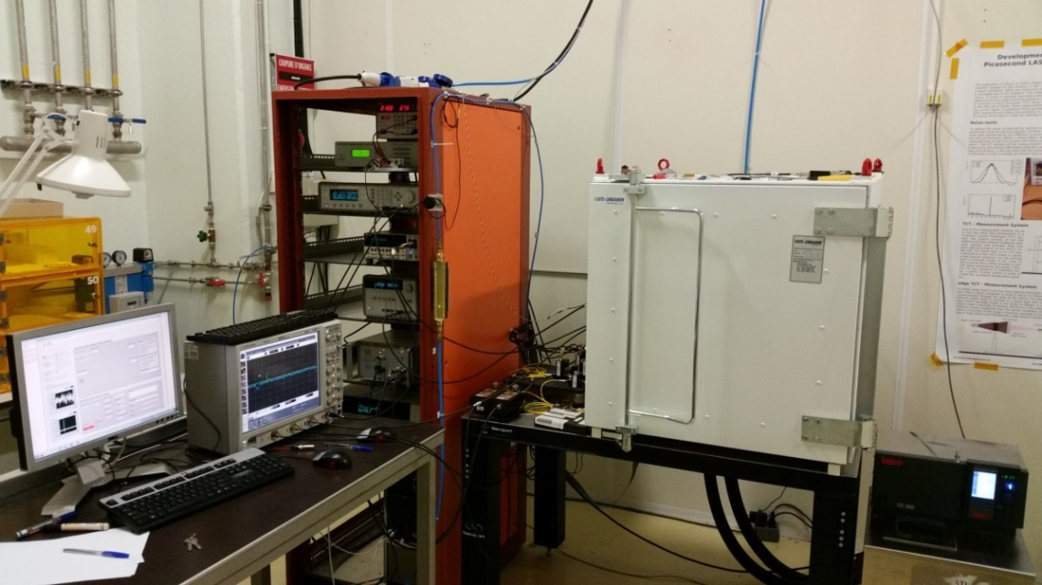
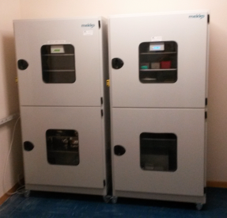
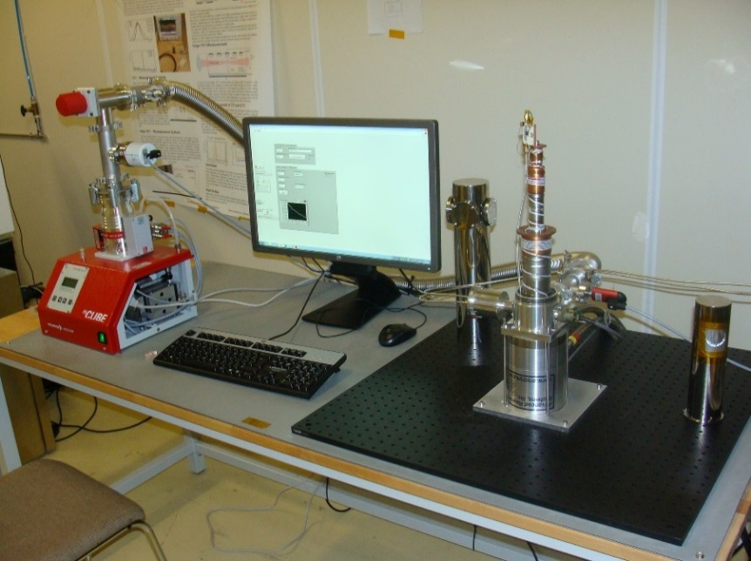
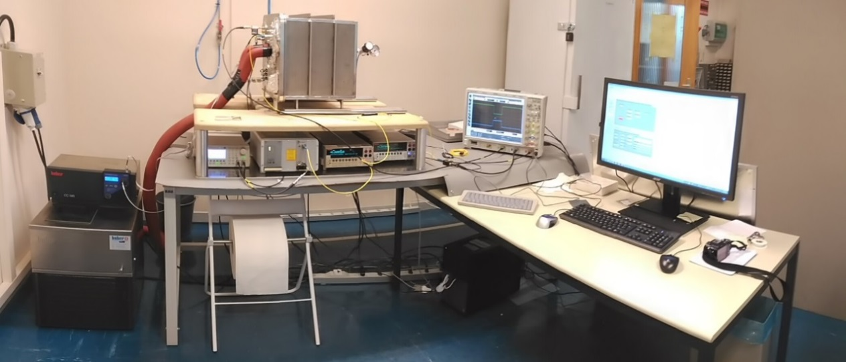
Infrastructure & Equipment
Bldgs.28/186 (4 labs, 1 sensor storage area, 4 offices, ..)
  IV/CV [2x], Alibava (CCE) [2x], Beta (CCE), e-TCT, TCT+; I-DLTS, TSC
-70C to 180C
Wafer/Sample storage
CCE (Charge Collection Efficiency)
TCT+: TCT (Transient Current Technique)
Cooling to 10K
I-DLTS (Current Deep Level Transient Spectroscopy)
TSC (Thermally Stimulated Currents)

