Slide 1
Status of D2 development
P.Fabbricatore, S.Farinon, B.Caiffi and R.Cereseto
(INFN Genova)
Foussat
(CERN)
Updates on magnetic and mechanical designs
Quench analysis
Engineering Design
Procurement of the short model
D2 integration (A.Foussat)

Slide 2
Revised 2D magnetic design
The needs of integrating the D2 magnet and homogenize the cold masses dimensions have imposed some variations of the iron yoke :
Reduced outer dimensions (10 mm less on the horizontal plane) for matching the dimensions of other cold masses
Modified cuts for lifting
New cuts for allowing the longitudinal welds of the two halves of the outer shell
Further modifications in the iron yoke (new holes) were necessary due to the design of the longitudinal pre-stress system.
All these changes required a re-optimization of the whole iron yoke for minimizing the impact on the field quality.

Slide 3
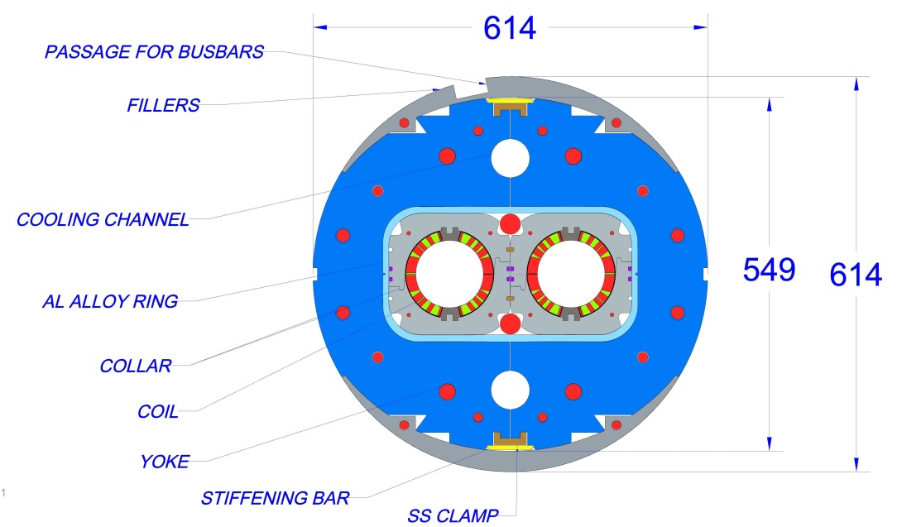
2015 version
2016 version (some iterations still needed)
544
624

Slide 4
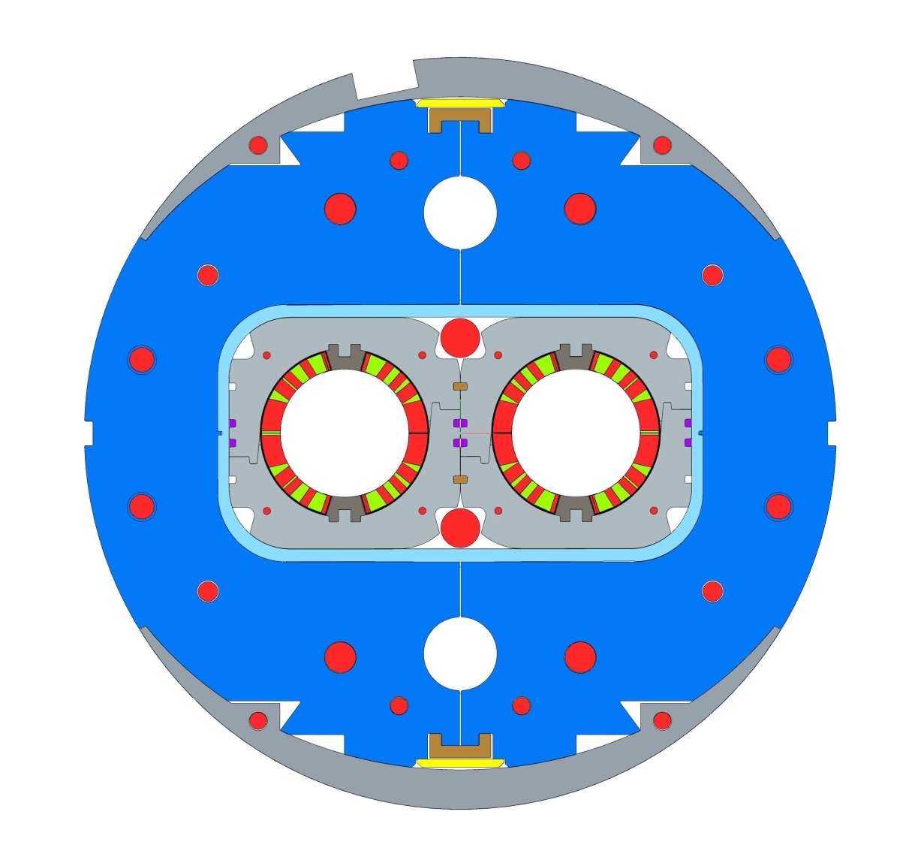
Modifications in the iron yoke lay-out and dimensions
From 624 mm to 614 mm
Larger cuts (4 in total ) for lifting
New holes (4 in total 26 mm diameter ) for the longitudinal tie-rods
New cuts (2 on the midplane) for allowing the welding of outer shell
The dimensions and diameters of these two holes (for fine magnetic field optimization) were changed and are not final yet
From fully elliptical to
round + elliptical cross section for symplifying the integration into the outer shell and the fillers shape

Slide 5
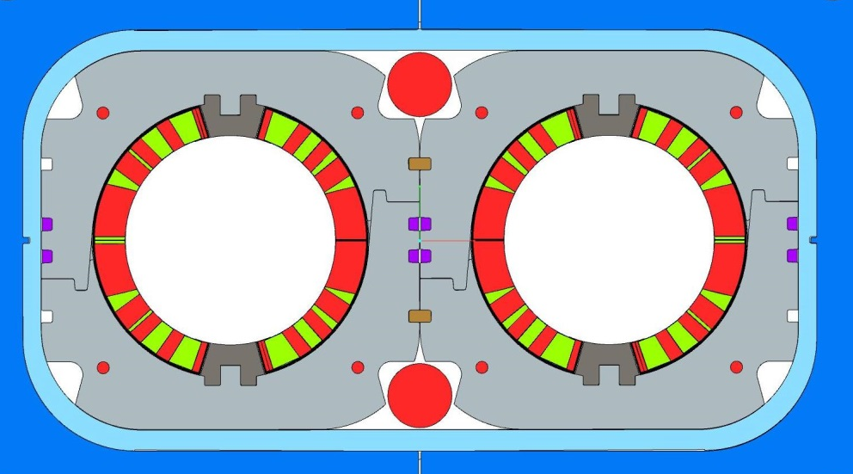
Other Changes
The collars were modified for accomodating the widest longitudinal tie-rods. The system involves six tie rods (two 30 mm diameter passing between the collared cois and four 25 mm diameter passing through the yoke)

Slide 6
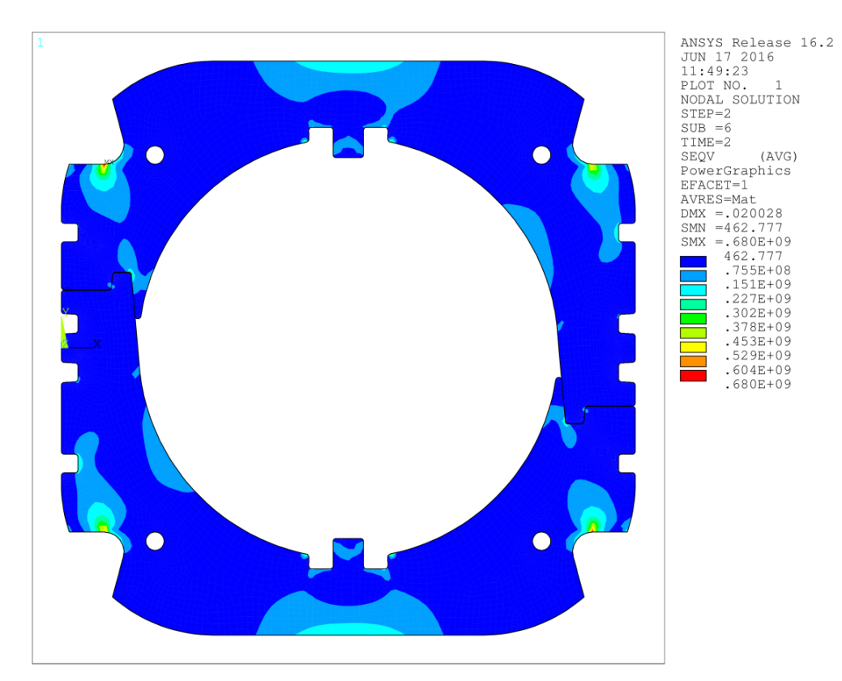
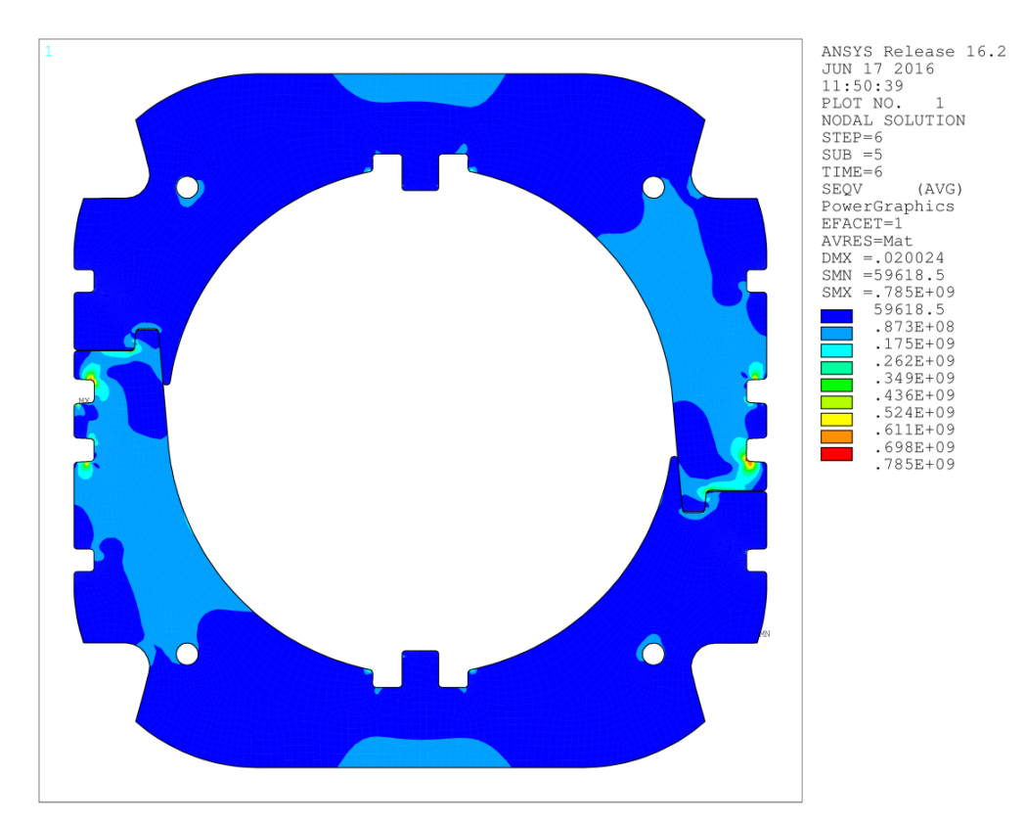
Stress due to collaring (F=290 ton/m)
Revised 2D mechanical design
UNDER PRESSURE
PRESSURE RELEASED
average stress in the winding:
89 MPa
average stress in the winding:
82 MPa

Slide 7
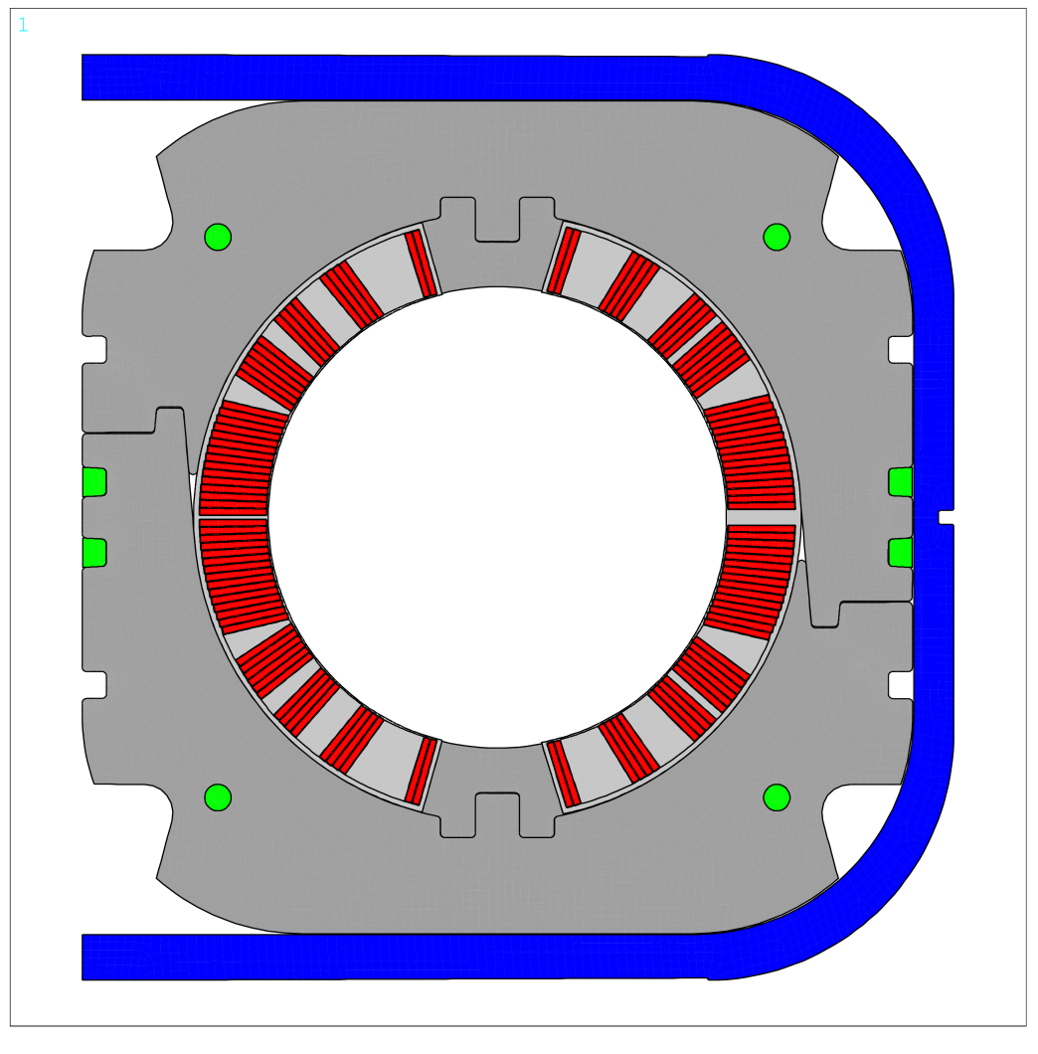
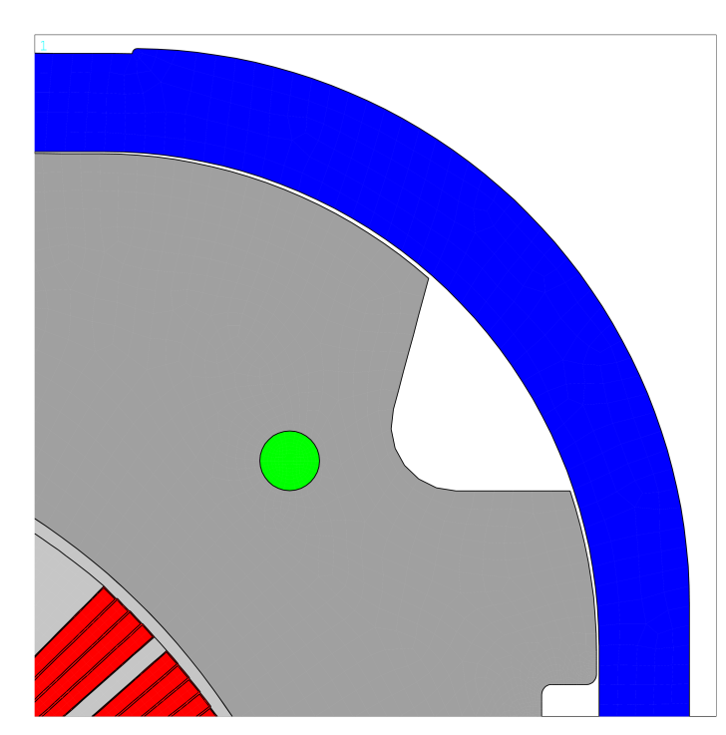
Al alloy ring insertion
no stress results from this operation because of the continuous gap between collars and rings
0.16 mm residual gap
0.27 mm residual gap

Slide 8
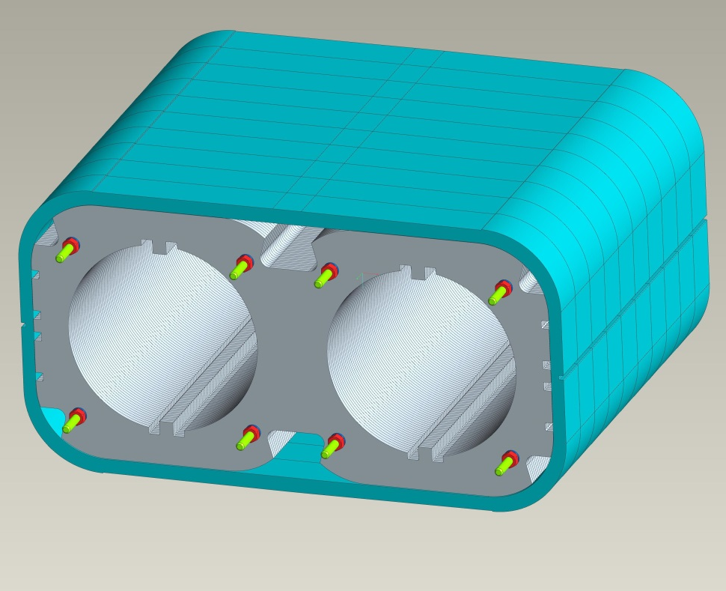
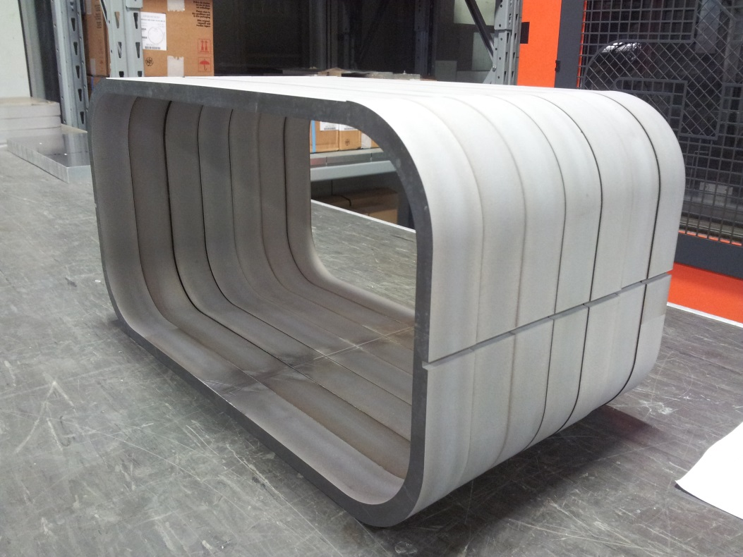
In order to check the assembly procedure of the assembled collared coil into the Al sleeves, a mock-up is under construction in the INFN Genova workshop with spark erosion

Slide 9
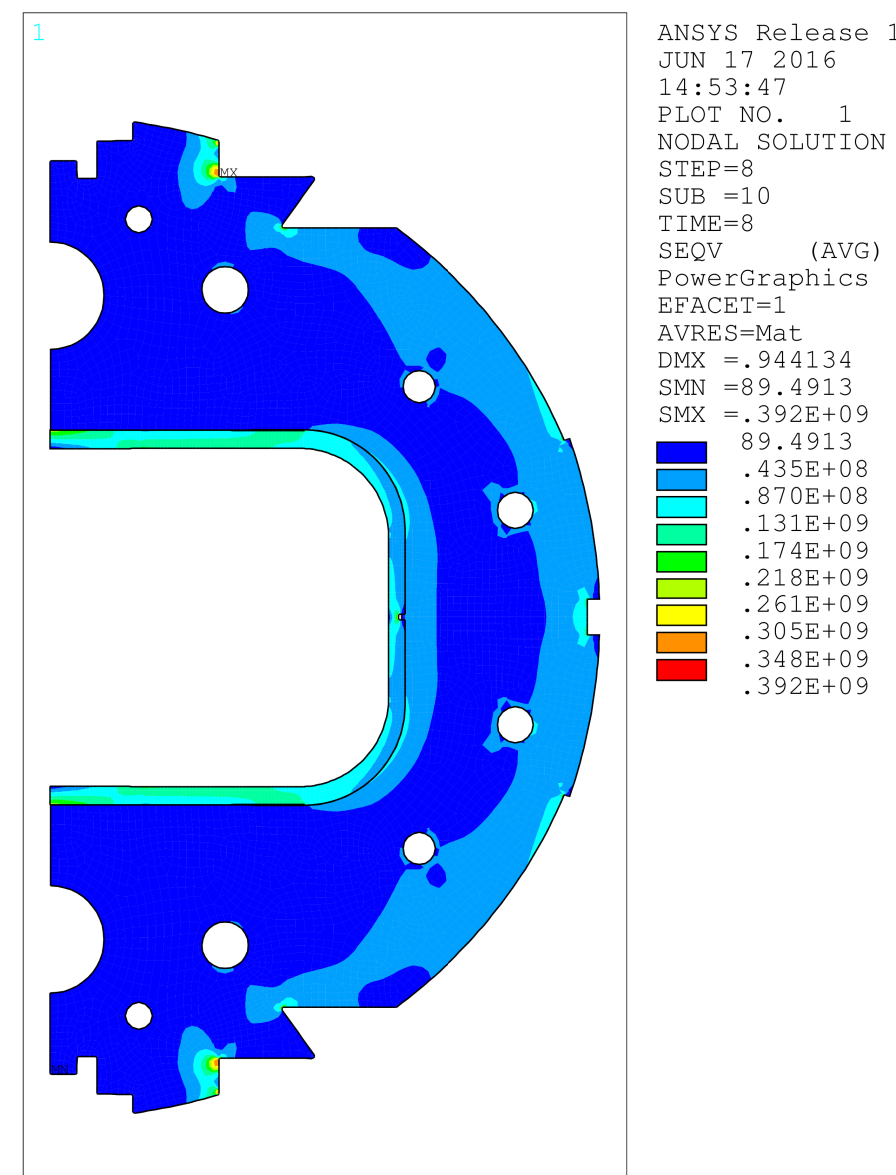
Stress due to iron yoke assembly (F=395 ton/m)
the stress is absorbed by the Al alloy ring, with no effect on the collared coil
the average stress of Al alloy ring is <σ_{VM}>=112 MPa
(in compression)
except the pressing locations, the stress in the yoke is quite low (<σ_{VM}>=32 MPa)

Slide 10
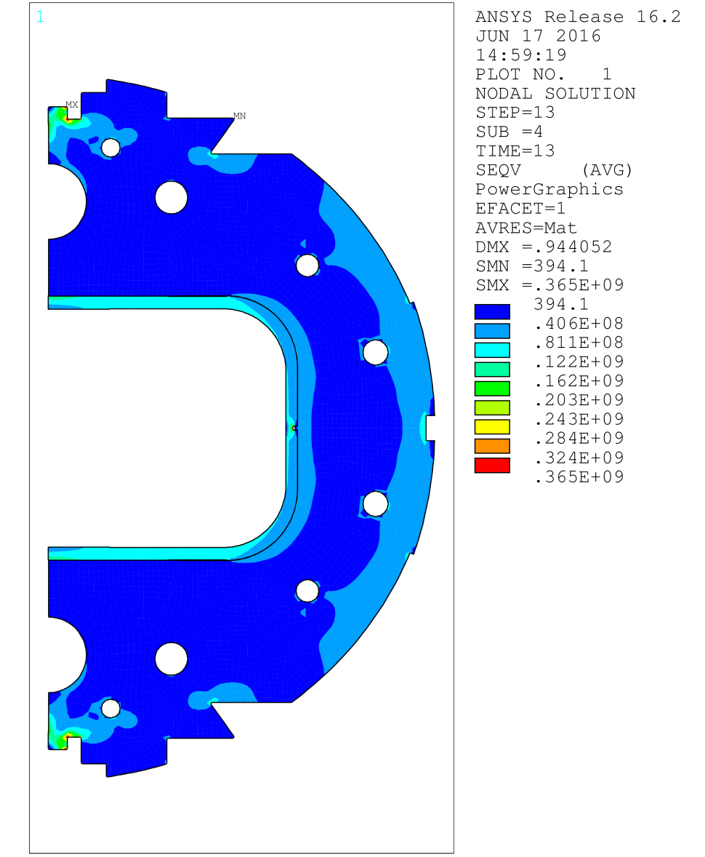
Warm magnet
the peak stress in the iron moves to the clamping locations
in average, the stress is slightly discharged, in Al alloy rings <σ_{VM}>=88 MPa

Slide 11
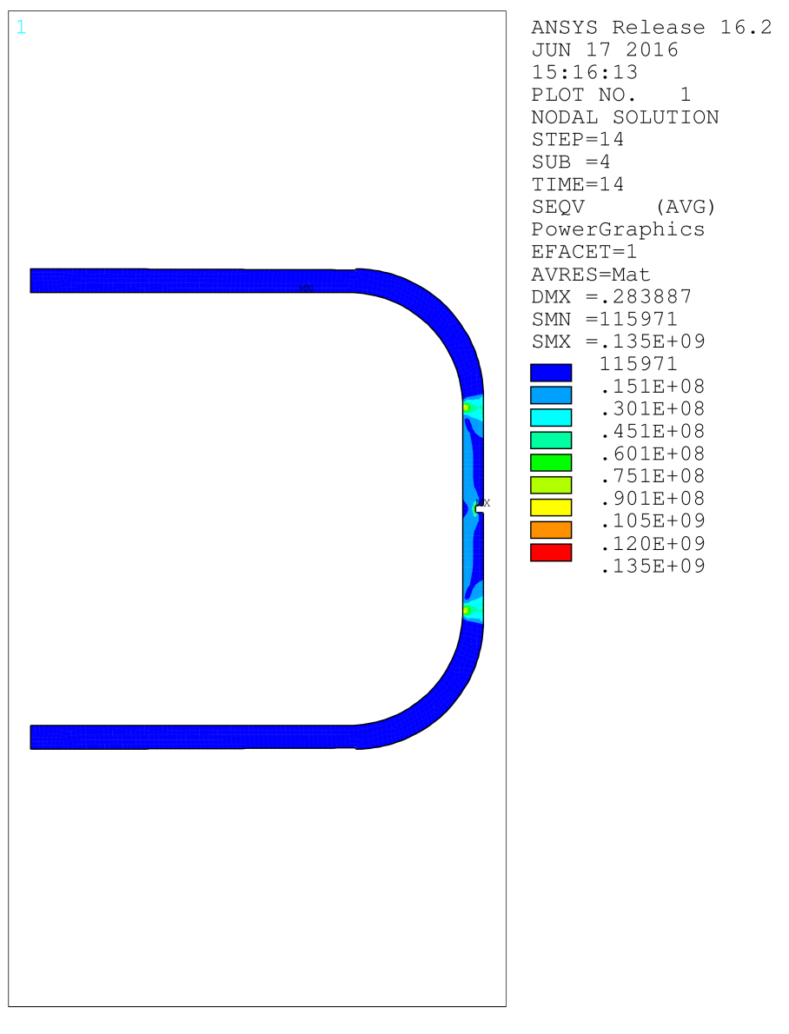
Gaps at 1.9 K
the gap between Al alloy rings and collared coils is closed and there is a residual stress in the rings <σ_{VM}>=6 MPa

Slide 12
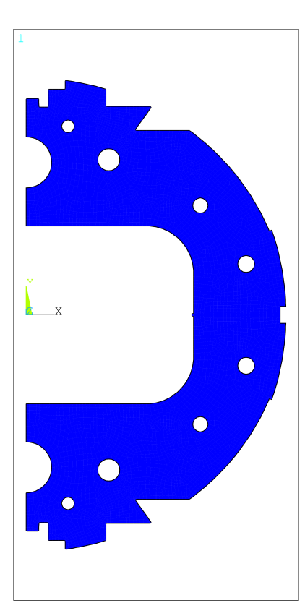
Gaps at 1.9 K
the horizontal gap (initially 1.2 mm) between the two halves of the iron yoke doesn’t close completely; the residual gap is 2 X 0.1 mm
y
x

Slide 13
Lorentz forces at 4.5 T
F_{x}=190 kN/m and corresponds to the unbalance between the left and right part of each coil
(F_{xA}=+1355 kN/m and F_{xB}=-1165 kN/m)
Fy=-831 kN/m (F_{xA}=-425 kN/m and F_{xB}=-406 kN/m)
F_{y}
B
F_{y}
A
F_{x}
F_{x}

Slide 14
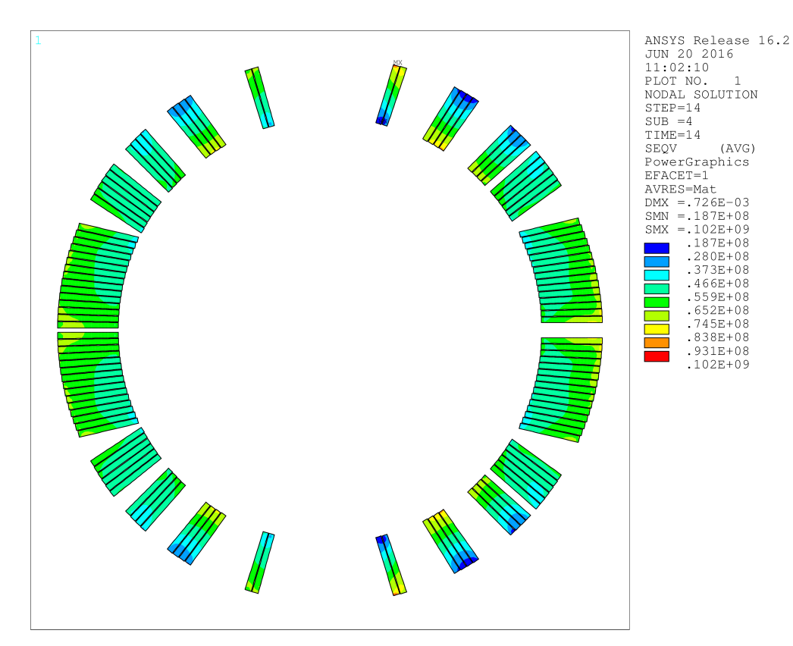
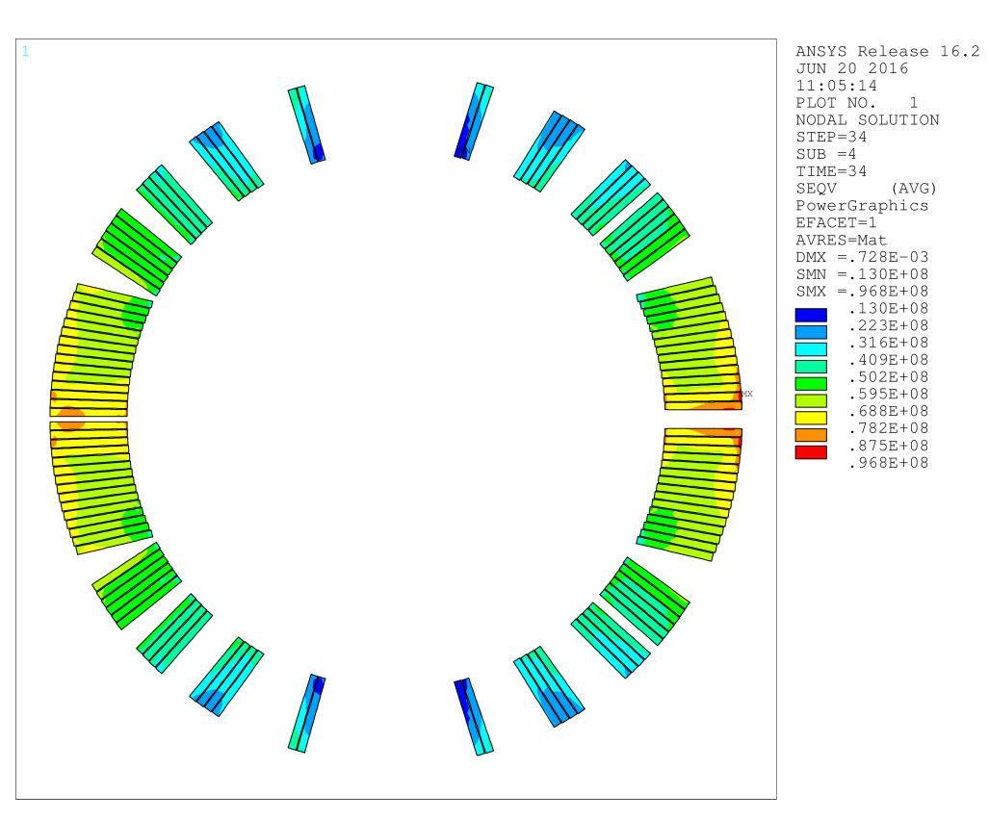
Stress in winding at cool-down and energization
cool-down
<σ_{VM}>=55 MPa
energization at 4.5 T
<σ_{VM}>=55 MPa

Slide 15
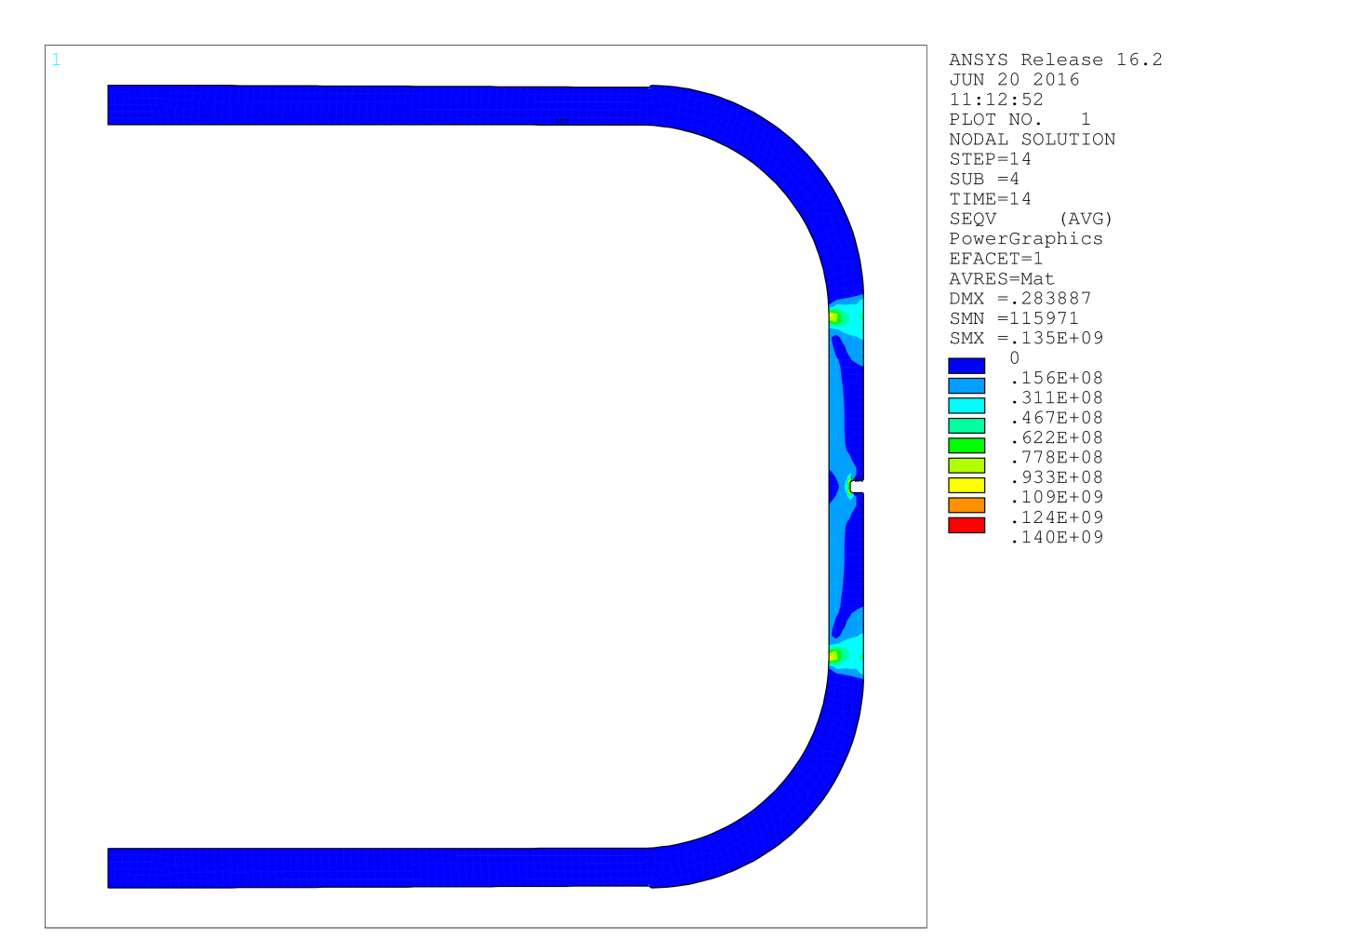
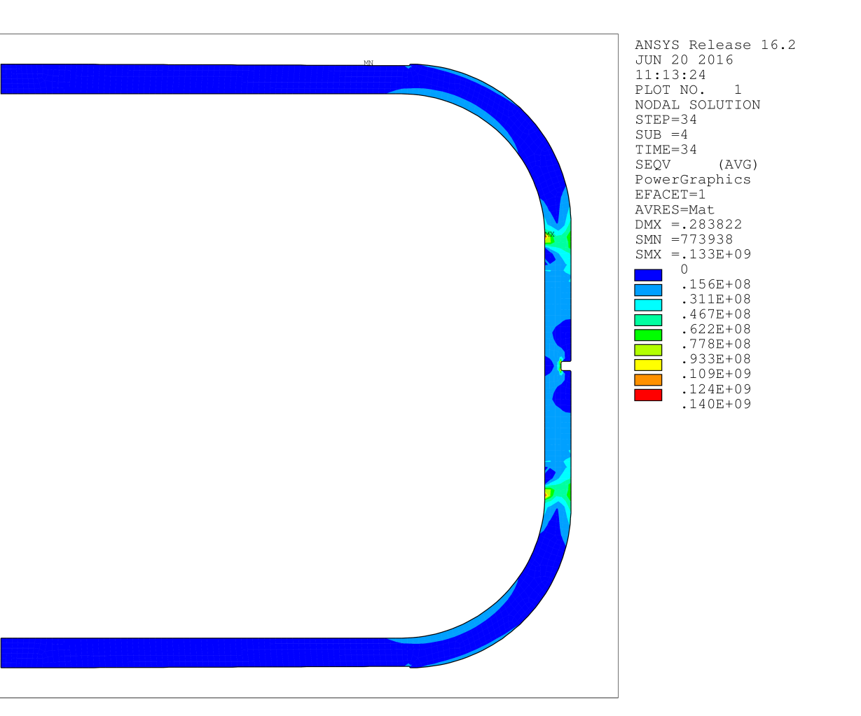
Stress in Al alloy rings at 4.5 T
before energization
after energization
<σ_{VM}>=6 MPa
<σ_{VM}>=10 MPa

Slide 16
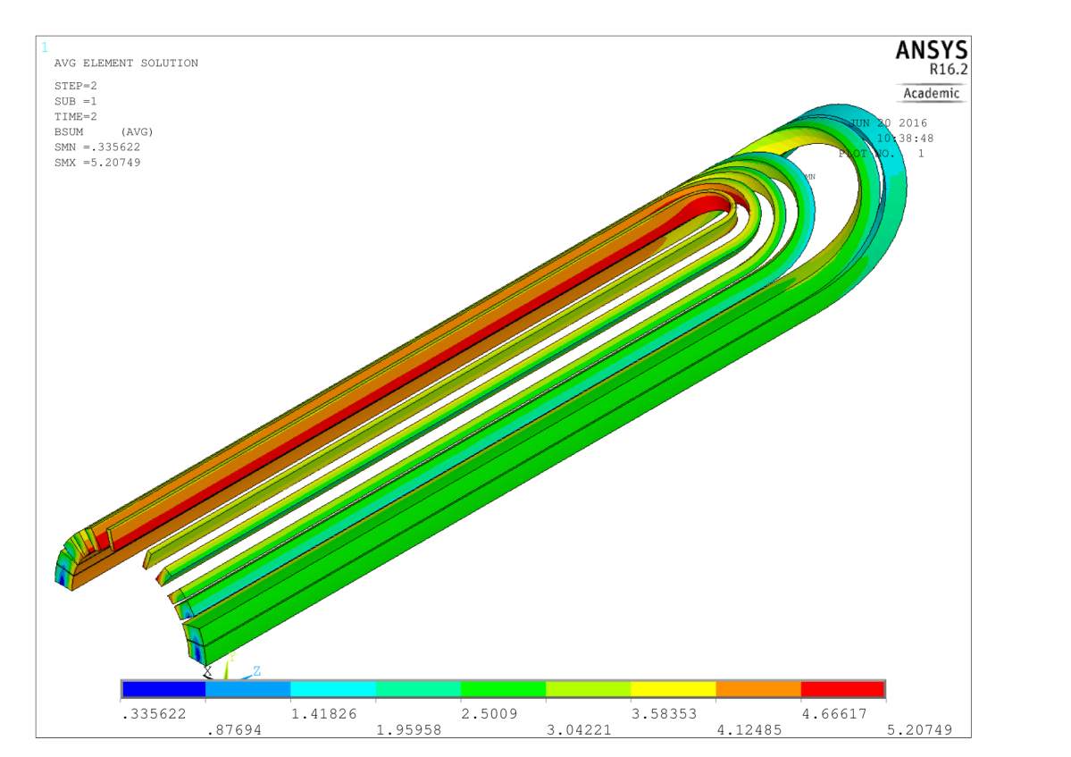
Longitudinal pre-load
The total axial magnetic force sums-up to 264 kN (calculated with both ANSYS and Roxie).
This force is held by the prestressed magnet (coils +collars) and by six ss tie rods (two 30 mm diameter and four 25 mm).
The total longitudinal displacement due to magnetic force is about 0.15 mm (per side). The 3D mechanical analysis is still under way

Slide 17
Circuit lay-out and quench protection
In the envisaged circuit lay-out, D2 is presently a stand alone magnet.
It is assumed that in case of quench the magnetic energy is totally dissipated in the magnet→ D2 is a heater protected magnet.
Preliminarly, the QHs of LHC main dipoles have been considered.
Two 0.025 mm thick stainless steel strips bonded in between two layers of poly-imide
Part of the strips are covered with copper (0.005 mm thick).
A single strip has a width of 15 mm
The pattern is 120 mm ss and 400 mm copper
The covered surface is 0.028 m² (per strip)
For the 8 m long D2 magnets the resistance of a single strip is 2.91 Ω
The two strips are connected in series (R _{circuit total}= 7.32 Ω)
With 900 V (± 450 V) the peak current is 122 A → 150 W/cm²

Slide 18
PRELIMINARY QUENCH HEATERS LAY-OUT
8 circuits formed by 2 heaters each. One heater in the HF zone and the second in the LF.
Only 4 circuits are used (1,6,3,8). The voltage is 900 V per each circuit
H7+
H3+
H5+
H1+
H7-
H3-
H5-
H1-
H8-
H4-
H6-
H2-
H8+
H4+
H6+
H2+

Slide 19
Roxie results
The peak temperature at the quenched turn is 220 K.
The Current decays at 2kA in 320 ms.
The peak voltage to ground is 123 V

Slide 20
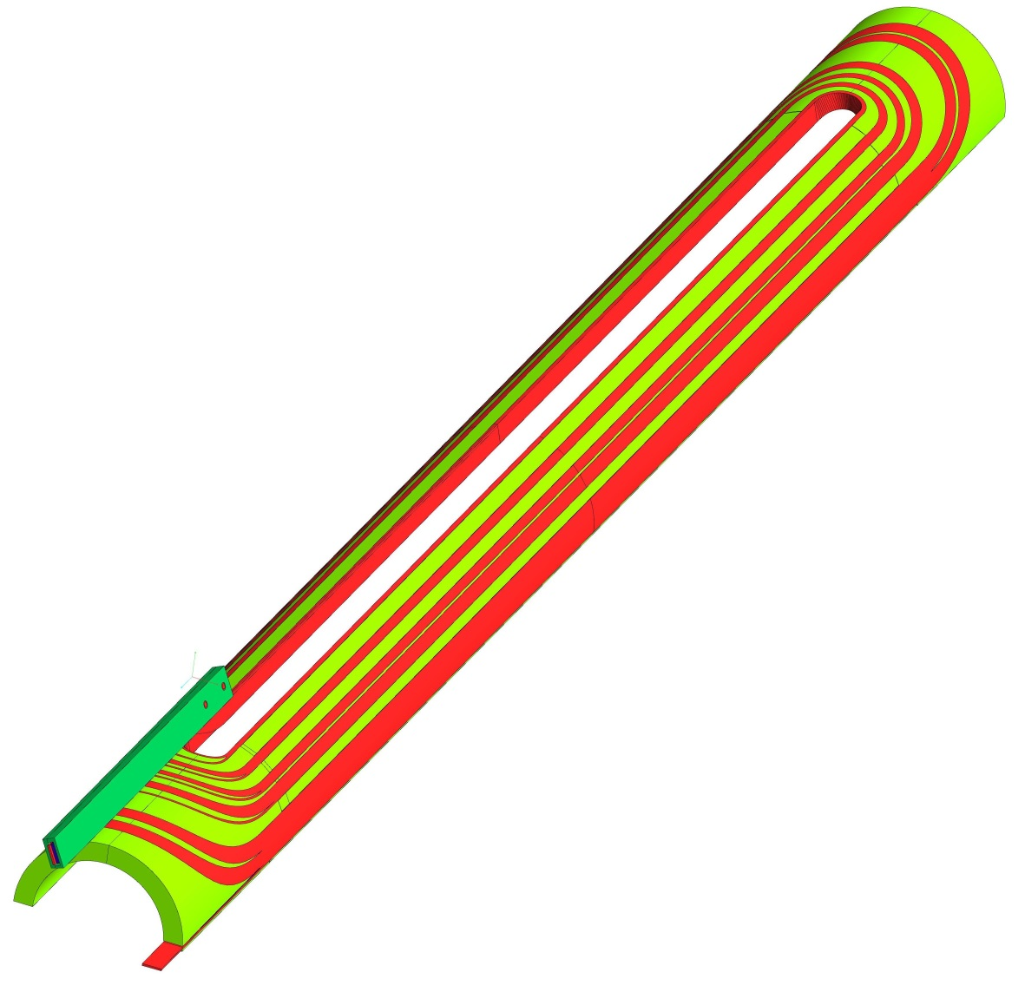
Engineering of the cold mass (short model)
Single coil

Slide 21
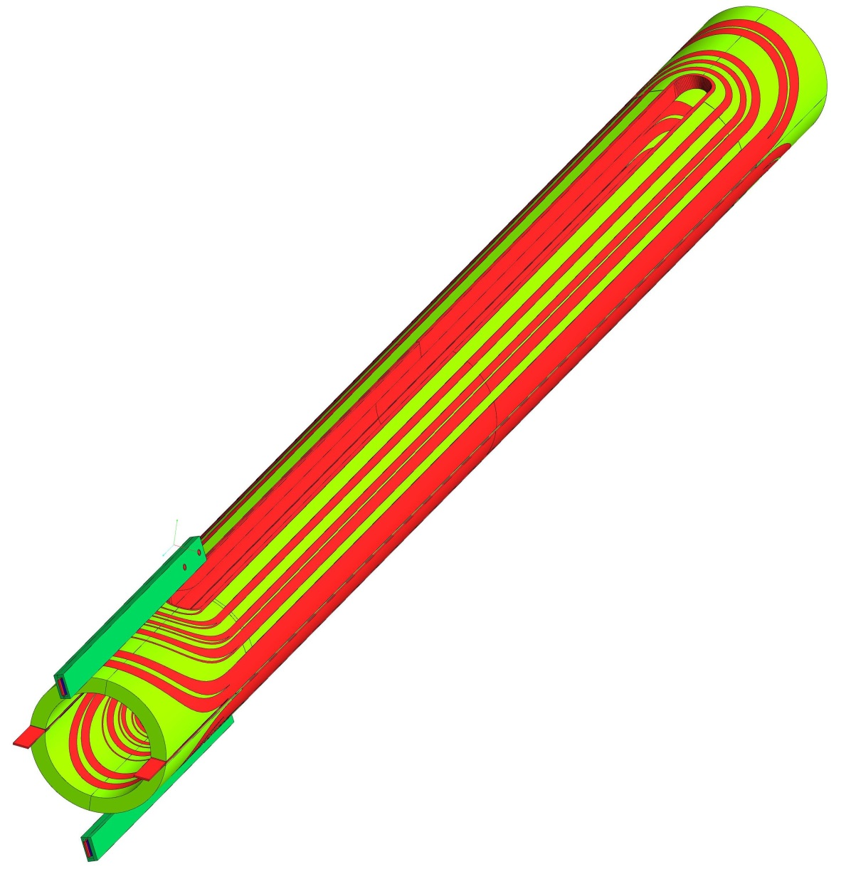
Assembly of the two coils (upper and lower)

Slide 22
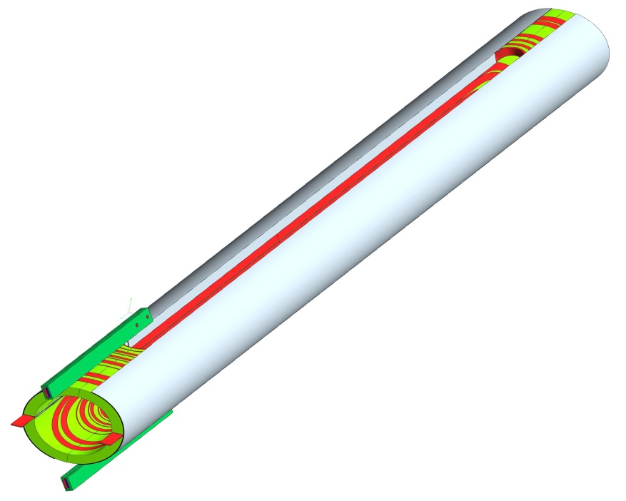
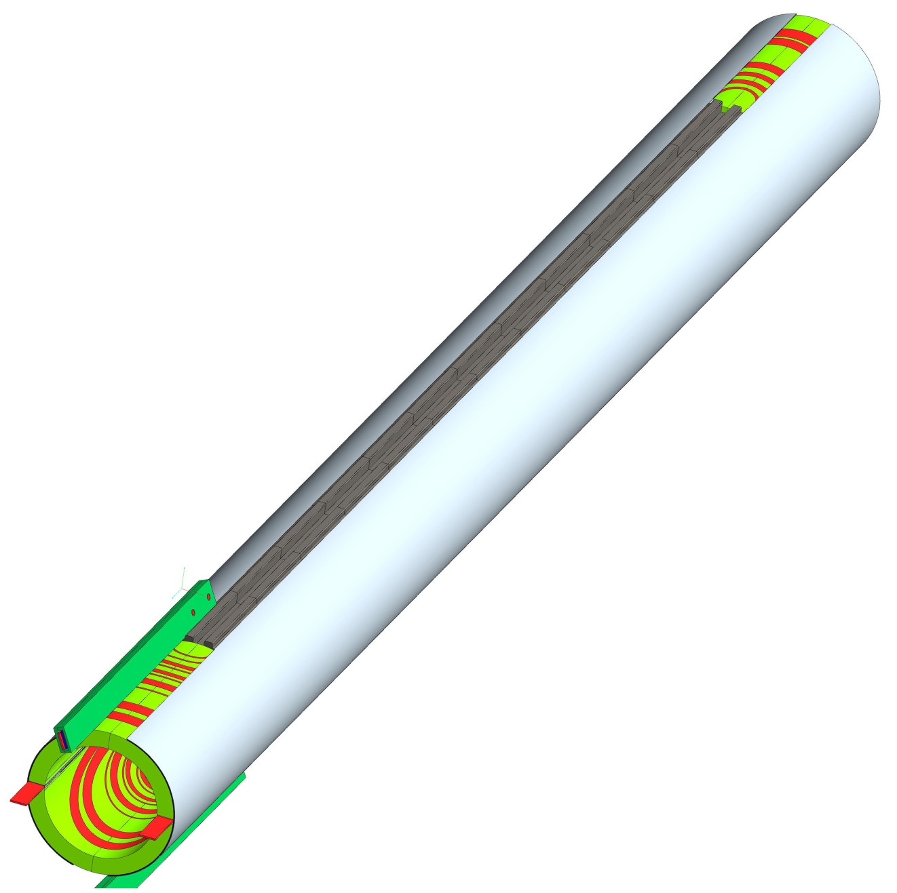
Installation of various layers (ground insulation, QH, coil protection sheets)
Installation of poles

Slide 23
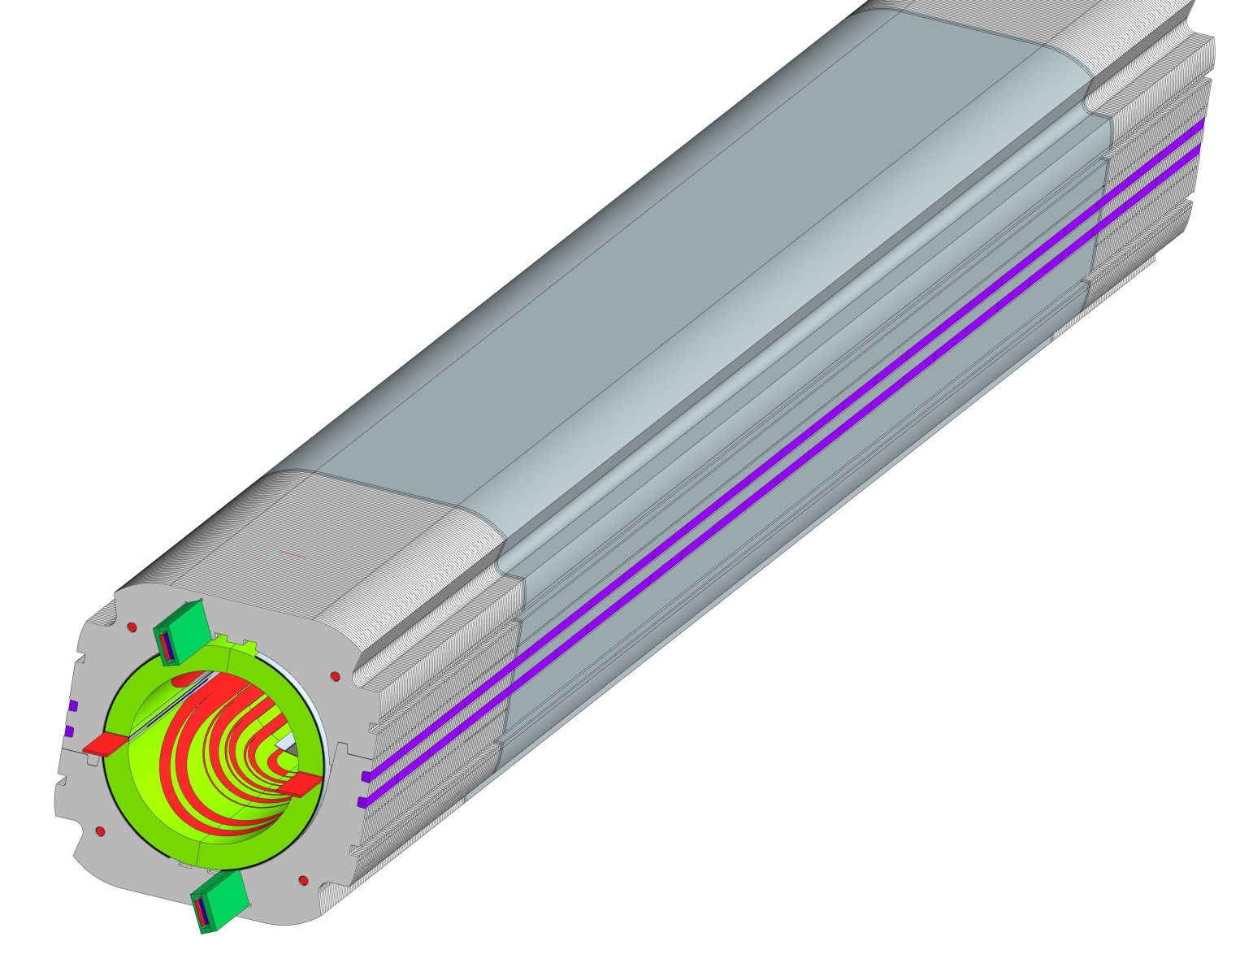
collaring

Slide 24
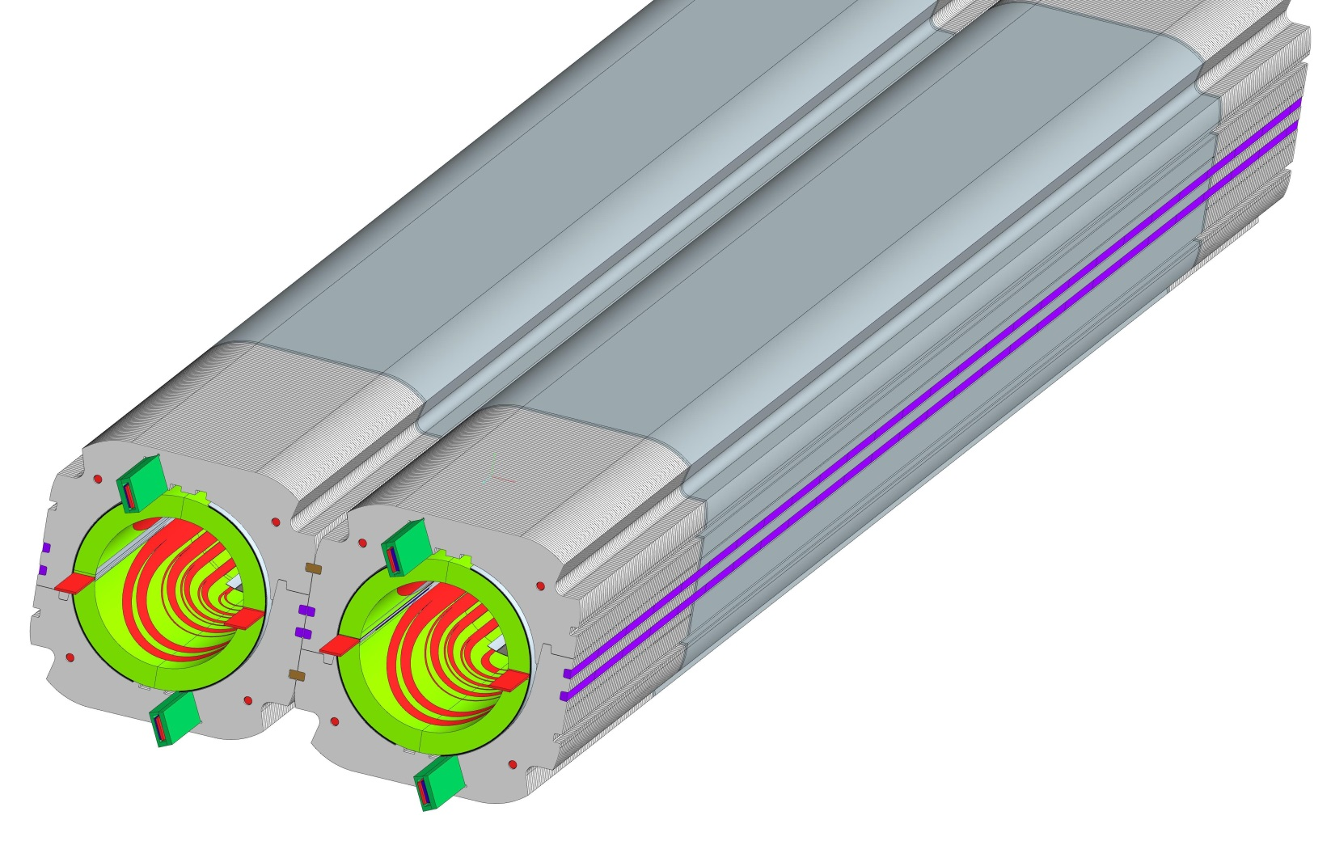
Assembly of the two collared coils

Slide 25
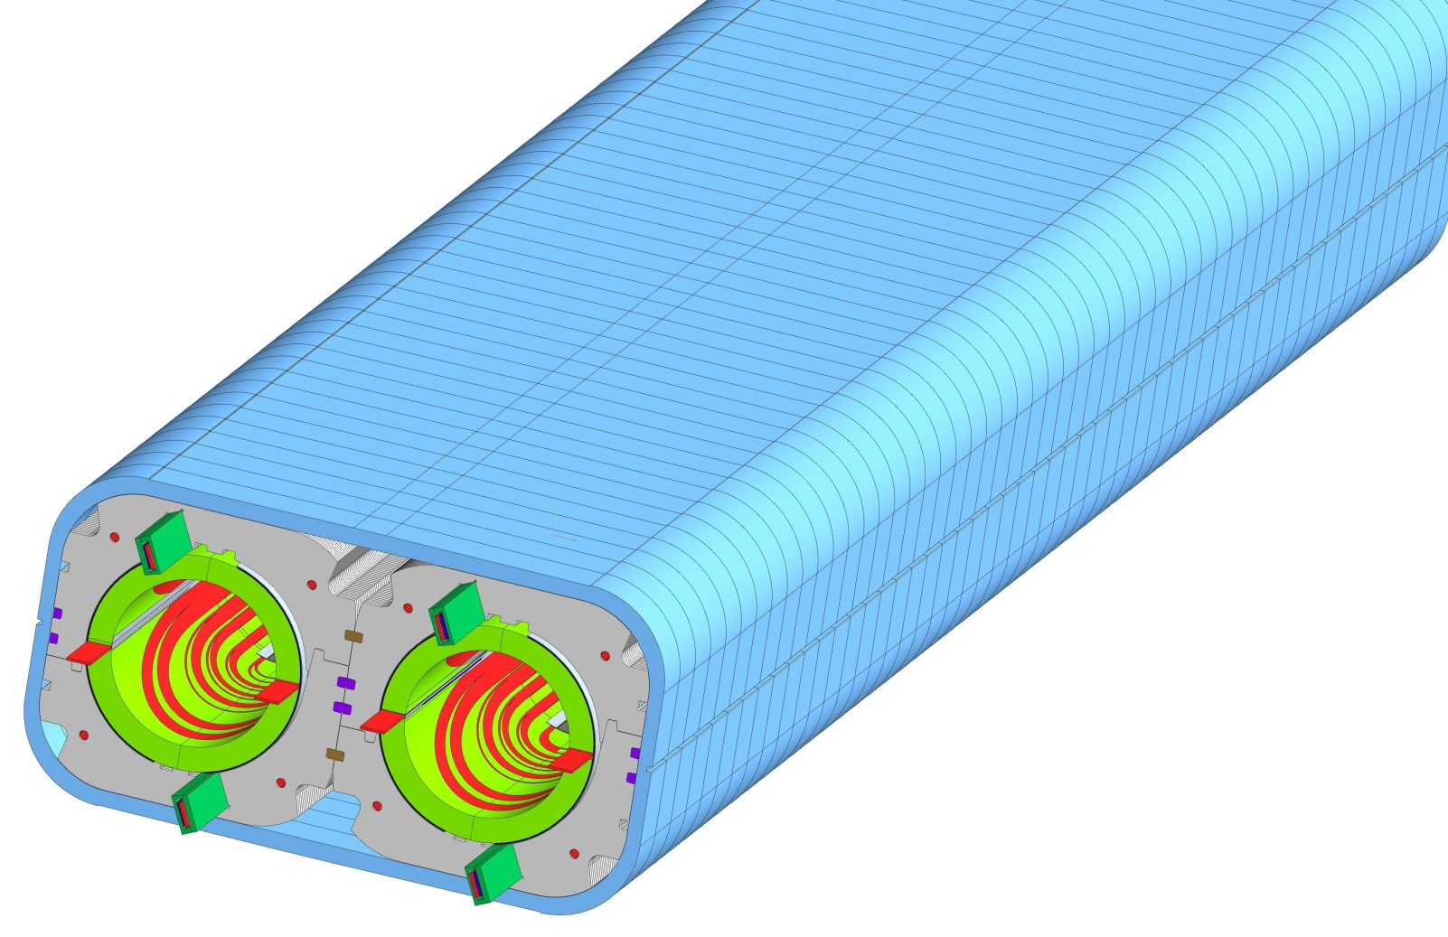
Assembly of the Aluminium sleeves

Slide 26
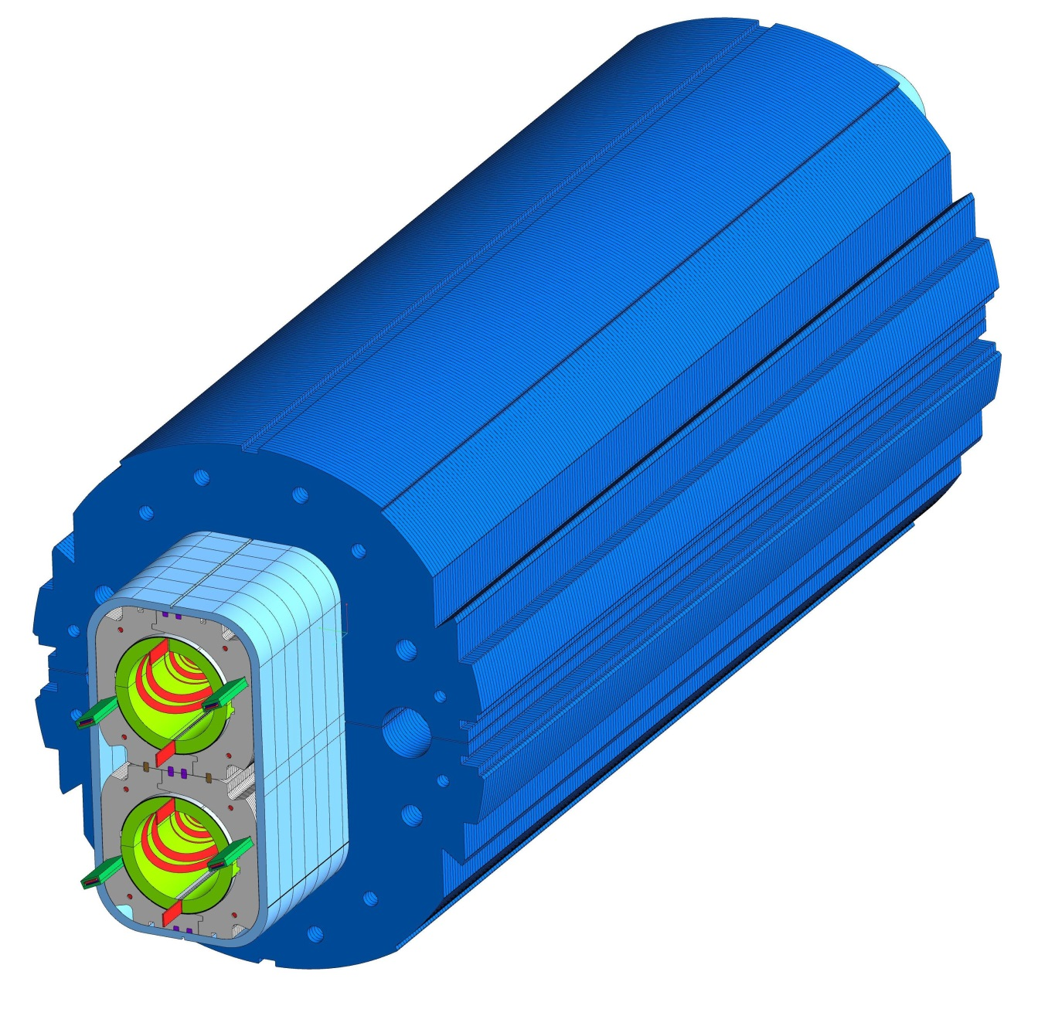
Assembly of the iron yoke

Slide 27
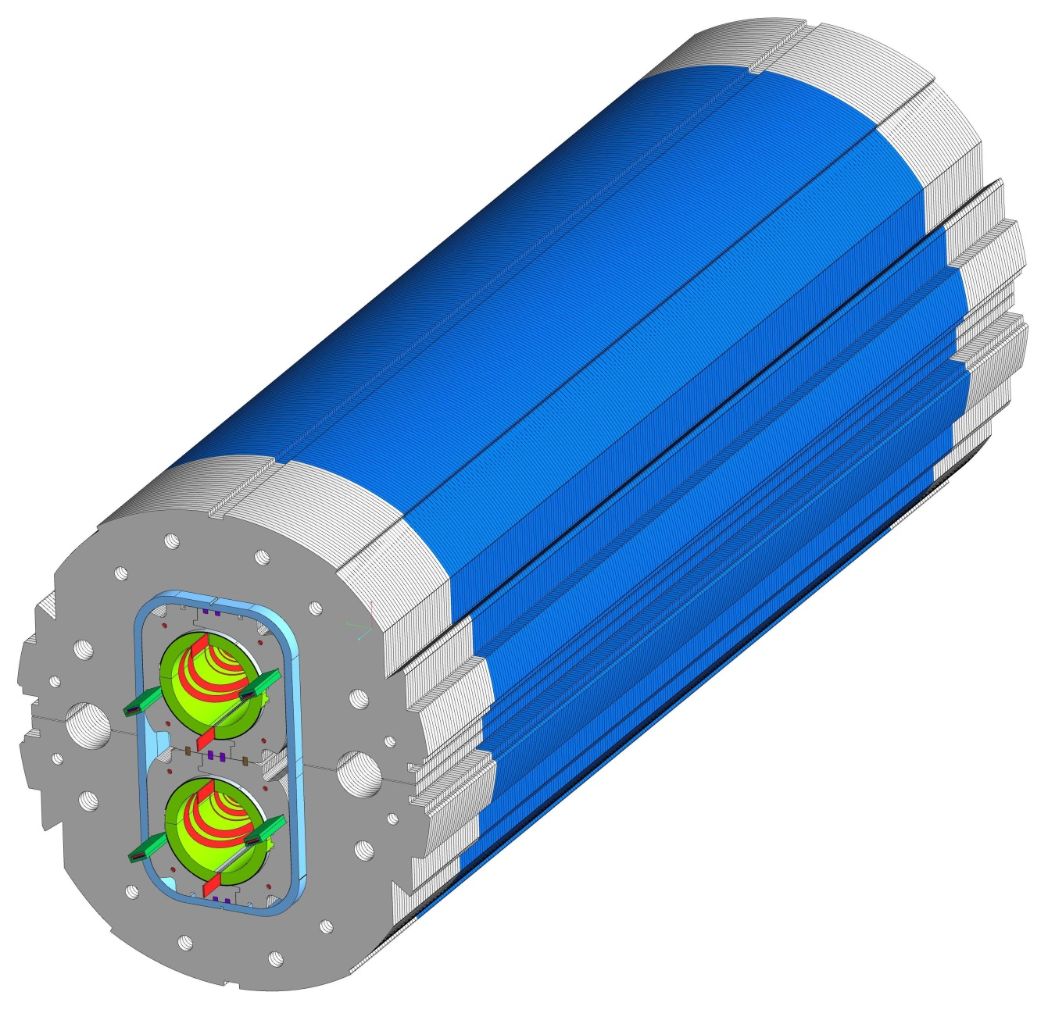
Assembly of the yoke ends in SS

Slide 28
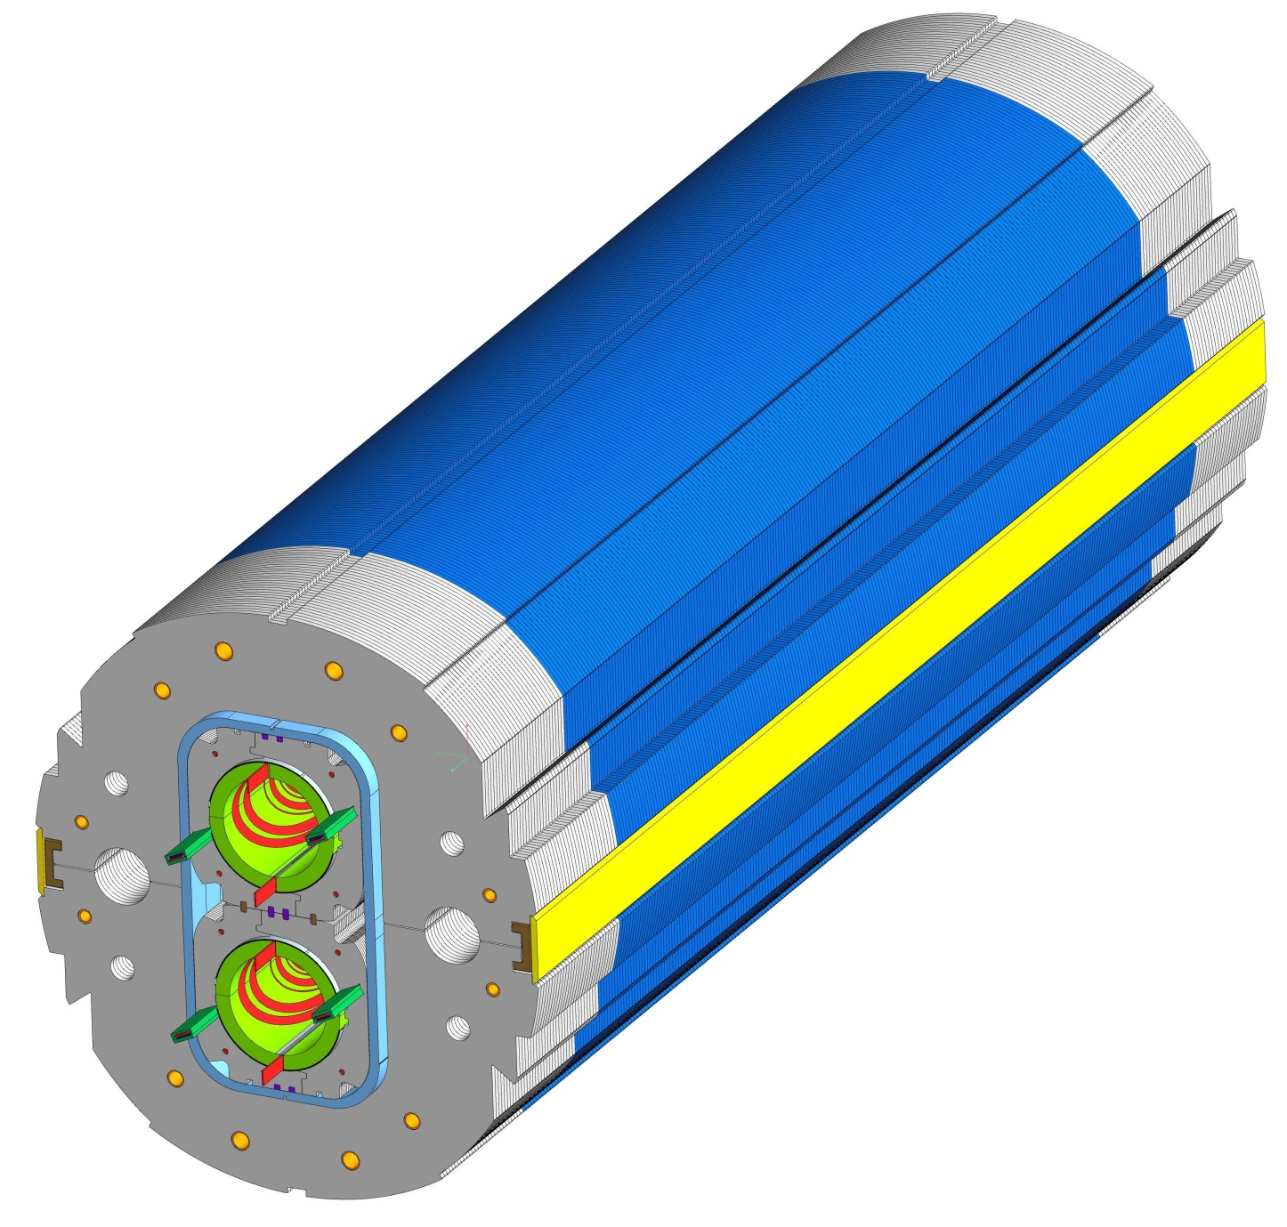
Assembly and welding of closures of the yokes

Slide 29
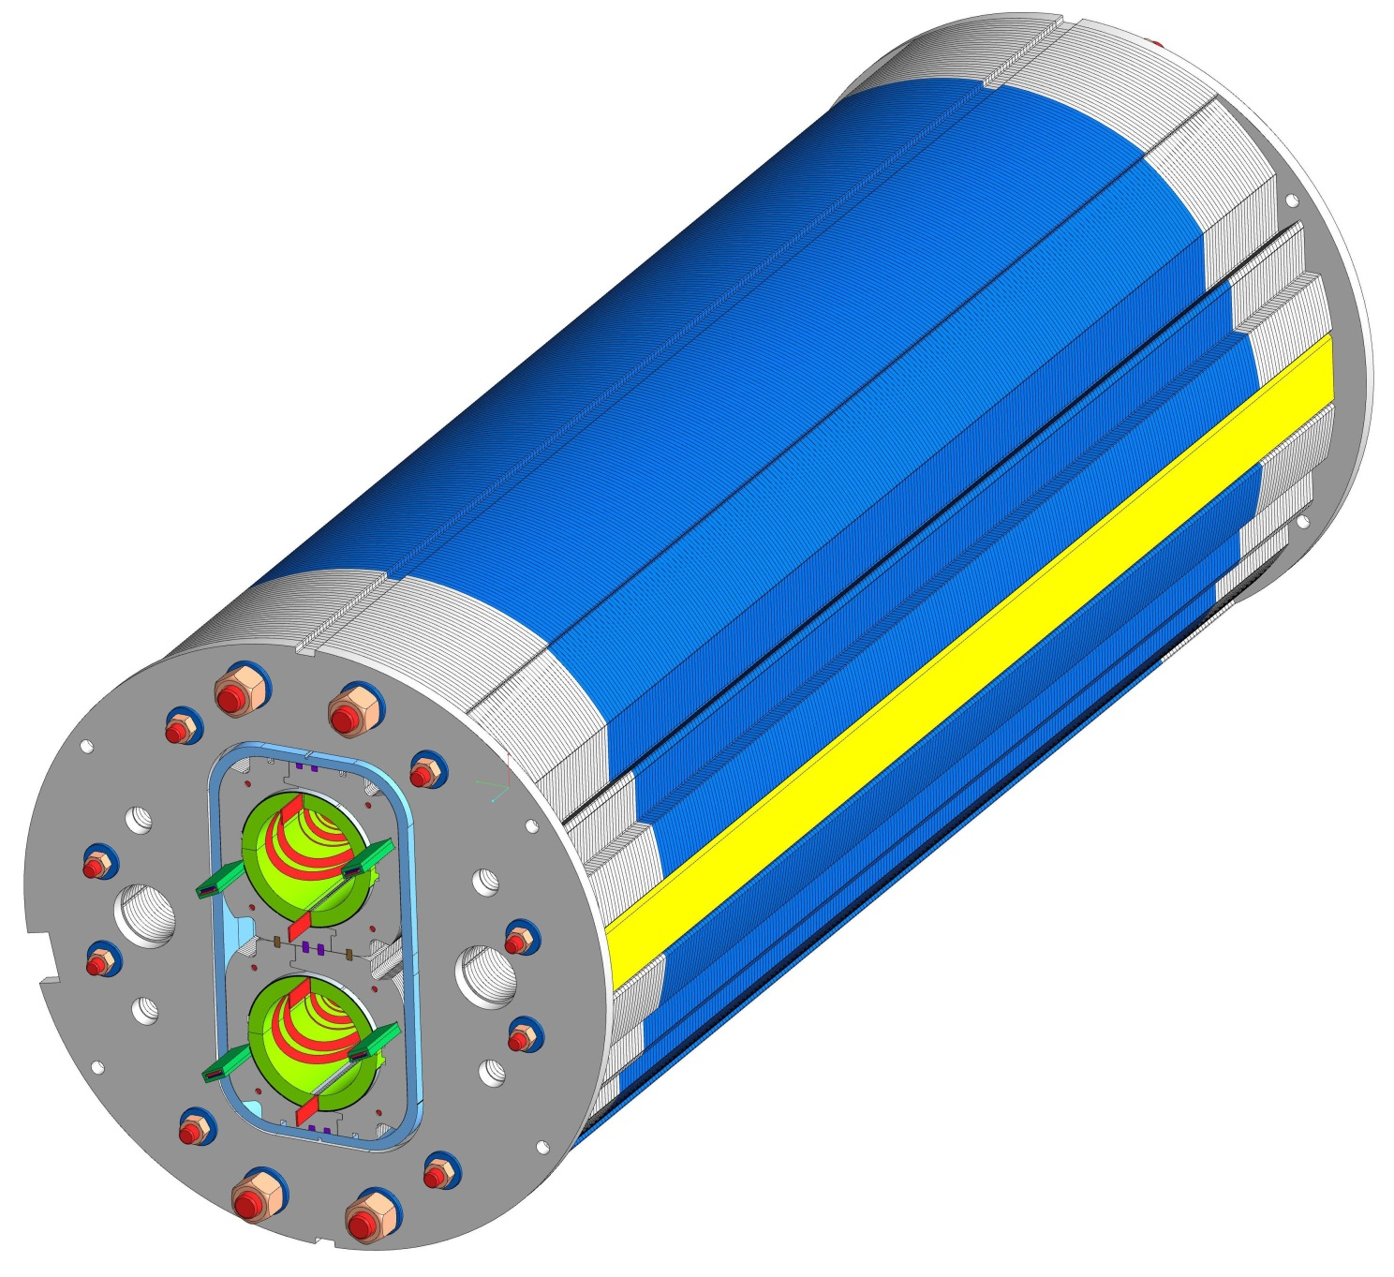
Assembly of the
two end plates of the yokes

Slide 30
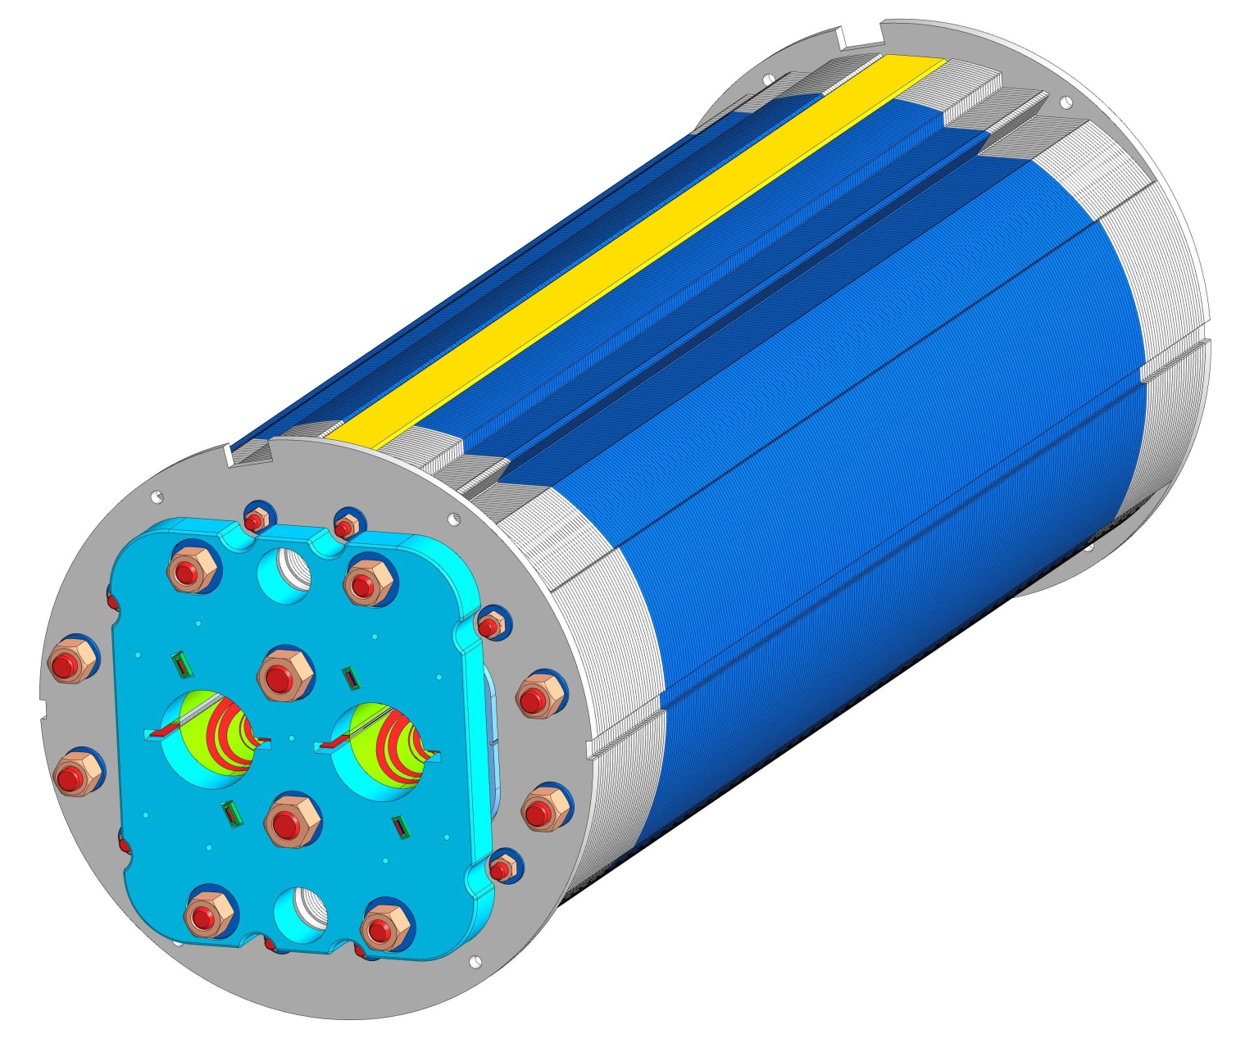
Pressing flanges and tie-rods

Slide 31
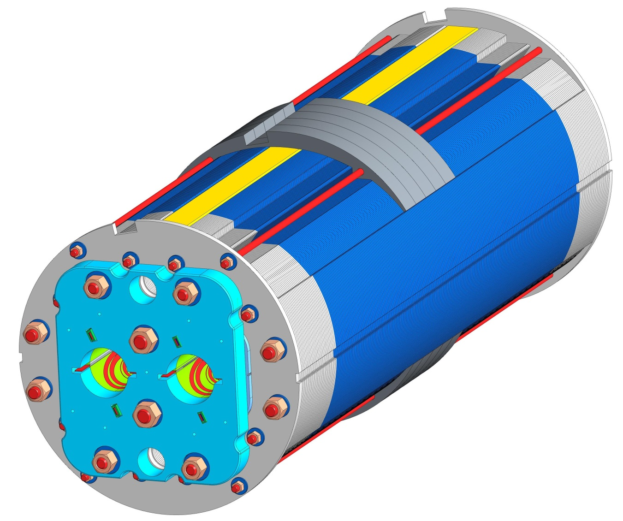
Fillers (Shape adapters)

Slide 32
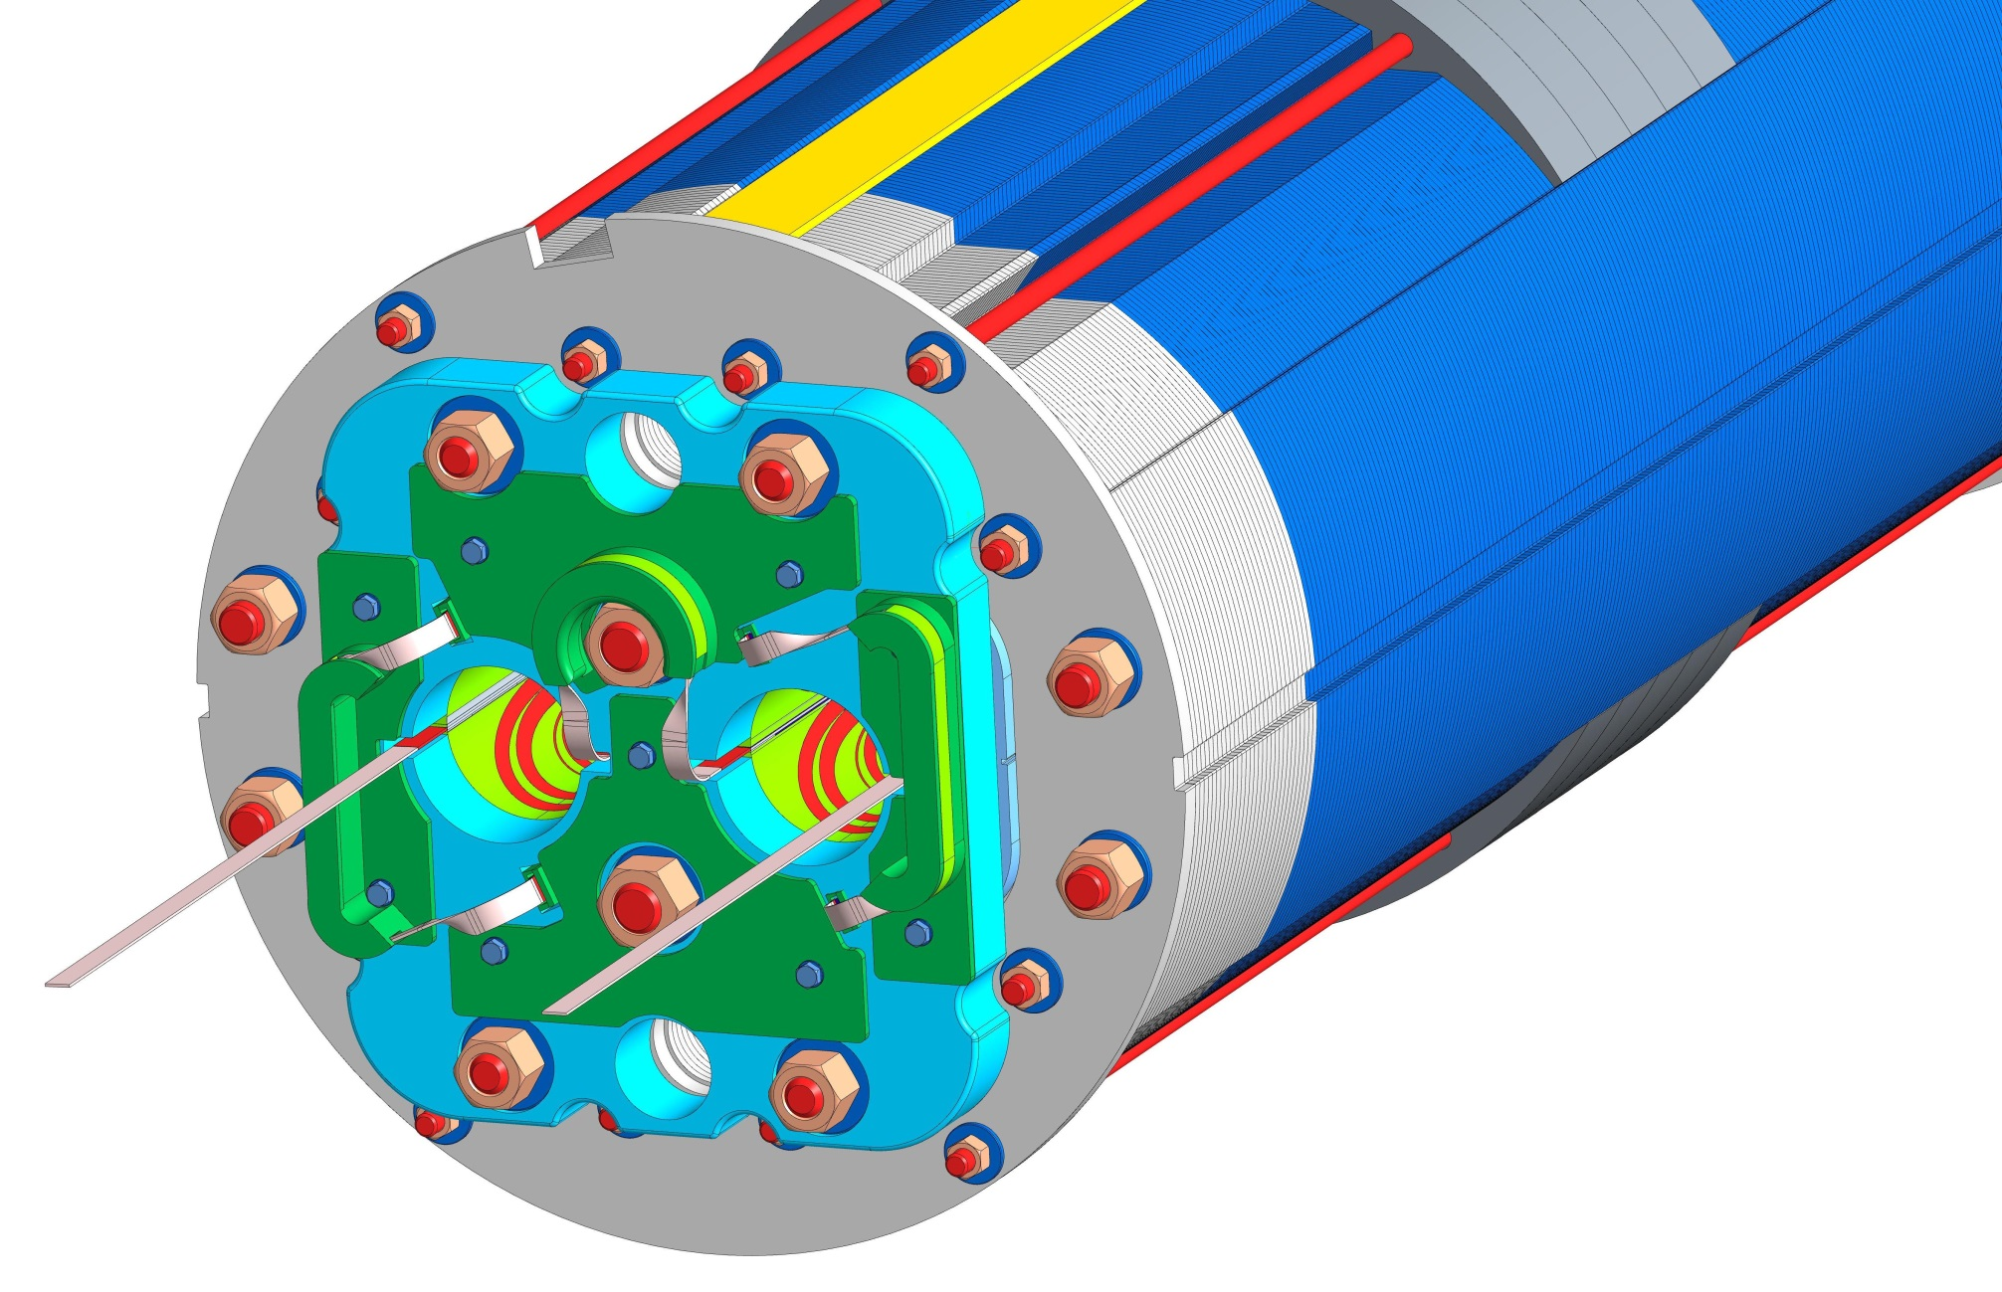
Electrical connections

Slide 33
Procurement of the short model
In the framework of an agreement CERN-INFN, the procurement of a short model (by INFN) has been decided. The main aim of the model (1600 mm) is to verify the magnetic feld cross talk compensation with specular coils.
The tender is started. On May 31th the request for an offer were asked to the 4 companies qualified by CERN. The tender is of the type «Best Quality/Price ratio»
The deadline for receiving the offers is July 15th
The selecting board (3 persons) shall meet on July 25th for technical evaluation and possibly on July 26th for opening the envelopes with economical offers. Formal contract in October.
Delivery 16 months, but the companies can propose a shorter time → Delivery to Cern January-February 2018 for a cold test in vertical cryostat.

Slide 34
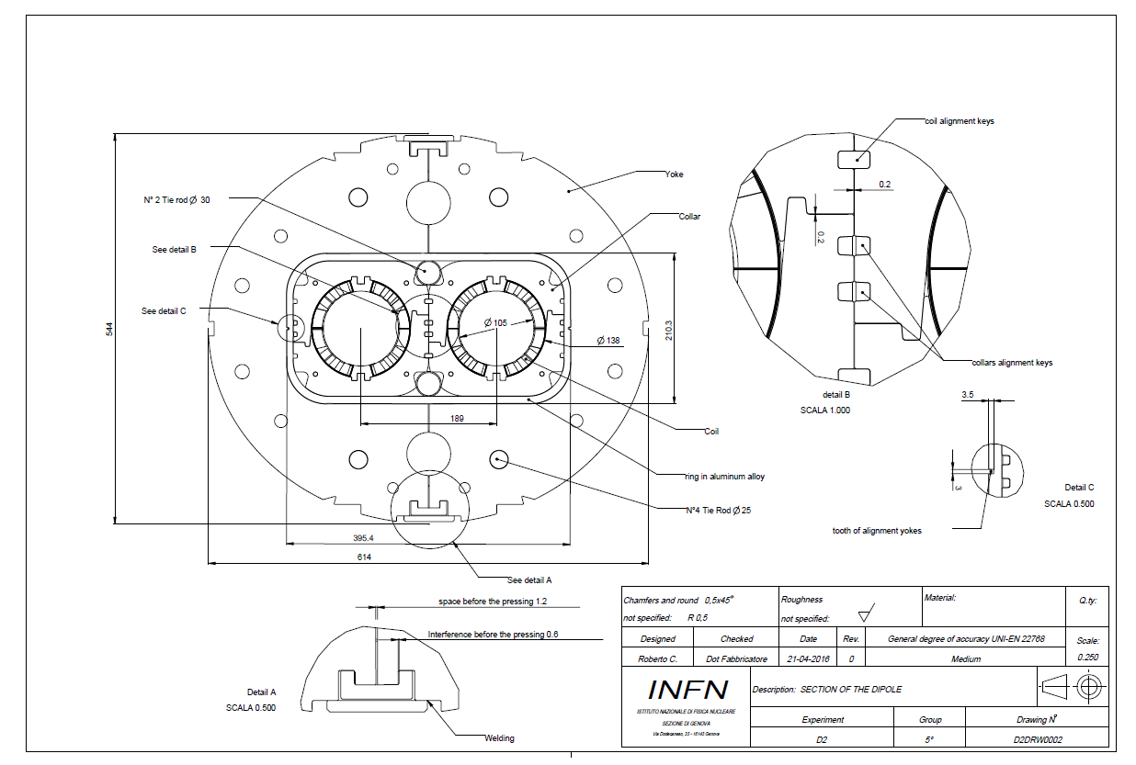
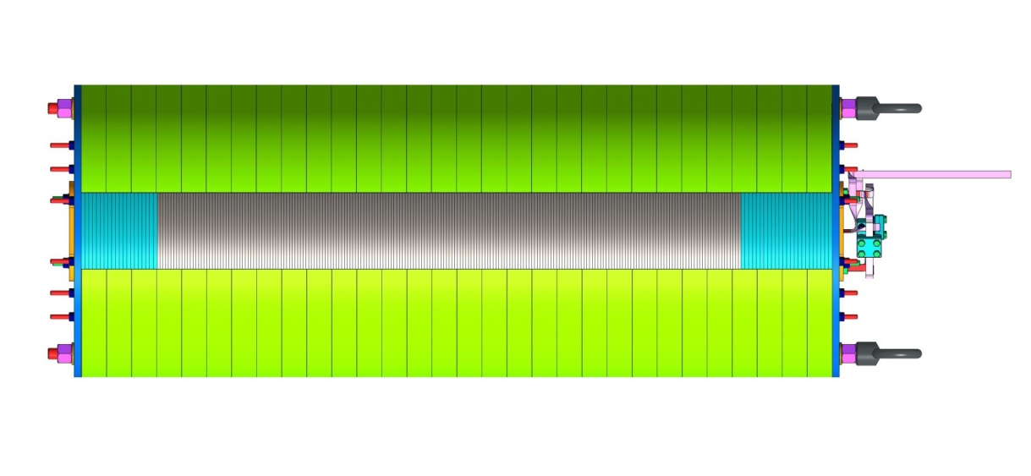
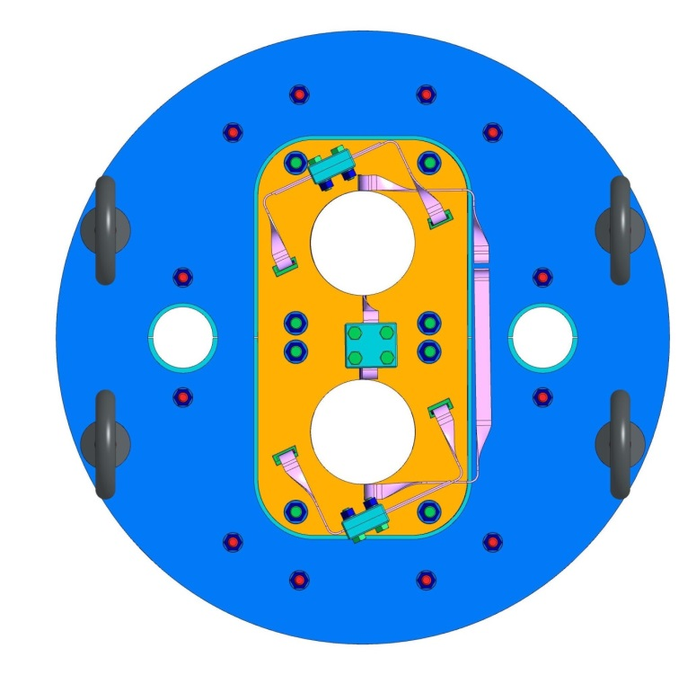
The drawings sent to companies reflected the design before last modifications of the iron yoke.
However the companies were informed that the final drawings will be given as the contract starts (provided that these modification are not really so large to cause a cost change).

Slide 35
Conclusions
The 2 D magnetic and mechanical designs were revised for accounting changes due to integration and mechanics
Quench analysis did not show criticietis for D2
Engineering design is well advanced
The procurement of a short model is started

