Slide 1
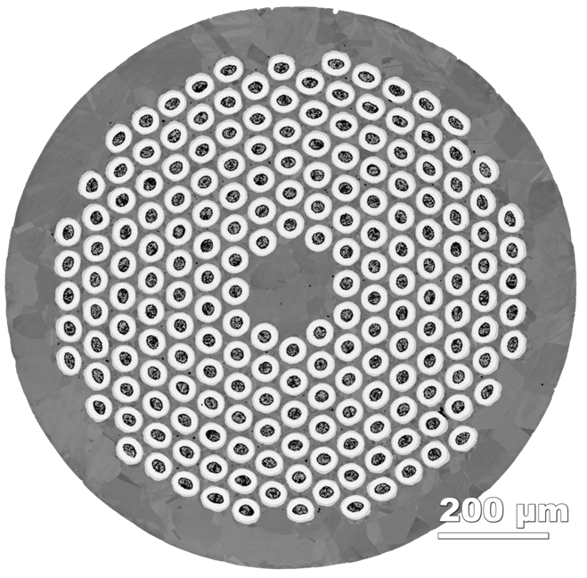





Update of PIT Nb₃Sn work at ASC
Chris Segal
June 24th, 2016
Note – although it was planned after the February meeting to work on the enhanced Sn samples made in late 2015, actually no samples have been sent so all recent work is on the same 0.78 mm wire sent to the US in the CDP-CERN RRP-PIT wire exchange whose vintage and make up is very different from the present R&D plans.
Funding provided: This work was supported by the US Department of Energy (DOE) Office of High Energy Physics under award DE-SC0012083, by CERN, and by the National High Magnetic Field Laboratory (which is supported by the National Science Foundation under NSF/DMR-1157490) and by the State of Florida.

Slide 2
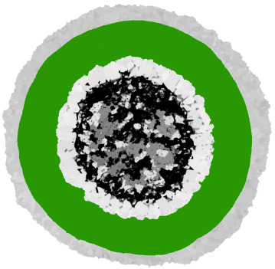
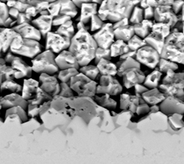
Driving Questions
Can J_{c} of standard formulation be raised?
  Probably not; we find layer J_{c} is lower in 0.78 mm than in 0.85 and 1 mm diameter wires
Do SG A15 and LG A15 form by different reaction paths?
  We think so; it appears that there is critical point early in the SG A15 formation where LG’s begin precipitating in the Nb₆Sn₅ at the SG A15 interface. All of this is the consequence of the NbSn₂ to Nausite to NbSn₂ to Nb₆Sn₅ reaction path (Cu-free PIT was discussed in February – is the Cu really valuable for PIT?)
Can LG A15 be diminished in favor of SG A15?
  Welded samples suggest yes (atypical filaments)
  Multistep HT can do this, but without benefit to J_{c} partly because 1st step is at 670 or 690 C

Slide 3
Critical Current density degrades in smaller wires
(670C 50h)
billet/sample | ramp (C/h) | wire d (mm) | I_{c} (A, 12T, 4.2K) | J_{c} (A/mm², 12T, 4.2K) | J_{c} _{SG-layer} (A/mm², 12T, 4.2K) | Nb | Total A15 | core A15 | LG A15 | SG A15
CERN HT B29992 | ? | 0.85 |  | 2404 | 5683 | 24.4% | 57.0% | 1.0% | 13.7% | 42.3%
ASC HT B31284 | 100 | 0.78 | 458 | 2045 | 4696 | 23.9% | 57.3% | 1.0% | 12.8% | 43.5%
-15%
-17%
There is a 17% reduction in layer J_{c} from 0.85mm to 0.78mm. Why?
We do not understand this: it implies an intrinsically lower Jc – but we do not know whether this is a property of this particular wire or its smaller size

Slide 4
Driving Questions
Can J_{c} of standard formulation be raised?
  Probably not; we find layer J_{c} is lower in 0.78 mm diameter wires
Do SG A15 and LG A15 form by different reaction paths?
  We think so; it appears that there is critical point early in the SG A15 formation where LG’s begin precipitating in the Nb₆Sn₅ at the SG A15 interface
Can LG A15 be diminished in favor of SG A15?
  Welded samples suggest yes (atypical filaments)
  Multistep HT can do this, but has lower J_{c}

Slide 5
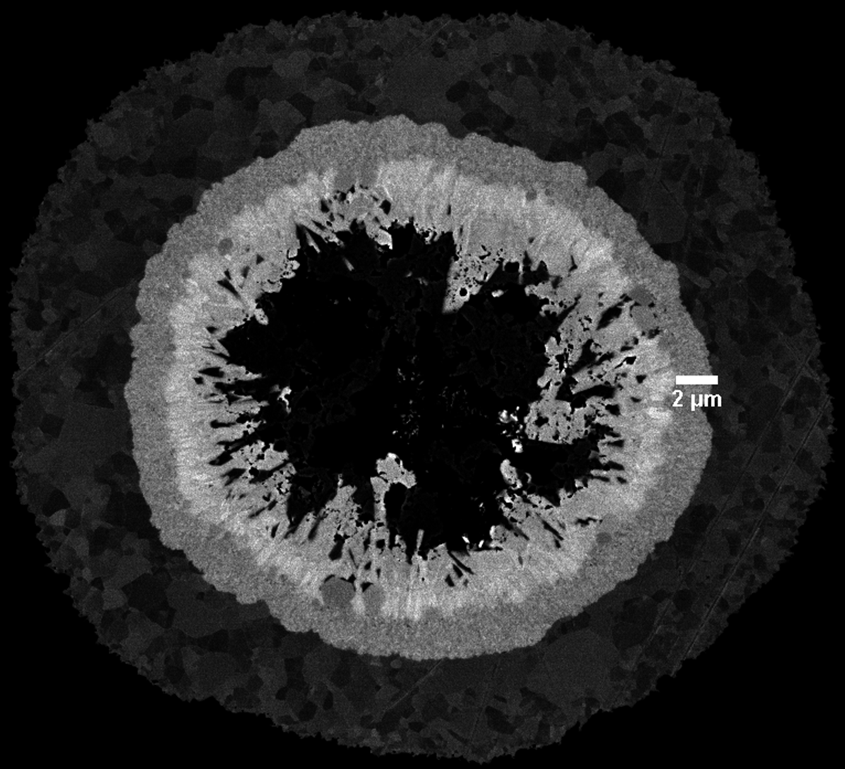
Quenched samples show LG A15 forming in the Nb₆Sn₅ annulus arising from the decomposed Nausite layer, not the Nb(Ta) tube/SG layer
SG A15 first forms by reaction of Nb₆Sn₅ with the Nb-Ta tube. After 5 hours at 670C, there is nearly a 2um thick layer of SG A15 before LG formed from Nn₆Sn₅ decomposition appears.
  We do not believe that LG A15 forms directly from the tube
  Looking at the ‘regular’ boundary between SG A15 and the Nb₆Sn₅ layer, the LG A15 appears to form inside the Nb₆Sn₅ layer at the SG A15 interface
670C 5h
Nb(Ta)
SG A15
Nb₆Sn₅
LG A15

Slide 6
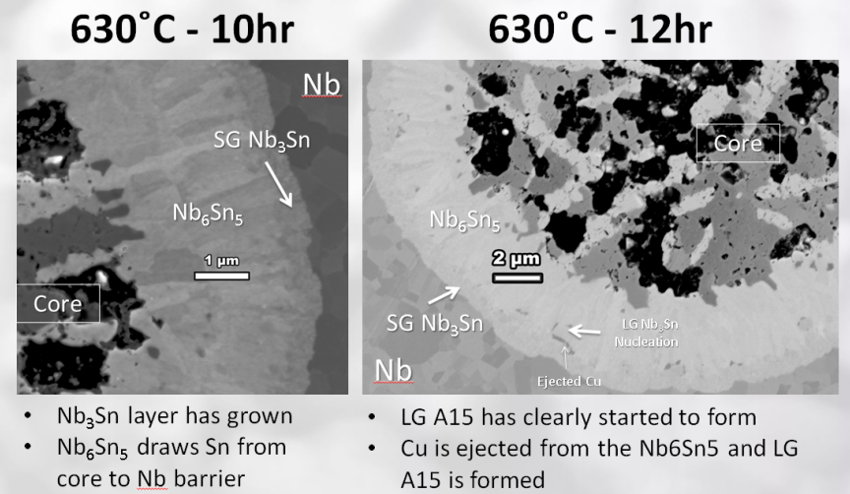
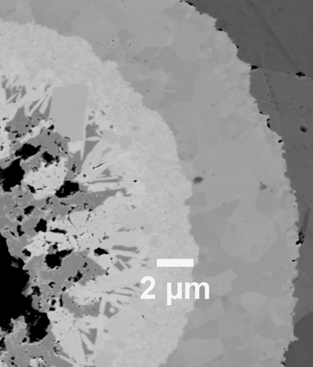
The LG A15 formation reaction path from Nb₆Sn₅ varies with temperature
We previously showed that the complex reaction path for Nb₃Sn ends (at 630C) with (Nb₆Sn₅ + Cu) feeding Sn to the Nb-Ta tube to produce A15 (images at right)
Comparing 630 to 690C we find
    First, the LG A15 forms very early on in the reaction (<12 hours for T>630 ˚C)
    Second, the layer thickness of SG A15 formed prior to LG A15 formation is sensitive to the temperature. LG A15 forms in <3 hours at 690 ˚C with more than double the SG layer thickness found at 630 ˚C
690 ˚C 3hr

Slide 7
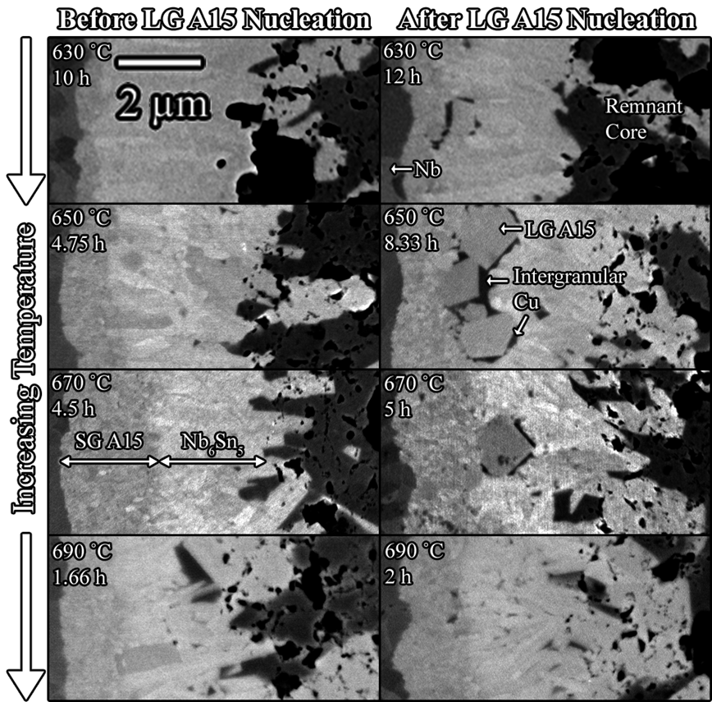
The time until formation of LG A15 is dependent on temperature
Billet 31284
Wire diameter: 0.78 mm
Ramp rate: 100C/h
This proves that the LG and the SG reactions are distinctly different, leading to the conclusion that LG is an exhaustion reaction of the core
Based on these results, I designed a multistep HT aimed to avoid forming LG A15

Slide 8
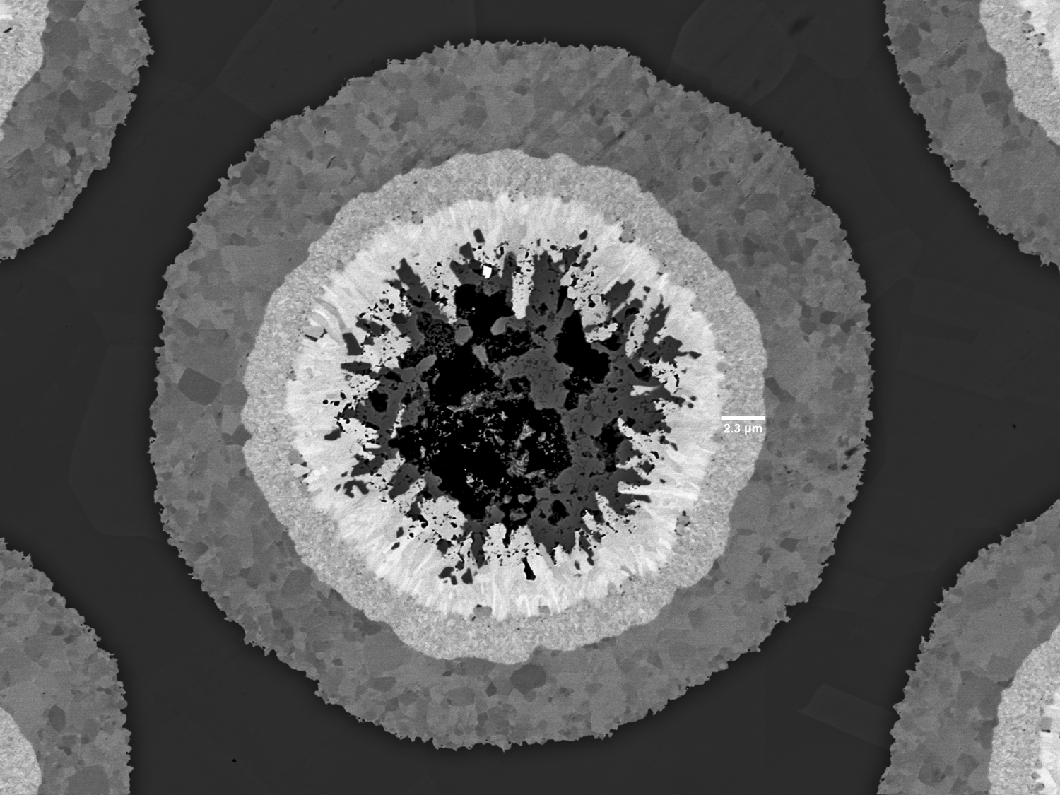
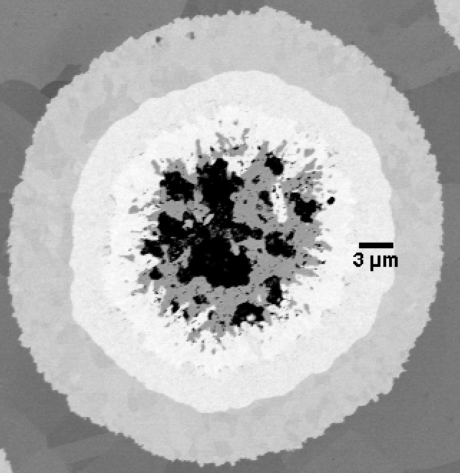
Step A + 630 ˚C 13h – we see a nice 2.2 um layer!
Nb(Ta)
LG A15
From previous slides, the most we could get in a single step was 1.9 μm!
Nb₆Sn₅
SG A15
After 9 more hours, one filament still has very little LG formation, with a SG thickness of 3-4 μm

Slide 9
Multistep Heat Treatments do well converting core and LG A15 to more SG A15
B31284, 0.78mm wire
Heat treatments done at ASC
Critical current measurements at 12T, 4.2K
Non-Cu area = 0.224 mm²; calculated by averaging area of 768 reacted filaments (4 cross sections)
Heat treatment description | Heat treatment (temp/soak time) | I_{c} (A) | J_{c} (A/mm²) | J_{c} _{SG-layer} (A/mm²) | Nb | Total A15 | core A15 | LG A15 | SG A15
BEAS recommended | 620/100+640/90 | 501 | 2237 | 5564 | 23.4% | 56.0% | 2.5% | 13.3% | 40.2%
Multistep | Step B +630/190 | 489 | 2183 | 4958 | 24.4% | 56.0% | 0.8% | 11.2% | 44.0%
% change from recommended HT |  | -2.4% | -2.4% | -10.9% | +4.3% | 0% | -68% | -15.6% | +8.6%
Transport properties went down ☹
All aspects of the microstructure improved!!!
Why?
The first step is at 690 or 670C – producing larger grains of SG A15 than BEAS recommended HT
By comparison, 0.78 mm has 17% decrease in layer Jc properties even with single step HT

Slide 10
Summary
Can J_{c} be raised above 2500 A/mm² at 12 T in the standard formulation?
  Empirically the answer after many optimizations at BEST and CERN has been no
  There are some hints it is still possible, though the possibility keeps moving lower…
    Multistep HT’s has improved LG/SG ratio, however J_{c} has not increased, and the layer J_{c} goes down.
  Could better understanding of the reaction conditions and especially of the LG/SG ratio help find more J_{c}?
Does LG contribute to J_{c}? Chiara’s paper makes a strong case for NO!
  Chris’s SuST paper makes the case that SG/LG ratio can be enhanced in some filaments if the local Sn core content is varied by intense local heat
  Does J_{c} rise if the SG/LG is enhanced? No answer possible with welded samples
    Recent BEST R&D billets have addressed this question with variable Sn:Nb ratios but with uncertain outcome
    Agreed in February that these samples, reacted and unreacted would come to Chris
Does the LG form by a different reaction path than the SG?
  At BEST/CERN/FSU meeting in February we suggested that LG forms by decomposition only of core constituents
  Samples quenched as the LG A15 grains are forming show that the LG forms in the Nb₆Sn₅ annulus formed from Nausite decomposition formed from core reactions rather than from the SG A15 annulus formed by diffusion of Sn into the Nb-Ta tube.

Slide 11
Present conclusions
We are close to concluding experiments with this standard ratio PIT conductor (whose properties may be compromised by its small size too?)
LG incubation can definitely be delayed
  Consistent with there being two different reactions
    SG is formed by direct diffusion of Sn into Nb-Ta supplied by Nb₆Sn₅
    LG forms when Nb₆Sn₅ decomposes to LG A15
    Probing the Ta content of LG shows a little Ta signal in the LG but clearly much less than in SG (strong overlap of Cu and Ta signals makes this experiment difficult)
We are still unclear about the value of the Cu sleeve
  In principle Cu should NOT be needed to allow A15 since the pathway NbSn₂ through Nb₆Sn₅ to A15 exists (this is not the bronze route)
  We have found that Cu is soluble in Nausite, insoluble in NbSn₂ and soluble in Nb₆Sn₅
  When Nb₆Sn₅ decomposes, Cu is dumped in small mesoscopic piles at LG A15 GBs
We are constrained by having only one chemistry to work with

Slide 12
Conclusions of the February meeting
Bruker presented multiple variable (all increased Sn) billets that responded to our earlier observations of variable LG/SG ratio observations in welded wires where we believed that we had locally modified the local Sn:Nb ratio
  Reacted wire was to be sent for microstructural analysis (SG/LG volume fractions/EDS)
  Unreacted wire for DTA analysis and quench experiments opening up the reaction paths
Unreacted Cu-free wire to study formation in the absence of Cu
Reacted, global barrier wire for microstructural analysis

