Slide 1
FCC-hh Vertex detector Optimization
Estel Perez 23 June
1 – Flavour tagging performance in pp collisions (50 GeV jets)
[+ cross-checking we reproduce ee results]
2 - Performance of the Reconstruction (PFA) for very energetic jets (flavour tagging will build on PFOs…)

Slide 2
Flavour tagging performance
0: reproducing Nilou’s master thesis results

Slide 3
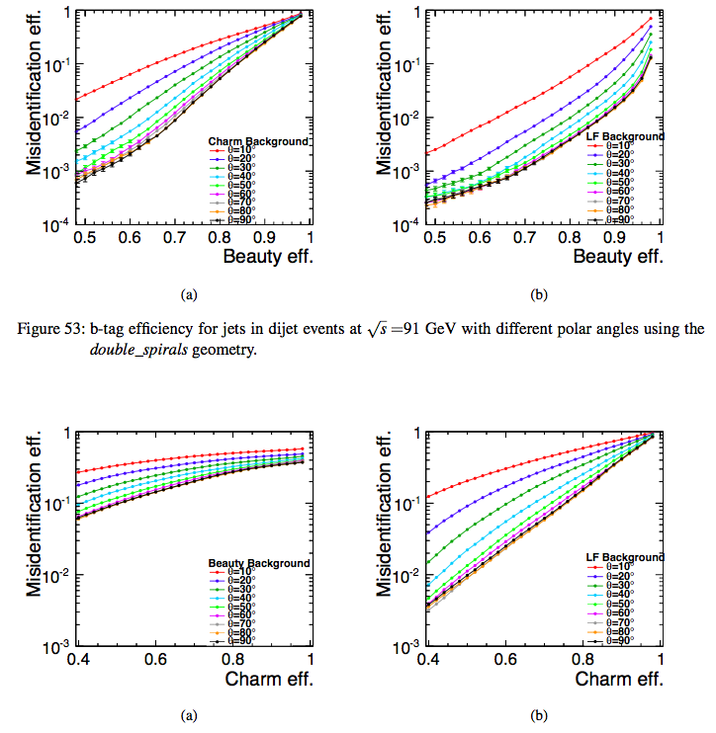
5*10^-2
4*10^-3
Take as reference central jets (theta=90) at sqrt(s)=91GeV

Slide 4
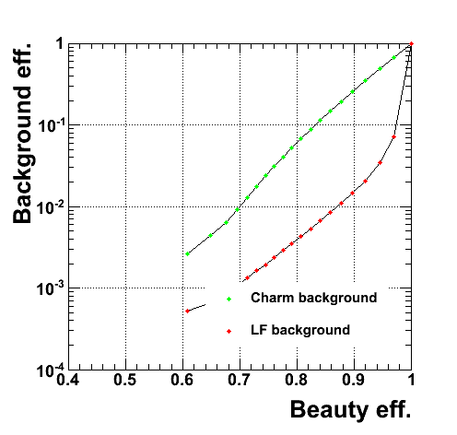
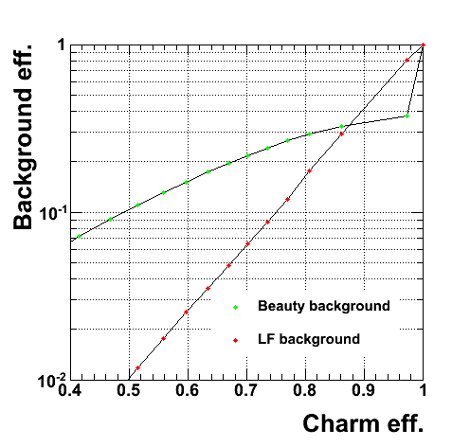
Reproducing ee results
Use all PFOs (incl. beamjets) – no overlay
No timing cuts
No pT cut on input particles
Use beamspot constrain
LF rejection is spot on
C/B rejection close enough

Slide 5
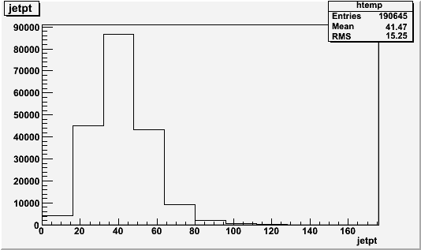
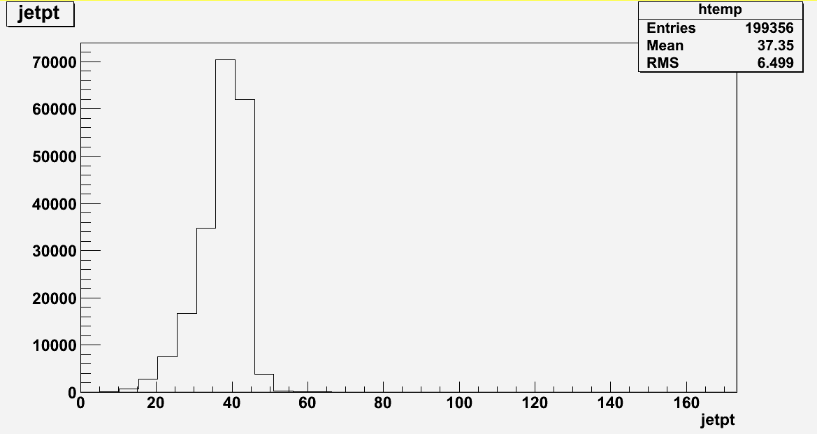
Flavour tagging performance
1: use pp collisions,
  quark pT = 50 GeV,
  theta = 90
Jet pT spectrum
pp->bb 50 GeV
ee->bb sqrt(s)=91 GeV

Slide 6
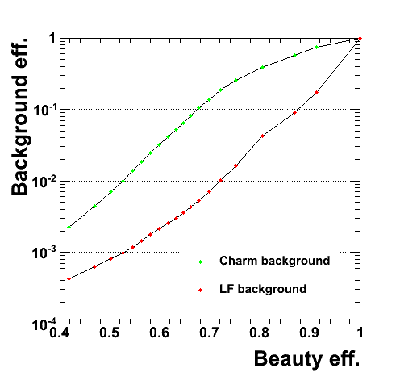
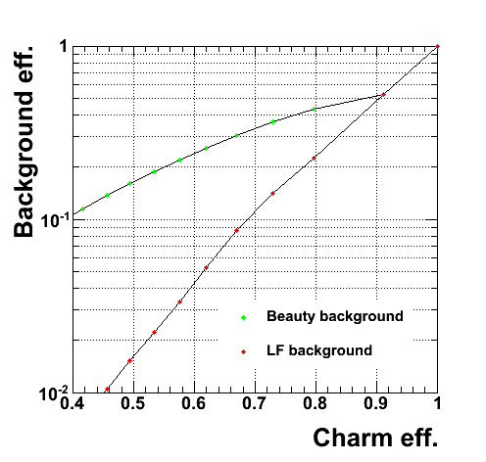
pp->bb/cc/uu (pT=50GeV)
Use PFOs with pT>500 MeV clustered in 2 kt jets (R=0.3) (beamjets removed)
No timing cuts
No beamspot constrain
100k bb evts ; 100k cc evts ; 500k uu evts

Slide 7
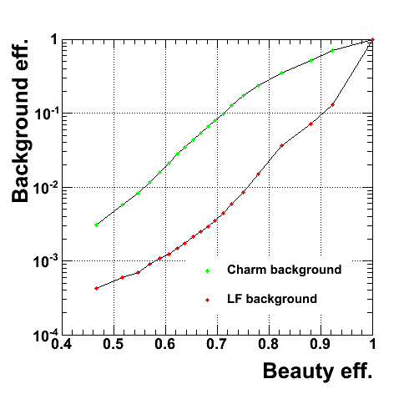
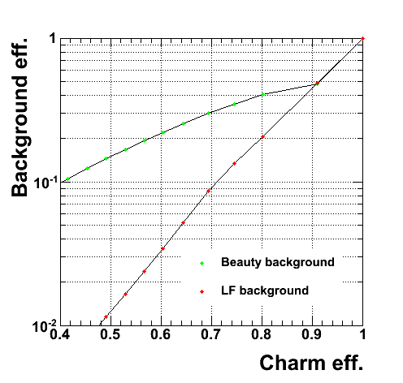
pp->bb/cc/uu (pT=50GeV)
Use PFOs with pT>500 MeV clustered in 2 kt jets (R=0.3) (beamjets removed)
No timing cuts
No beamspot constrain
30<jetpt<50 GeV
100k bb evts ; 100k cc evts ; 500k uu evts

Slide 8
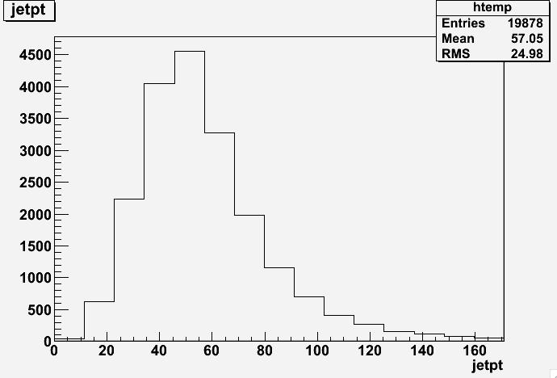
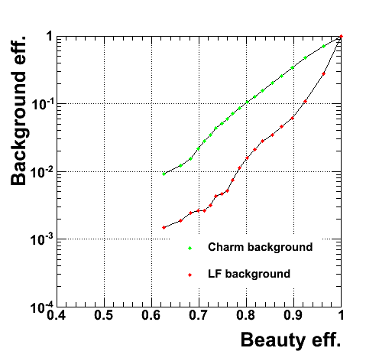
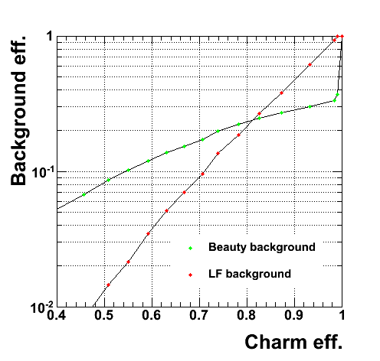
Previous results with inclusive samples (pT>50GeV)
Use PFOs with pT>500 MeV clustered in 2 kt jets (R=0.3) (beamjets removed)
No timing cuts
No beamspot constrain
50<jetpt<100 GeV
10k bb evts ; 10k cc evts ; 10k uu evts

Slide 9
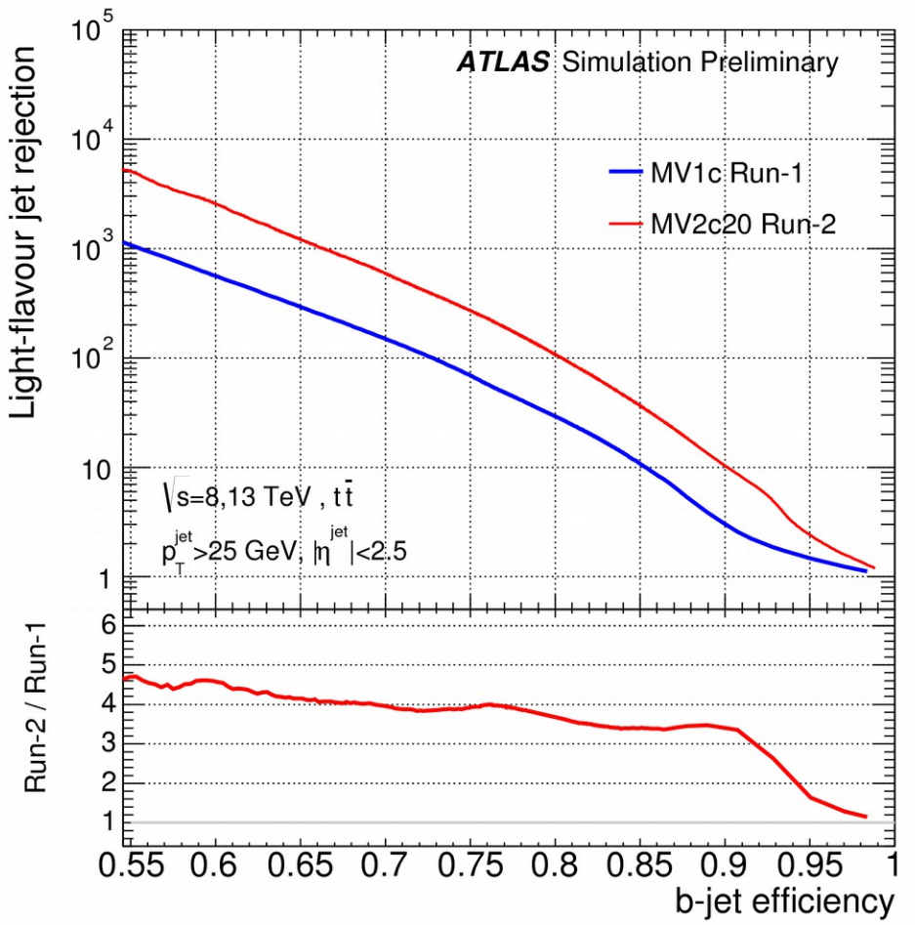
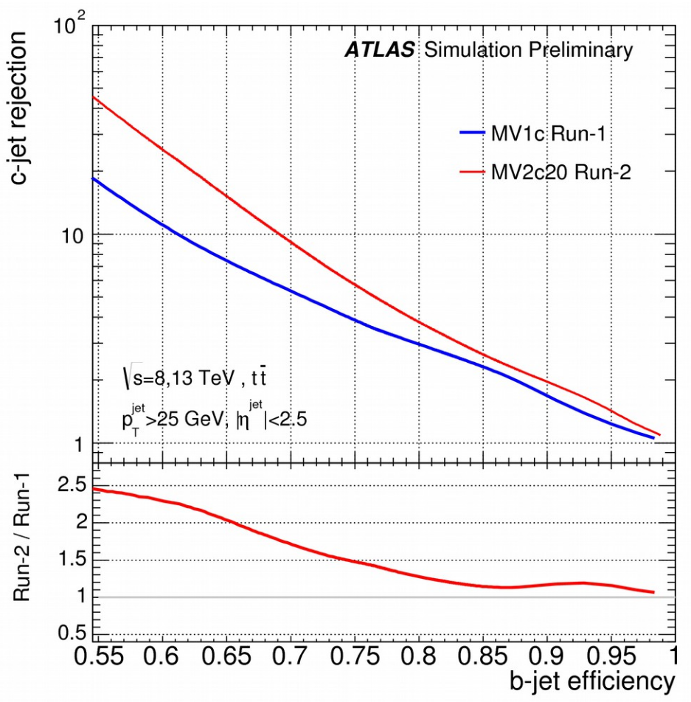
Compare to ATLAS
https://indico.cern.ch/event/442390/contributions/1096052/attachments/1289960/1920661/jiri-tracking-and-btagging-v7.pdf

Slide 10
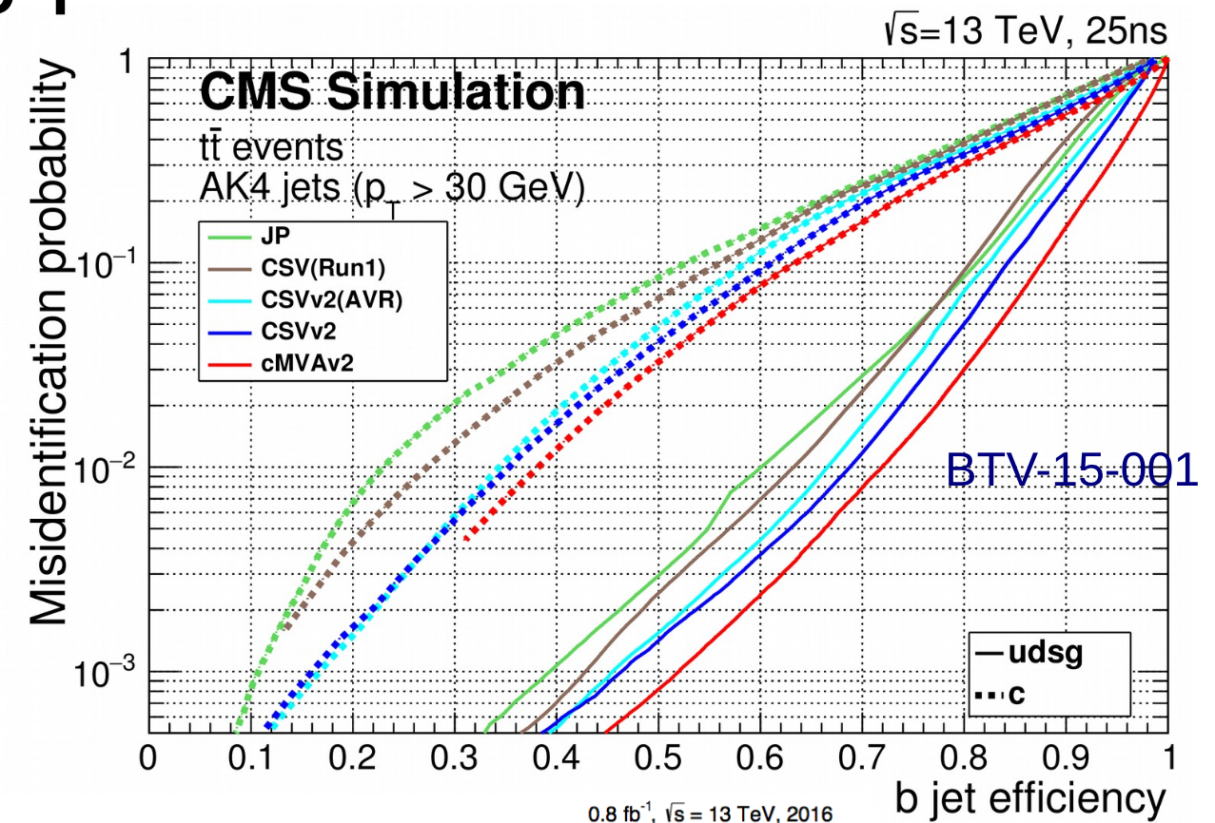
Compare to CMS
https://indico.cern.ch/event/442390/contributions/1096052/attachments/1289960/1920661/jiri-tracking-and-btagging-v7.pdf

Slide 11
Similar to ATLAS run 1 & CMS
Why different from inclusive samples?

Slide 12
extra

Slide 13
Previous results with inclusive samples (pT>50GeV)
Use PFOs with pT>500 MeV clustered in 2 kt jets (R=0.5) (beamjets removed)
No timing cuts
No beamspot constrain
50<jetpt<100 GeV
10k bb evts ; 10k cc evts ; 10k uu evts

Slide 14
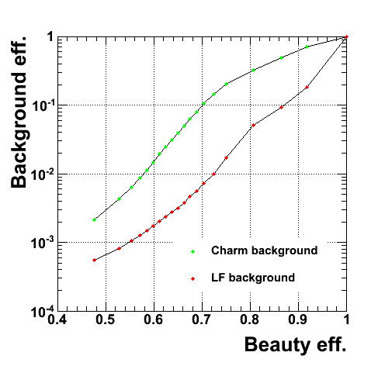
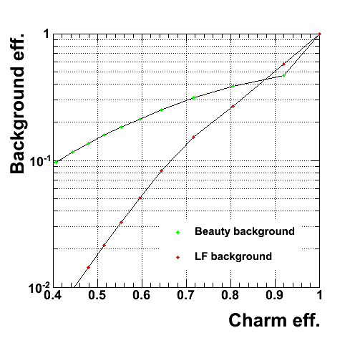
pp->bb/cc/uu (pT=50GeV)
Use PFOs in 2 kt jets (R=0.5) (beamjets removed)
No timing cuts
No beamspot constrain
100k bb evts ; 100k cc evts ; 500k uu evts

Slide 15
2- Reconstruction performance for high energy jets
  Is there energy leakage affecting PFA ?

Slide 16
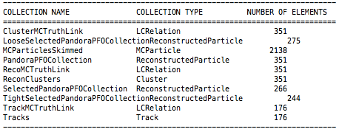
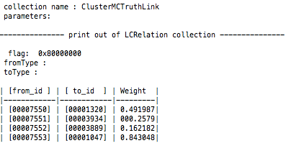
Info Available
Every cluster is linked to a MCParticle and most of the times has a corresponding a PFO
Every track is linked to a MCParticle
several Tracks, Clusters and PFOs can be linked to the same MCParticle
The weight gives you the fraction of the total corresponding to that object (??)

Slide 17
Links
RecoClusters
Tracks
weight
weight
MCParticles
weight
with associated
cluster
PFOs
with associated
track

Slide 18
samples used
selection
single pion
  pT(pi-) 1-10000 GeV
pp->bb
  pT(b) == 50 GeV
  pT(b) == 500 GeV
  pT(b) == 5000 GeV
pp->uu
  pT(u) == 5000 GeV
MCParticle & PFOs
- abs(Theta-pi/2)<pi/8

Slide 19
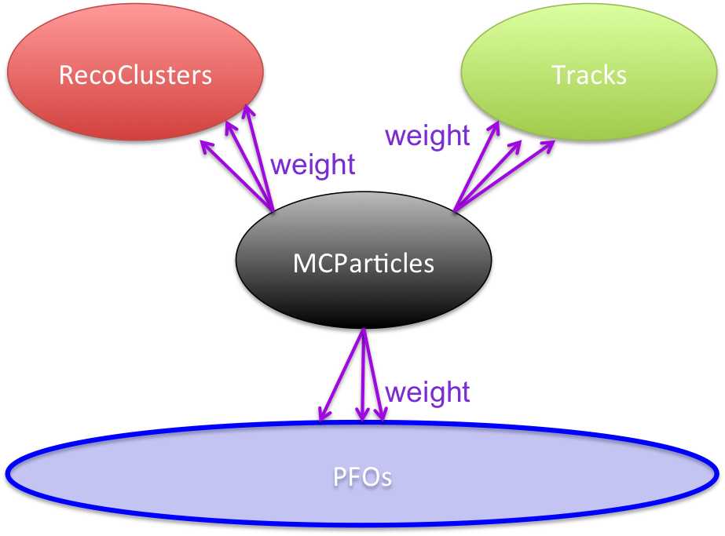
uu 5000 GeV. For each MCParticle, links to objects

Slide 20
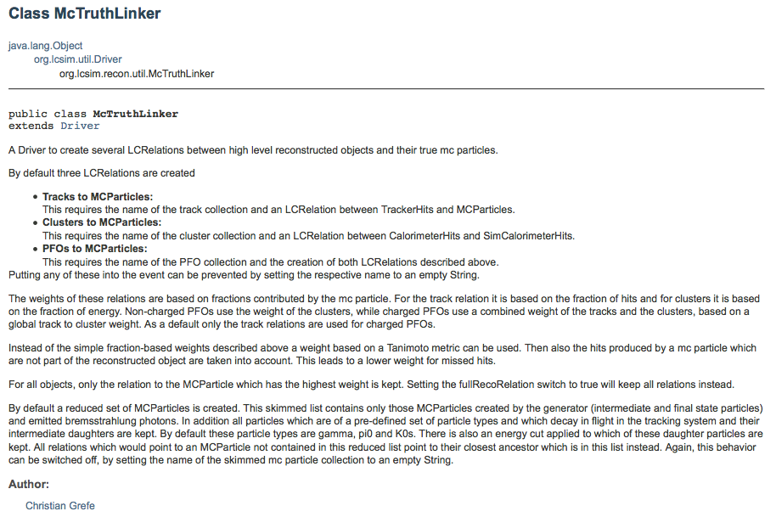
http://www.lcsim.org/sites/lcsim/apidocs/org/lcsim/recon/util/McTruthLinker.html

Slide 21
Efficiency of PFA identifying a pion
loop over mcp
  if pdgID not 211 continue (status=1, central Theta)
  loop over pfo’s linked to it
    check if abs PFO Type ==211
      Fill(1)
    else
      Fill(0)
plot versus the energy of the mcp
plot # of reco pions to the same mc pion
for single reco pion, plot
  E reco pion / E mcp vs Emcp or R mcp

Slide 22
eff of finding a reco pion
multiplicity of reco pions per mc pion
if single reco pion, energy correlation
E ratio vs E truth
E ratio vs R truth
Single pions
50 GeV
pp->bb pions in jets
500 GeV
5000 GeV
pp->uu 5000 GeV
ee->bb 91 GeV

