Slide 1
Timing Scan 24.06.2016

Slide 3
The Spill warning…
Spill warning from PS
Spill 540ms
1 s
Acquisition
Spill 540ms
Delay set on C-Train Counter
In control room T9
Trigger for FEB data acquisition
External pulse gen.
100 kHz
1us wide pulse
10us period
100000 cycles
1 s

Slide 4
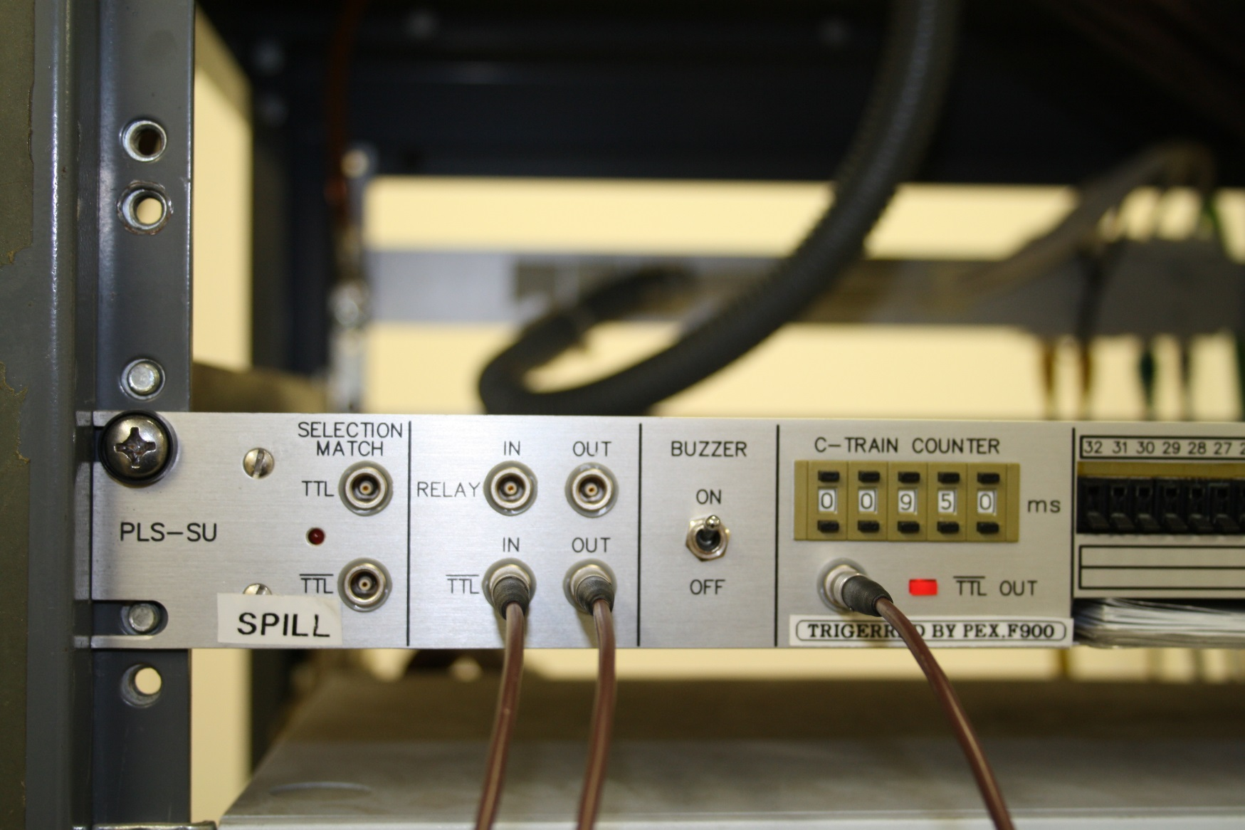
Connections for spill delay settings in Control Room T9
Manual for this kit is a bit opaque but worked out

