Slide 1
TE-MSC

Slide 2

11T Coils 114 & 115 Metrology Analysis
26/05/2016
Christian H. Loffler TE-MSC-LMF
Jose Ferradas TE-MSC-MDT
Alejandro Carlon TE-MSC-MDT

Slide 3
Outline
Introduction
Last updates
Coils History
114 & 115 metrology analysis
Results – Summary
Results – 114 vs 115
Results – Comparison with previous production

Slide 4
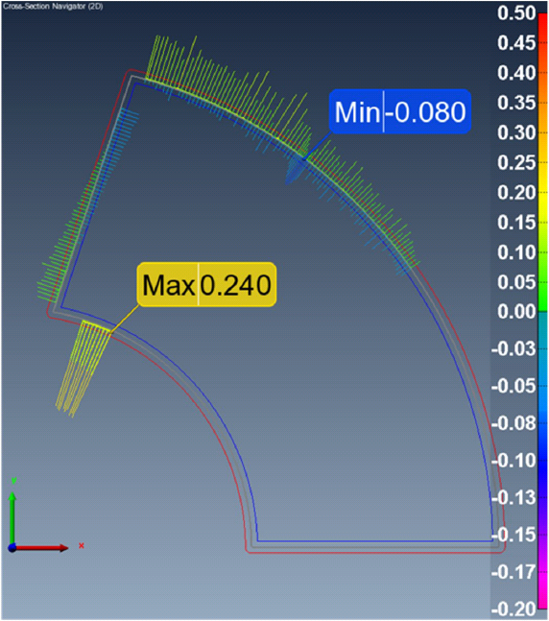
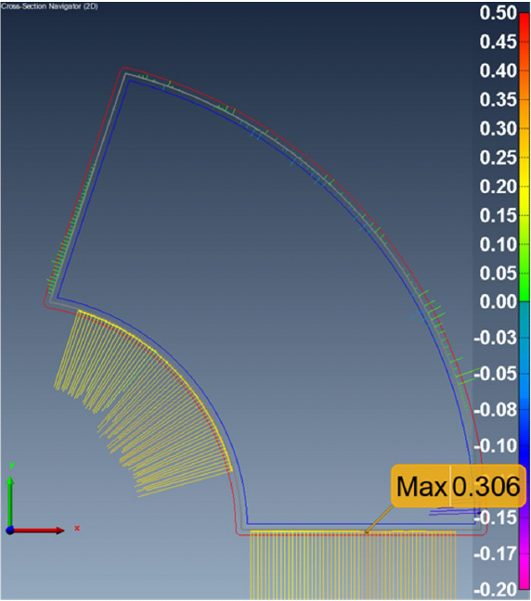
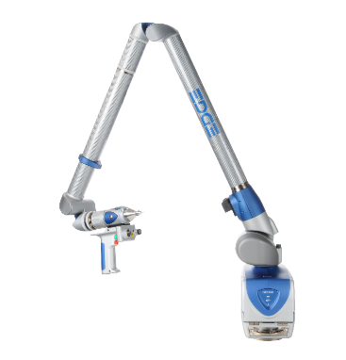
Introduction
3D – Measurement device Faro Arm Edge 2.7
6 mm. Touch Probe
HD – LaserLine Probe
Results based in cross-section analysis
Cross sections divided in left and right
Individual alignment of each cross section
Outer Diameter and Loading Plate
Each 100 mm. one cross section is measured
Before alignment
After alignment

Slide 5
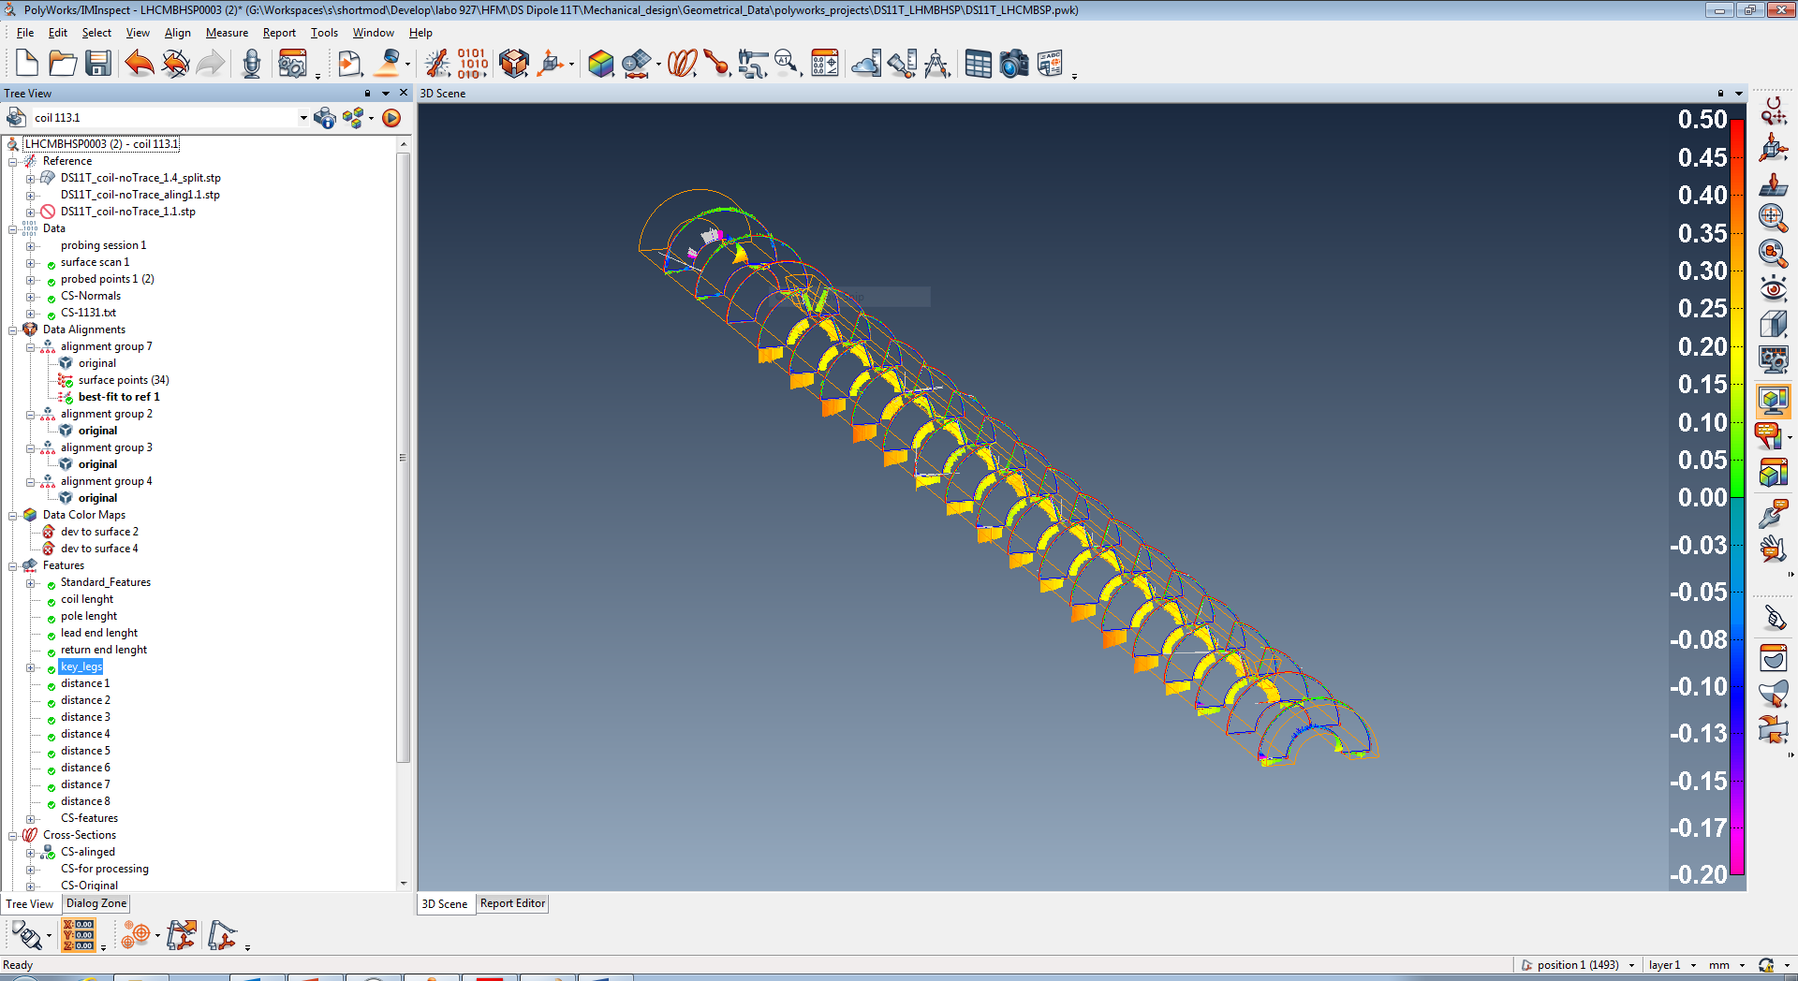
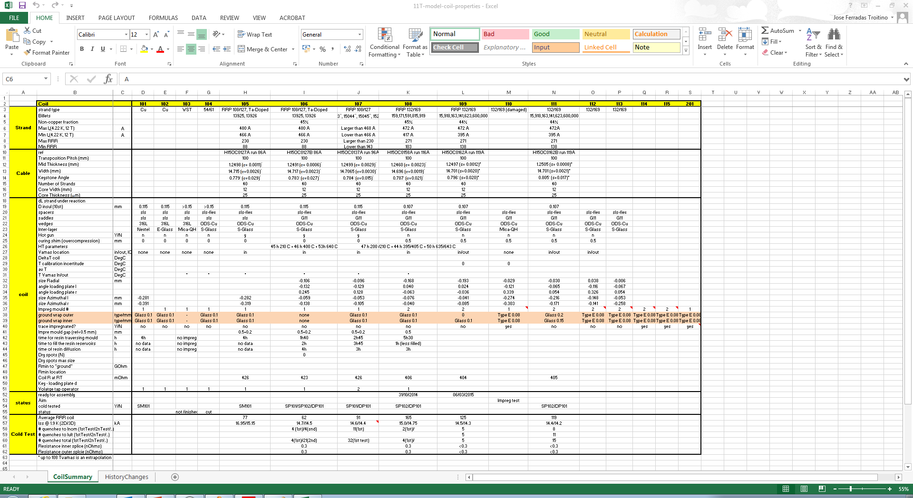
Last updates
Small corrections made in result analysis for coils 114 & 115
Debugging software data analysis
Extracted results refined for one problematic cross section
Results updated in DFS server

Slide 6
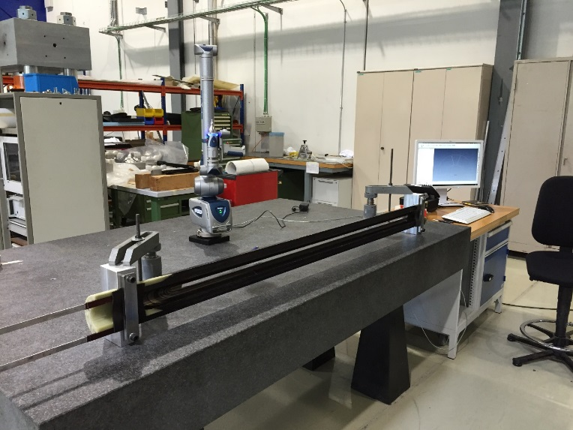
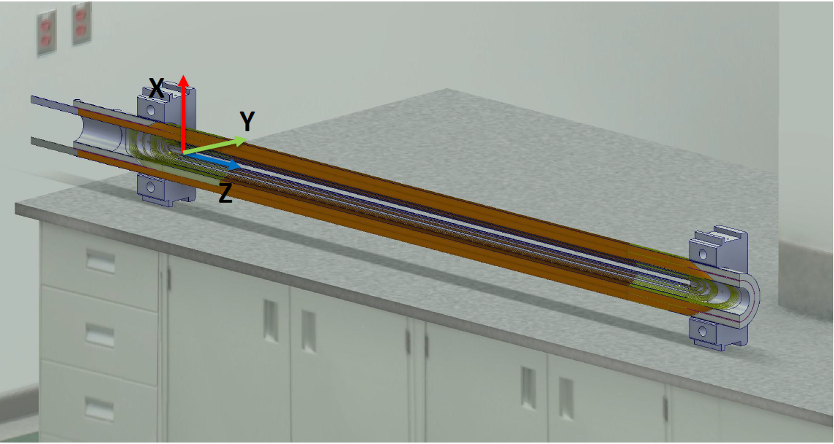
Coils History
114 & 115 short coils
11T Dipole RRP 132/169 cable coils:
Impregnated in Long Magnet Facility
Impregnated trace
Measurements performed by Alejandro Carlon.
Analysis focused in radial size, mid-plane position and loading plate angle.

Slide 7
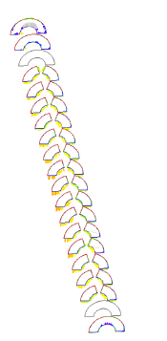
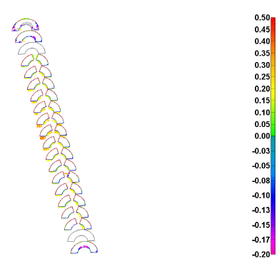
114 & 115 Metrology analysis
Coil 114
Coil 115

Slide 8
Results - Summary
 | COIL
 | 114 | 115
Size Radial [mm] | 0.066 | 0.082
Angle loading plate Left [⁰] | -0.096 | -0.029
Angle loading plate Right [⁰] | 0.104 | 0.029
Size Azimuthal Left [mm] | -0.110 | -0.099
Size Azimuthal Right [mm] | -0.221 | -0.172
Impreg mould number | 2 | 2
IMPREG MANDREL NUMBER | 1 | 1
Average deviation values (from nominal) extracted from the straight section
*Negative values in azimuthal size means excess

Slide 9
Results - Summary
Coil 114
Coil 115
*Negative values in azimuthal size means excess
Mid-plane deviation from nominal (straight section)

Slide 10
Results - Summary
Coil 114
Coil 115
Outer diameter deviation from nominal (straight section)

Slide 11
Results - Summary
Coil 114
Coil 115
Loading plate angle deviation from nominal (straight section)

Slide 12
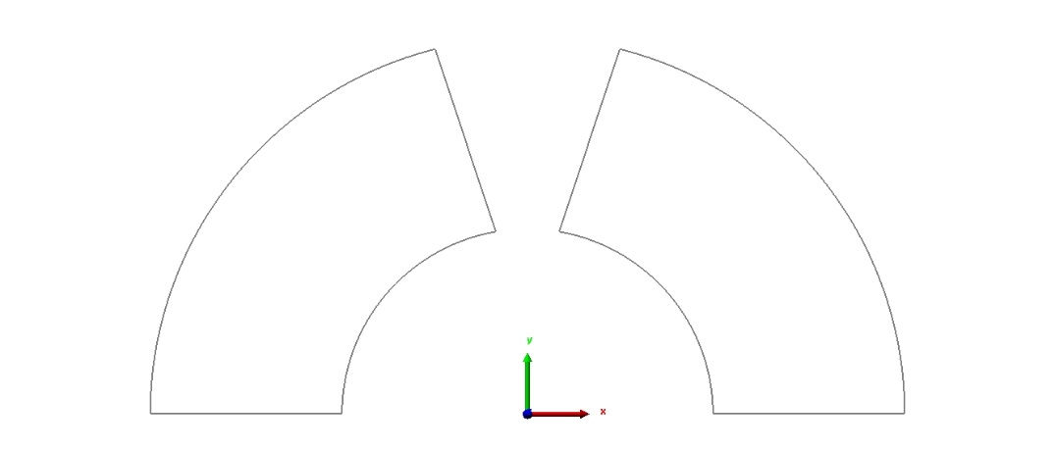
Results - Summary
 | COIL
 | 114 | 115
Size Radial | 0.066 | 0.082
Angle loading plate Left | -0.096 | -0.029
Angle loading plate Right | 0.104 | 0.029
Size Azimuthal Left | -0.110 | -0.099
Size Azimuthal Right | -0.221 | -0.172
Impreg mould number | 2 | 2
IMPREG MANDREL NUMBER | 1 | 1
Signs convention
-
+
Left
Right
-
-
*Negative values in azimuthal size means excess
*Angles in degrees (⁰)
** Distances in mm
Average deviation values (from nominal) extracted from the straight section
Loading plate angle: 0.1 degree = 50µm azimuthal difference in length over the loading plate
(50µm=25MPa difference during powering) ¹
Both coils are impregnated using the same tooling and same configuration
¹ From C.H. Loffler

Slide 13
Results - Summary
 | COIL
 | 114 |  | 115
Size Radial | 0.066 |  | 0.082
Angle loading plate Left | -0.096 | δ = 0.008 | -0.029 | δ ~ 0
Angle loading plate Right | 0.104 |  | 0.029
Size Azimuthal Left | -0.110 | δ = 0.111 | -0.099 | δ = 0.073
Size Azimuthal Right | -0.221 |  | -0.172
Impreg mould number | 2 |  | 2
IMPREG MANDREL NUMBER | 1 |  | 1
 | Abs δ (114 – 115)
Size Radial | 0.016
Angle loading plate Left | 0.067
Angle loading plate Right | 0.075
Size Azimuthal Left | 0.011
Size Azimuthal Right | 0.049
Loading plates moving ~ Same order of magnitude
Mid-Planes moving differently
*Negative values in azimuthal size means excess
For each coil:
~ Symmetric LP angle deformation
Asymmetric azimuthal deviation
For both coils:
Loading plates moving ~ Same order of magnitude
Mid-Planes moving differently

Slide 14
Results - 114 vs 115
*Negative values in azimuthal size means excess
Mid-plane deviation from nominal (straight section)

Slide 15
Results - 114 vs 115
Outer diameter deviation from nominal (straight section)

Slide 16
Results - 114 vs 115
Loading plate angle deviation from nominal (straight section)

Slide 17
Coil results – Magnet Arc
Before refining
After refining

Slide 18
Coil results – Comparison with previous coils
 | COIL
 | 106 | 107 | 108 | 109
Size Radial | -0.106 | -0.096 | -0.168 | -0.193
Angle loading plate Left | -0.132 | -0.129 | 0.040 | 0.024
Angle loading plate Right | 0.245 | 0.128 | -0.063 | -0.036
Size Azimuthal Left | -0.059 | -0.053 | -0.076 | -0.041
Size Azimuthal Right | -0.138 | -0.105 | -0.040 | -0.085
Impreg mould number | 1 | 1 | 2 | 2
IMPREG MANDREL NUMBER | 1 | 1 | 2 | 2
Ground wrap outer | none | Glass 0.1 | Glass 0.1 | 0
Ground wrap inner | none | Glass 0.1 | Glass 0.1 | Glass 0.1
Best geometry up to now. Except radially

Slide 19
Coil results – Comparison with previous coils
 | COIL
 | 110 | 111 | 112 | 113 | 114 | 115
Size Radial | -0.029 | -0.030 | 0.038 | -0.006 | 0.066 | 0.082
Angle loading plate Left | -0.121 | -0.065 | -0.116 | -0.067 | -0.096 | -0.029
Angle loading plate Right | 0.339 | 0.054 | 0.326 | 0.054 | 0.104 | 0.029
Size Azimuthal Left | -0.274 | -0.216 | -0.148 | -0.053 | -0.110 | -0.099
Size Azimuthal Right | -0.303 | -0.171 | -0.141 | -0.258 | -0.221 | -0.172
Impreg mould number | 1 | 2 | 2 | 2 | 2 | 2
IMPREG MANDREL NUMBER | 1 | 1 | 2 | 2 | 1 | 1
Ground wrap outer | Type E 0.08 | Glass 0.2 | Type E 0.08 | Type E 0.08 | Type E 0.08 | Type E 0.08
Ground wrap inner | Type E 0.08 | Glass 0.15 | Type E 0.08 | Type E 0.08 | Type E 0.08 | Type E 0.08
Missing 0.125 mm releasing film over mandrel external face and inox shim internal face
Impregnated Trace

Slide 20
CONCLUSIONS
Coils 114 & 115 (same configuration) have shown same tendency but different deviation magnitude.
Mid-plane geometry distribution can cause stress concentration after shimming and assembly.
Loading plate angle is much better in coil 115. Deviations in loading plate angle cannot be corrected with shims.
Impregnation mould 2 + mandrel 1 common configuration.
Coil mid-plane geometry varying along production. Different configurations used.
Coil 111 (very similar configuration to 114 & 115) shows completely different behaviour.
Difficult to establish relationship between loading plate deviation and mid-plane deviation.

Slide 22
Backup slides

Slide 24
Geometry differences along coil production
Note that Different configurations have been used

Slide 25
Geometry differences along coil production
Note that Different configurations have been used

Slide 26
Geometry differences along coil production

