Slide 1
HPS Readout RCE Deployment
Ben Reese, SLAC National Accelerator Laboratory

Slide 2
What will be covered
Background on HPS detector
  Sensor Overview
  Front End Electronics
RCE implementation
  Data Flow
  Configuration
  Timing Distribution

Slide 3
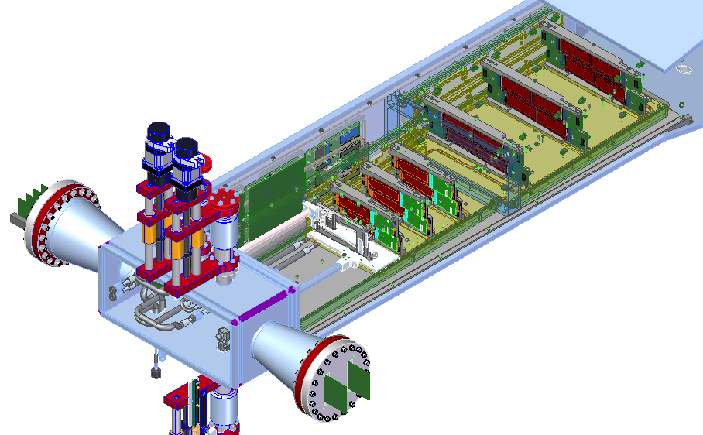
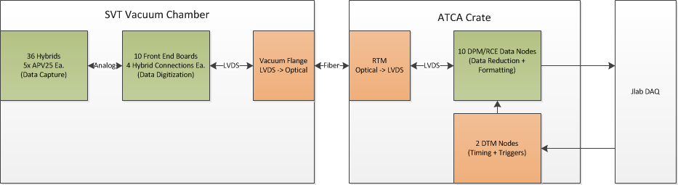
HPS SVT Overview
Search for A’ (Dark Photon)
e⁻ beam on fixed target
6 layers of silicon strip sensors
36 total sensors
Notes:
This talk will focus on the DAQ electronics. There is a separate talk later today at the Silicon Detectors session that will cover the SVT design and the physics motivations behind it.

Slide 4
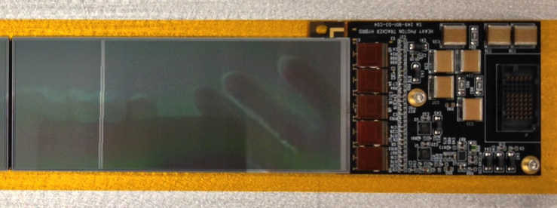
Hybrid Sensor Module
Attaches APV25 analog ASICs to silicon strip sensors
APV25 originally developed for CMS experiment at LHC
128 strip lines per APV25
5 APV25s per Hybrid – 640 strip lines
36 Hybrids in SVT
23,040 total readout channels
Hybrid Module

Slide 5
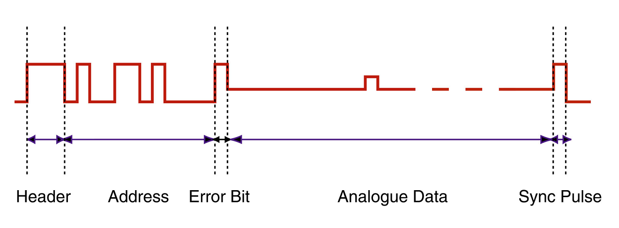
APV25 Configuration & Readout
Configuration
    “Multi-peak” mode – 3 Samples / channel / trigger
    1 DAQ trigger = 2 APV triggers
    6 readout frames per DAQ trigger
    Clocked at 41.667 MHz (125/3)
Readout
    Sync pulse every 35 cycles – establishes connection
    12 Sample rail-to-rail digital header
    128 analog channel samples
    140 cycles per frame – 840 cycles per trigger for 6 frames
    Maximum trigger rate: 49.6 kHz
    APV can accept up to 5 outstanding triggers

Slide 6
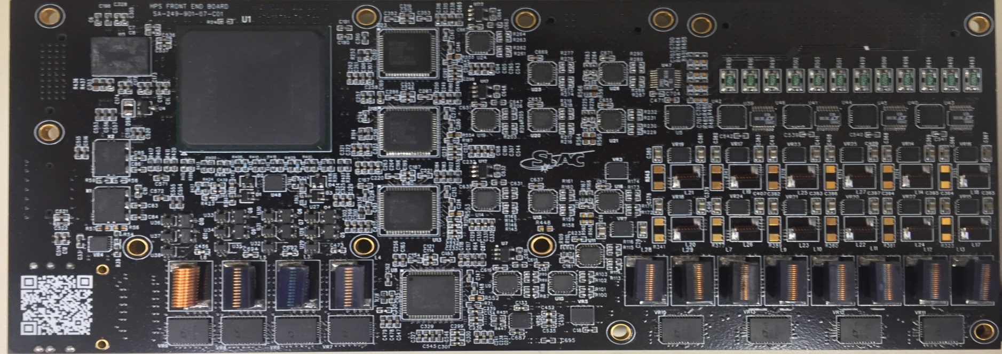
In-Chamber Front End Board
Distance from DAQ crate
DAQ crate sits 30m from SVT
Long way to run analog signals
Long way to run low voltage power to Hybrids
  Need either thick cables or large overdrive to deal with voltage drop
Vacuum penetration count
36 Hybrids, 5 APVs each
  180 differential analog signals
  Need 3 individual voltages lines per Hybrid
    108 LV lines + grounds
Config PROM
Xilinx Artix 100T FPGA
HV sensor bias in
(Bottom)
Connector to hybrids
(Bottom)
Hybrid power monitoring
Each FEB connects to 4 Hybrids
10 FEBs deployed in chamber
Xilinx Artix FPGA
20 ADC channels
High density connectors
8 switching regulators
16 linear regulators
1 Full-duplex PGP link for control
4 TX only PGP links for data output
LV power in
(Bottom)
High speed data I/O
(Bottom)
Air core inductors
FPGA power regulators
ADCs
ADC preamplifiers
Hybrid switching regulators
Hybrid linear regulators
Notes:
The Hybrids are connected in in-chamber front end boards. Why in chamber?

Slide 7
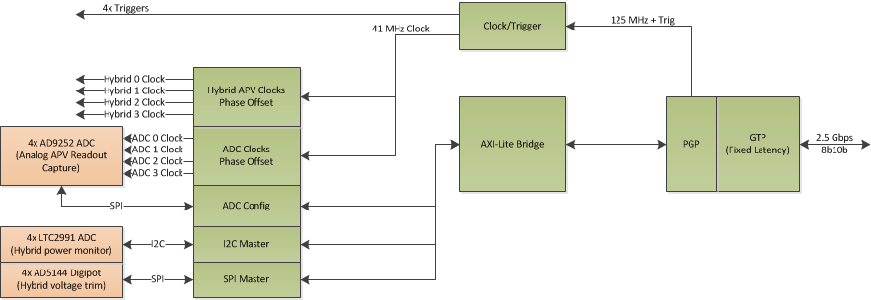
FEB Firmware – Clock, Trigger, Configuration
Clock and triggers
  Use PGP in fixed latency mode
  Beam clock and triggers recovered from 8b10b stream
  Create 41 MHz APV25 clocks with adjustable phase
  Create 41 MHz ADC clocks with adjustable phase
Configuration and monitoring
  I2C interface for each Hybrid for APV25 configuration
  Hybrid current and voltage monitoring with I2C ADC
  Hybrid voltage trimming with SPI digi-pot on linear regulator feedback
  SPI interface for ADC configuration

Slide 8
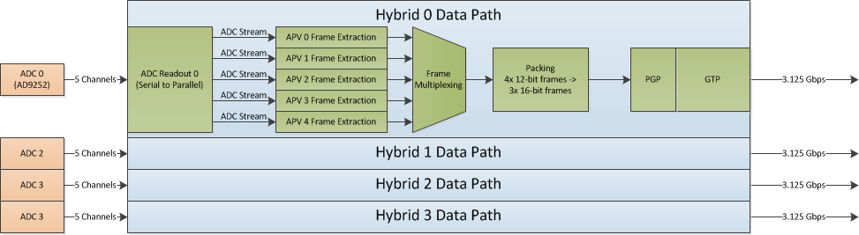
FEB Firmware – Data Path
  Deserialize ADC data (5 channels each per hybrid)
  Extract APV25 frames from 20 ADC streams
    Allows upstream data rate to scale with trigger rate
  Pack 4 12-bit samples into 3 16-bit words
  Transmit extracted frames on high speed GTP links
    1 upstream link per Hybrid, 3.125 Gbps per link

Slide 9
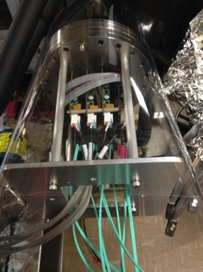
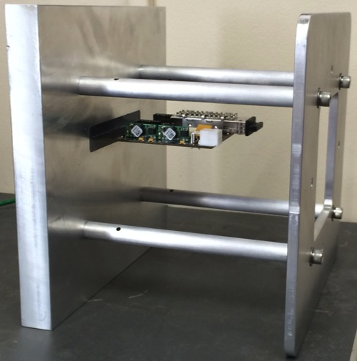
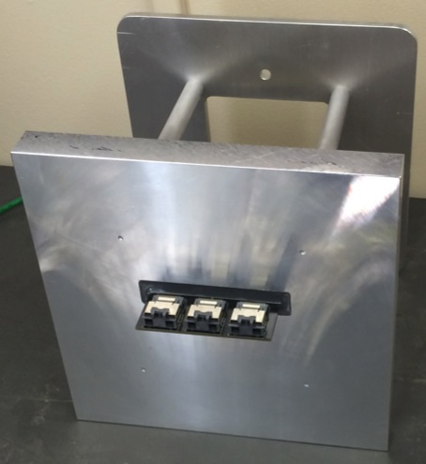
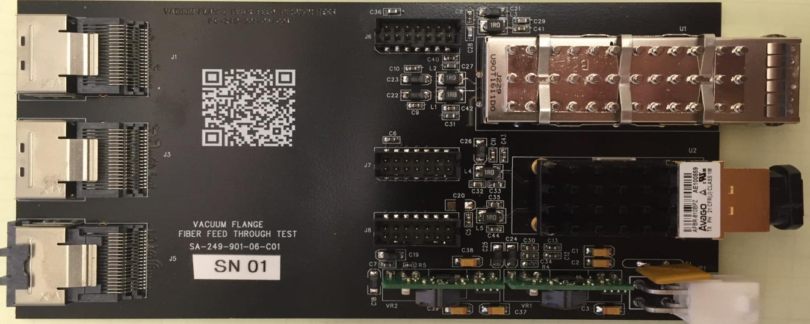
Vacuum Transition Flange Boards
High speed differential signals from FEB are converted to optical signals on a custom vacuum flange board
Each flange board services up to 3 FEBs – 4 Flange boards total
Flexible, vacuum compatible, 0.5m mSAS cable connect to FEB
Optical conversion on air side
30m optical fiber to DAQ crate
Vacuum
SNP12 QSFP
Control links for 3 FEBs
Air
Installed in vacuum box
Flange
Penetration
3M mSAS
Connector to FEB
12c Channel Transmitter
Data links for 3 FEBs
Potted in test flange
Flange Board

Slide 10
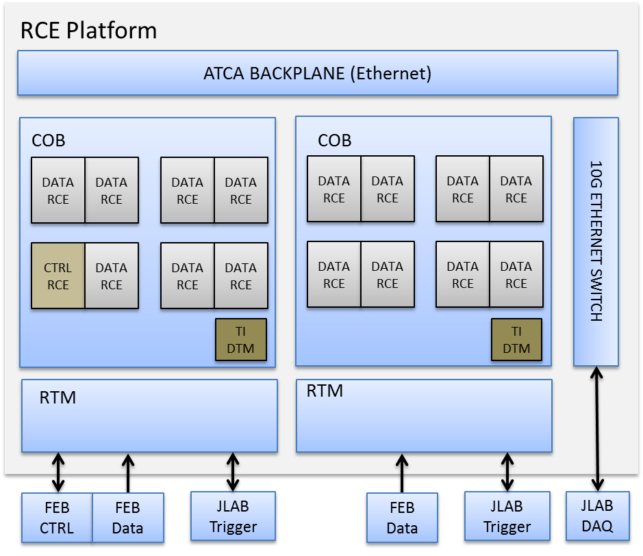
HPS RCE Configuration
2 COB blades / 16 RCE nodes
One RCE node dedicated for FEB configuration channels
All other RCE nodes configured for data processing
RTM distributes 4 Hybrid data channels to each RCE
DTM hosts JLAB timing interface firmware
JLab Read-Out-Controller (ROC) app runs on Zynq CPU
RCE Platform
ATCA BACKPLANE (Ethernet)
COB
COB
DATA
RCE
DATA
RCE
DATA
RCE
DATA
RCE
DATA
RCE
DATA
RCE
DATA
RCE
DATA
RCE
10G ETHERNET SWITCH
CTRL
RCE
DATA
RCE
DATA
RCE
DATA
RCE
DATA
RCE
DATA
RCE
DATA
RCE
DATA
RCE
TI
DTM
TI
DTM
RTM
RTM
FEB
CTRL
FEB
Data
JLAB
Trigger
FEB
Data
JLAB
Trigger
JLAB DAQ
RCE Crate Configuration

Slide 11
Control RCE
One RCE contains all of the control links that configure the downstream FEBs.
10 PGP links running at 2.5 Gbps in fixed latency mode.
Links distribute both Configuration and Timing (clock and triggers) to the FEBs.
Attached to Zynq software via AxiStreamDma driver.

Slide 12
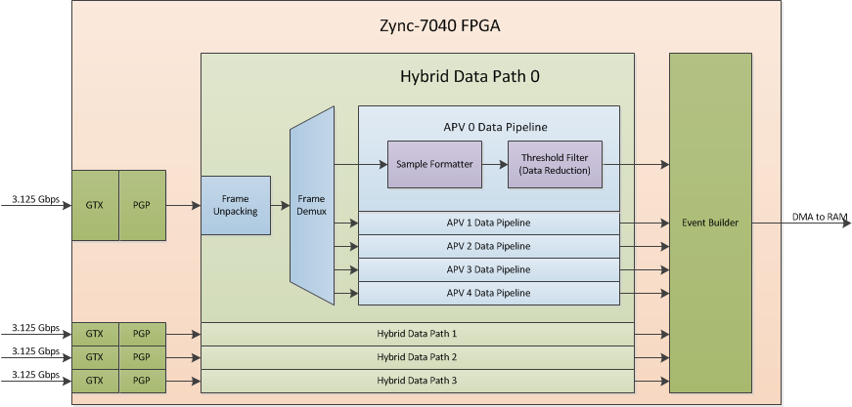
RCE Data Node Firmware – Data Pipeline
Process data streams from up to 4 Hybrids (20 APVs)
Unpack 3 16-bit stream words into 4 12-bit samples
Demultiplex frame by source APV
Group 6 trigger samples by channel
Filter samples that don’t meet programmable thresholds
Build an event frame for each trigger
Push event frames into RAM via DMA for DAQ software

Slide 13
Sample Formatter
The 6 APV frames that correspond to 1 trigger need to be regrouped by channel.
This is effectively like matrix transpose operation that needs to be performed on incoming AxiStreams.
Input
  6 frames, each 128 16-bit words.
Output
  1 frame, 128 (6*16=96)-bit words.
  96-bit word called a “Multisample” in HPS terminology.
First word of each frame grouped into a single word.
Second word of each frame grouped into a single word.
Etc.
APV and Channel number also tracked alongside each Multisample.

Slide 14
Threshold Filtering
Multisamples from the data formatter can be filtered out by a programmable filter.
Filter thresholds can be set for each channel of each APV individually.
  128 thresholds per APV (1 for each channel)
  23,040 individual thresholds in the whole system
  Use AxiDualPortRams to efficiently hold all of these.
Filter algorithm looks for N or more consecutive samples of a Multisample above the threshold for that APV/Channel.
  N is also programmable (globally).
Multisamples that don’t pass the filter are dropped.
Filter can be disabled for calibration runs in which you want to keep all data.

Slide 15
Event Builder
Filtered Multisamples from up to 20 APV pipelines arrive at central EventBuilder.
EventBuilder packages all of the multisamples related to a given trigger into a single AxiStream frame.
Event frames are tagged with distributed trigger data and DMA’d into RAM.

Slide 16
Timing Distribution
PGP Fibers
RTM
DPM RCE 0
FEB 0
Hybrid 0
PLL
JLAB
TI
TI
Firmware
(DTM)
FEB 1
Hybrid 1
Fiber
TX/RX
FEB 2
Hybrid 2
FEB 3
Hybrid 3
  System timing provided by JLAB Trigger Interface
    250Mhz base clock
    Synchronized reset for derived clocks
    Trigger signal and timestamp
    Delivered on NPO fiber
  RTM
    Fiber and PLL hardware extract clock and triggers
  DTM
    JLAB TI firmware
    Distributes timing to DPMs on local COB
    125Mhz clock
    PLL reset (used for 41Mhz clock alignment)
    Trigger pulse
    Trigger timestamp and status to ROC DPM
  Control DPM
    Forward timing information to front end boards over PGP
    Clock encoded into serial data stream which the front end board recovers
    Fixed latency path for encoded PLL reset and trigger signals

Slide 17
Software
JLab Read Out Controller (ROC) app
  Runs on each RCE
  Recompiled for ARM
    Not specifically developed for RCE but was easily adapted to work.
  Gets event data from FPGA via DMA and sends it via ethernet to Jlab back-end DAQ system.
SLAC software used for system configuration and monitoring
  RCE and FEB register configuration.
  FEB temperature and voltage monitoring.
    Tied in to EPICS

Slide 18
Backup slides

Slide 19
RCE JLab DAQ Integration
RCE crate must tie into JLab Timing and DAQ system.
Timing receiver core firmware from JLab deployed on DTM
  Connects DAQ to JLab Timing Master (via RTM) to receive beam clock and trigger data.
  DTM distributes clock and trigger data with fixed latency to all RCE nodes on COB.
RTM
COB Blade
Clock +
Triggers
Timing Master
DTM
RCE
JLab
TI
Core
RCE
RCE
RCE
RCE
RCE

Slide 20
DtmTimingSource and DpmTimingSink
DTM
DPM 0
Application
DpmTimingSink
From RTM
Timing Interface
Logic
dtmFb(0)
Application
DtmTimingSource
dtmClk[2:0]
.
.
.
.
.
.
Clock, Serial Data fanned out to each DPM
Received synchronously across all DPMs
Feedback data from each DPM to RTM
DPMs may distribute timing down to
Front End electronics
DPM 7
dtmFb(7)

Slide 21
Status
Successful engineering run in Spring 2015
Nominal 20 kHz trigger rate, 150 MBytes/sec
Tested up to 47 kHz
Another run planned for Spring 2016

Slide 22
Hybrid Board
CLKP/M
Buff/Dist
APV25
OUT0P/M
APV25
OUT1P/M
TRGP/M
Buff/Dist
APV25
OUT2P/M
I2C
APV25
OUT4P/M
DVDD
APV25
OUT5P/M
AVDD
1.25V
Temperature
Sensor
Bias
  Incoming clock & trigger buffered and fanned out to APV25s
  I2C bus for APV25 configuration & temperature sensor readout
  2.5V and 1.25V for APVs
  2.5V for digital ICs
  High voltage bias routed directly to wire bond pads with local bypassing
  Differential analog outputs from APV25s

Slide 23
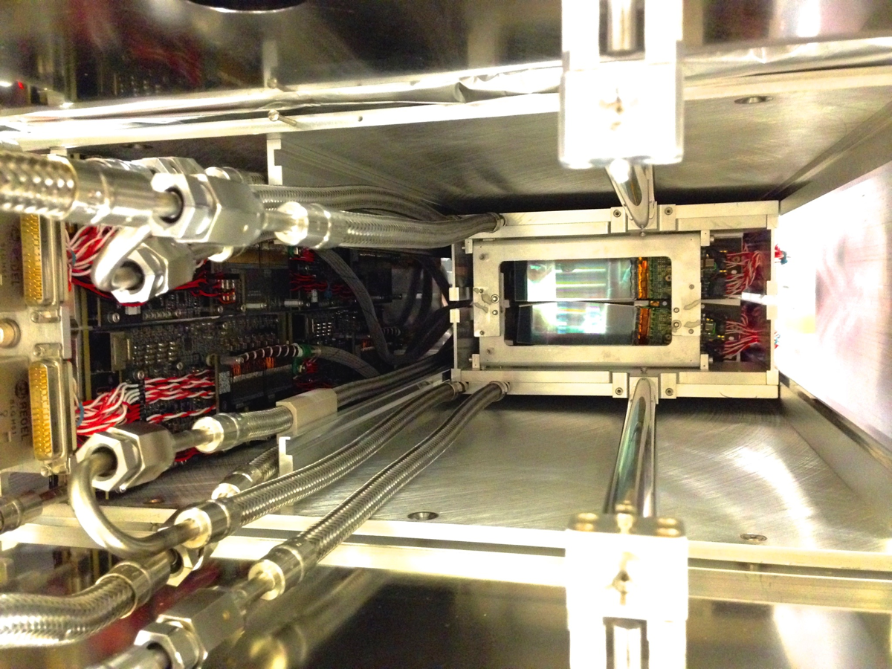
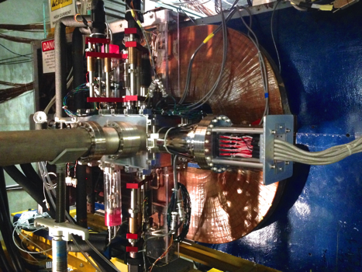
Front End Board - Challenges
Inside of SVT is a difficult place to deploy electronics
Vacuum
Boards must be actively cooled on a custom cooling plate
Magnetic Field
SVT box sits in 2T magnetic field
Ferrite materials saturate
    Must use air core inductors for power supplies and filters
    Can’t use crystal oscillators either → MEMS oscillators
Radiation from beam interactions
Neutrons can cause Single Event Upsets in FPGA
X-ray exposure breaks down ICs over time
  Boards sit very close to the target
  Mitigations
    Borated Polyethylene shield installed around FEBs
    FEBs have 20 layer PCB!
    Serviceable installation – can swap out FEBs if needed

