Slide 2
CERN methods, interfaces and tools
Infor EAM training

Slide 3
Summary
Feeding information in
  Objects and events – CERN’s upload utility
  Meter readings – SCADA bridge
Using CMMS workflows
  EAM-light
  Other CERN interfaces
Retrieving information
  Pentaho
  Equipment graphs (possibly in main course)
  Hyperlink to Infor objects
Need any help
  Where to get information, support and further training

Slide 4
CERN Upload Utility

Slide 5
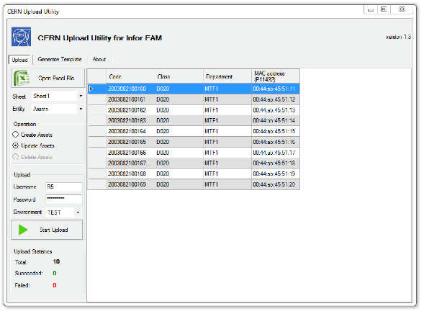


CERN Upload Utility
The more data we have in the system – the more difficult it is to keep it updated.
CERN Upload Utility was put in place to perform massive data manipulation in Infor EAM using Excel files.
Supports major system entities including Custom Fields and Equipment Hierarchy

Slide 6
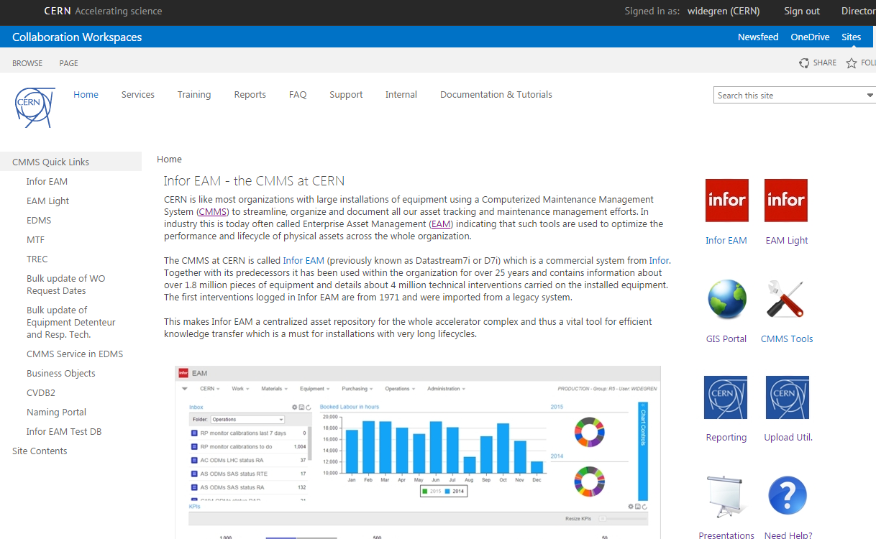
CERN Upload Utility
Available at CMMS Service web page: www.cern.ch/cmms-service

Slide 7
CERN Upload Utility
Demo!

Slide 8
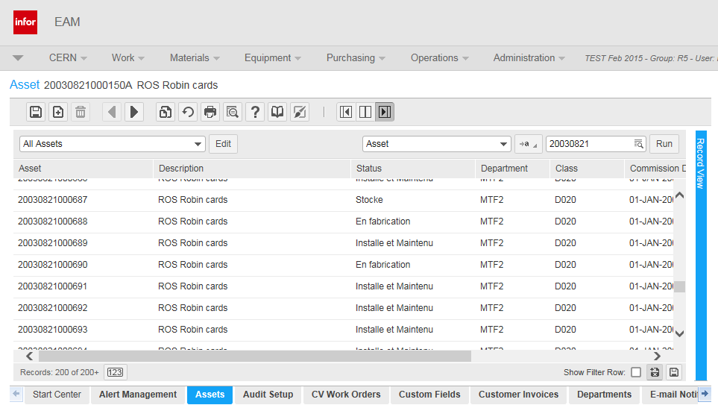
Example of updating data

Slide 9
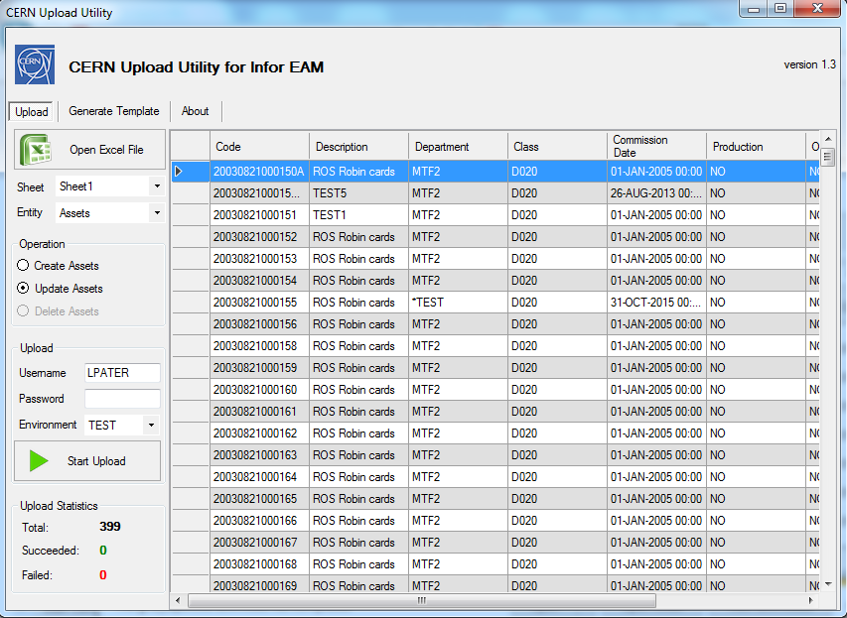
Example of updating data

Slide 10
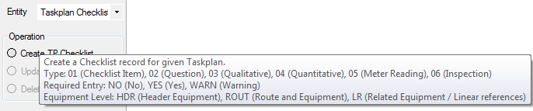
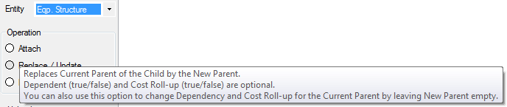
Helpful Information
Hover the mouse over the operation name to see some useful hints.

Slide 11
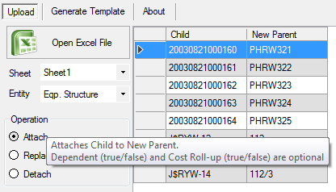
Equipment Hierarchy
CERN Upload Utility enables you to perform any manipulation on the equipment structure

Slide 12
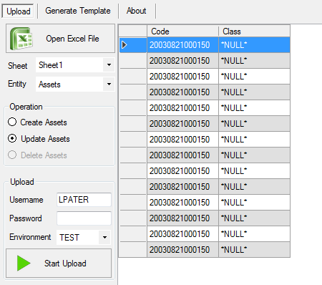
Deleting values
Supplying an empty cell won’t erase a value.
Please provide a
“null-marker” instead: *NULL*

Slide 13
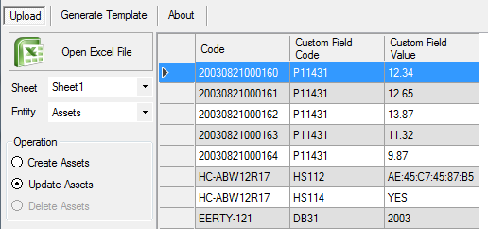
Updating Custom Fields
For Equipment in different classes you can use Custom Field Code and Value columns.

Slide 14
SCADA bridge

Slide 15
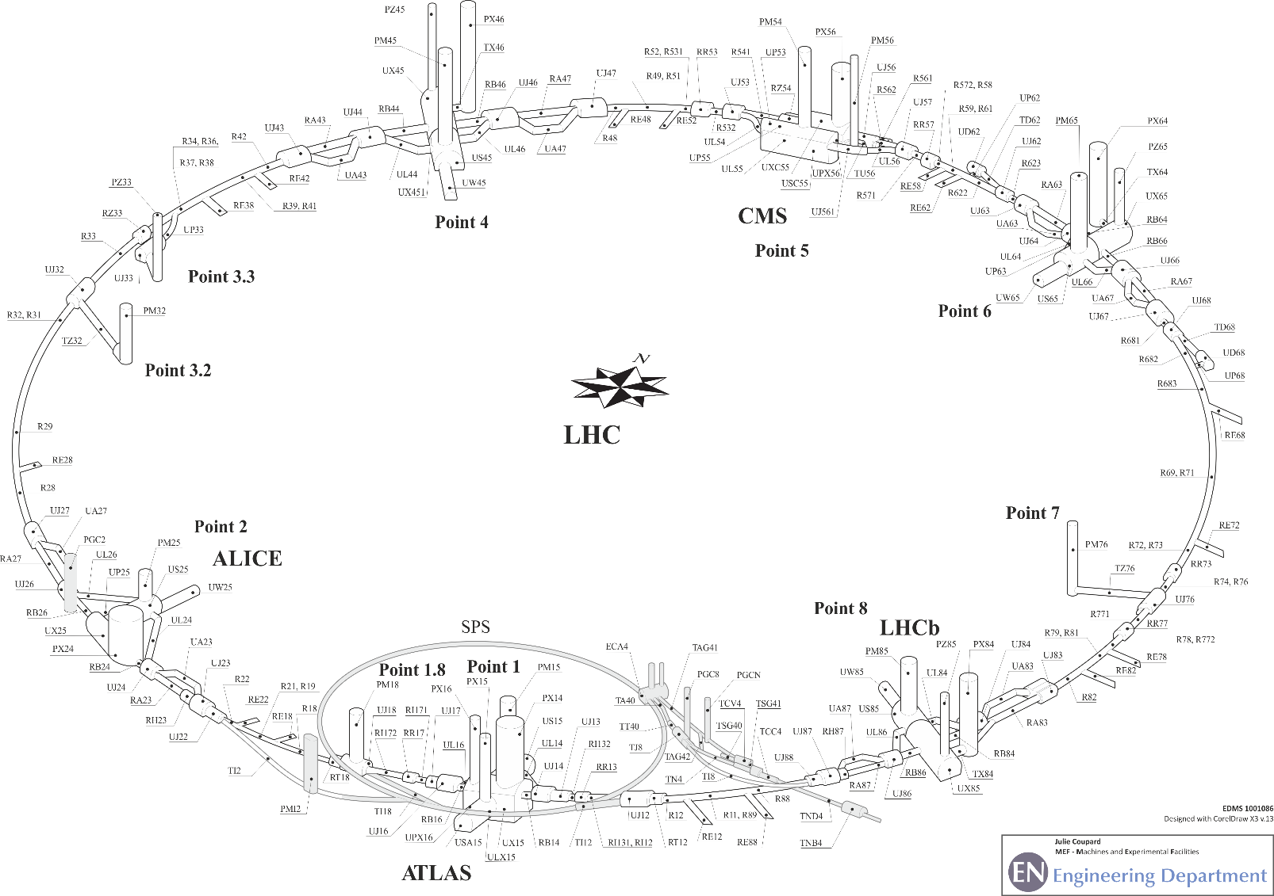
Context of the pilot project
EN-HE-LM section
  maintenance of 118 elevators at CERN
  Uses Infor EAM to manage maintenance
Critical assets = lifts giving access to the underground machines (LHC lifts)
Systematic preventive maintenance plans (12 interventions per year and per lift).

Slide 16
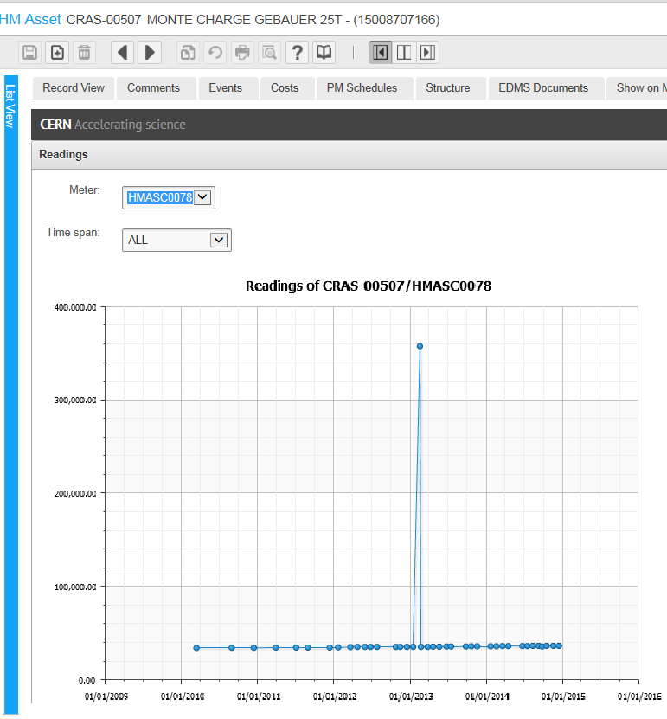
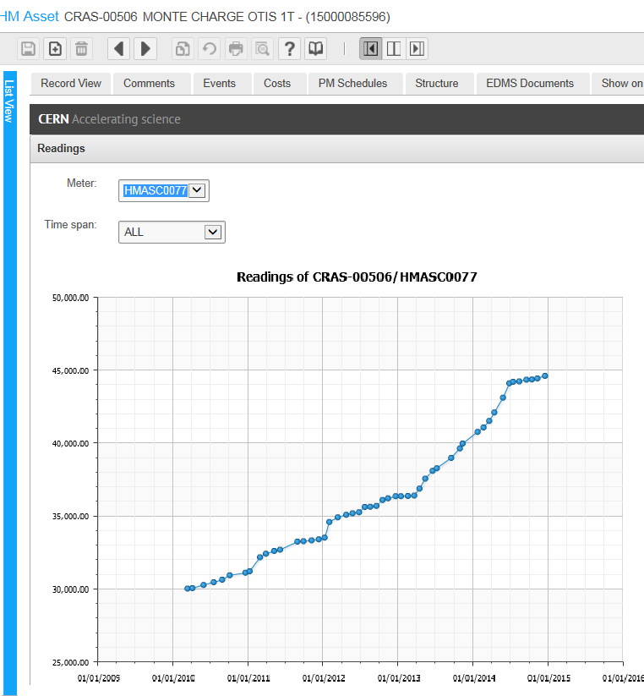
Project genesis
For condition-based maintenance (every 5000 trips) we need efficient monitoring the usage of the lifts;
Lift usage is currently monitored through manual monthly meter readings :

Slide 17
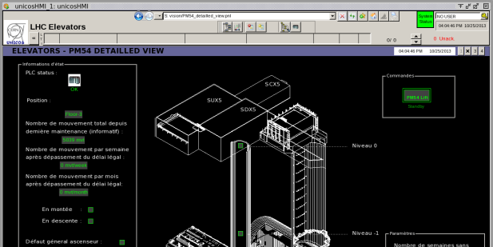
Project genesis
LHC lifts are now monitored through WinCC OA system (formerly PVSS);
Infor can generate preventive work orders based on meter threshold

Slide 18



Project genesis
Date | Trips
01/01/2015 14:01 | 1
05/01/2015 08:00 | 1
06/01/2015 10:00 | 1
07/01/2015 12:00 | 1
08/01/2015 14:00 | 1
09/01/2015 16:00 | 1
12/01/2015 12:01 | 1
14/01/2015 07:42 | 1

Slide 19
Solution developed
Data needed on the Infor side exists in the WinCC OA system;
The LHC logging database collects data from (not only) WinCC OA and makes it available for other users (including databases such as Infor).

Slide 20
Solution developed
Meter Readings
The LHC logging database can be configured to log data from WinCC OA.
An extraction tool configurable by the end-user from the Infor EAM interface computes and transfers data from the LHC logging database to the Infor EAM meters
1
Meter Readings
2
1
2

Slide 21
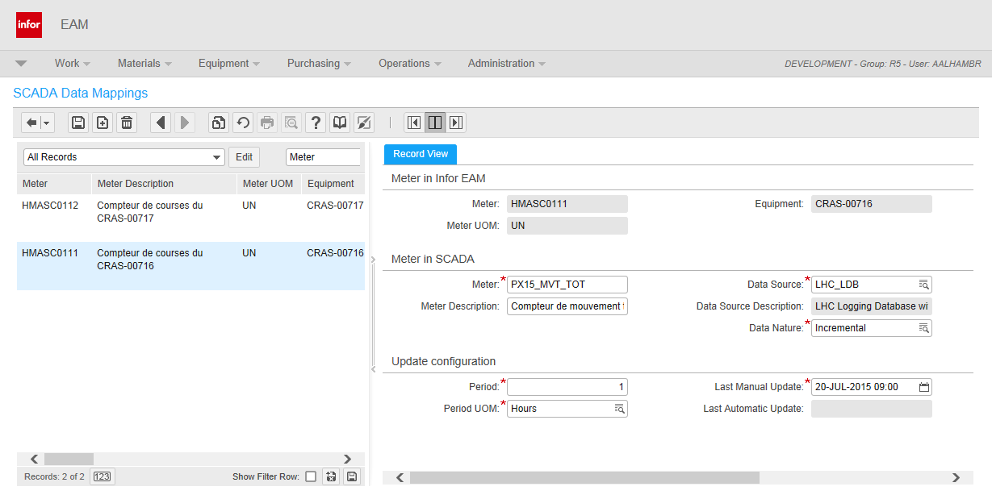
Outcome
User screen seen from Infor EAM :
… and the EDMS documentation !
  Quick guide ref. EDMS 1537894
  Detailed user manual ref. EDMS 1537903
Notes:
Add documentation in EDMS !

Slide 22
Modular & Scalable solution
Current solution is designed to easily be extended to cover other additional data sources.
  TIM, other SCADA systems, etc.
  Smart/networked equipment
  Databases
Different meters can receive data with different intervals.
No limit in how many meters can be fed with data via this integration – the limit is how many Preventive Maintenance Schedules you can/want to manage…
Important to remember:
Infor EAM is not, and cannot replace, a SCADA system!

Slide 23
Automation with huge potential
Automating meter readings means;
Personnel can be used for more value-adding tasks
Human input errors can be minimized
Delays in capturing data can be reduced
Possibility to capture more meter readings that earlier could not be financially justified.
An important step towards a predictive maintenance where unnecessary maintenance can be eliminated.

Slide 24
EAM Light

Slide 25
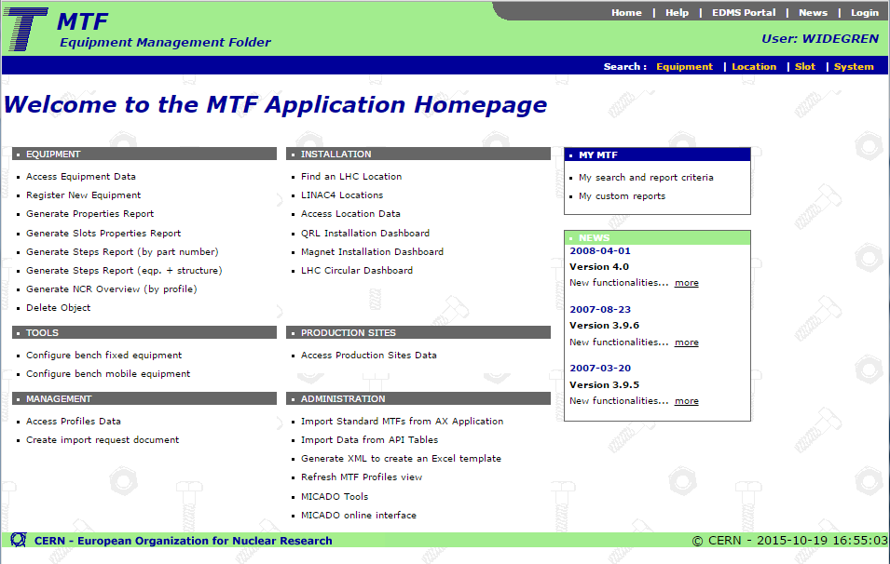
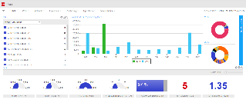
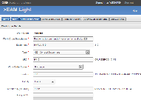


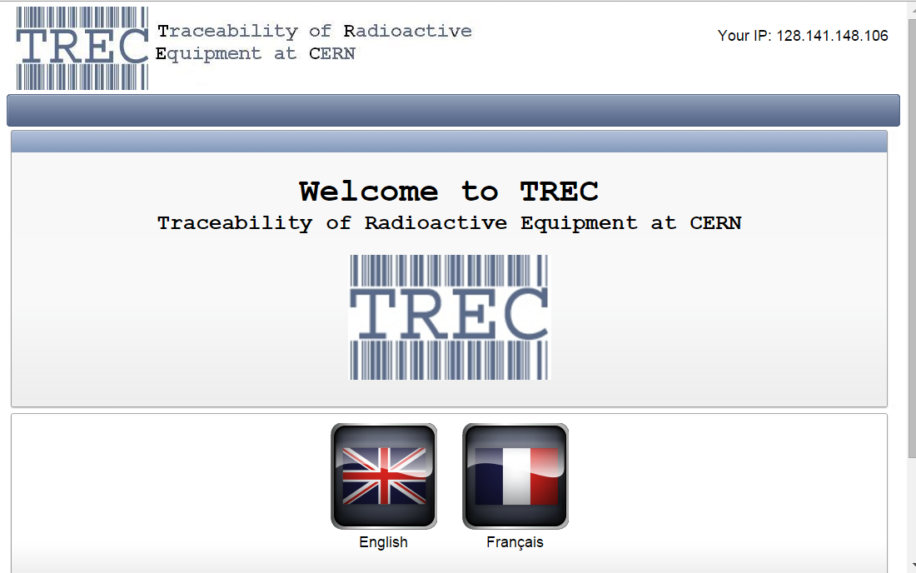
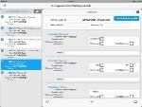

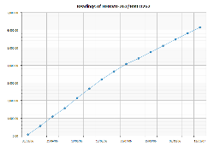
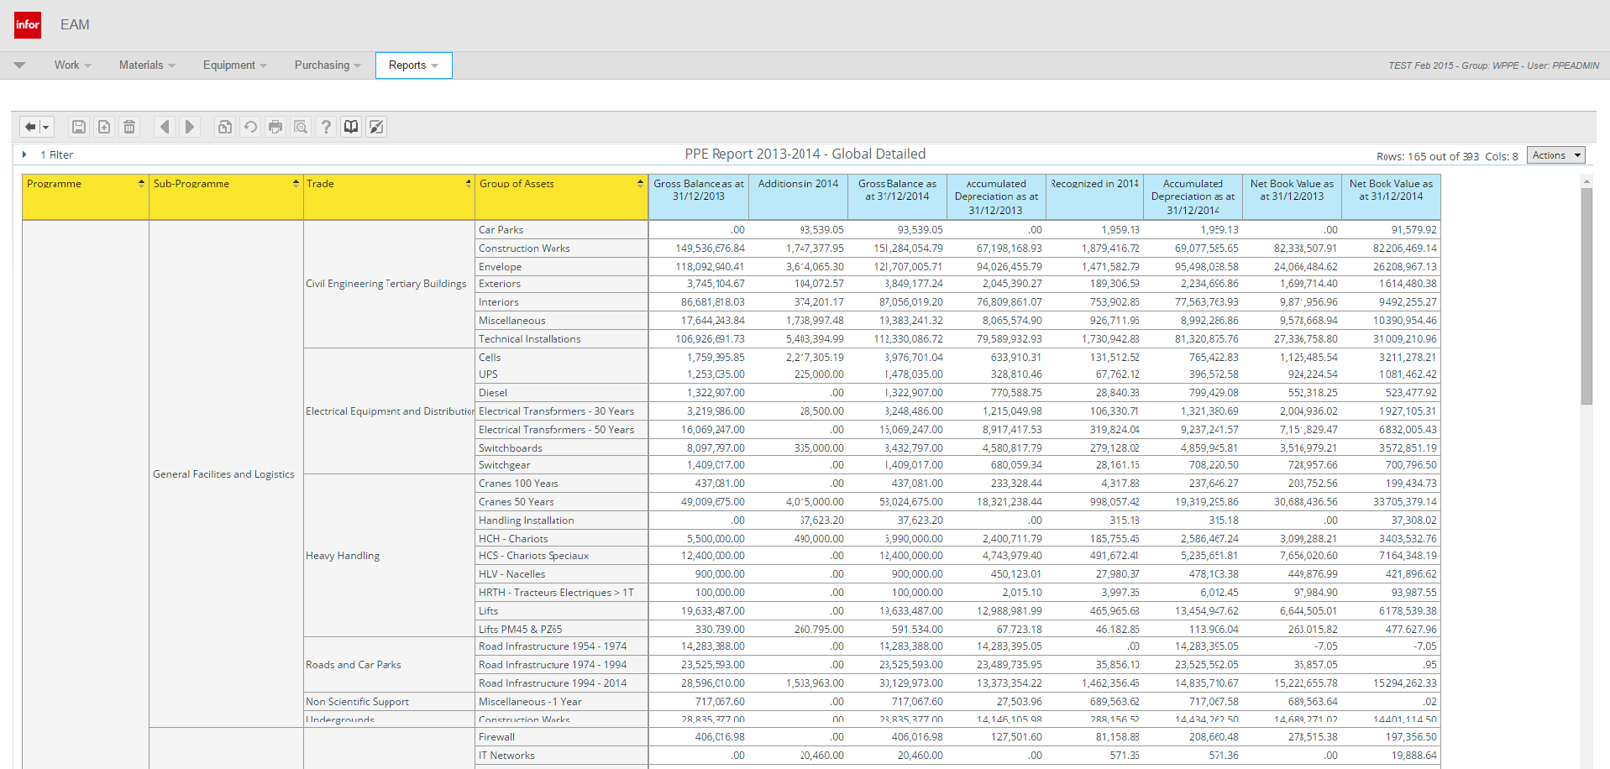
Interfaces to Infor EAM
MTF
Manufacturing & Testing
Infor EAM
Enterprise Asset Management
TREC
Radioactive Traceability
BI
Business Intelligence / Reports
PPE
Plant, Property & Equipment
Web Services API
Used for integrating with other applications and systems.

Slide 26
EAM Light - background
An easy to use interface for Work Orders and Equipment.
  Accessible from all devices with a web browser – including tablets.
  It is a simple alternative for users that do not need the full Infor EAM functionality – for example contractors.
In production since August 2012 with very positive feedback
  Version 1.0 was released on 14 August 2012 and 13 consecutive versions were since then based on user input. (Current version: 2.2a, released April 2014.)
  Currently widely used and very appreciated by equipment groups.
  Examples of users: EN/HE, EN/CV, TE/CRG, GS/FB, GS/ASE, IT/CIS, etc.

Slide 27
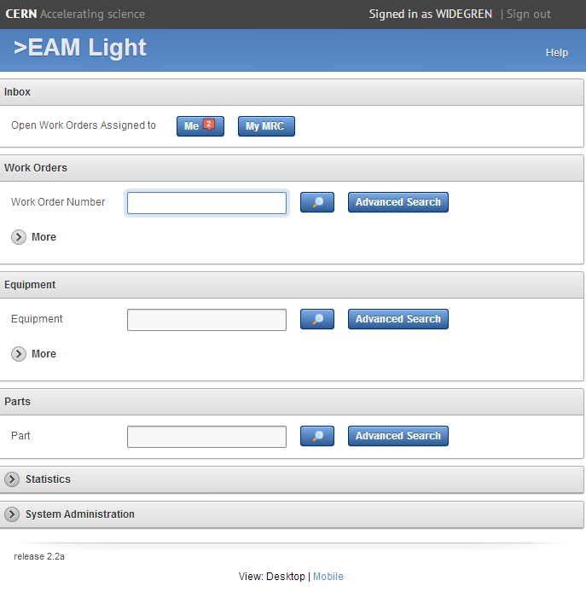
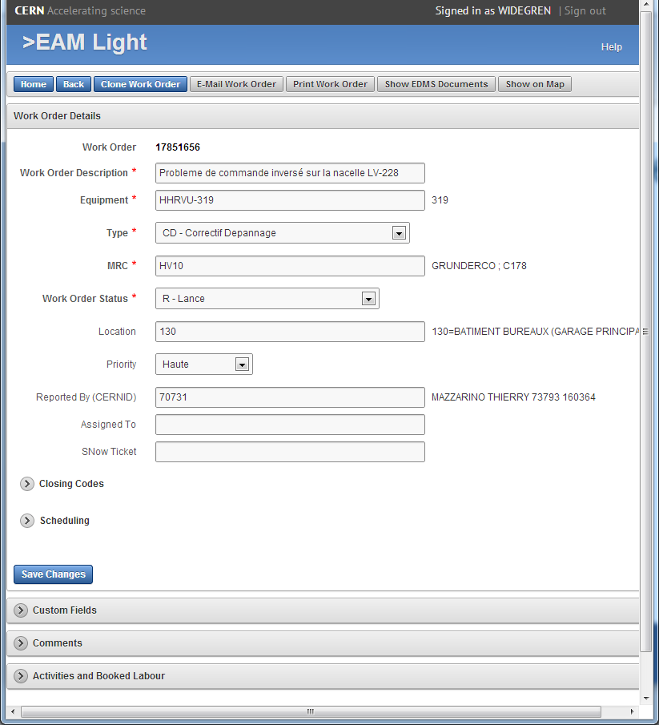
EAM Light – the interface

Slide 28

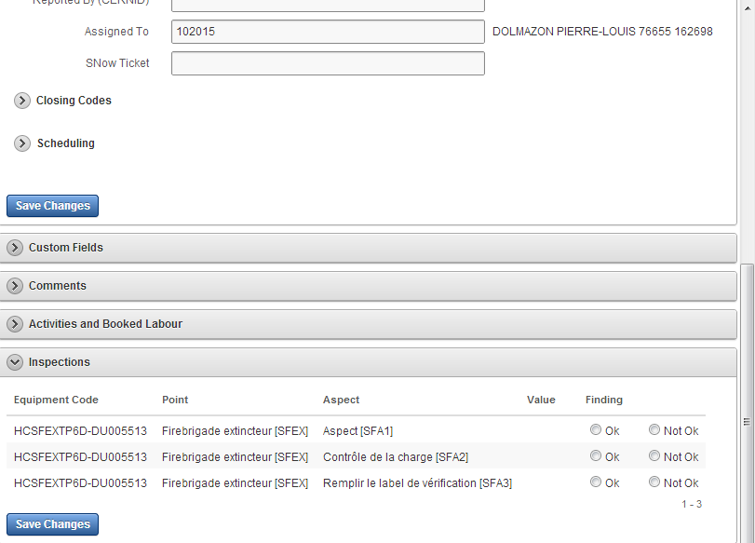

EAM Light – GS/FB example
Inspections of fire extinguishers using tablets and Bluetooth barcode laser scanners in the field.
1 tablet (with protection) + barcode scanner per team.

Slide 29
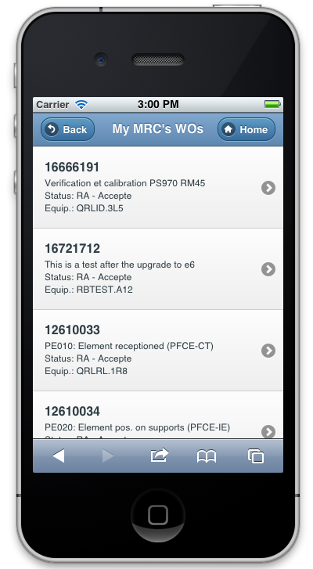
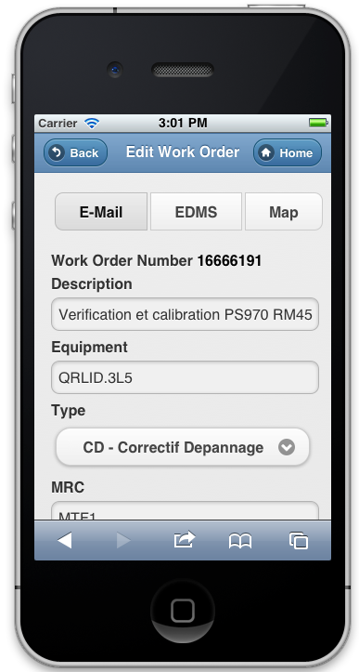
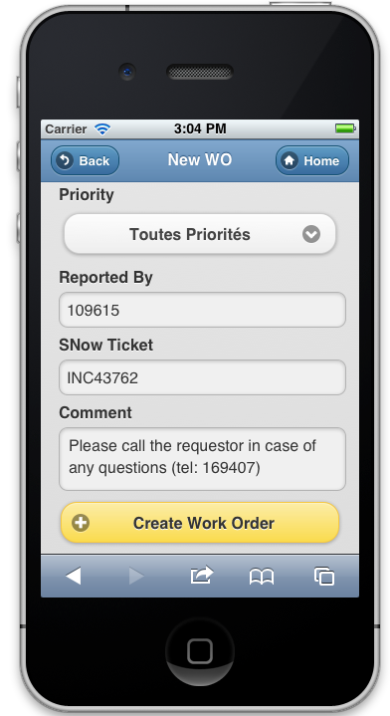
EAM Light – smartphone version
Smartphone friendly version of EAM Light with the same URL.
Available for any smartphone (iOS, Android, Windows Phone, etc.)
It is an online tool requiring internet connection (GSM or WiFi)

Slide 30
Exercise - Demo
How to consult and update my Work Order in EAM Light?
How to use a tablet with barcode scanner in the field?
How to upload photos from a tablet/smartphone to document an intervention?

Slide 31
Work management & SNow
The CERN Service Desk is via Service-Now fully integrated with the Work management module in Infor EAM.
Used for all Service Elements using Infor EAM for Work Management.
A ticket registered in Service-Now can (if required) generate a Work Order in Infor EAM – with a link and feedback loop.
Req/Inc
Ticket
Service Now
Infor EAM
User
ServiceDesk personell
Maintenance team

Slide 32
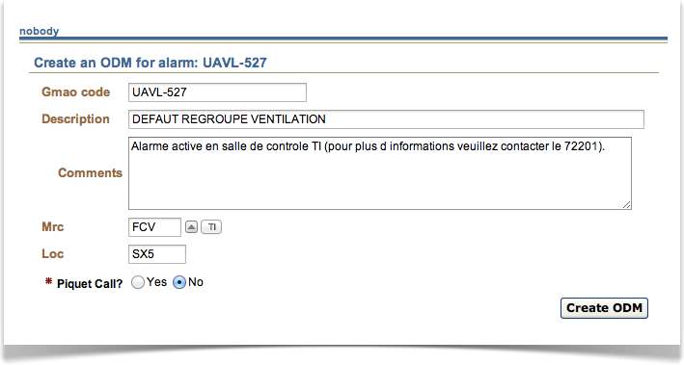
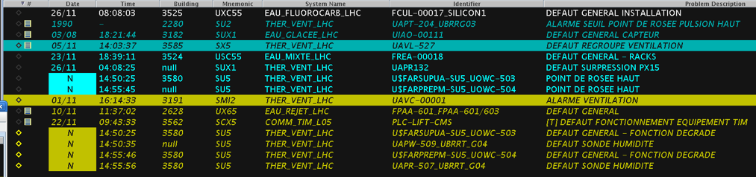
Work management & CCC/TI
The Technical Infrastructure part of CCC is also fully integrated with the Work management module in Infor EAM.
In case of alarms, the operator can directly decide to create a corrective Work Order in Infor EAM with a simple click.
All main information of the Work Order is filled in by default and it is automatically dispatched to the corresponding service.
CERN Control Center
– Technical Infrastructure:

Slide 33
Equipment Graph

Slide 34
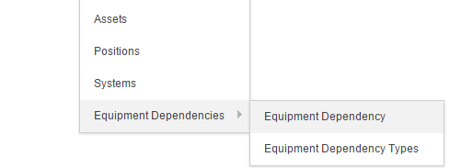
Reminder: Equip. Dependencies
Now possible to manage and model dependencies between equipment – others than just the classic “installed in” structure
Examples:
  A Motor is «powered by» a Generator,
  which in our SCADA system is «controlled by» a PLC,
  that is «connected to» a Fire Detector
  and is «cabled to» the Network Router
Notes:
Network of links / not a tree

Slide 35
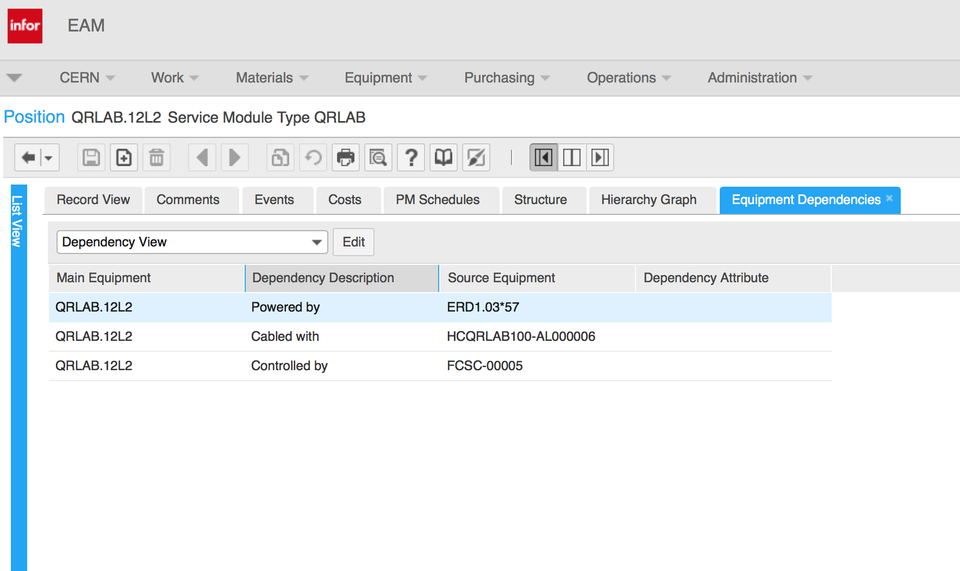
Reminder: Equip. Dependencies

Slide 36
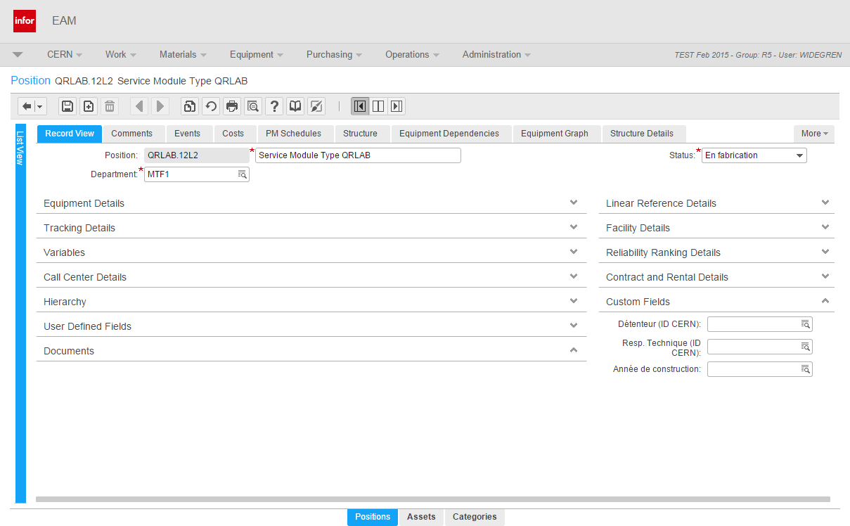
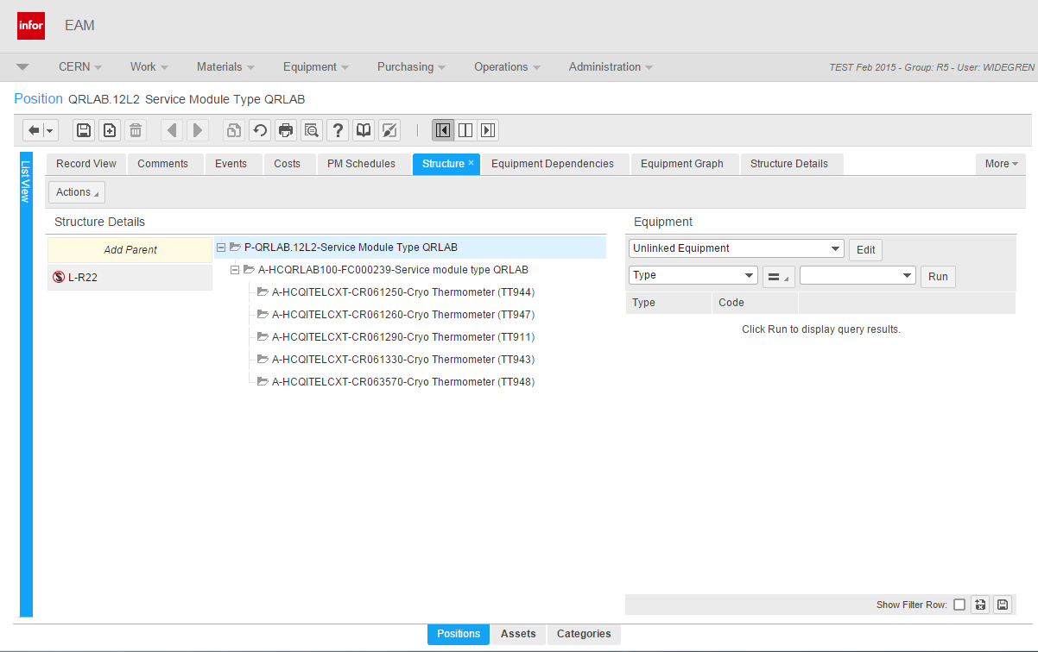
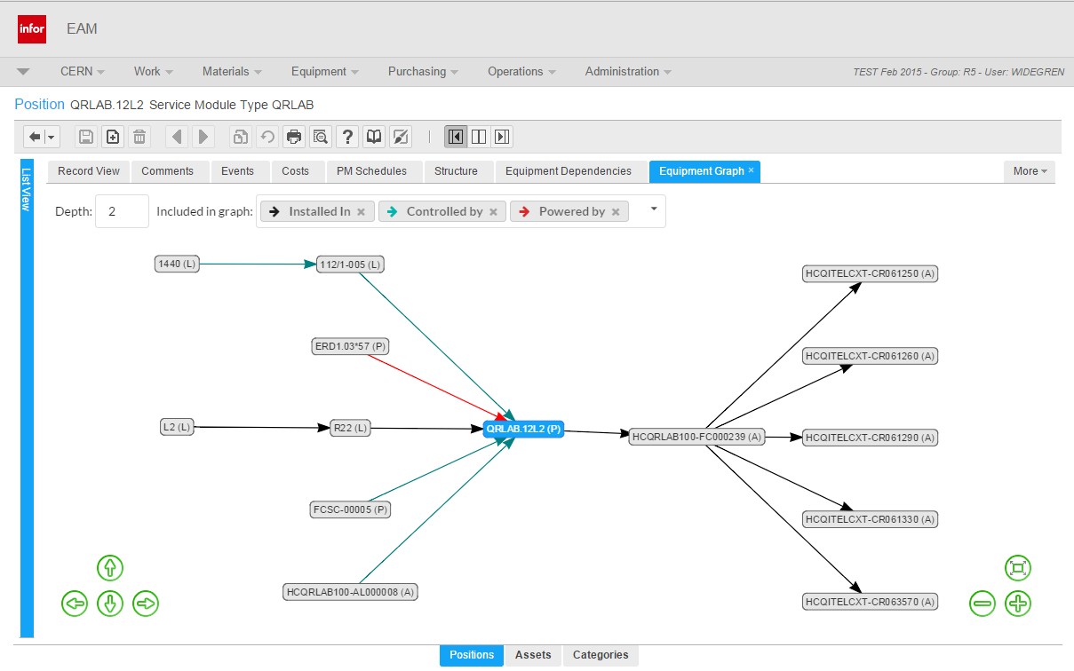
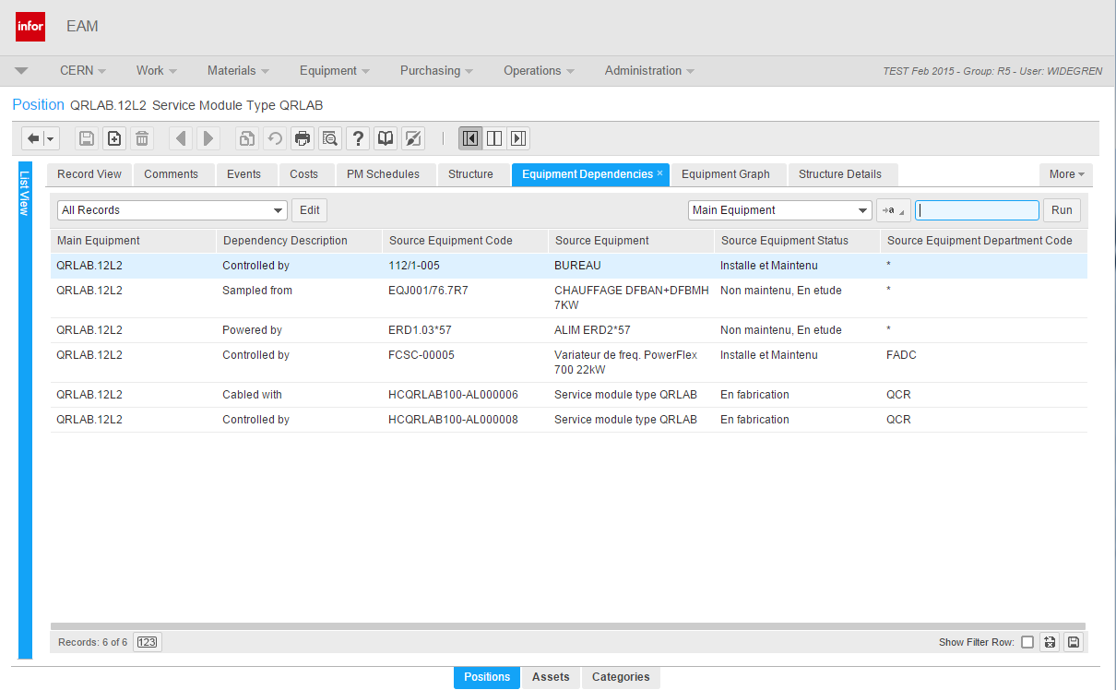
New Equipment Graph

Slide 37
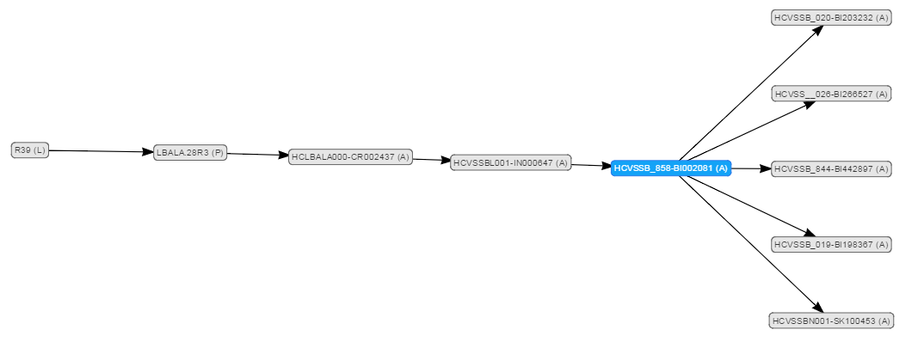
New Equipment Graph
Allows to visualize and to navigate in both equipment structures and equipment dependency networks.
The number of levels as well as types of structure/dependencies can be set on demand by the user.
Can allow very efficient navigation in large structures – especially to different parent equipment.

Slide 38
New Equipment Graph
Demo in TEST (with test data)!
https://www.cern.ch/cmms-test/position.php?code=QRLAB.12L2

Slide 39
Hyperlinks to Infor EAM objects

Slide 40
What are Infor EAM Hyperlinks?
Links that open the screen for a specific record in Infor EAM
Assets
https://www.cern.ch/cmms/asset.php?code=asset code
Positions:
https://www.cern.ch/cmms/position.php?code=position code
Systems:
https://www.cern.ch/cmms/system.php?code=system code
Locations:
https://www.cern.ch/cmms/location.php?code=location code
Work Orders:
https://www.cern.ch/cmms/workorder.php?code=workorder code
Parts:
https://www.cern.ch/cmms/part.php?code=part code

Slide 41
More information
General information:
www.cern.ch/cmms-service
Documentation Manuals & Training material:
https://edms.cern.ch/nav/CERN-0000088826
Questions or need help?
CMMS.support@cern.ch

