Slide 2
Linac4-PSB 160 MeV connection readiness review
Tuesday 30 August 2016

Slide 3
TE-EPC
Serge Pittet
Table of Contents:
Equipment dismantling
Equipment installation
Risks / Mitigation
Additional information
Summary

Slide 4
Equipment dismantling
System | Equipment | Estimated activation | Cooldown requested + duration | Particular requests for removal | Storage / Waste | DEC Done | Updates needed | Group ressource | Remarks | ECR/SRR EDMS
 |  |  |  |  |  |  | Database / Integration / Controls …
LT, LTB, LBE, LBS | Powering | - | - |  | Waste |  | Database / Integration / |  | 9 converters to remove
BI.RSMV10 | Powering | - | - |  | Waste | No | Database / Integration / |  | 4 converters to remove
BR.RQCD, BR.RQCF | Powering | - | - |  | Waste | No | Database / Integration / |  | 8 converters to remove
BI.RBVT10 | Powering | - | - |  | Waste | No | Database / Integration / |  | 3 converters to remove
BI.RDHZ, BI.RDVT | Powering | - | - |  | Waste | No | Database / Integration / |  | 8 converters to remove
BI.RQNO | Powering | - | - |  | Waste | No | Database / Integration / |  | 12 converters to remove

Slide 5
Equipment installation
System | Equipment | Quantity | Readiness by December 2016 | Installation duration (in hours) | Specific EN/HE Installation requests | Cooling and Ventilation requests |  |  | EN/EL needs |  | Controls needs (FESA, BIS, Expert) | Individual System Tests |  | HW commissioning duration + Access condition | Beam commisionning duration | Group ressource | EDMS ECR / SRR Number | Number of spares | Remarks
 |  |  |  |  |  | Water cooling | Ventilation requests | Functional Specification / Engineering Specification Number | DIC Done | Other information
LT, LTB, LBE, LBS | Powering | 8+1 | Yes | 9*8 | Transport | Yes |  | 1541748 | No |  | WIC | Yes | 1 | 5 days / B361 |  | MPC | To be done for PC | 1
BI.RSMV10 | Powering | 3+1 | Yes | 3*8 | Transport | No |  | 1541748 | Yes |  | BIS, WIC | Yes | 1 | 5 days / B361 |  | FPC | No | 1 | Converter already installed, transformer and cables to be installed
HST, BI.RBSW | Powering | 16+2 | Yes, except transformers alcove | 20*8 | Transport | Yes |  | 1495860 | Yes |  | BIS, WIC | Yes | 1 | 5 days / B400 |  | FPC | 1560692 1707703 To be done for PC | 2
BR.RQCD, BR.RQCF | Powering | 16+2 | Yes | 4*8 | Transport | No |  | 1537264 | Yes |  |  | Yes | 1 | 5 days / B361 |  | LPC | To be done for PC | 2
BI.RBVT10 | Powering | 3+1 | Yes | 4*8 | Transport | Yes |  | 1526080 | Yes |  | WIC | Yes | 1 | 5 days / B361 |  | LPC | 1494503 To be done for PC | 1
BI.RDHZ, BI.RDVT | Powering | 8+2 | Yes | 5*8 | Transport | No |  | 1584667 | Yes |  | WIC | Yes | 1 | 5 days / B361 |  | FPC | 1494503, To be done for PC | 2
BI.RQNO | Powering | 12+2 | Yes | 5*8 | Transport | No |  | 1698077 | Yes |  | WIC | Yes | 1 | 5 days / B361 |  | FPC | 1494503, To be done for PC | 2
BR.RDSHAH, BR.RDSHAV | Powering | 8+4 | Done | 12*8 | Transport | Yes |  |  | No |  |  | Yes | 1 | 5 days / B361 |  | FPC | No | 4 | Under validation in operation
Ring correctors | Powering | 114+8 | Done |  |  |  |  | 803043 |  |  |  | No |  |  |  | LPC | No | 8 | Already in operation

Slide 6
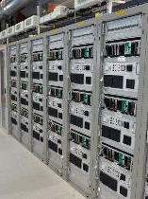
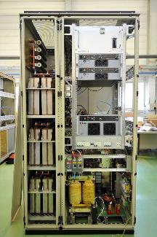
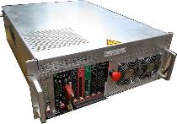
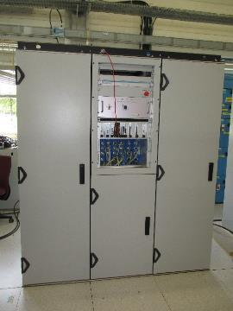
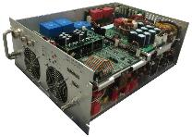
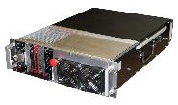
Equipment installation
18x Cancun
14x MaxiDiscap
3x MegaDiscap
10x MidiDiscap
27x Sirius
4x LHC600A/40V

Slide 7
Risks / Mitigation
Precision – speed of the chicane converter is challenging.
      To be validated during the Half Sector test.
      Integration not finalized yet.
      Should be done by the end of the year. Installation of the converters can wait until May 2017 in case of connection.

Slide 8
Risks / Mitigation
      Many converters have not be tested on real loads and operational conditions.
      Bad surprises may impact the commissioning time.
      Most of EPC staff would be involved in case of early connection.
      Possible delay on other projects.

Slide 9
Additional information
Only 10% of the remaining workload for power converters has to be done by EPC.
90% to be done by GS-SMB, EN-EL, EN-HE, EN-CV, TE-MPE,…
No open issues / Concerns.

Slide 10
Summary
EPC is on track to be ready by the end of 2016.
«Intense» hardware commissioning period foreseen for EPC specialists.

