Slide 2
Linac4-PSB 160 MeV connection readiness review
Tuesday 30 August 2016

Slide 3
EN-EL-ENP
James Devine
Table of Contents:
List of activities
Risks / Mitigation
Work status
Additional information
Summary

Slide 4
List of activities
Activity description | Pre-requisites to activity (decommissioning?) | Particular precautions / Working conditions | Activity duration | System commissioning duration | EDMS documentation (Funct.&Eng. Specs., ECR) | Remarks
Installation of new switchboard ERD1*7A | Integration required, free space needed | Modifications to false floor structure local to installation | 5 days | 1 day | Draft being prepared (combined) | Switchboard dimensions to be confirmed by manufacturer (ABB)
Cable pulling | Installation of switchboard, agreed containment routes | Access to false floor in 363, asbestos issues to be clarified | 30 days | 1 day | Draft being prepared (combined) | Cables reserved, contractor quotation in progress

Slide 5
Risks / Mitigation
Activity / Equipment | List of major Risks | Mitigation | Remarks
Switchboard installation | Late delivery of switchboard | Switchboard to be ordered as soon as possible
Switchboard installation | Integration issue leading to postponed installation | 1) Integrate with floor structural model, 2)Plan activities for the start of EYETS to maximise margin
Switchboard installation | Incorrect feeder/power rating | Verification with TE/EPC prior to order
Switchboard installation | Delivery/transport/installation accident | Dimensions and weights of columns to be provided to transport service after order placed.
Cable pulling | Late delivery of cables | Cables reserved, delivery expected October 2016
Cable pulling | Co-activity causing scheduling problems | Work schedule to be agreed ahead of time
Cable pulling | Opening of false floor leading to falls | Barriers to be set up, openings reduced to minimum
Cable pulling | Installation of cables on existing cable trays at high level | Safety procedures established for working at height.
All activities | Delay in availability of funding, causing comensurate delay in installation | Budget to be prepared as soon as possible.
Cable pulling | Abestos risk for cable pulling | Strategy to be discussed.

Slide 6
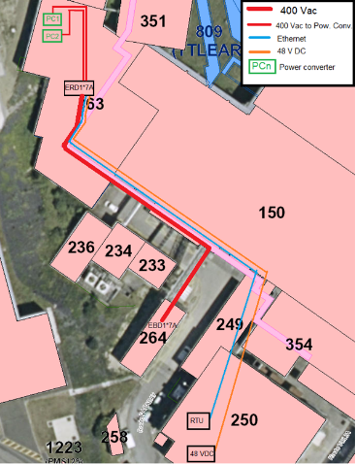
Work status
Power sources identified.
Cable routes identified.
Civil engineering required (asbestos removal + additional holes).
Integration of switchboard pending finalisation of racks.
Budget for these works remains to be allocated.

Slide 7
Additional information
Significant co-activity with EN/EL-FC anticipated.
Linac 4 connection:
  Supplies to 2 additional converters (EYETS)
  Supplies to 3 additional converters (LS2/Linac4 connection)
EL Infrastructure required in PSB already scheduled for installation in EYETS.

Slide 8
Summary
Ready by the end of 2016.
Integration of switchboard to be completed.
Cable reserved, orders ready but not yet placed.

