Slide 2
Linac4-PSB 160 MeV connection readiness review
Tuesday 30 August 2016

Slide 3
Fibres Optics & Cabling
Georgi Minchev GEORGIEV
on behalf of EN-EL-FC
Table of Contents:
List of activities
Risks / Mitigation
Draft schedule
Work status
Additional information
Summary

Slide 4
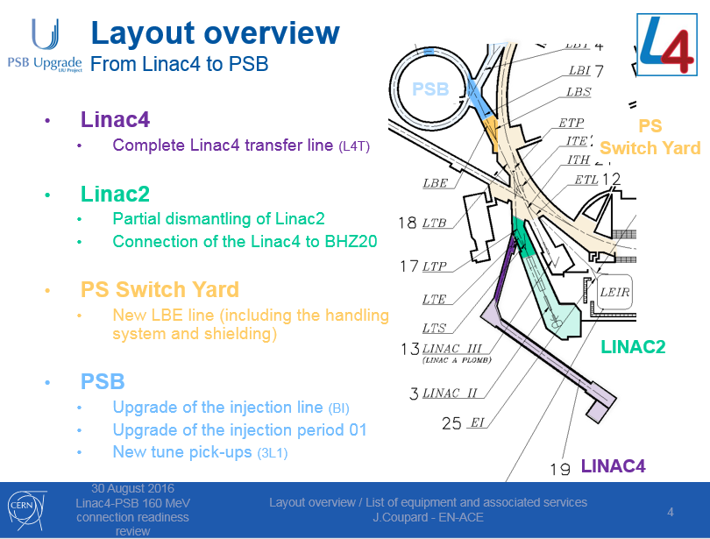
Courtesy J. Coupard

Slide 5
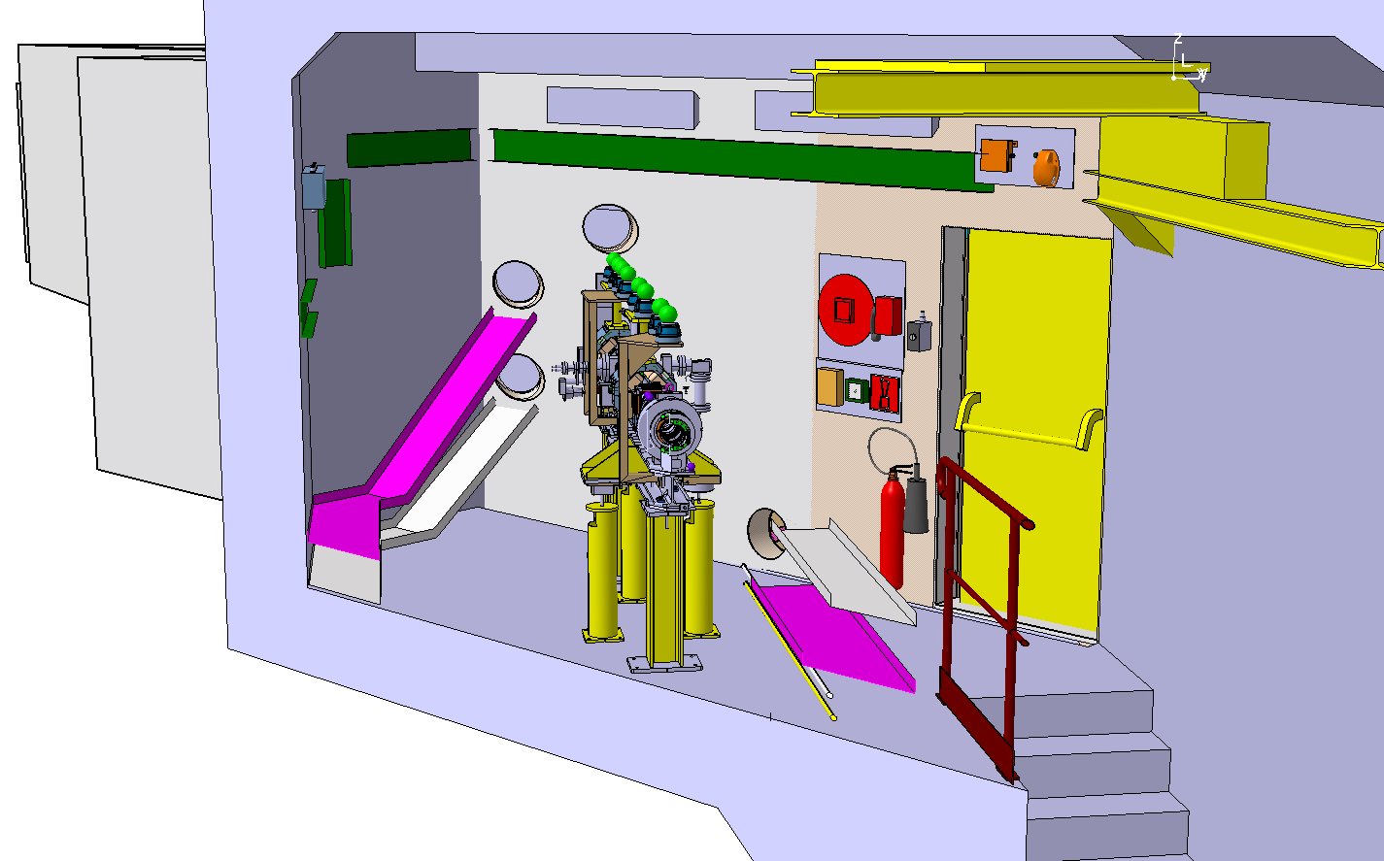
List of activities
Linac4 transfer line (L4T)
Activity description | Pre-requisites to activity (decommissioning?) | Particular precautions / Working conditions | Activity duration
Cables passing through the wall Li4-Li2: 26 cables. | New civil engineering passages through the walls Li4-Li2 should be finished before cabling; | Access to the cable trays. | 1 week

Slide 6
List of activities
Linac2
Activity description | Pre-requisites to activity (decommissioning?) | Particular precautions / Working conditions | Activity duration
De-cabling: Signal cables from the end of Linac2 RF cavities to BHZ20 | - Pre-DECs (Demande Enlèvement des Câbles) should be sent to EL before 15/09/2016; - All cables should be disconnected on both ends & marked with purple tape by the users; - Final DEC should be send at least 4 weeks before the beginning of the work; - Budget has not been allocated yet. | Full electrical lock-out of the zone, access to the false floor and to the cable trays. | 3 weeks, this estimation is based on an assumption of 500 cables, 20km, to be removed.
Signal cabling: - Modification of the existing signal cable trays for the new shielding installation; - TE-EPC, PLAN10320, DIC only for BHZ20 2 cables; | - Modification of the false floor of building 363 should be done before the installation of the new racks; - Budget for cable trays modification has not been allocated yet. |  | 1 week
DC cabling: - Modification of the existing DC cables for powering the transfer line; - New DC cables for BHZ20 | - New civil engineering passages through the walls of LTS line gallery should be finished before cabling; - Modification of the false floor of building 363 should be done before the installation of the new racks; - Power converters should be installed before; - Budget has not been allocated yet. |  | 2 week

Slide 7
List of activities
PS Switch Yard
Activity description | Pre-requisites to activity (decommissioning?) | Particular precautions / Working conditions | Activity duration
De-cabling: Signal cables old magnet interlock system | - Pre-DECs (Demande Enlèvement des Câbles) should be sent to EL before 15/09/2016. - All cables should be disconnected on both ends & marked with purple tape by the users. - Final DEC should be send at least 4 weeks before the beginning of the work. Budget has not been allocated yet. | Full electrical lock-out of the zone, access to the false floor and to the cable trays. ALARA level to be evaluated. | 3 weeks
Signal cabling: TE-VSC, PLAN10675, DIC 63 cables; - TE-MPE, PLAN10819, DIC 138 cables, DIR 2 racks; -Modification of the existing signal cable trays for the new crane installation, LBE line. | - DICs (Demande d'installation des câbles) received; - New civil engineering passages through the walls of LTS line gallery should be finished before cabling; - Modification of the false floor of building 363 should be done before the installation of the new racks. Budget for cable trays modification has not been allocated yet. |  | 5 weeks
DC cabling: installation of new 5 cables (2 bendings + LT.QDN65). | - New civil engineering passages through the walls of LTS line gallery should be finished before cabling; - Modification of the false floor of building 363 should be done before the installation of the new racks; - Power converters should be installed before; - Budget has not been allocated yet. |  | 1 week

Slide 8
List of activities
PSB
Involved Systems | Activity description | Pre-requisites to activity (decommissioning?) | Particular precautions / Working conditions | Activity duration
-BI corrector magnets; - BI corrector, quadrupole, BVT magnet interlocks; - BI quadrupoles; - BI.BVT; - BI.DIS; - BI.SMV; - BI.SMV position monitors; - BLMs in BI line and Diamond injection region - BI.KSW; - BI.BWS; - Charge exchange foil; - H0/H- monitor; - Stripping foil camera; - Vacuum; - Q-strip converters (QDE3+14); - Transverse damper kickers & pickup; - Ring pickups; - Watchdog BR.TMD8L1; - Wide-band pickup; - Beam Interlock System. | De-cabling: systems replacement: 1090 cables, 75km | - All DECs (Demande Enlèvement des Câbles) received. | Full electrical lock-out of the zone, access to the false floor, access to the cable trays. ALARA level to be evaluated. | 6.5 weeks (two shifts)
 |  | - All cables should be disconnected on both ends & marked with purple tape by the users.
 |  |  |  | 11.5 weeks (two shifts)
 | Signal cabling: 1628 cables, 81km | - All DICs (Demande d'installation des câbles) received;
 |  |  |  | 2 week
 | DC cabling: Pulling of 67 new cables & modif. of 66 existing ones, 4.5 km | - Power converters should be installed before;
 | Racks installation: 20 racks | Metal structure for 10 racks should be installed | Surface | 1 week

Slide 9
Risks / Mitigation
Activity / Equipment | List of major Risks | Mitigation | Remarks
De-cabling | Linac2 work preparation could be delayed, because of DECs not sent on time | Action of the coordination | All the Pre-DECs to be established before 15/09/2016; Final DEC should be send at least 4 weeks before the beginning of the work
 | Electrical risk for the personnel | Applying the same procedure as for de-cabling project
Signal cabling | Overlook some systems needed for Linac4 connection. | All the systems which will be replaced or upgrade should be identified before 15/09/2016.

Slide 10
Draft schedule
Linac4
Linac2
t
PS Switch yard
Booster

Slide 11
Work status
Integration of racks and cable trays 90% completed
Preparation of EL database (GESMAR) and technical files planned since September
Materials procurement ongoing

Slide 12
Additional information
The preparation of the work and the materials procurement depends of on time users requests (DIC, DEC, DIR, DIF).
Cabling of the Booster could start after completion of the de-cabling project (9 weeks in 2 shifts)

Slide 13
Summary
All material for full connection is expected to be at CERN by the end of 2016
Total execution time 31 weeks:
  time optimisation possible:
  - work of several teams in parallel in the different geographical areas;
  - work in two shifts as required
DECs for de-cabling from the end of Linac2 RF cavities to BHZ20 still missing

