Slide 2
Risk Assessment / Mitigation / Spares
B.Goddard
Thanks to all, especially:
A.Lombardi,
K.Hanke,
W.Weterings,
J.Coupard,
J.Borburgh,
B.Mikulec,
C.Bracco,
M.Plum
Risk assessment
Mitigation measures
(Equipment spares)

Slide 3
Potential Risk categories
Schedule delay
Unable to reach required availability
Unable to reach beam performance target

Slide 4
Methodology
List possible risks for three categories
Evaluate Probability and Impact of each to give total “Risk Scores”
Elaborate possible mitigations for “Top 5”, to reduce Probability or/and Impact, and evaluate modified Risk scores

Slide 5
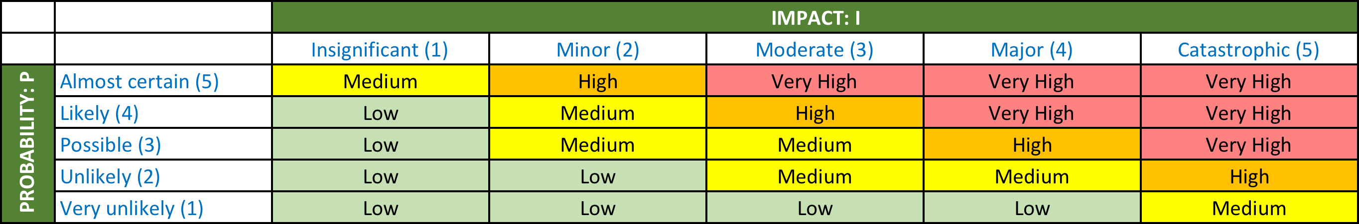
Risk assessment
Standard Risk Matrix approach (as applied e.g. to risk analysis for L4 spare RFQ)
“Probability” and “Impact” assessed in context of L4-PSB connection and subsequent operation

Slide 6
Risk classification
Probability: P | Level/score
Very unlikely | 1
Unlikely | 2
Possible | 3
Likely | 4
Almost certain | 5
Risk “Score” = Probability x Impact
Impact: I | Level/score | Schedule delay | Downtime/y (above 120h) | Beam Parameters
Insignificant | 1 | <1 day | <12h | >99%
Minor | 2 | 1 – 7 days | 12 – 48h | 95 – 99%
Moderate | 3 | 1 – 4 weeks | 48 – 200h | 80 – 95%
Major | 4 | 1 – 3 months | 200 – 1000h | 60 – 80%
Catastrophic | 5 | >3 months | >1000h | <60%

Slide 7
Risk scores: schedule I/II
Subsystem/infrastructure readiness
 | Risk | Analysis | P | I | S
1 | Infrastructure modifications not ready for connection (CE, decabling, cabling, CV, …) | Likely (for transformer CE), otherwise scope of work is clear and planned into the shutdown. | 4 | 4 | 16
2 | BI.STR stripping foil units not ready, due to failed vacuum acceptance tests | Possible, as issues with cleaning and RGA still not understood | 3 | 4 | 12
3 | Delay in provision of beam instrumentation systems | Possible but main concern is for HWC and beam commissioning of BI | 3 | 3 | 9
4 | Linac4 not commissioned to 160 MeV in time, due to unforeseen problems | Unlikely, as all systems now installed for 160 MeV, and commissioning in progress | 2 | 4 | 8
5 | Delay in provision of “in specification” BI.DIS PFN and controls, due to issues with PFN coil heating | Almost certain, but operation with present version possible and impact on schedule insignificant | 5 | 1 | 5
1
4
5
9
10
14
15
25
Score = Probability x Impact

Slide 8
Risk scores: schedule II/II
During shutdown
 | Risk | Analysis | P | I | S
1 | Unforeseen problems (technical, integration or requiring coactivity), extending shutdown and compressing beam commissioning | Almost certain, need some contingency in planning and in resources to be able to react, plus close coordination | 5 | 2 | 10
2 | Integration or installation issue with very tight injection straight equipment and supports | Possible but risk is minimised by mock-up now being assembled in 867 and by EYETS inspections and scans | 3 | 3 | 9
3 | Insufficient resources for key teams to complete work on time | Unlikely, as careful planning of all (co)activities, resource loading and smoothing | 2 | 3 | 6
4 | Serious worksite accident or incident | Unlikely to arise from specific extra shutdown activities | 2 | 3 | 6
5 | Beam commissioning delayed because beam instrumentation commissioning needs beam | Possible, needs correct planning of beam commissioning and dedicated time for BI at correct phases | 3 | 2 | 6
1
4
5
9
10
14
15
25
Score = Probability x Impact

Slide 9
Risk scores: availability
 | Risk | Analysis | P | I | S
1 | Linac4 teething issues requiring dedicated debugging time, e.g. BI, LL RF, … | Almost certain if no Reliability Run, as debugging will be done in operation. Impact should be moderate, but can expect 48-200h extra downtime in first year of operation | 5 | 3 | 15
2 | Poor overall operability: debugging time needed with subsystems working together (timing, controls, kickers, Linac, interlocks, …) | Likely, as cannot foresee all interdependencies until system working as whole. L4/PSB injection controls and SW still in first versions with expert interfaces. Reliability run, HST, HWC and beam commissioning all crucial | 4 | 3 | 12
3 | BI.DIS PFN overheating causes extra downtime for cooling | Likely with present design but moderate impact and replaced by end of 2017 | 4 | 3 | 12
4 | Stripping foil system teething issues (foil lifetime, …) requiring dedicated debugging time | Possible but HST and L4 stripping foil test stand experience crucial to debug before operation | 3 | 3 | 9
5 | H- source teething issues requiring dedicated debugging time | Unlikely as performance already OK and stable for LHC beams | 2 | 3 | 6
6 | Chopper teething issues requiring dedicated debugging time | Unlikely, as performance already demonstrated, but 24/7 operation in RR | 2 | 3 | 6
1
4
5
9
10
14
15
25
Score = Probability x Impact

Slide 10
Risk scores: performance
 | Risk | Analysis | P | I | S
1 | Uncontrolled beamloss from injection process in unexpected location in PSB limits injected intensity | Possible, given SNS experience and completely new injection system and injection process | 3 | 4 | 12
2 | Limitations in pulse length from BI.DIS overheating reduce number of turns which can be injected | Possible but will only affect non-LHC beams and only serious if source current is not nominal | 3 | 3 | 9
3 | Not possible to obtain specified emittance for given intensity, due to painting schemes and complex waveforms | Likely, but impact is low as commission LHC beam first, and margin to inject more turns with little impact on emittance | 4 | 2 | 8
4 | Unexpected emittance increase or transmission issue in high energy part of Linac4 | Unlikely, as beam dynamics well understood and results to date as expected | 2 | 4 | 8
5 | Linac4 RF LL issues increase rise time of current pulse beyond specification for SMV head/tail dump, so more turns to inject | Likely without RR, but impact low as emittance increase very small with more turns for given intensity | 4 | 2 | 8
6 | Lower than required minimum current from H- source limits parameters | Unlikely, as source performance now OK for LHC beams and can be reproduced. Also can inject more turns for LHC beam if needed. | 2 | 3 | 6
1
4
5
9
10
14
15
25
Score = Probability x Impact

Slide 11
Risk ratings: top 6
 | Risk | Analysis | P | I | S
S | Infrastructure modifications not ready for connection (CE, decabling, cabling, CV, …) | Likely (for transformer CE), otherwise scope of work is clear and planned into the shutdown. | 4 | 4 | 16
A | Linac4 teething issues requiring dedicated debugging time, e.g. BI, LL RF, … | Almost certain if no RR, as debugging will be done in operation. Impact moderate?, can expect 48-200h extra downtime in first year | 5 | 3 | 15
A | Poor overall operability: debugging time needed with subsystems working together (timing, controls, kickers, Linac, interlocks, …) | Likely, as cannot foresee all interdependencies until system working as whole. L4/PSB injection controls and SW still in first versions with expert interfaces. | 4 | 3 | 12
A | BI.DIS PFN overheating causes extra downtime for cooling | Likely with present design but moderate impact and replaced by end of 2017 | 4 | 3 | 12
S | BI.STR stripping foil units not ready, due to failed vacuum acceptance tests | Possible, as issues with cleaning and RGA still not understood | 3 | 4 | 12
P | Uncontrolled beamloss from injection process in unexpected location in PSB limits injected intensity | Possible, given SNS experience and completely new injection system and injection process | 3 | 4 | 12
1
4
5
9
10
14
15
25
Score = Probability x Impact

Slide 12
Mitigations?
 | Risk | Mitigation | P’ | I’ | S’
S | Infrastructure modifications not ready for connection (CE, decabling, cabling, CV, …) | Crash program to advance CE to this EYETS | 2 | 4 | 8
A | Linac4 teething issues requiring dedicated debugging time, e.g. BI, LL RF, … | Perform Reliability Run (i.e. early connection not until end 2017) | 4 | 2 | 8
A | Poor operability: debugging time needed with subsystems working together (timing, controls, kickers, Linac, interlocks, …) | HWC, Dry Runs, commissioning and operate Linac4 from CCC with (by?) BE/OP teams working on PSB | 3 | 2 | 6
A | BI.DIS PFN overheating causes extra downtime for cooling | Replace affected coils in 2017 Increased source current, fewer turns | 4 | 2 | 8
S | BI.STR stripping foil units not ready, due to failed vacuum acceptance tests | Crash effort from ABT and VSC to solve problem (cost to other activities?) Modify and formalise acceptance criteria (presently not yet discussed or approved) | 3 | 3 | 9
P | Uncontrolled beamloss from injection process in unexpected location in PSB limits injected intensity | Full H⁻, H⁰ and p particle tracking in 3D field-map of injection chicane and adjacent dipoles | 2 | 4 | 8
1
4
5
9
10
14
15
25
Score = Probability x Impact

Slide 13
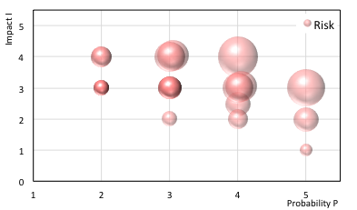
Risk Analysis summary
Late BI.STR (S)
Uncontrolled beamloss (P)
BSW transformer CE
L4 teething (A)
Poor operability (A)
BI.DIS PFN heating (A)

Slide 14
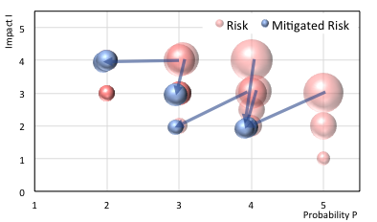
Risk Analysis summary
BSW transformer CE
Uncontrolled beamloss (P)
Late BI.STR (S)
Poor operability (A)
L4 teething (A)
BI.DIS PFN heating (A)

Slide 15
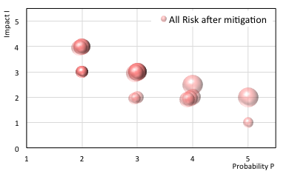
Risk Analysis summary

Slide 16
Discussion on Risk analysis
Main risk for shutdown schedule is timely availability of key subsystems
  Linac4, BI.STR units, BSW transformer CE, …
  Actual shutdown execution has less risk of schedule impact
Availability in first year(s) likely to be lower than targets
  Very high standards to reach of 99% from Linac2
Target parameters (with initial goal of recovering present LHC performance) should be OK
  More risk for non-LHC beams
  Timeline for commissioning of LIU beams to work on (hybrid situation with 160 MeV and 1.4 GeV)

Slide 17
Discussion on mitigations
Full HST and L4 Reliability Run are crucial to minimise availability issues in first year(s) of operation
  Early 2017 would increase risk of poor availability
Performing HWC, dry runs, beam commissioning (and subsequent operation?) of Linac4 from CCC by BE/OP could reduce risk of Operability issues
Full particle tracking of all ion species in injection region with 3D field map could be started now to guard against uncontrolled loss
  Methodology under discussion (Opera modelling, tracking, …)
Vacuum acceptance of key components ongoing issue
  Need to urgently discuss and formalise criteria
Replacement of BI.DIS PFN coils high priority, but margin in parameters (for LHC beam)

Slide 18
Input from SNS (M.Plum)
“Initial commissioning went faster than planned”.
  Circulating beam in 1 day, extraction in 2 days, target intensity of 1e13 ppp after 11 days.
Beam revealed “design flaw in injection chicane magnet/stripper foil system”
  Unintended consequences of design change. Had to use wider/thicker stripper foil, & redesign injection dump beam line.
Instrumentation was only “working at a very basic level during the initial conditioning [which was] frustrating”
“Main lesson learnt was to pay attention to the injection section”.
  Should have tracked beam though 3D fields with the stripper foil inside the field, in absolute coordinate system.
If doing it again “would get infrastructure working better first (e.g. machine protection, beam instrumentation, etc.) and model injection area better”.
  But was a race to get everything ready for commissioning, and not enough resources to check out and debug all sub-systems before the start.

Slide 19
Conclusions
No risk identified which is simultaneously “potentially catastrophic” in consequence and “almost certain” to occur…
Availability of L4 and new injection systems will affect first year(s) of operation
  L4 reliability run very important to reduce this risk
Tracking of all particles with foil in final PSB injection region field map strongly recommended
Operation of Linac4 from CCC by BE/OP to consider

Slide 21
“Point of no Return”
Removal of old cabling
  Although one could imagine recabling to present schema
Removal of old injection elements
  New BI.SMV not compatible with 50 MeV p beam from Linac2 or Linac4 (smaller apertures)
  New PSB injection straight only works with H- beams
  Note: removal methodology and storage is presently not-reversible: it assumes ripping equipment out and immediate disposal of old SMV and SMH
A change in policy to dismantle carefully, prepare and keep for potential re-use is problematic
  Increased shutdown time in removal phase, manpower, radiation dose, and no storage space available.

Slide 22
(Critical) spares
Linac4
  RFQ: parts being purchased
  H- source: several spare sources…
  RF cavities: spare parts (standard situation)
  Klystrons: (waiting input from Alessandra)
Transfer and injection elements
  BI.DIS, SMV, KSW, BSW, STR & associated powering & controls all have at least one spare
  Spare foils are included in each foil holder (6 foils total), and 4 spare foil holders (will) exist

