Slide 2
Linac4-PSB 160 MeV connection readiness review ( TE/VSC )
Tuesday 30 August 2016

Slide 3
TE-VSC
Table of Contents:
Equipment dismantling
Equipment installation
Risks / Mitigation
Additional information
Summary
José de la Gama
Jan Hansen
Jose Somoza

Slide 4
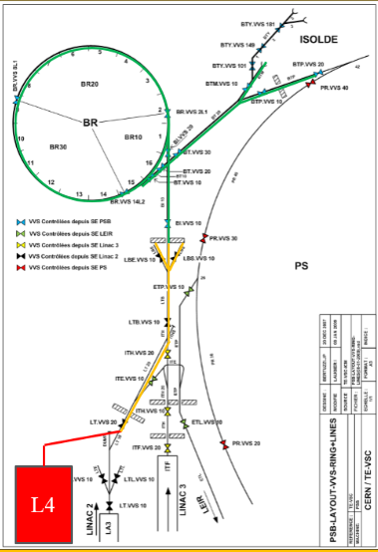
Layout overview
L4
L4T
L2
LT-BHZ20
LBE
LBS
PSB
LT
BI
PS

Slide 5
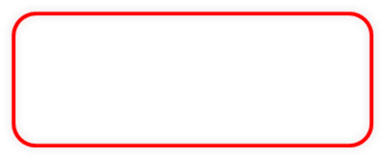

Equipment dismantling
Sector or Machine | Vacuum equipment | dismantling time | Request for Help | Remarks
Disconnect L4T line (HST) | -Reuse of chambers and pumps in L4 and PSB | 3 days | EN/HE transport and handling | Obsolete cables from HST
Disconnect transfer line LT-BHZ20 to PSB and dismantle LINAC 2 | -WASTE (drift chambers and chambers inside magnets) Cables obsolete | 2 weeks | EN/HE transport and handling | Material from L2 needed for LBS line.
Dismantle LBE line and partly LBS line. | -WASTE (drift chambers and chambers inside magnets) -Reuse of cables | 1 week | EN/HE transport and handling | LBS shall be modified at the same time as the LBE line (common primary pumping)
Disconnect and dismantle parts of BI line in the PSB | -Drift chambers will be modified and reinstalled. -Magnet vacuum chambers will be cut and reinstalled in new magnets --Reuse of all cables -Waste (Ion pumps) | 2 week | EN/HE: transport and handling EN/MME: Cut of chambers | Injection Kickers and Septa shall be dismantled and disposed by TE/ABT
Disconnect PSB injection zone and dismantle part of the PSB | -Vacuum supports and chambers will be reinstalled or stored for future installation --Reuse of all cables Waste (Ion pumps) | 1 week | EN/HE: transport and handling EN/MME: Cut of chambers | BHZ 162 and BHZ 11: Replace old chambers with new vacuum chambers outside the tunnel
/
/

Slide 6
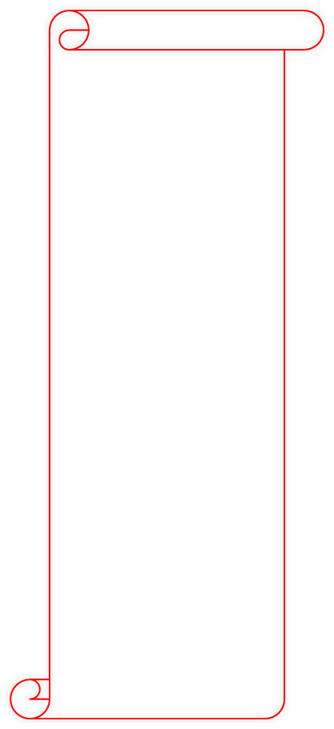
Equipment installation
System or Machine | Installation of equipment | Installation time (Acceptance test not included) | Groups required before TE/VSC work can start | Remarks
L4T transfer line in LINAC4 | RF cavity BI equipment Vacuum chambers and supports | Mechanical: 2 weeks Controls 1 week | Mechanical: BE/BI, BE/RF, EN/ACE (survey) Controls: EN/EL | The installation of BHZ20 cannot start before vacuum chambers is installed in the new wall between L4 and L2
Connection L2 to L4. Transfer line LT-BHZ20 to PSB | Vacuum chambers and supports (L4 to L2) and L2 LT-BHZ20 | Mechanical: 1 week Controls: 2 weeks | Mechanical: TE/MSC, EN/ACE (survey) Controls: EN/EL | Cabling shall be moved from L2 equipment room to PSB and PS vacuum equipment rooms,
LBE line and parts of LBS line. | NEW beam line Magnets, BI equipment, Dump, vacuum chambers and supports. | Mechanical: 1 week Controls: 1 week Bakeout: 1 week (DUMP) | Mechanical: TE/MSC, EN/STI, EN/ACE (survey) Controls: EN/EL | LBS must be modified at the same time as the LBE line (access; common primary pumping)
BI line in the PSB | BI.DIS; BI.SMV; BI. BTV; BI.BVT; BI.DHZs (7) | Mechanical: 3 weeks Controls: 1 week Bakeout: 1 week (BI.SMV) | Mechanical: TE/ABT; TE/MSC, BE/BI; EN/STI, EN/ACE (survey), Controls: EN/EL | -Require Radioactive workshop EN/MME shall be available for cutting and welding of existing chambers for magnets and drift chambers.
PSB injection zone and All sectors in PSB | BR.BSW; BR.BHZ11. BR.BHZ162, BR.KSWs; BR.BTV; New internal dumps, Vacuum pumps. Create new vacuum sectors | Mechanical: 3 weeks Controls: 2 weeks Bakeout: 1 week (sector 30) | Mechanical: TE/ABT TE/MSC, BE/BI; EN/STI, EN/ACE (survey), Controls: EN/EL | - The BHZ162 and BHZ11 will be fitted with new vacuum chambers and sector valves outside the tunnel. -The positioning of BHZ injection chambers will be done by TE/MSC and TE/VSC in the tunnel.

Slide 7
Risks / Mitigation
System or machine | List of major Risks | Mitigation | Remarks
L4T transfer line in LINAC4 | None | None | None
Connection L2 to L4. Transfer line LT-BHZ20 to PSB | -Magnetic field from PS main magnets | -Add extra shielding (Mu-metal) | None
LBE line and parts of LBS line. | -Magnetic field from LT line magnets | . -Add extra shielding (Mu-metal) | None
BI line in the PSB | None | None | Insufficient cooling of head and tail dump would lead to higher outgassing and require extra pumping.
PSB injection zone and All sectors in PSB | -Misalignment between old (unknown none conformities) and new installation. -Delays due to difficult installation (space) -Higher working temperature of dumps with respect to technical specification, -Higher outgassing of materials with respect to technical specification | -Make cooling test of dumps. -Measure total outgassing of all components to be installed | None.

Slide 8
Additional information
Strong interdependences with other groups:
All equipment's to be installed in the vacuum system have to pass a vacuum acceptance test. Equipment to be tested or none conform to the specified vacuum technical requirements cannot be considered as ready for installation.
EN/HE require all power to be cut for removal cables. So no vacuum test can be done in the tunnel during this period.
Manpower:
Difficult to hire extra manpower, so extra manpower has to be moved from lower priority activities.
Issues / Concerns:
Layout / Assembly drawings required for the installation are missing for 3 section and will only be created after the installation by EN/ACE. (unknown installation problems)
The fabrication of the new BHZ vacuum chambers is on the critical path to be ready for installation by end of 2016 (No margin in planning. Fabrication is done by the same company producing the BSW chambers, (Single supplier))
Remarks:
Vacuum commissioning can only start after all new cables has been installed and with power in the tunnel.
A bakeout is required of the septa in sector BI and BR30 after the finally closure of the vacuum system. No other activity can take place in the septa zones during this time.

Slide 9
Summary (1)
TE/VSC vacuum equipment is expected to be ready for connection by the end of 2016. All purchase orders are in place.
Preparation of BHZ magnets with new vacuum chambers can only start after removal of the BHZ magnets from the tunnel.
Re-cabling of LT-LBE-BI lines and PSB injection are required before commissioning of the vacuum system

Slide 10
Summary (2)
The Modification and installation of the vacuum chambers and vacuum equipment are highly dependent on other groups.
TE/VSC need EN/MME available for cutting and welding of vacuum chambers including radioactive workshop (building 109)
All equipment to be installed in the vacuum system have to be vacuum acceptance tested. Only accepted material can be considered as ready for installation.
PSB Layout / Assembly drawings required for the installation are missing for some sections.

Slide 12
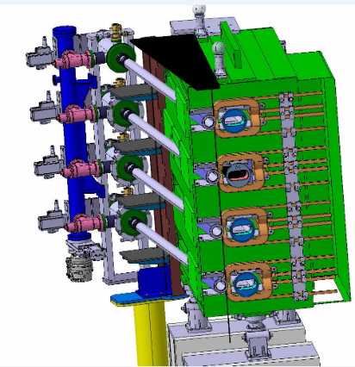
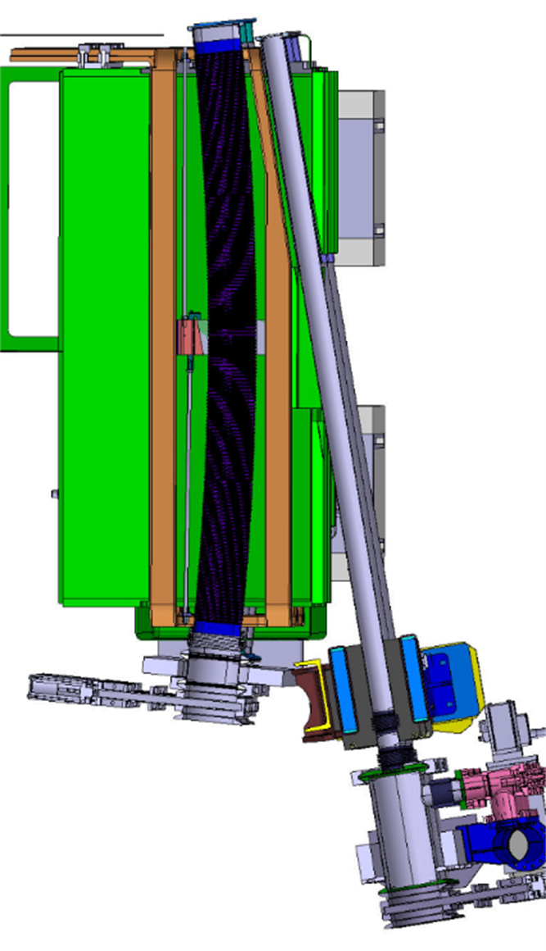
Extra slides (BHZ162)

Slide 13
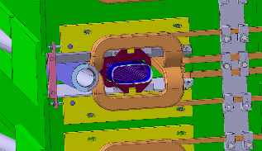
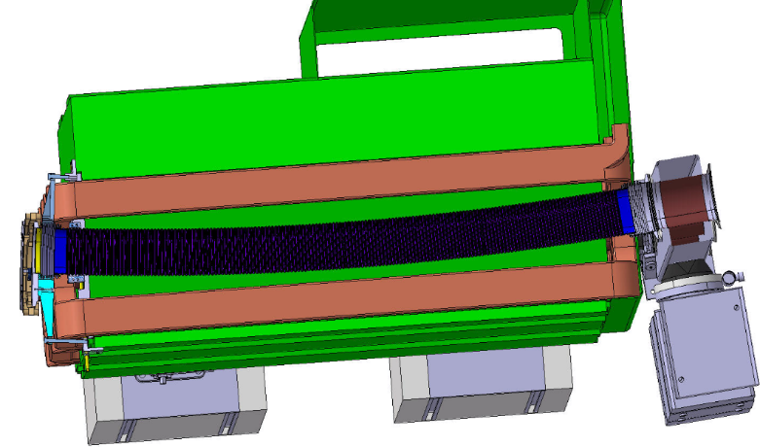
Extra slides (BHZ11)
End view
Bellows compression
And chamber adjustment
Chamber adjustment
Magnet
BSW

