Slide 2
Linac4-PSB 160 MeV connection readiness review
Tuesday 30 August 2016

Slide 3
TE-MSC
Antony Newborough
Table of Contents:
Equipment dismantling
Equipment installation
Risks / Mitigation
Additional information
Summary

Slide 4
Equipment dismantling
System | Equipment | Estimated activation | Cooldown requested + duration | Particular requests for removal | Storage / Waste | DEC Done | Updates needed | Group ressource | Remarks | ECR/SRR EDMS
 |  |  |  |  |  |  | Database / Integration / Controls …
LBE.QFW.10 | Magnet | 1µSv/40cm | 6wks | Buffer Zone | Waste | ? | Database / Integration / | MNC
LBE.QDW.10 | Magnet | 1µSv/40cm | 6wks | Buffer Zone | Waste | ? | Database / Integration / | MNC
LBE.DHV.10 | Magnet | 1µSv/40cm | 6wks | Buffer Zone | Waste | ? | Database / Integration / | MNC
LBE Vacuum
LBE Magnet interlock
LBE Supports
BI.DHZ.DVT10 | Magnet | 5µSv/40cm | 6wks | Buffer Zone | Waste | ? | Database / Integration / | MNC |  | 1494503
BI.DHZ.DVT20 | Magnet | 5µSv/40cm | 6wks | Buffer Zone | Waste | ? | Database / Integration / | MNC |  | 1494503
BI.DHZ.DVT30 | Magnet | 5µSv/40cm | 6wks | Buffer Zone | Waste | ? | Database / Integration / | MNC |  | 1494503
BI.DHZ.DVT40 | Magnet | 315µSv/40cm | 6wks | Buffer Zone | Waste | ? | Database / Integration / | MNC |  | 1494503
Bi(1:4).DHZ.DVT50 | Magnet | 60µSv/40cm | 6wks | Buffer Zone | Waste | ? | Database / Integration / | MNC |  | 1494503
BI(1:4).DHZ.DVT70 | Magnet | 240µSv/40cm | 6wks | Buffer Zone | Waste | ? | Database / Integration / | MNC |  | 1494503
BI Corrector Magnet Interlock
BI Corrector Vacuum
BI.BVT10 | Magnet | 162µSv/40cm | 6wks | Buffer Zone | Waste | ? | Database / Integration / | MNC |  | 1494503
Magnet Interlock
Vacuum
BR.BHZ11 | Magnet | 2000µSv/40cm | 6wks | Transport to Workshop: to be fitted with new vacuum chamber + minor mods |  | NA | Database / Integration / | MNC |  | 1422358
BR.BHZ162 | Magnet | 240µSv/40cm | 6wks | Magnet Storage | Storage | NA | Database / Integration / | MNC |  | 1422358
BR Vacuum
BI.QNO10 | Magnet | 236µSv/40cm | 6wks | Buffer Zone | Waste | ? | Database / Integration / | MNC |  | 1494503
BI.QNO20 | Magnet | 310µSv/40cm | 6wks | Buffer Zone | Waste | ? | Database / Integration / | MNC |  | 1494503
BI.QNO30 | Magnet | 92µSv/40cm | 6wks | Buffer Zone | Waste | ? | Database / Integration / | MNC |  | 1494503
BI.QNO40 | Magnet | 350µSv/40cm | 6wks | Buffer Zone | Waste | ? | Database / Integration / | MNC |  | 1494503
BI(1:4).QNO50 | Magnet | 60µSv/40cm | 6wks | Buffer Zone | Waste | ? | Database / Integration / | MNC |  | 1494503
BI(1:4).QNO60 | Magnet | 60µSv/40cm | 6wks | Buffer Zone | Waste | ? | Database / Integration / | MNC |  | 1494503
BI Quadrupole Interlock
BI Quadrupole Vacuum
Considering dose rate could be performed <6wks cooldown
Changed for Consolidation reasons, not directly linked to L4 connection
First Out – Last In?
Changed for Consolidation reasons, not directly linked to L4 connection

Slide 5
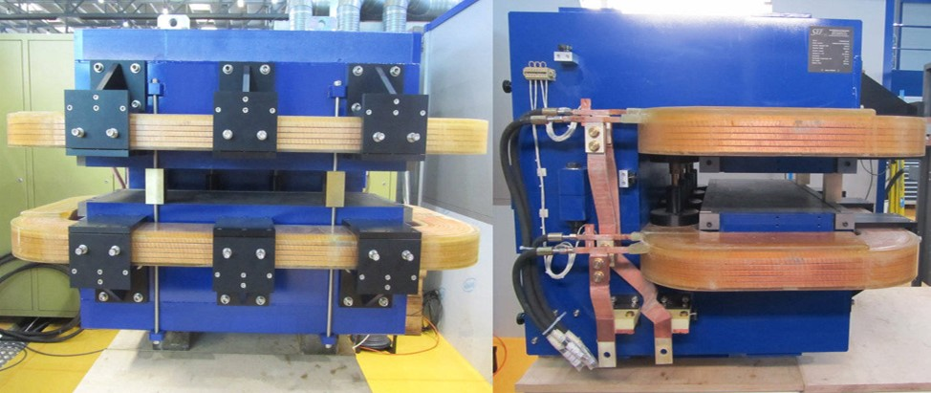
Equipment installation
System | Equipment | Quantity | Readiness by December 2016 | Installation duration (in hours) | Specific EN/HE Installation requests | Cooling and Ventilation requests |  |  | EN/EL needs |  | Controls needs (FESA, BIS, Expert) | Individual System Tests |  | HW commissioning duration + Access condition | Beam commisionning duration | Group ressource | EDMS ECR / SRR Number | Number of spares | Remarks
 |  |  |  |  |  | Water cooling | Ventilation requests | Functional Specification / Engineering Specification Number | DIC Done | Other information
LINAC 4 and L4T Magnets | Magnets | 56 | Y | Installed |  |  |  |  |  |  |  | Y | 4 | 4 days / tunnels |  | MNC |  | Available | Magnets already installed and some commisoned. Additional tests required.
LT.BHZ20 | Magnet | 1 | Y | 16 | Transport / Lifting | Existing |  | 1083362 | Other info: | EN / EL |  | Y | 2 | 2 days / tunnel |  | MNC |  | 1 | Coils from the installed magnet will be installed on a new yoke to become dedicated spare
 | Vacuum
 | Interlock
 | Powering
The new BHZ 20 magnet delivered 2015

Slide 6
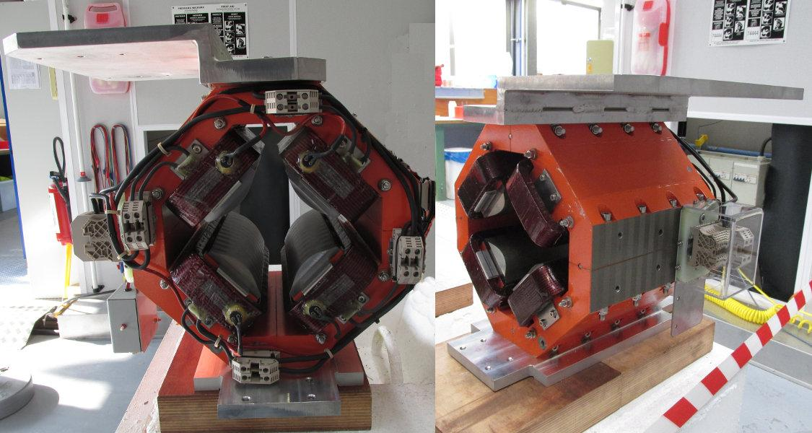
Equipment installation
System | Equipment | Quantity | Readiness by December 2016 | Installation duration (in hours) | Specific EN/HE Installation requests | Cooling and Ventilation requests |  |  | EN/EL needs |  | Controls needs (FESA, BIS, Expert) | Individual System Tests |  | HW commissioning duration + Access condition | Beam commisionning duration | Group ressource | EDMS ECR / SRR Number | Number of spares | Remarks
 |  |  |  |  |  | Water cooling | Ventilation requests | Functional Specification / Engineering Specification Number | DIC Done | Other information
LBE.QFW.0015 | Magnet | 1 | Y | 4 | Transport / Lifting |  |  | 1054490 | Other info: | EN / EL |  | Y | 0.10 | 0.5 days / tunnel |  | MNC | ABP | 4
LBE.QDW.0020 | Magnet | 1 | Y | 4 | Transport / Lifting |  |  | 1054490 | Other info: | EN / EL |  | Y | 0.10 |  |  | MNC | ABP
LBE.DHV.0010 | Magnet | 1 | Y | 4 | Transport / Lifting |  |  | 1165034 | Other info: | EN / EL |  | Y | 0.10 |  |  | MNC | ABP | 1
LBE Vacuum | Vacuum |  | TBC by VSC
LBE Magnet interlock | Interlock |  | TBC by MPE (WIC)
LBE Magnet Powering | Powering |  | EPC responsibility
LBE Supports | Supports |  | ABP responsibility
L4 type magnets available in storage

Slide 7
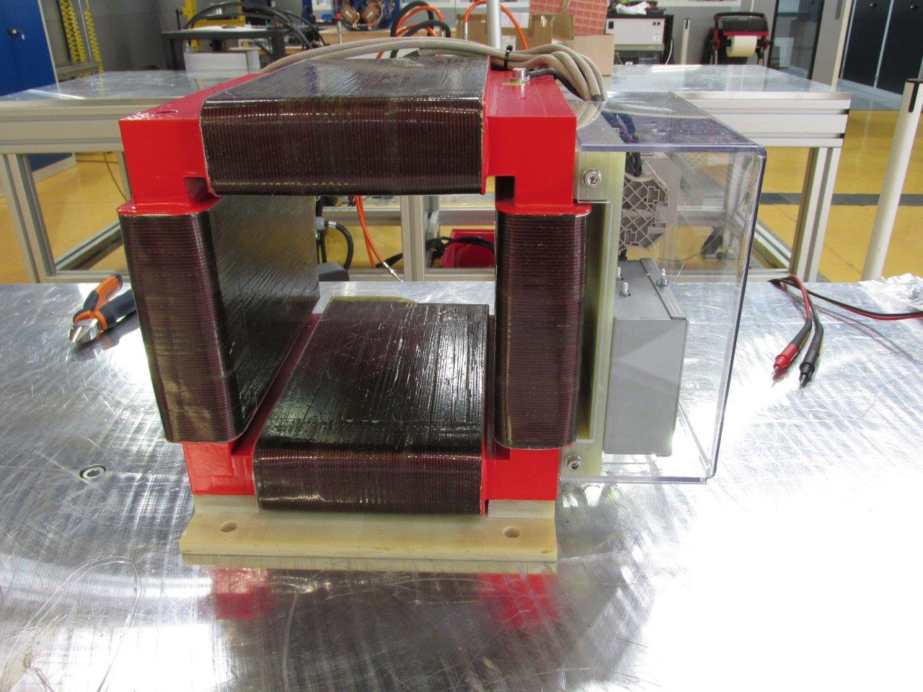
Equipment installation
System | Equipment | Quantity | Readiness by December 2016 | Installation duration (in hours) | Specific EN/HE Installation requests | Cooling and Ventilation requests |  |  | EN/EL needs |  | Controls needs (FESA, BIS, Expert) | Individual System Tests |  | HW commissioning duration + Access condition | Beam commisionning duration | Group ressource | EDMS ECR / SRR Number | Number of spares | Remarks
 |  |  |  |  |  | Water cooling | Ventilation requests | Functional Specification / Engineering Specification Number | DIC Done | Other information
BI.DHZ.DVT10 | Magnet | 1 | Y | 8 | Transport / Lifting |  |  | 1277962 | Other info: | EN / EL |  | Y | 0.1 | 1 day / tunnel |  | MNC | 1494503 | 2 | Magnet replaced for consolidation purposes, linked to the replacement of the power converter for the other corrector magnets
BI.DHZ.DVT20 | Magnet | 1 | Y | 8 | Transport / Lifting |  |  | 1277962 | Other info: | EN / EL |  | Y | 0.1 |  |  | MNC | 1494503
BI.DHZ.DVT30 | Magnet | 1 | Y | 8 | Transport / Lifting |  |  | 1277962 | Other info: | EN / EL |  | Y | 0.1 |  |  | MNC | 1494503
BI.DHZ.DVT40 | Magnet | 1 | Y | 8 | Transport / Lifting |  |  | 1277962 | Other info: | EN / EL |  | Y | 0.1 |  |  | MNC | 1494503
Bi(1:4).DHZ.DVT50 | Magnet | 4 | Y | 16 | Transport / Lifting |  |  | 1277962 | Other info: | EN / EL |  | Y | 0.3 |  |  | MNC | 1494503 |  | Required for L4 – Supports to be ordered in coming weeks
BI(1:4).DHZ.DVT70 | Magnet | 4 | Y | 16 | Transport / Lifting |  |  | 1277962 | Other info: | EN / EL |  | Y | 0.3 |  |  | MNC | 1494503
BI Corrector Magnet Interlock | Interlock | 24 | TBC by MPE (WIC)
BI Corrector Vacuum | Vacuum | 12 | TBC by VSC
BI Corrector Powering | Powering | 24 | EPC responsibility
22 corrector magnets delivered and tested

Slide 8
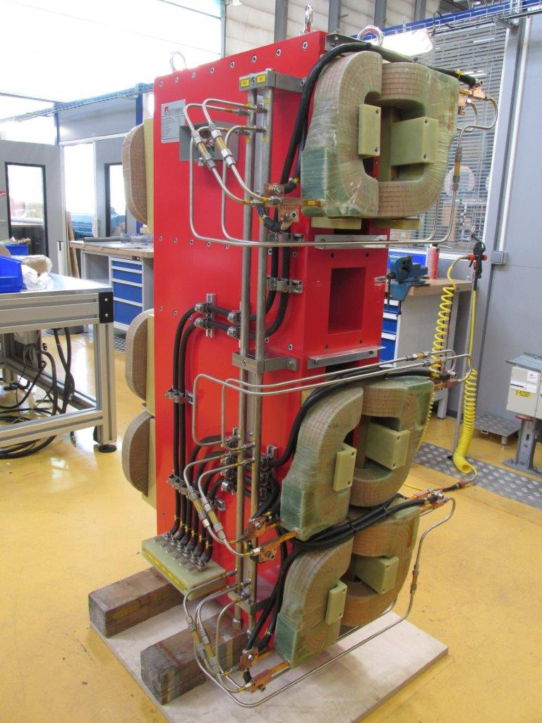
Equipment installation
System | Equipment | Quantity | Readiness by December 2016 | Installation duration (in hours) | Specific EN/HE Installation requests | Cooling and Ventilation requests |  |  | EN/EL needs |  | Controls needs (FESA, BIS, Expert) | Individual System Tests |  | HW commissioning duration + Access condition | Beam commisionning duration | Group ressource | EDMS ECR / SRR Number | Number of spares | Remarks
 |  |  |  |  |  | Water cooling | Ventilation requests | Functional Specification / Engineering Specification Number | DIC Done | Other information
BI.BVT10 | Magnet | 1 | Y | 16 | Transport / Lifting | Existing |  | 1188530 | Other info: | EN/EL |  | Y | 1 | 0.5 days / tunnel |  | MNC | 1494503 | 1
 | Interlock | 4 | TBC by MPE (WIC)
 | Vacuum | 4 | TBC by VSC
 | Powering | 3 | EPC responsibility
first Magnet delivered to CERN – measurements and a few modification still to be made.
The spare magnet to follow by the end of the year.

Slide 9
Equipment installation
System | Equipment | Quantity | Readiness by December 2016 | Installation duration (in hours) | Specific EN/HE Installation requests | Cooling and Ventilation requests |  |  | EN/EL needs |  | Controls needs (FESA, BIS, Expert) | Individual System Tests |  | HW commissioning duration + Access condition | Beam commisionning duration | Group ressource | EDMS ECR / SRR Number | Number of spares | Remarks
 |  |  |  |  |  | Water cooling | Ventilation requests | Functional Specification / Engineering Specification Number | DIC Done | Other information
BR.BHZ11 | Magnet | 1 | Other information: If required the spare BHZ magnet can be used however it is the only non-radioactive spare which is destined to become the new reference magnet for 2 GeV, the ideal solution would be to remove and modify the existing magnet | 16 | Transport / Lifting | Existing |  |  | Other info: | NA |  | Y | 1 | 0.5 day / tunnel |  | MNC | 1422358 | 0 | A dedicated spare will become available for 2 GeV, in the meantime a repair would need to be made for which all components exist.
BR.BHZ162 | Magnet | 1 | Other information: If required the spare BHZ magnet can be used however it will need to be exchanged again for 2 GeV operation | 16 | Transport / Lifting | Existing |  |  | Other info: | NA |  | Y | 1.00 | 0.5 day / tunnel |  | MNC | 1422358 | 1 | A new dedicated spare will become available for 2 GeV, the existing magnets will need to be upgraded for 2 GeV operation.
 | Vacuum |  | Other information: TBC by VSC

Slide 10
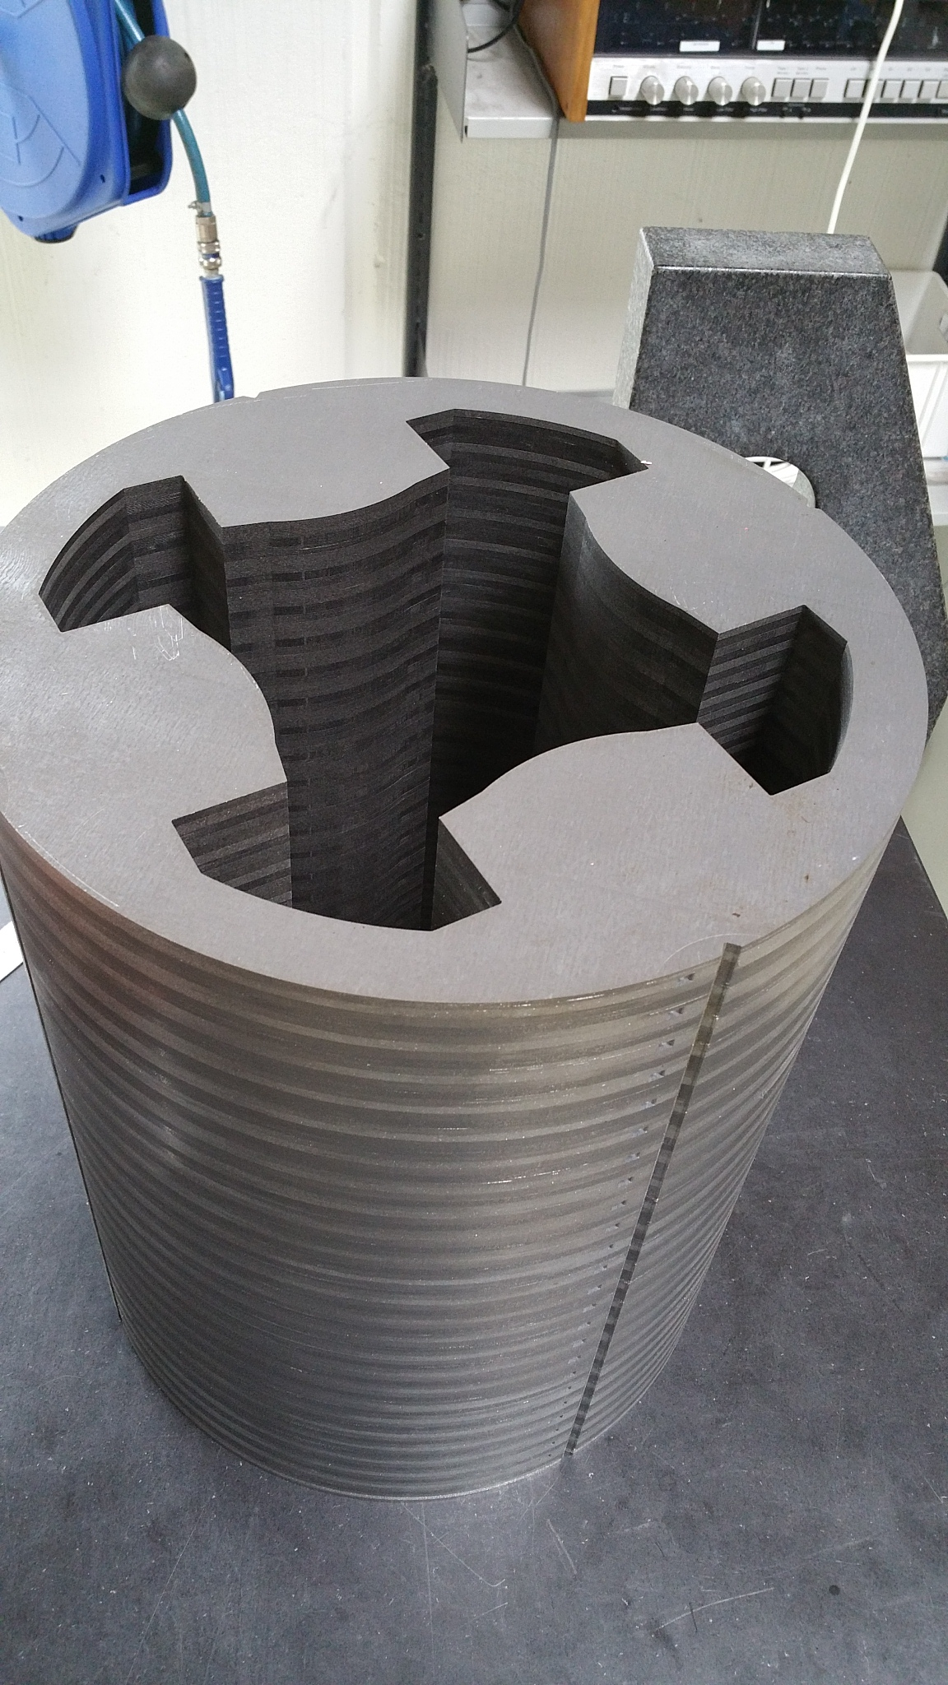
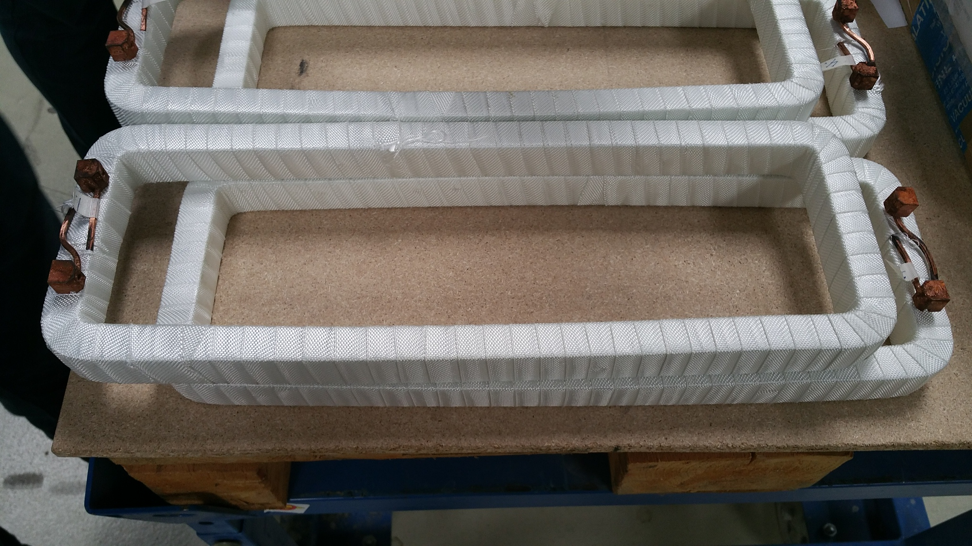
Equipment installation
System | Equipment | Quantity | Readiness by December 2016 | Installation duration (in hours) | Specific EN/HE Installation requests | Cooling and Ventilation requests |  |  | EN/EL needs |  | Controls needs (FESA, BIS, Expert) | Individual System Tests |  | HW commissioning duration + Access condition | Beam commisionning duration | Group ressource | EDMS ECR / SRR Number | Number of spares | Remarks
 |  |  |  |  |  | Water cooling | Ventilation requests | Functional Specification / Engineering Specification Number | DIC Done | Other information
BI.QNO10 | Magnet | 1 | N | 8 | Transport / Lifting |  |  | 1297809 | Other info: | EN/EL |  | Y | 0.10 | 1 day / tunnel |  | MNC | 1494503 | 2 | Magnets replaced for consolidation purposes, linked to the replacement of the power converter for the corrector magnets
BI.QNO20 | Magnet | 1 | N | 8 | Transport / Lifting |  |  | 1297809 | Other info: | EN/EL |  | Y | 0.10 |  |  | MNC | 1494503
BI.QNO30 | Magnet | 1 | N | 8 | Transport / Lifting |  |  | 1297809 | Other info: | EN/EL |  | Y | 0.10 |  |  | MNC | 1494503
BI.QNO40 | Magnet | 1 | N | 8 | Transport / Lifting |  |  | 1297809 | Other info: | EN/EL |  | Y | 0.10 |  |  | MNC | 1494503
BI(1:4).QNO50 | Magnet | 4 | N | 16 | Transport / Lifting |  |  | 1297809 | Other info: | EN/EL |  | Y | 0.30 |  |  | MNC | 1494503
BI(1:4).QNO60 | Magnet | 4 | N | 16 | Transport / Lifting |  |  | 1297809 | Other info: | EN/EL |  | Y | 0.30 |  |  | MNC | 1494503
BI Quadrupole Powering | Powering | 12 | Other information: TBC by EPC
BI Quadrupole Interlock | Interlock | 12 | Other information: TBC by MPE (WIC)
BI Quadrupole Vacuum | Vacuum | 12 | Other information: VSC responsibility
Pre-series magnet expected in the coming weeks

Slide 11
Risks / Mitigation
Proven technology - low risk

Slide 12
Additional information
Strong interdependences with other groups?
TE-EPC
TE-VSC
TE-MPE
EN-HE
EN-EL
EN-ACE
Manpower: FSU team available. Additional resources have already been requested for connection during LS2 to help cover the work in the other areas of the PS complex

Slide 13
Summary
All of the magnets required for the connection of the L4 to the PSB are available at CERN. Some support structures still need to be ordered.
The main PSB BHZ magnets need modification for L4 connection and 2 GeV.
The BI quadrupoles (cons.) should be available by the end of 2017.

