Slide 1

TBB integration on GeantV
Andrei Gheata
Joel Fuentes
Notes:
- Single-track (stack) approach : for the "Classical simulation"
- Vector-of-tracks (basket) approach : for the GeantV simulation

Slide 2
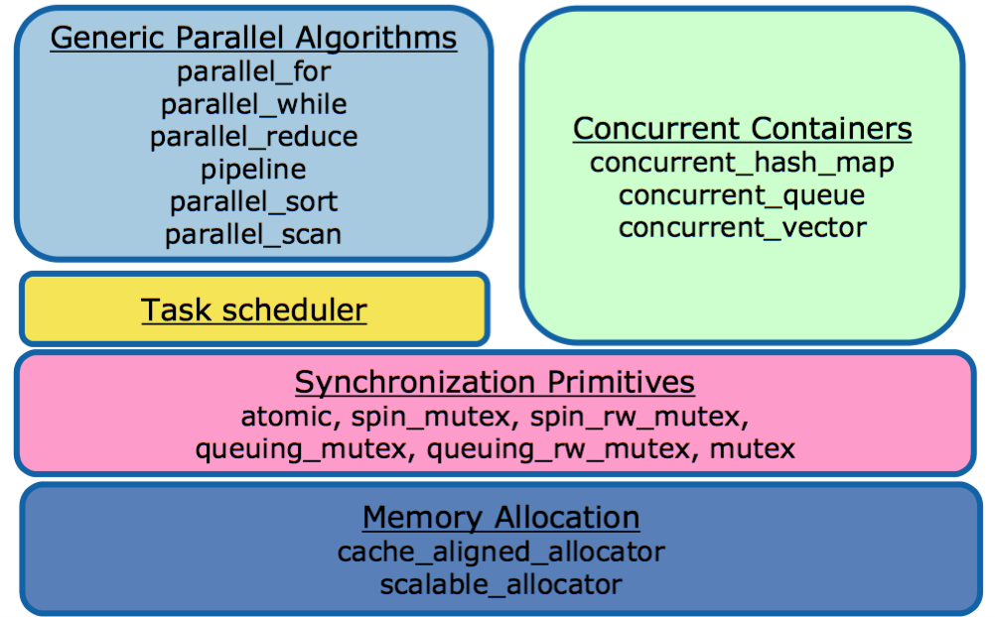
TBB Components

Slide 3
Task Scheduler
Problem | Solution
Oversubscription Fair scheduling High overhead Load imbalance Scalability | One TBB thread per hardware thread Non-preemptive unfair scheduling Programmer specifies tasks, not threads Work-stealing balances load Specify tasks and how to create them, rather than threads

Slide 4
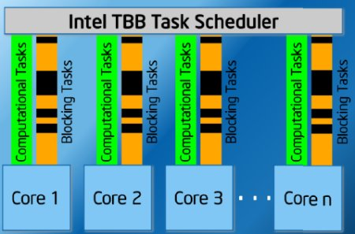
• Each thread has its own ready pool, which is a lists of tasks.
• A task goes into each pool when it is allocated.
• Each thread steals tasks from other pools when necessary.

Slide 5
task approach of GeantV
Transport task may be further split into subtasks
spawn
Feeder task
Reads from file a number of events. Invokes the concurrent basketizer service
spawn
Transport task
Transports one basket for one step
reuse tracks keeping locality
output
transported tracks
inject
particle
input
dequeue basket
enqueue basket
Basket queue
concurrent service
spawn
Basketizer(s)
concurrent service
injects full baskets
Scoring
This is a user task reading track info and creating ”hits”
event finished?
command
dump all your baskets
inspect
I/O task
Write data (hits, digits, kinematics) on disk
Garbage collector
Forces partially filled baskets into the basket queue to boost concurrency
Flow control task
event finished? queue empty?
spawn
event finished?
queue empty?
spawn
Digitizer task
This is a user task working on “hits” data

Slide 6
First step: Feeder Task
Feeder task
Reads from file a number of events. Invokes the concurrent basketizer service
spawn
Transport Threads
(original transport thread)
output
transported tracks
inject
particle
input
dequeue basket
Basketizer(s)
concurrent service
injects full baskets
enqueue basket
Basket queue
concurrent service

Slide 7
Second step: Transport Task
Feeder task
Reads from file a number of events. Invokes the concurrent basketizer service
spawn
Transport task
output
transported tracks
inject
particle
input
dequeue basket
Basketizer(s)
concurrent service
injects full baskets
enqueue basket
Basket queue
concurrent service

Slide 8
Third step: Flow Control Task
Feeder task
Reads from file a number of events. Invokes the concurrent basketizer service
spawn
Transport task
Transports one basket for one step
output
transported tracks
inject
particle
input
dequeue basket
Basketizer(s)
concurrent service
injects full baskets
enqueue basket
Basket queue
concurrent service
event finished?
inspect
Flow control task
event finished? queue empty?
spawn
Initial task

Slide 9
Some issues for migrating to tasks
Thread ID integration
  Now we have static threads with unique id’s, how to deal with this in task mode
  Use of Thread ID for tasks.
    Advantage: locality.
    Disadvantage: It may cause work-stealing to fail.
    At least the Feeder and Transport Tasks use data accessed by Thread ID.
Feeder task: only one task at a time
Assignation of new tasks to be executed in same thread

Slide 10
Affinity methods on TBB
These methods enable optimizing for cache affinity. They enable you to hint that a later task should run on the same thread as another task that was executed earlier. To do this:
In the earlier task, override note_affinity(id) with a definition that records id.
Before spawning the later task, run set_affinity(id) using the id recorded in step 1,

