Slide 1
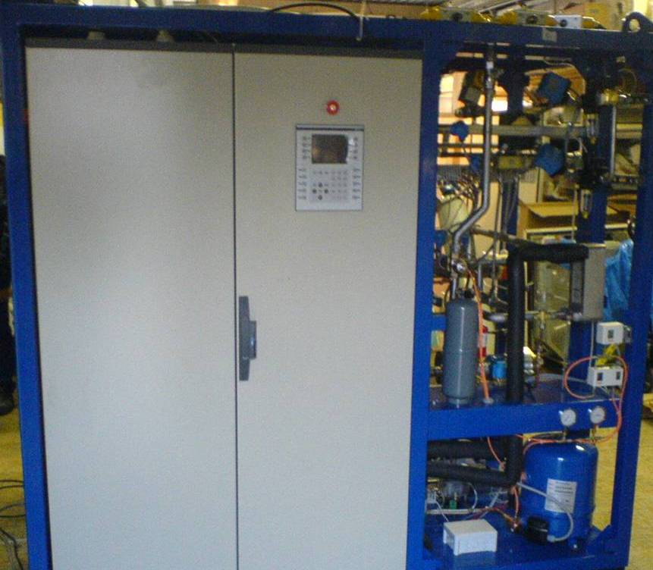
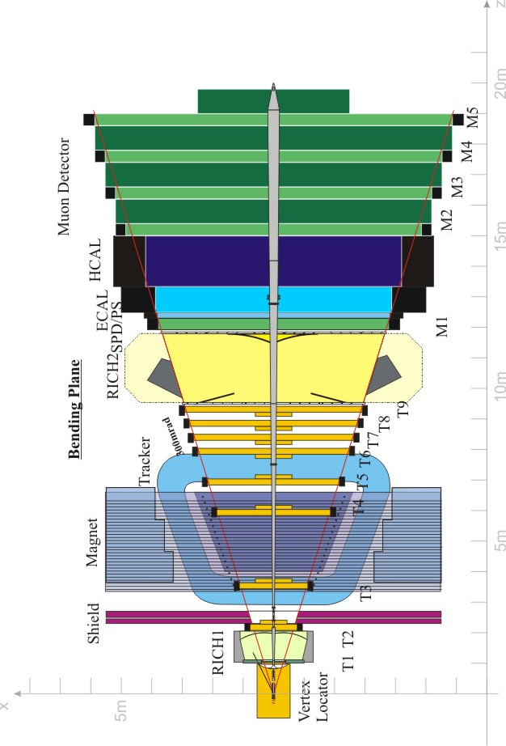
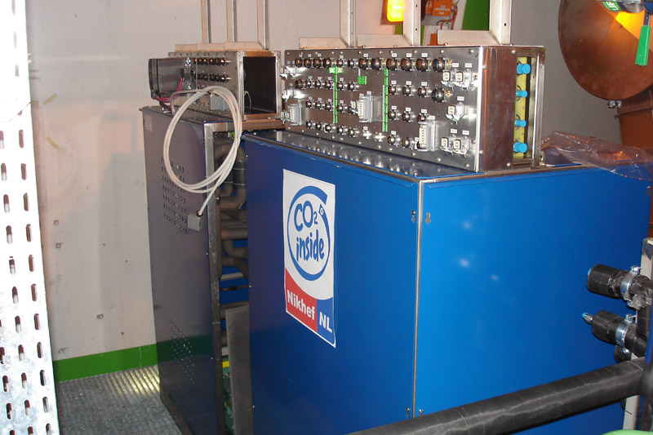
LHCb
Detector
Cooling
CHILLED WATER
MIXED WATER
Detector Cooling
Electronic cooling
C6F14
RICH1 RICH2
C6F14
Inner Tracker
C6F14
Trigger Tracker
H20
Outer Tracker / PS/SPD
CO2
VELO
Two phases evaporative system
Large evaporation heat
Low material budget

Slide 2
- No major problem to reports.
Performances inline with specifications
Commissioning and consolidation done in 2008.
Current goal: stable operation before the startup of 2009 run
Problems being addressed.
Leaks in C6F14 circuits (RICH/IT), ~03-04l/week
Back-up chiller for IT/TT needs to be tested as well as real performances (max temp.
to be reached for simultaneous use by IT and TT).
Problematic flow switch.

