Slide 1


24th CATIA FORUM
Introduction

Slide 2

PLEASE TURN OFF YOUR PHONE

Slide 3




85 ATTENDEES IN AVERAGE PER FORUM
MORE THAN 200 CATIA USERS AT CERN
LESS THAN 10% MADE A
PRESENTATION AT THE FORUM
KEEP
YOUR FORUM
ALIVE
PARTICIPATE !
PLEASE CONTACT Benoit.Riffaud@cern.ch
VOLUNTEERS
FOR
“TIPS & TRICKS”

Slide 4
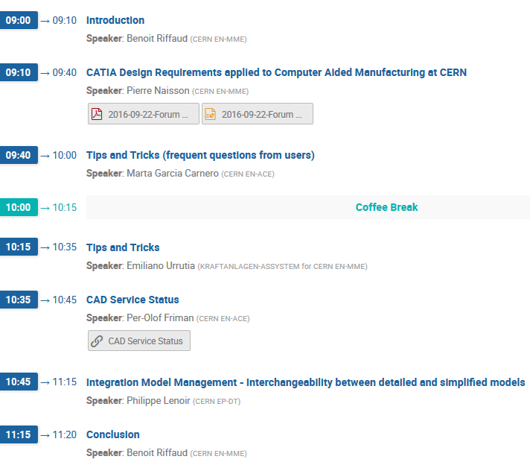

TODAY’S PROGRAM
KEYWORDS
CAD FOR CAM
COMMUNICATION
CONSISTENCY 3D/2D
CAD @ CERN
CLICK OK TO TERMINATE
PRESENTERS WANTED
TRAINING / FAQs
CAD LIFE CYCLE
LARGE SCALE INTEGRATION
COLLABORATIVE WORK
METHODOLOGY / RULES

