Slide 1

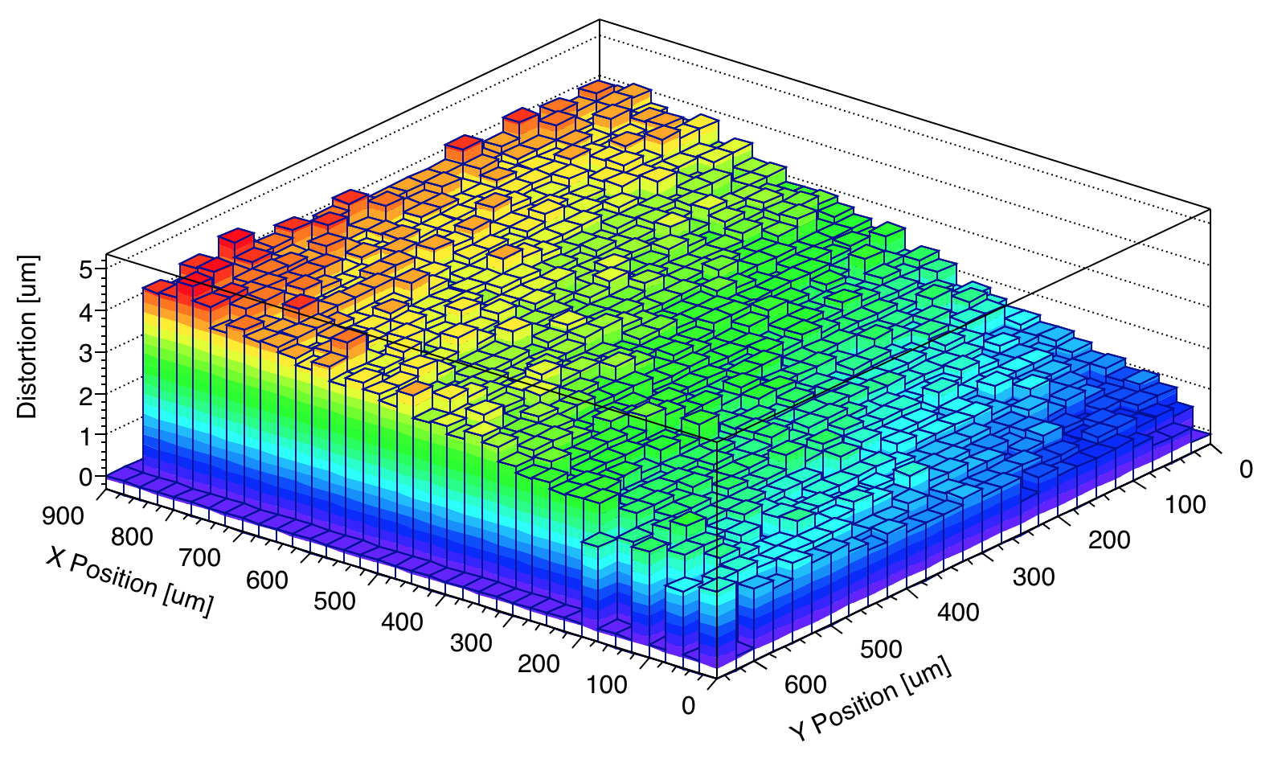

Capacitive Coupling Simulation
+ Lens Correction
for Flip-Chip
CLICdp WG Vertex meeting
19/08/2016
Mateus Vicente

Slide 2


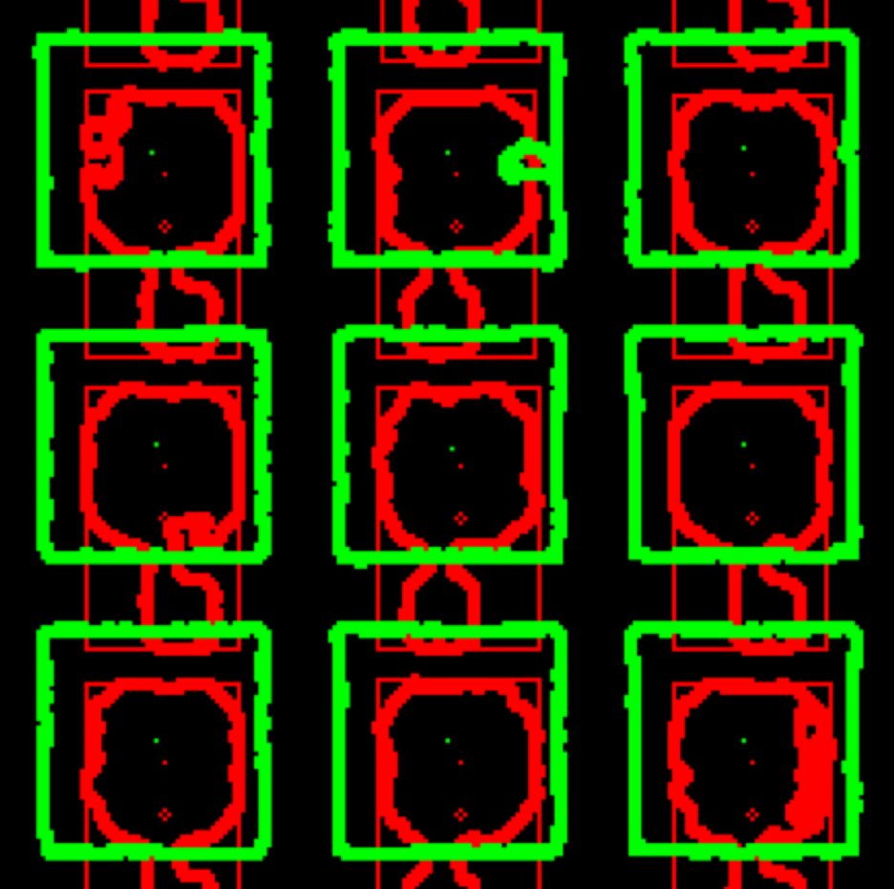


Outline
Flip-chip alignment (SET29 sample)
  Alignment offset
  Lens distortion
    Effort to correct the distortion
Pixel Coupling Simulation
  Possible (mis)alignments
  3D model used
    3x3 and 5x5 pixel matrix
  Misalignment effect
Conclusions
CLIXpix and CCPDv3 pixels pads recognized
in the picture from the Flip-Chip machine
Notes:
ultimate track recording rate was 5 Mtracks/s and was limited only by the beam intensity that the SPS could provide

Slide 3
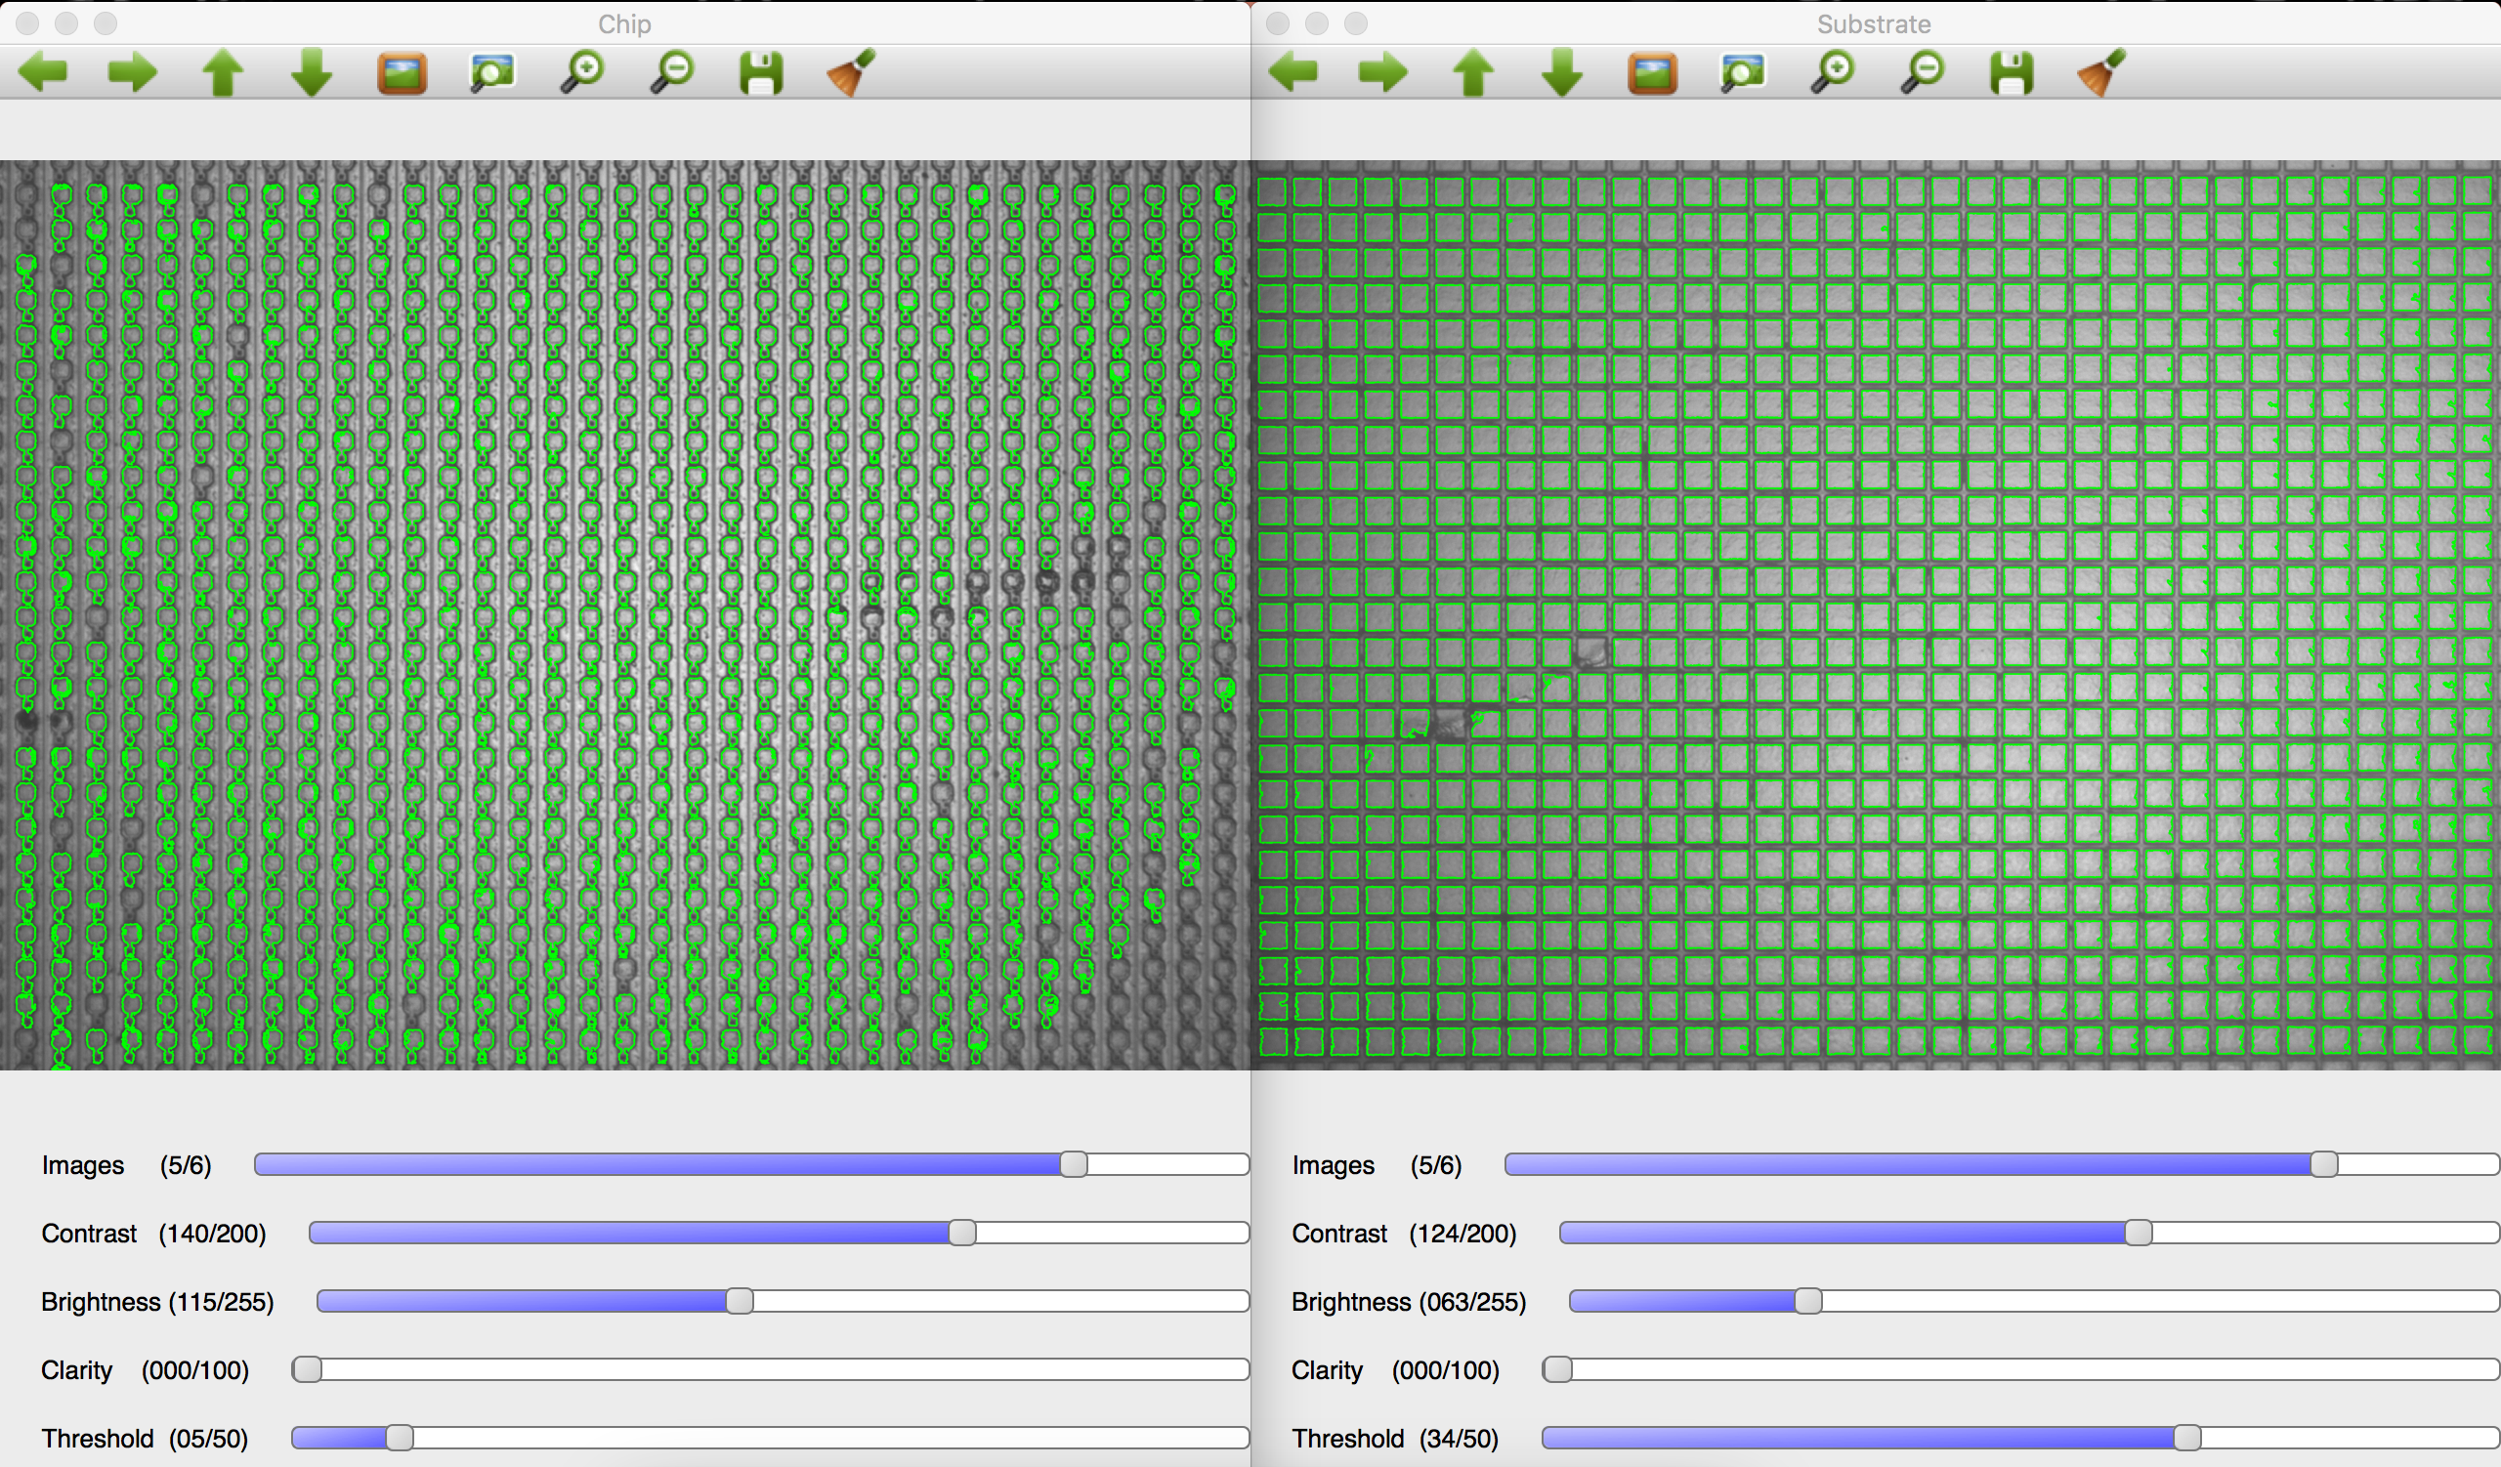
Flip-chip + PixelShop
Alignment Measurement
Thanks to Mathieu Benoit
Notes:
ultimate track recording rate was 5 Mtracks/s and was limited only by the beam intensity that the SPS could provide

Slide 4
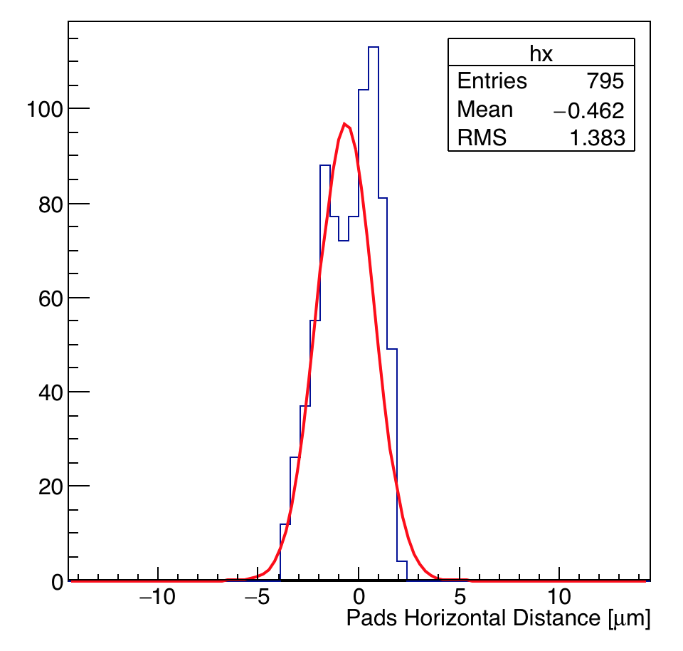
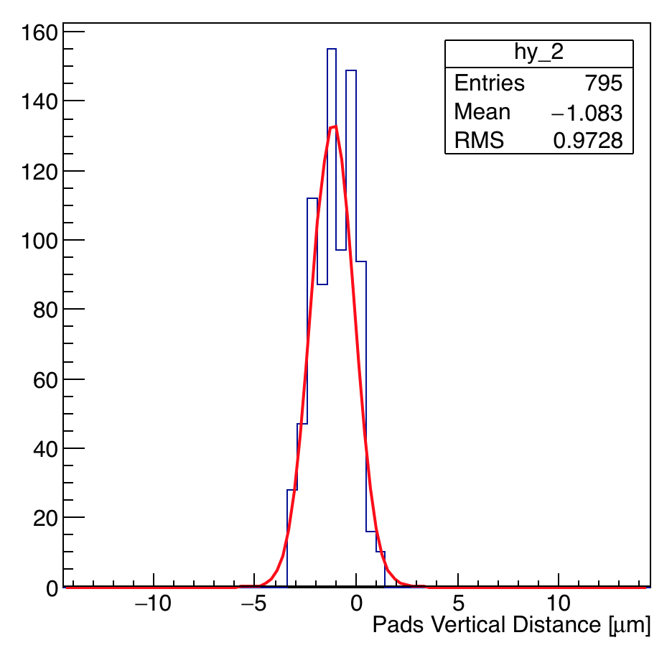
Flip-chip + PixelShop
Alignment Measurement (before gluing)
Distance between sensor and read-out chip pixel pads on SET29
  Distance (Y) AFTER gluing ~ 1.1 um
Notes:
ultimate track recording rate was 5 Mtracks/s and was limited only by the beam intensity that the SPS could provide

Slide 5
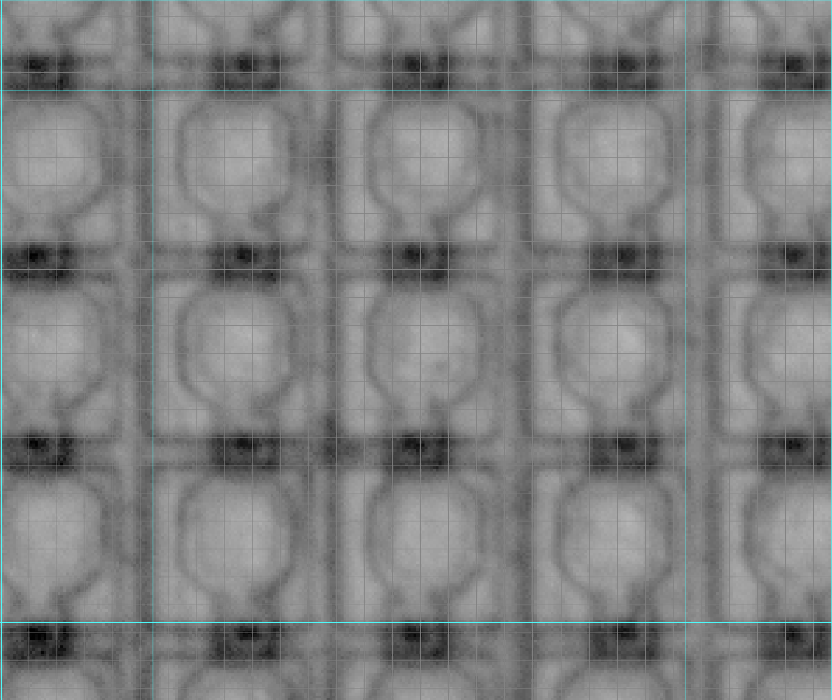
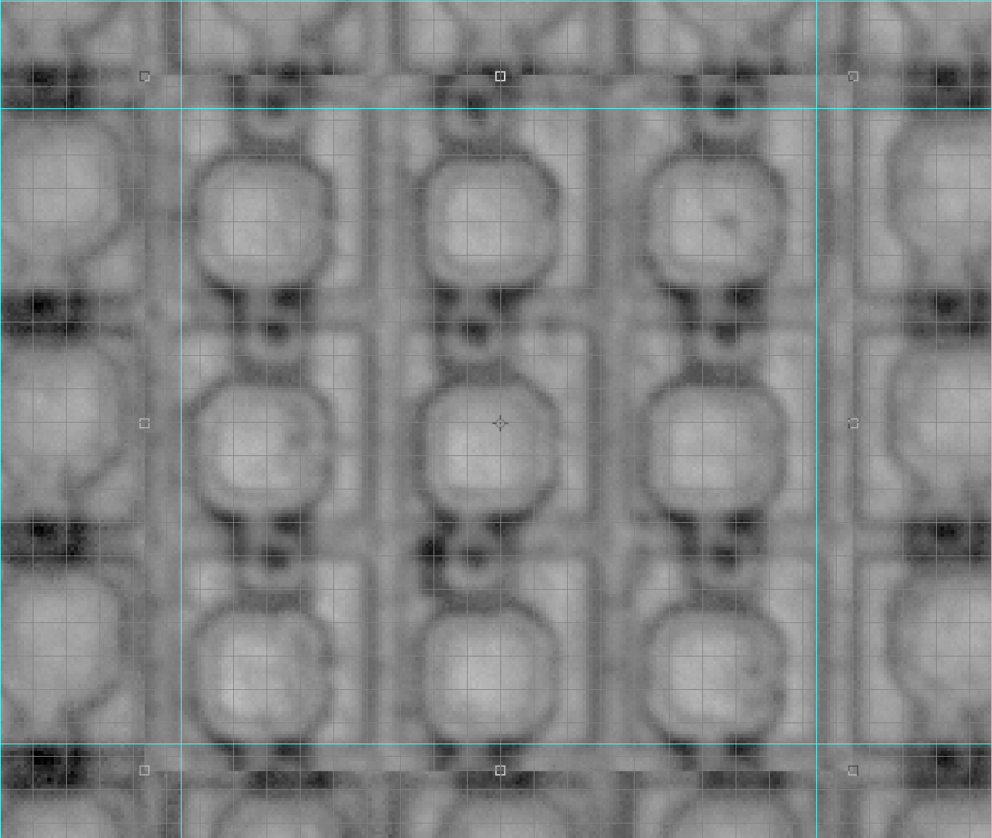
Lens Distortion
Check Superposing the Same Picture
Bottom left part of the picture
Top right corner pasted on top of bottom left
Notes:
ultimate track recording rate was 5 Mtracks/s and was limited only by the beam intensity that the SPS could provide

Slide 6
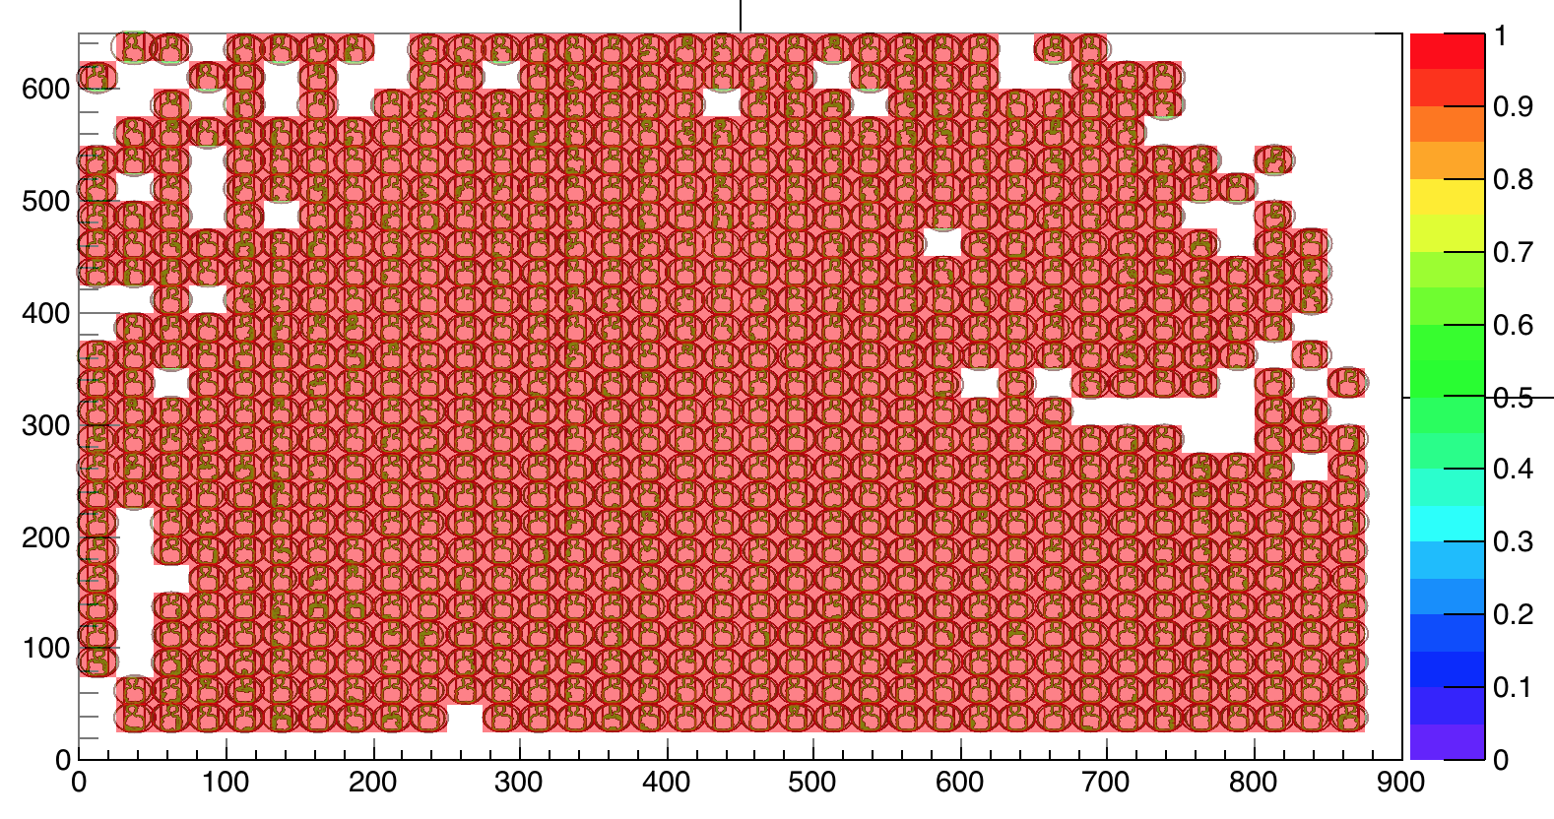
Lens Distortion
”Digitizing” the pixel information - CHIP
Picture Y position [um]
Picture X position [um]
Notes:
ultimate track recording rate was 5 Mtracks/s and was limited only by the beam intensity that the SPS could provide

Slide 7
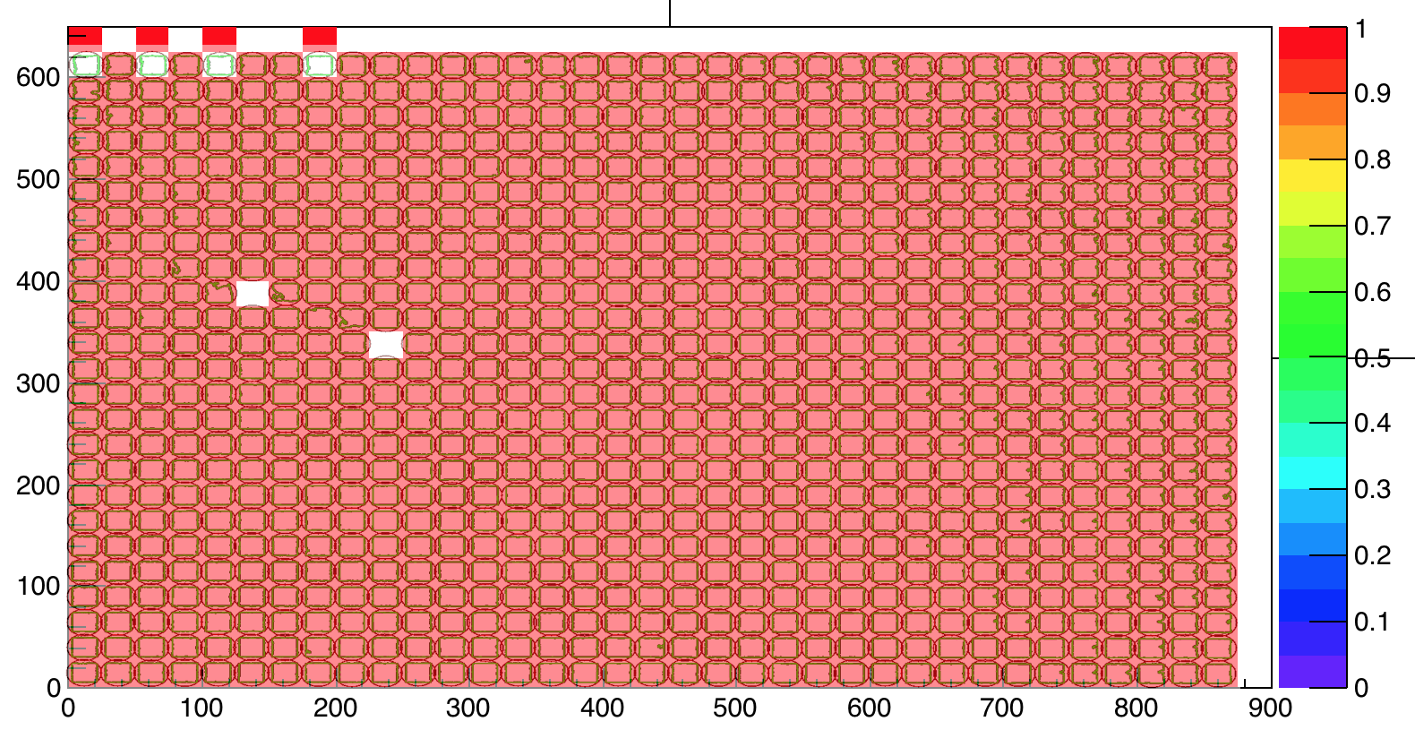
Lens Distortion
”Digitizing” the pixel information - SUB
Picture Y position [um]
Picture X position [um]
Notes:
ultimate track recording rate was 5 Mtracks/s and was limited only by the beam intensity that the SPS could provide

Slide 8
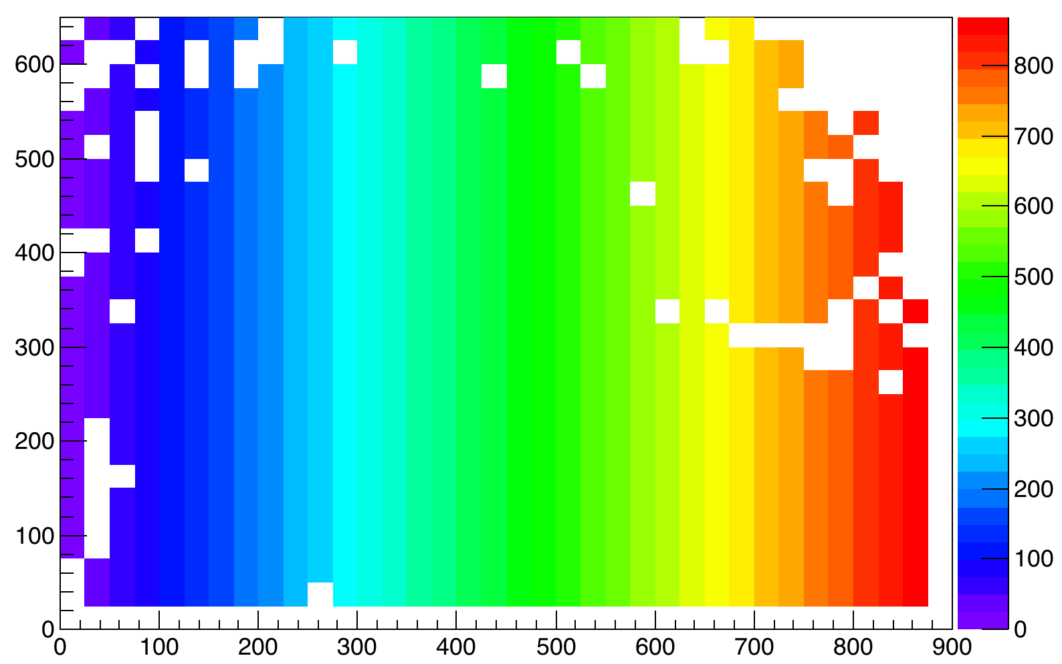
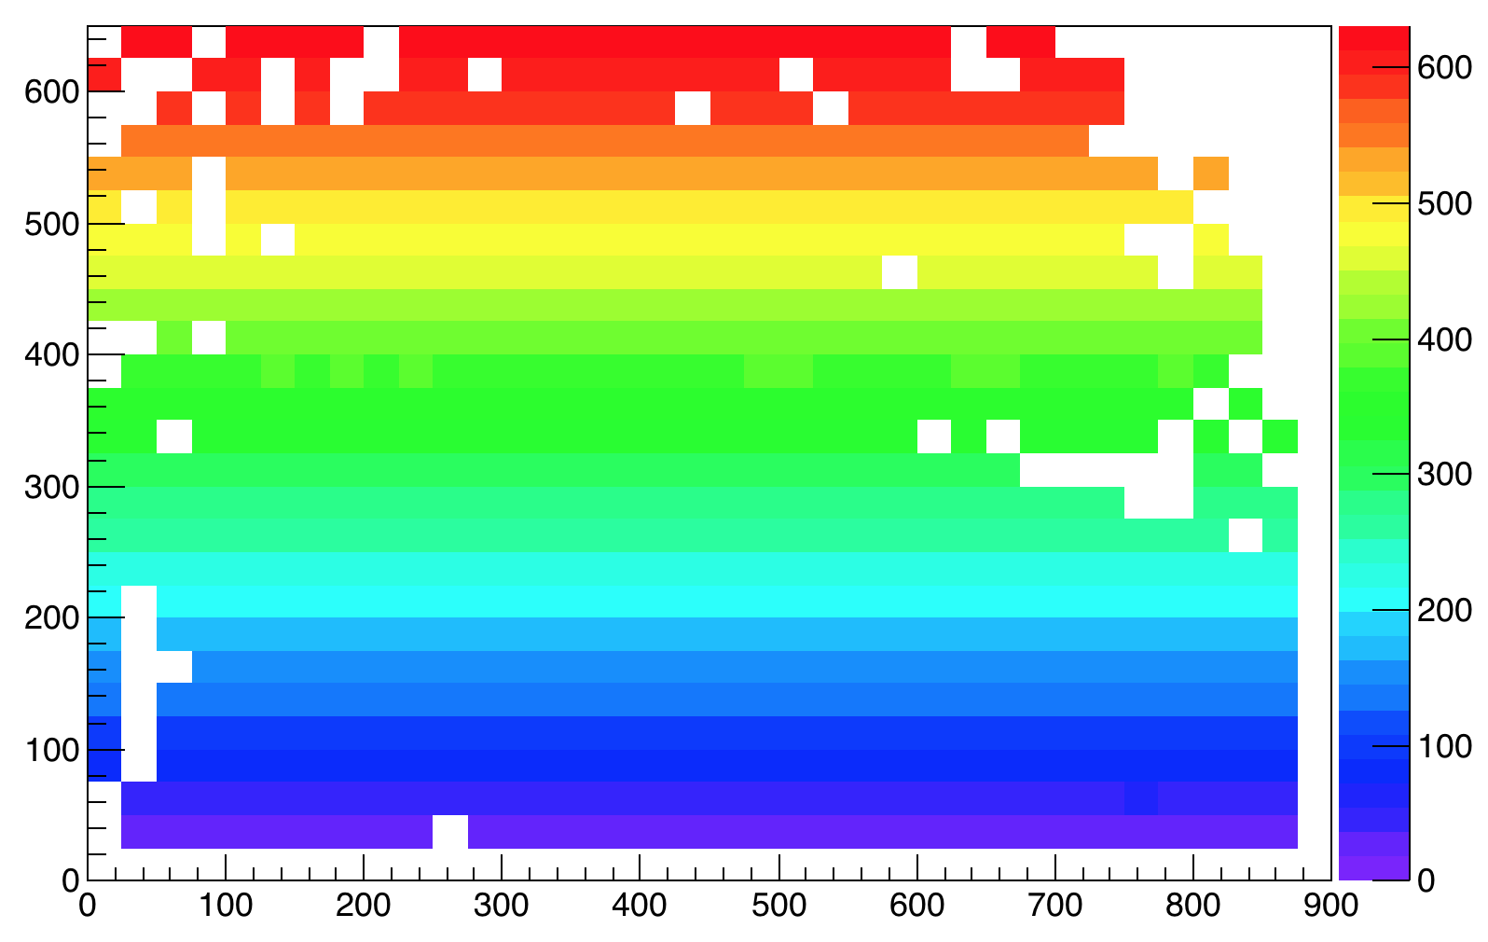
Lens Distortion
”Digitizing” the pixel information - CHIP
Storing the pixel X and Y position in a histogram
  Much easier to handle than a vector!
Pixel X Position [um]
Pixel Y Position [um]
Picture Y position [um]
Picture Y position [um]
Picture X position [um]
Picture X position [um]
Notes:
ultimate track recording rate was 5 Mtracks/s and was limited only by the beam intensity that the SPS could provide

Slide 9

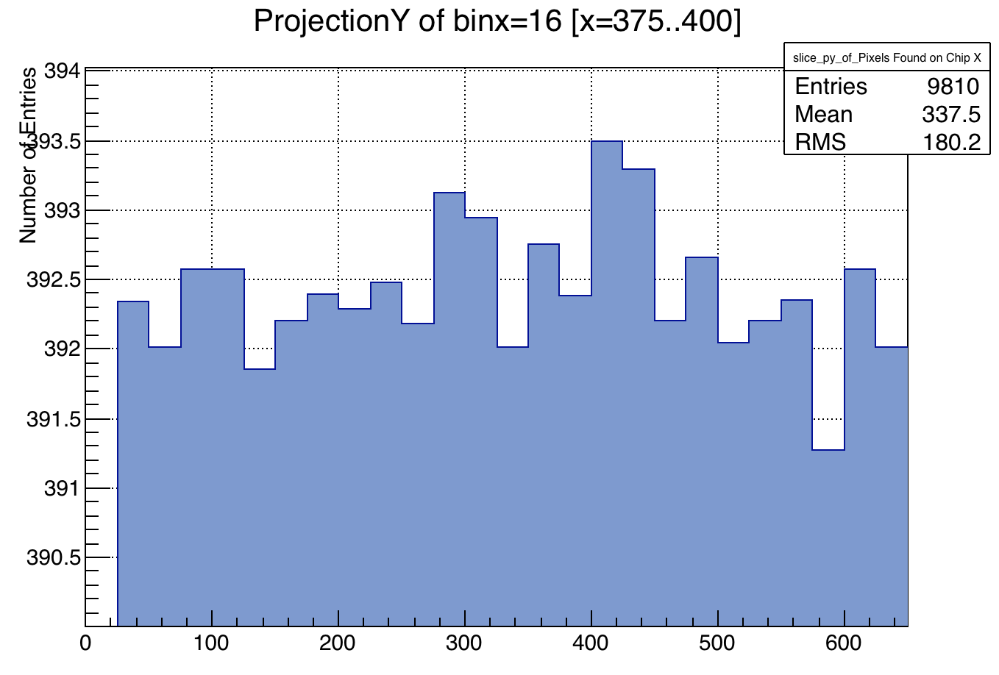
Lens Distortion
”Digitizing” the pixel information - CHIP
Storing the pixel X and Y position in a histogram
  Much easier to handle than a vector!
Pixel X Position [um]
Picture Y position [um]
Picture X position [um]
Picture X position [um]
Picture Y position [um]
Notes:
ultimate track recording rate was 5 Mtracks/s and was limited only by the beam intensity that the SPS could provide

Slide 10
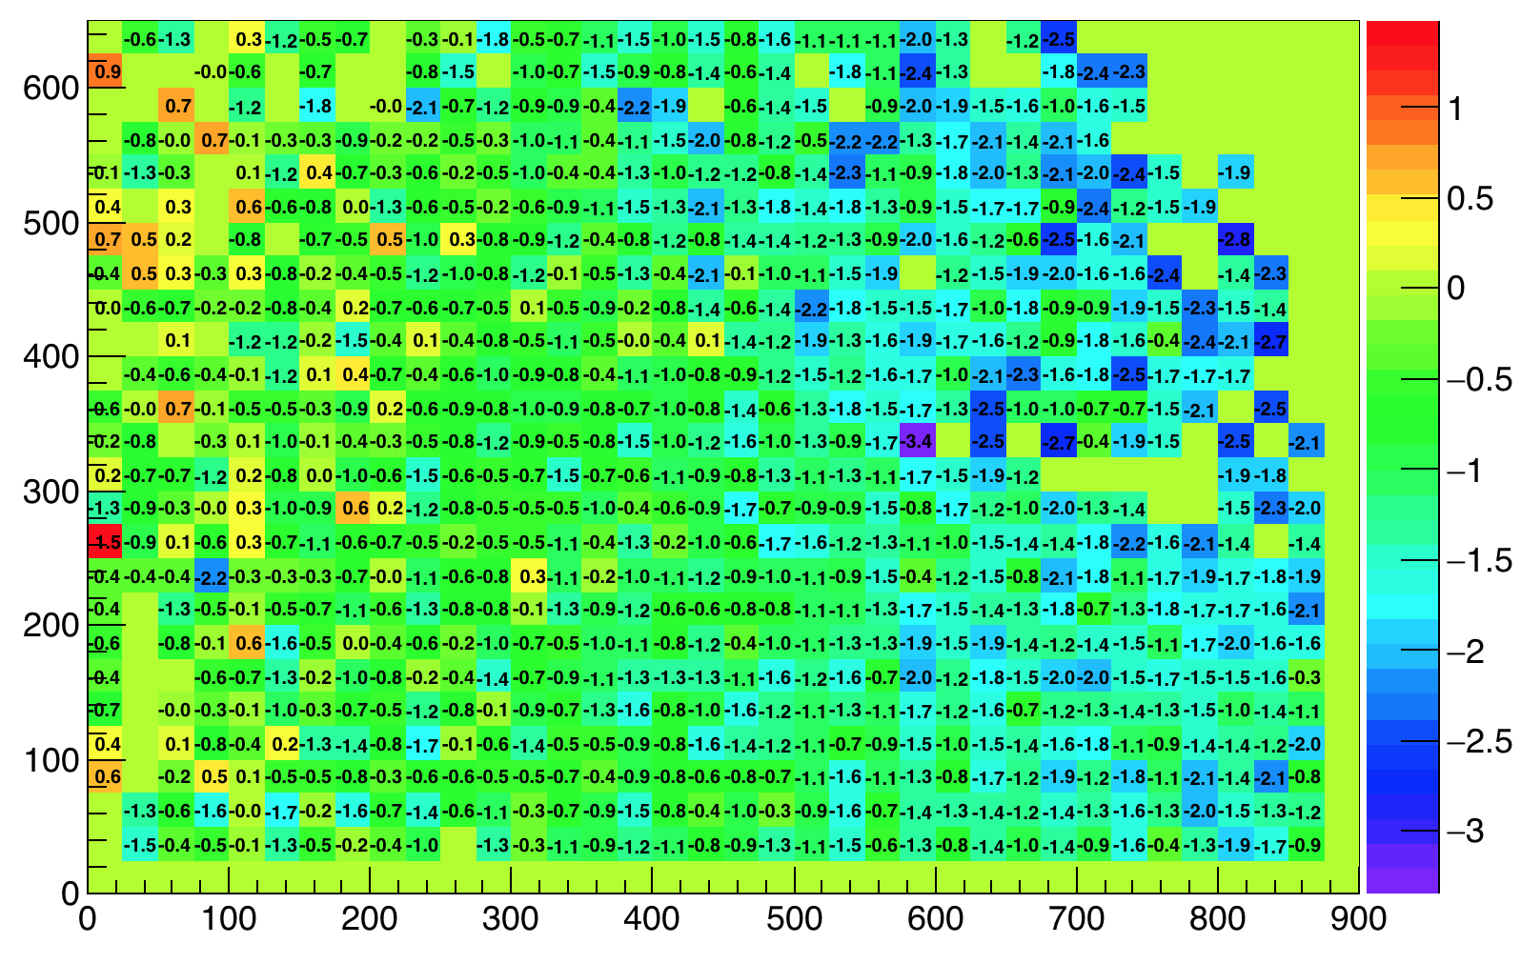
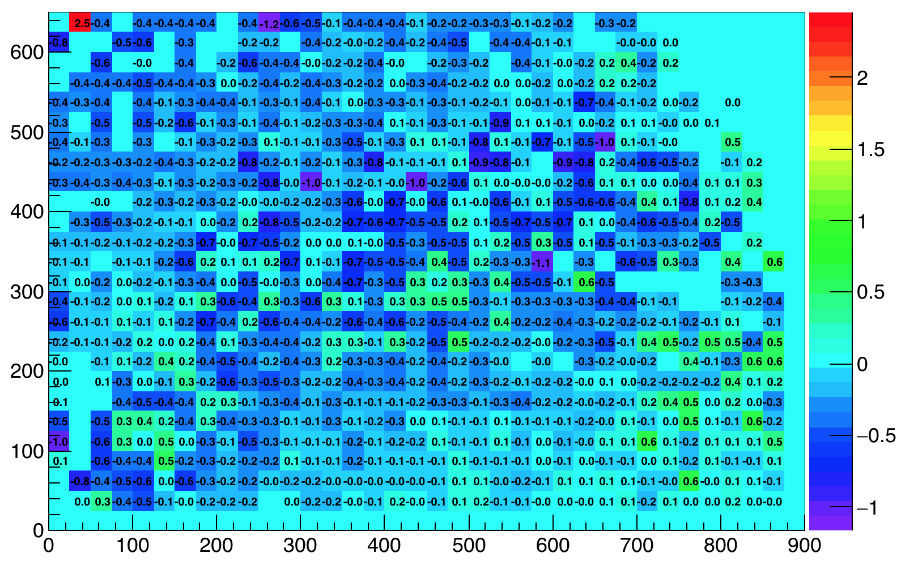
Lens Distortion
”Digitizing” the pixel information - CHIP
Storing the pixel X and Y position in a histogram
  Offset = Pixel X,Y position – bin_address_position*25um
Pixel X Offset [um]
Pixel Y Offset [um]
Picture Y position [um]
Picture Y position [um]
Picture X position [um]
Picture X position [um]
Notes:
ultimate track recording rate was 5 Mtracks/s and was limited only by the beam intensity that the SPS could provide

Slide 11
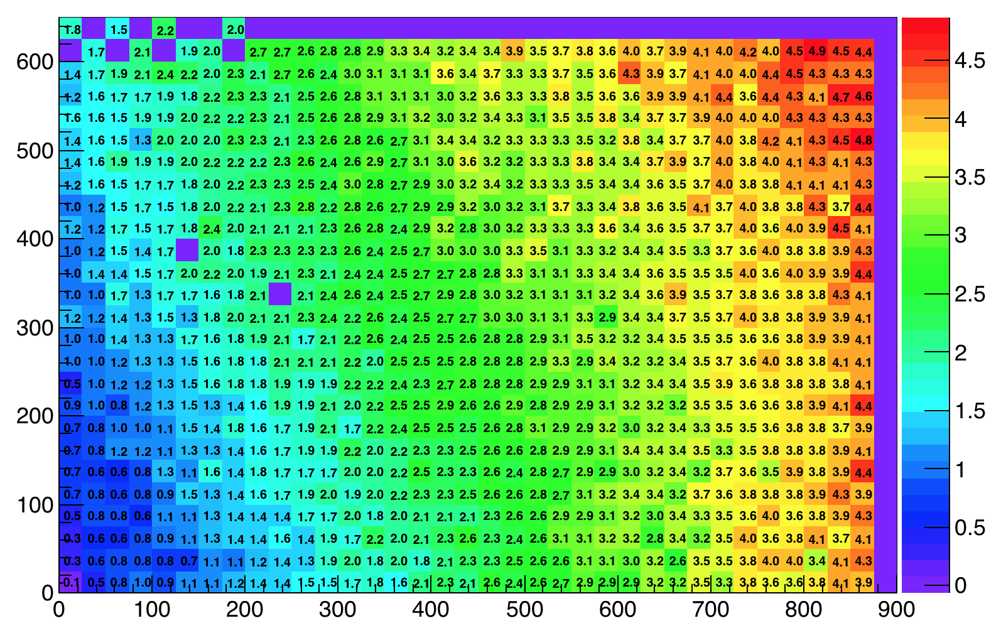
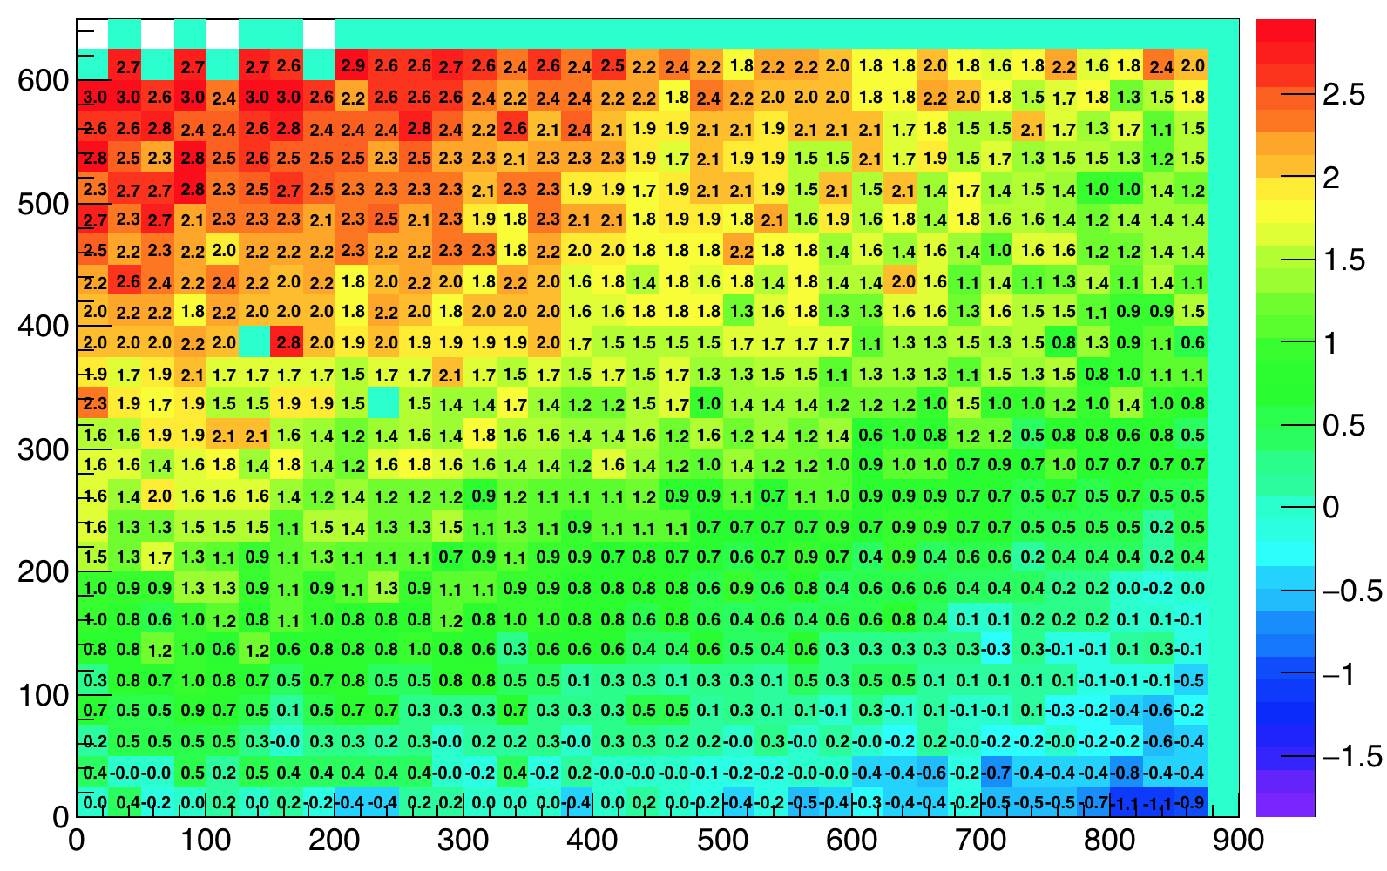
Lens Distortion
”Digitizing” the pixel information - SUB
Storing the pixel X and Y position in a histogram
  Offset = Pixel X,Y position – bin_address_position*25um
Pixel X Offset [um]
Pixel Y Offset [um]
Picture Y position [um]
Picture Y position [um]
Picture X position [um]
Picture X position [um]
Notes:
ultimate track recording rate was 5 Mtracks/s and was limited only by the beam intensity that the SPS could provide

Slide 12
Lens Distortion
Correcting for the distortion - Idea
Fit a 2D function describing the distortion
  Correct X,Y measured pixel position with known X,Y offset
SUB X distortion
Notes:
ultimate track recording rate was 5 Mtracks/s and was limited only by the beam intensity that the SPS could provide

Slide 13
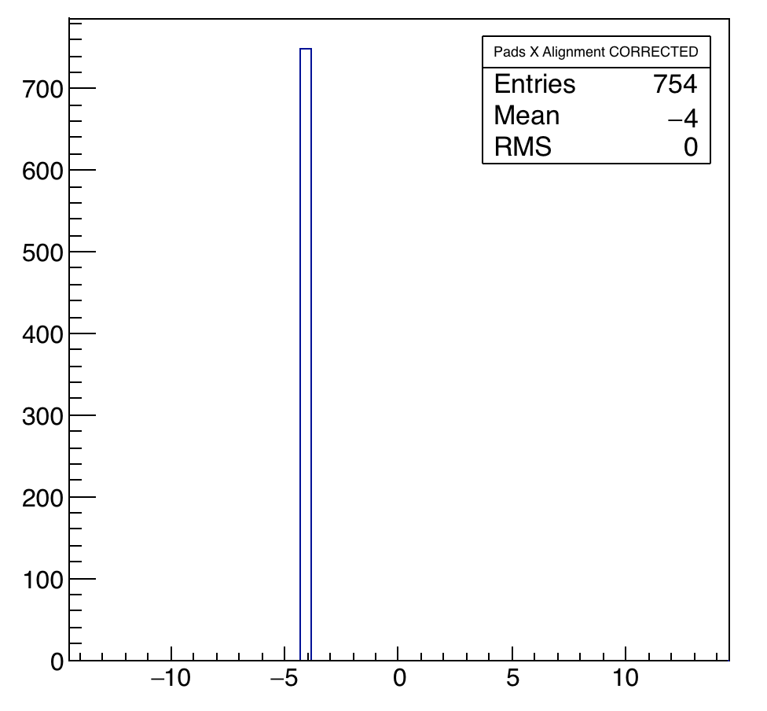
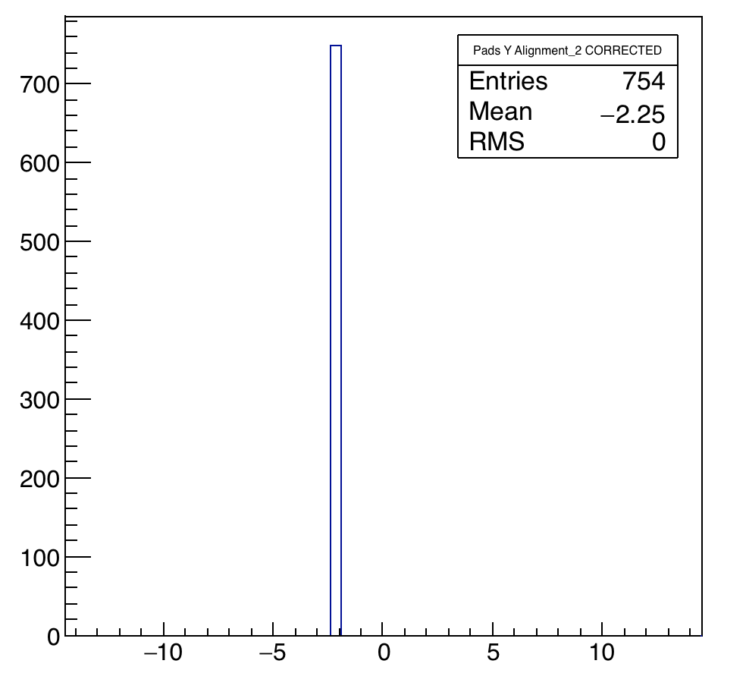
Lens Distortion
Correcting for the distortion - Result
PRELIMINARY!!!
Pads Horizontal Distance [um]
Pads Vertical Distance [um]
Notes:
ultimate track recording rate was 5 Mtracks/s and was limited only by the beam intensity that the SPS could provide

Slide 14
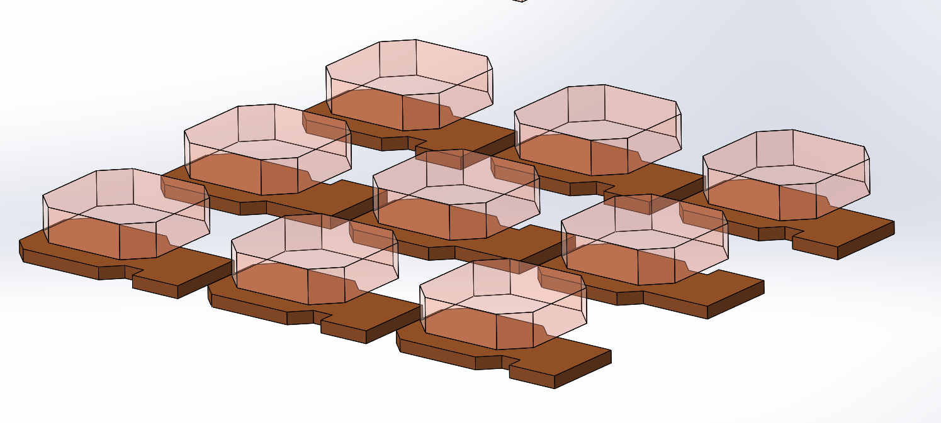
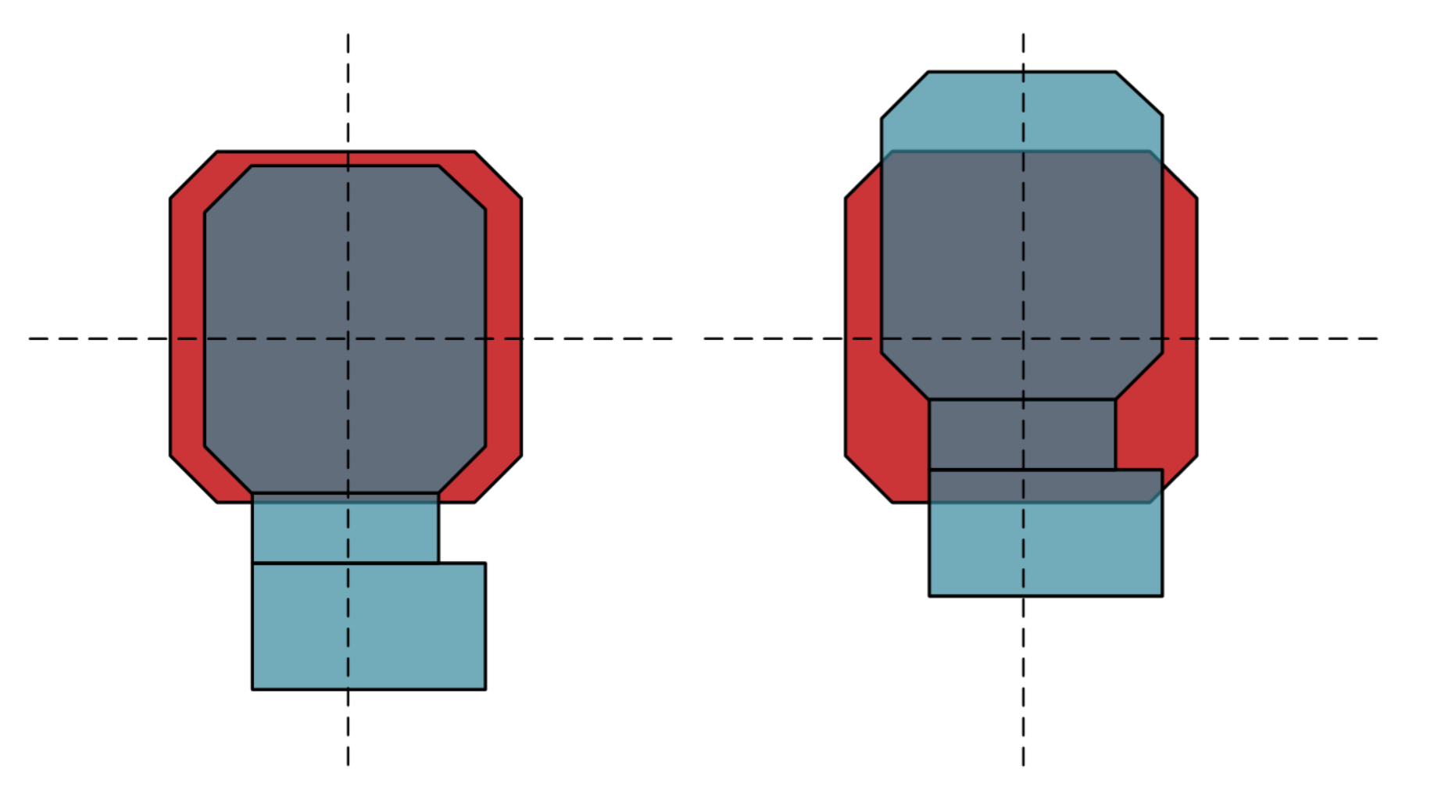
Chips Alignment
Two proposals
Two alignment marks on the two sides of the chips
  two different implementations of the alignment
A
”Pad Alignment”
B
”Ideal Alignment”
Pixel pads
Used for Cross
Section Measurements
on early assemblies
Used For Test Beam
on later samples
Notes:
ultimate track recording rate was 5 Mtracks/s and was limited only by the beam intensity that the SPS could provide

Slide 15
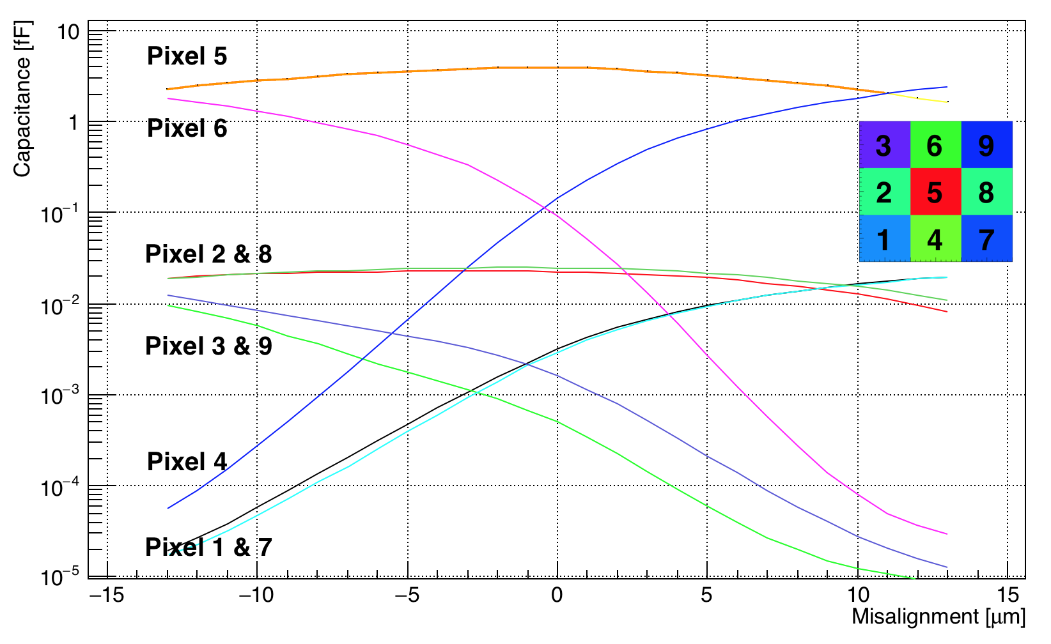
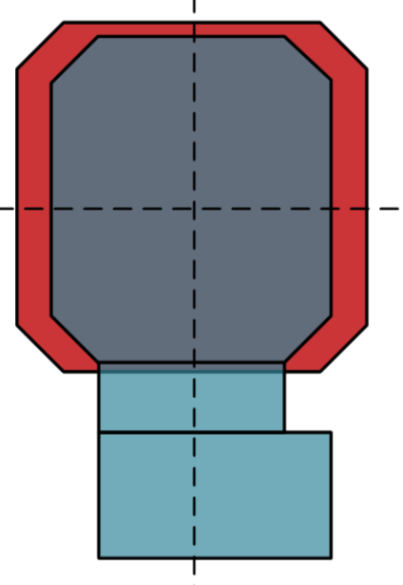
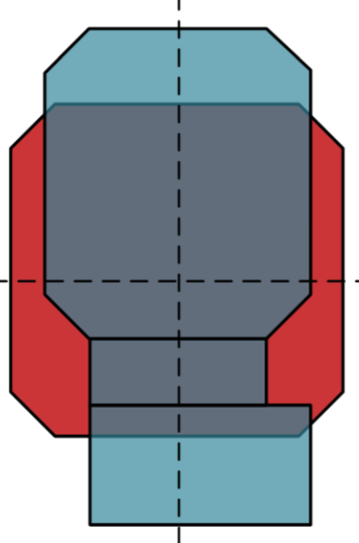
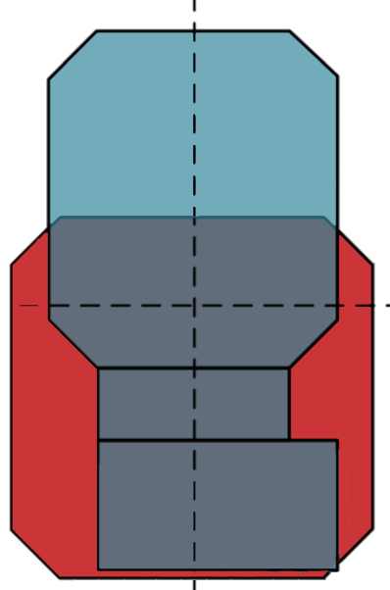
Effect of Y-direction Misalignment
Cross Pixel Coupling
Notes:
ultimate track recording rate was 5 Mtracks/s and was limited only by the beam intensity that the SPS could provide

Slide 16
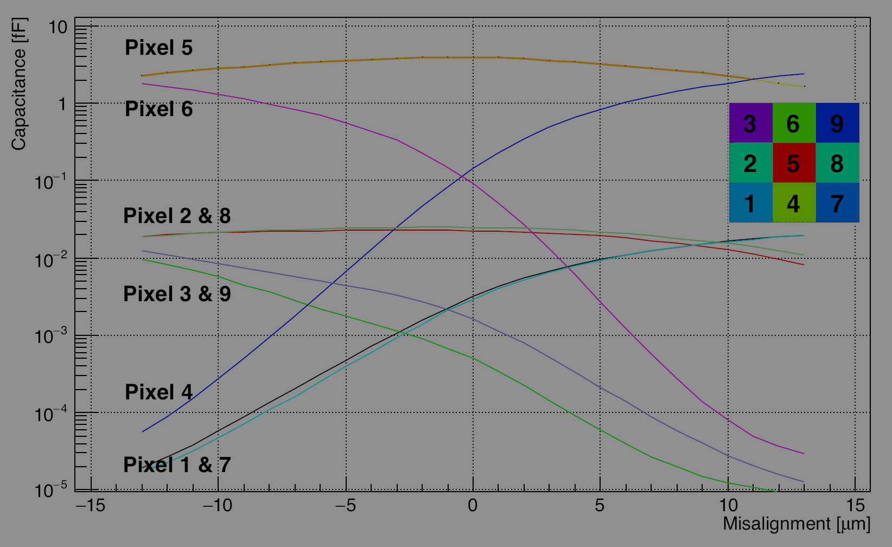
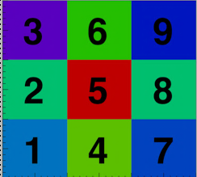

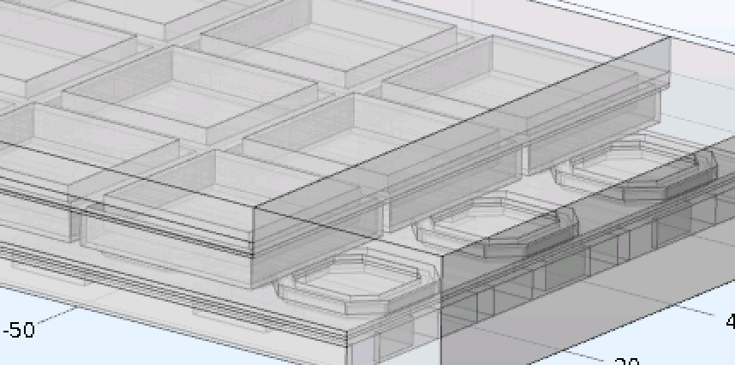
Effect on Y-direction Misalignment
Cross Pixel Coupling (PRELIMINARY!)
Notes:
ultimate track recording rate was 5 Mtracks/s and was limited only by the beam intensity that the SPS could provide

Slide 17
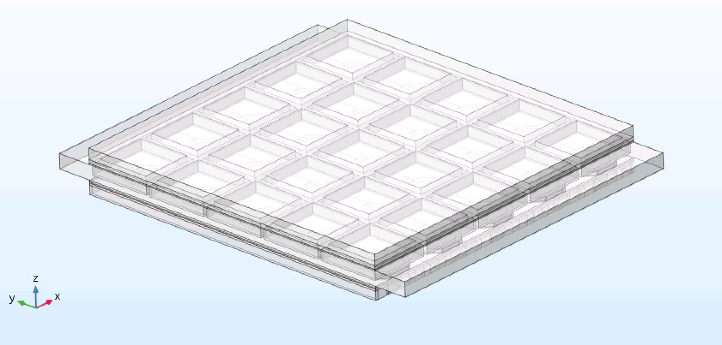
5x5 Matrix
Checking 3x3 central pixels
Notes:
ultimate track recording rate was 5 Mtracks/s and was limited only by the beam intensity that the SPS could provide

Slide 18
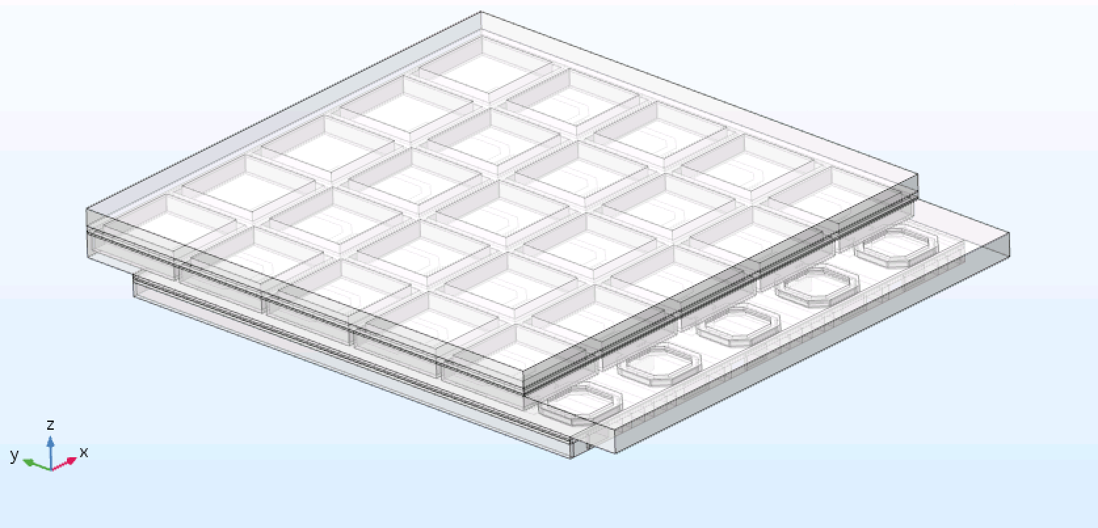
5x5 Matrix
Checking 3x3 central pixels
Notes:
ultimate track recording rate was 5 Mtracks/s and was limited only by the beam intensity that the SPS could provide

Slide 19
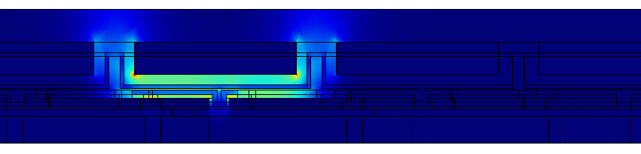
5x5 Matrix
Checking 3x3 central pixels
Notes:
ultimate track recording rate was 5 Mtracks/s and was limited only by the beam intensity that the SPS could provide

Slide 20
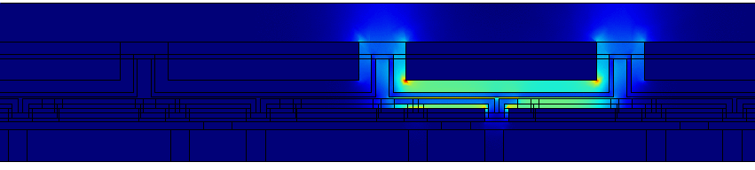
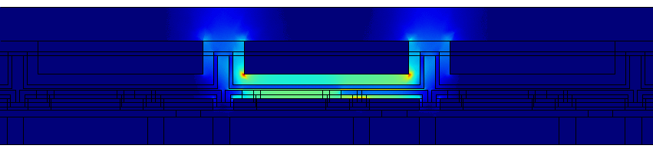
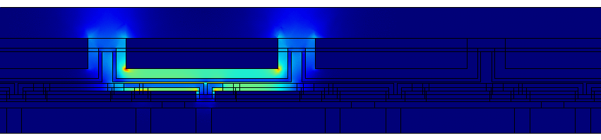
5x5 Matrix
Checking 3x3 central pixels
13 um
0 um
-13 um
Notes:
ultimate track recording rate was 5 Mtracks/s and was limited only by the beam intensity that the SPS could provide

Slide 21
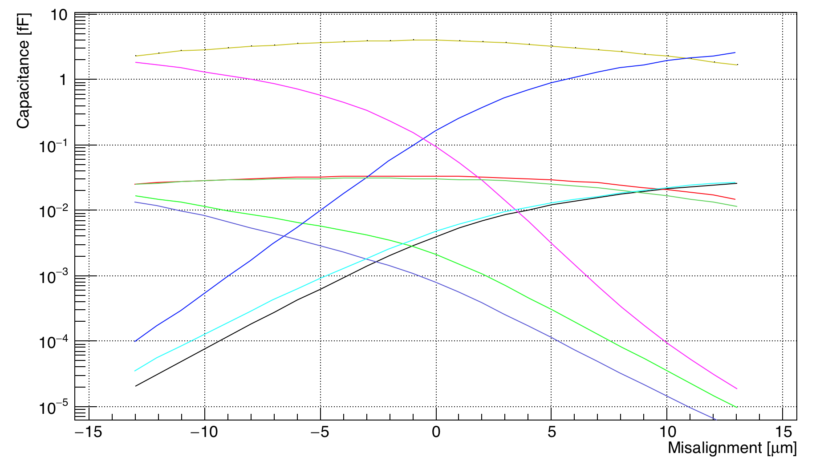
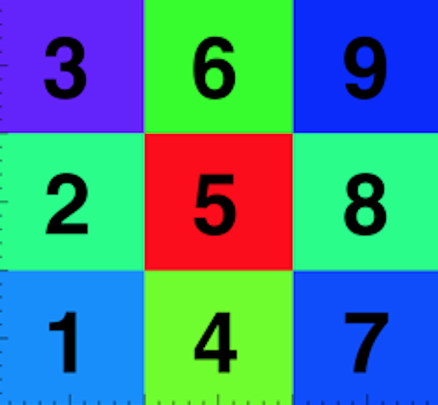
Effect on Y-direction Misalignment
Cross Pixel Coupling
Pixel 5
Pixel 6
Pixel 2 & 8
Pixel 3 & 9
Pixel 4
Pixel 1 & 7
Notes:
ultimate track recording rate was 5 Mtracks/s and was limited only by the beam intensity that the SPS could provide

Slide 22
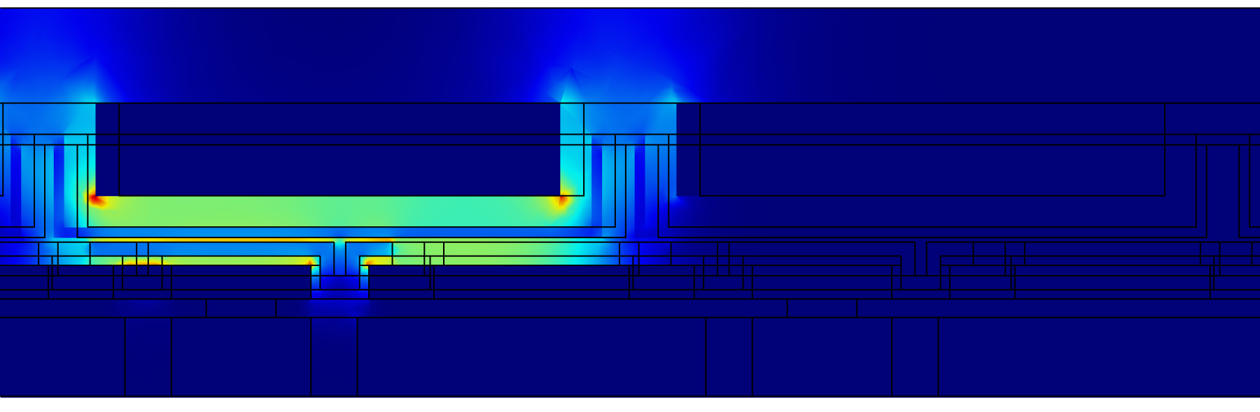
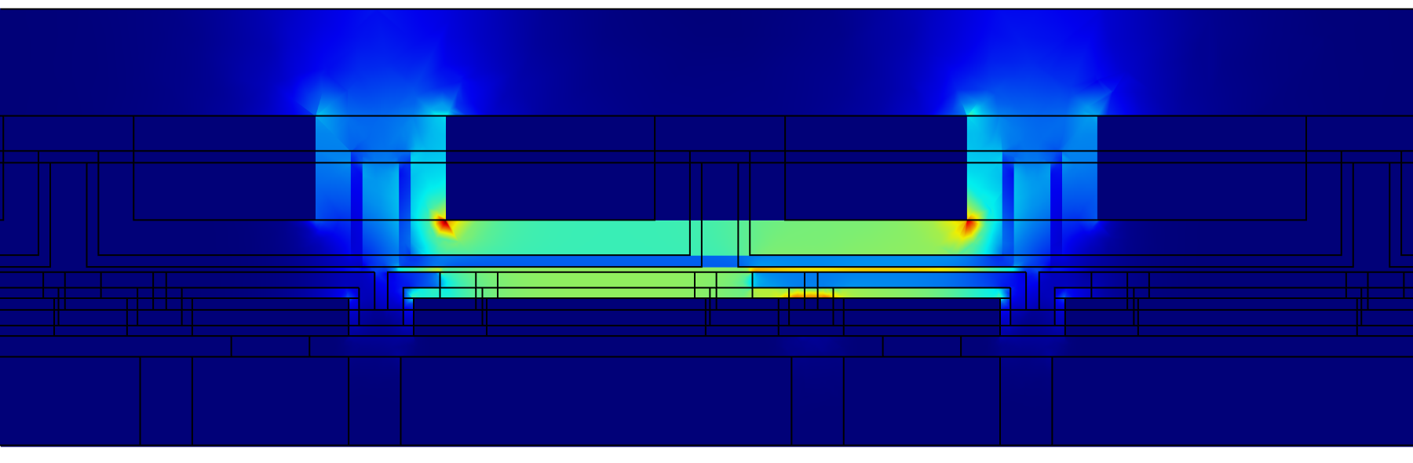
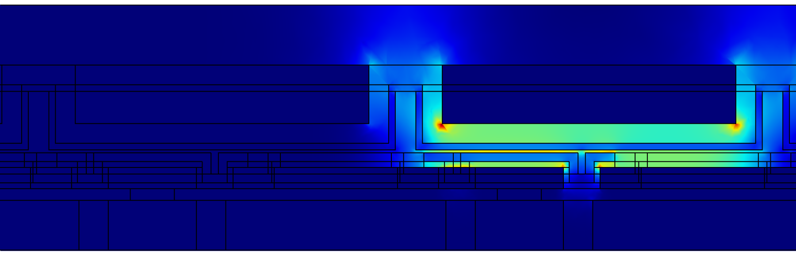
Conclusions and next steps
Flip-Chip machine lens correction
  Progress made on the lens distortion correction
  Offset from ideal position found per pixel
  Offset of pads distance, with the correction for the distortion, under investigation
Chip coupling new results
  Pixel coupling with different alignments
    Best alignment for smaller (asymmetric) cross talk: B
  5x5 pixels simulation similar to 3x3 matrix
  Analyze this effect in data from testbeam
Notes:
ultimate track recording rate was 5 Mtracks/s and was limited only by the beam intensity that the SPS could provide

