Slide 1



Slide 2
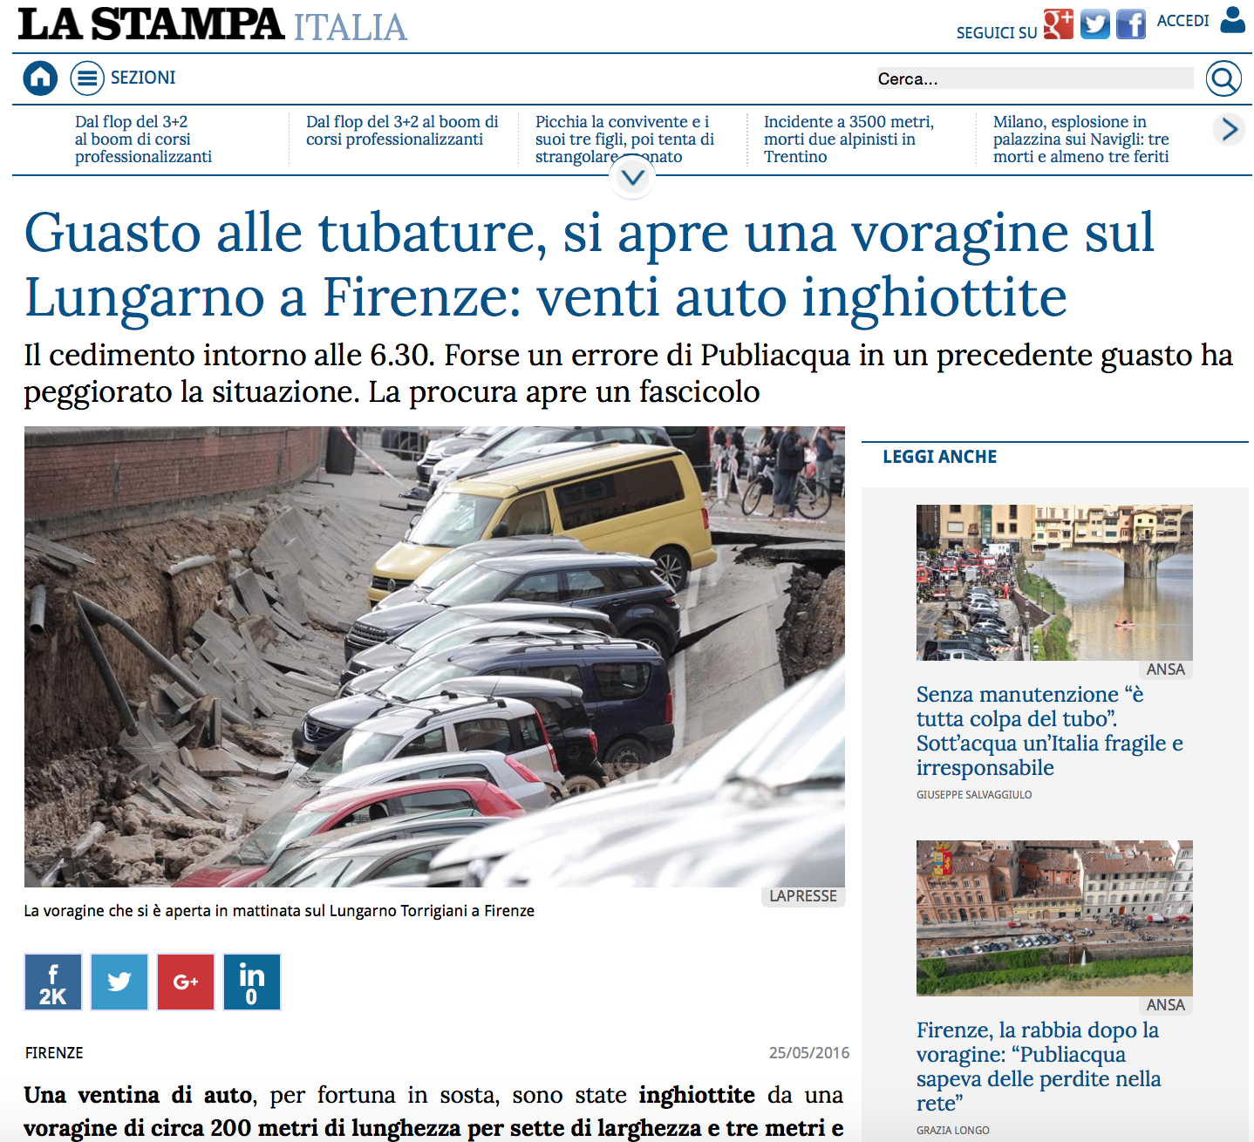
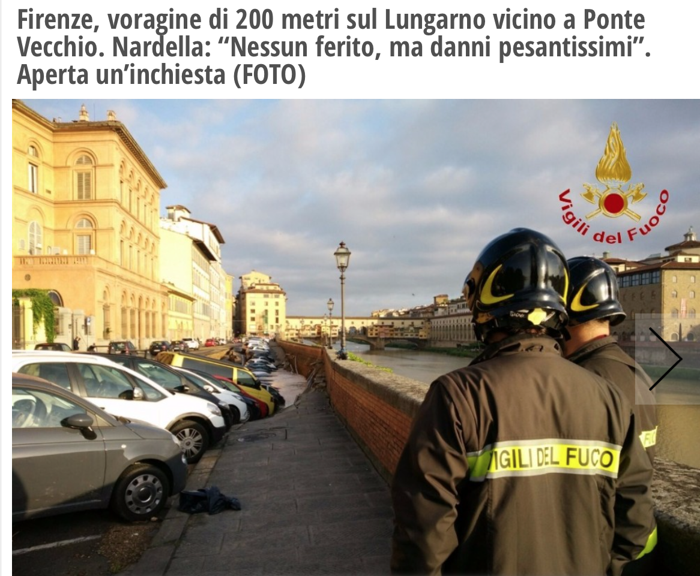
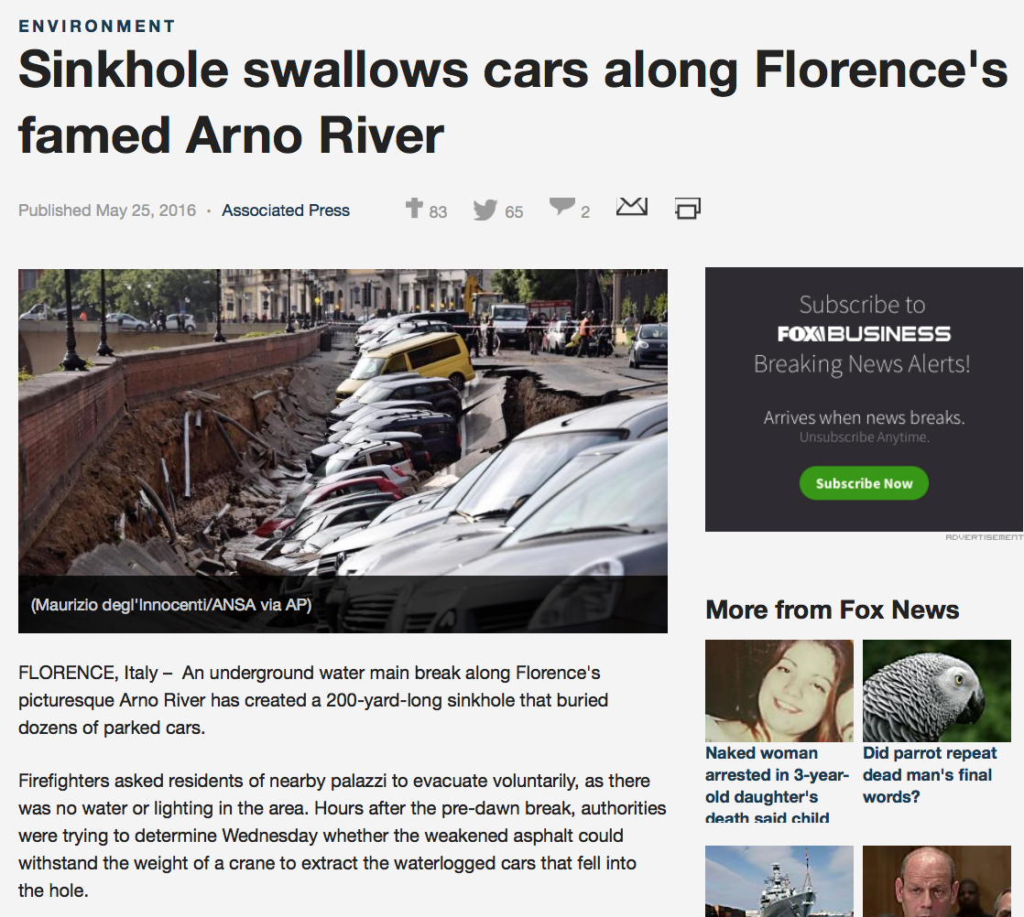

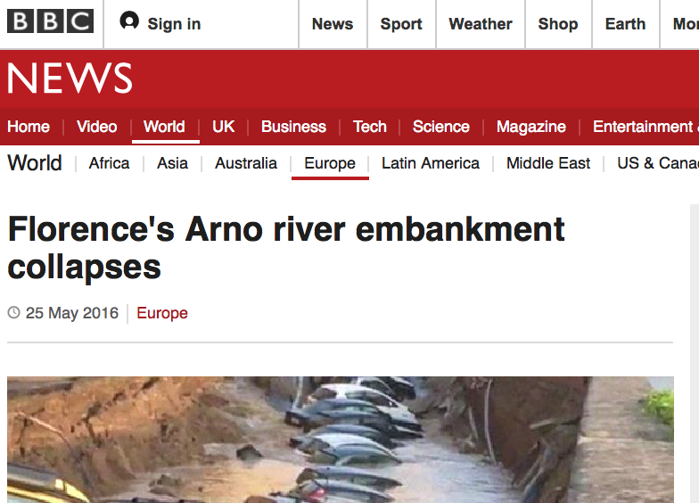
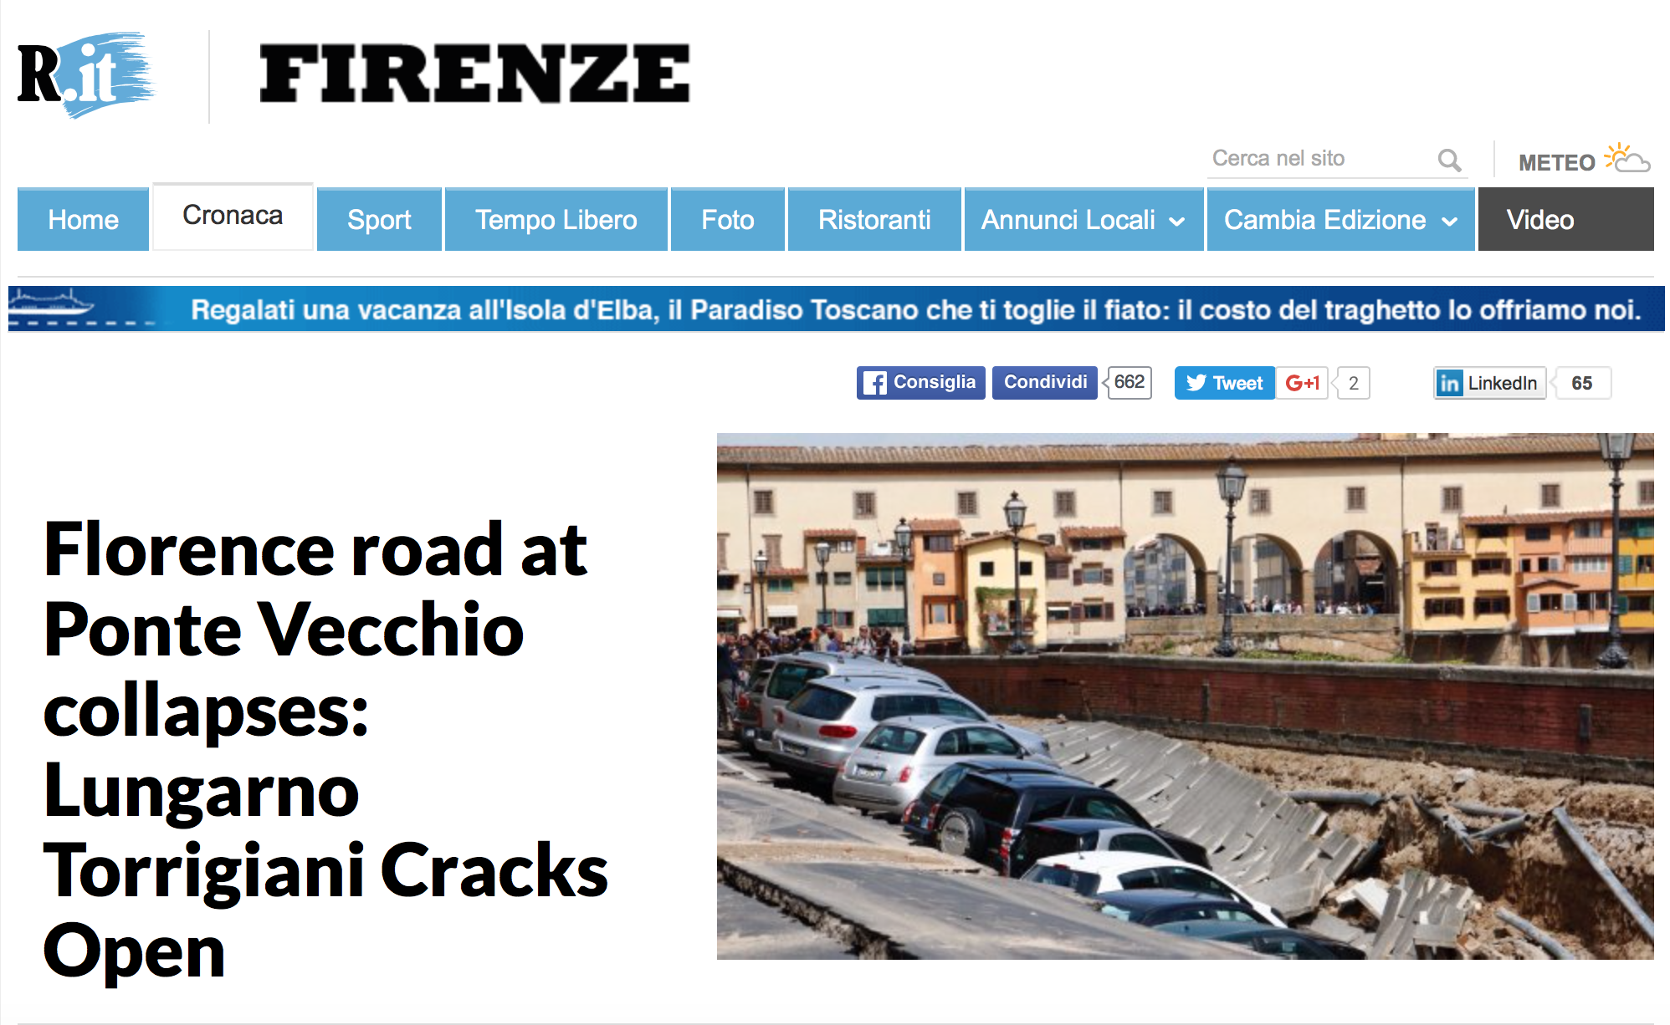
There is a problem…

Slide 3
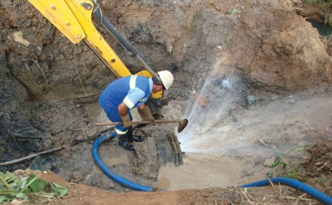
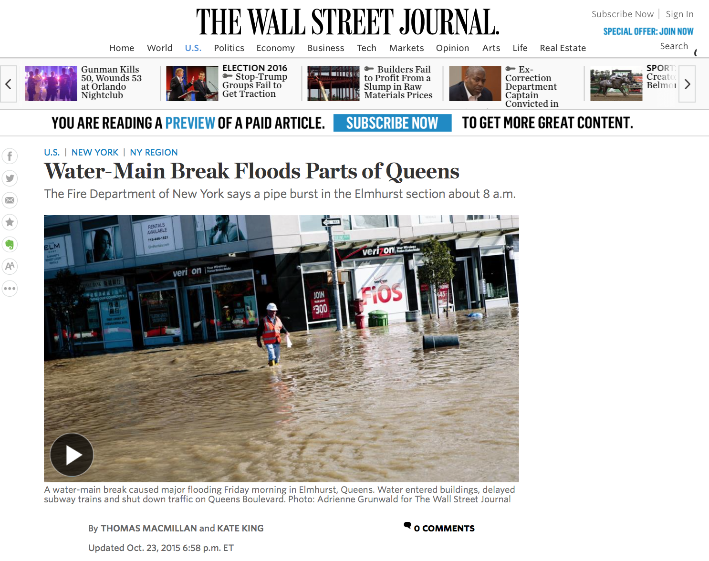
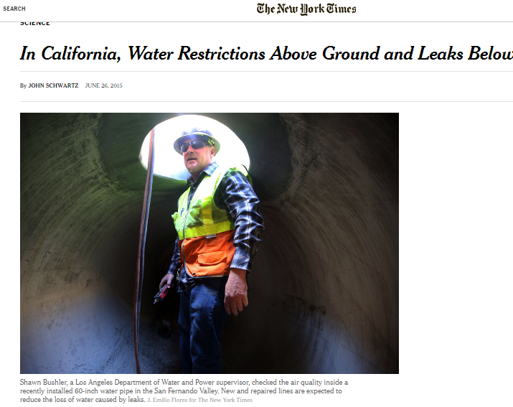
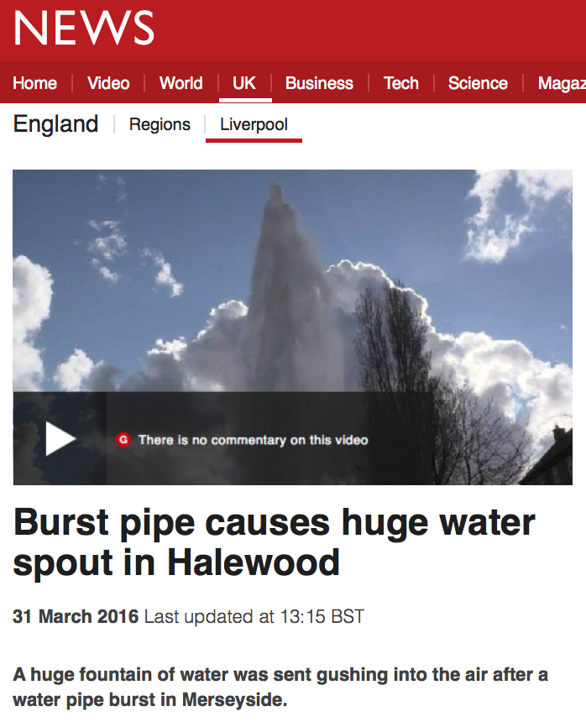
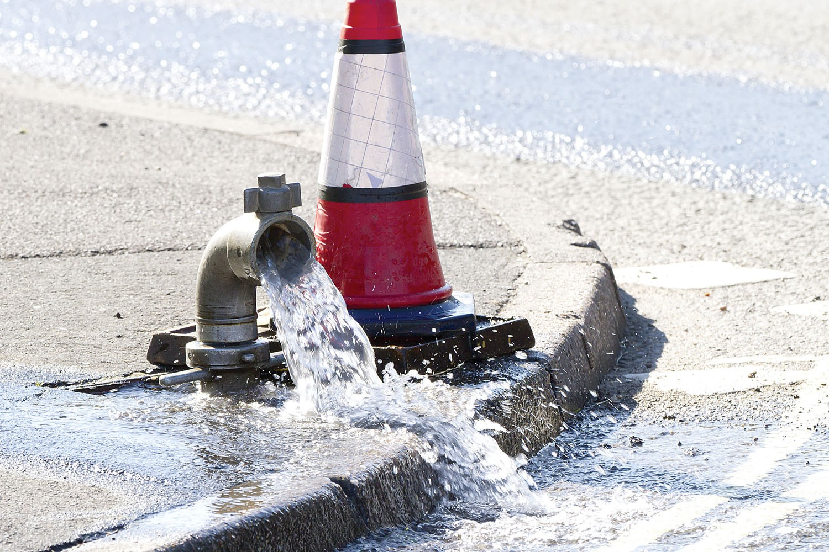
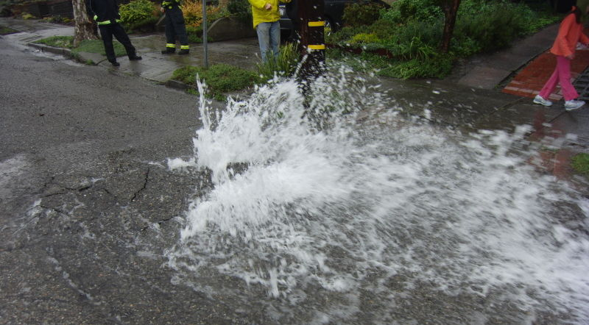
… And it’s global

Slide 4
… And it’s global
1 in 5 people
Don’t have access
to safe drinkable water

Slide 5
… And it’s global
We are going to run
out of water
Before we run out of Oil

Slide 6


Market trends
60B€
40#
Water losses (worldwide)
Megacities by 2025 (worldwide)

Slide 7
Solution
AquaSmart allows water utilities metering their water flows in real time and detecting potential leakages
Save money & Energy
For Utilities
Reduce Losses
Of drinkable water
Safer
Cities
For people

Slide 8
Product

Slide 9
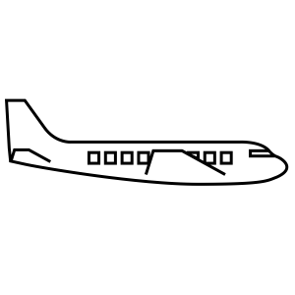















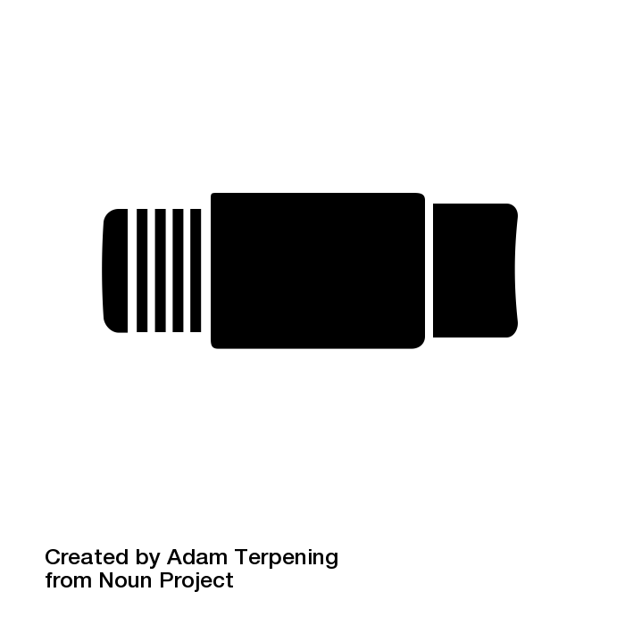
WELCOME TO AQVA CITY
WATER UTILITY
Flow rate
Pressure

Slide 10









Slide 11
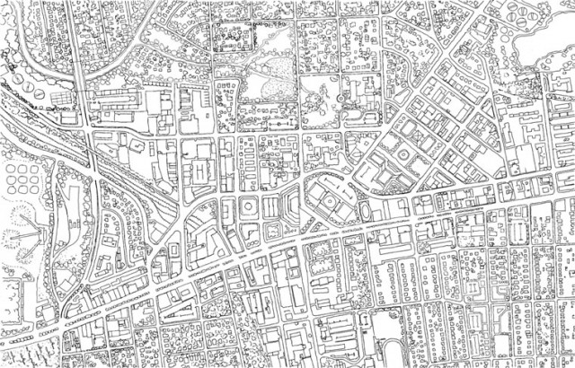


WELCOME TO AQVA CITY
AQVA CITY MAP
WATER UTILITY

Slide 12
WELCOME TO AQVA CITY
1
Input water volume metering
WATER UTILITY
WATER UTILITY
Flow rate
Pressure

Slide 13

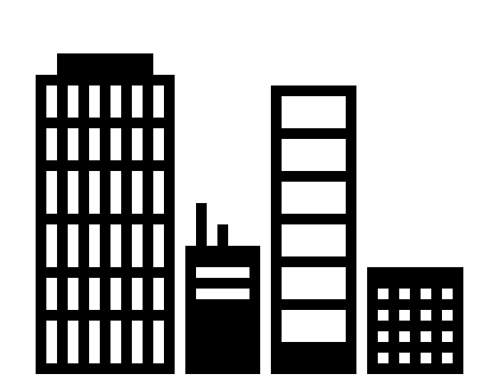
2
Real-time data collection

Slide 14


WELCOME TO AQVA CITY
3
AQVA CITY MAP
WATER UTILITY
Data Analysis
MAP
SW

Slide 15

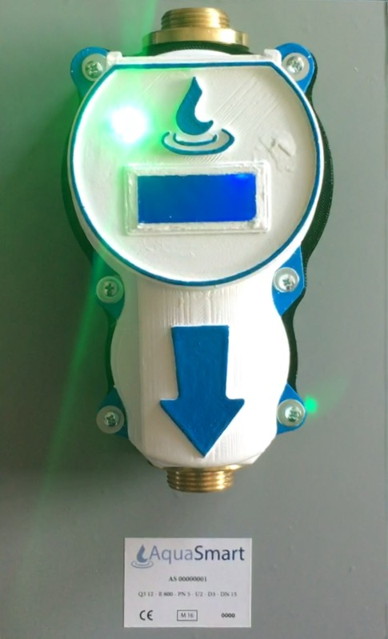
Business Model
Hardware + Software package
System Target Price = 120 € (per smart meter)
Worst case scenario: utility break-even = 3 years

Slide 16

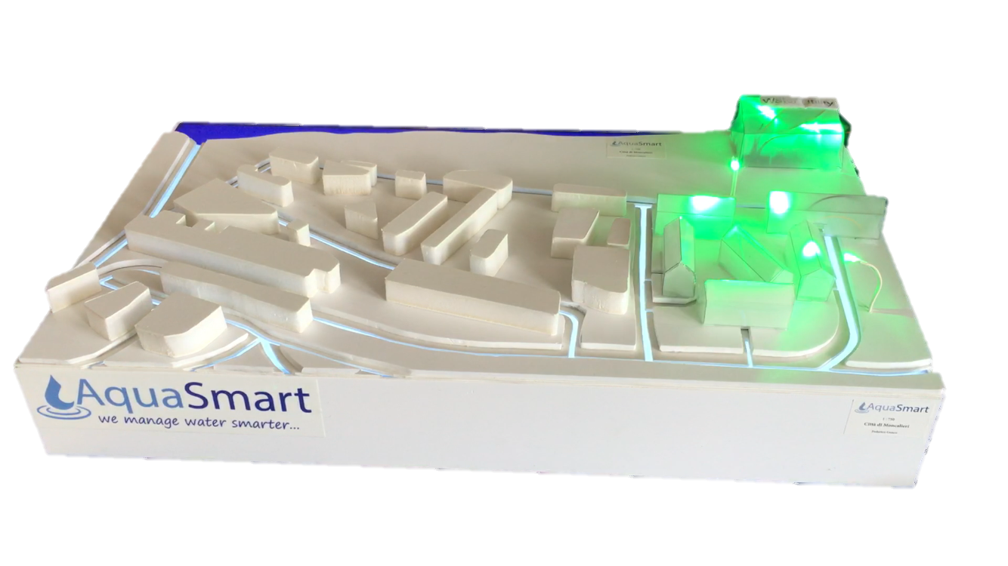


Market adoption
WHERE
Expansion to megacities
HOW
Adoption by networks of water utilities serving different areas/cities
Pilot case:
Moncalieri city
WHEN
24 months after Pilot case

Slide 17


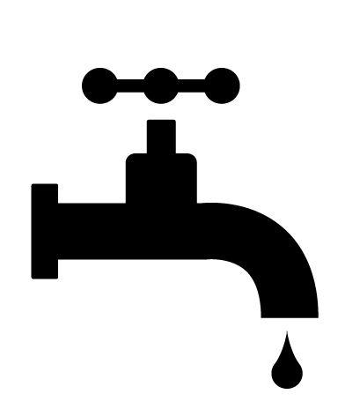
Competitive advantage
Plug & Play
Solution
Real Time
Data
Strong
Partnerships

Slide 18
Investment needs
50k€
200k€
Product prototypes &
software α
Products Pre-series & software β

Slide 19
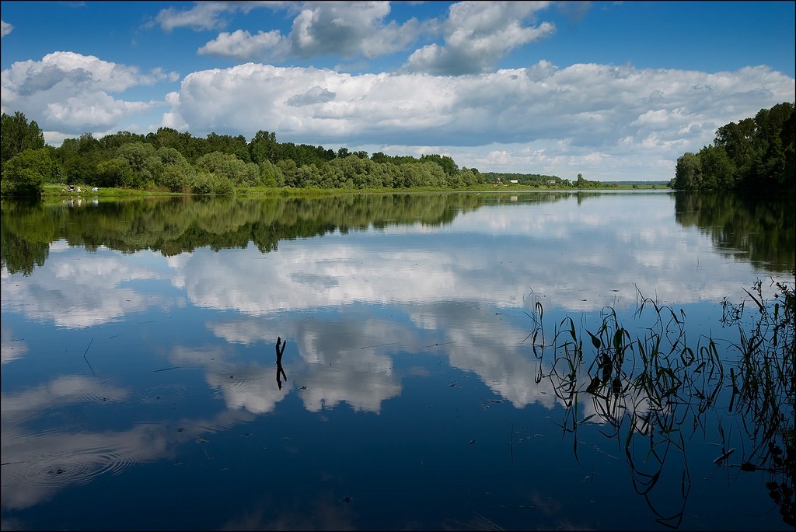

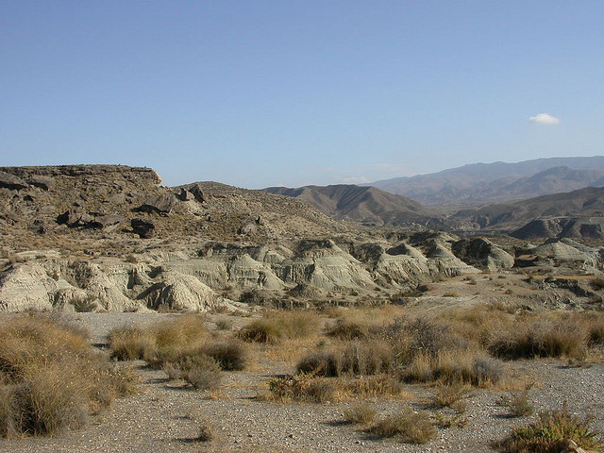
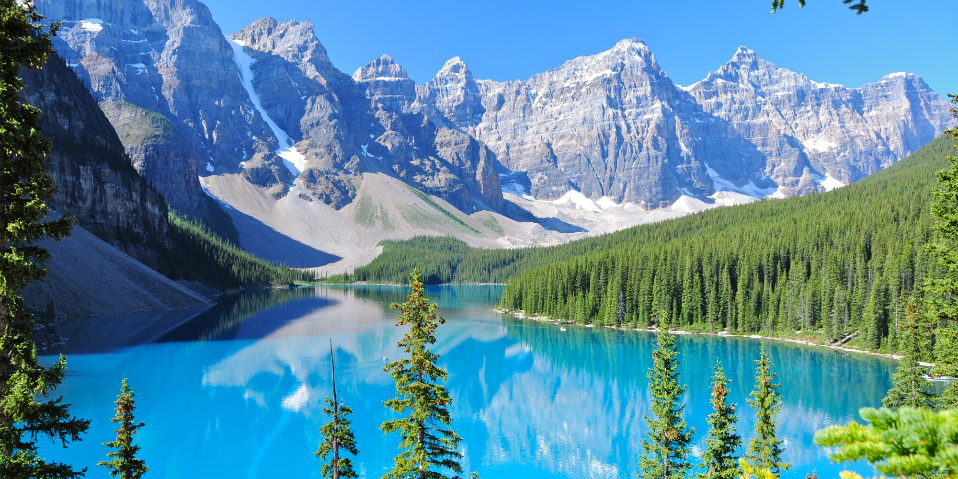
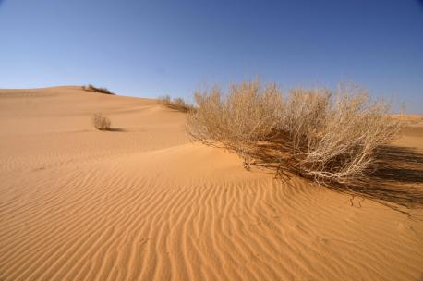
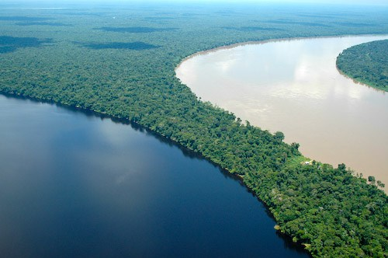
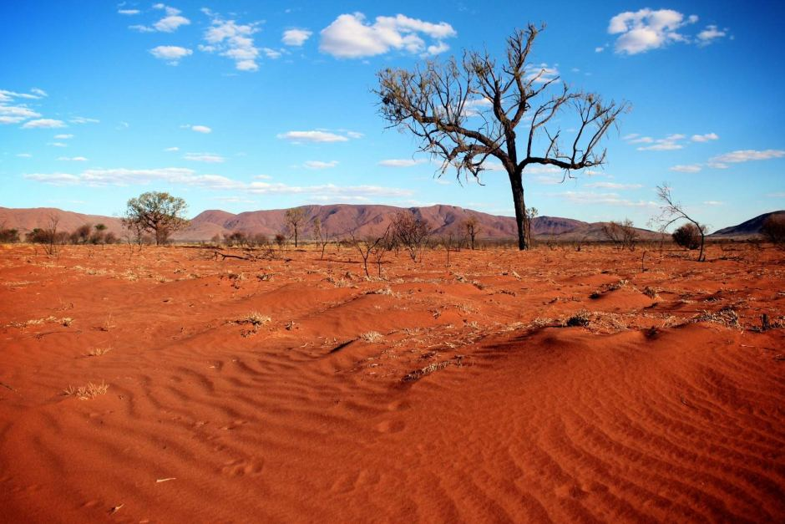
Water Globalisation

Slide 20

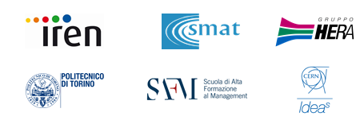

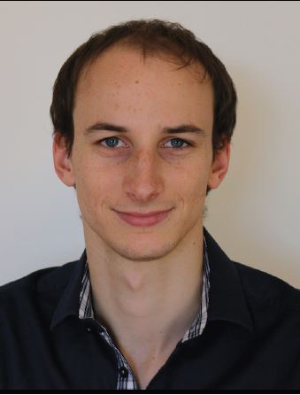






Our partners
Our sponsors
Our team
Davide Lora
Giulia Balmativola
Massimo
Verini
Alessandro Ferraris
Luigi Piccarreta
Luca
Venturini

Slide 21
Back-Up

Slide 22
20-20-20 development plan
Architectural solution prototype
Product prototypes and pilot
Water globalization
20 June
PROBLEM SOLVING
20 months
PREVISION
20 years
PREVENTION

Slide 23












Competition
service
prevention
detection
SW/HW

Slide 24
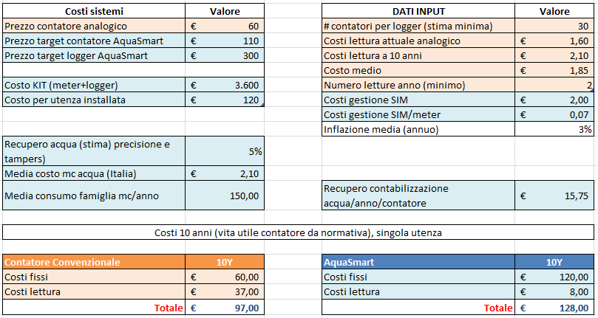
Business model validation

Slide 25
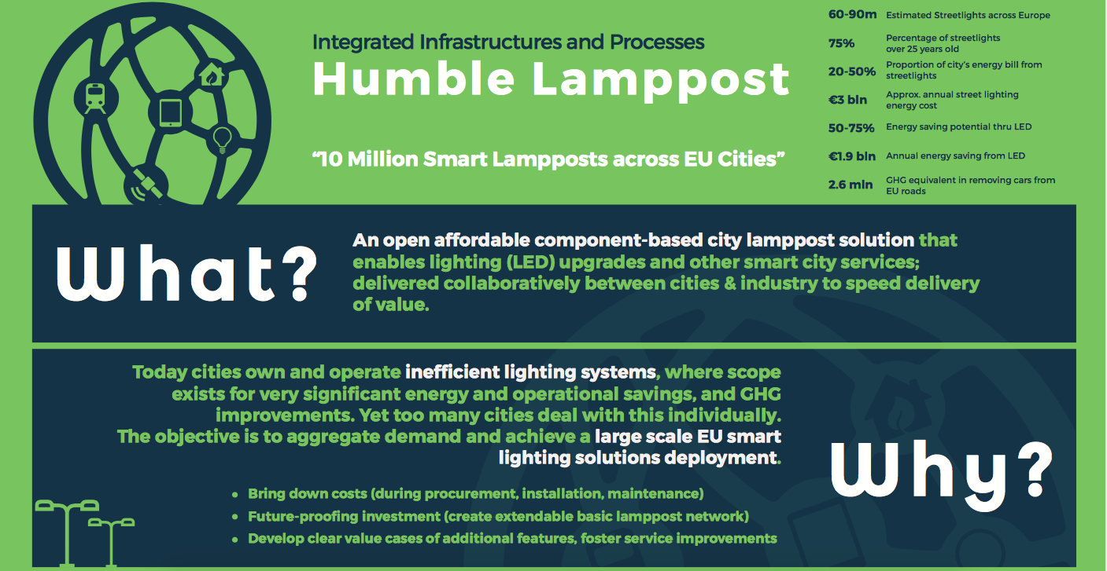
EU smartcities
https://eu-smartcities.eu/content/humble-lamppost

Slide 26
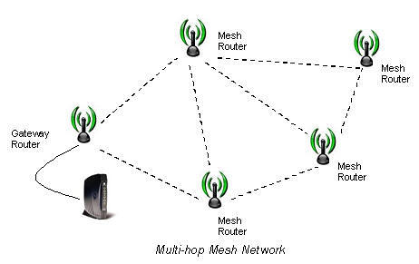
Multi-hop communication
A mesh network is a network topology in which each node relays data for the network. All mesh nodes cooperate in the distribution of data in the network.
Mesh networks can relay messages using either a flooding technique or a routing technique. With routing, the message is propagated along a path by hopping from node to node until it reaches its destination.

Slide 27
Current water providers costs
30%
Energy expenditures on total costs
60€
Installed smart meter cost
97€
Total current cost per utilities

Slide 28
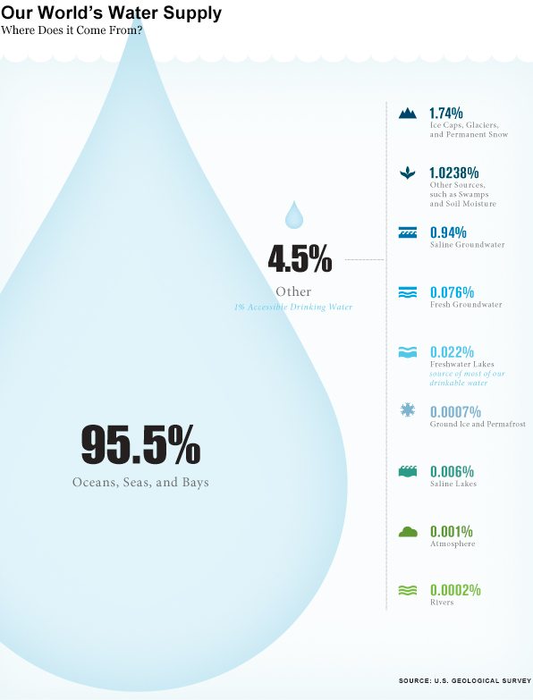
Water globalisation
Globalization trends have affected the water sector, most notably by opening it up to significant competition and external influences. Water privatization activity has increased since 1997. Although all geographic regions have seen some water privatization, it has occurred predominately in Latin America and the Asian and Pacific Basin regions.
The privatization of previously public assets generates revenue from sales and promotes greater efficiency from revamped operations while promoting profits for the new owners. As a basic necessity of modern life, many corporations view water as a good investment. In many places, past fiscal mismanagement of the public sector's provision of local water services has increased the appeal of privatization. On the other hand, privatization of water services has drawn criticism from those concerned with the accountability of large private corporations, the needs of the poor for basic services, and environmental integrity.
Read more: http://www.waterencyclopedia.com/Ge-Hy/Globalization-and-Water.html#ixzz4BwBJ63TP

