Slide 1
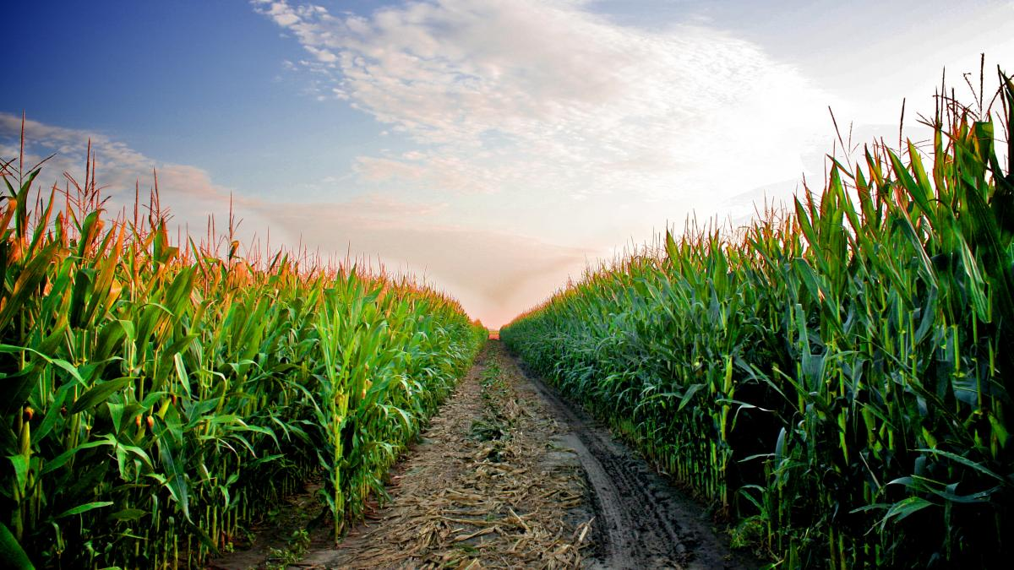
demetra
growingreen

Slide 2
this is how future is forecasted
Challenges
9
80%
40%
billion
people in 2040
of water drawn from the ground used for irrigation
necessary
yield increase

Slide 3



agriculture needs CHEMICALS
Problems
EXPENSIVE
POLLUTING
DEMANDING
if the farmer spends more,
the customer pays more
the water we all drink,
the air we all breathe
management
for the farmer

Slide 4
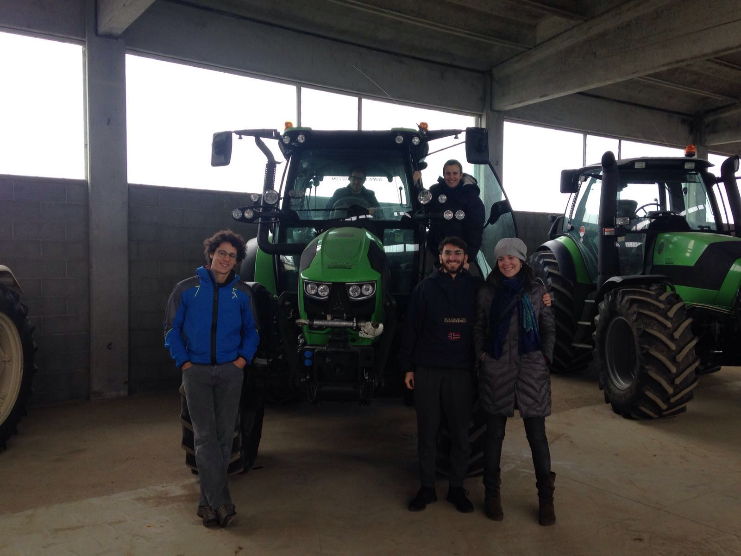
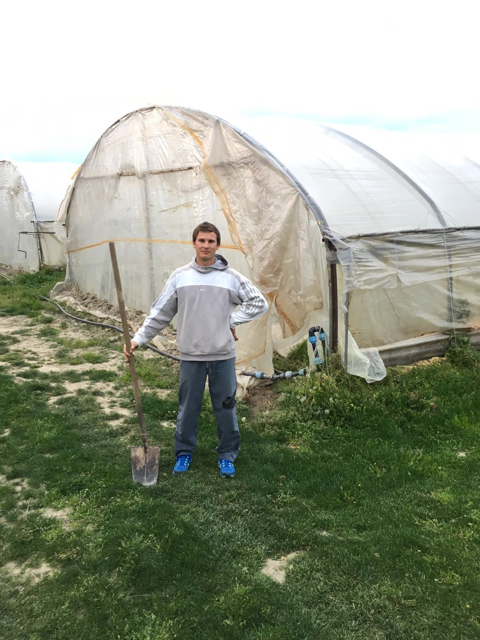
on
field

Slide 5
an integrated system for easier and efficient crop management to
Value proposition
save money
stop pollution
earn time
the right amount,
just when it’s needed
of water, air and soil
a free sunny afternoon
to spend with your kids

Slide 6



Technical solution
crop status
intelligence
on demand
data collection
precise
on field
real time
data analysis
modeling
feedback
auto pilot
optimization
irrigation
fertilization
pesticide

Slide 7
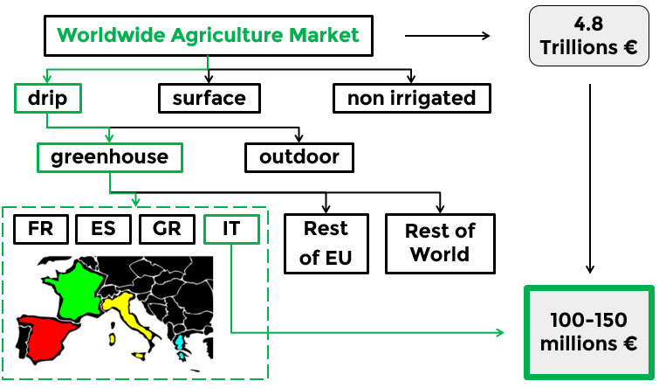
Entry market
Notes:
Ridurre l’utilizzo dei fertilizzanti

Slide 8













Competitors & Players
equipment
software

Slide 9
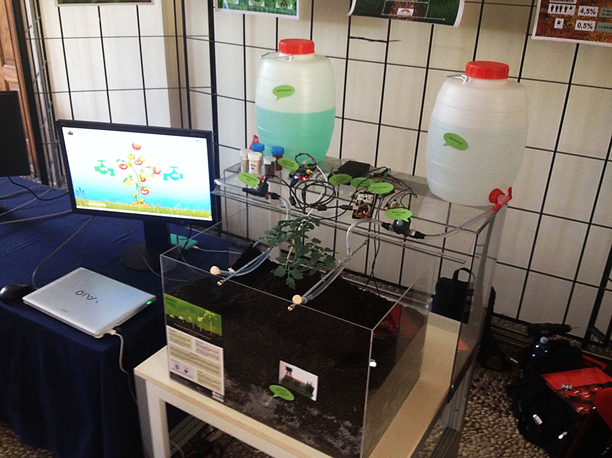
Notes:
Ridurre l’utilizzo dei fertilizzanti

Slide 10
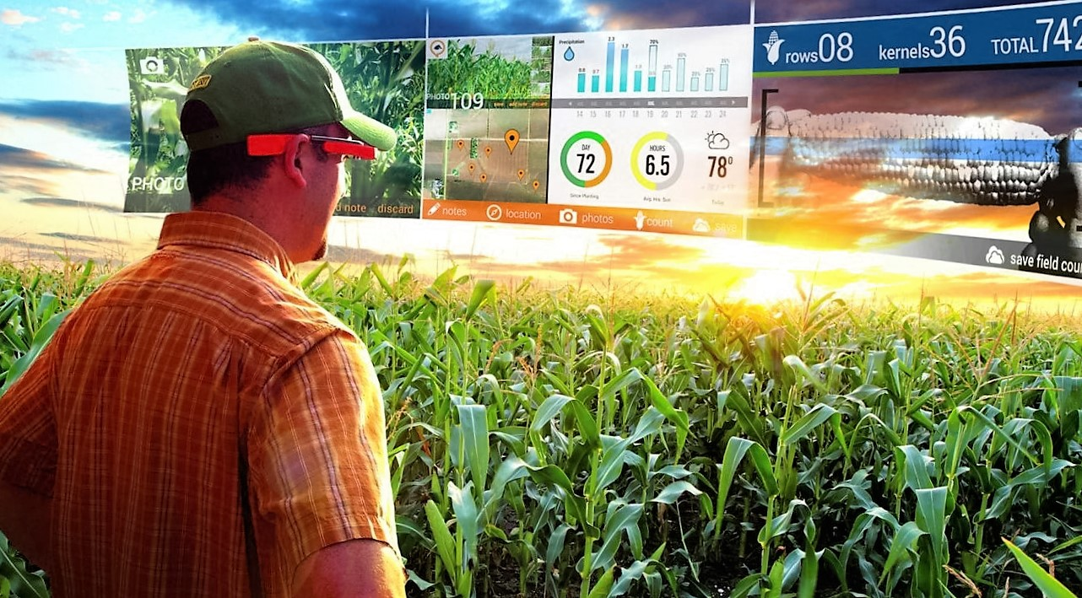

Slide 11
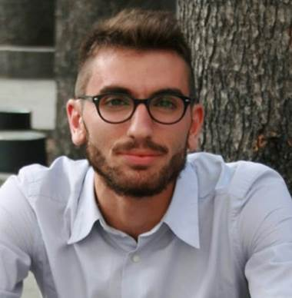

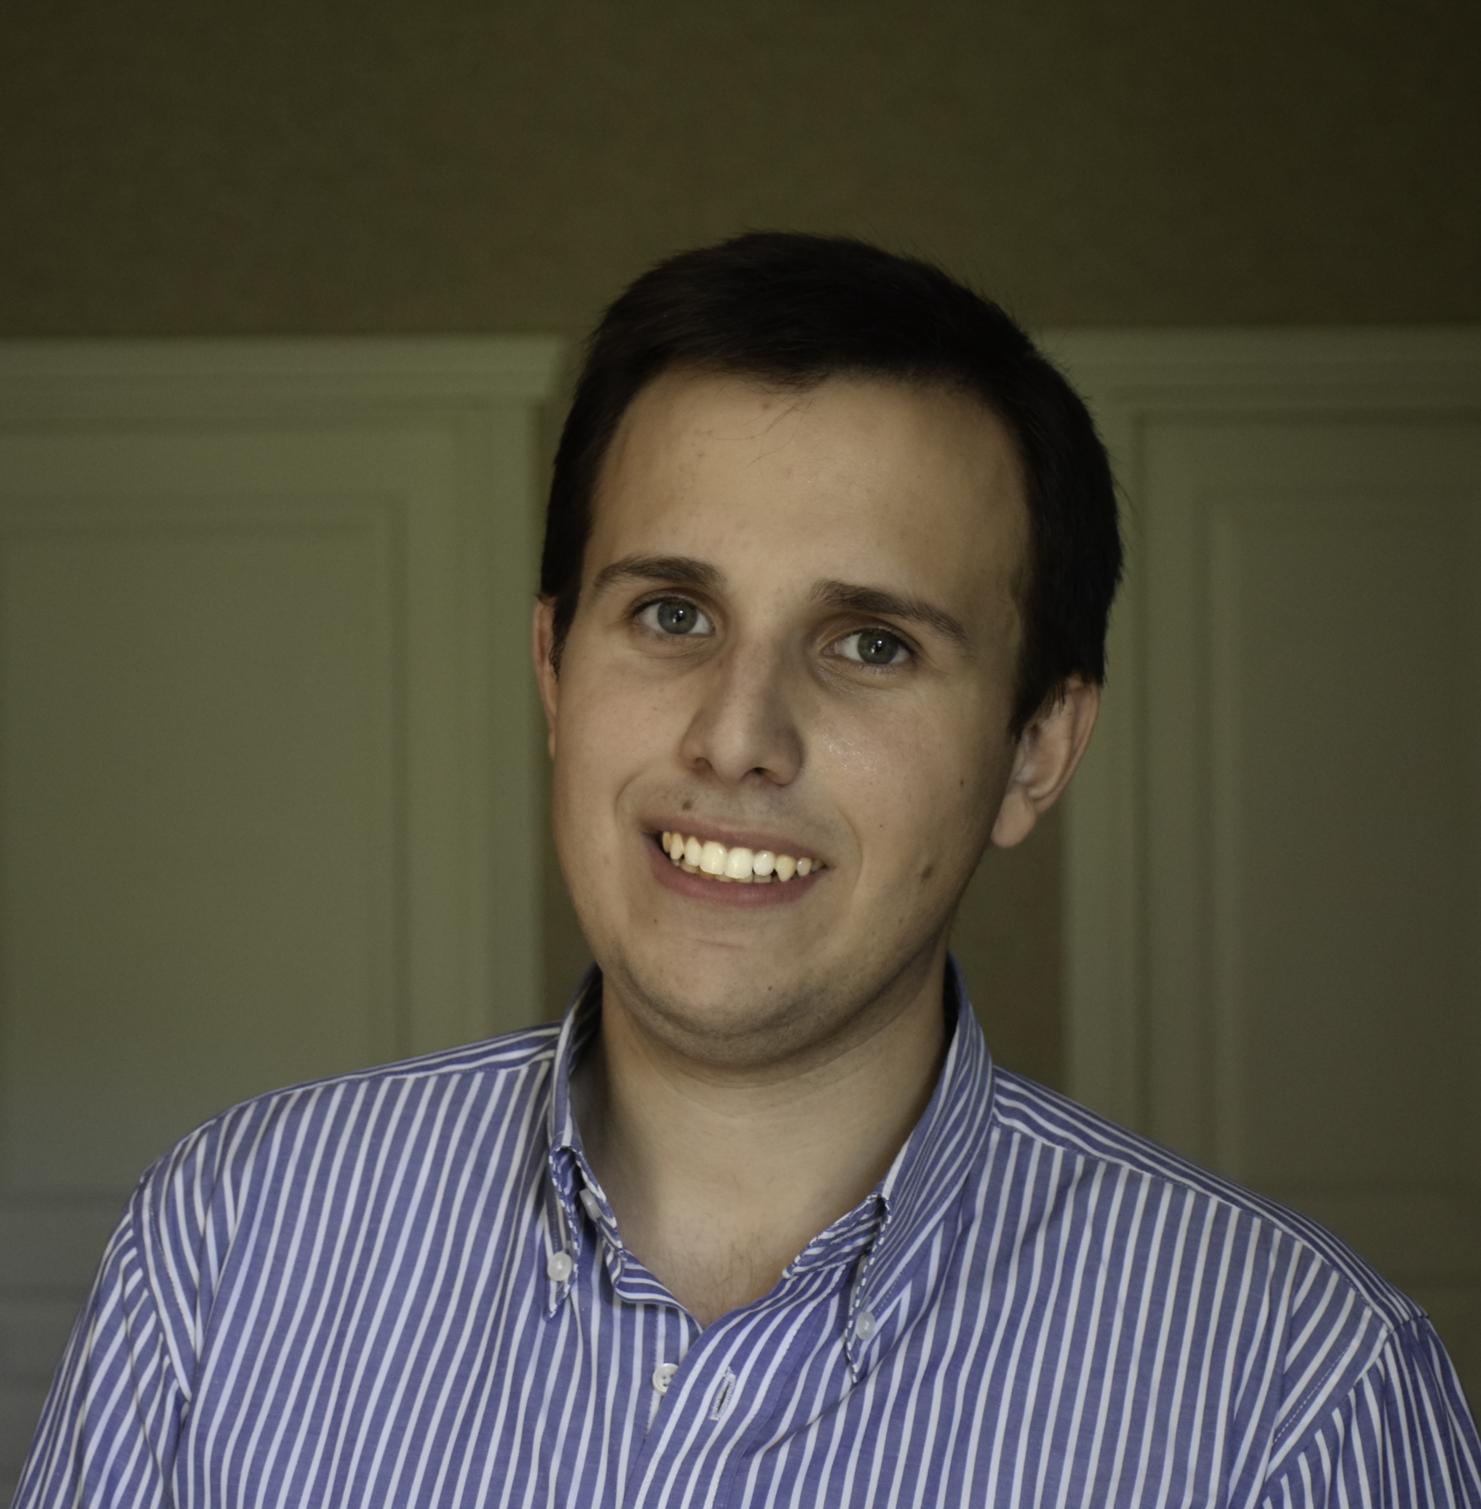

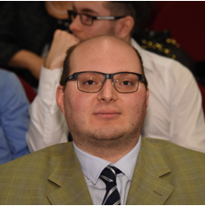

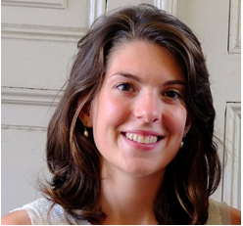
Green Team
Balestra Andrea
CNHi – ICT
Mouhssine Omar
UBIS – ICT
Mussinatto Alberto
HR - FCA
Ciccone Enrico
Marketing - Reda
Piumatti Davide
R&D - PoliTO
Jarre Matteo
PhD - Energy
Solly Alys
PhD - Urban development

Slide 12
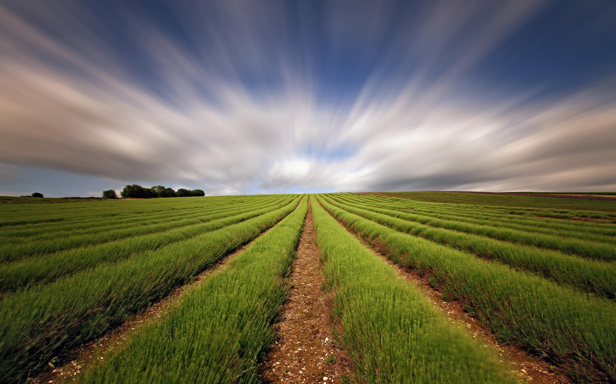
.
Mega Trends
Agri Process
Competitor
Roadmap
Segmentation
Business Model
Back up
Innovation Elements
Business
Plan
Platform
Business Case
Vision

Slide 13
.
Backup
Mega Trends

Slide 14
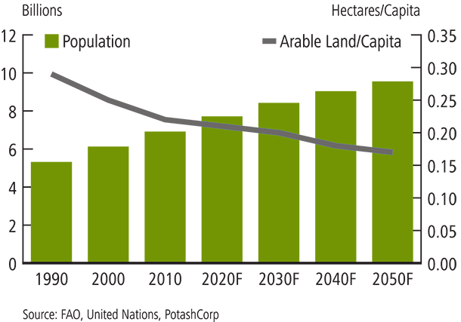

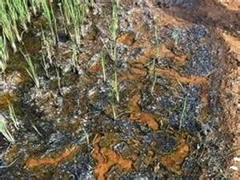
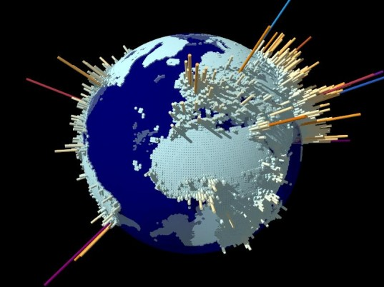
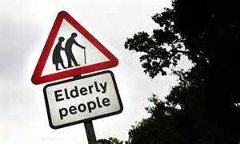
Global population in 2050
Arable Land for farming
Water scarcity & desertification
Air and soil pollution

Slide 15
.
Backup
AgriProcess

Slide 16







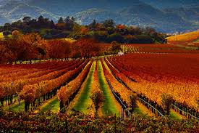
AS-IS Scenario
Pump
Farmer Activities
Hardware
Water
Well
Fertilized Solution
Fertilized Solution
Mixer

Slide 17








TO-BE Scenario
Mix Valve
Master
Water
Instructions
Fertilized Solution
Data Analysis
Farmer
Hardware
Data
Feedback
Sensors

Slide 18
.
Backup
Competitor

Slide 19




Components
Platform
Data
Analysis
Distribution
Foundation: 2011
Avg Rev: € 300k
(Smart Agri Kit: €5k)
Foundation: 2011
2014 Rev: € 300k (+609% from 2012)
Foundation: 2004
Avg Rev: € 450k
Foundation: 2014
Avg Rev: € 300k
Demetra Prototype
HW: €1k/hectare

Slide 20


Competitors
€1
mln
10%
7%
EBITDA
CASH FLOW
REVENUE CAGR (5YR.)
REVENUE
98K
66K
18%

Slide 21

Competitors
4,5 mln
24%
24%
EBITDA
CASH FLOW
REVENUE CAGR (5YR.)
REVENUE
1 mln
67,5%
1,1 mln

Slide 22

Competitors
124K
32%
26%
EBITDA
CASH FLOW
REVENUE CAGR (3YR.)
REVENUE
41K
30K
102%

Slide 23

Competitors
350K
24%
14%
EBITDA
CASH FLOW
REVENUE CAGR (3YR.)
REVENUE
84K
50K
flat

Slide 24
.
Backup
Roadmap

Slide 25
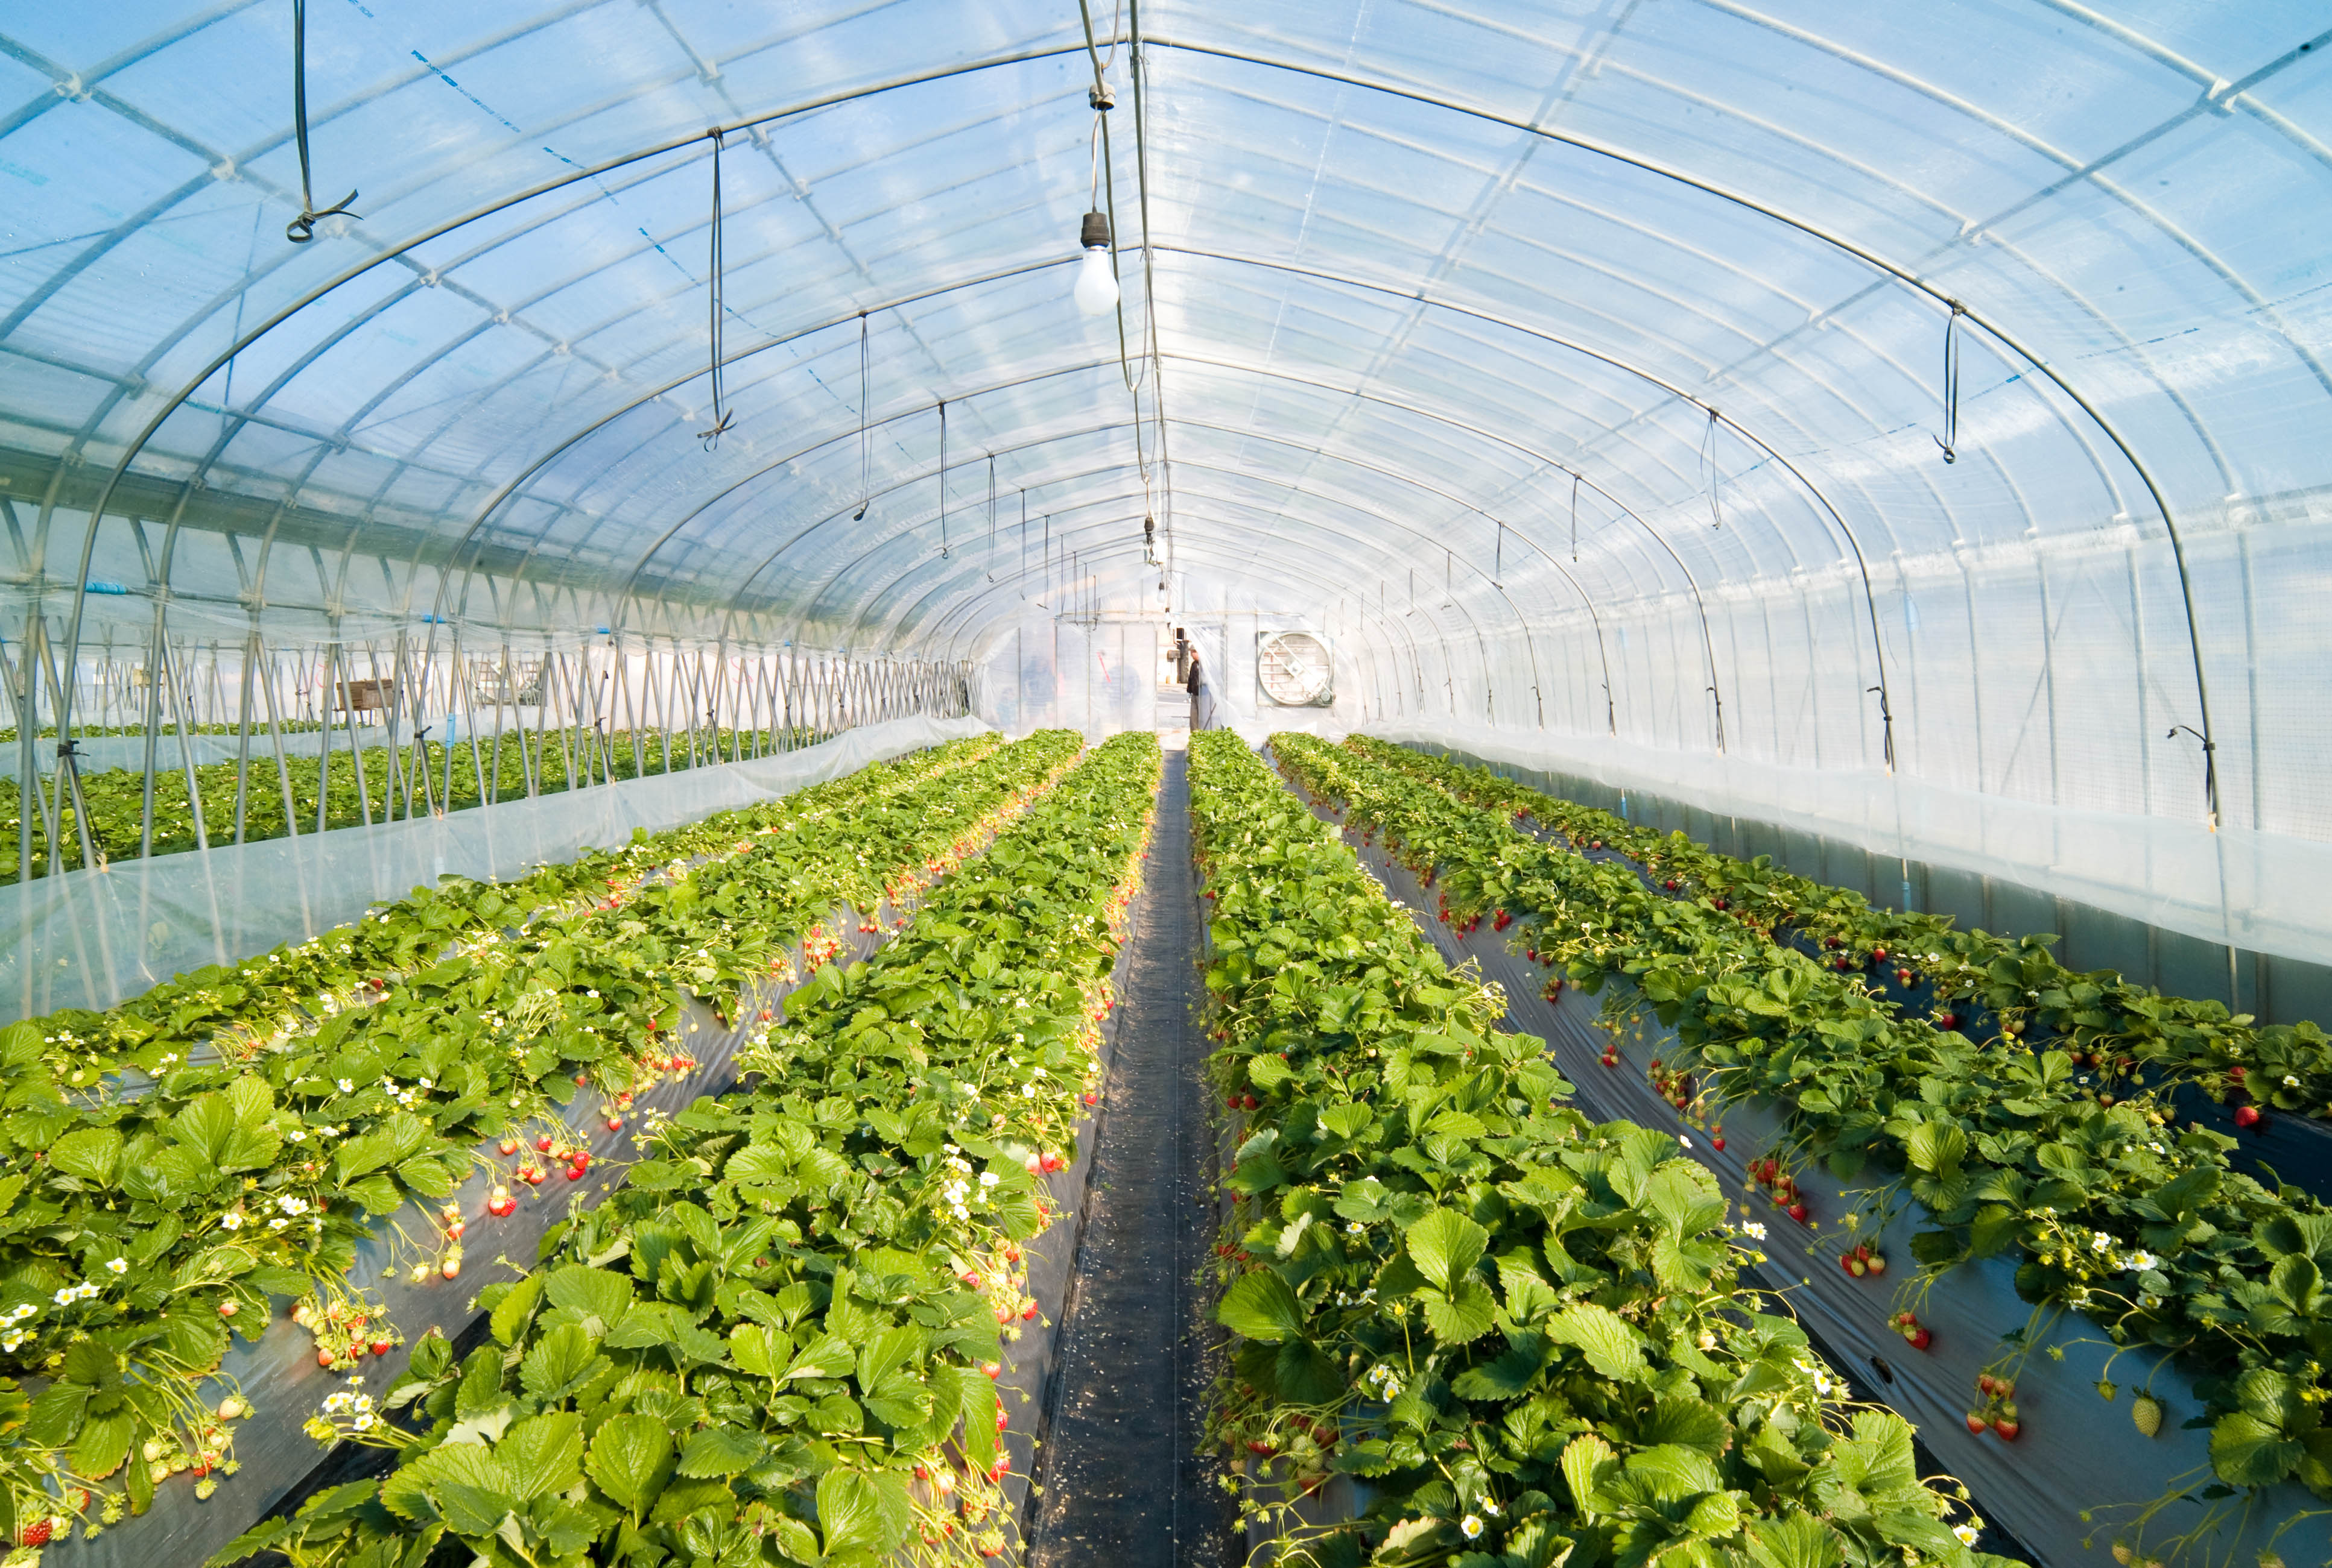
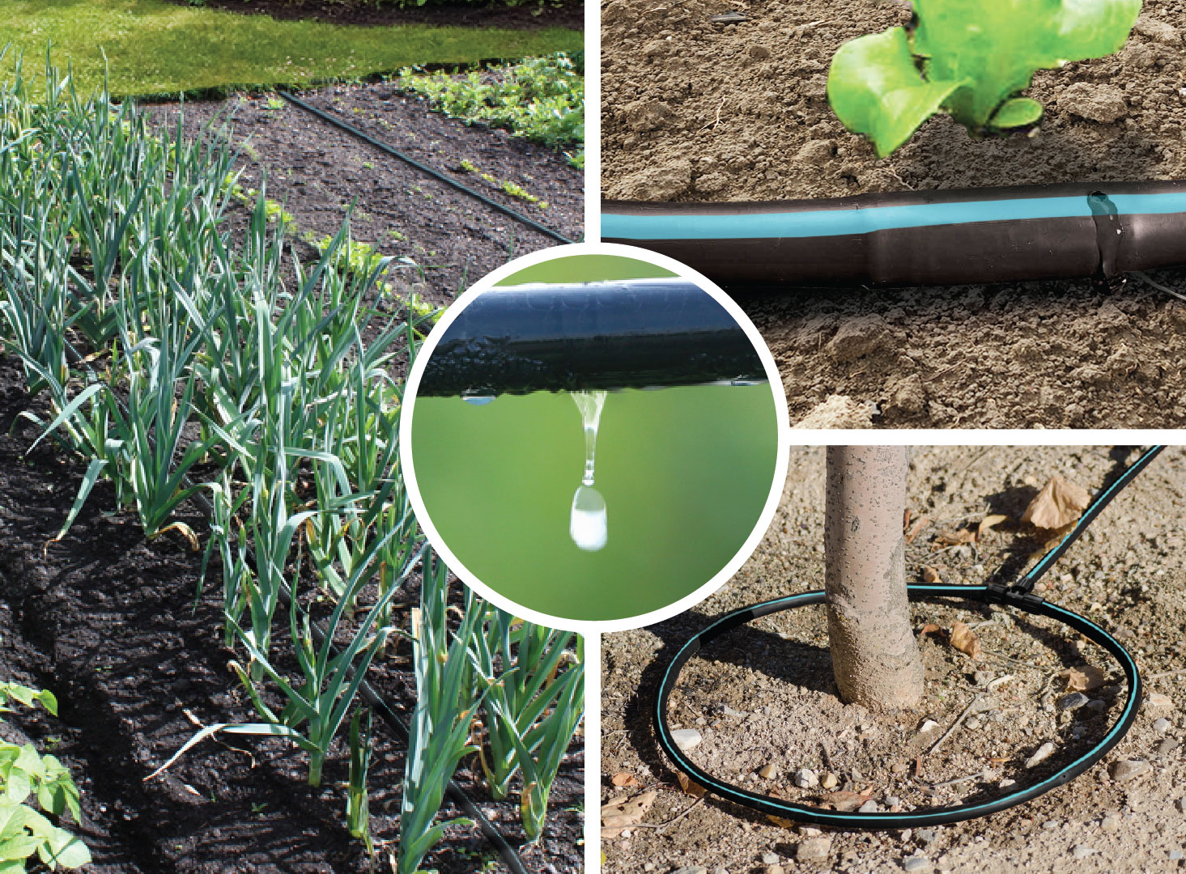
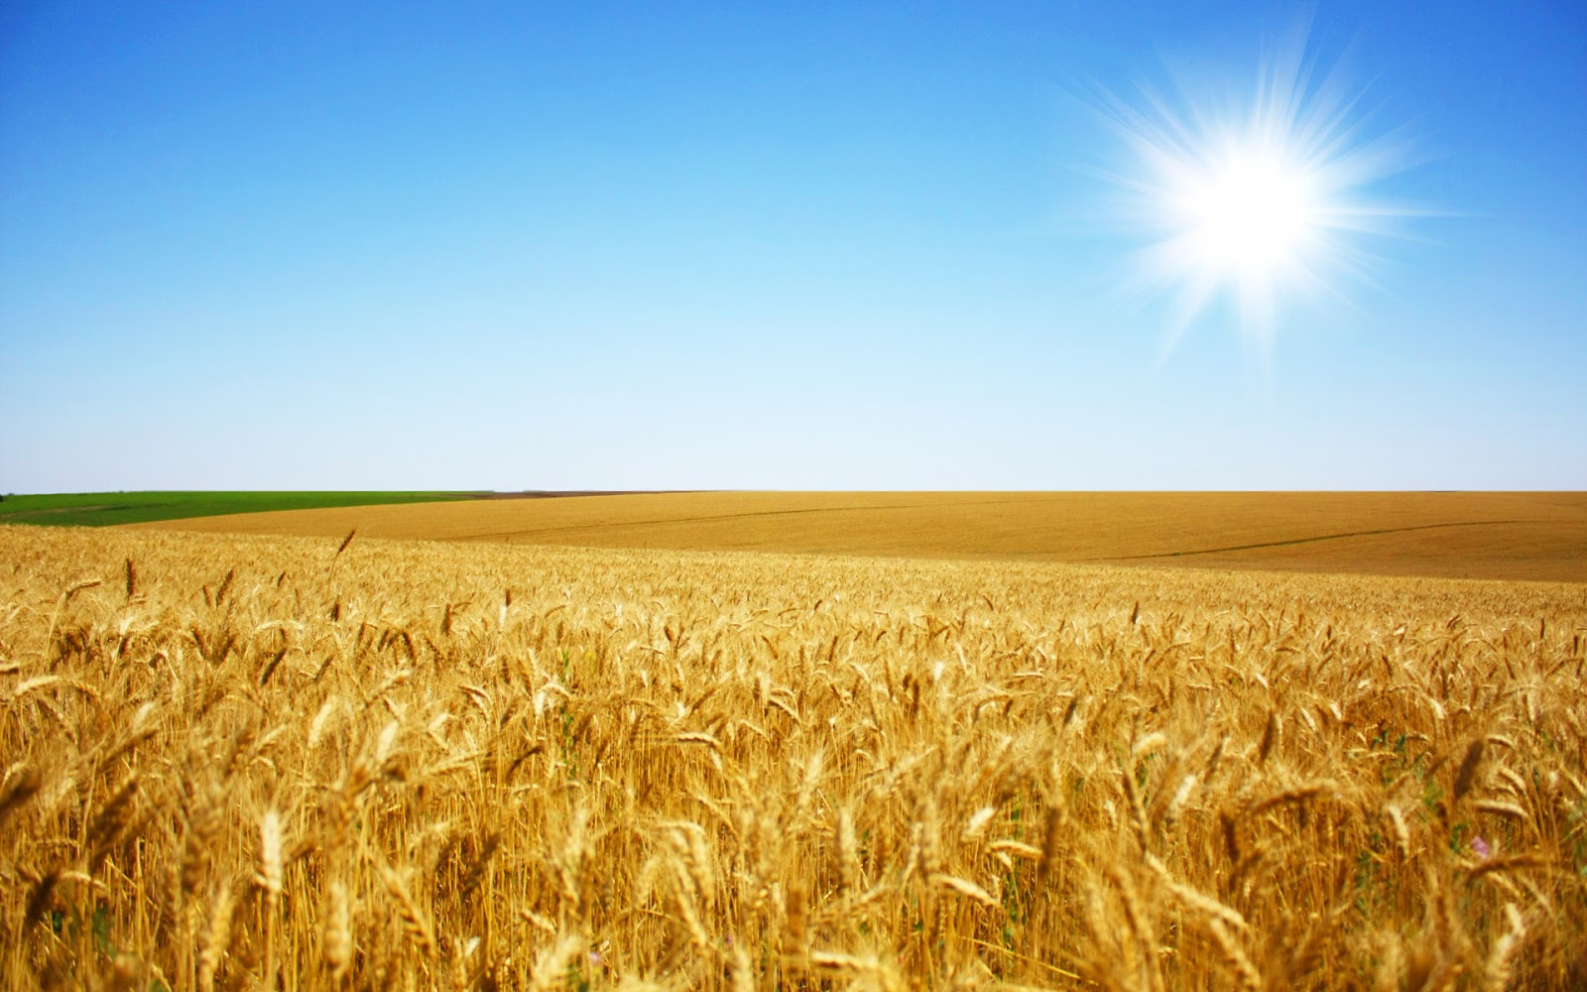
FOCUS on greenhouse drip irrigation
High value crops
Existing structure
Controlled area
SCALABLE to open field
HW: Gap 30%
SW: GPS, layout mapping, weather forecast

Slide 26
20-20-20 AgTech Roadmap
Drip
Open Field
Market Segmentation
Greenhouse Drip
Outdoor
Drip
Small/ Medium
Size
Large Size
MVP Prototype (20th June 2016)
Software
Demetra 1.0
(Industrialized Prototype)
Demetra 2.0
(1.0 + Meteo Forecast + Spectrophotometer)
Demetra 3.0
(2.0 + GIS)
Demetra 4.0
(3.0 + …)
Hardware
Sensors + ICT Cabin + Dosatron
Drones + Tractors Equipment
R&D
Drones
Time

Slide 27
.
Backup
Segmentation

Slide 28

Precision farming market 2020
4.8 Bln $
CAGR: 11.7 %
2.9 Bln $
CAGR: 12.5 %
Sensors solutions applied to agriculture

Slide 29
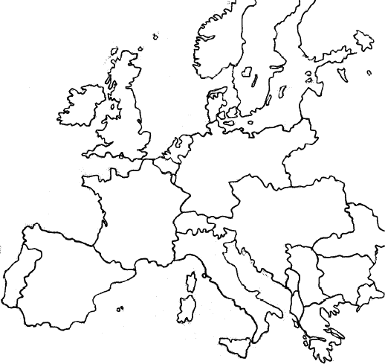
Our potential entry market
EU
750 M€
Sensors solutions applied to greenhouse monitoring
Italy
120 M€

Slide 30


Precision Farming Worldwide Market (2020 forecast)
Sensors solutions
applied to agriculture
11,7% CAGR (5yr.)
12,8%CAGR (5yr.)
4,8
Bln $
2,9
Bln $

Slide 31

European sensors for agriculture market (2020 forecast)
1,3 Bln $

Slide 32
Greenhouses in Europe
500k
Europe
80k
Italy

Slide 33
Italian potential market
120
mln $
Sensors solutions
applied to greenhouse monitoring

Slide 34


The Market
Irrigation
Agriculture Value
% of crop’ surface
42,6 Bln Euros
Our potential market
600 Mln €
Italy only
(Drip Irrigation crop)
Potential savings (revenues %)
Mln € | 25% | 35% | 50%
5% | 260 | 415 | 780
8% | 360 | 580 | 1090
15% | 520 | 830 | 1560
Value of drip crops
20,8 Bln Euros
Fertilizer cost (revenues %)

Slide 35

The Market Segmentation
SEGMENT
(Revenue)
AVG
REVENUE
AVG
MOL
95%
€ 0 to
100.000
€ 35.000
€ 15.000
4,5%
€ 100.000
to 500.000
€ 200.000
€ 99.000
0,5%
> € 500.000
€ 1.000.000
€ 422.000

Slide 36
Customer Target

Slide 37
.
Backup
Business Model

Slide 38

how we make money
farmers save at least
25%
of input costs
we take 20% or 100 €
monthly fee
Entry market only
3.2 B€
800 M€
200 M€
drip inputs costs
savings for farmers
potential revenue

Slide 39
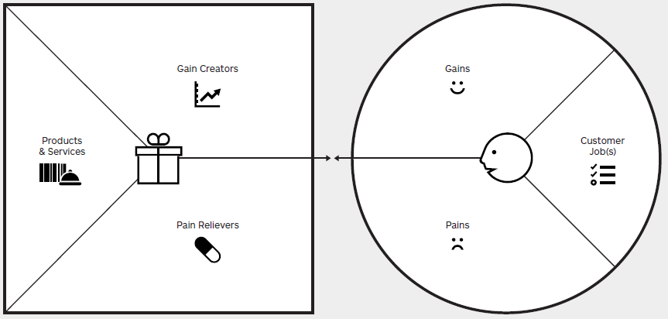






demetra
farmer
Increased yield
Increased quality
Increased land knowledge
Life in nature
Passion for product
Tradition experience
Value proposition
Seed
Irrigate
Fertilize
Protect
Harvest
Remote control
Auto-pilot
Feedback from field
Low margins
Use of chemicals
Not easy management
No free time
Reduced costs
Reduced pollution
Simplify processes
Introduce free time

Slide 40
Analysis for Business Model Definition
Integrated System for water, fertilizer and pesticide management:
Benefit
Purchase Expense
5-15%
of Total Revenues
Crop Yield:
Labor Expense
2%
of Total Revenues
- Quantity
0-20%
of Total Revenues
Environmental Pollution
n\a
0%-?
- Quality
of Total Revenues
Cost
vs
Service:
Product:
- Installation Fee
€1k
per hectare
- Purchase
TBD
per hectare
50%
- Assistance, Training
TBD
- Crop Harvest Fee
of Fertilizer Saving
rate per hour
Note: Assistance, Training is included
Note: ???

Slide 41
.
Backup
Business Plan

Slide 42
Activity Plan for Market Penetration
We
need
Time-to-market: up to 20 months
Cost-to-market: €150k
Pre-series (50 units among farmer & lab test)
Lab Test (Partnership with agro research lab)
Market Analysis (Customer, Competitor, supplier focus)
We
deliver

Slide 43
.
Backup
Innovation

Slide 44



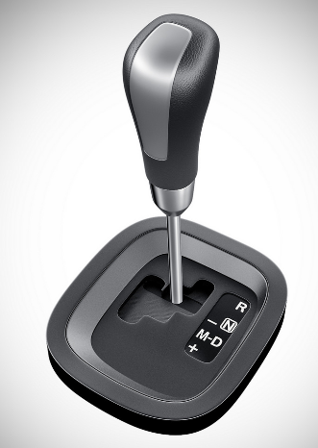
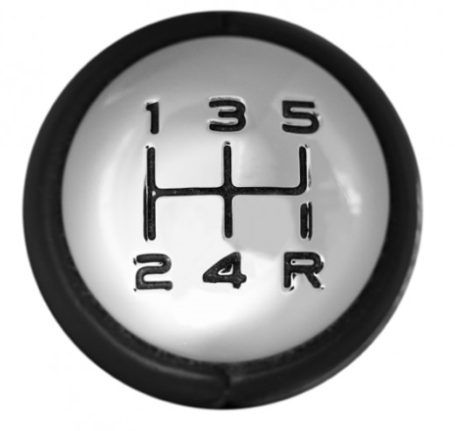
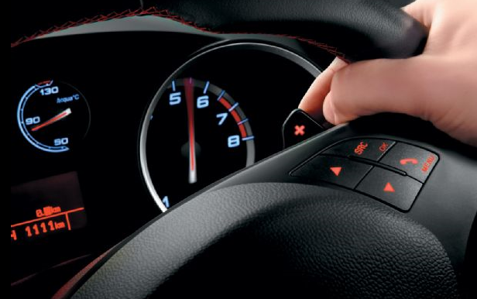
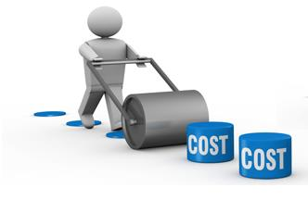
Innovation Elements for Users
Get the data
Close the loop
Enjoy free time
Choose the mode
Reduce costs

Slide 45
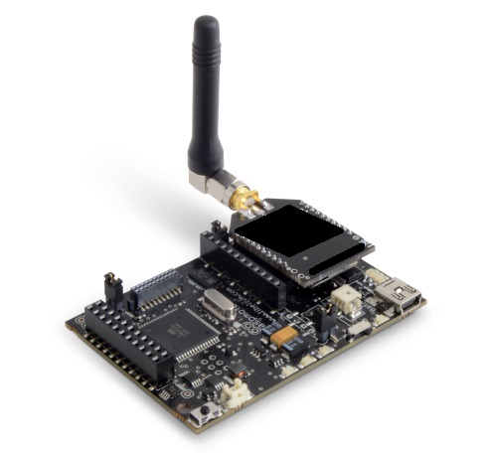

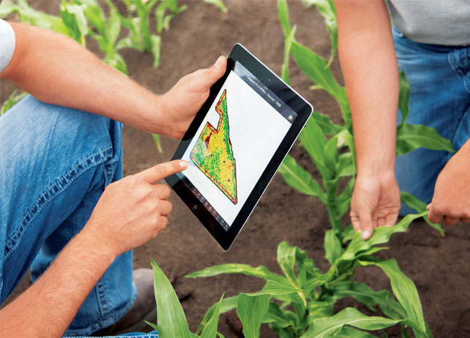

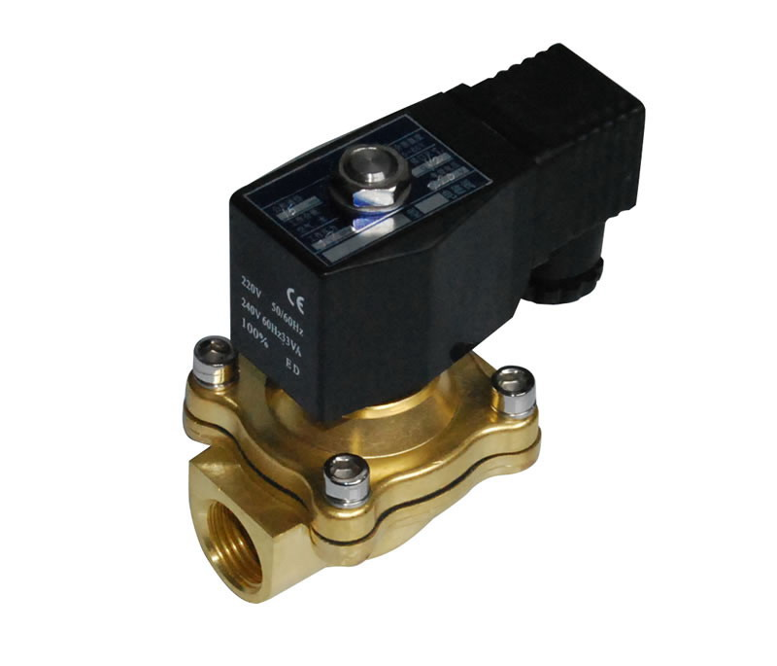


Innovation Elements for Investors
New integrated sensors
Big Data collection
Farmer - Machine interface
Reliable components
Machine learning
Optimized crops model

Slide 46

What We Do
What We Buy
What We Need
300k€
New integrated sensors
Big Data collection
Farmer - Machine interface
Reliable components
Machine learning
Optimized crops model

Slide 47
.
Backup
Platform

Slide 48
System Functionalities
Your Farm: Control Panel of crops current status
Command: Set manual, assisted or auto pilot mode and send instructions to the actuation
Data Analysis: Historical data view
Report: Report generator for legal, functional documents
Please visit www.demetra.tech

Slide 49
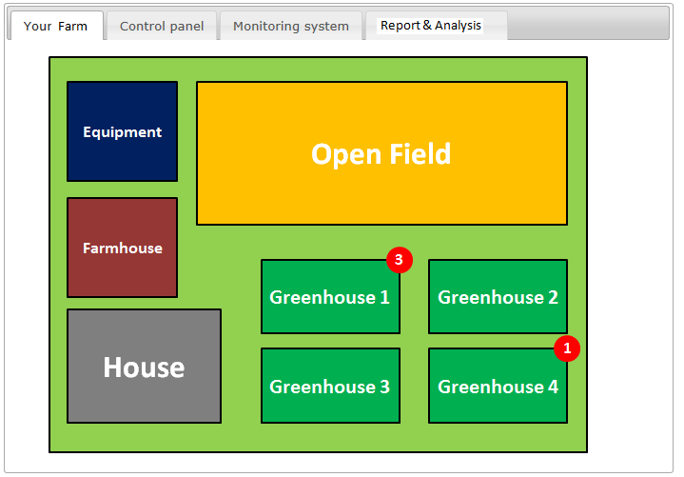
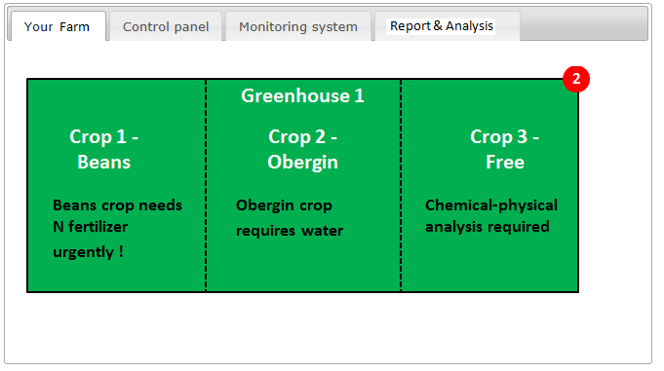
Your Farm

Slide 50
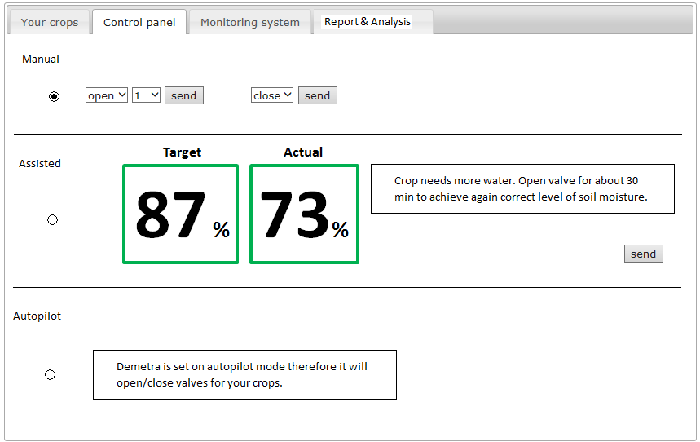
Command

Slide 51
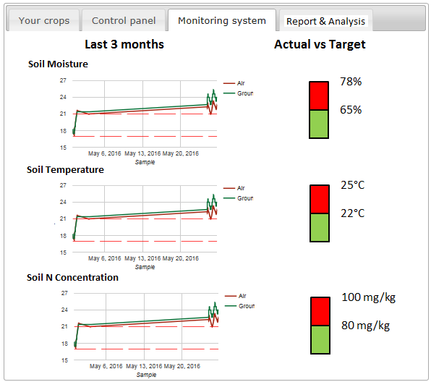
Data Analysis

Slide 52
.
Backup
Vision

Slide 53

Towards open fields
Vision
1.0

Slide 54
Towards open fields
Vision
1.0

Slide 55
Towards open fields
Vision
1.0
2.0

Slide 56
.
Backup
Business Case

Slide 57
Innovation Elements
New integrated sensors
Big Data collection
Farmer - Machine interface
Reliable components
Machine learning
Optimized crops model

Slide 58
 | Value | % value/revenue
Revenue | 50.000 | 1
Fertilizer | 4.000 | 8%
Energy | 7.500 | 15%
Labour | 5.000 | 10%
Other op. Cost | 5.000 | 10%
Tot Op variable op cost | 21.500 | 43%
EBITDA | 28.500 | 57%

