Slide 1
Perspectives of B_{c} physics at LHCb
Rolf Oldeman
B_{c} micro workshop
LHCb A&S week 13/7/2016
With crucial input from Lucio Anderlini, Liupan An, Alison Tully

Slide 2
Outline
General remarks
B_{c}->DDD: Tetraquarks
B_{c} spectroscopy
B_{c}->DD : γ

Slide 3
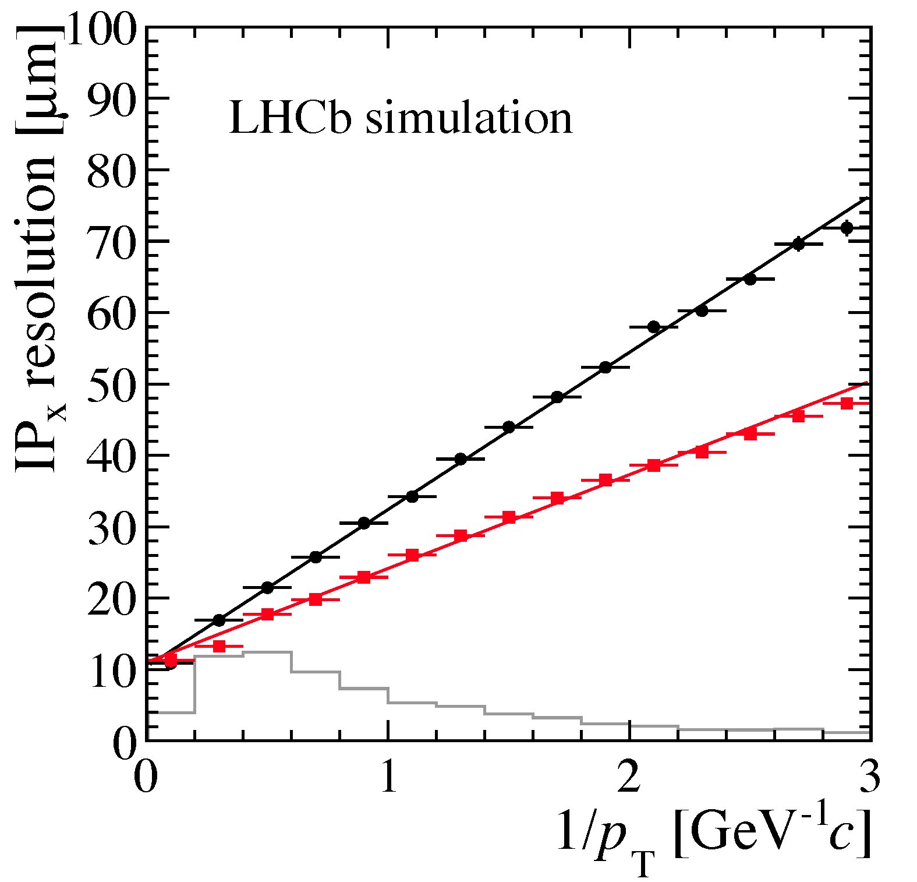
General remarks
Great outlook for B_{c} at LHCb:
  Unique DAQ, VTX, PID to further improve in upgrade
Probe all 3 main types of B_{c} decays:
  b-quark decay, c-quark decay, bc annihilation
B_{c} production
  high-precision, associated production
Spectroscopy
  Search for excited states in B_{c}X, BD
VELO
VELO upgrade

Slide 4
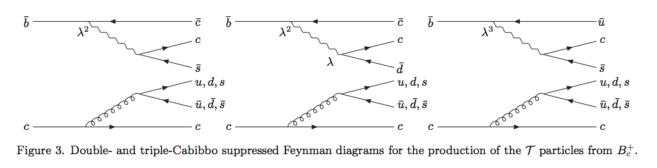
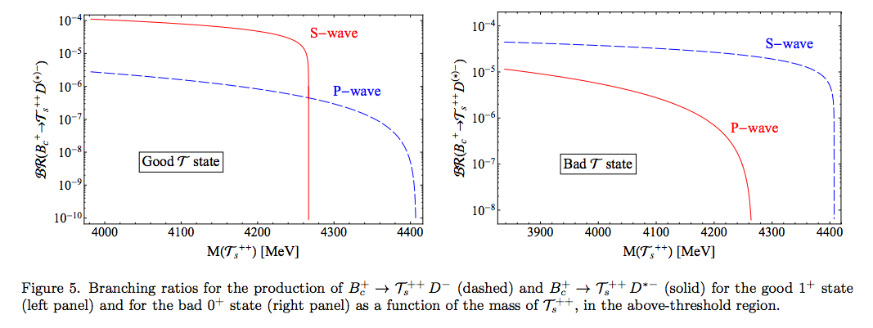
Bc->DDD: tetraquarks
Esposito, Papinutto, Pilloni, Polosa, Tantalo Phys. Rev. D 88, 054029 (2013)

Slide 5
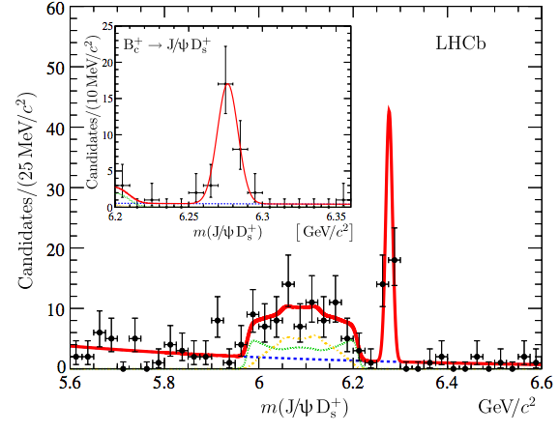
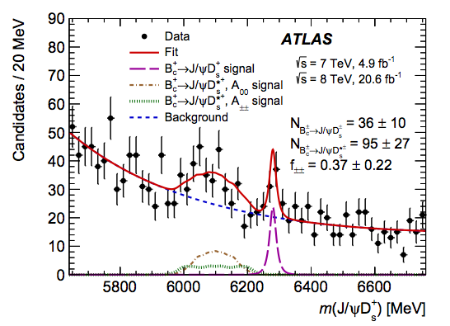
Bc->DDD in LHCb
B_{c}->Jpsi D_{s} already observed,
  LHCb 3fb⁻¹ ATLAS 25fb⁻¹
B_{c}->D⁰D⁰barD_{s} ~100x less
efficient because of extra
D (BF~5%, 2 extra tracks)

Slide 6
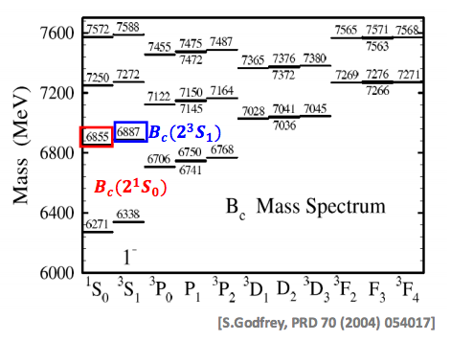
B_{c} spectroscopy
Expect excited Bc states similar as in B⁰,B⁺ and B_{s} system
Decay channel depends on mass: B_{c} γ, B_{c} π⁺π⁻, BD

Slide 7
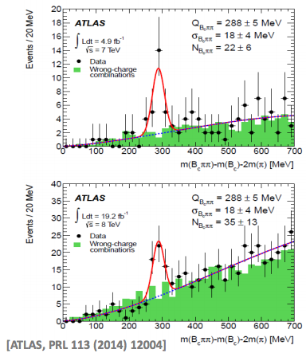
Status and outlook
ATLAS observation consistent with expected 2S state (mass, decay channel)
  Not yet confirmed by other experiments
  LHCb Run I B_{c} yield 10x higher than ATLAS
  If confirmed, will show up clearly in LHCb
B_{c}γ final state hard because of low-pT gamma
BD final state: B⁺D⁰ or B⁰D⁺ to be explored

Slide 8
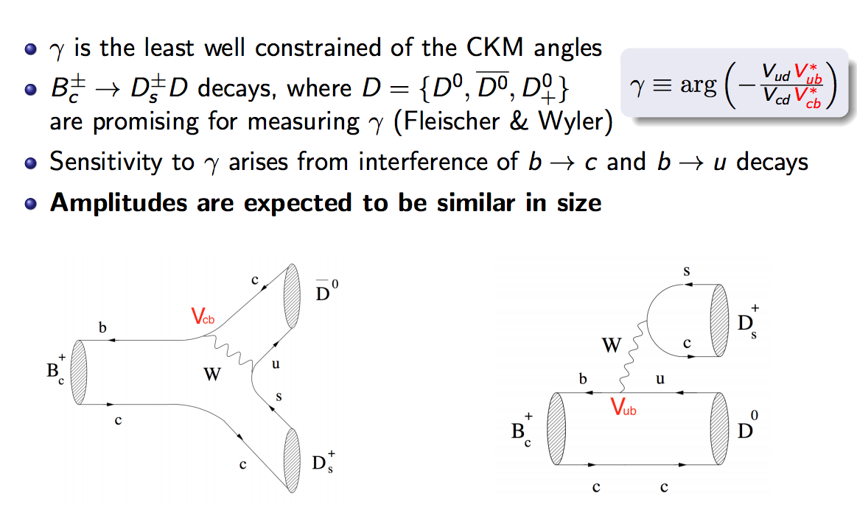
B_{c}->DD for gamma: motivation

Slide 9
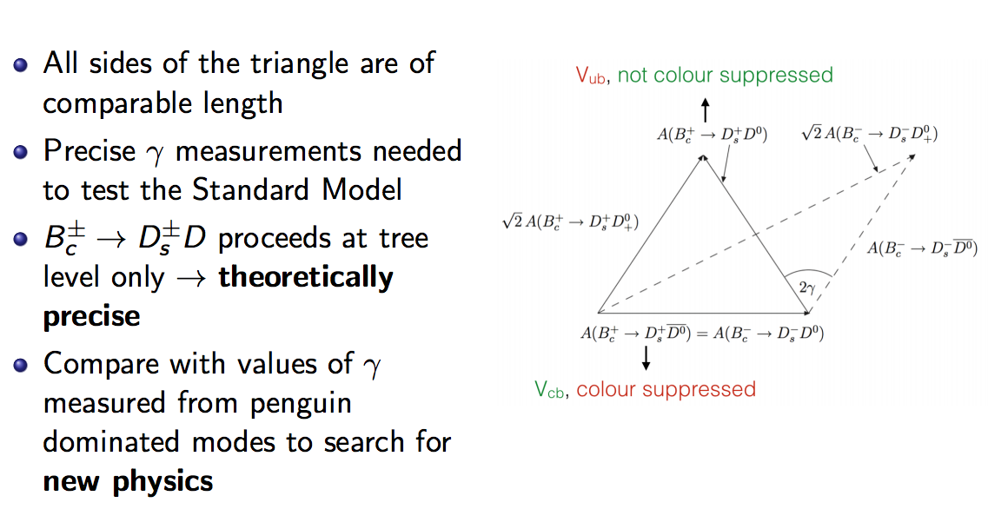
B_{c}->DD for gamma: motivation

Slide 10
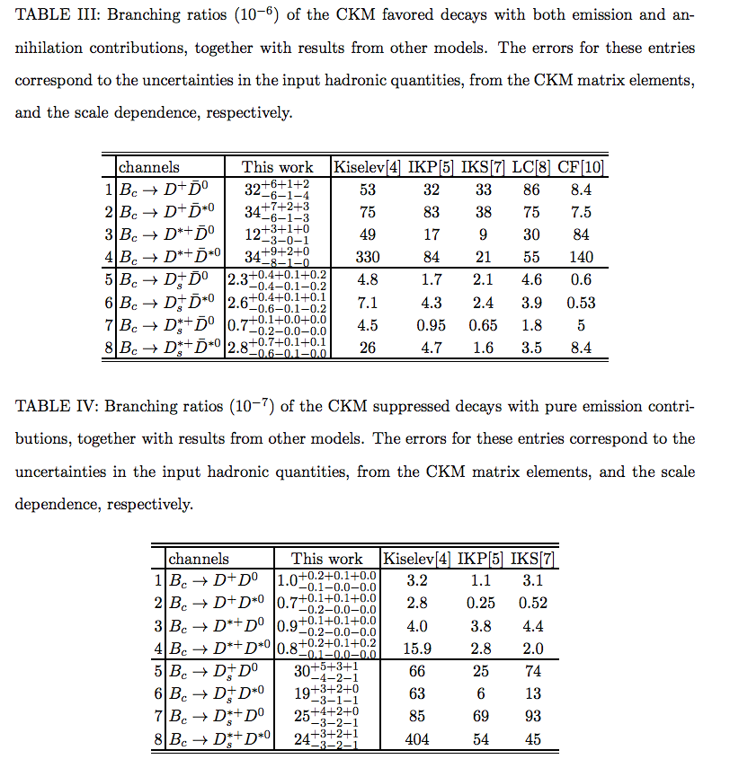
B_{c}->DD branching ratio predictions
Phys. Rev. D 86, 074019 Zhou Rui, Zou Zhitian, Cai-Dian Lu:
Cabibbo-favoured in (/10⁻⁶)
Cabibbo-suppressed (/10⁻⁷)
Note that CS > CF for Ds mode

Slide 11

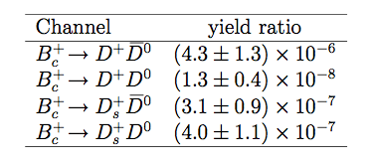
B_{c}->DD for gamma: event yield
Combining LHCB measurement with B(Bc->Jpsipi)=0.29%
Rui Zhitian Lu PRD86(2012)074019
assuming
results in

Slide 12
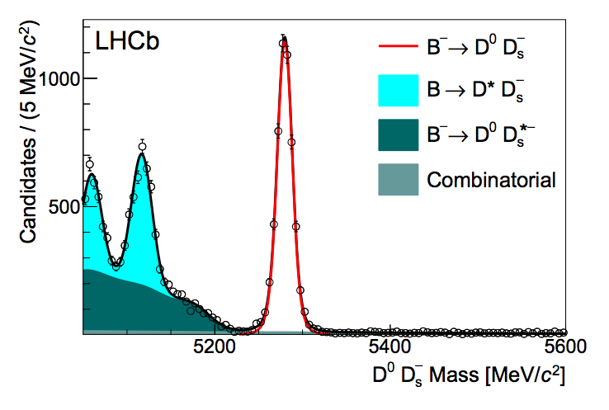
Yield expectation
With B_{c}/B⁺ rate of 1/200k do not expect signal in Run I data:
5k B⁺->D_{s}D⁰bar in 1 fb⁻¹ at 7 TeV
Phys. Rev. D87 (2013) 092007
Expect no signal from Run I but maybe from Run 2 or Run 3

Slide 13
B_{c}->DD for gamma: outlook
Predictions are small but differ by an order of magnitude
Does not look hopeful for competitive gamma measurement
Need experimental input on BF’s
Explore other channels with larger BF?

Slide 14
Conclusions
Bright outlook for B_{c} physics at LHCb:
  larger cross-section in Run 2
  higher efficiency in Run 3
  better vxt resolution in Run 3
Updated Run I measurements obvious gains
Tetraquarks, spectroscopy, γ may be harder

Slide 15
BACKUP

Slide 17
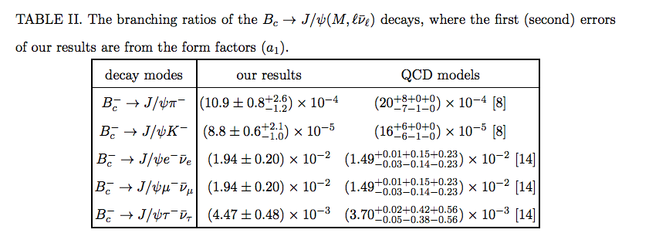
branching ratio calculations
From arXiv:1607.02718 Y.K. Hsiao and C.Q. Geng

