Slide 1
Superconducting Magnet Developments at INFN for HL-LHC and other CERN programs
P.Fabbricatore
INFN

Slide 2
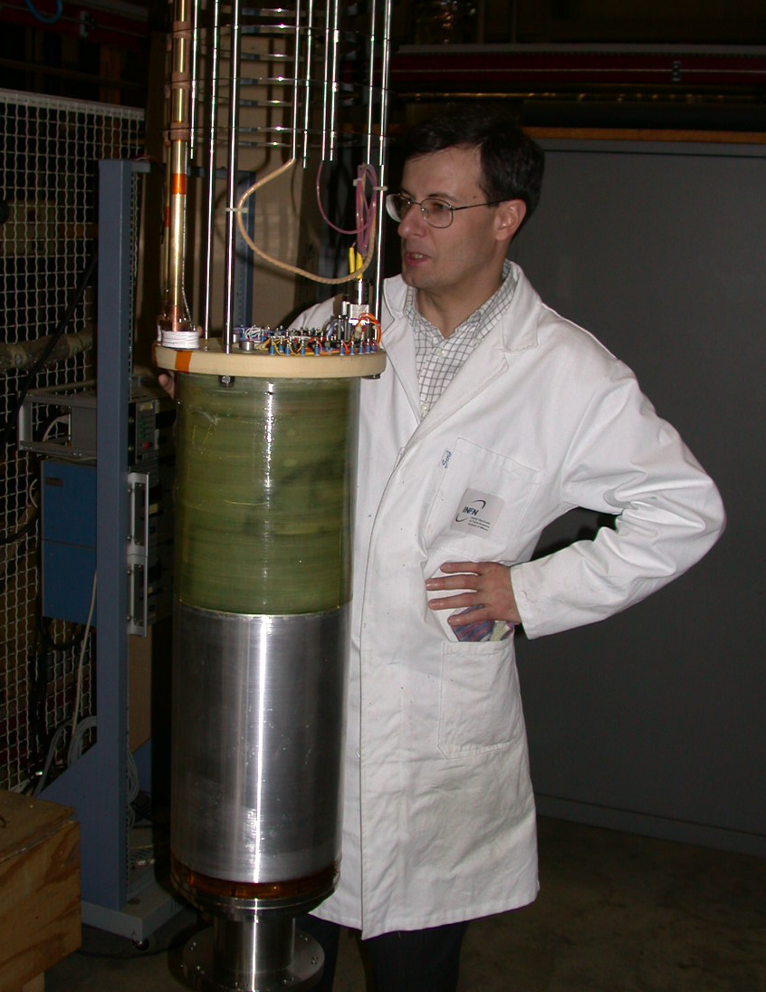
A dear friend left us
Giovanni Volpini 1962-2016

Slide 3
Outline
Applied superconductivity and cryogenics in INFN
MAGIX and INFN participation to HL-LHC
The development of the corrector magnets at Milano LASA
The design of D2 at INFN Genova
New agreement s
Future

Slide 4
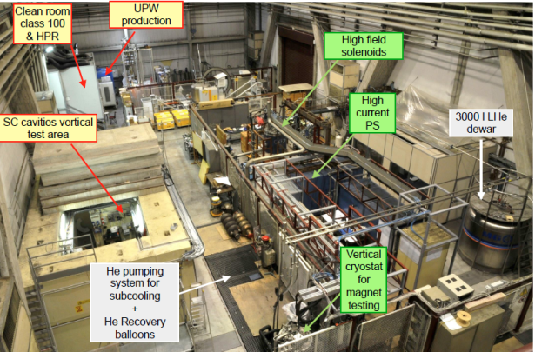
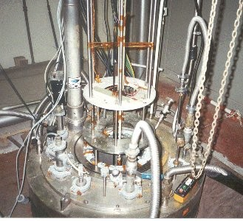
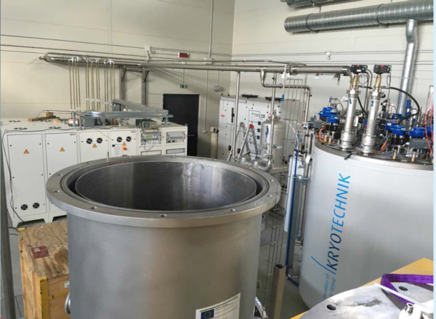
Applied superconductivity and cryogenics in INFN
INFN can count on a distributed large technical infrastructure for applied superconductivity dedicated to coordinated developments and tests of superconducting magnets for accelerators and accelerating cavities.
The infrastructure is based on large cryogenic facilities located in four different sections and laboratories (Genova, Laboratori di Legnaro, Milano-LASA and Salerno-Napoli), some of them operating since 30 years.
All local facilities are equipped with cryogenic plants for liquid helium (bi-phasic and supercritical) with cooling power at 4.2K ranging from 100 W to 1100 W.
The facilities dedicated to sc magnets can count on large power converters up to 20 kA at 25 V and all ancillary equipment for testing long magnets (up to 8 m) in vertical and horizontal cryostats.
Milano- LASA
Genova
Napoli-Salerno

Slide 5
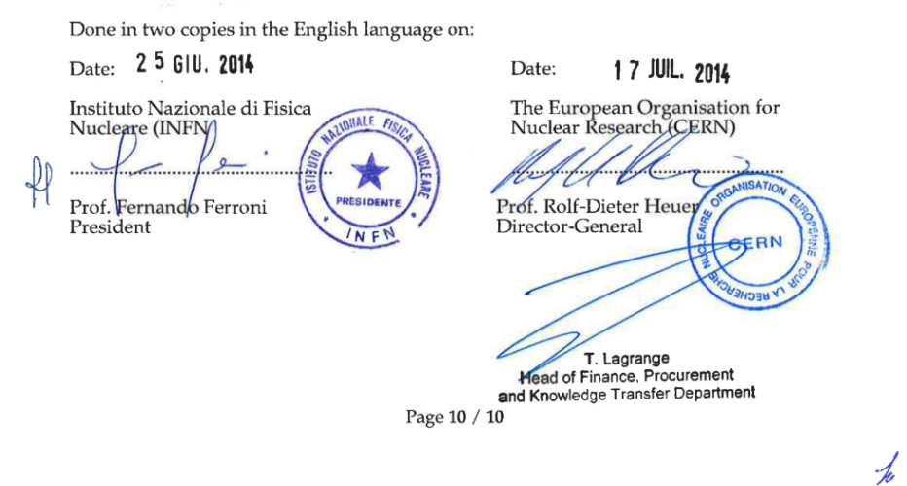

MAGIX & INFN participation to HL-LHC
MAGIX
WP1 | CORRAL | Design, construction and test of the five prototypes of the corrector magnets for the HL interaction regions of HiLUMI
WP2 | PADS | 2D & 3D engineering design of the D2 magnets
WP3 | SCOW-2G | Development of HTS coil for application to detectors and accelerators
WP4 | SAFFO | Low-loss SC development for application to AC magnets
CERN-INFN Collaboration Agreement
CERN endorses MAGIX WP1 & WP2 deliverables and milestones, contributing with 527 k€, through the collaboration agreement KE2291/TE/HL-LHC
1
2
MAGIX is a INFN-funded research project, (1.3 M€ in 2014-2017) with goal to develop superconducting technologies for application to future accelerator magnets .
It includes four WP’s, two of which are relevant to HL-LHC
INFN already involved in FP7-HiLumi
WP2 beam dynamics, LNF
WP3 magnets, MI-LASA
WP6 cold powering, MI-LASA

Slide 6
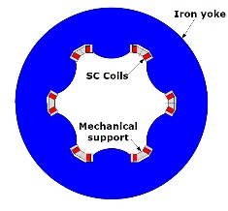
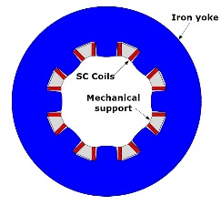
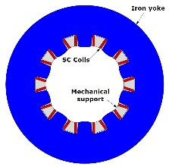



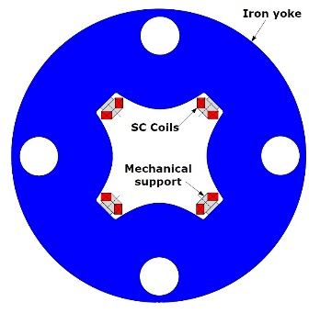
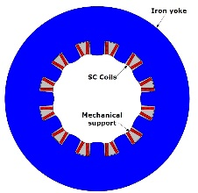
Development of corrector magnets at Milano LASA
OD=320 mm
OD=320 mm
OD=320 mm
Completed
& succefully tested
Construction phase
Ordering phase
Sextupole
Octupole
Decapole
OD=460 mm
Physical lenght:
90-120 mm from 6-pole to 10-pole
430 mm 12-pole normal
840 mm 4-pole skew
Conductor type: NbTi
Peak field on cond.: 2-3 T
Operating current: 120-180 A
Margin on load line: 40%
OD=320 mm
Dodecapole
Courtesy of M.Sorbi
Skew quad

Slide 7
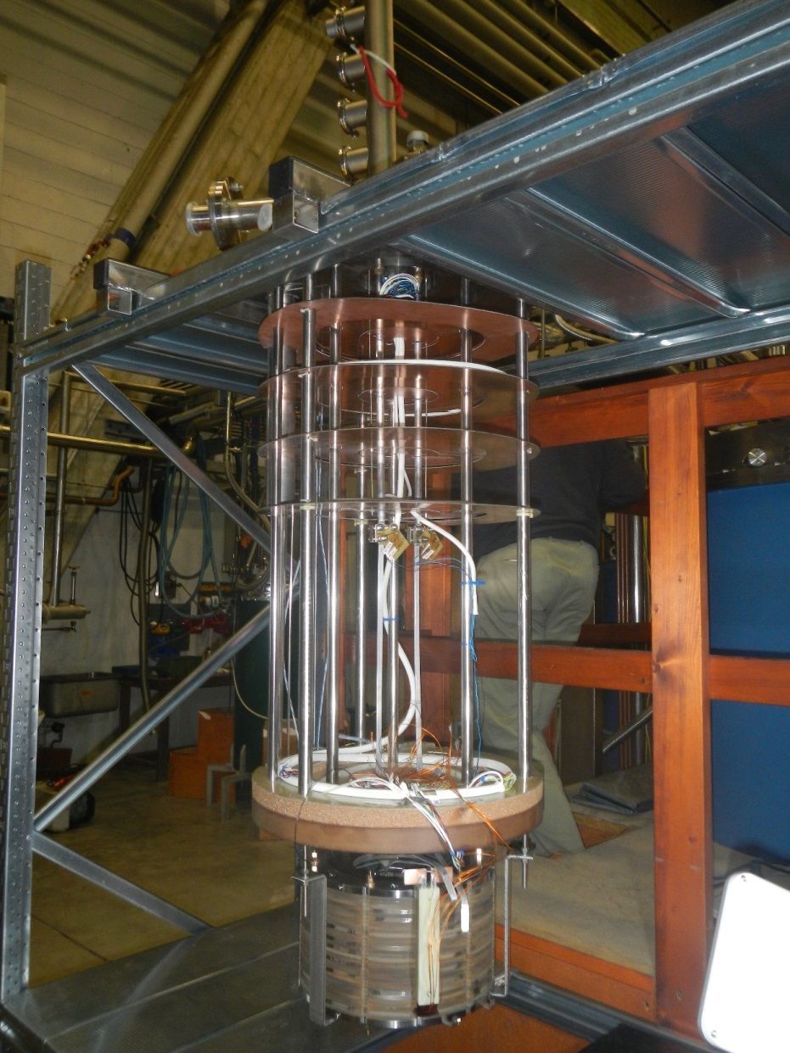
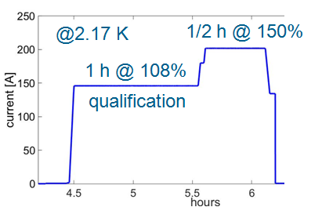
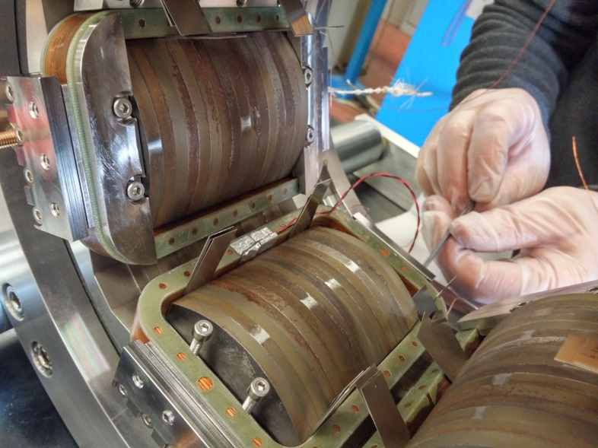
Design, construction and test of the prototype sextupole at Milano LASA

Slide 8
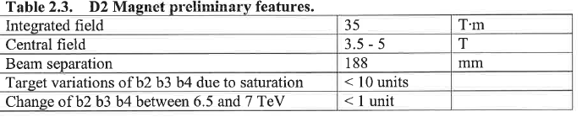
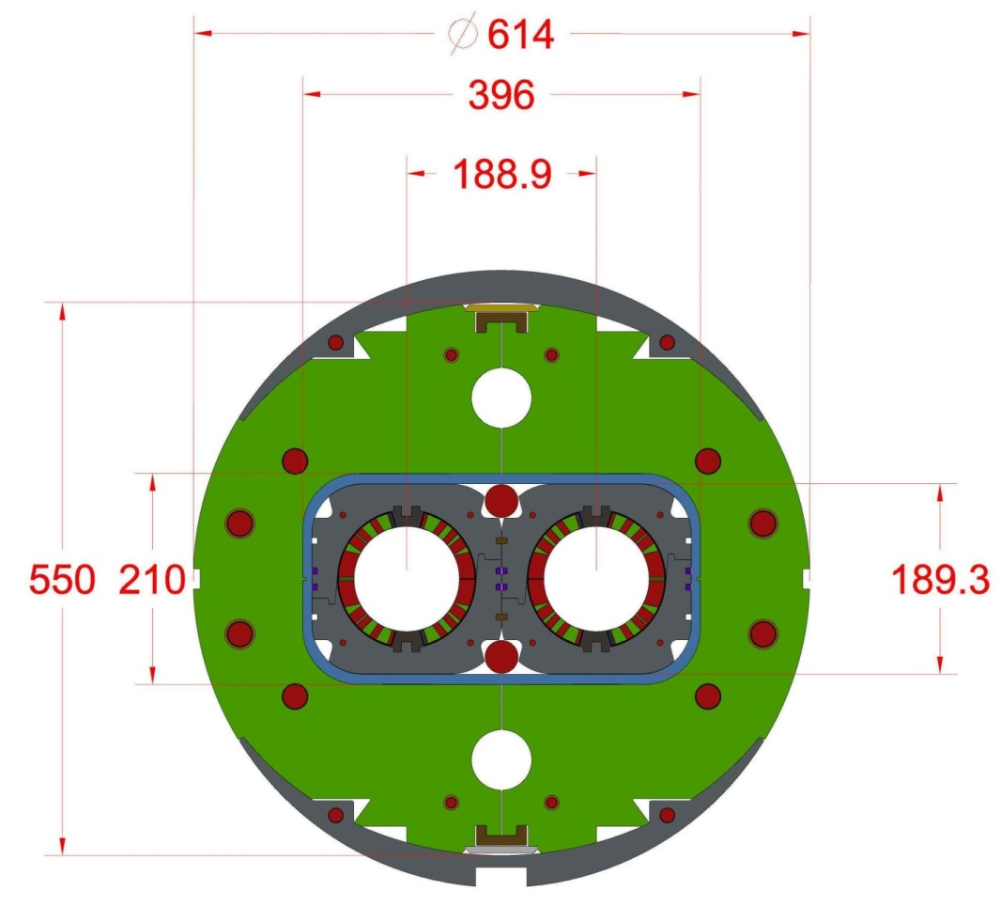
Design of the separation/recombination dipole D2

Slide 9
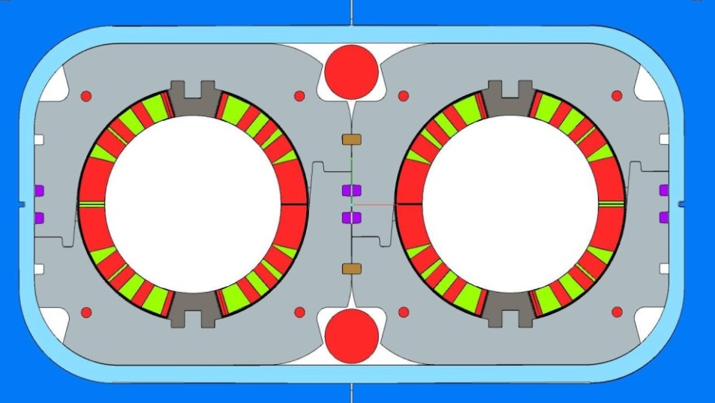
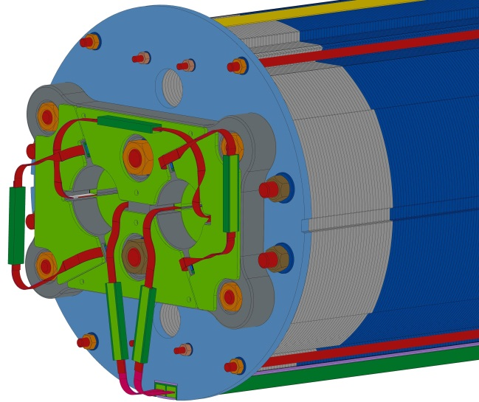
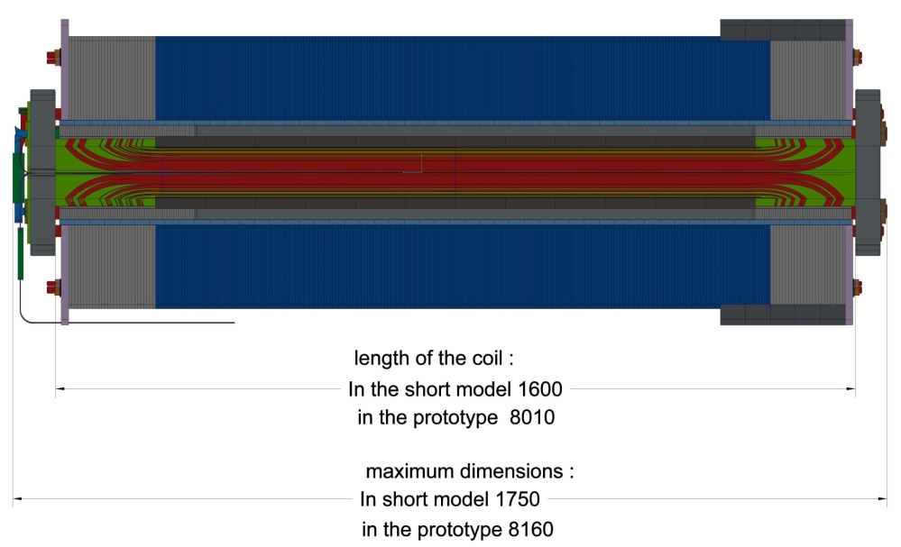
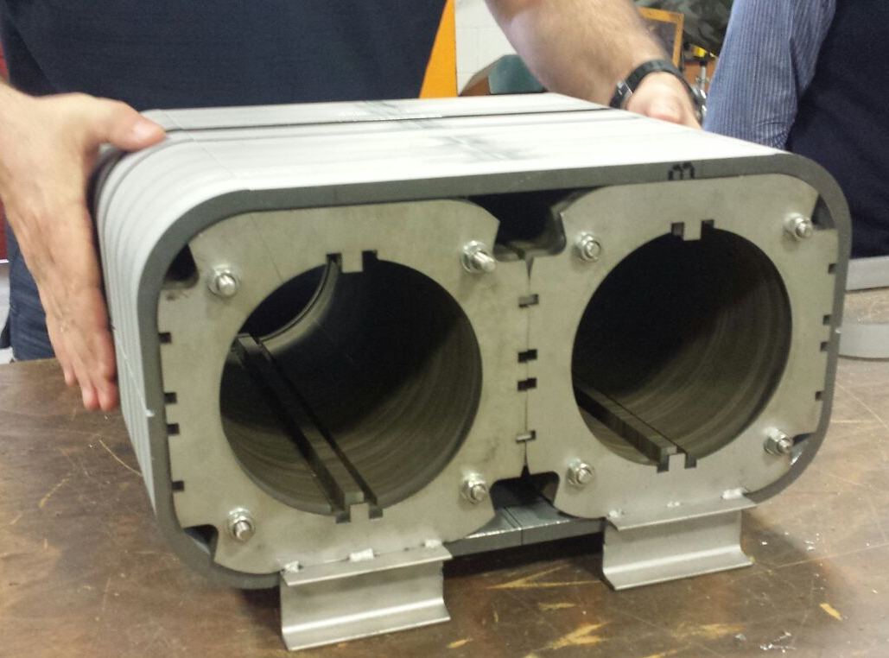
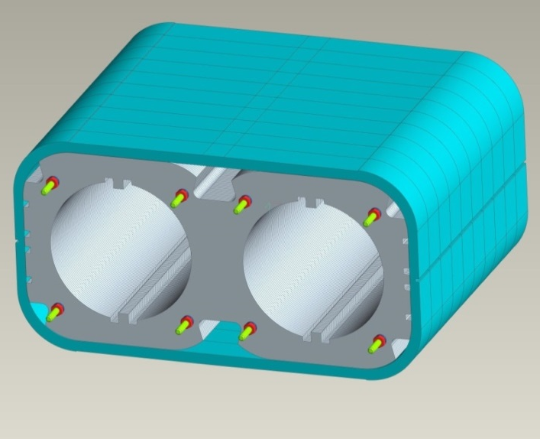
D2 engineering design completed

Slide 10
New agreements CERN-INFN for magnet constructions
A agreement is being finalised between CERN and INFN for the construction (in industry) of a short model (1.6 m) and a prototype (8 m) of the D2 magnet.
The short model shall be delivered to CERN at the end of 2017 and tested at CERN in a vertical cryostat.
The prototype shall be delivered at end of 2019, assembled in a cold mass with the correctors, and tested in a horizontal cryostat.
The involved INFN section is the Genova section.
On the basis of this agreement and subsequently to an international tender, INFN has awarded to ASG Superconductors the construction of the short model
In parallel an agreement is being finalised for the design, procurement and testing of the high-order orbit corrector superconducting magnets (54 magnets to be built).

Slide 11
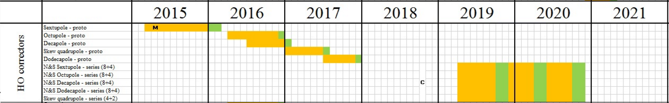
Schedule in HL LHC scheme
Existing Agreements
New Agreements

Slide 12
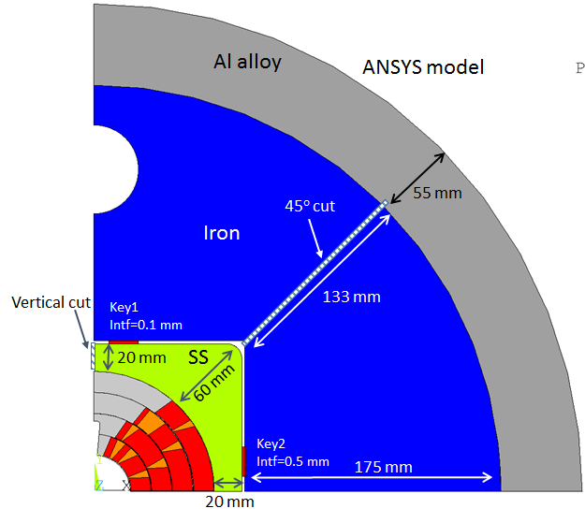
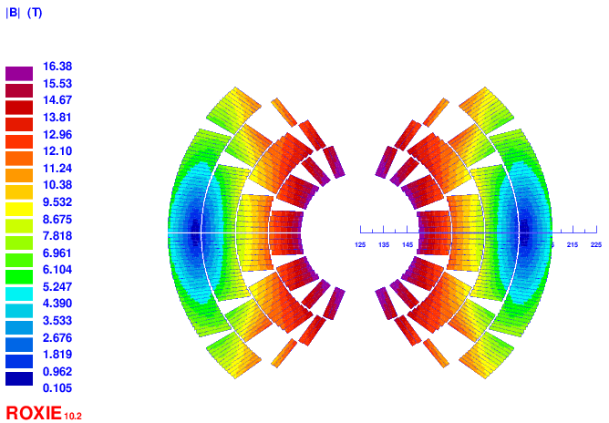
Future
The INFN teams of Genova and Milano-LASA are currently involved in the design of a 16T dipole for FCC in the framework of EuroCirCol project WP5 (H2020).

Slide 13
Summary
INFN is involved in the superconducting magnets of HL-LHC through design and prototyping activities involving the team of Genova and Milano-LASA
New agreements are being finalised for D2 prototyping and construction of high-order orbit correctors.
The INFN teams are involved in the project EuroCirCol with the design of a 16T magnet. A cos-theta design is under development.

Slide 14
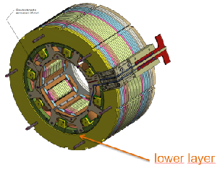
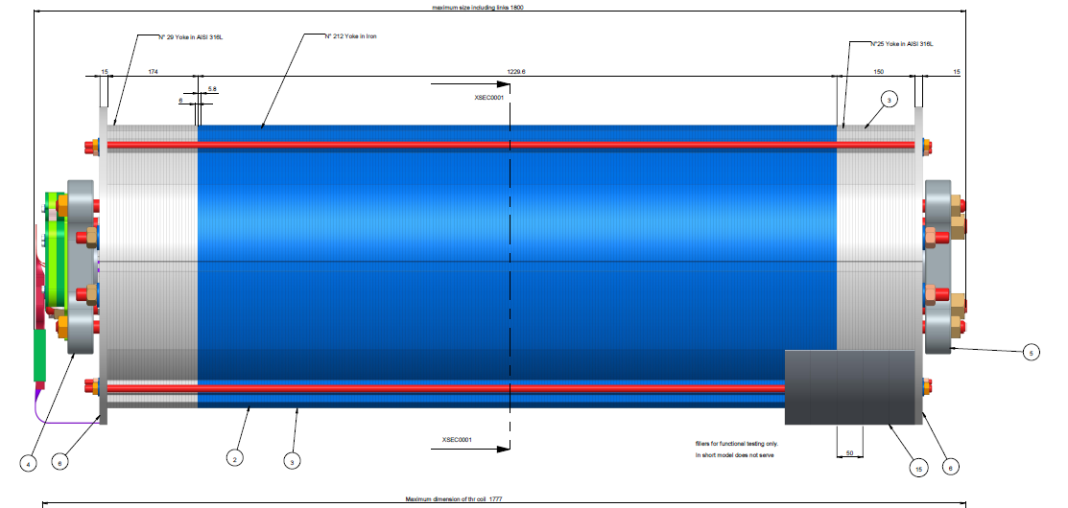
Thank you for your attention

