Slide 1

LHC Status and Outlook
Mike Lamont
for the LHC team

Slide 2

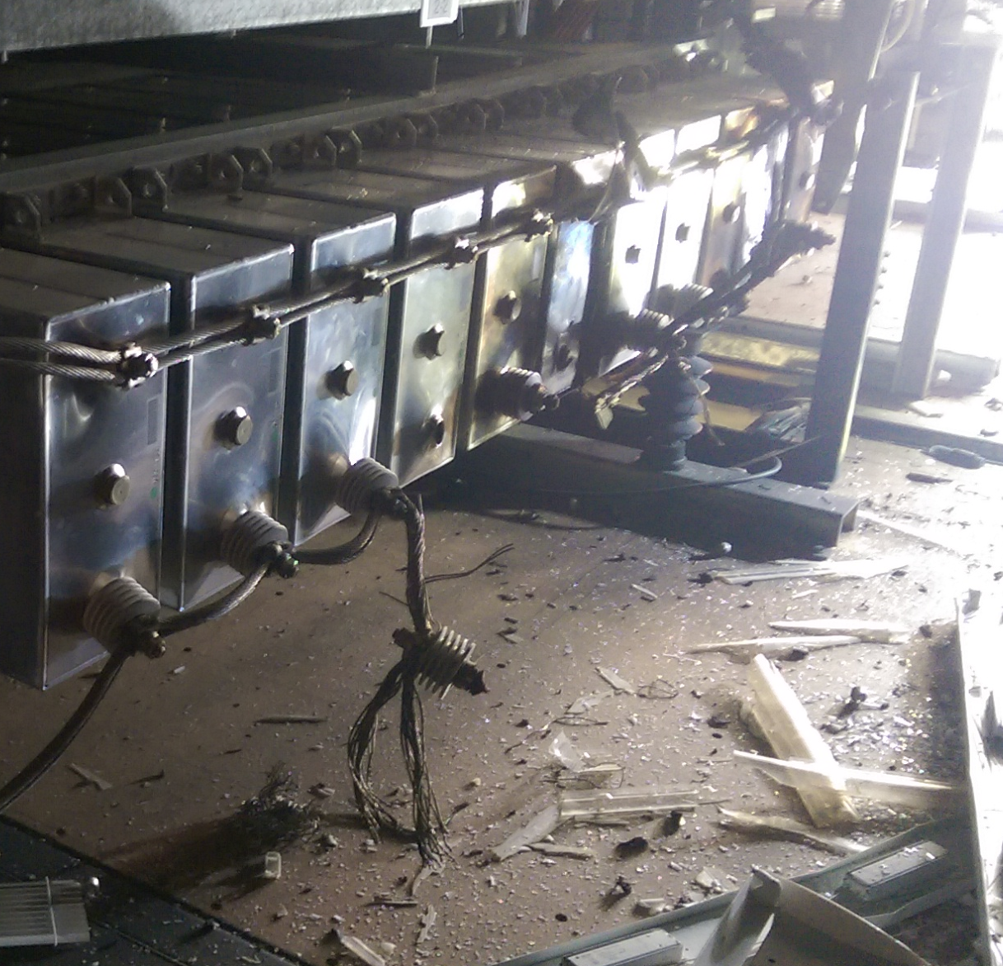
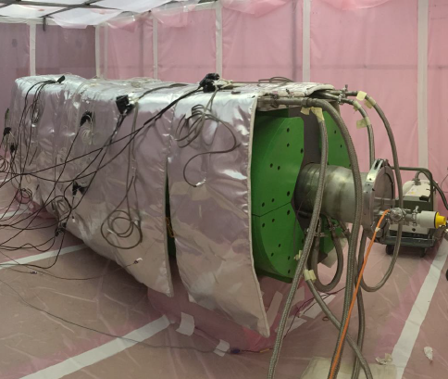
2016: Overcome a few problems…
WEASEL
PS MAIN POWER SUPPLY
SPS BEAM DUMP
Limited to 96 bunches per injection
2220 bunches per beam cf. 2750

Slide 3
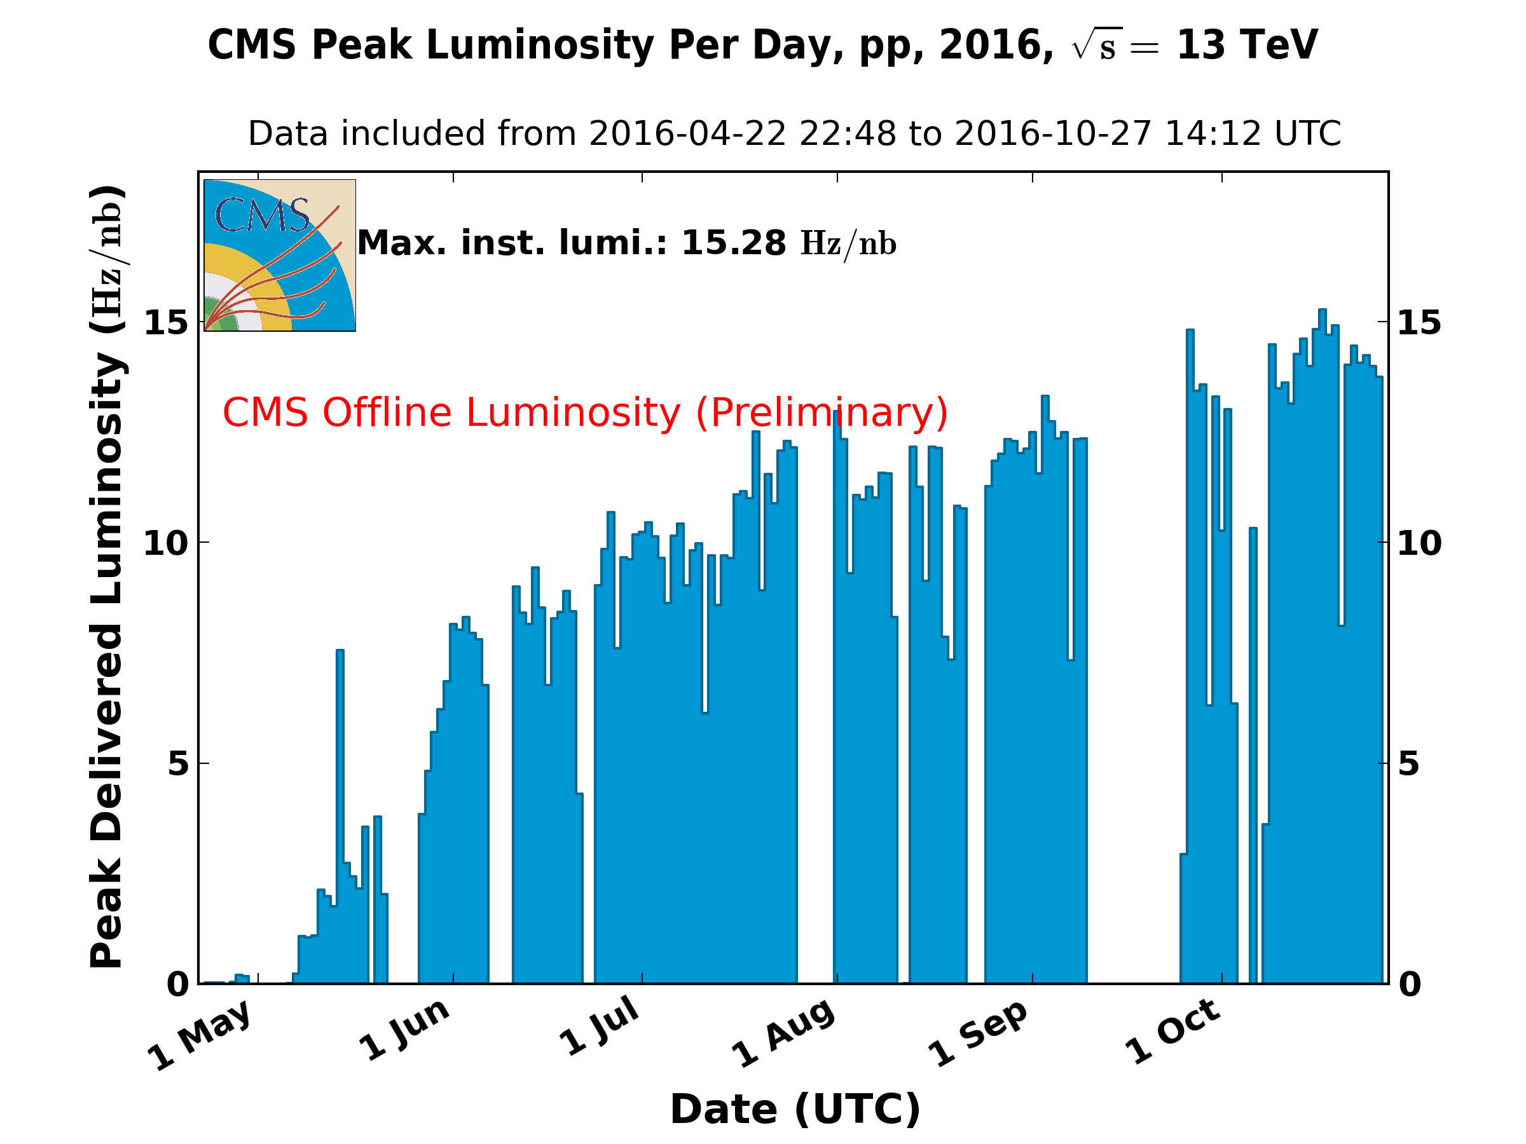
Thereafter: reasonably quick ramp-up in number of bunches
  Electron cloud still very much with us but effects under control
1.5 x 10³⁴ cm⁻²s⁻¹
10³⁴
BCMS
Reduced crossing angle

Slide 4
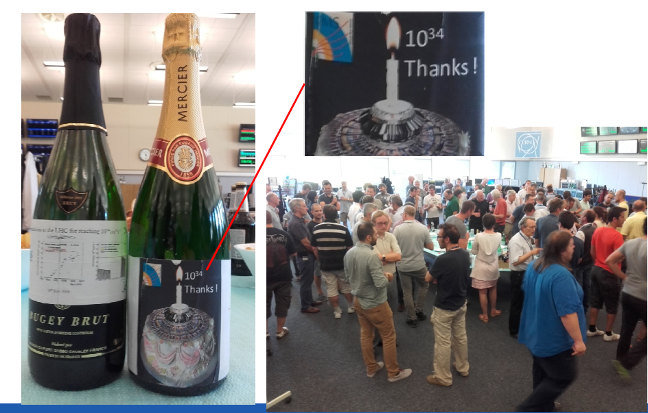
Design luminosity reached
  Reduced beta* and lower transverse beam sizes from the injectors compensating the lower number of bunches

Slide 5
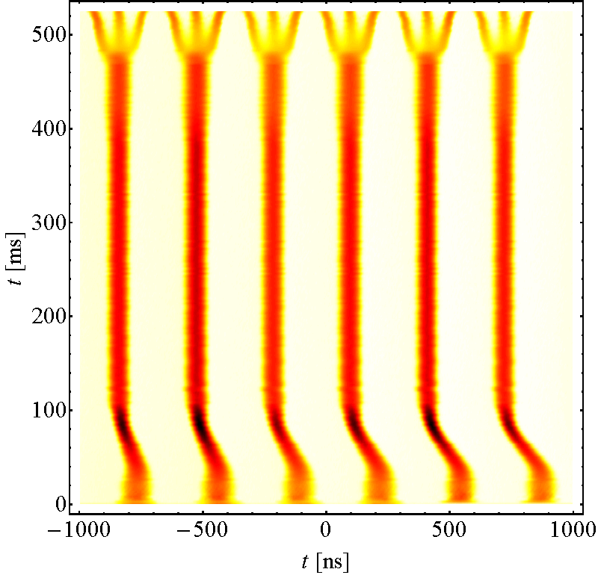
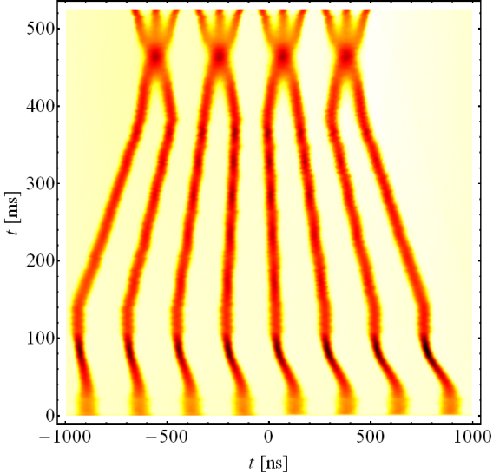
Beam from injectors
Acknowledgements to Steve Hancock
Lower than nominal emittance taken a step further
BCMS
(Batch Compression, Merging & Splitting)
Standard 25 ns scheme
PS circumference
Lower intensity, smaller bunches from PSB

Slide 6
Good peak performance
Beta* = 40 cm
BCMS
Reduced crossing angle, bunch length
Limited in number of bunches
Limited in bunch intensity (injection kicker vac.)
Bunch population | ~1.1e11
Number of bunches | 2220
Beta* | 40 cm
Crossing angle | 280 urad
Emittance (BCMS) | ~2.0 um
Peak (CMS) | ~1.5e34 cm⁻²s⁻¹
Crossing angle reduced end September
X-angle [urad] | F
370 | 0.59
280 | 0.7

Slide 7
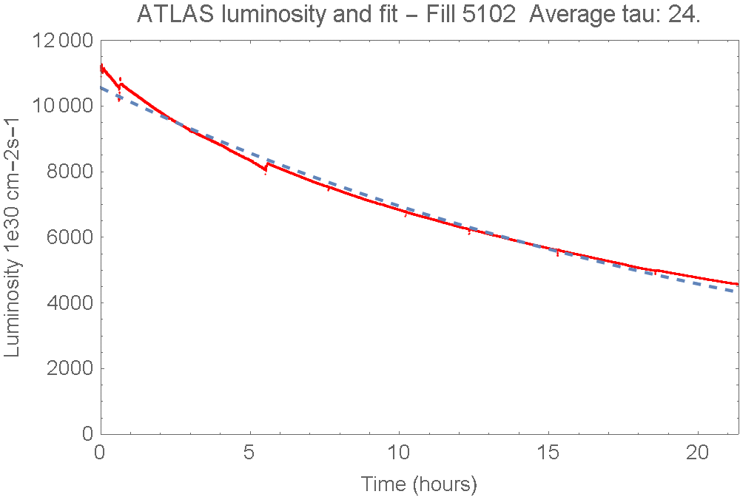
Luminosity lifetime
Excellent luminosity lifetime – main component - proton loss to inelastic collisions in ATLAS, CMS and LHCb
Enjoying effects of synchrotron radiation damping

Slide 8
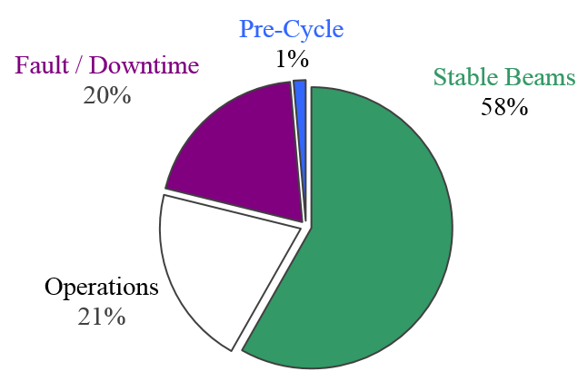
Availability: 11th June – 8th September
79 days proton physics
Stable Beams 58%!
Andrea Apollonio et al

Slide 9
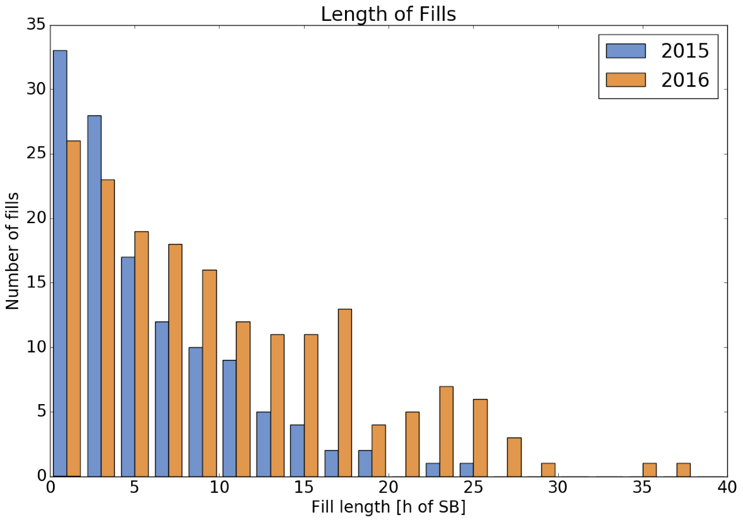
Premature dumps
Almost half of the fills ended by operations
Start to worry about optimum fill length!
Ben Todd

Slide 10
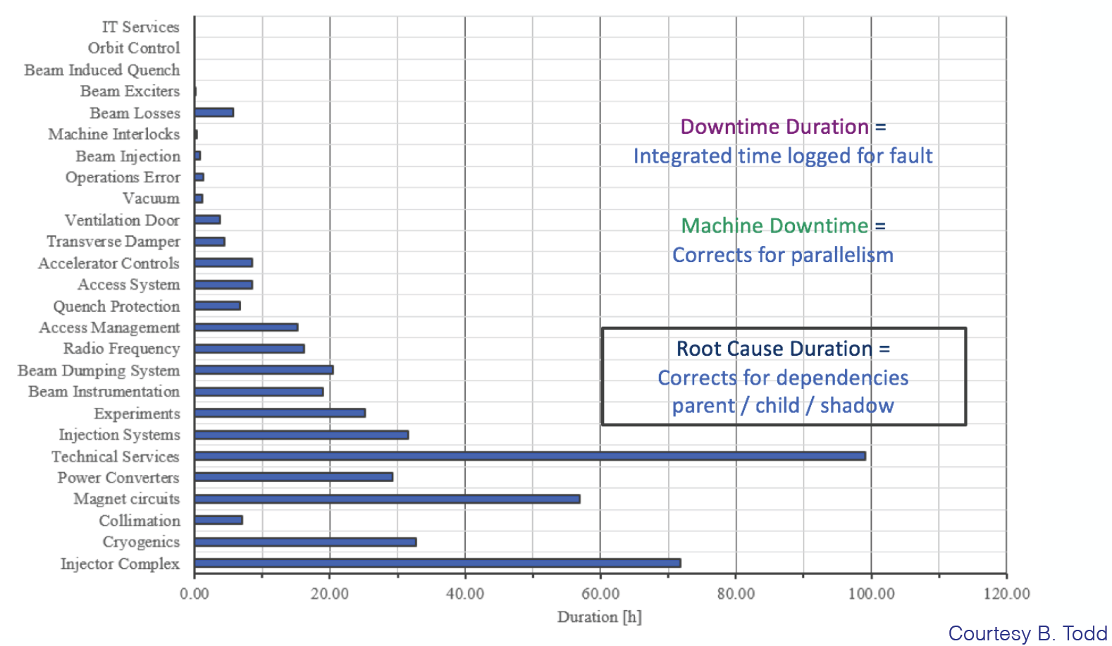
Fault analysis

Slide 11
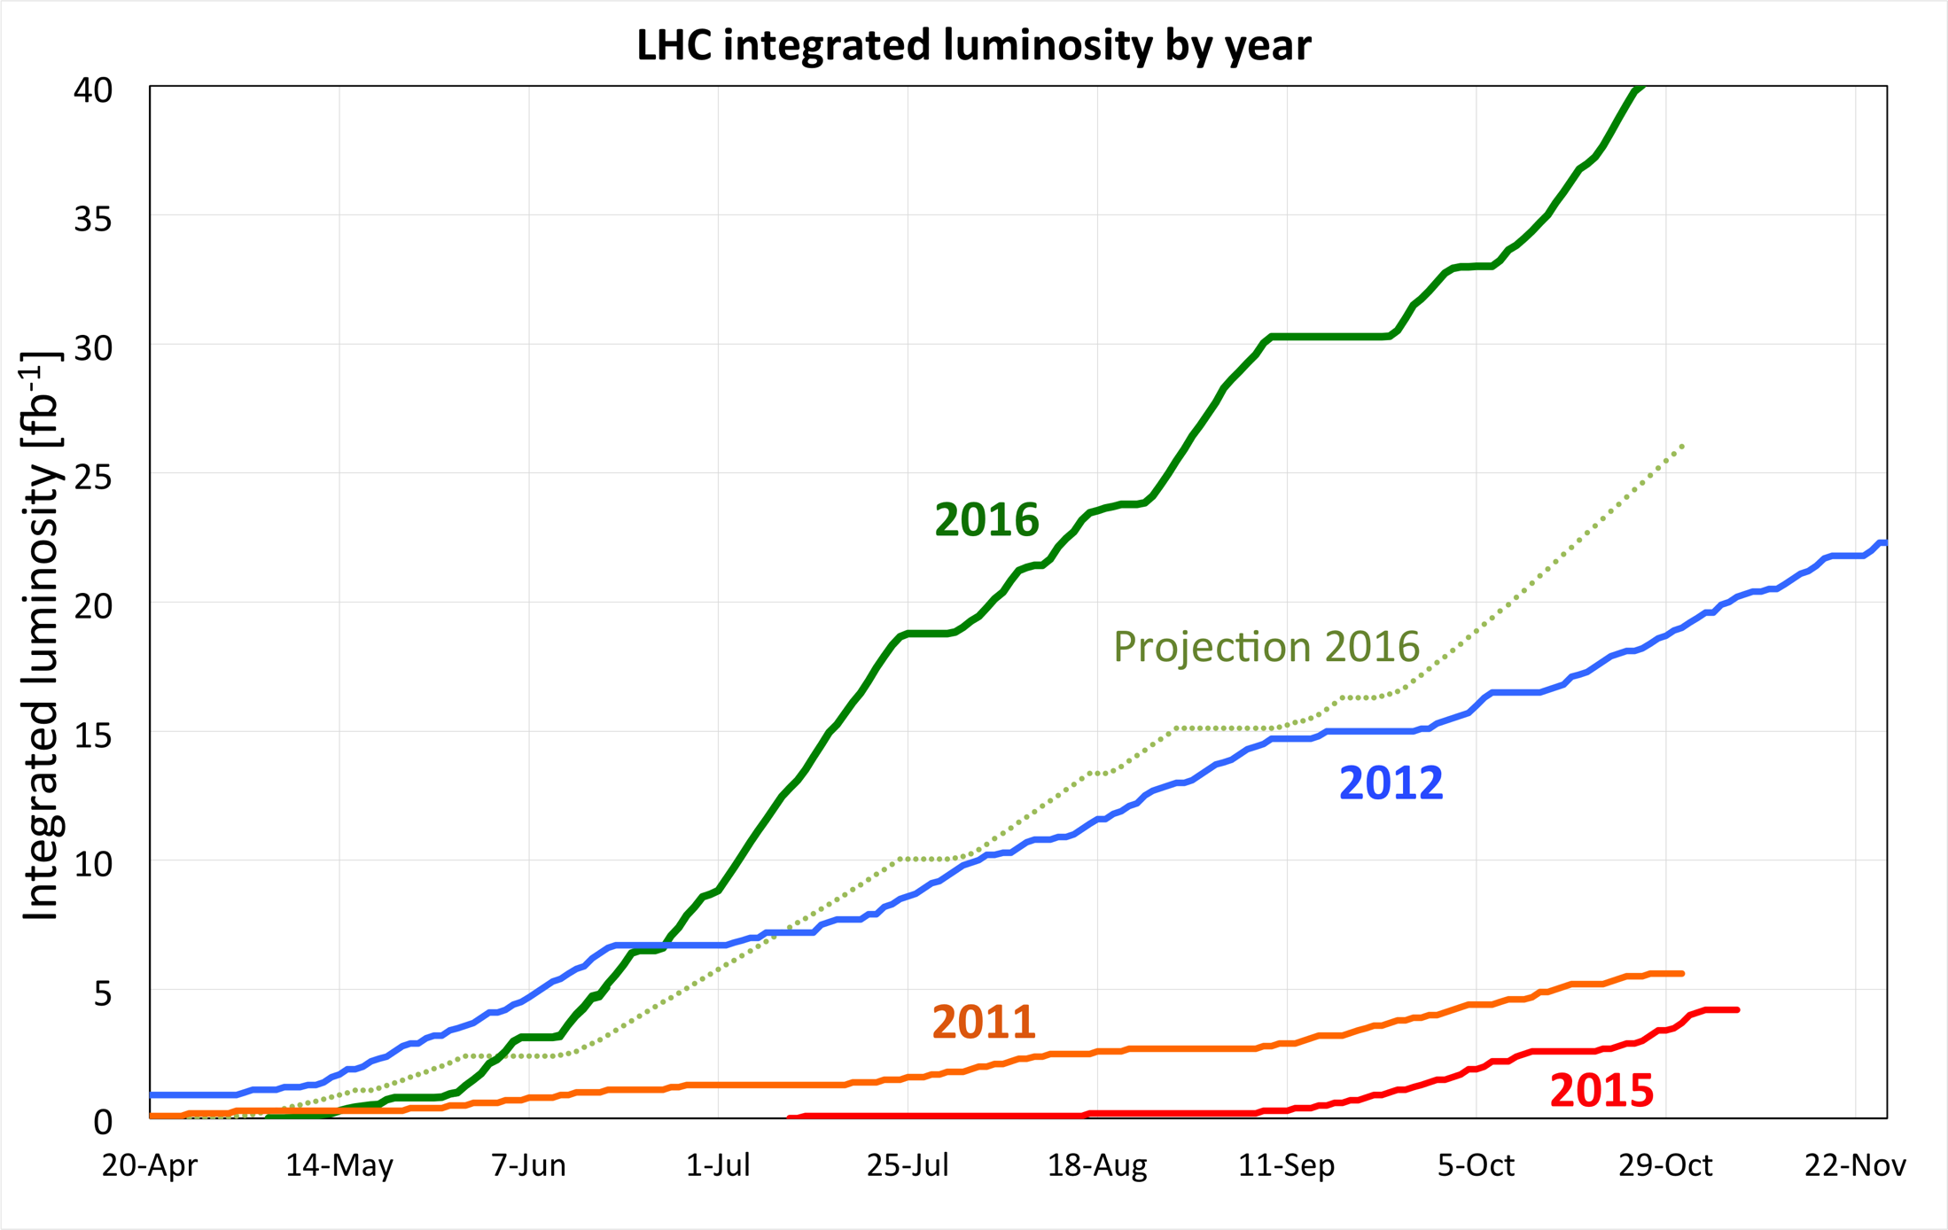

Slide 12
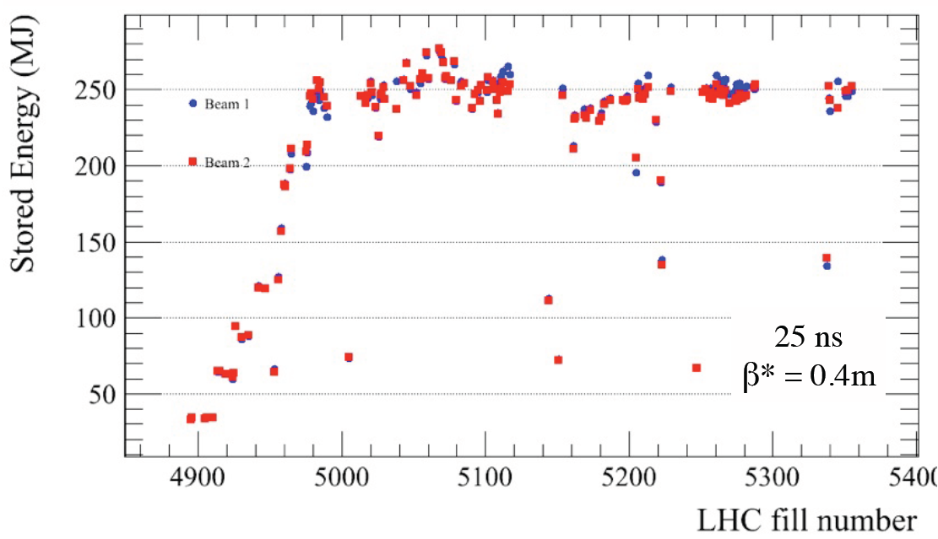
This with > 250 MJ per beam
Operations underpinned by superb performance of the machine protection system

Slide 13
Limitations
SPS beam-dump
  No of bunches per injection limited to 96
  Total number of bunches: 2200
Injection kicker
  Outgassing from ceramic connection (MKI8D-Q5)
  Bunch population limited to around 1.1 x 10¹¹
Electron cloud
  Still significant heat-load within cryogenic limits
UFOs
  Frequency has happily conditioned down

Slide 14
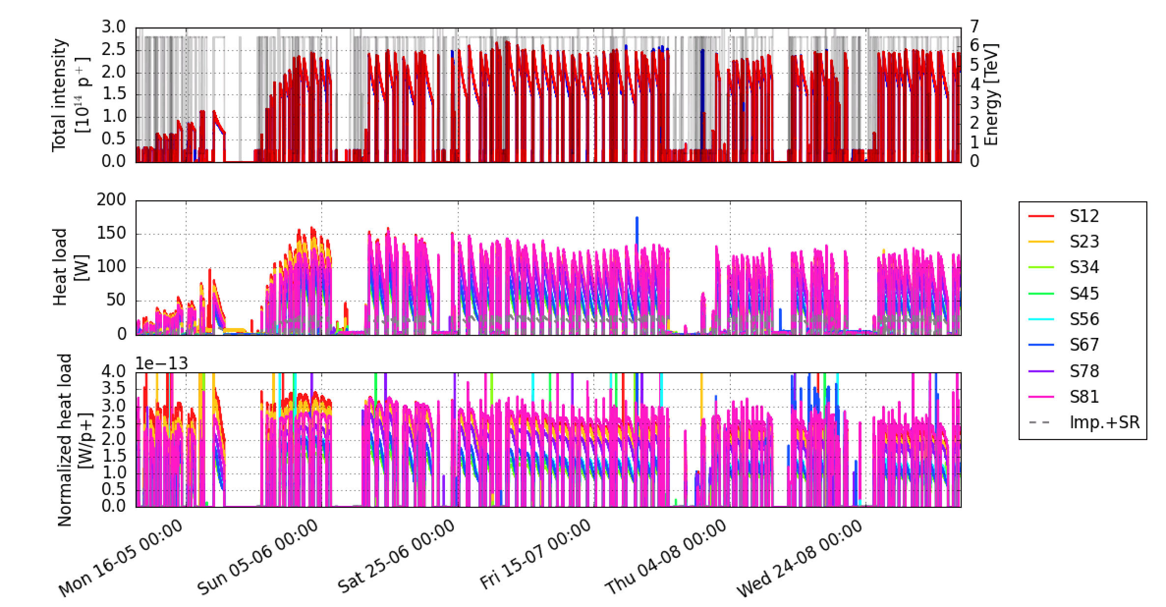
Electron Cloud - Heat Loads
Courtesy G. Iadarola
Very slow electron cloud reduction despite significant doses
Improved handling of dynamics by cryogenics
Drives instabilities – running with high chromaticity, octupoles and damper gain to successfully counter

Slide 15
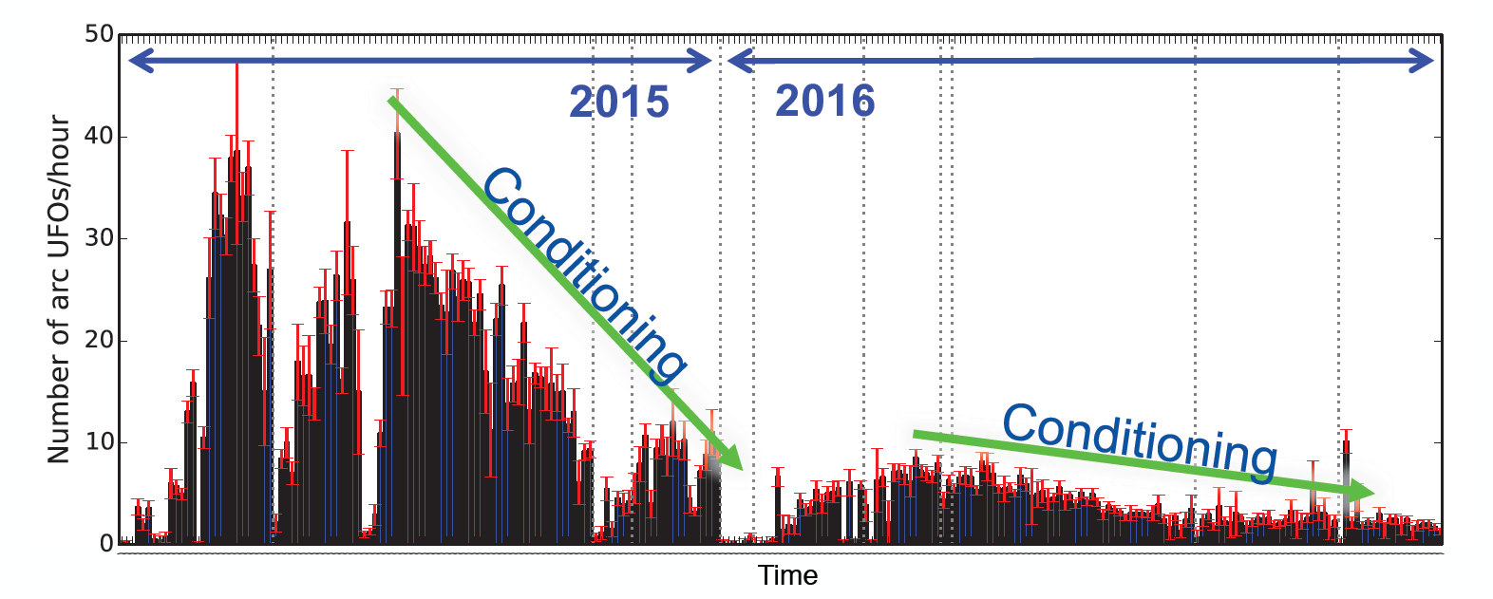
UFOs
Clear conditioning effect
Not known if conditioning will be lost after venting
At the present rate UFOs are at a very acceptable rate

Slide 16
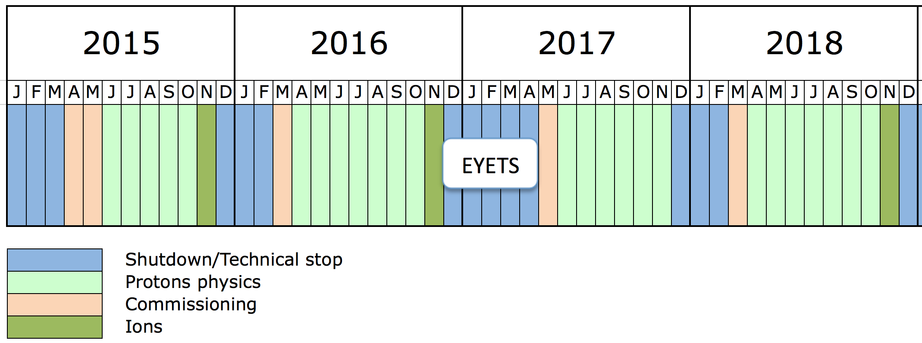
Run 2
Extended Year End Technical Stop – 20 weeks
- CMS pixel upgrade
- dipole exchange in sector 12
Complementary objectives:
Prepare for HL-LHC and post-LS2 LIU era
Prepare for 7 TeV operation - operation at over 6.5 TeV in 2018 being explored – see Chamonix

Slide 17
Main Options 2017
Optics
  ATS versus nominal
  From a performance perspective nothing to choose between them (beta*, squeeze length etc.)
  Might worry about commissioning time – strategic choice
Squeeze
  40 cm or lower (33 cm seems popular)
  Luminosity levelling options being explored
Nominal 25 ns versus BCMS
Limits from SPS beam dump and LHC injection kicker vacuum should be lifted

Slide 18
Possible 2017/18 parameters
 | Nominal | BCMS | BCMS+
Beta* (1/5) [cm] | 40 | 40 | 33
Half crossing angle [urad] | 185 | 155 | 170
No. of colliding bunches | 2736 | 2448 | 2448
Proton per bunch | 1.25e11 | 1.25e11 | 1.25e11
Emittance into SB [um] | 3.2 | 2.3 | 2.3
Bunch length [ns] | 1.05 | 1.05 | 1.05
Peak luminosity [cm⁻²s⁻¹] | ~1.4e34 | ~1.7e34 | ~1.9e34
Peak pile-up | ~37 | ~51 | ~56
Luminosity lifetime [h] | ~21 | ~15 | ~14
Naively applying 2016’s overall Hübner factor gives between 45 and 60 fb⁻¹
Final configuration following discussion at Evian and Chamonix

Slide 19
Machine status - summary
Excellent and improved system performance
Magnets behaving well at 6.5 TeV
Good beam lifetime through the cycle
Operationally things well under control
Magnetically reproducible as ever
Optically good, corrected to excellent
Aperture is fine and compatible with the collimation hierarchy.
Collimation can take anything that’s thrown at it

Slide 20
Conclusions
Reasonable peak performance
  Well above design luminosity (squeeze, beams from injectors)
  Still margin for improvement in Run 2
Good integrated delivery
  Excellent availability (normal caveats apply)
  Electron cloud conditioning slowly
  Fortunate that UFOs have conditioned down
Interesting to note that a machine of this complexity with such a challenging operational regime can work pretty well!

Slide 21
Looking good | Keep an eye on
Availability and R2E | Electron cloud
Injectors | Instabilities
Optics | Losses at start of fill
Magnet model, magnets at 6.5 TeV | Beam-beam, DA
Aperture | Emittance growth
Reproducibility, stability | Earth faults
Nominal cycle++, turn-around | Robustness of protection devices
Losses through cycle
Machine protection, QPS
ADT, RF, Power converters
Beam instrumentation, feedbacks
Collimation, beam cleaning
LBDS, Injection
Cryogenics
Vacuum, UFOs, Beam induced heating

Slide 22
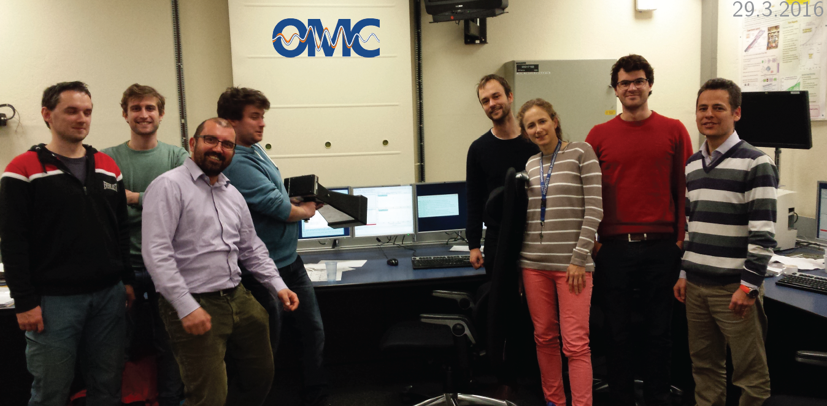
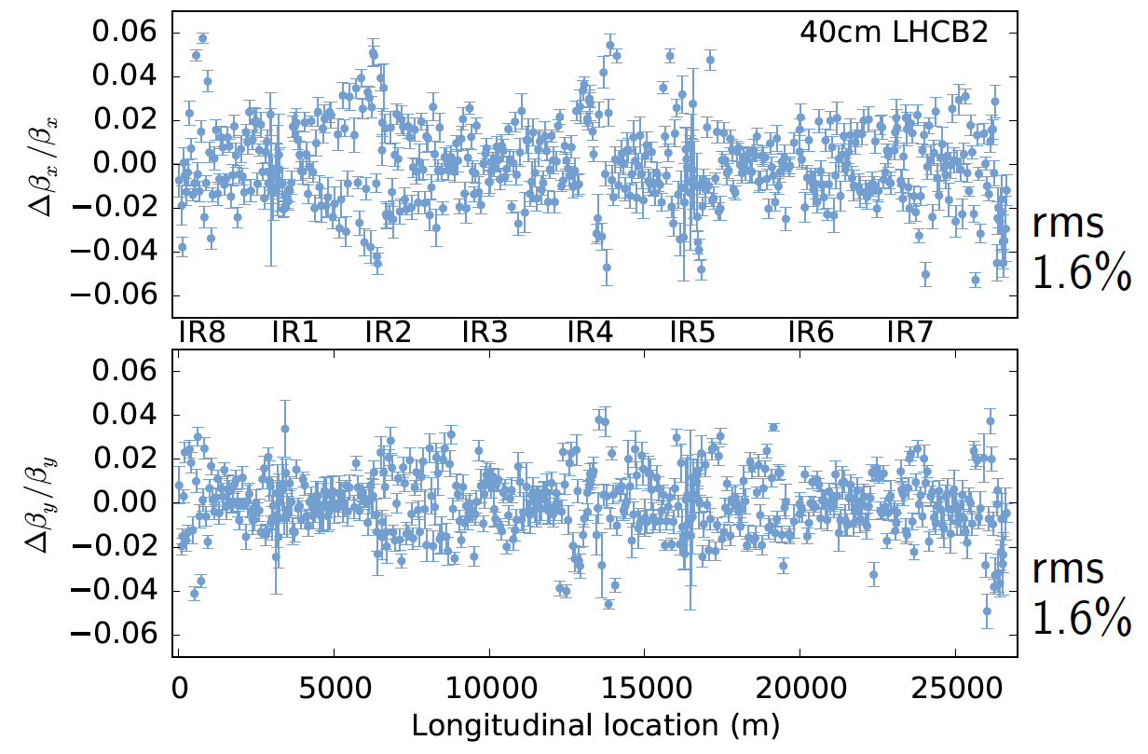
2016: 1% rms beta-beating, C- of 0.0002 and lot more to celebrate!

Slide 23
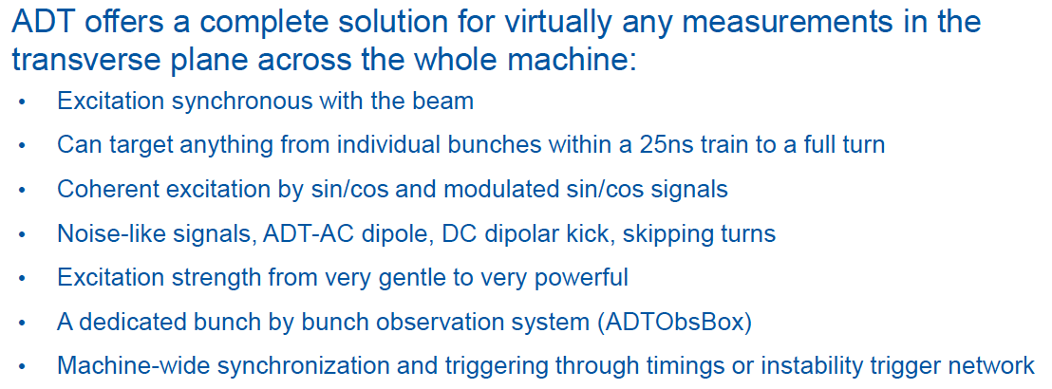
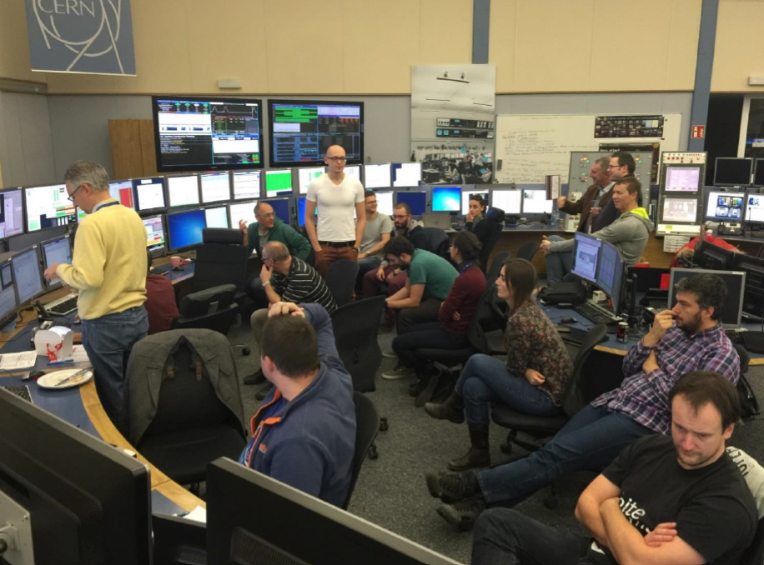
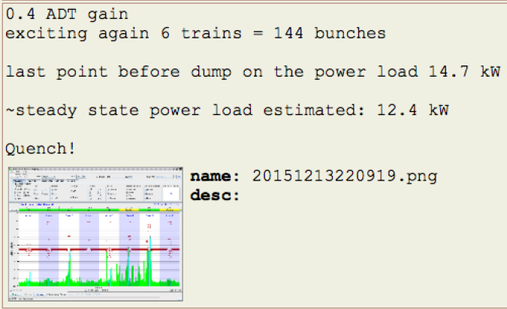
Courtesy Daniel Valuch

Slide 24
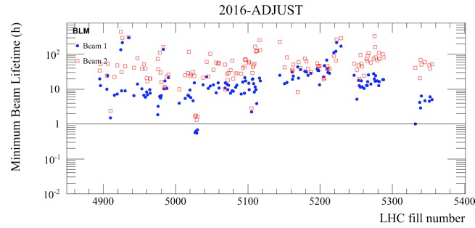
Lifetime
Lifetime very good in Run 2. Not clear how to scale to HL-LHC.
Isolated case during intensity ramp up
After reduction of crossing angle.
Mitigation deployed
Belen

Slide 25
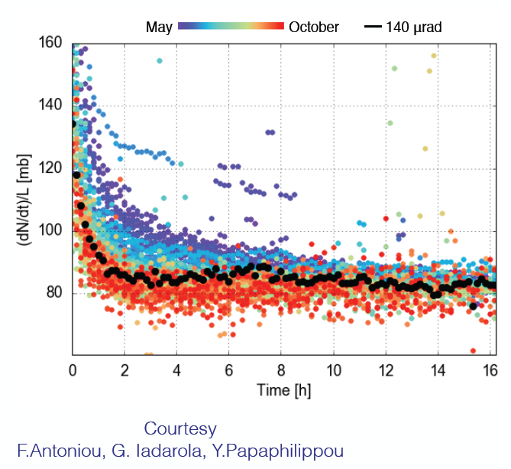
Lifetime in Stable Beams
NB first hour – was worse with higher bunch population in 2012

