Slide 1






IR magnets overview
E. Todesco, P. Ferracin, on behalf of WP3
14 November 2016 - CERN

Slide 2
SCOPE
Replacement of IR magnets in IP1 and IP5 with larger aperture (~twice) to allow a β* reduction (~one fourth)
HL LHC 2024-2035
LHC 2008-2022

Slide 3
MAIN NEWS SINCE TSUKUBA MEETING
  Test
    Sextupole corrector
    2 triplet short models, 3 coils from US and 5 coils from CERN
    1 mirror 4-m-long coil
    D1 short model
  Baseline review
    10% savings on the WP (from 220 to 200 M)
    Change of position of the heat exchanger in D1 and CP
    US collaboration will provide Q1/Q3 in the final cryostat
    Magnets on one circuit
  Contracts attributed
    D2 short model contract
    MQYY prototype (QUACO) for the first phase

Slide 4
STRUCTURE UPDATE
J. C. Perez in charge of orbit correctors from CERN side
A. Foussat in charge of D2 and MQYY from CERN side
A. Musso in charge of D1 and high order correctors from CERN side
M. Sorbi in charge of high order correctors from LASA
H. Prin in charge of all cold masses made with existing magnets
A warm thanks to P. Fessia for his work on the correctors

Slide 5
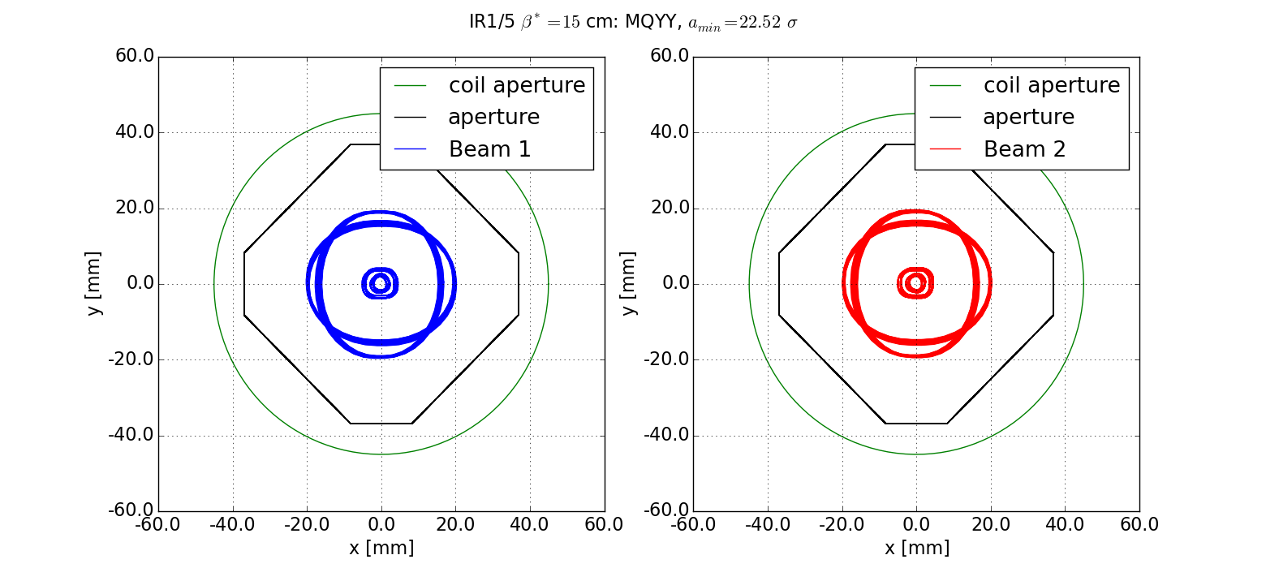
BASELINE CHANGES
Use a laminated structure for the triplet
  The LARP structure consisted of 50-mm-long pieces, we decide to go for 3-mm-thick laminations
  Considerable saving, the longitudinal mechanics may change, iterations may be needed
    The second short model MQXFS3
    has a laminated structure
Q4 in IR1 and IR5
  Based on the aperture requirement of 90 mm, the MQYY model has been developed in CEA-Saclay since 2012
  For the round beam case, 70 mm aperture are enough, 90 mm needed for the flat beam option
  Q4 will use existing magnet with 70 mm aperture (MQY)
    The development of the 90 mm aperture magnet MQYY will continue with short model (CEA Saclay) and prototypes (QUACO) (see also talk of P. Vedrine)
Simplification of layout
  Q6 will stay at 4.5 K (higher gradient is not needed)
  Q5 in IR6 will be the LHC cold mass but at 1.9 K
Beam envelope and MQYY aperture [R. De Maria]

Slide 6
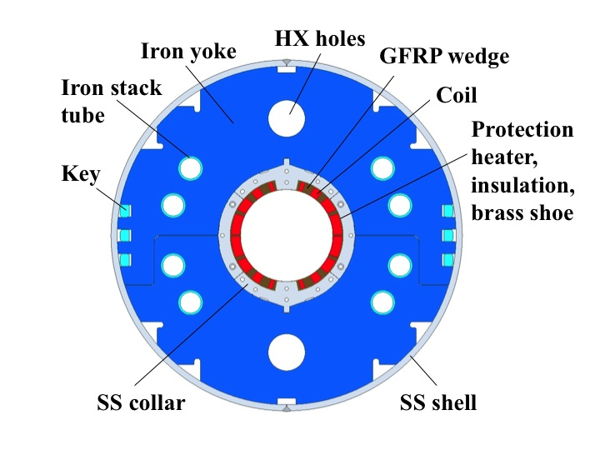
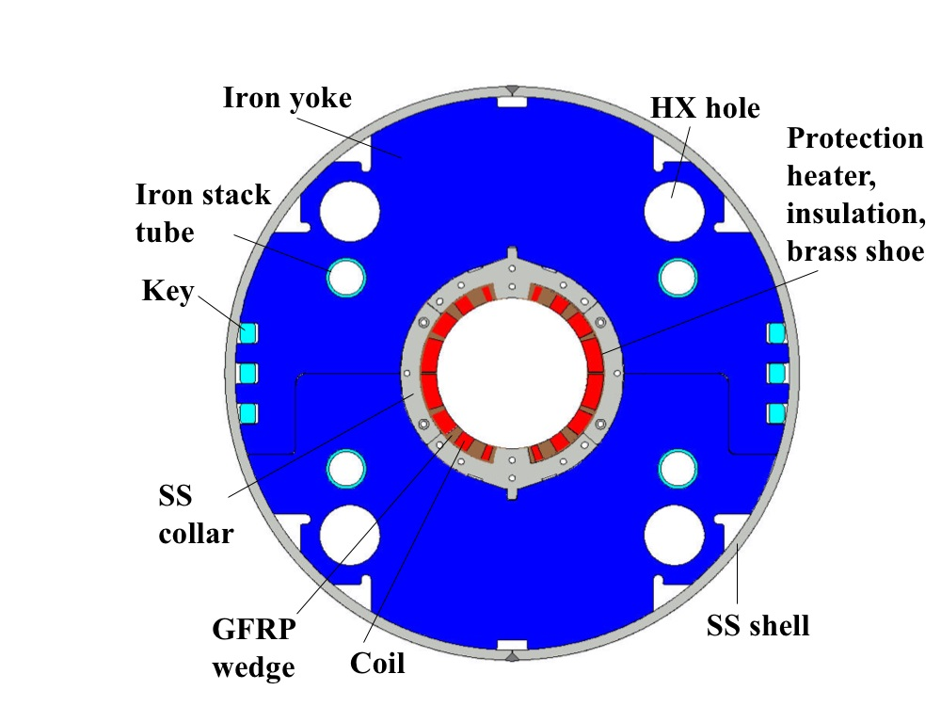
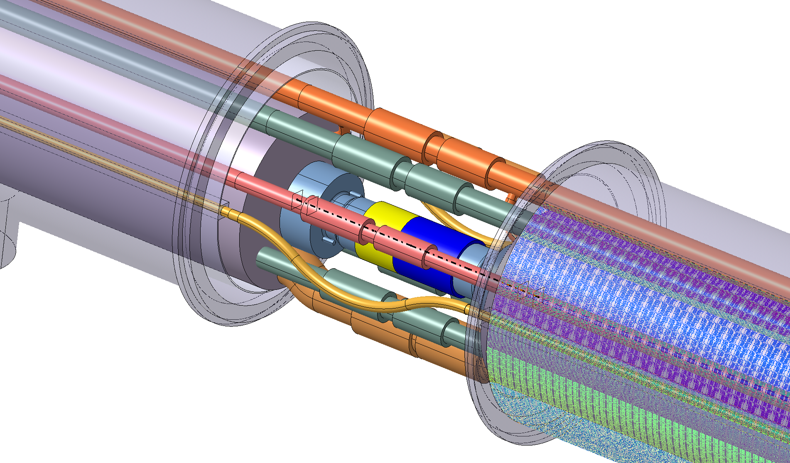
BASELINE CHANGES
Position of heat exchangers in D1 and corrector package
  In the first design D1 had smaller HX at 90 degrees
  The study of the interconnection showed that they should be aligned with the triplet HX, so they should stay at 45 degrees
  (see also talk of M. Sugano)
Old cross section
[T. Nakamoto, M. Sugano]
New cross section
[T. Nakamoto, M. Sugano]
Interconnection study [H. Prin, D. Duarte Ramos, et al.]

Slide 7
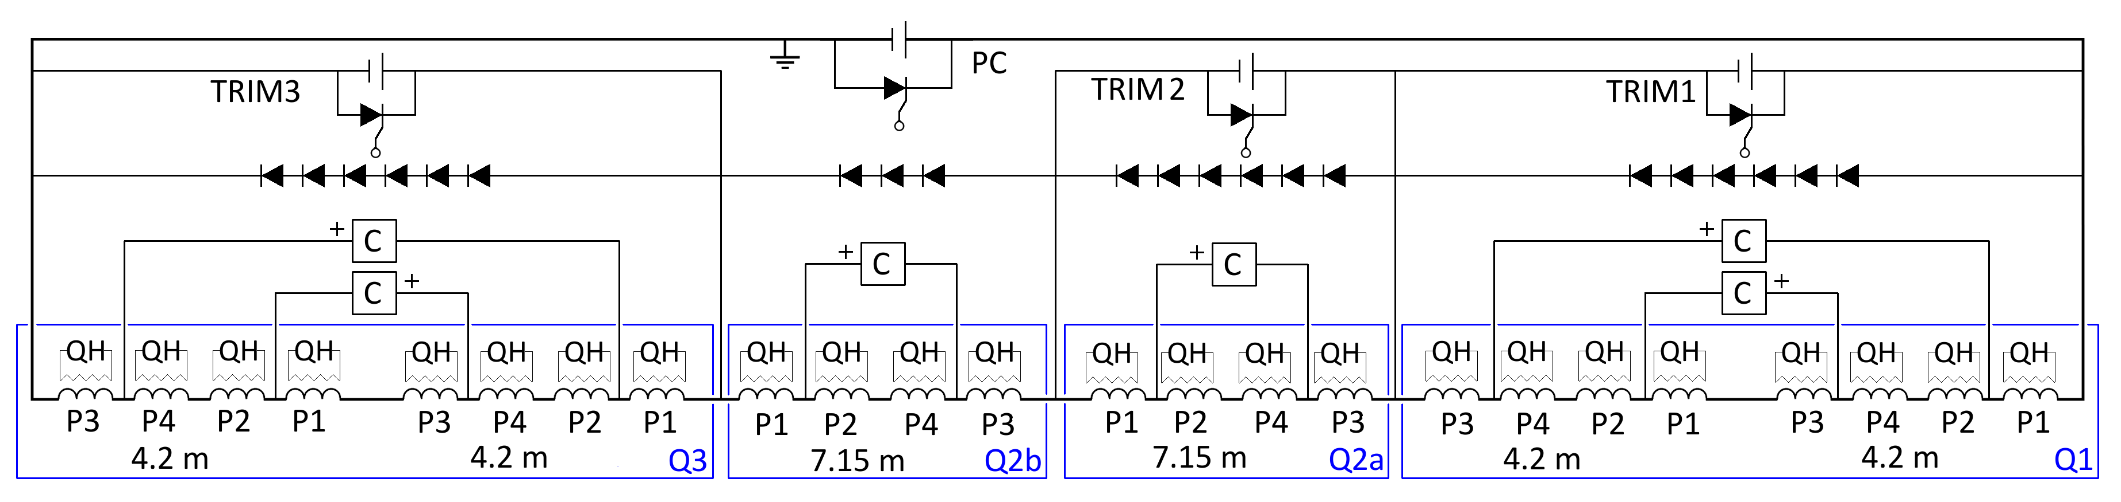
BASELINE CHANGES FROM 2015 TO 2016
Scope of the US in kind contribution (see also talk of G. Apollinari)
  Previous: horizontal test in temporary cryostat, shipping, final cryostat at CERN, and test
  New: US will assembly a final cryostat, designed by CERN, with components from CERN
Circuit for the triplet (see also talk of F. Rodriguez Mateos)
  Previous baseline: Q1/Q3 on one circuit, Q2a/Q2b on another
  New baseline: Q1, Q2a, Q2b, Q3 in series with trims
  Implications on protection discussed in the parallel session (R. Denz, E. Ravaioli)
Design of D2 corrector
  Previous design based on Rutherford cable, operational current of 1.5 kA
  New baseline: use the canted cos theta design with a single wire, operational current of 500 A
Triplet circuit [E. Ravaioli, F. Rodriguez Mateos, D. Wollman, et al.]

Slide 8
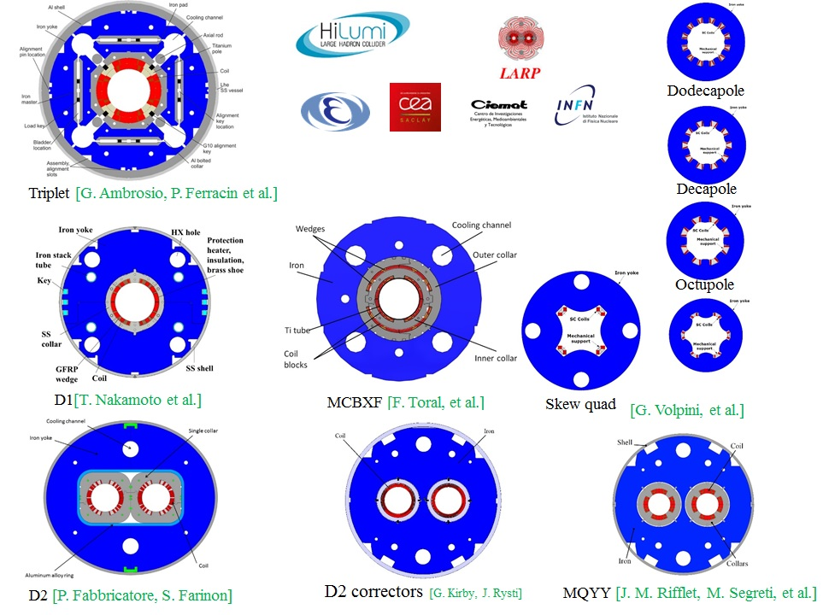
THE MAGNET ZOO: LATEST VERSION
Note: position of the holes in the skew quad will be rotated at 45 degrees

Slide 9
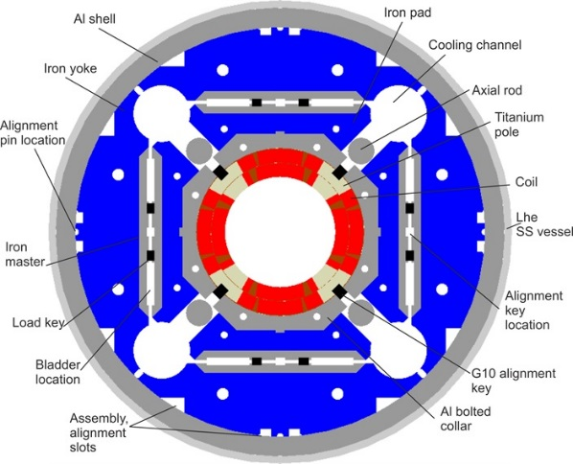
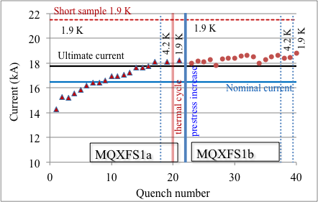
TRIPLET STATUS
Two shorts model tested plus one long mirror
  (Talks from G. L. Sabbi, H. Bajas, J. Muratore)
  MQXFS1a: Ultimate reached, perfect memory
    Slow training, more prestress has been added and second test
  MQXFS1b:
    First quench above ultimate, 90% of short sample reached
MQXF cross-section
[P. Ferracin, G. Ambrosio]
MQXFS1a test [G. Chlachidze et al.]

Slide 10
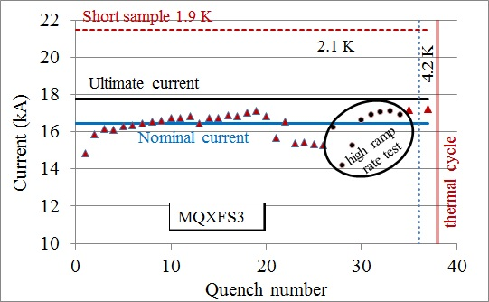
TRIPLET STATUS
MQXFS3: Nominal reached, ultimate not reached
    Large detraining recovered after ramp rate studies
    Thermal cycle is being done, prestress in the heads has been added
MQXFS3 test [H. Bajas et al.]

Slide 11
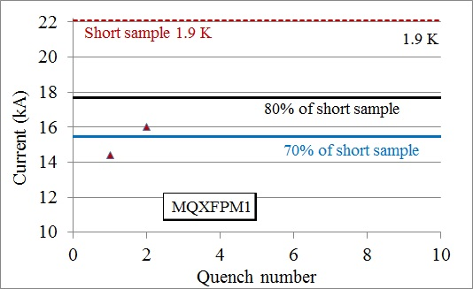
TRIPLET STATUS
First mirror: Above 70% with two quenches
  New world record in length for a Nb₃Sn coil in accelerator magnets
  Next steps [see G. Ambrosio talk]
    US protoype in 2017
    7.15-m-long prototype in 2019
    Exploring the possibility of building the series in the industry: in mid 2018 we will have answers to the invitation for tender
MQXFPM1 test [J. Muratore et al.]

Slide 12
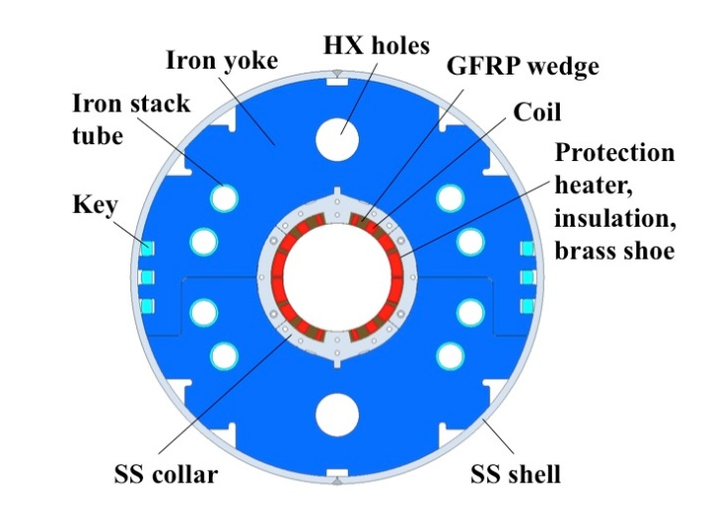
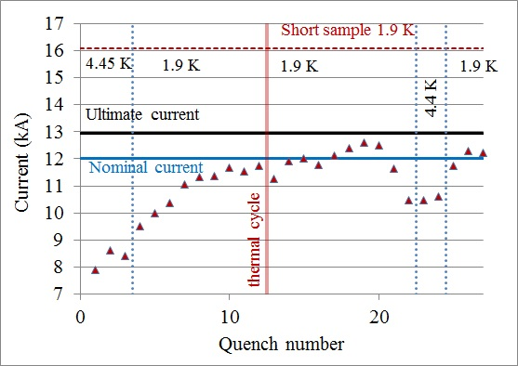
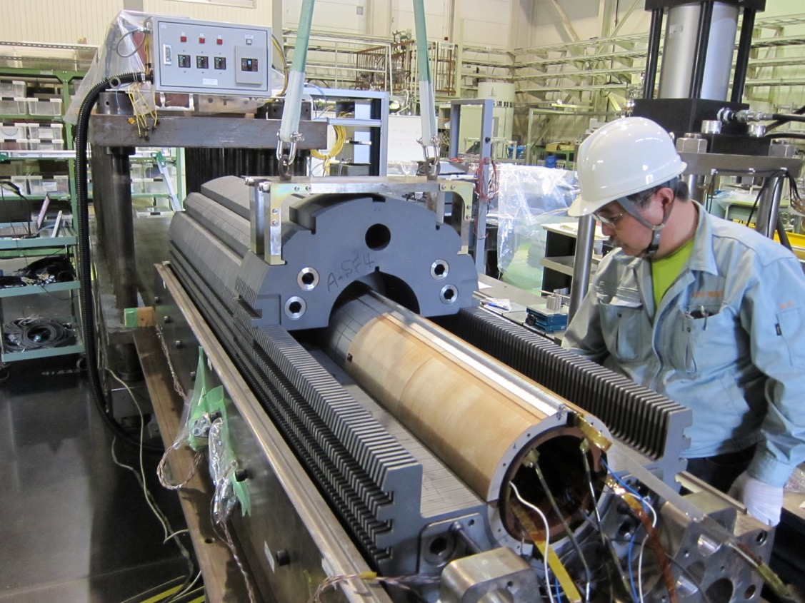
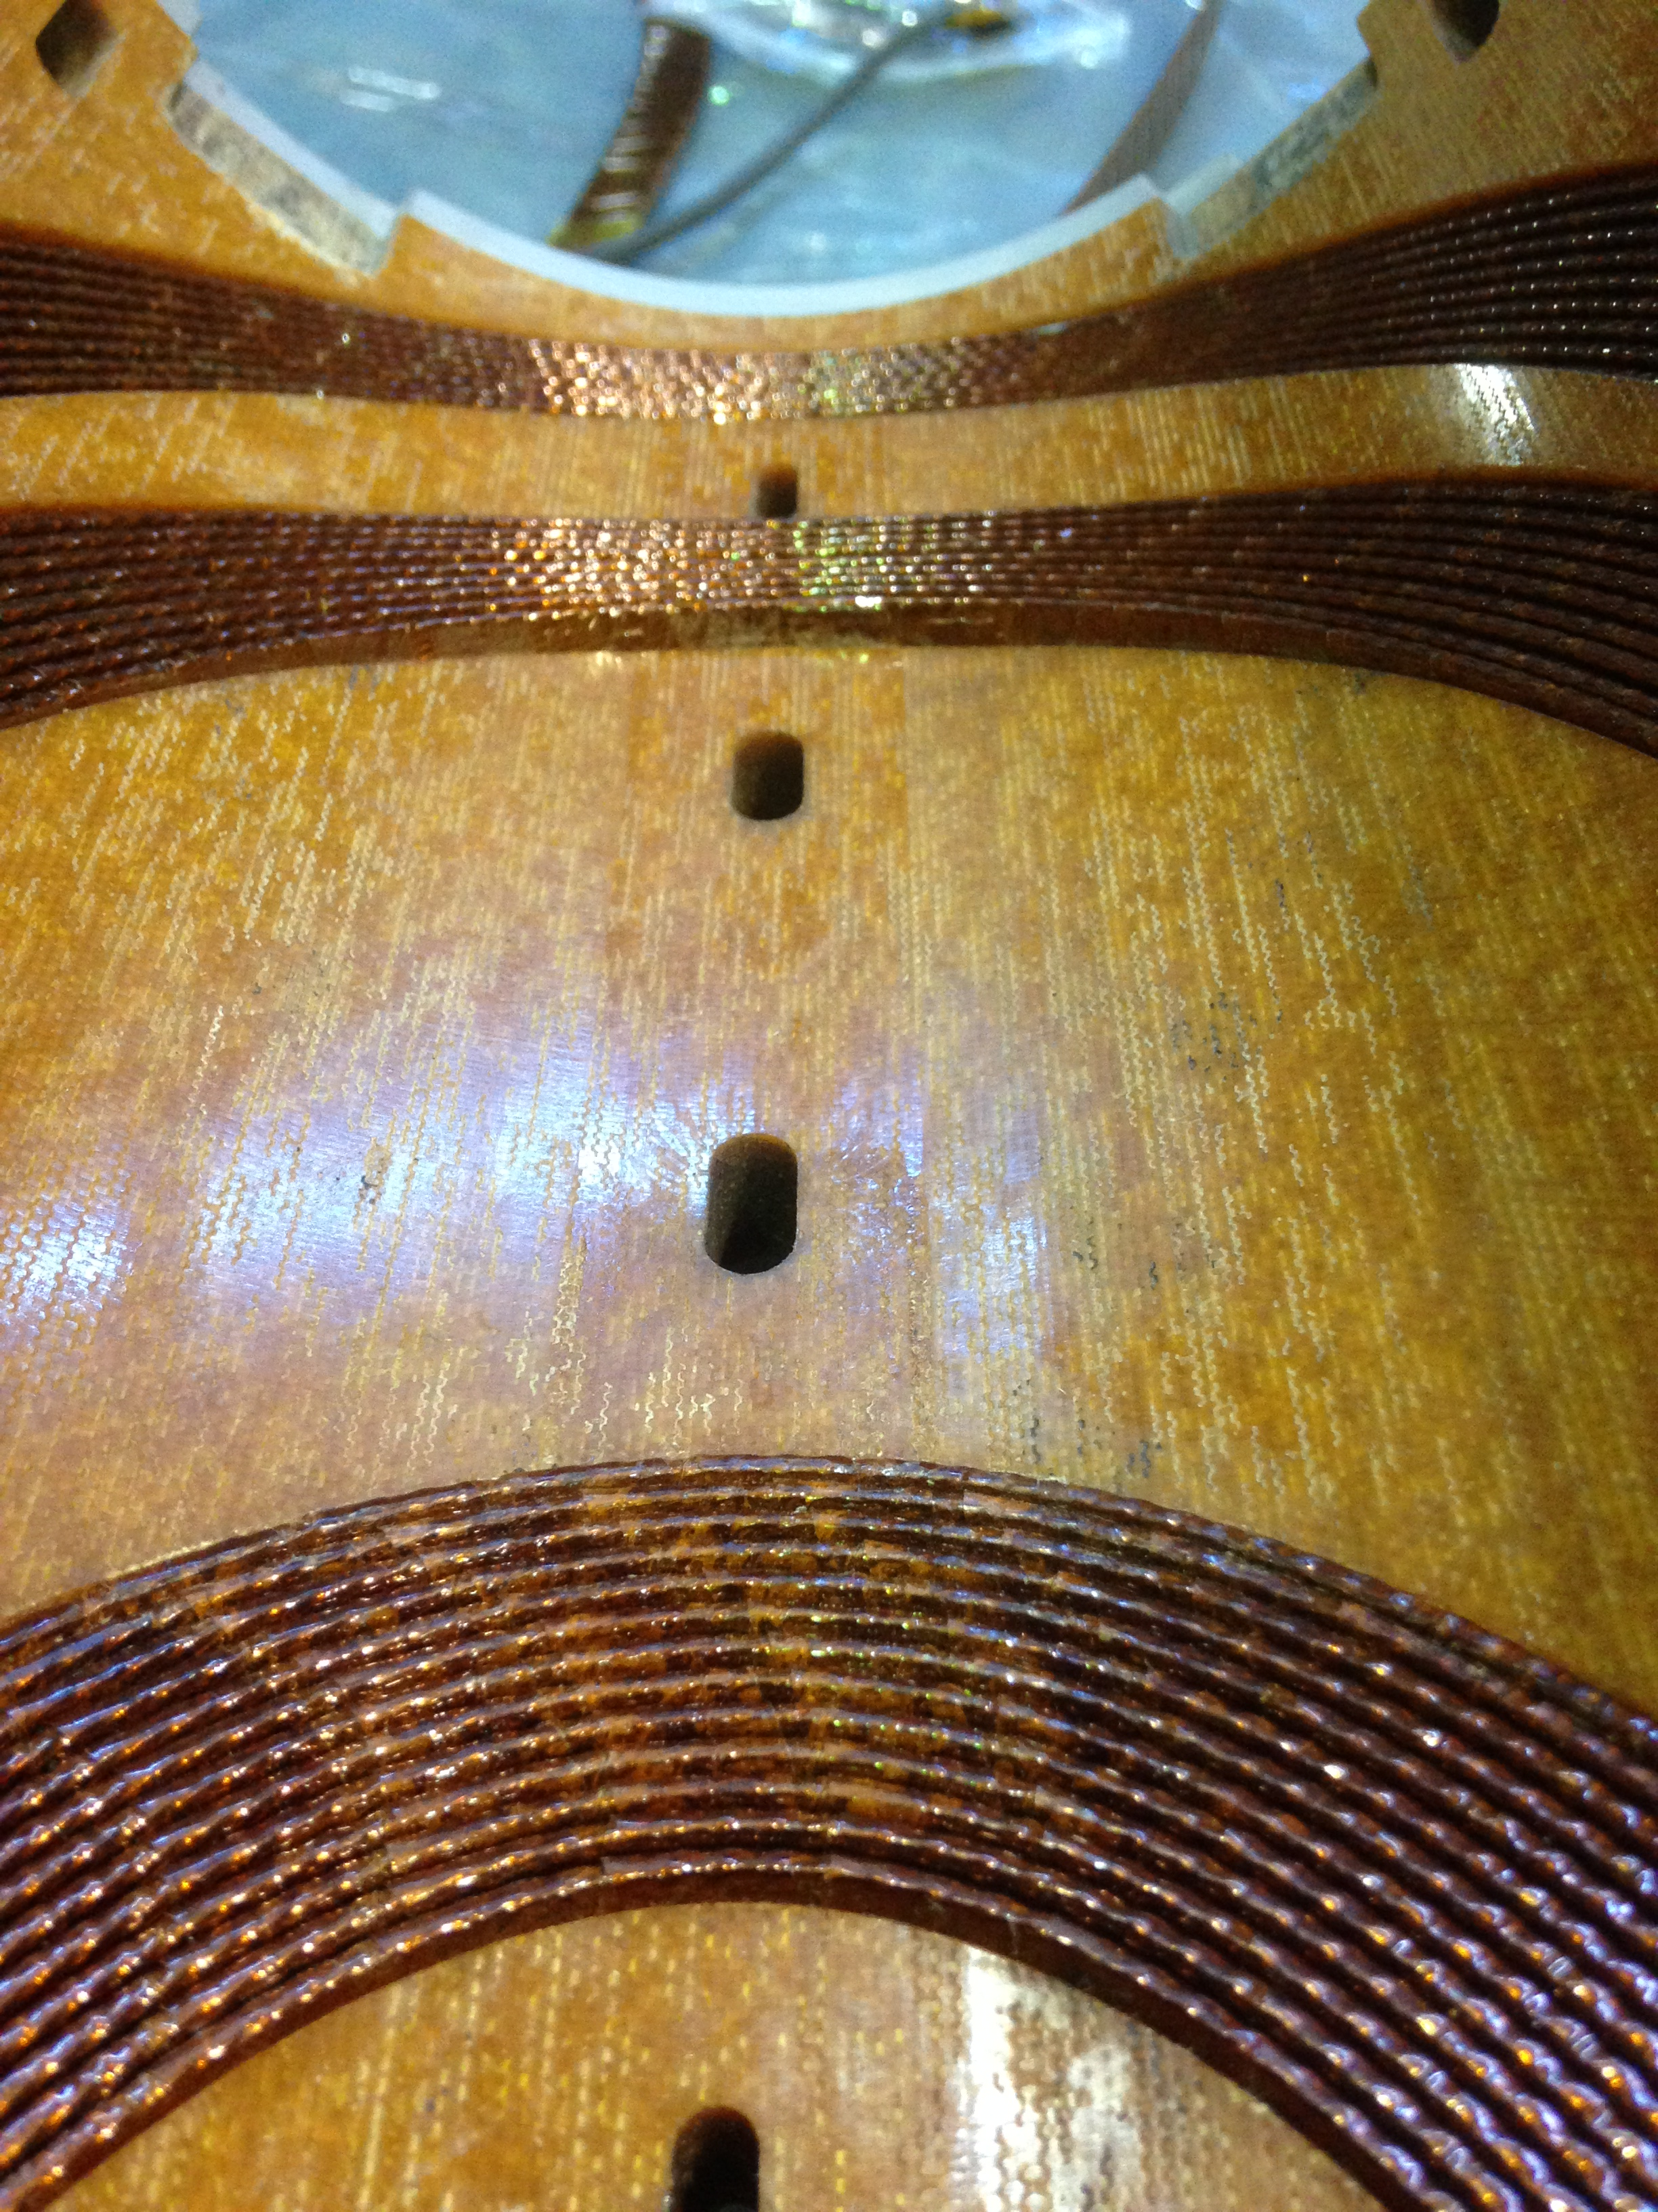
D1 STATUS
First model tested in April 2016
  Nominal reached, erratic towards ultimate, good memory [see M. Sugano talk]
    Clear indication of lack of prestress
    Disassembled in August 2016
    New assembly with larger prestress
    Test in January 2017
  Baseline change
    HX position should be at 45 degrees as in MQXF
    Second model including FQ optimization
    Discussing the option of a third model
MBXFS1a test [M. Sugano, et al.]
Coil after disassembly [M. Sugano, et al.]
Magnet disassembly [M. Sugano, et al.]

Slide 13
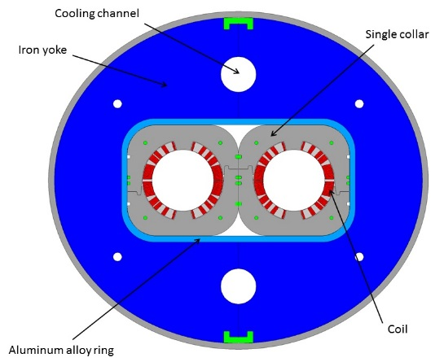
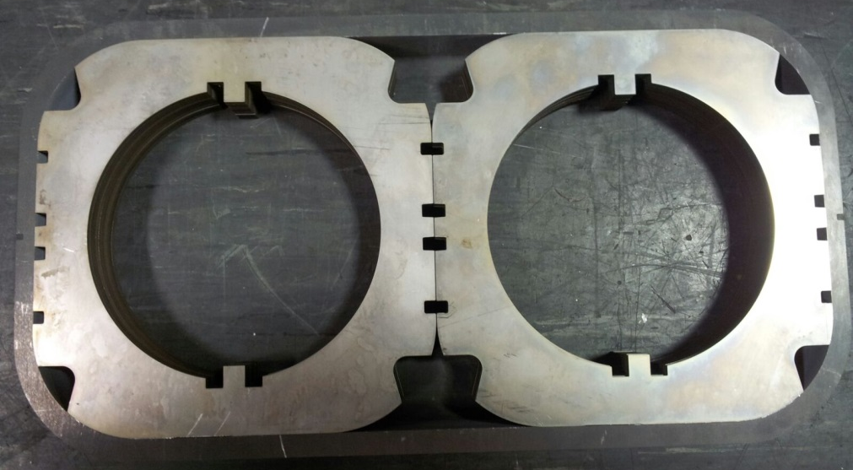
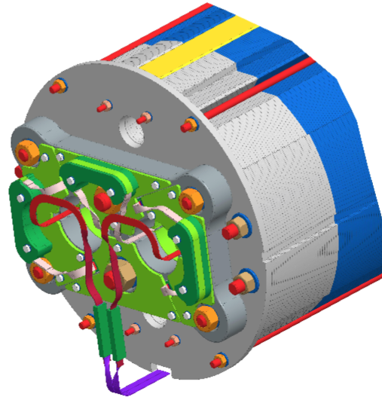
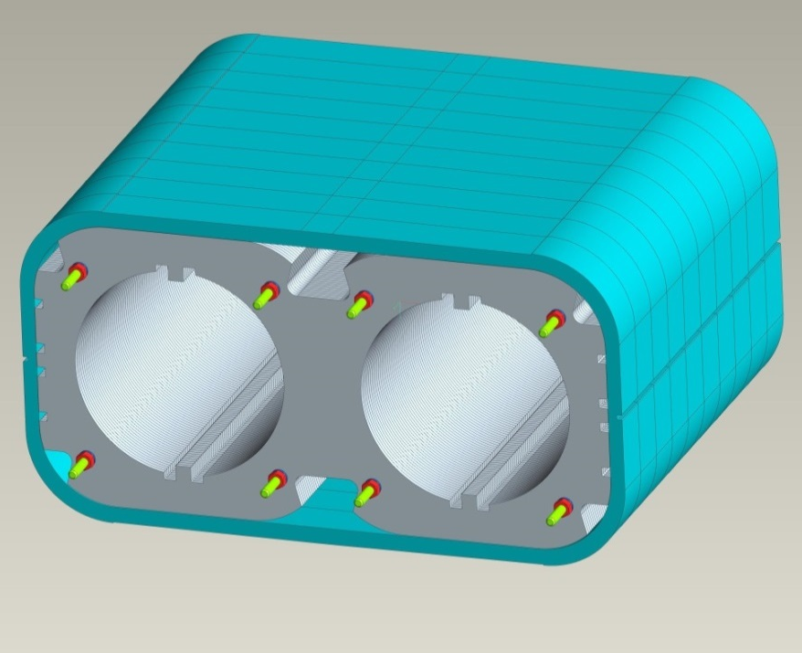
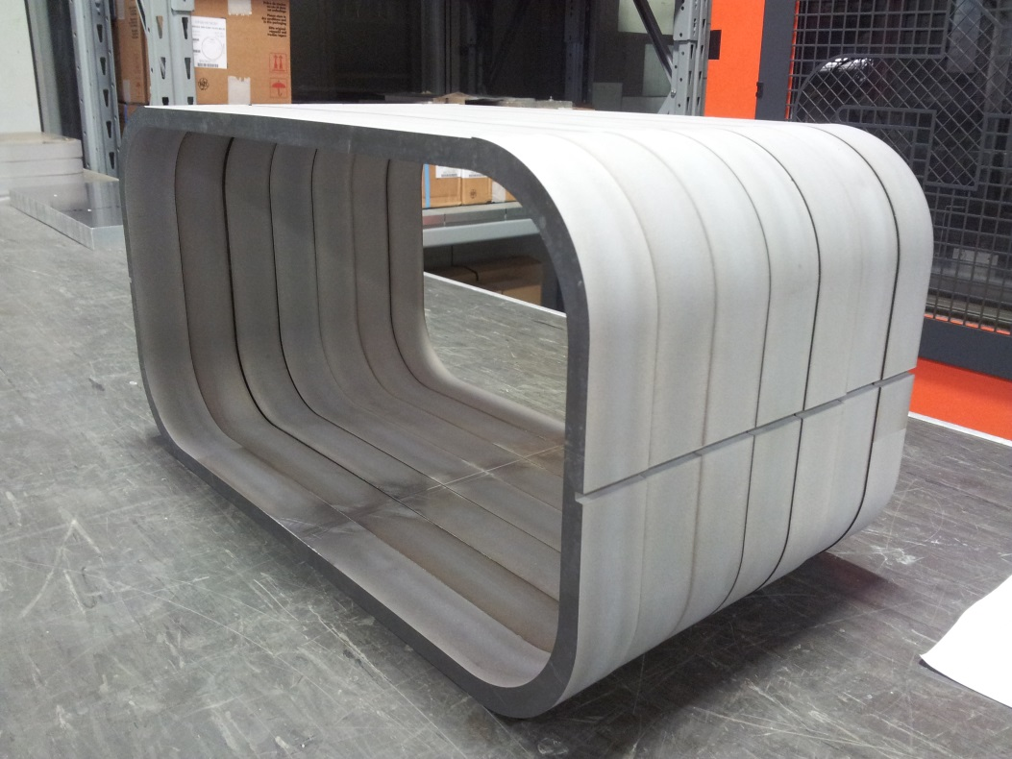
D2 STATUS
Engineering design completed
[see P. Fabbricatore talk]
  Call for tender for short model attributed in September 2016 by INFN
    Costs within the expected envelope
  Mechanical tests ongoing
  Construction in 2017, test in early 2018
Collar pack in Al sleeve [S. Farinon, et al.]
Detail of connections [A. Foussat, et al.]

Slide 14
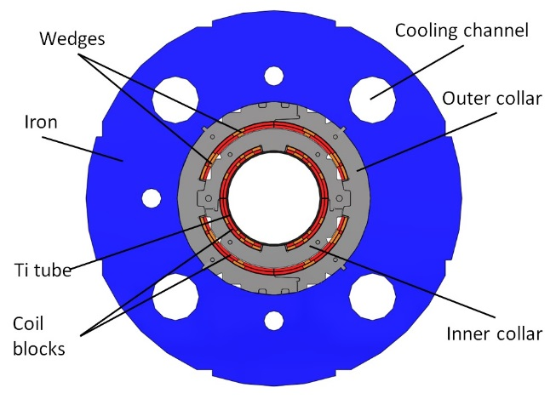
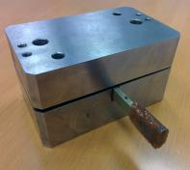
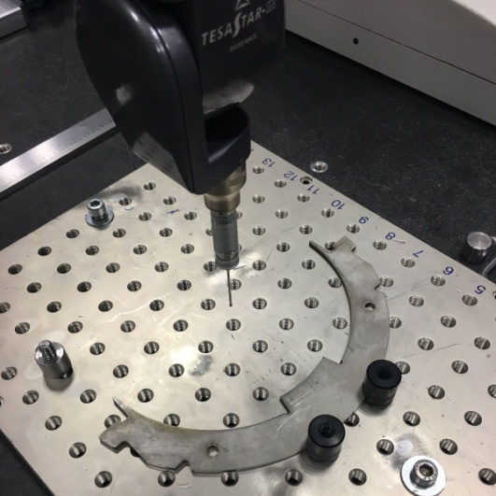
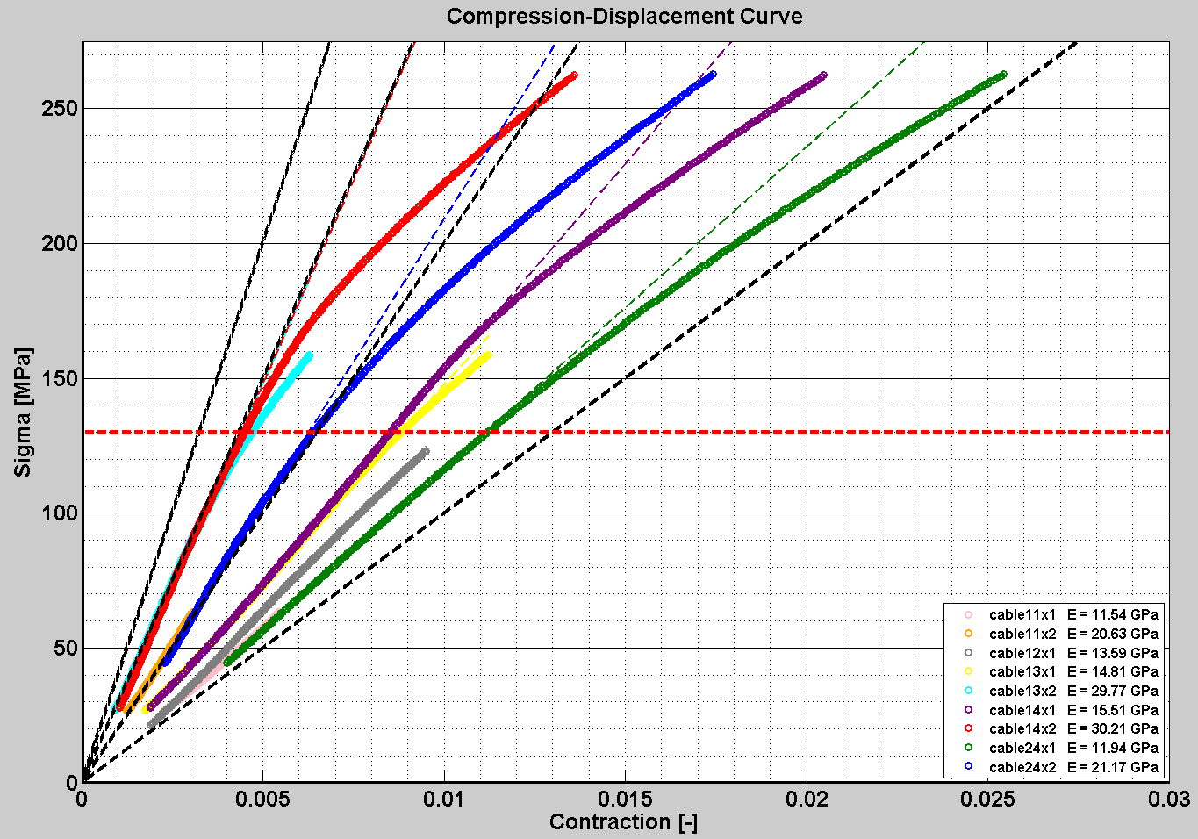
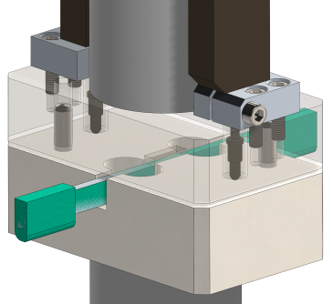
ORBIT CORRECTORS (MCBXF) STATUS
Design completed
  [see L. Garcia-Tabares and F. Toral talk]
  Mechanical tests in progress
  Components being ordered
  Tooling being commissioned
Construction in 2017, test in 2018
First collars manufactured [F. Toral, et al.]
Measurement of the elastic modulus of the coil [F. Toral, J. Garcia Matos, et al..]

Slide 15
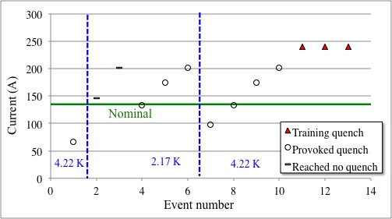
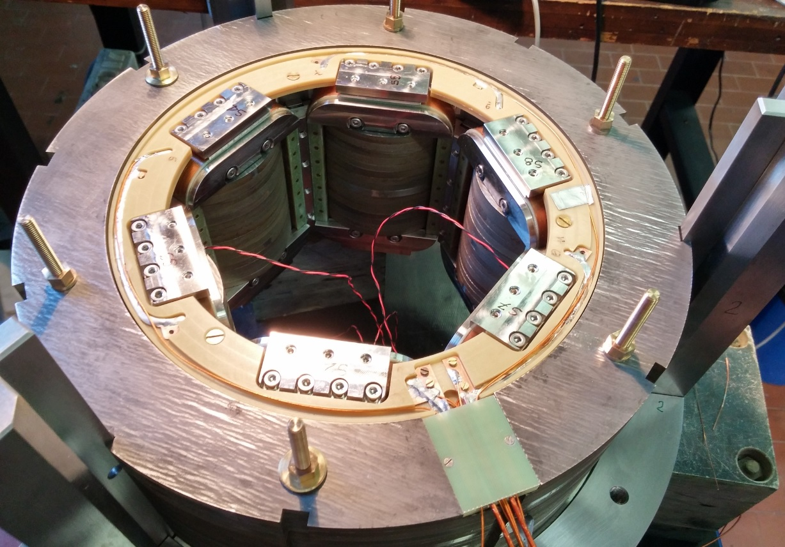
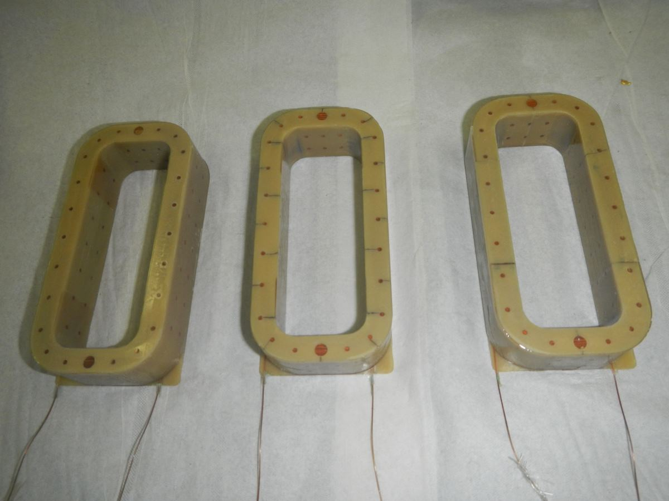
HIGH ORDER CORRECTORS STATUS
Sextupole model succesfully tested [see M. Statera talk]
  Just perfect, no quench
  Iteration on some design aspects
  First octupole coils wound
  Octupole and decapole test in 2017
First test of sextupole [G. Volpini, et al.]
Sextupole corrector [G. Volpini, et al.]
Octupole coils [G. Volpini, M. Statera, et al.]

Slide 16
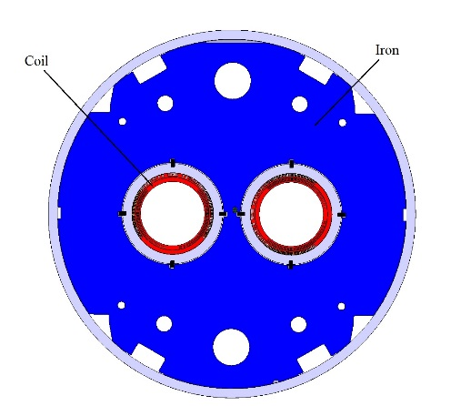
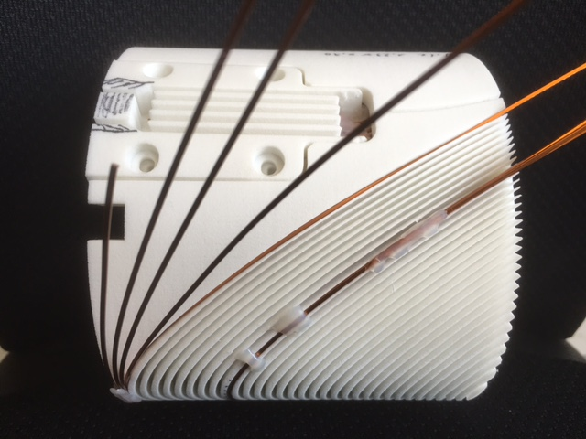
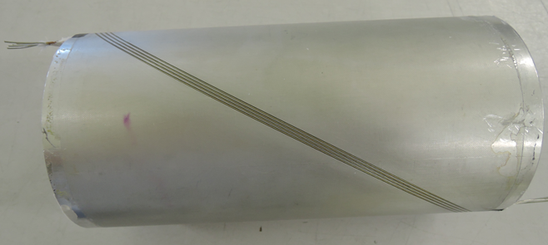
D2 ORBIT CORRECTORS STATUS
Large corrector: 5 T· m (1/7 of D2 !)
  1.9-m-long, 2.6 T bore field
  Canted cos theta design adopted - Based on experience of LBL, large loadline margin (50%)
Design and manufacturing tests ongoing
  First winding and impregnation tests
  Short model to be tested in 2016
  Full size prototype to be tested in 2017
  Development program at CERN, series in industry
Winding tests of the canted model [G. Kirby, J. Rysti, J. Mazet, et al.]

Slide 17
COLLABORATION AGREEMENTS
(see also talk by O. Bruning)
Q1/Q3: in-kind contribution of US
  This includes tested cryomagnet (8+2)
    3 prototypes (one cold mass), plus the common program of short models inside US-LARP
D1: scenario of in-kind contribution of Japan (KEK)
  Two models, one prototype, tested cryomagnet (4+2)
    For the moment in kind contribution is two short models
D2: collaboration agreements with Italy (INFN)
  Design of short model (first agreement), construction of short model and prototype magnet (second agreement)
Orbit correctors: collaboration agreement with Spain (CIEMAT)
  Design and construction of a prototype (first agreement)
  Series under discussion (second agreement)

Slide 18
COLLABORATION AGREEMENTS
(see also talk by O. Bruning)
High order correctors: collaboration agreements with Italy (INFN)
  First agreement: design and construction of 5 prototypes
  Second agreement: series of 54 magnets
Test of orbit correctors: collaboration agreement with Sweden (FREIA, see also talk from M. Bajko)
  Test of 20 magnets, MCBXF and/or MCBRD
MQYY: collaboration agreement with France
  CEA agreement: design and construction of single aperture short model
MQYY: EU project to build two prototypes (QUACO)
  With French, Polish and Spanish institutes

Slide 19
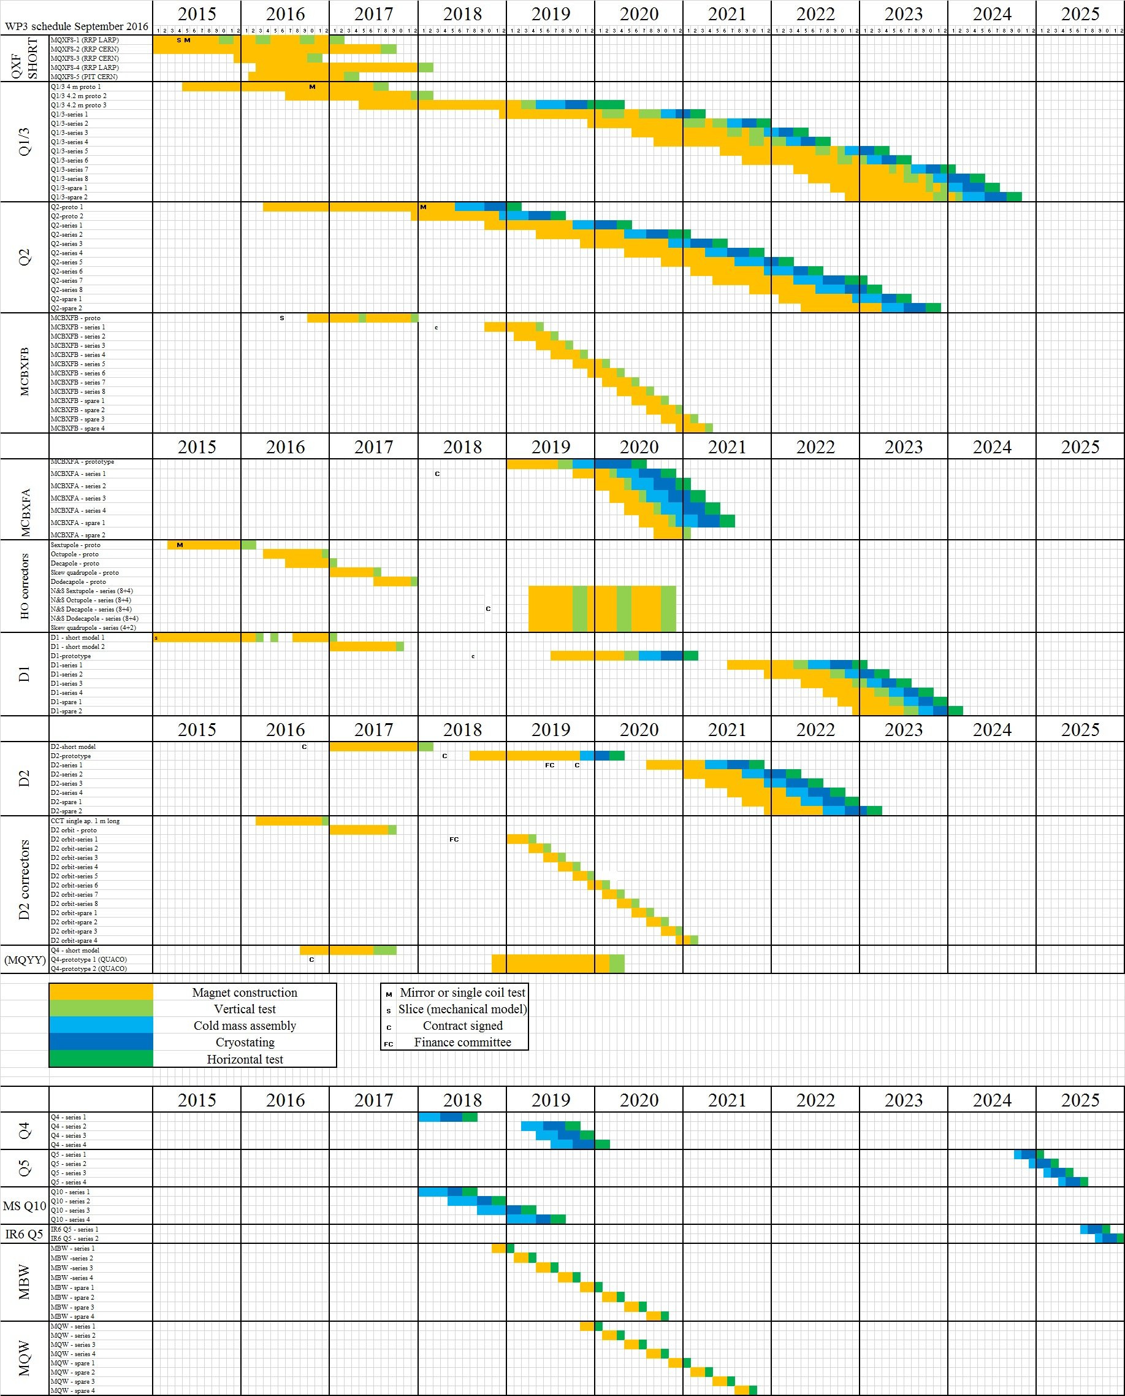
SCHEDULE
Legenda
  One line per magnet (except HO correctors – one line per cold mass for the US triplet)
  Tentative dates of invitation to tender
  Orange lines are the magent construction
    They start with the beginning of winding
  Cold mass fabrication in blue
    Main magnet takes the cold mass and cryostat
  Cryostating in deep blue
  Tests in green (Vertical or Horizontal)
  Warm thanks to M. Barberan Marin for implementing our complex timeline in the global project schedule

Slide 20
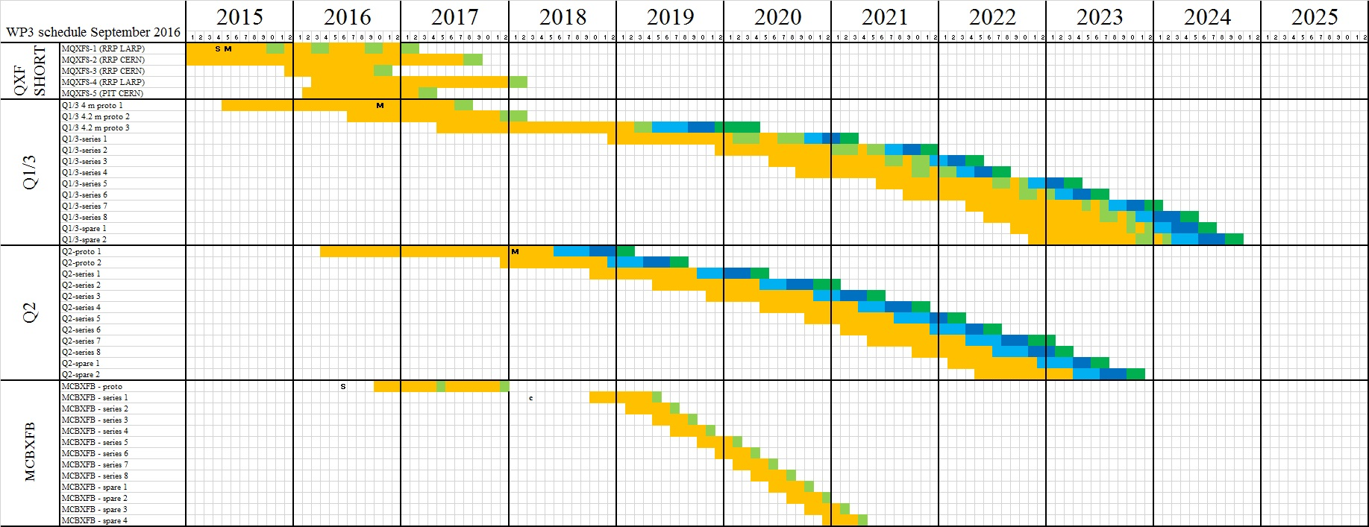
SCHEDULE
Main driver of the triplet: about 3 magnets/year is the max production rate (with one production line) [see P. Ferracin talk]
  Us has twice the magnets, so two production lines [see G. Ambrosio talk]
The orbit corrector can get on the critical path for the initial Q2 series magnets

Slide 21
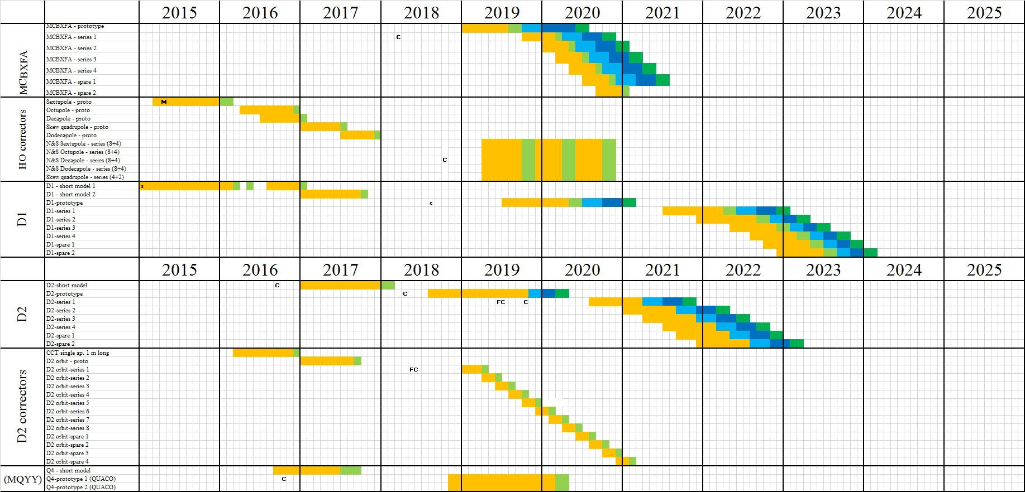
SCHEDULE
We try to get rid of the corrector package in 2020 before the large workload in 180 for D2 and triplet cold masses
Adquate margin of the D2 correctors

Slide 22
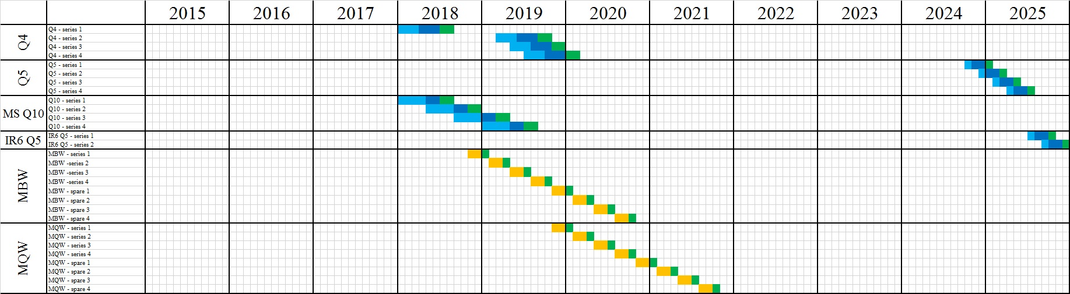
SCHEDULE
We anticipate the work on the Q4 and Q10 cold masses before the large workload in 180 for D2 and triplet cold masses

Slide 23
CONCLUSIONS
We reached about 15% of the earned value (EVM) of the WP3 (as presented by B. Delille at cost and schedule review)
We are entering the delicate phase of prototype tests
  Three magnets types out of the six different types have been tested
  Encouraging results, but more work needed to improve/understand/control
  Technology is not trivial and sensitive to errors
Cost and schedule looks consistent and allowing margin to include these corrective actions
Most critical milestone are the Nb₃Sn long coils in 2017 and 2018

