Slide 2

LHC Availability Dependencies and Lessons Learnt from LHC Run 2
J. Uythoven, A. Apollonio, TE-MPE
HL-LHC Annual Meeting, Paris, 16/11/2016

Slide 3
Outline
Time allocated for Physics Production (Technical stops, intensity ramp-up, MPS tests,..)
Hardware Performance
(Cryogenics, QPS, Power Converters,…)
Beam Parameters (Intensity, Energy, β*,…)
HL-LHC Integrated
Luminosity
Operational Efficiency (Turnaround,…)
Control UFOs, Beam Instabilities

Slide 4
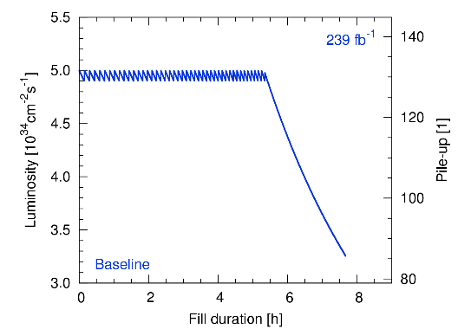
Integrated Luminosity for HL-LHC
L. E. Medina Medrano, R. Tomas Garcia
Target: 3000 fb⁻¹ over HL-LHC lifetime
  250 fb⁻¹ per year
  160 days of p-p physics
  1.56 fb⁻¹ per day
Levelling: 5*10³⁴ [cm⁻²s⁻¹]
Simple calculation:
A fill of 12 h HL-LHC would produce ~ 1.5 fb⁻¹
Requirement for HL-LHC physics efficiency is ~ 50 %
The physics efficiency depends on the achieved machine availability

Slide 5
Availability for HL-LHC
Starting point: 2016 LHC availability
  Rate of premature dumps
  System Downtimes
  Turnaround time
  Availability of the injector chain
In addition, for HL-LHC, account for:
  Operation at 7 TeV
  Introduction of new systems and technologies (uncertainty !), potentially leading to:
    Increased number of premature dumps = increased sensitivity to turnaround time and availability of the injector complex
    Increased downtime
  Effect of different beam parameters
  Ageing of accelerator equipment

Slide 6
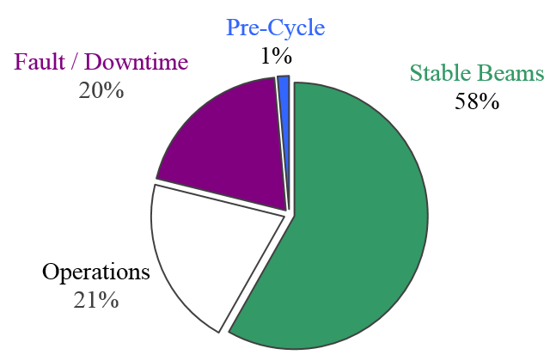
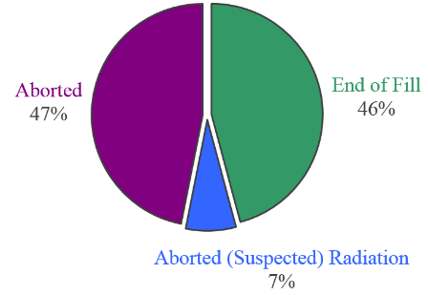
2016 Statistics for period TS1 to TS2
Physics Efficiency
Physics Fills
The period from TS1 to TS2 in 2016 is chosen as a reference for the reproducibility of operating conditions – ideal conditions
96 fills to Stable beams for a total of 1112 h

Slide 7
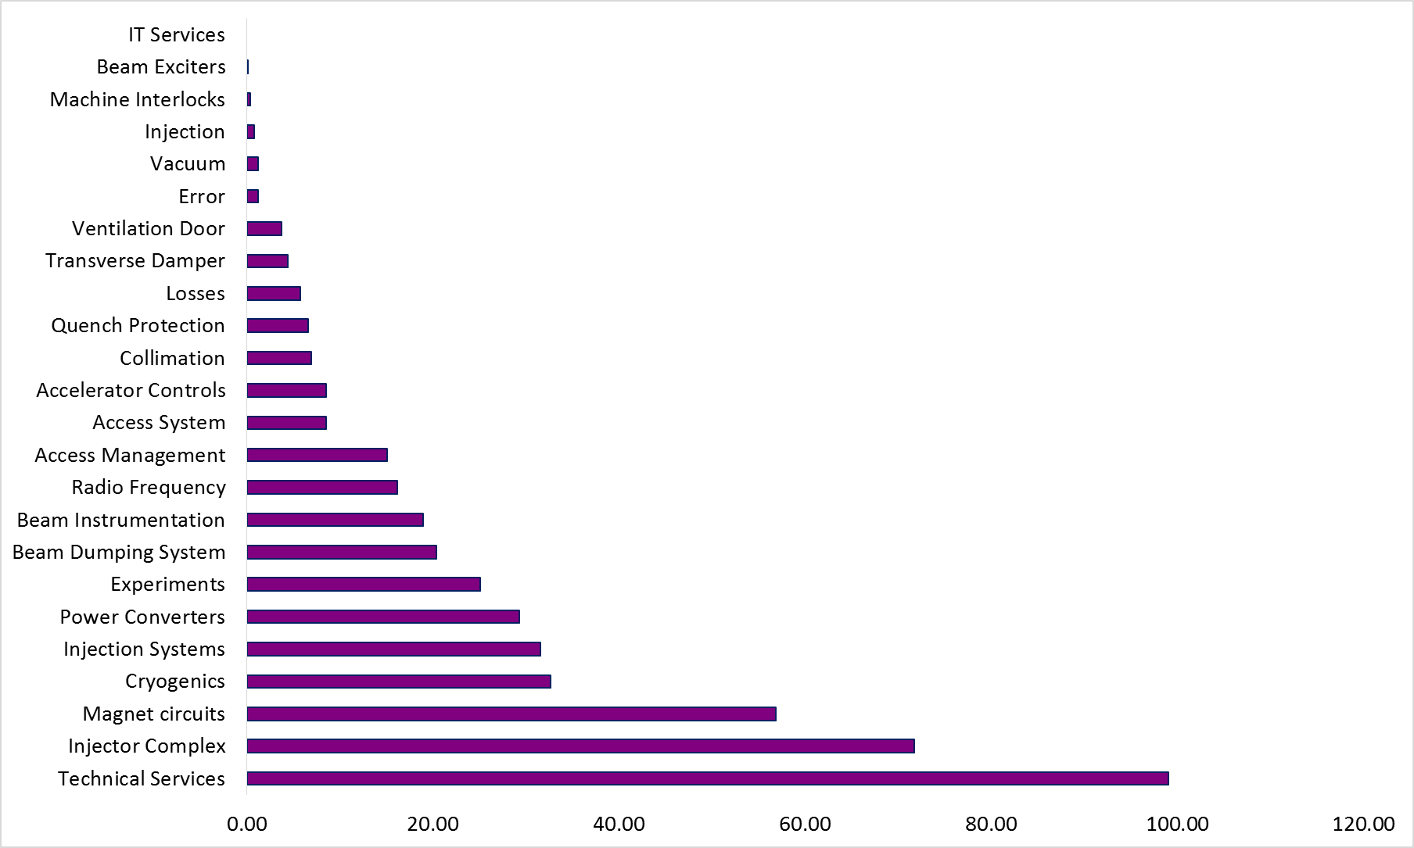
2016 Downtime Distribution (TS1-TS2)
LHC availability in 2016 mainly limited by:
Isolated, long stops (not in this period: transformer Pt8, LBDS erratics, POPS)
Electrical perturbations
Availability of the injector complex
Investigation intra-turn short RB.12
No beam for LHC, PS vacuum leak
Flood Pt3, EL. perturbations
[h]

Slide 8
Extrapolation to HL-LHC
Operation at 7 TeV + higher beam brightness:
  UFOs:
    UFO rate: release mechanism not understood, scaling with intensity unknown
    Lower quench levels (30 %) → Potentially 3x more quenches due to UFOs (3 quenches in 2015 and 2016, low statistics)
    BLM thresholds are already tolerating few quenches
  Impact of R2E: target 0.1 SEUs dumps / fb-1 (order of 25-30 per year)
  Possibly increased failure rate of LBDS due to running at higher voltage
  No major impact expected on:
    Quench recovery times and failure rate of power converters
    Availability of the injector chain: new elements, but mostly established technology (exception: H⁻ stripping foil)
New systems:
  Quench behaviour of Nb₃Sn magnets, reliability of HTS links
  Reliability of crab cavities (failure rate, failure modes and effects)
  New cryogenic configuration (Pt. 1-5, 4)

Slide 9
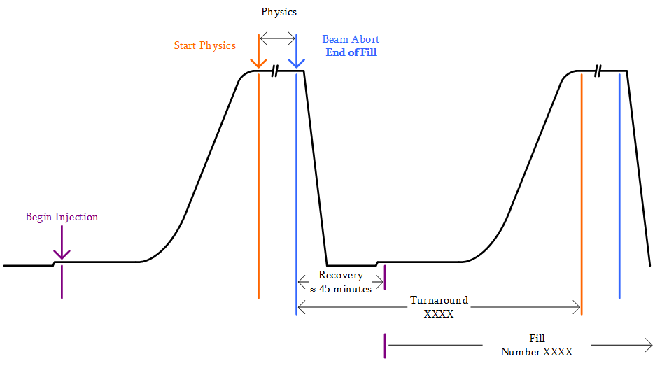
Definition of Turnaround Time
Beam Energy

Slide 10
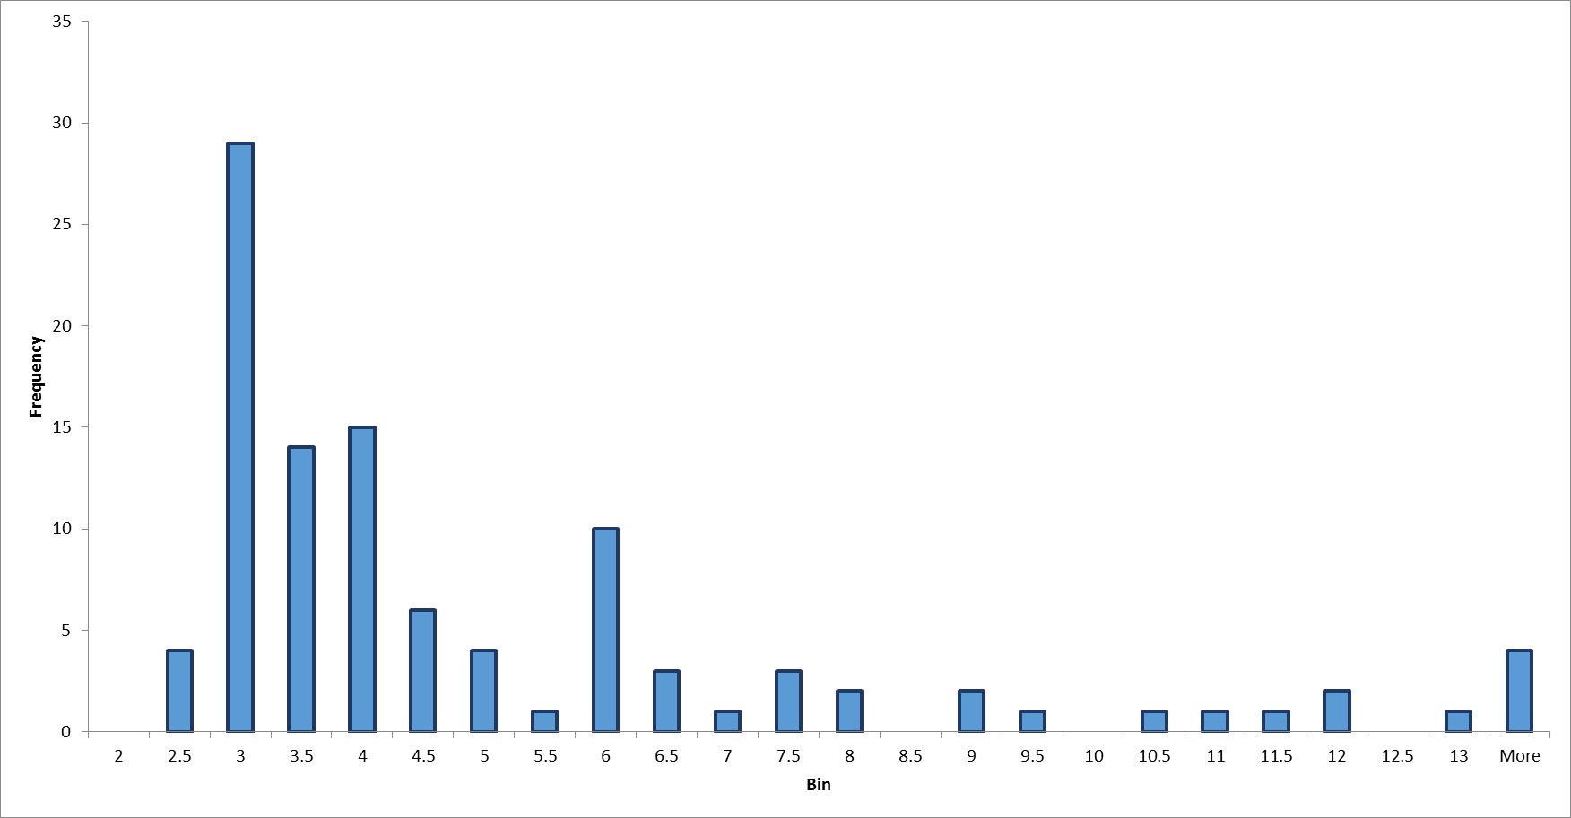
Turnaround Distribution (2016 TS1–TS2)
Inj. Tuning or
1 precycle
Long / Multiple faults, 1 or more pre-cycles + injector issues
Measurements, loss maps, planned access
‘Nominal’
Average turnaround subtracting faults time is 4.9 h (with faults 8.7 h)
Average turnaround time is independent from the reason of the dump if faults time is subtracted

Slide 11
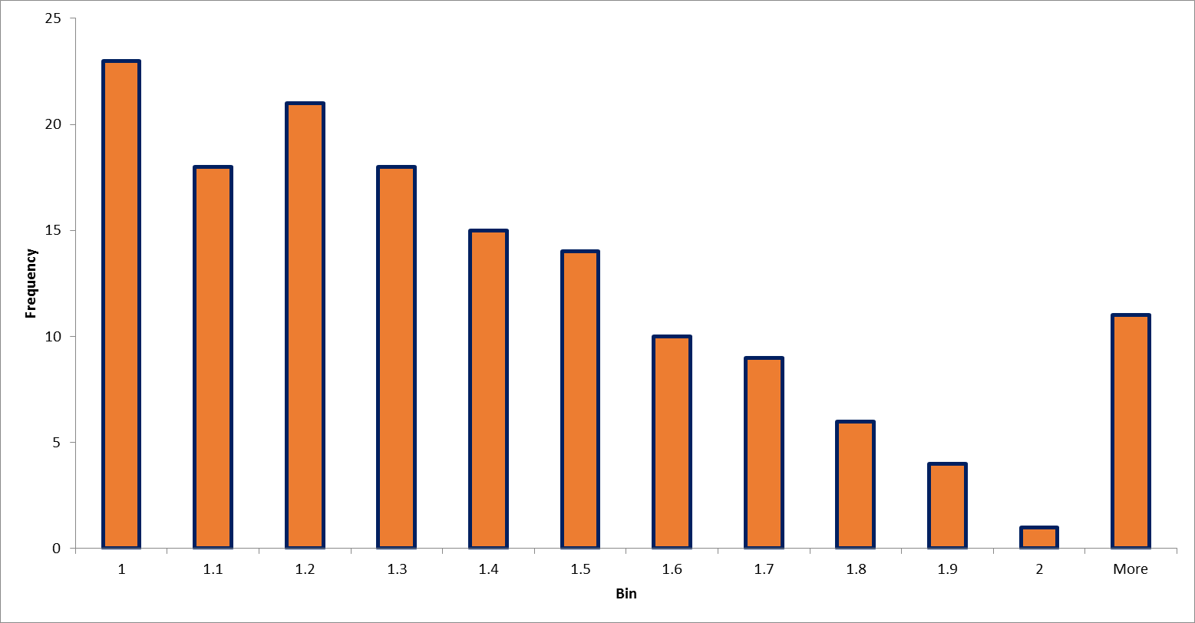
Injection Time Distribution (2016)
Factor 2x longer injection times on average
Average: 1.37 h Theoretical minimum: 0.6 h

Slide 12
2016 Figures - Extrapolation to HL-LHC
Turnaround Time
  Increased time for energy ramps (small impact)
  Still consider inefficiency of factor 2 time spent at injection
  (with 288 b / injection):
    Faster: Increased experience and optimisation
    Slower: Additional complexity in handling high brightness beams
  Overall similar average turnaround: 4.9 h
Fraction of premature dumps: 50 %
Average Downtime following premature dumps: 5.6 h
Optimal Fill Length 9.2 h

Slide 13

HL-LHC Luminosity Predictions
A Monte Carlo model was developed to describe integrated luminosity production as a function of LHC availability
Premature
Dump
Stable Beams
Fault
Turnaround
Turnaround
Stable Beams
t = 0
Stable Beams
Fault
Turnaround
Operator
Dump
Stable Beams

Slide 14
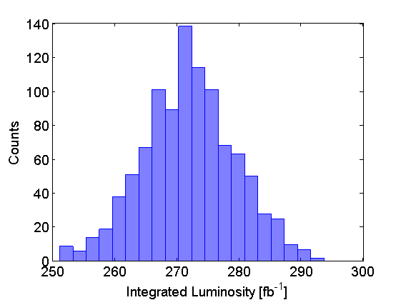
HL-LHC Availability and Luminosity Predictions – based on 2016 figures
Assumptions (from WP2):
Lumi Levelling Time: ~5 h
Lumi Lifetime (exp) after levelling: ~5 h
2016 fault and turnaround distributions
Model Output (160 days operation):
Availability: 75 %
Stable Beams Efficiency: 45 %
Integrated Luminosity: 272 fb⁻¹
For the same equipment availability, the stable beams efficiency is lower for HL-LHC due to shorter fills: 45 % compared to 58 % → higher sensitivity to turnaround time and injectors’ availability

Slide 15
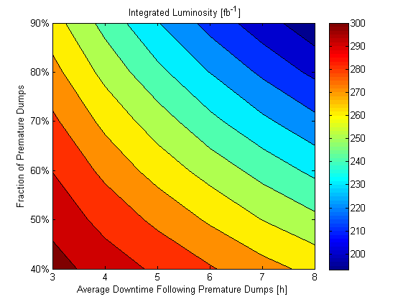
Sensitivity Analysis
M. Valette, “Crab cavities: failures and availability studies” on 15/11
New systems
272 fb⁻¹
7 TeV +
HL-LHC Beams + ageing
7 TeV +
HL-LHC Beams
?
Target
?
Ultimate HL Target
2016 Availability Figures

Slide 16
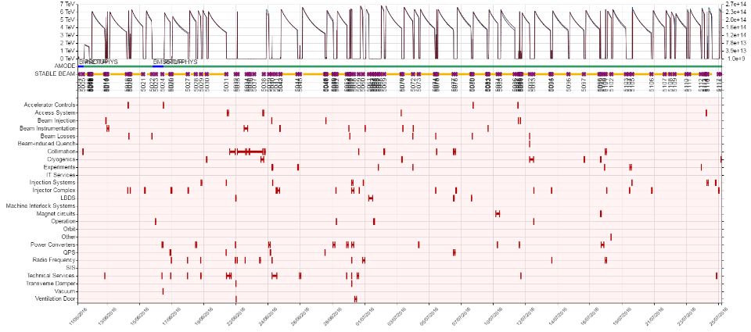
Fault Tracking Activities towards HL-LHC
Important: tracking faults, their dependencies and impact on operation
Exploitation of Accelerator Fault Tracker (AFT)
The IEFC endorsed the implementation of AFT in the injectors in 2017

Slide 17
Outlook
Assess availability of new HL-LHC systems
  Identify weaknesses during the design phase
  Schedule dedicated tests and reliability runs (e.g. Linac4)
Identify availability bottlenecks of the present LHC and injectors
  Prioritize consolidations based on impact on availability
  Monitor failure trends to anticipate systems’ “end-of-life” (ageing)
Optimize time allocated for physics production
  Schedule 2016: 233 days (excluding ions)
  10 % HW commissioning (24 days), 14 % Beam recommissioning (33 days), 9 % MDs (20 days), 67 % p-p Physics (156 days)
  3 technical stops + 1 Christmas shutdown
  Balance, need to keep the machine ‘safe’: if you break it downtime rockets up

Slide 18
Conclusions
Excellent LHC availability in 2016 (effectiveness of LS1 + YETS mitigations, increased experience with the machine, not pushing intensity limits)
Extrapolation to HL-LHC has to account for
  Increased energy and higher beam brightness
  Impact of new systems and failure modes: important to carry out availability studies and reliability runs
  Ageing of equipment
Based on 2016 TS1-TS2 availability figures, the yearly HL-LHC target (250 fb⁻¹) is in reach
Optimization of accelerator schedules to increase the number of days for physics production can have a very significant effect
Exploit potential of AFT tool for availability tracking of individual systems to aim for improvement

Slide 19
Thanks a lot for your attention!

