Slide 1


HL-LHC IT STRING
M. Bajko CERN

Slide 2
Outline of the presentation
WP16 in the HL-LHC Structure and IT STRING Scope
Brief return to the past
Experience with LHC Triplet
Relevance of HL-LHC IT String
ID Card
Main IT String components
IT String schedule: conflicts and synergies
Main IT String facilities
Work status

Slide 3
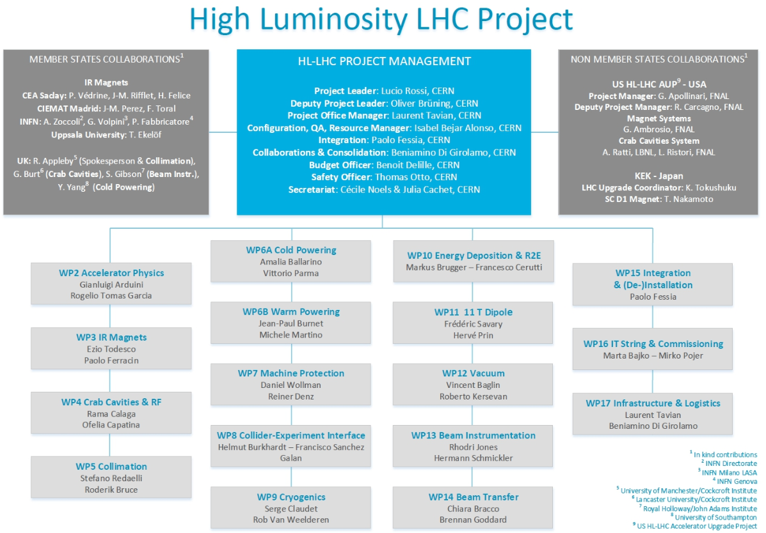
The HL-LHC IT STRING in the organigram
[…] THE WP16 covers the coordination of the commissioning of the HL-LHC equipment as part of the accelerator system. […] The first important system test will be the Inner Triplet (IT) STRING test.
The IT STRING should comprises all magnets with their cold and warm powering and associated cryogenics systems from Q1 to D1 magnets including DFX. […] The IT STRING will have conditions as similar as possible to the operational ones and will constitute an integration and system test of the most critical part of the upgrade.
Ref. HL_WP16 Conceptual specification : https://edms.cern.ch/document/1586706/1
Ref. HL_WP16 IT STRING Mandate: https://edms.cern.ch/document/1513780/1

Slide 4
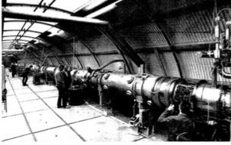
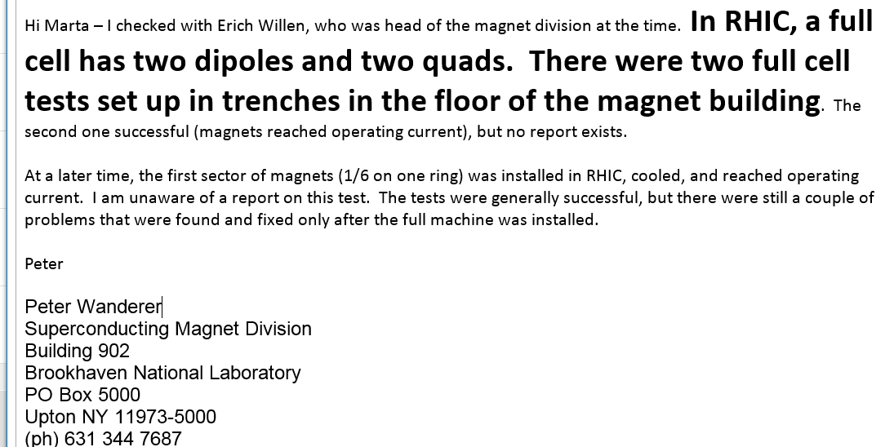
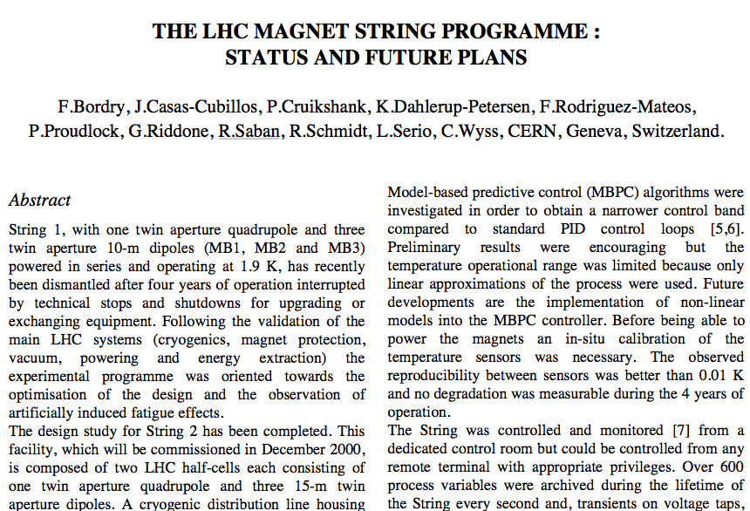
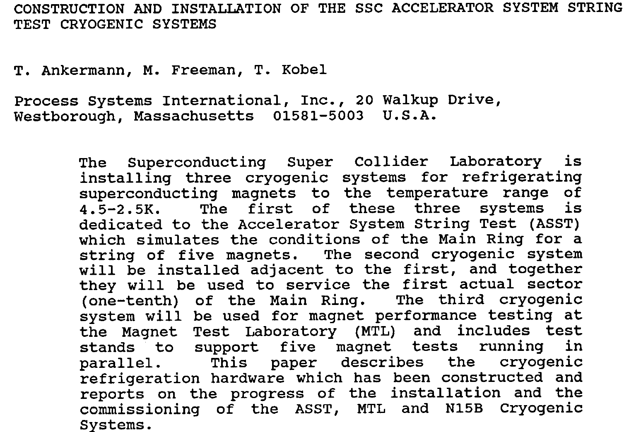
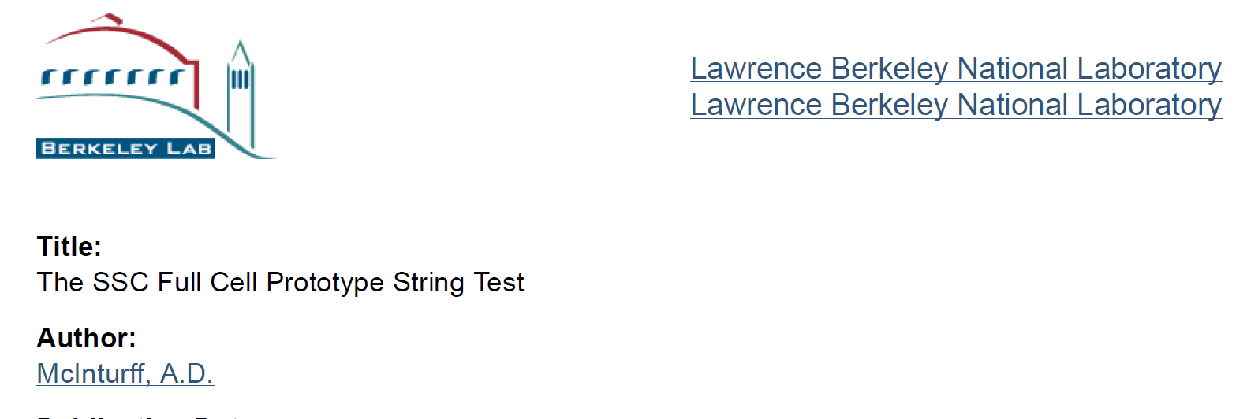
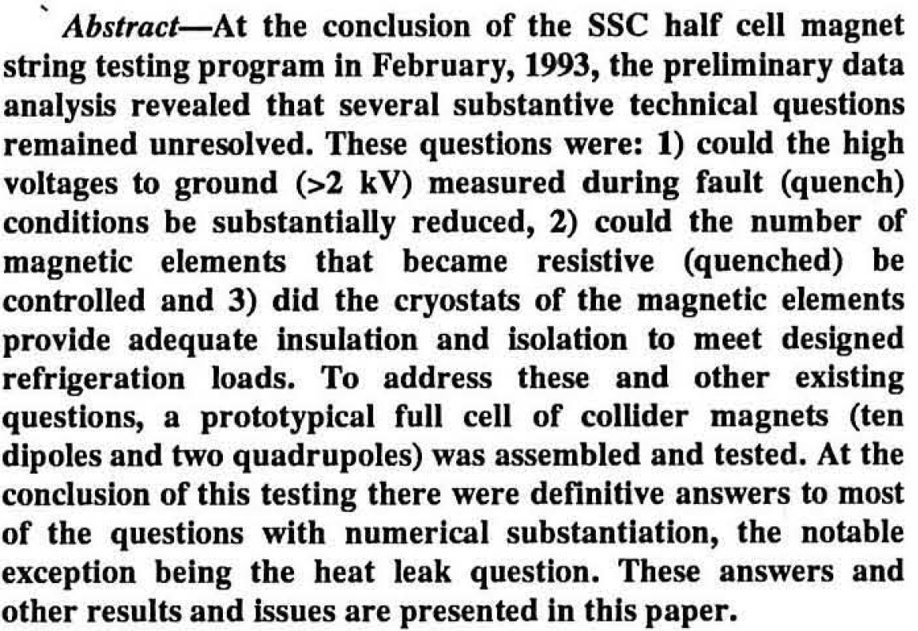
Previous experience - past
In the past STRING tests were run for
SSC
Hera
Tevatron,
RHIC and
LHC
DESY
Magnet string tests
A 36 metre chain of superconductive­ magnets built for the HERA electron-proton collider has been under test since April at DESY in Hamburg. The magnet string is composed of three full-sized prototype dipole magnets (with coils made at DESY and mounted in cryostats at BBC-Mannheim) and two quadrupoles
(made at Saclay).
[..] It has been quenched more than 20 times at magnetic fields between 1.8 and 5.8 tesla, the latter corre­sponding to a proton beam energy of 1010 GeV
CERN Courier, December 1987

Slide 5
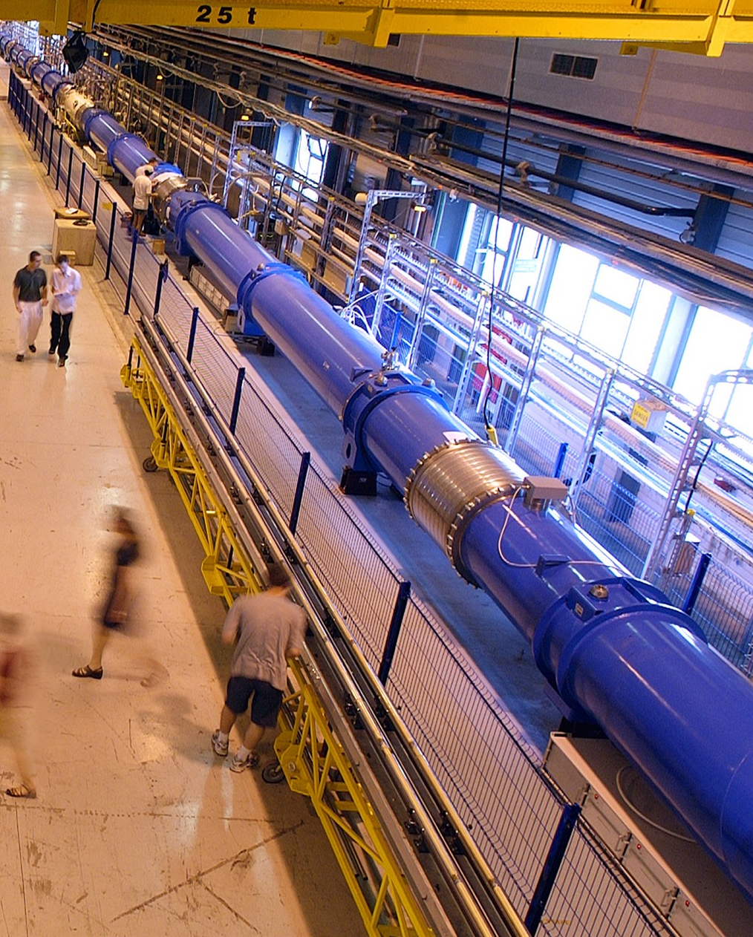
Previous experience @ CERN
1994-1998 STRING-1
ONE HALF LHC CELL
3 MB (10 m) + 1 MQ
2000-2004 STRING-2
ONE FULL LHC CELL
6 MB (15 M) + 2 MQ + CORRECTORS
Validation of:
  Cryogenics (6 CD’s)
  Vacuum
  Quench (172) and protection
  Powering and energy extraction
Validation of:
  Cryogenics,
  Vacuum
  Quench and protection
  Powering
  Accelerator relevant operation
  (e.g. quench propagation from magnet to magnet, tracking of MQ and MB)

Slide 6
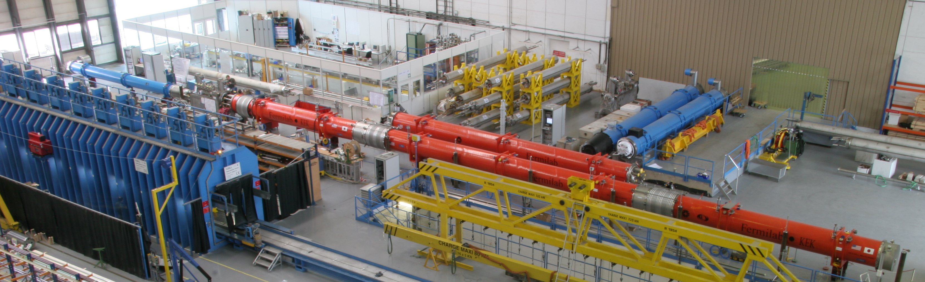
Previous experience : LHC triplets
What have we learned from it?
2005 STRING of Q1 Q2 Q3
  Validation of:
  Cryogenics,
  (Insulation) vacuum
  Quench and protection
  Powering
  Accelerator relevant operation
Ex. When pumping the vacuum magnets moved
Inner triplet linked via the “W” bellows ( not interconnected) in B. 181
Info from H. Prin

Slide 7
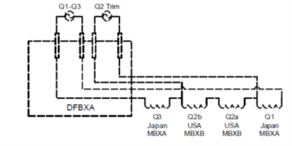
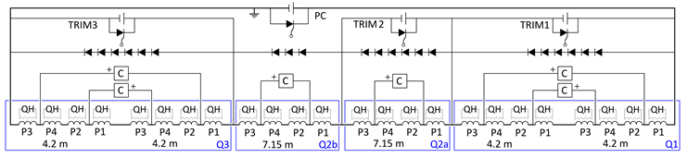
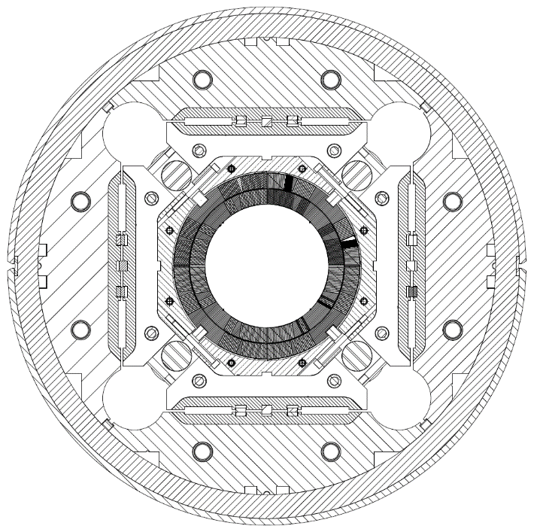
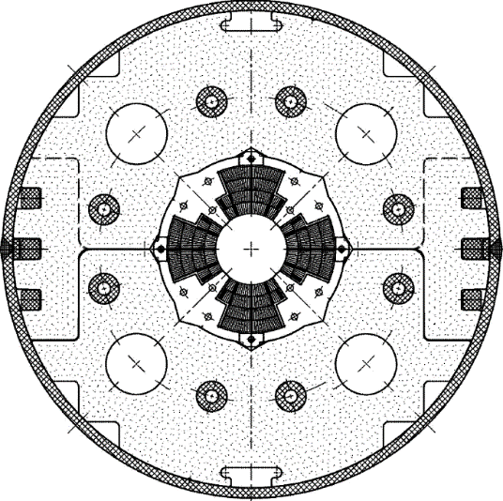
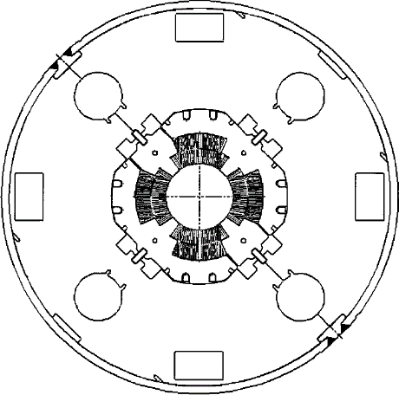
LHC vs HL-LHC triplet: few characteristics
Is one of the most complex electrical circuit in the tunnel
LHC
HL-LHC
MQXA
MQXB
MQXF
Comparison of main magnet characteristics
NbTi against Nb₃Sn technology
1.3-1.5 times the cold mass OD (to 630 mm)
2.14 times the aperture: (to 150 mm)
~ 4 times the e.m. forces in straight section
~ 6 times the e.m. forces in the ends
2- 4.8 times the stored energy (to 1.2 MJ/m)
Courtesy of P. Ferracin and G. Willering and E. Ravaioli

Slide 8
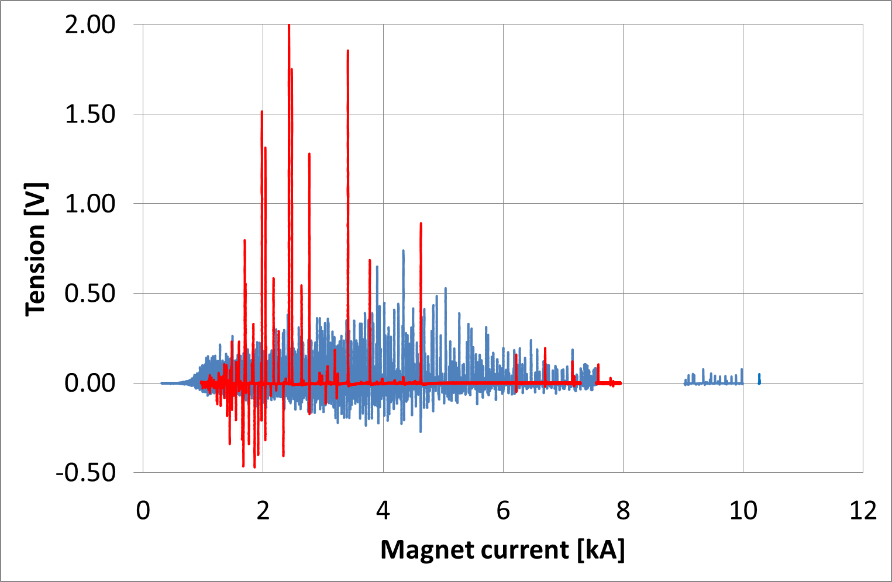
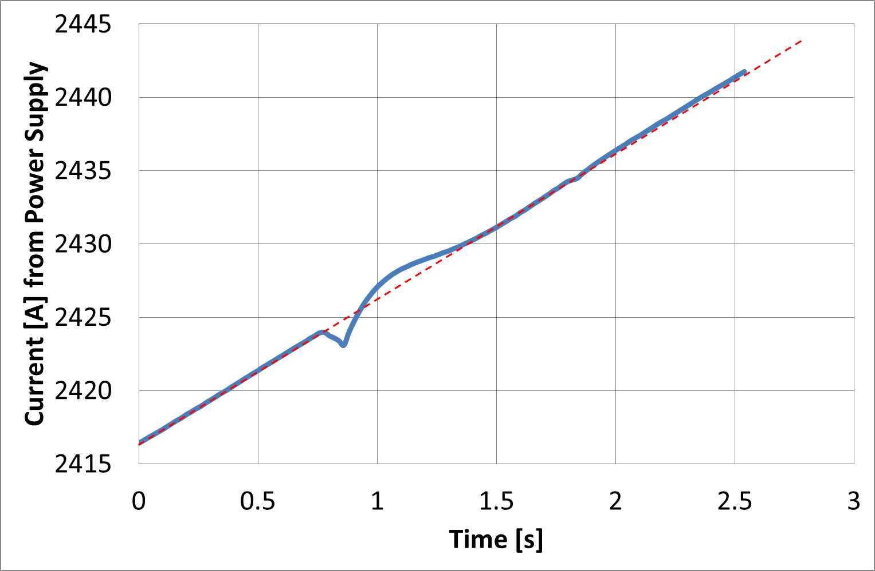
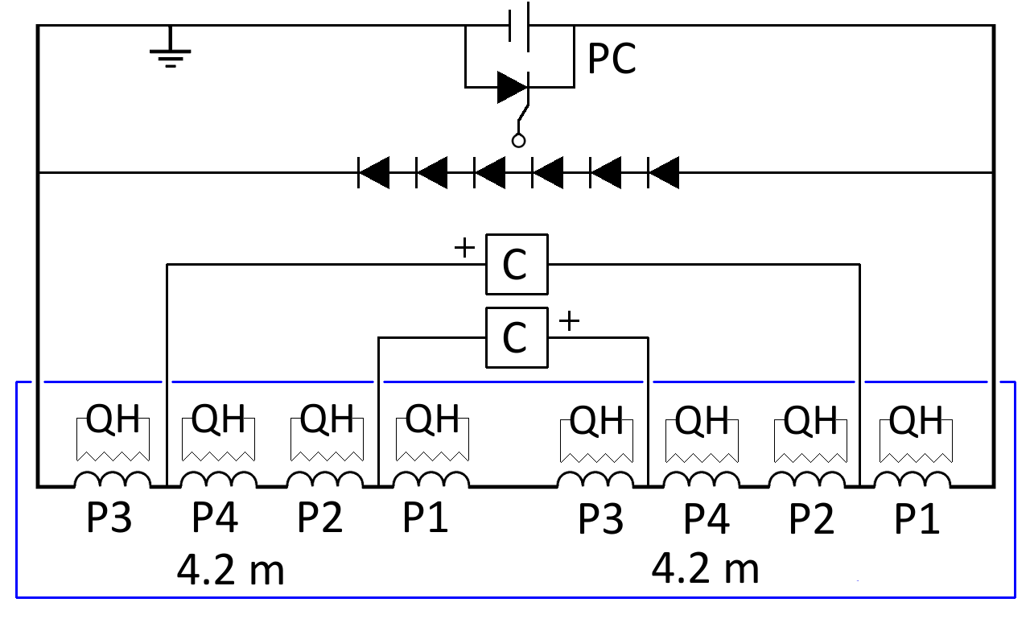
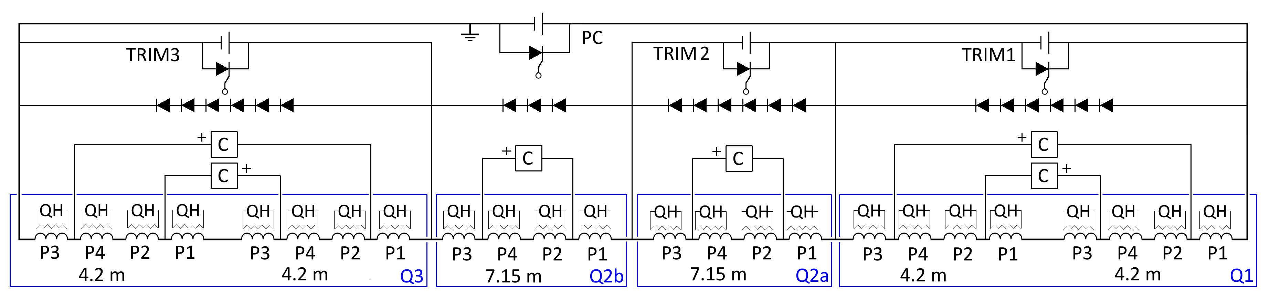
Ex. of future experience to gain with IT String
Features related to Nb₃Sn :
Flux jumps show up in Nb₃Sn magnets as a “noise”, both in the terminal and compensated voltage
  The effect propagates from one spot along the cable length
  Poles are coupled magnetically, attempting to reduce flux changes
Flux jumps are random in location, amplitude and occurrence
They can influence powering (1 ppm control) as well as the detect-ability of normal transitions
HQ01 flux jumps
HQ01 current control
Courtesy of H. Bajas
Features related to the HL-LHC IT Circuit:
Cold masses powered and protected individually by cliq and quench heaters but once in a circuit the effect can propagate : the ringing, the HV. Return currents in the trim bus bars and main bus bars aswell as in the Sc link
Cold mass test
All these aspects can be simulated but test needs to validate the simulations
Courtesy of E. Ravaioli
Circuit test
Q1
Q2a
Q2b
Q3

Slide 9
Relevance for the HL-LHC IT STRING
The HL-LHC IT-String can provide relevant experience (same object as in the LHC), validation (“first time” test) and advanced operation information on:
Magnet positioning, alignment, interconnection procedures (do not under-estimate)
Mechanical behavior of the IT continuous cryostat (Q1 to DFX) and other components (DSH, DFH) under pressure, vacuum, cool-down, operation and warm-up
Cryogenic behavior and operation under static (and dynamic) conditions
Insulation and beam vacuum static (and dynamic) behavior
Powering behavior of the system with Sc links, dynamic response (and associated field quality), interaction of circuits
Cross talk between magnets in operation and during a quench, detection, propagation and protection of the complete superconducting circuit
These aspects, especially the collective behavior, can only be tested in a representative test, a so-called STRING
GOALS in parallel:
Develop methods, techniques
Develop tooling
Develop procedures
Installations
Test
Operation
for
definition of
to
support
HWC and OP of HL-LHC

Slide 10
ID Card of HL-LHC IT-String
[…] a FULL INTEGRAL TEST of the equipment from Q1 till D1 including the DFX is foreseen in the HL-LHC project, in CONDITION AS SIMILAR AS POSSIBLE to the operational one.
The IT STRING of the HL-LHC will be composed by systems previously tested individually at least in nominal operational conditions.
HL_WP16 Conceptual specification : https://edms.cern.ch/document/1586706/1
Test Facility name: HL-LHC IT STRING
Test Facility location: SM18 (b. 2173)
Test date: 2021-2023
Operational temperature: 1.9 K
Operational current: 108% I_{nominal} = 18 kA?
Magnets: Q1, Q2a, Q2b, Q3, CP, D1
Cold powering: SC link (60 m) HTS leads DFH and DFX,
Warm powering: 1 x PC 18 kA , 3 Trim Q1-Q3, 6 x 2 kA , 1 x 12 kA, 9 x 0.1 kA Water cooled cables
Protection: CLIQ , QH and EE

Slide 11
Main components and schematics
QXL (lHe feed and pump)
gHe recovery
Valve box
Magnets (D1 ,CP ,Q3 ,Q2a ,Q2b ,Q1)
Beam Screens
Connection Module (DFX)
Superconducting Link (DSH)
Current Leads (DFL and DFH)
Water Cooled Cables (WCC)
Power Converters (PC)
EE and Protection
Interlock and DAQ system
Bus-bar
DFX
D1
CP
Q3
Q2b
Q2a
Q1
DSH (SC link)
20 kA
12kA
6x3 kA
9x120 A
Power converters
DFL
DFH
Switches and dump resistors

Slide 12
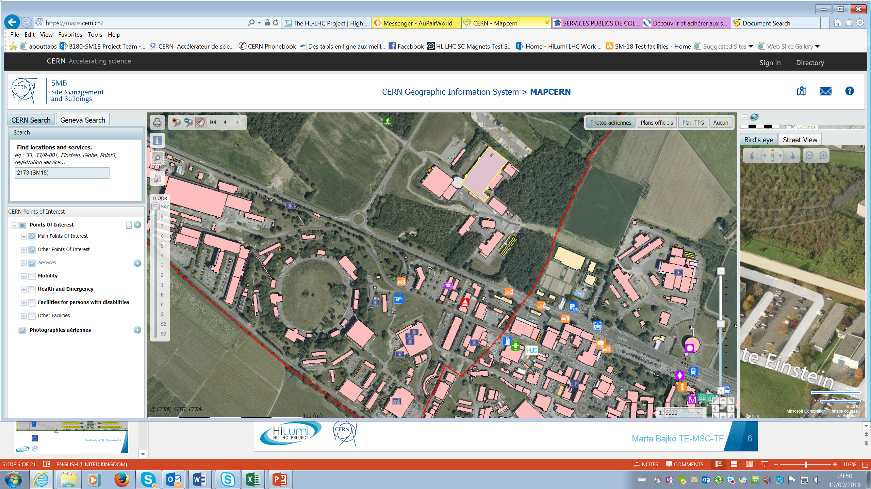
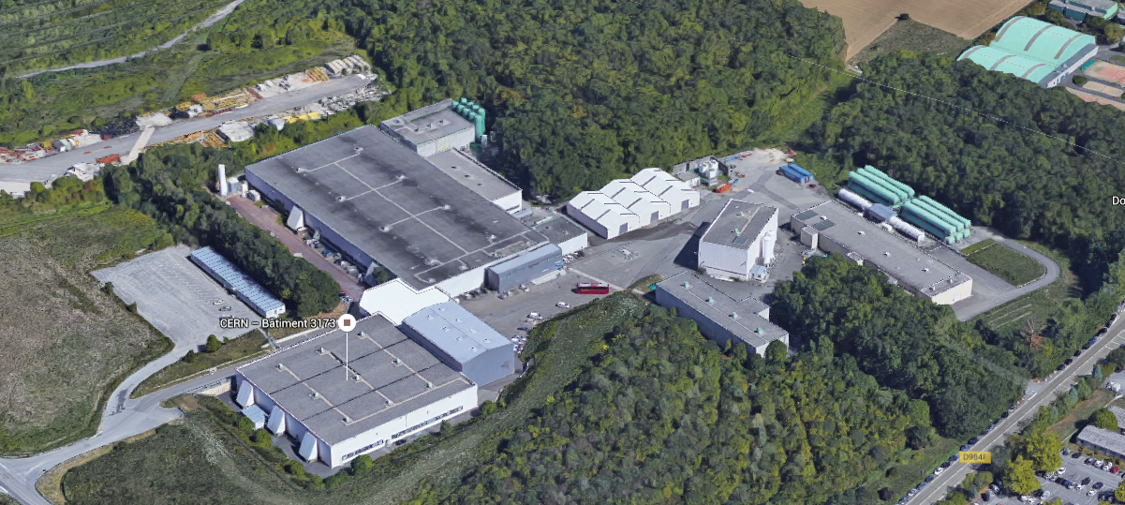
Location of IT STRING test: SM18
Bdg. 2173 (a.k.a. SM18) has a surface of 7200 m², of which the magnets test stands occupy about 50%.
2173

Slide 13
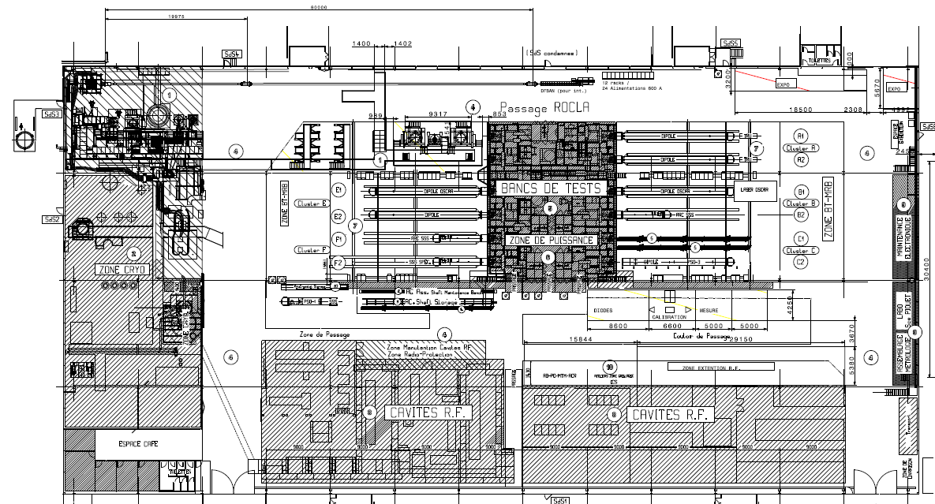
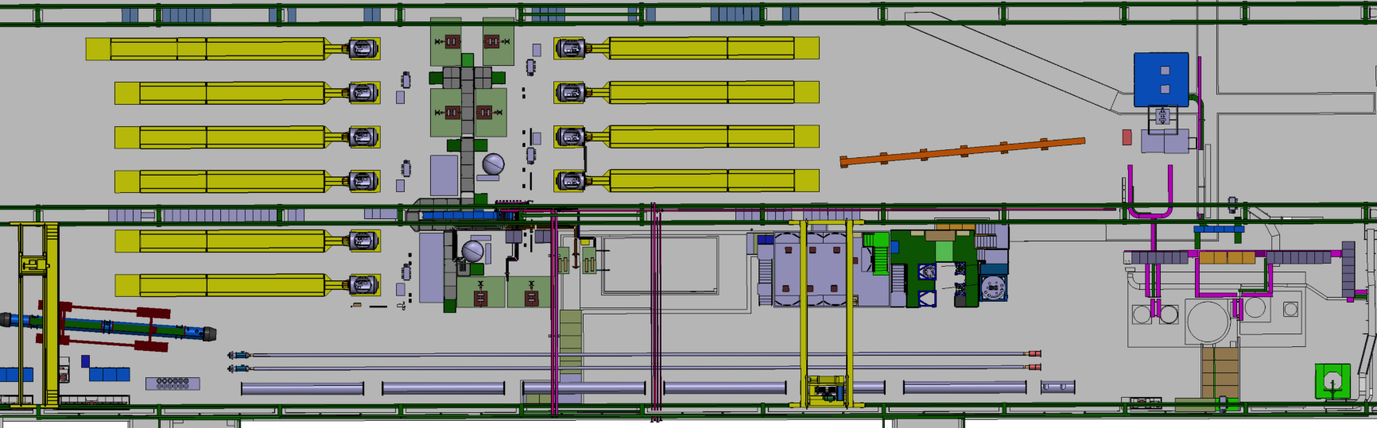
IT STRING test in SM18
Limitations in space in SM18
THE SUPERCONDUCTING MAGNET TEST STAND AT CERN in SM18
Boundary conditions considered
VISITORS
IT String and SC link test area
STRING and SC LINK area
VERTICAL BENCHES
CLUSTERS
C B A
CLUSTERS
F E D
HORIZONTAL BENCHES
CRYOGENIC ZONE
Superconducting RF CAVITY TEST ZONE
LN₂ TEST ZONE

Slide 14
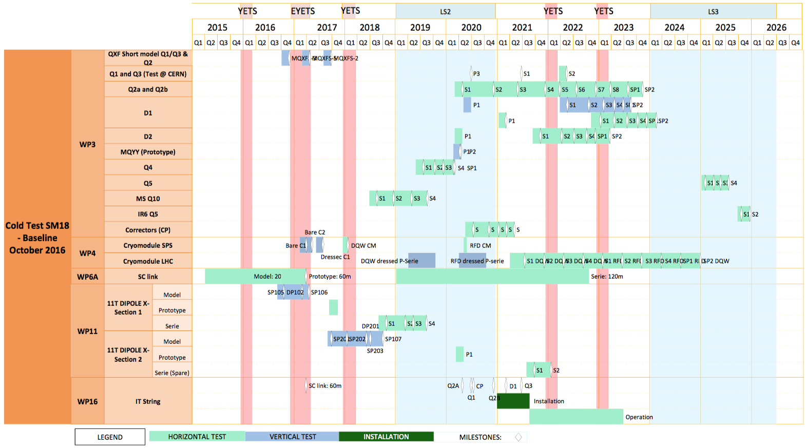
Conflict/synergy between test stands/IT String ?
2015
2016
2017
2018
2019
2020
2021
2022
2023
2024
2025
2026
Horizontal benches
Vertical test cryostats
SC link models
SC link series (110m)
Vertical test cryostats
Horizontal benches
IT String (80 m)

Slide 15

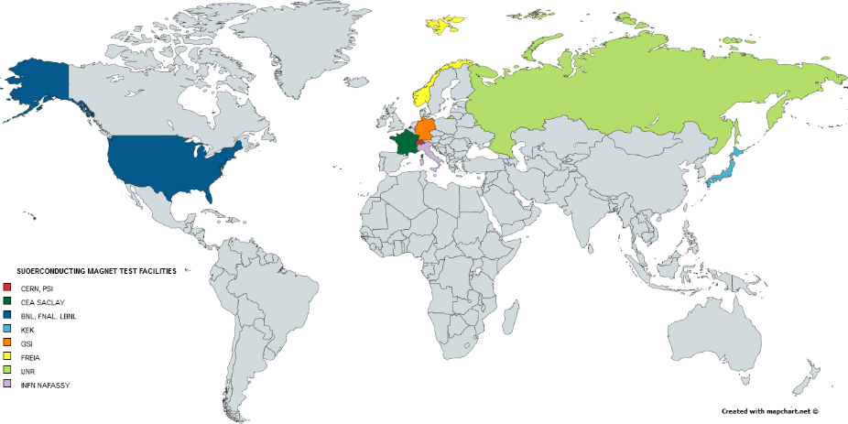










Test stands collaborating for HL-LHC

Slide 16
Main Facilities needed for the HL-LHC IT STRING
Remarks
UPGRADE DRIVEN BY the recommendation enabling to carry out the full test programme with no contraints
  CRYOGENIC COOLING PRODUCTION: + 35 g/s LHe to 60 g/s
  NEEDS essentially for the running of the HL LHC IR STRING in parallel with magnet testing
  DEMINERALISED WATER PRODUCTION: 150 m³/h ✔
  NEEDS FOR DEMINERALISED WATER ENTIRELLY COMING FROM MAGNET operation
  POWERING FROM THE NETWORK: 3 MVA
  NEEDS FOR NEW OR MODIFIED PC COMING FORM MAGNETS and IR STRING
SM18-UPG project of the TE department under the responsibility of V. Mertens:
[..] the upgrade of all necessary services to cover the needs for the test stands operation ( this includes the HL-LHC STRING as a test stand of a complete system).

Slide 17
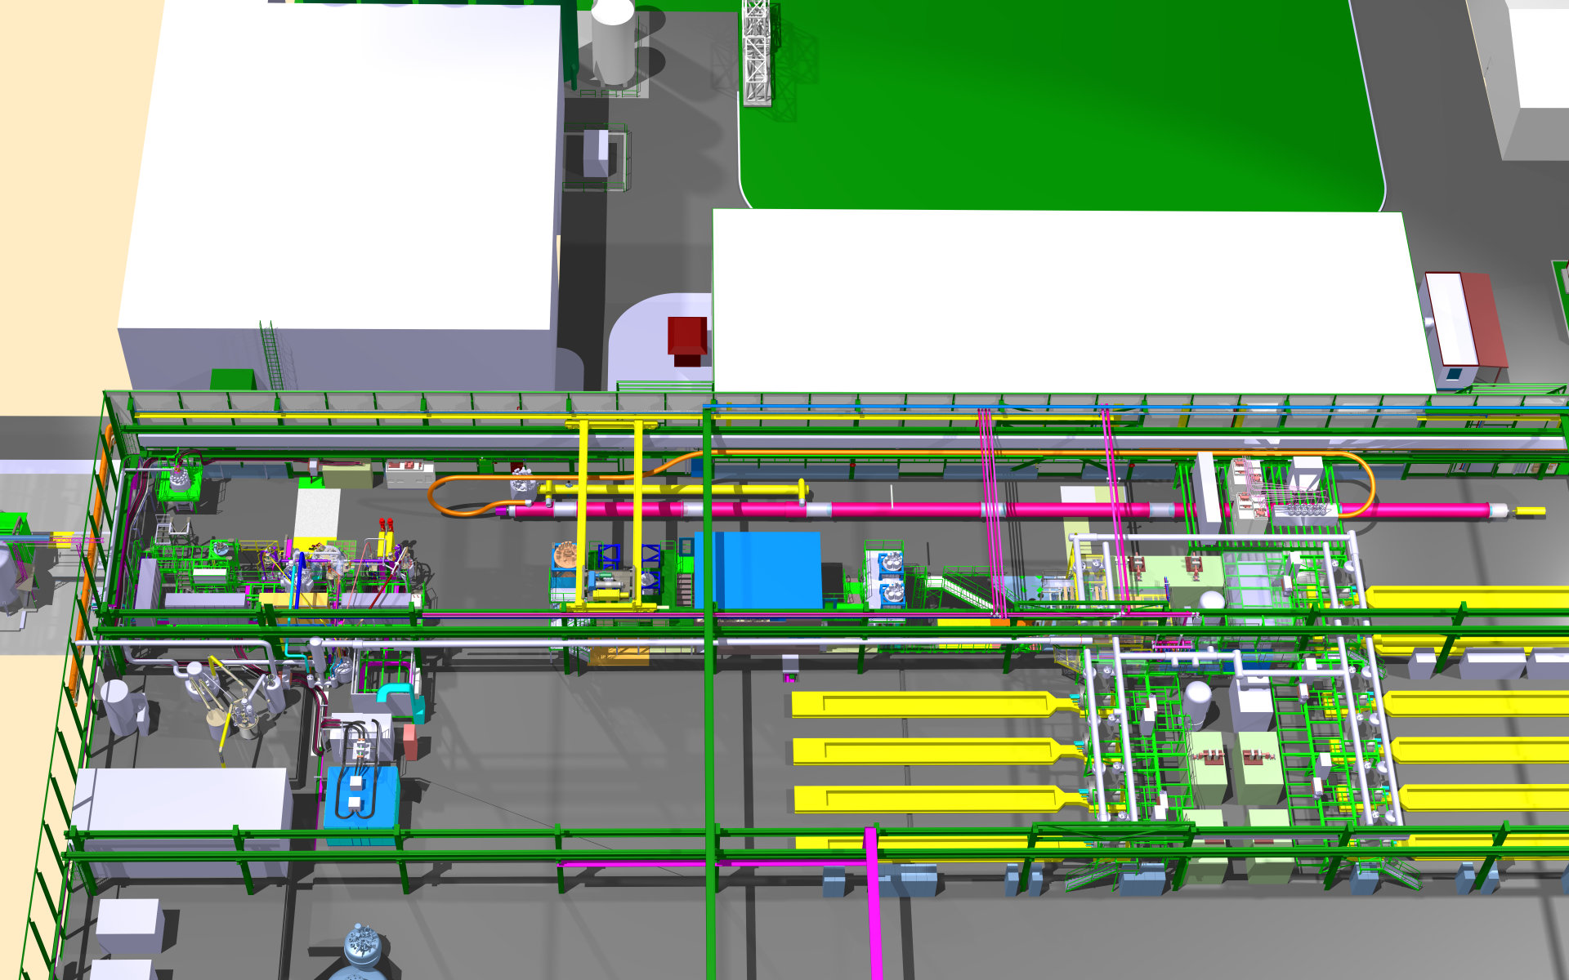
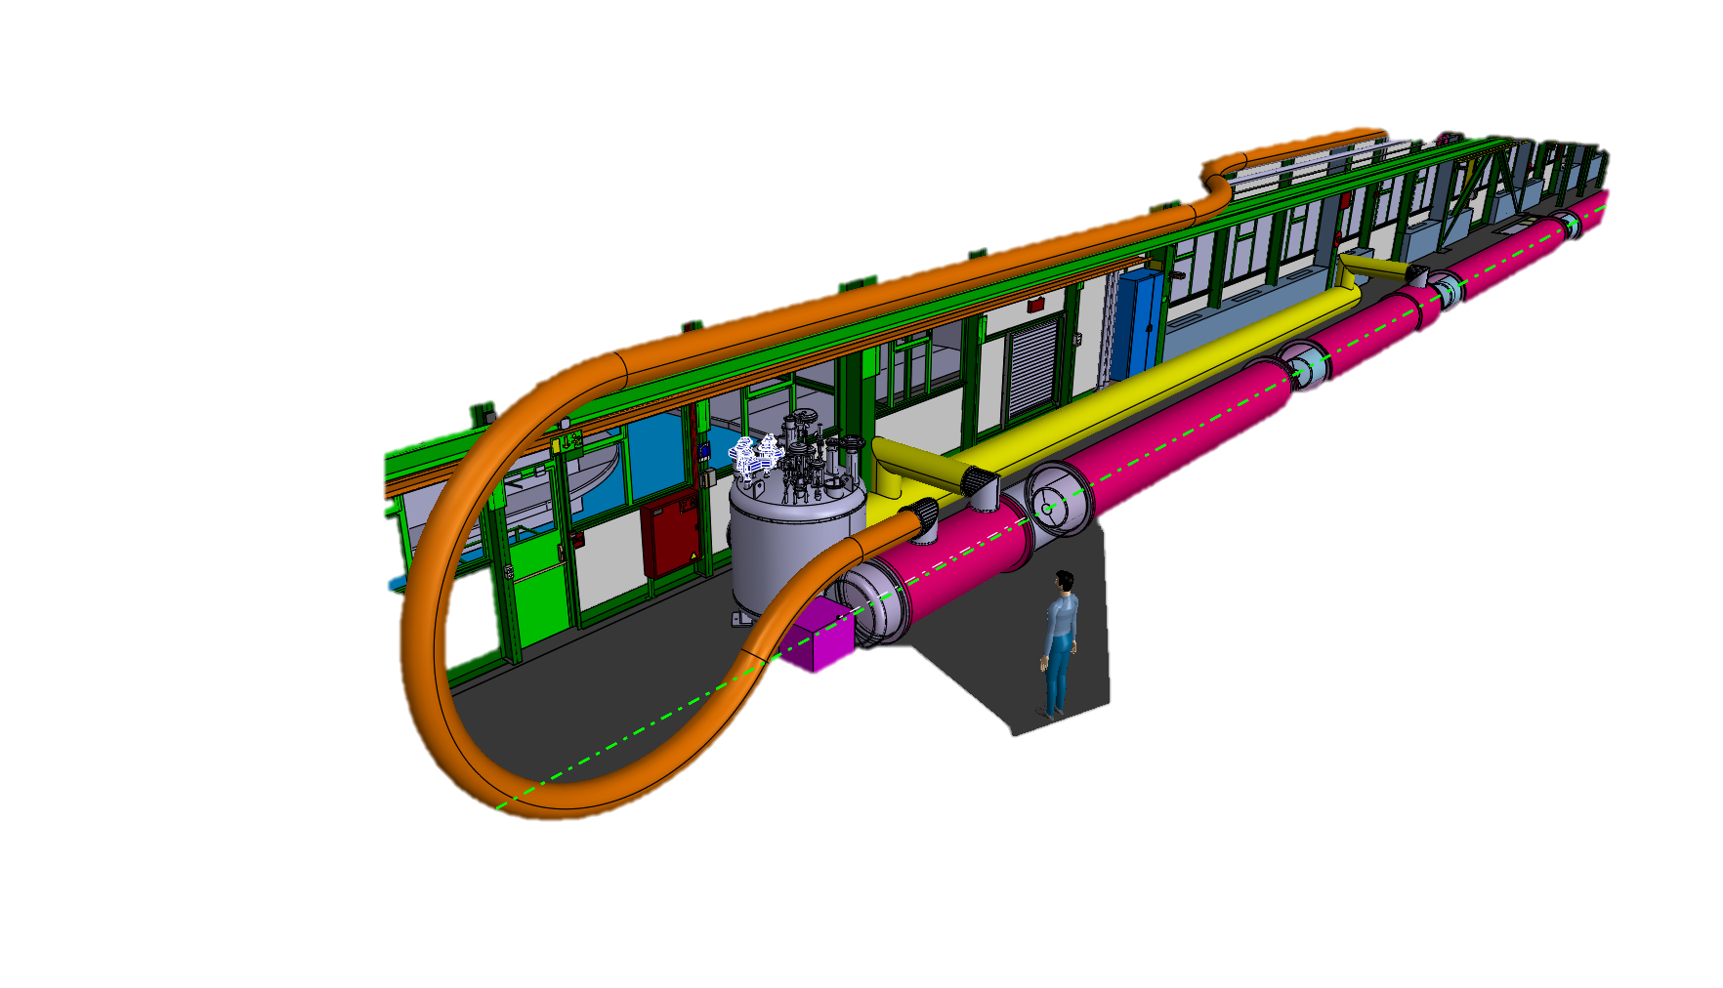
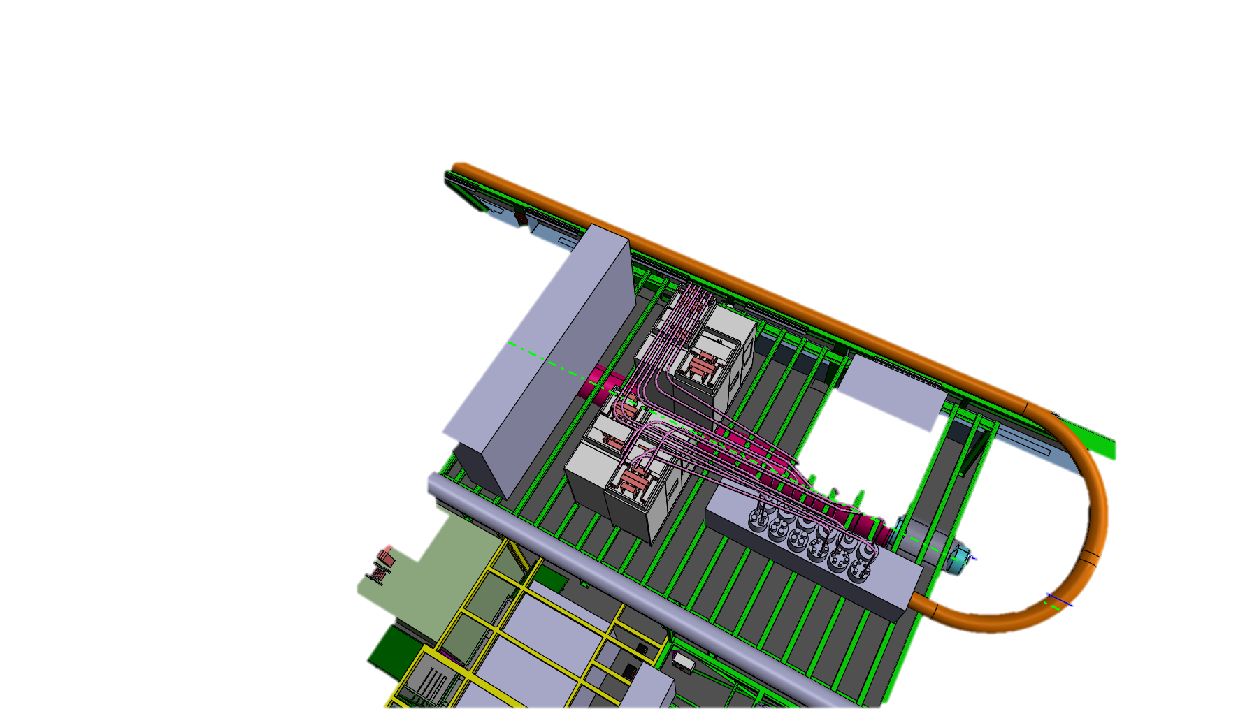
Work in progress
Cryogenic valve box
Sc LINK
Powering system
CLUSTER G
DFX D1 CP Q3 Q2b Q2a Q1
QRL
CLUSTER A
CLUSTER E
CLUSTER B
CLUSTER F
CLUSTER C
Cooling side
Powering side
DFX D1 CP Q3
SC LINK
QRL
Power Convertres
Visitor zone
Cryogenic valve box
WCC
Sc LINK
DFH
Thanks to A. Kosmicki

Slide 18
Current status
Integration ongoing with all elements that we know today
Budget estimation (5.8 MCHF) has been done and now is under verification The strategy is that
  All main components are part of the concerned WPs ( prototypes or series of WP3, WP6a and WP6b, WP7, WP12 )
  All components designed in purpose for IT STRING with the goal of the test stand optimisation ( local cryogenics , water cooled cables. …) are part of WP16
  All services are assured within the SM18 UPG project ( financed by TE dep. and HL-LHC project)
Manpower estimation has been done and now is under verification by WPs
On-going discussions for complete test plan definition with
WPs and different groups @CERN

Slide 19
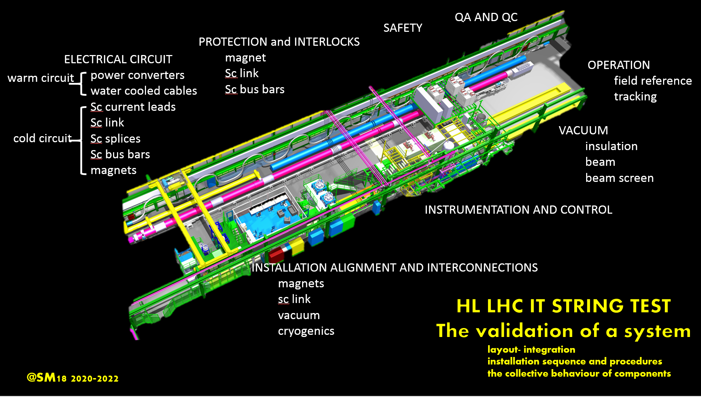
@SM18 2021-2023

Slide 20
Thanks for your attention

Slide 21
Spare Slides

Slide 22
Test stands : cryogenics upgrade
An additional 35 g/s liquefier (thus bringing the total production capacity for LHe at 4.2 K to 60 g/s)
The existing total pumping capacity in SM18 at 1.8 K is 12 g/s, combining the capacity of WPU1 and 2.
If need for IR STRING a dedicated 3rd WPU shall be installed.
Ref. L. Serio
Foreseen for 2019

Slide 23
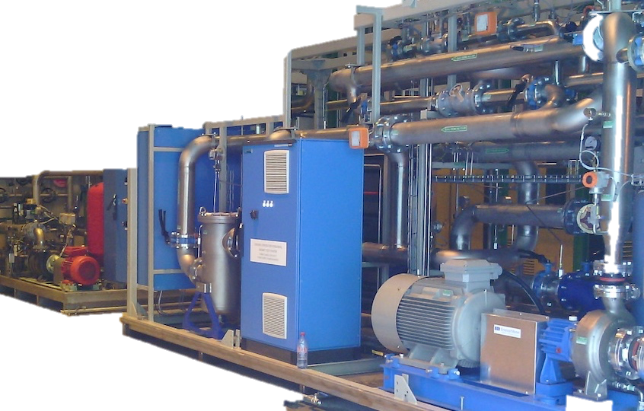
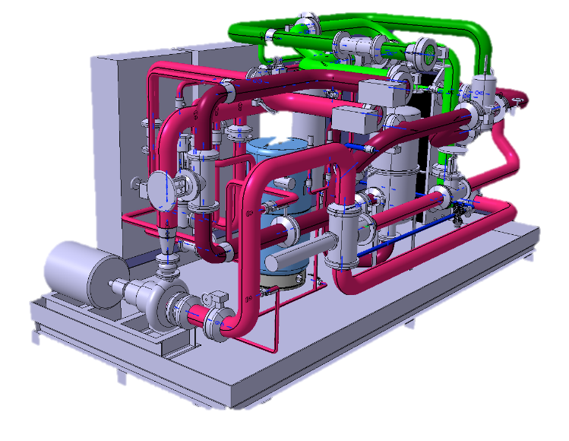
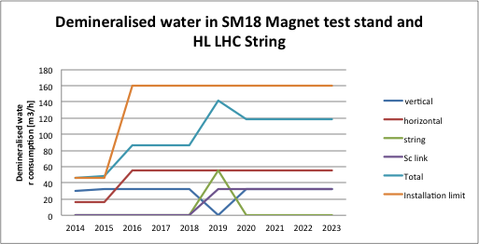
Test stands : demineralized water production
The demands for the magnet test stations, including the IT String, will rise to a peak need to 1.7 MW (142 m³/h).
In the past SM18 had a demineralised water station with a thermal capacity of 800 kW limiting the operation to two test stands
Operational from April 2016
Ref. A. J. Broche

Slide 24
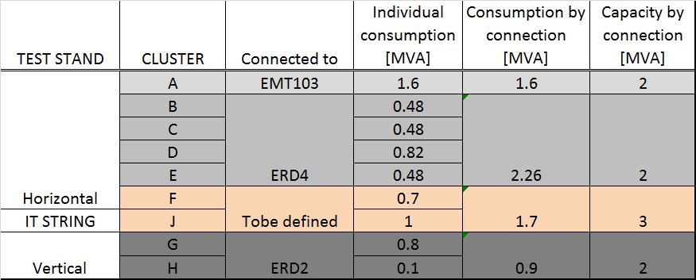
Test stand : electrical powering
Foreseen for 2019
To allow some flexibility and margin with new requests that are not formulated yet, the proposal is to INSTALL a TRANSFORMER OF a 3 MVA CAPACITY
The new transformer will feed HL-LHC IT STRING (Cluster J ) and the new Cluster F with the 20 kA power converter.
Ref. C. Giloux, F. Formenti, N. Dos Santos

Slide 25
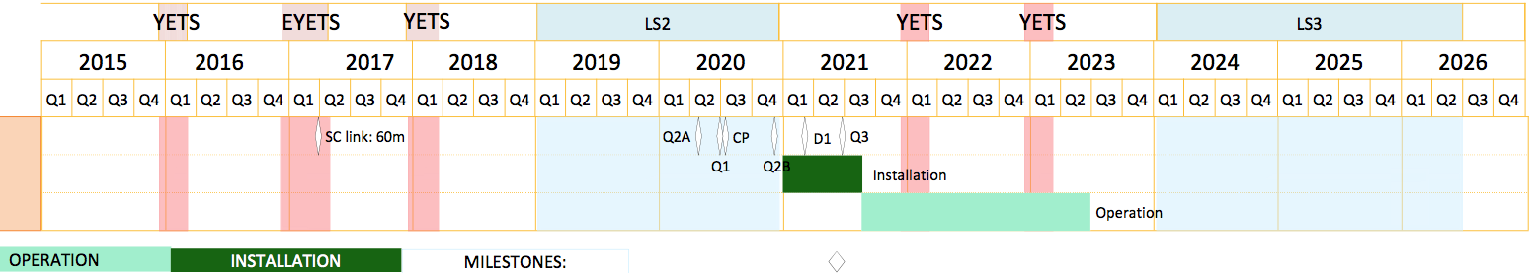
Schedule
Installation starts as soon as magnets are (individually cold tested) available and receptioned at CERN
(3 months for transport from Japan (D1) and US (Q1/Q3), no re-testing planned)
No staging, only one test phase (possibly several runs)
By courtesy of M. Barberan Marin

