Slide 1
Coordination of magnet circuits
Felix Rodriguez Mateos on behalf of the HL-LHC
Magnet Circuit Forum
HL-LHC Collaboration Meeting – 16th November 2016 - Paris

Slide 2
Table of contents
The Magnet Circuit Forum and recent work
Main open issues on circuit definitions
Documentation
Nomenclature
Outlook

Slide 3
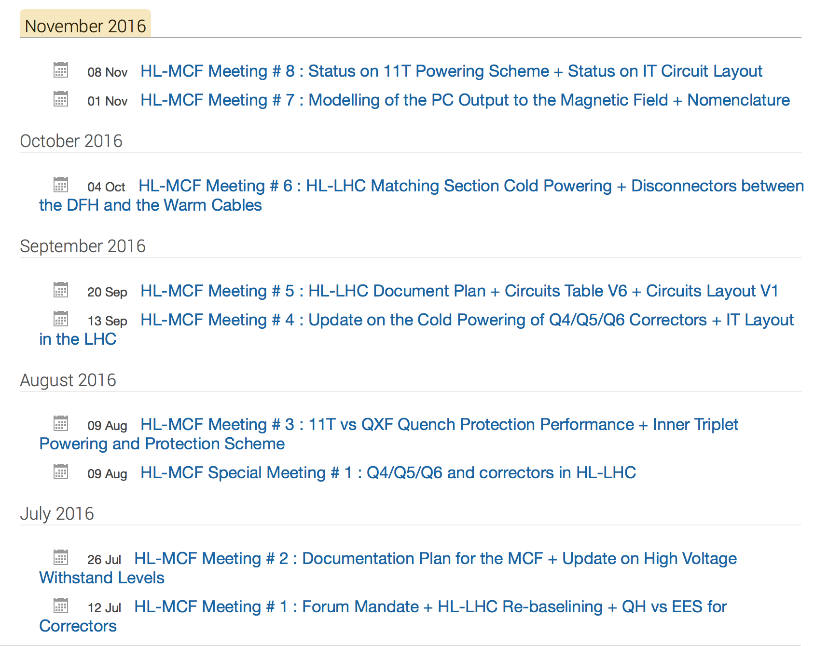
The HL-LHC MCF (Magnet Circuit Forum)
One of the recommendations of the March 2016 review on HL-LHC Magnet Circuits was:
“… to realize close and regular interaction (communication) between the involved experts and work-packages. This could be possibly done by setting-up of a dedicated working group or by using existing structures to discuss circuit integration and protection on a regular basis and to identify the optimum scheme for each magnet circuit system.”
Mandate
The Magnet Circuit Forum (MCF) is the meeting where all aspects related to powering and protection of the HL-LHC circuits are discussed, in particular the ones pertaining to the optimization of circuit layouts and definition of protection means.
Subjects in the agenda are defined in close collaboration with the relevant WPs.
Interface aspects between systems are clarified through meetings at the forum. To this end, a documentation plan has to be developed and completed.
The aim is to prepare a set of functional interface specifications that can be used as input for the design (technical specifications) of the different systems.
Assessment on realistic failure scenarios and required mitigation strategies on a global basis is part of the activities of the MCF.
The MCF is the meeting where aspects related to high voltage withstand levels are discussed and harmonized.
The MCF reports regularly to TCC and takes up any relevant discussion within the domain of cold/warm powering and protection of the HL-LHC circuits in collaboration with the relevant WPs .

Slide 4
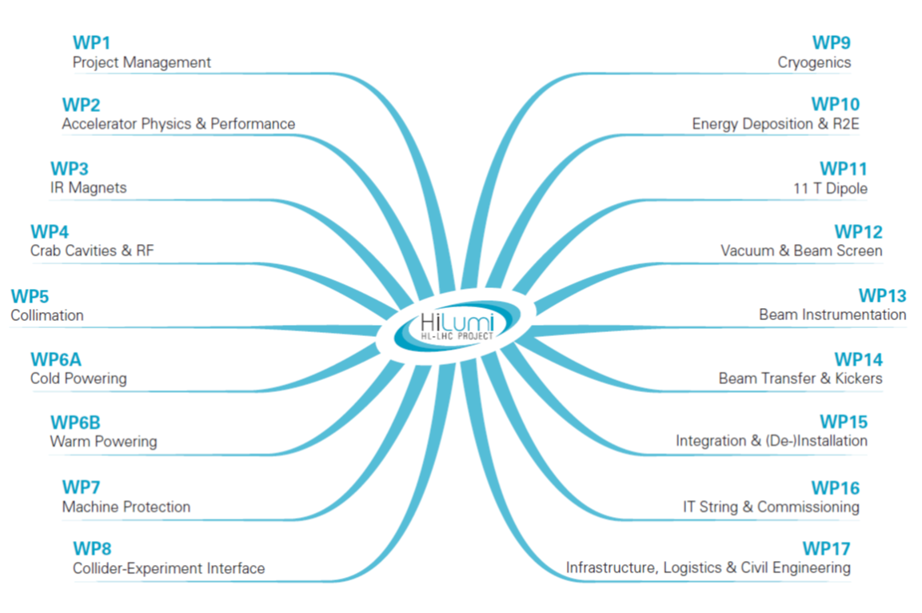
The players at MCF

Slide 5
Recent (major) activities of the MCF
Circuit definitions and design aspects
  Inner triplet RQX circuit
  Powering of the correctors in Matching Section after re-baselining
    Simulations of the series connection of two MCBY magnets
Documentation
  Reference Circuits Table (spreadsheet)
  First version of circuit drawings
  Functional specifications in work
    11T circuit
    High voltage withstand levels
Nomenclature
  Agreement on circuit and power converter names
Interfacing EN-EA for dose/fluence calculations
  Cold masses : 11T and RQX diodes
  RRs for quench protection equipment
  Tunnel in P7: quench heater discharge supplies (HDS) for 11T magnet, quench detectors and and HDS for neighboring magnets
Defining ramp and acceleration rates
Launching the concept of circuit separators
  Taken up by WP6b
Transfer functions V_{PC}-B_{aperture} (ripple effect to beam)
E Ravaioli, H Thiesen, myself
A Ballarino
S Danzeca
D Gamba
M Martino

Slide 6
Inner triplet’s RQX circuit
A
B
C
D
E
In a conservative scenario where one full magnet quenches by effect of beam, what will the currents be in the parallel paths? In other words, what will be the currents, loads and dI/dt seen by the bus bars, link and current leads?
Q2b quenches suddenly and completely (4 poles)
15 ms detection and validation
1 ms CLIQ firing
5ms heater firing
Simulation assumptions

Slide 7
The nominal scenario
Emmanuele Ravaioli, LBNL
CLIQ does not have any implications in the current rating in s.c. leads, bus bars or link
Quench at nominal current, with zero current in all trim power supplies
Quench at nominal current, with maximum currents in all trim power supplies

Slide 8
Conservative scenario (1/2)
Emmanuele Ravaioli, LBNL
TS 1
TS 2
TS 3
C
D
A
B
E
Worst-case for Leads B and D, and for the three crowbars of the trim power supplies
Initial currents: I_{MS}=16.5 kA, I_{TS1}=I_{TS3}=-2 kA, I_{TS2}=-0.12 kA. Quench of the entire Q2b coil (all four poles)

Slide 9
Conservative scenario (2/2)
Emmanuele Ravaioli, LBNL
TS 1
TS 2
TS 3
C
D
A
B
E
Worst-case for Lead C
Initial currents: I_{MS}=16.5 kA, I_{TS1}= I_{TS2}=I_{TS3}=0. Quench of the entire Q2b coil (all four poles)

Slide 10
Adding resistances to the crowbars
Samer Yammine
TS 1
TS 2
TS 3
D
C
A
B
E
RcrowQ1 = 15 mΩ
RcrowQ2a = 80 mΩ
RcrowQ2b = 80 mΩ
RcrowQ3 = 15 mΩ
Maximum current decrease of less than 200A in the trim circuits → Low impact (MIITS and current peaks)

Slide 11
Adding crowbar resistances & cold diodes
Samer Yammine
RcrowQ1 = 15 mΩ
RcrowQ2a = 80 mΩ
RcrowQ3 = 15 mΩ
Diode Vf = 6 V
A
B
C
D
E
But will cold diodes resist the radiation levels?
I_{C} <= Vf/0.08Ω <= 75A
I_{B} < 500 A
I_{D} < 400 A
Zoom on Trim Currents
INTEGRATION ISSUES!

Slide 12
Optimizing in a global way
Hugues Thiesen
Water Failure and Main Converter Crowbar Resistance
Introduction of 30 V Crowbar Resistance
Energy Dissipated in Free-Wheeling Thyristor = 11.5 MJ
Energy Dissipated in DC Cables = 30 MJ → ΔT = 86 °C in case of water failure
Energy Dissipated in Free-Wheeling Thyristor = 2.12 MJ
Energy Dissipated in DC Cables = 5 MJ → ΔT = 15 °C in case of water failure
Energy Dissipated in Crowbar Resistance = 34 MJ

Slide 13
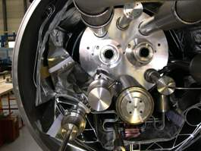
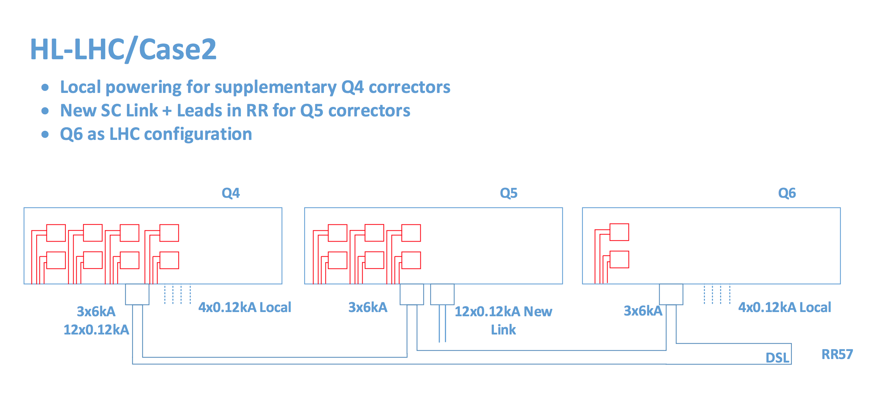
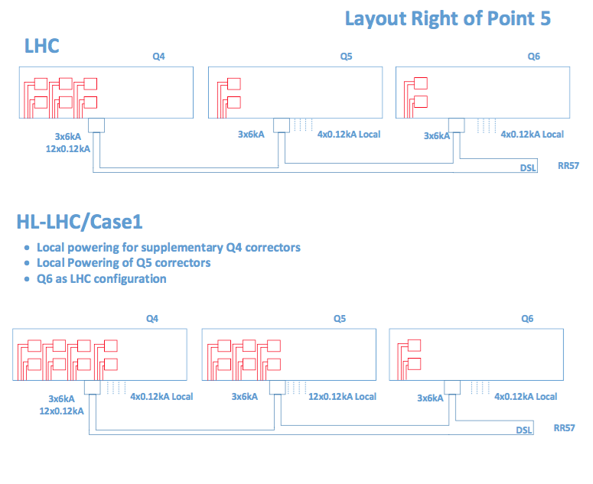
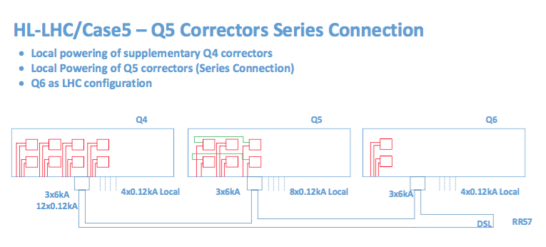
Different solutions for the powering of the
HL-LHC Matching Section circuits
Can we connect two MCBYs in series?
INTEGRATION ISSUES!
Amalia Ballarino, Samer Yammine

Slide 14
Circuit Layouts and Database
First versions of circuit schemes have been prepared and will be detailed from now on in the same style of the work already done for LHC
Nomenclature for the circuits has been prepared and submitted to TCC
A substantial effort has been deployed over the last months in order to have a reference Circuits Table with all parameters related to the circuits

Slide 15
Circuits Table V6
  Working version is available from the MCF sharepoint
Interlinked Sheets for different WPs

Slide 16
Nomenclature
R + Optical Function + . + Machine Position + Beam Number (if applicable)
RQX.R5
Inner Triplet Circuit + Orbit & HO Correctors
RTQX2.R5
RTQX3.R5
RTQX1.R5
RCSX3.R5
RCSSX3.R5
RCOX3.R5
RCOSX3.R5
RCDX3.R5
RCDSX3.R5
RCTX3.R5
RCTSX3.R5
RCBXH1.R5
RCBXV1.R5
RCBXH2.R5
RCBXV2.R5
RCBXH3.R5
RCBXV3.R5
RQSX3.R5
16
Samer Yammine for the MCF Meeting No.7 - 01/11/2016

Slide 17
Outlook
The work towards definition of magnet circuits intensively profits from the Magnet Circuit Forum where representatives of the involved WPs and activities are present
The baseline of the HL-LHC magnet circuits . . .
  has seen modifications in 2016 following the Circuits Review and re-baselining
  is properly documented in TDR
The baseline has some issues pending:
  Rating of cold powering components in RQX circuit
    Radiation dose/fluence for cold diodes
  Powering scheme of matching section correctors
    Series connection of MCBY
Protection tests during model/prototype test campaigns are fundamental to confirm the choices
Documentation has to accelerate now, especially with respect to 11T powering and protection and high voltage withstand levels for all circuit components
Circuit Schemes work will continue in full swing until completion

Slide 18

Thanks for your attention
Many thanks to all of those who participate to the Forum activities, to those who help keeping work efficient and those who promote the fruitful exchanges

Slide 19
Inner Triplet and Correctors
1 Circuit per IP side
Power Converters:
  1 x18 kA 2 quadrants
  2 x 2 kA 4 quadrants
  1 x 0.12 kA 4 quadrants
  Location: UR
Cold Powering:
  2 x 18 kA leads
  3 x 2 kA leads (over currents due to failure scenarios are not taken into account)
  Feedbox: DFHX @ UR
Quench Protection:
  Outer layer quench heaters
  CLIQ
  Inner layer quench heaters
Open Issues:
  Overcurrent simulations
  Cold powering rating
IT Orbit Correctors
Superferric High Order Correctors
6 Circuits per IP side
Power Converters:
  6 x 2 kA 4 quadrants
  Location: UR
Cold Powering:
  12 x 2 kA leads
  Feedbox: DFHX @ UR
Quench Protection:
  Quench heaters (baseline)
  Energy extraction (Possibility)
9 Circuits per IP side
Power Converters:
  1 x 0.2 kA 4 quadrants
  8 x 0.12 kA 4 quadrants
  Location: UR
Cold Powering:
  2 x 0.2 kA lead
  16 x 0.12 kA leads
  Feedbox: DFHX @ UR
Quench Protection:
  PC crowbar

Slide 20
D1, D2 and Correctors; 11 Tesla Dipole
D1
D2
D2 Orbit Correctors
1 Circuit per IP side
Power Converters:
  1 x 13 kA 1 quadrants
  Location: UR
Cold Powering:
  2 x 13 kA leads
  Feedbox: DFHX @ UR
Quench Protection:
  Quench heaters
1 Circuit per IP side
Power Converters:
  1 x 13 kA 1 quadrants
  Location: UR
Cold Powering:
  2 x 13 kA leads
  Feedbox: DFHM @ UR
Quench Protection:
  Quench heaters
4 Circuit per IP side
Power Converters:
  4 x 0.6 kA 4 quadrants
  Location: UR
Cold Powering:
  8 x 0.6 kA leads
  Feedbox: DFHM @ UR
Quench Protection:
  PC Crowbar
11 Tesla Dipole
Power Converters:
  One power converter per circuit rated at ± 300 A
Cold Powering:
  Copper cables will be placed between the power converters placed in the TZ76 or RR and the local current leads of 11T trim.
Quench Protection:
  Quench heaters
  Existing RB EE

Slide 21
Quadrupoles Q4, Q5 and Q6 and Correctors
Q4
Q5/Q6
2 Circuit per IP side
Power Converters:
  2 x 6 kA 1 quadrants
  Location: RR
Cold Powering:
  3 x 6 kA leads
  Feedbox: DFBL @ RR
Quench Protection:
  Quench heaters
2 Circuit per IP side
Power Converters:
  2 x 6 kA 1 quadrants
  Location: RR
Cold Powering:
  3 x 6 kA leads
  Feedbox: DFBL @ RR
Quench Protection:
  Quench heaters
Q4 orbit corrector
Q5 orbit corrector
Q6 orbit corrector
8 Circuit per IP side
Power Converters:
  8 x 0.12 kA 4 quadrants
  Location: RR
Cold Powering:
  16 x 0.12 kA leads
  Feedbox: DFBL @ RR
  Local powering (tbc)
Quench Protection:
  PC Crowbar
6 Circuit per IP side
Power Converters:
  6 x 0.12 kA 4 quadrants
  Location: RR
Cold Powering:
  12 x 0.12 kA leads
  Feedbox: DFBL @ RR
  Local powering (tbc)
Quench Protection:
  PC Crowbar
2 Circuit per IP side
Power Converters:
  2 x 0.12 kA 4 quadrants
  Location: RR
Cold Powering:
  4 x 0.12 kA leads
  Local Powering
Quench Protection:
  PC Crowbar

